Slide 1
Real life example DB
And further learning

Slide 2
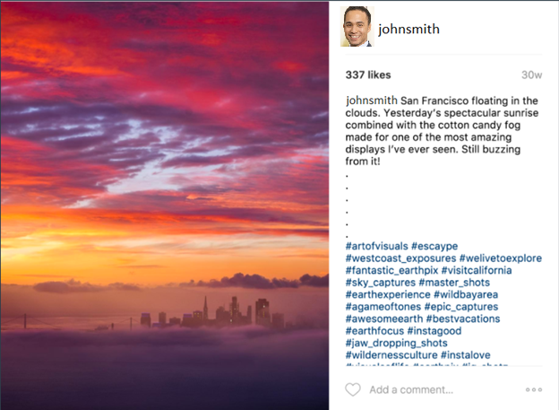
Clone of Instagram

Slide 3
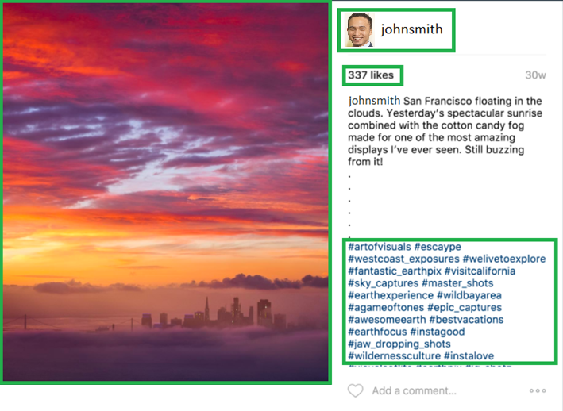
Cloning Instagram
Users
Photos
Likes
Hashtags

Slide 4
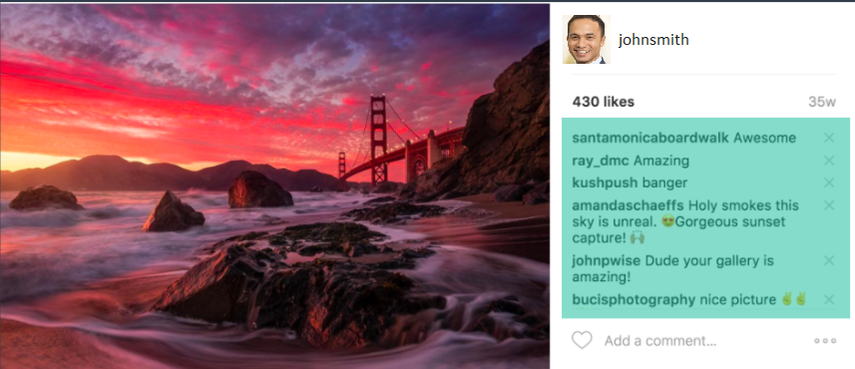
Cloning instagram
comments

Slide 5
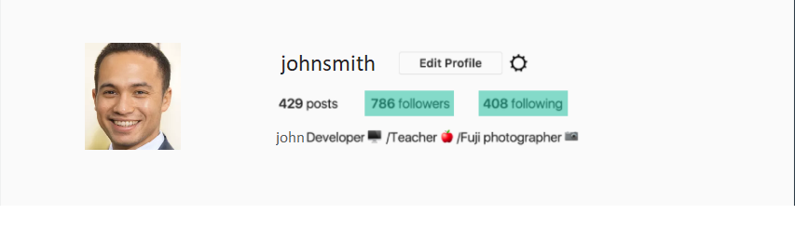
Cloning Instagram
Followers/Followees

Slide 6
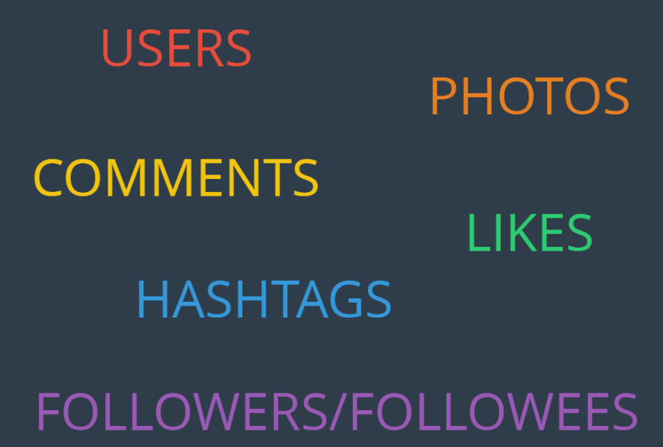
Cloning instagram

Slide 7
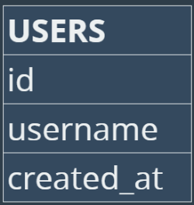
Let’s check tables one by one

Slide 8
Create users table
CREATE TABLE users (
id INTEGER IDENTITY PRIMARY KEY,
username VARCHAR(255) UNIQUE NOT NULL,
created_at DATETIME DEFAULT CURRENT_TIMESTAMP
);

Slide 9
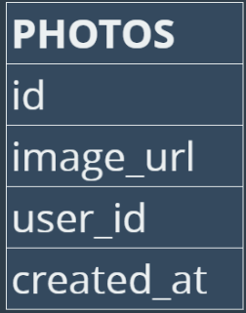
Let’s check tables one by one

Slide 10
Let’s check tables one by one

Slide 11
Create photos table
CREATE TABLE photos (
id INTEGER IDENTITY PRIMARY KEY,
image_url VARCHAR(255) NOT NULL,
user_id INTEGER NOT NULL,
created_at DATETIME DEFAULT CURRENT_TIMESTAMP,
FOREIGN KEY(user_id) REFERENCES users(id)
);

Slide 12
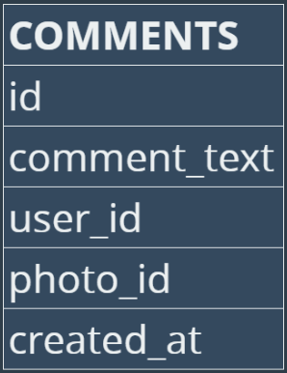
Let’s check tables one by one

Slide 13
Let’s check tables one by one

Slide 14
Let’s check tables one by one

Slide 15
Let’s check tables one by one

Slide 16
CREATE TABLE comments (
id INTEGER IDENTITY PRIMARY KEY,
comment_text VARCHAR(255) NOT NULL,
photo_id INTEGER NOT NULL,
user_id INTEGER NOT NULL,
created_at DATETIME DEFAULT CURRENT_TIMESTAMP,
FOREIGN KEY(photo_id) REFERENCES photos(id),
FOREIGN KEY(user_id) REFERENCES users(id)
);

Slide 17
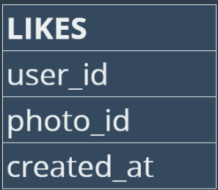
What about likes?

Slide 18
What about likes?

Slide 19
What about likes?

Slide 20
Create likes table
CREATE TABLE likes (
user_id INTEGER NOT NULL,
photo_id INTEGER NOT NULL,
created_at DATETIME DEFAULT CURRENT_TIMESTAMP,
FOREIGN KEY(user_id) REFERENCES users(id),
FOREIGN KEY(photo_id) REFERENCES photos(id),
PRIMARY KEY(user_id, photo_id)
);

Slide 21
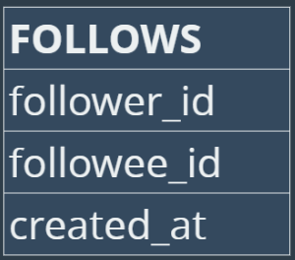
Relationship troubles

Slide 22
Create follows table
CREATE TABLE follows (
follower_id INTEGER NOT NULL,
followee_id INTEGER NOT NULL,
created_at DATETIME DEFAULT CURRENT_TIMESTAMP,
FOREIGN KEY(follower_id) REFERENCES users(id),
FOREIGN KEY(followee_id) REFERENCES users(id),
PRIMARY KEY(follower_id, followee_id)
);

Slide 23
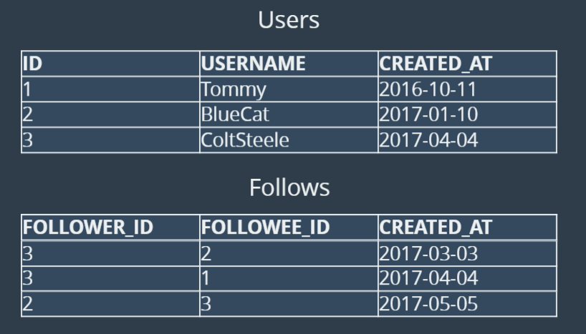
Followers / Followees

Slide 24
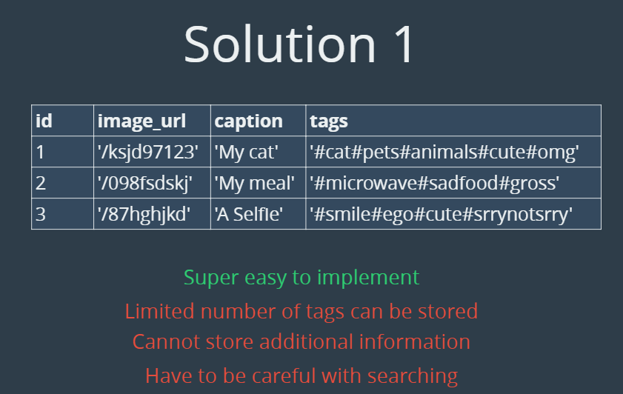
Tags
3 Possible ways of tagging

Slide 25
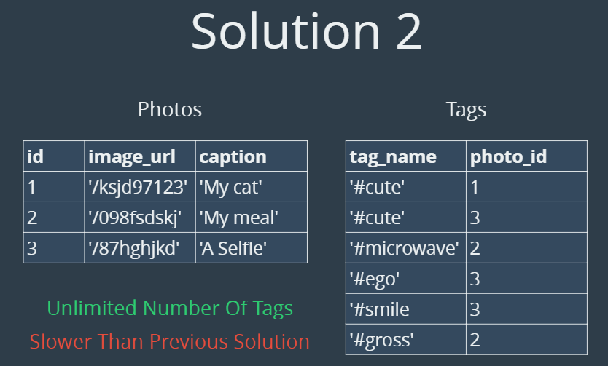
Tags

Slide 26
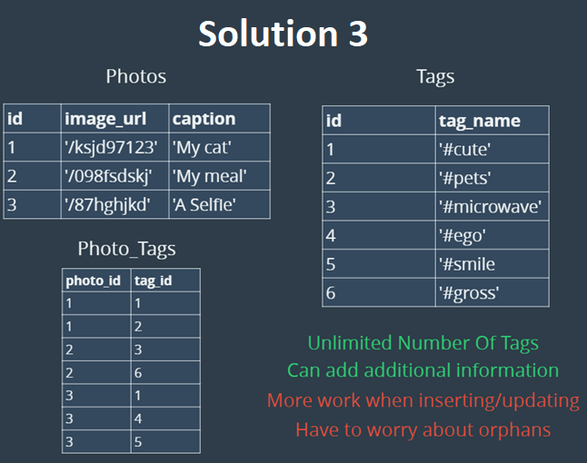
Tags

Slide 27
Creating tags table
CREATE TABLE tags (
id INTEGER IDENTITY PRIMARY KEY,
tag_name VARCHAR(255) UNIQUE,
created_at DATETIME DEFAULT CURRENT_TIMESTAMP
);
CREATE TABLE photo_tags (
photo_id INTEGER NOT NULL,
tag_id INTEGER NOT NULL,
FOREIGN KEY(photo_id) REFERENCES photos(id),
FOREIGN KEY(tag_id) REFERENCES tags(id),
PRIMARY KEY(photo_id, tag_id)
);

Slide 28
Now practical part
First let’s insert the data
Then let’s check the database data
Do couple of selects in each table to get familiar with tables
Then proceed to exercises

Slide 29
Exercises
We want to reward our users who have been around the longest:
Find the 5 oldest users
We need to figure out when to schedule an ad campgain:
What day of the week do most users register on?
We want to target our inactive users with an email campaign:
Find the users who have never posted a photo

Slide 30
Exercises
We're running a new contest to see who can get the most likes on a single photo:
WHO WON?
Our Investors want to know:
How many times does the average user post?
A brand wants to know which hashtags to use in a post:
What are the top 5 most commonly used hashtags?

Slide 31
Exercises (hard – check first further reading)
We have a small problem with bots on our site...
Find users who have liked every single photo on the site
We also have a problem with celebrities:
Find users who have never commented on a photo
Are we overrun with bots and celebrity accounts?
Find the percentage of our users who have either never commented on a photo or have commented on every photo

Slide 32
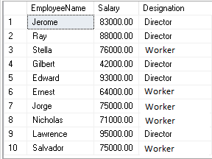
Further learning
CASE Statement: When we have query and want to show value depending on the condition:
CASE WHEN condition1 THEN result1 WHEN condition2 THEN result2 WHEN conditionN THEN resultN ELSE result END
Practice online:
https://www.w3schools.com/sql/sql_case.asp
SELECT
EmployeeName,
CASE
WHEN Salary >=80000 AND Salary <=100000 THEN 'Director'
WHEN Salary >=50000 AND Salary <80000 THEN ‘Worker'
Else 'Director'
END AS Designation
from Employee

Slide 33
Further learning
UNION syntax:
SELECT column_name(s) FROM table1 UNION SELECT column_name(s) FROM table2;
Note: you can union the same table
Practice online:
https://www.w3schools.com/sql/sql_union.asp
Example:
select * from tv_shows where released_year > 2009
Union
select * from tv_shows where released_year < 2000

Slide 34
Further Learning
Having clause
Used only for aggregated functions (GROUP BY + count(), sum(), avg(),min(), max(), etc…) because WHERE keyword could not be used
Requires a lot of practice
It allows more complex queries, therefore it is not part of the basics course
Online simple explaination and practice:
https://www.w3schools.com/sql/sql_having.asp

Slide 35
Further learning
Variables
Defining variable as integer, whose value we set to 1:
Defining variable as integer, whose value we set to 2:
Defining variable without value:
Third variable = first + second:
Show third variable on the screen
Example:
DECLARE @firstVariable INT = 1
DECLARE @secondVariable INT = 2
DECLARE @thirdVariable INT
SET @thirdVariable = @firstVariable + @secondVariable
SELECT @thirdVariable

Slide 36
Further Learning
Stored procedures – Something similar to functions
We can start procedure by writing command:
EXEC name_of_stored_procedure
More about procedures:
https://www.w3schools.com/sql/sql_stored_procedures.asp
Always be careful with procedures, since they may change data in the database (not all of them do just reading from tables)

Slide 37
Homework 1
Find 20 newly joined users
Find 10 newlest liked photos, and show user who liked them
Which photos had smallest number of likes?

Slide 38
Homework 2
How many times has hashtag "smile" has been used (how many photos have that hashtag?)
Find 3 least used hashtags
Find all photos that have following hashtags:
- sunrise
- sunset
- landscape
- photography

Slide 39
Homework 3
Find out who made the longest comment – show username and comment
Find out who made the most comments– show number of comments by usernames
Check if there is any tag that has not been used (not been added to photo)

Slide 40
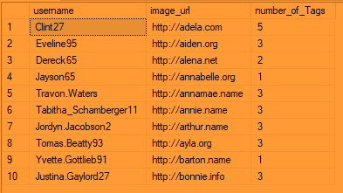
Homework 4
Return username and image_url (of photo) with number of tags on each of the photos

Slide 41
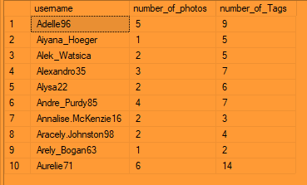
Homework 5
Return username, and distinct number of photos, and tags.
(Check manually if number of photos are alright for person, and number of tags for a photo)

Slide 42
Exercises solutions
SELECT TOP 5 * FROM users
ORDER BY created_at
SELECT TOP 2 DATENAME(WEEKDAY,created_at) AS day, COUNT(*) AS total
FROM users
GROUP BY DATENAME(WEEKDAY,created_at)
ORDER BY total DESC

Slide 43
Exercises solutions
SELECT username FROM users
LEFT JOIN photos ON users.id = photos.user_id
WHERE photos.id IS NULL;
SELECT TOP 1 users.username, photos.id, photos.image_url, COUNT(*) AS total
FROM photos
INNER JOIN likes ON likes.photo_id = photos.id
INNER JOIN users ON photos.user_id = users.id
GROUP BY users.username,photos.id,photos.image_url
ORDER BY total DESC

Slide 44
Exercise (hard) solutions
SELECT (SELECT Count(*) FROM photos) / (SELECT Count(*) FROM users) AS avg;
SELECT TOP 5 tags.tag_name, Count(*) AS total
FROM photo_tags
JOIN tags ON photo_tags.tag_id = tags.id
GROUP BY tags.tag_name ORDER BY total DESC;

Slide 45
Exercise (hard) solutions
SELECT username,
Count(*) AS num_likes
FROM users
INNER JOIN likes
ON users.id = likes.user_id
GROUP BY likes.user_id
HAVING num_likes = (SELECT Count(*)
FROM photos);
SELECT username,
Count(*) AS num_likes
FROM users
INNER JOIN Comments
ON users.id = Comments.user_id
GROUP BY users.username
HAVING Count(*) = 0

Slide 46
Exercise (hard) solutions
SELECT username
FROM users
INNER JOIN Comments
ON users.id = Comments.user_id
GROUP BY users.username
HAVING Count(*) = 0
UNION
SELECT username
FROM users
INNER JOIN Comments
ON users.id = Comments.user_id
GROUP BY users.username
HAVING Count(*) = (SELECT Count(*)
FROM photos);

