Slide 1
Week 2
Git and Versioning control

Slide 2
What is it?
What is Git?
A Free and open-source version control system
What is Version Control?
The management of changes for:
Documents
Computer programs
Large Websites
Other collections of information

Slide 3
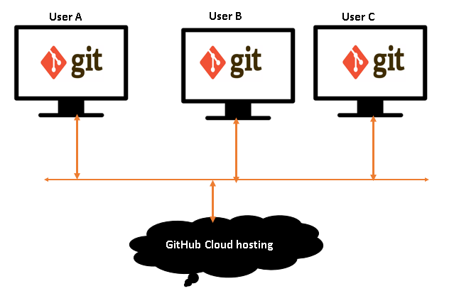
How versioning control work
Make changes locally
Git remembers each step in the changes that you made (versioning)
Save them on cloud (remotely)
Allows your teammates to access same files and change them
Git will recognize any changes in files
You can use commands through:
CLI
GUI

Slide 4
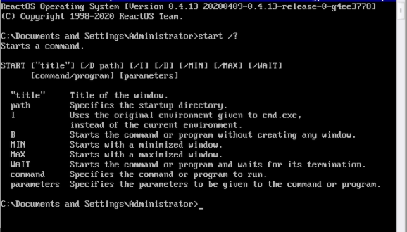
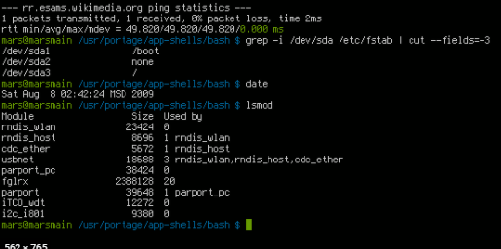
Command Line Interfaces
CMD – (used in Windows)
Shell - (used in Linux and Mac and Windows recently)

Slide 5
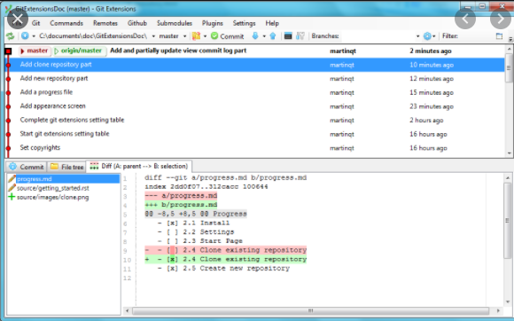
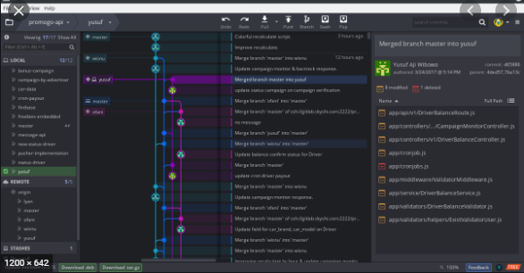
Graphical User Interface
Gui apps are easier way to execute commands
More user friendly

Slide 6
Getting familiar with some expressions
Directory = Folder
Terminal or Command Line = Interface for text commands
CLI = Command line interface
CD = Change Directory
Code Editor = Program used for for Writing Code
Repository = Project or the folder/place where your project is kept
GitHub = A website to host your repositories online

Slide 7
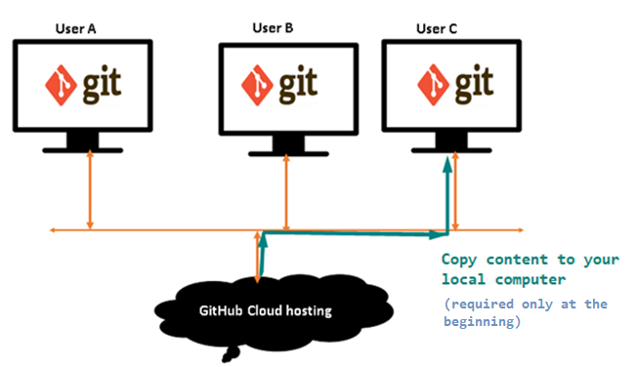
Basic Commands
Clone - bring repository that is hosted somewhere like Github into a folder on your local machine
Hosted – exists, is kept and used somewhere online

Slide 8
Basic Commands
Git init – Create new local repository
Then Create a remote, empty folder/repository on Github
Login to your Github account.
At the top right of any Github page, you should see a '+' icon. Click that, then select 'New Repository'.
Give your repository a name--ideally the same name as your local project.
Click 'Create Repository'. The next screen you see will be important, so don't close it.
After connecting you are ready to Push your changes there

Slide 9
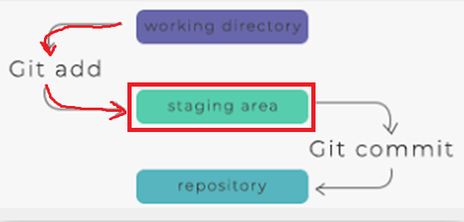
Basic Commands
Add – Track your files and changes in Git
This way you are telling Git that you made some changes on files, so it can track those changes.
This command will move these changes to staging area

Slide 10
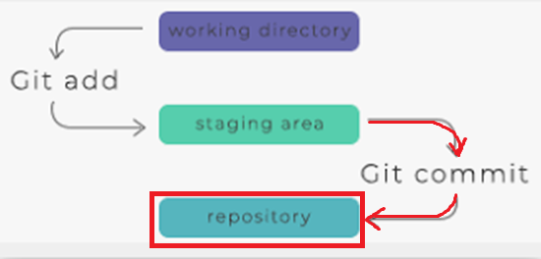
Basic Commands
Commit – Save changes in your code, program, document, etc.
Use this command when you are sure that you are satisfied with your changes.
Commit command moves code to repository area

Slide 11
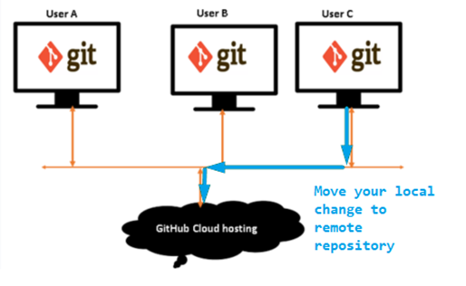
Basic Commands
Push – Upload Git commits to remote repository.
In our example from local directory to Github
Do this when you are absolutely sure that change you committed is OK, since it will replace remote data

Slide 12
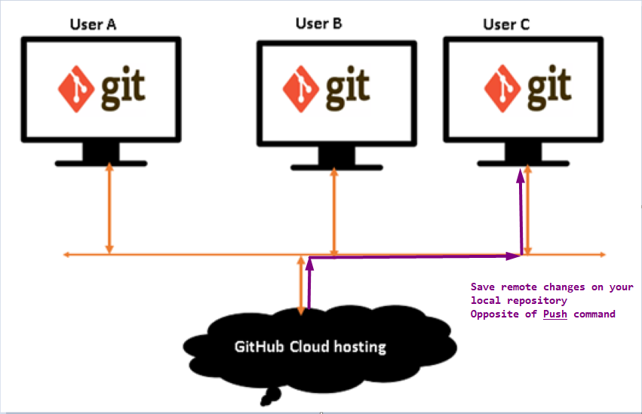
Basic Commands
Pull – Download content to local repository
In our example from Github to local directory
NOTE: This will replace local data with those that you downloaded

Slide 13
How to connect your local git with Github
We need to connect our computer to GitHub
Way to connect: HTTPS or SSH key pair
HTTPS – secure HTTP – easier for beginners
SSH key pair – slightly more complicated but more secure

Slide 14
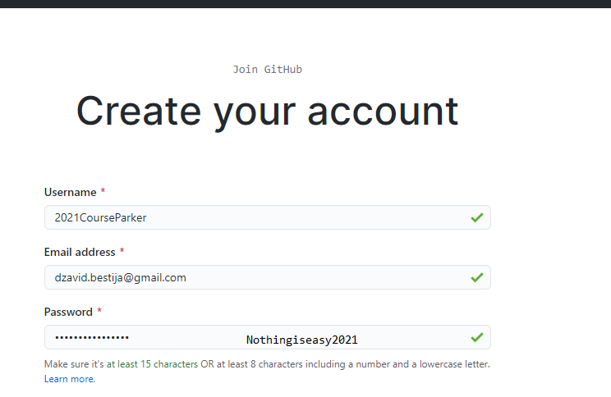
Practice
Create new account (already done)
Login to github.com using new account:
Download git
Download GitHub client (desktop version)
Connect GitHub to local setup (desktop)
Add Readme file online and download it to local environment
Go through the steps: Add change -> Commit -> Push
Experiment with: .txt, .doc, C# project

Slide 15
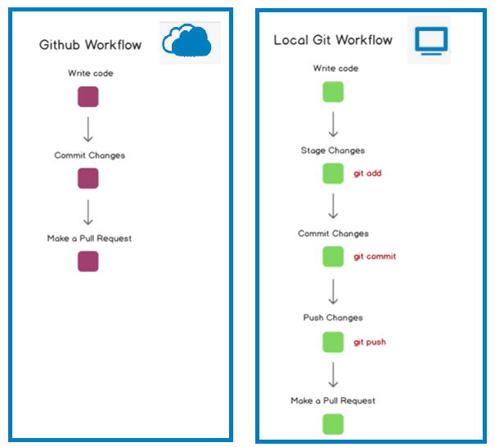
WorkFlow
Github is remote repository
Local Git should be used to make
most of the changes and then
apply them on remote repository

