Slide 1

NYCFTAeTix
TEAM 1:Gaelle Gilles and Briana Figueroa
Notes:
Gaelle

Slide 2
What is this app and why?
WHAT:
This application is the new metrocard for the everyday commuter and for those who need it in a pinch. This app will allow for someone to create an account and sign in to purchase a metrocard type of their choosing for all NYC transit.
WHY:
The purpose of this application is to replace the physical metrocard that New Yorkers are used to seeing everyday. The issue with the physical metrocard is that a user:
Can easily lose their metrocard
Can easily forget it at home
Needs to be physically refilled at a subway station or a bus stop (if there is a machine there)
Will need to pay a $1 fee to get a new one along with the cost of the tickets that a user is purchasing for that day
Expires every two years
Can malfunction and not work which may cause a rider to easily lose up to $127.00 (cost of monthly ticket)
With this mobile application nearly all of those issues, riders will not have to worry about.
Notes:
Gaelle

Slide 3
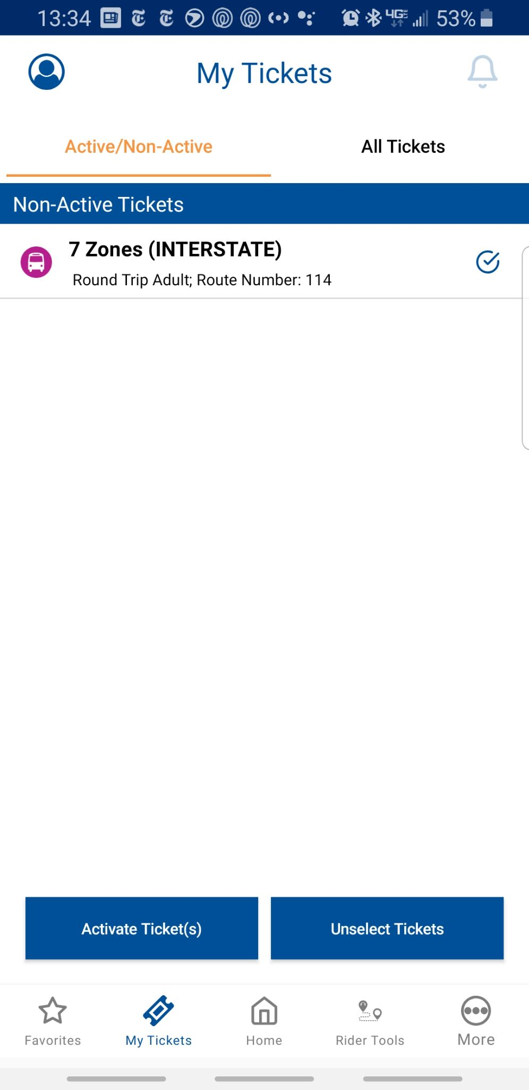
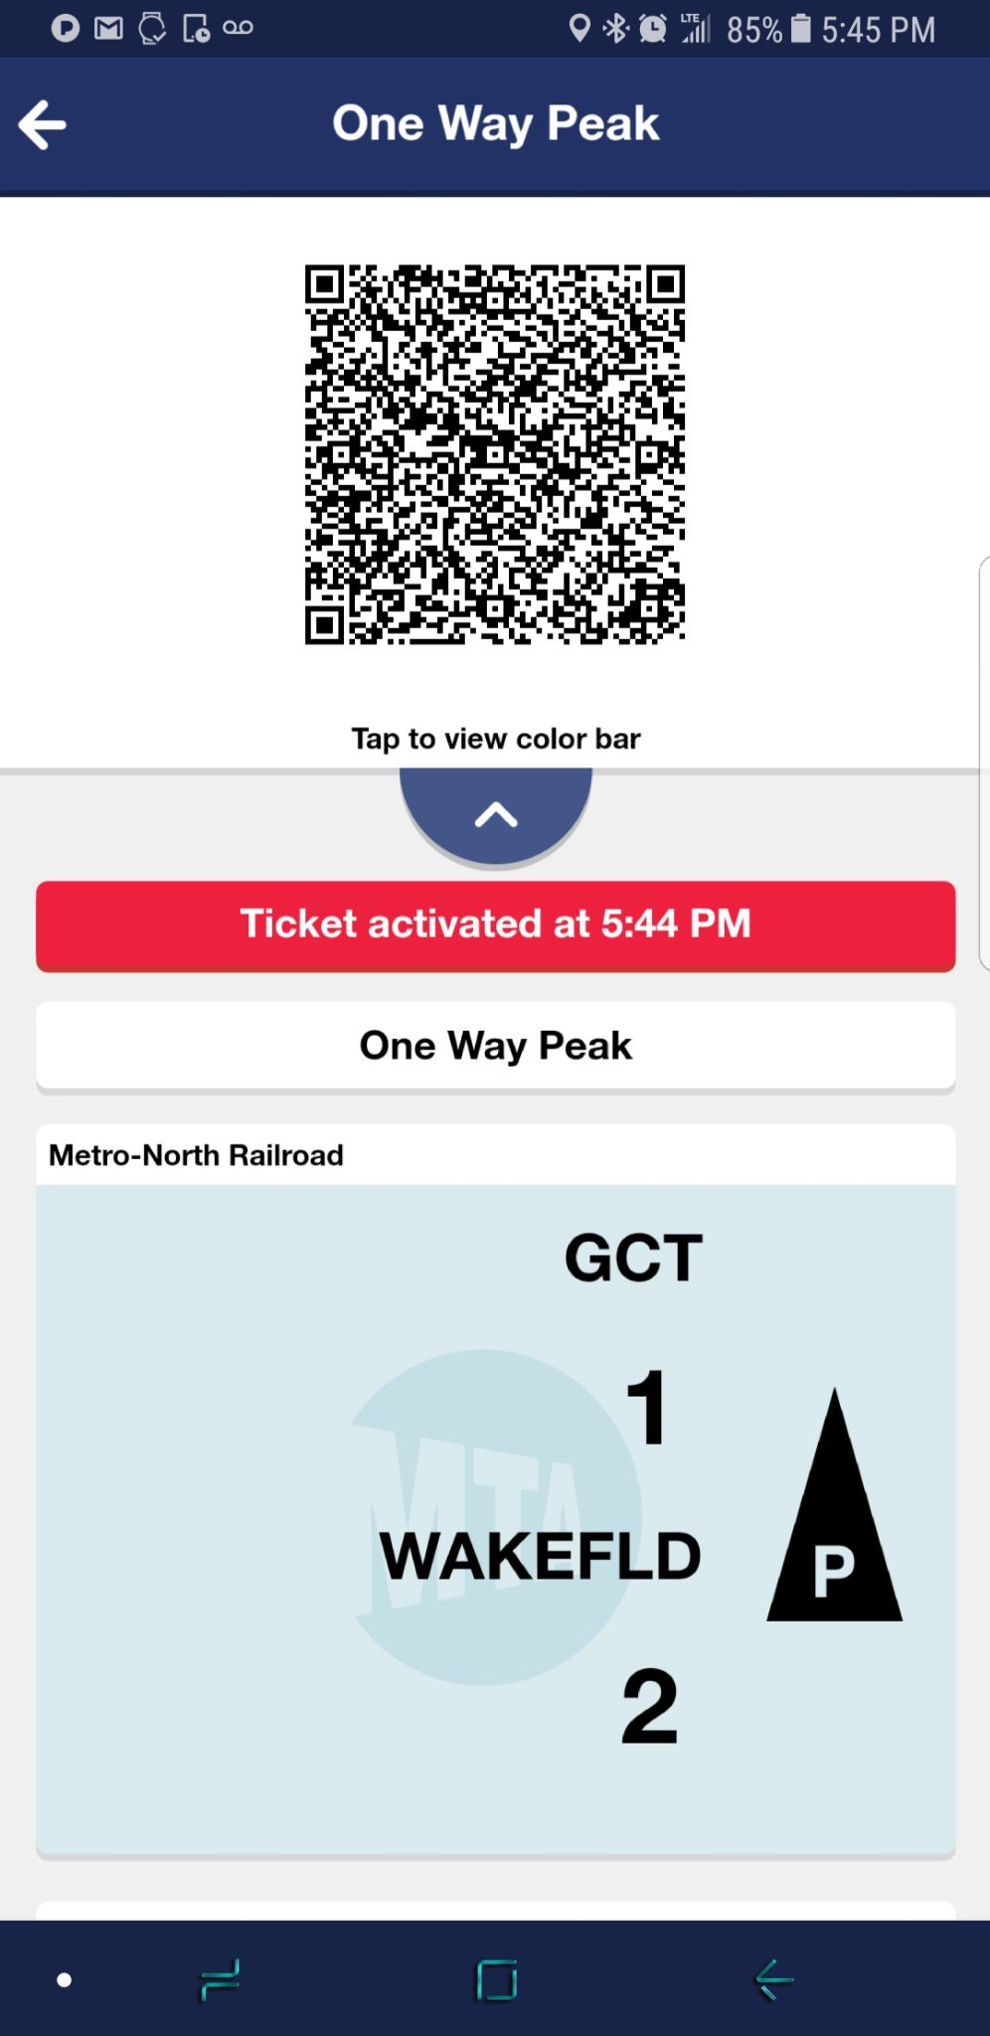
Transit Applications in circulation
New Jersey transit:
Users can purchase tickets for local and interstate trains and busses. This allows easy travel within the state of NJ and between the states of Pennsylvania and New York. User has option to purchase ticket and activate it later.
MTA eTix:
The MTA application is used to buy train tickets for the Metro North. The purchased ticket has a QR code and also states what time the ticket was activated and when it will expire.
Notes:
Gaelle

Slide 4
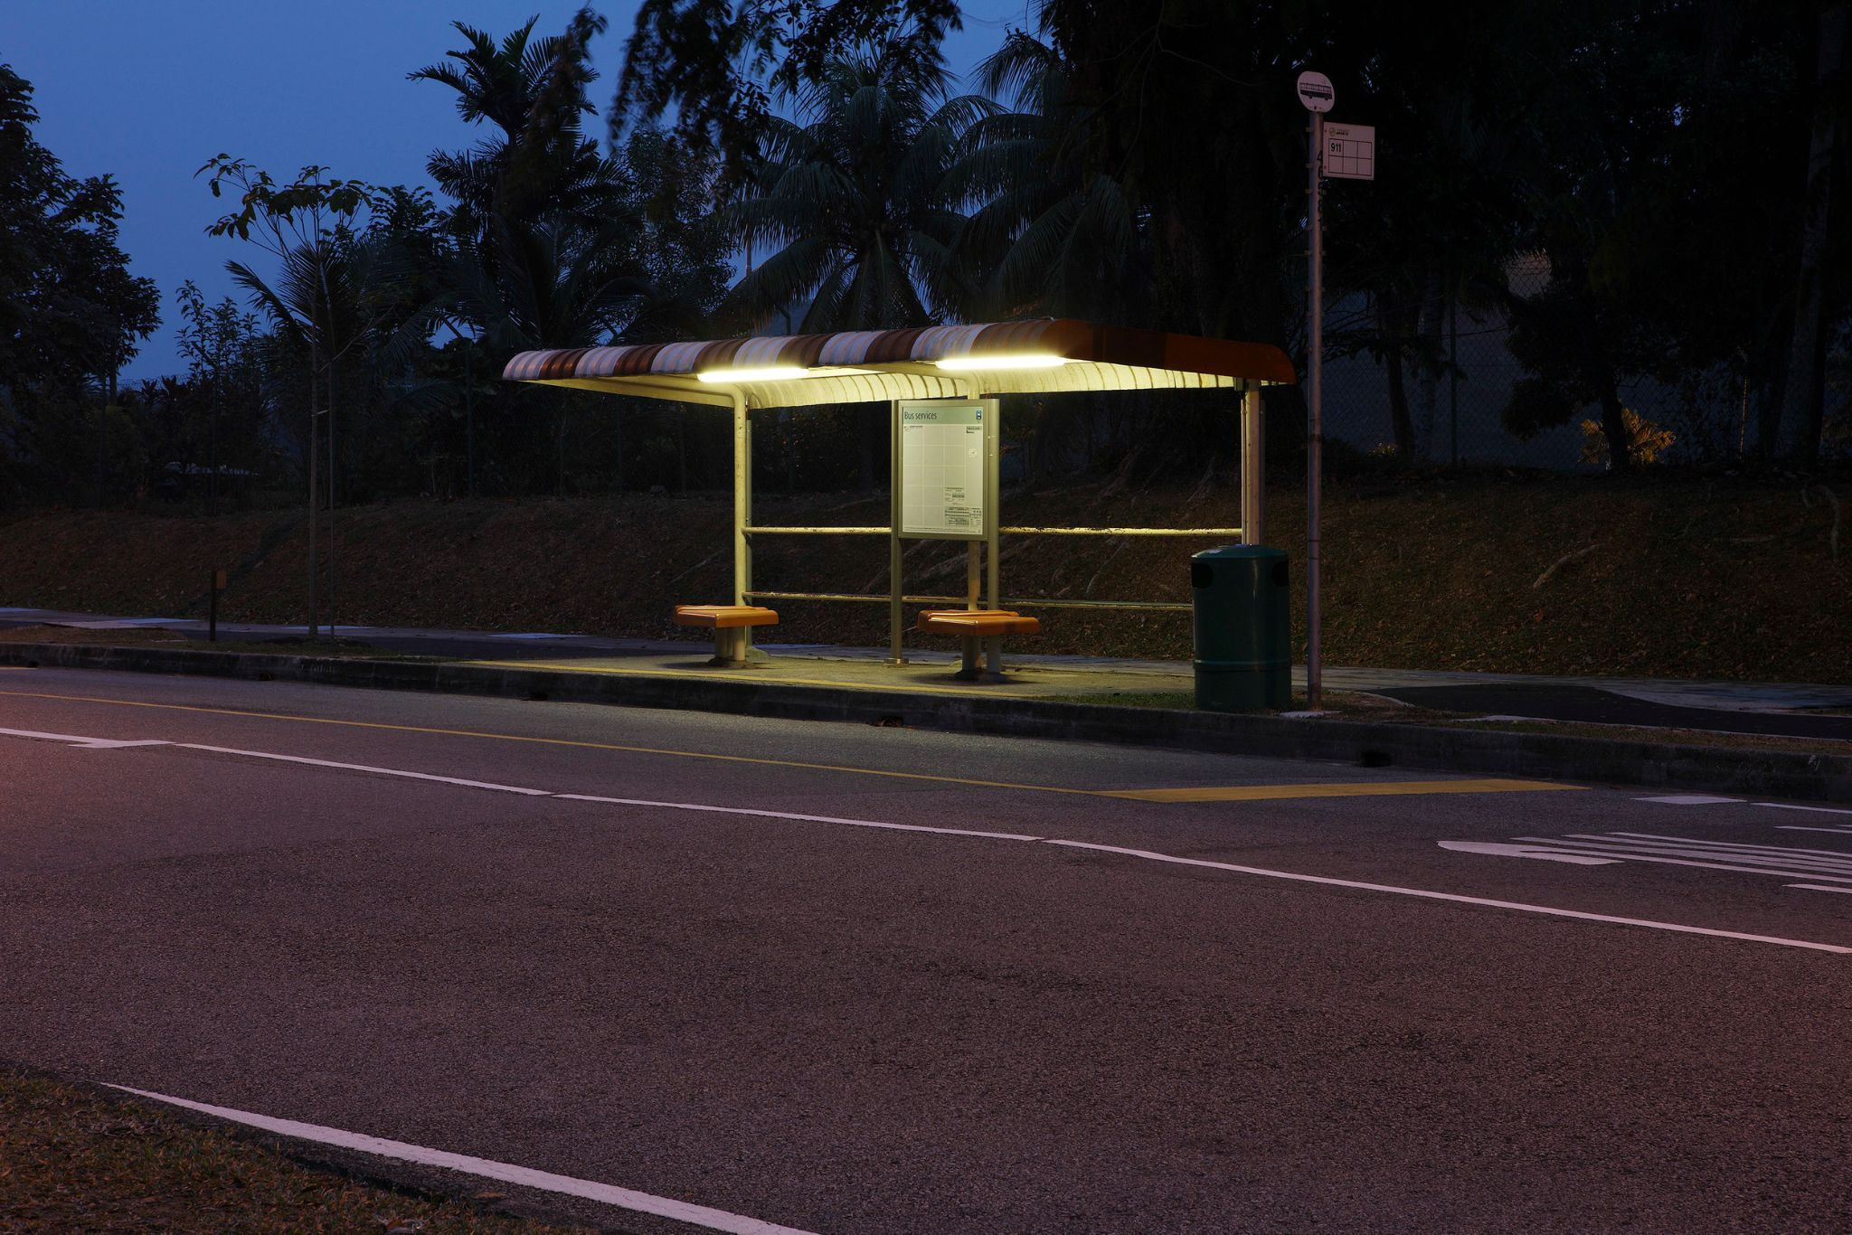
Persona 1:
Details:
Marie is a young high school student who buys her metrocard form the school and usually asks for the exact amount to get her home. However, Marie was not paying attention one day and missed her stop. This normally would not be a problem but the spacing for this stop was unusually large since it passed a cemetery. Realizing her mistake, Marie got off on the next stop but had no way to catch another bus as her metrocard was empty even though she had a credit card and cash on her. She would be unable to use her credit card on the bus as the bus only accepts cash. Unfortunately, she was unable to use the cash she had on her as well as bus drivers do not carry cash on them, unable to give users a refund.
Goals:
Marie would have appreciated it if there had been an app like NYCFTAeTix so that she could purchase a ticket from her phone and not have to worry about walking home through the cemetery.
Notes:
Briana

Slide 5

Persona 2:
Details:
Linda is a 30-year-old commuter who tends to be forgetful. She usually forgets to grab her metrocard before heading to the bus stop in the morning on her way to work. She realizes her mistake as she arrives at the bus stop, causing her to turn around and go back home to retrieve it. Which, causes her to miss the bus that will get her to work on time. Now she has to wait for another bus that won’t come until 30 minutes later, causing her to be late for work.
Goals:
With this application Linda will no longer need to worry about remembering her metrocard as she will now have it on her phone. Now Linda will never miss her bus again or be late to work because of her metrocard.
Notes:
Briana

Slide 6
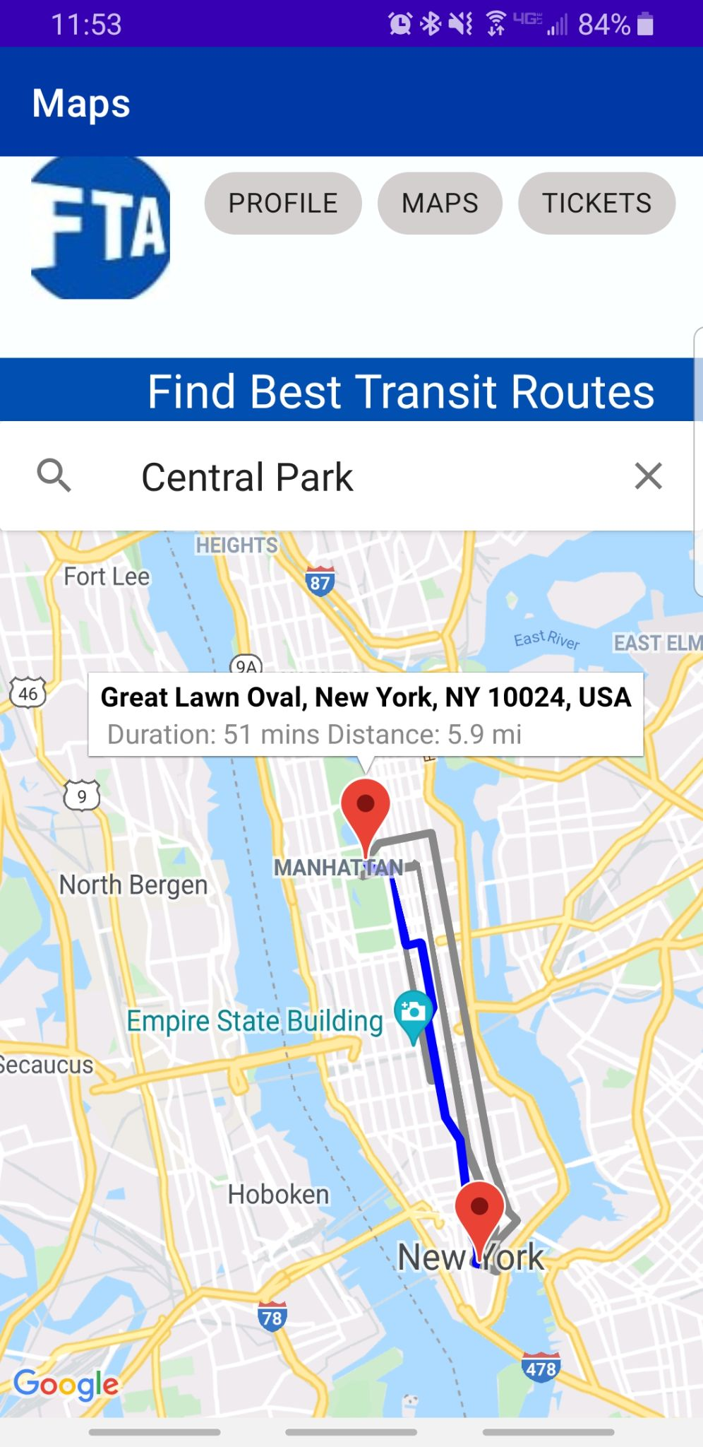
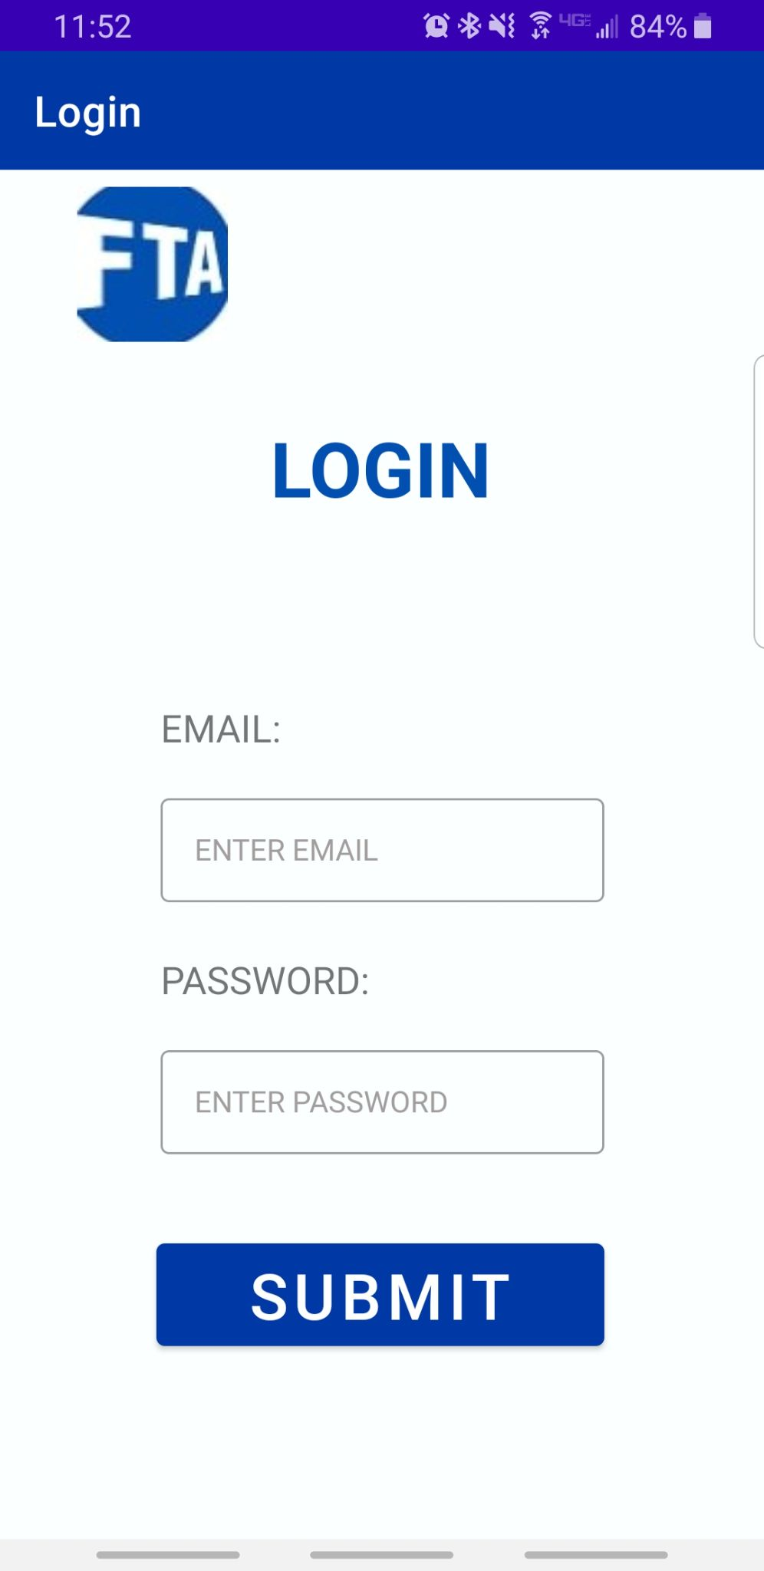
Features
Purchase bus/transit ticket on your phone
QR code to scan or be viewed by driver
API Map with Routes and Time estimates
Sign up and login to save information and tickets
Notes:
Briana

Slide 7




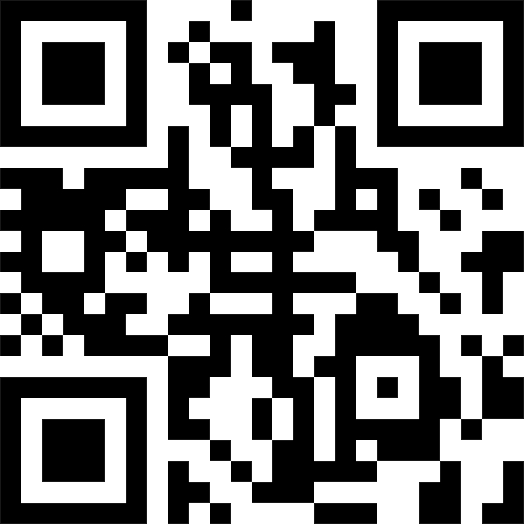
Technology Used
Android Studio
Google MAPs API
Firebase
QR Code generator library
Google Maps API
Android Studio
QR Code Library
Notes:
Gaelle

Slide 8
Problems encountered while in development
Had some issues with Google Maps Api.
Retrieving users location
Getting the AutocompleteSupportFragment to work
User unable to search up a place like Target.
Cause app to crash
Getting polylines to work properly
Getting duration and distance of destination from users location to work properly.
Getting bus line name
Issues with adding information to the database
Adding new data without overwriting the child of the user.
Notes:
Gaelle

Slide 9
Where we are
Currently users can:
Set up an account / log into their account
Add Credit/Debit card information
Access Google Maps within the app to see duration and distance from their location to their destination
Users can also open Google maps from the application to get an even more detail information about their trip
Such as bus or train transfers
What line the need to take and so forth
Purchase a ticket of their choice (monthly, weekly or a one-way)
Access the QR code that would be shown to the driver or scanned at the subway station
Notes:
Briana

Slide 10
NYCFTAeTix
Video Demo: https://youtu.be/rSCeq2HMVrI
Notes:
Briana

Slide 11
Reference Links:
GitHub: https://github.com/2021PaceAppDevelopment/2021AppDevelopmentProject
Maps API Video Demo: https://goo.gl/pfGNnw (Tutorial on how to use Google Maps API)
API Links:
https://developers.google.com/maps (Google Maps API)
Other Links:
https://stackoverflow.com/ (Stack Overflow)
Notes:
Briana

Slide 12
THANK YOU
Any Questions?

