Slide 1
Weekly Report
2021-07-17 week 2
Yang Zhouchang

Slide 2
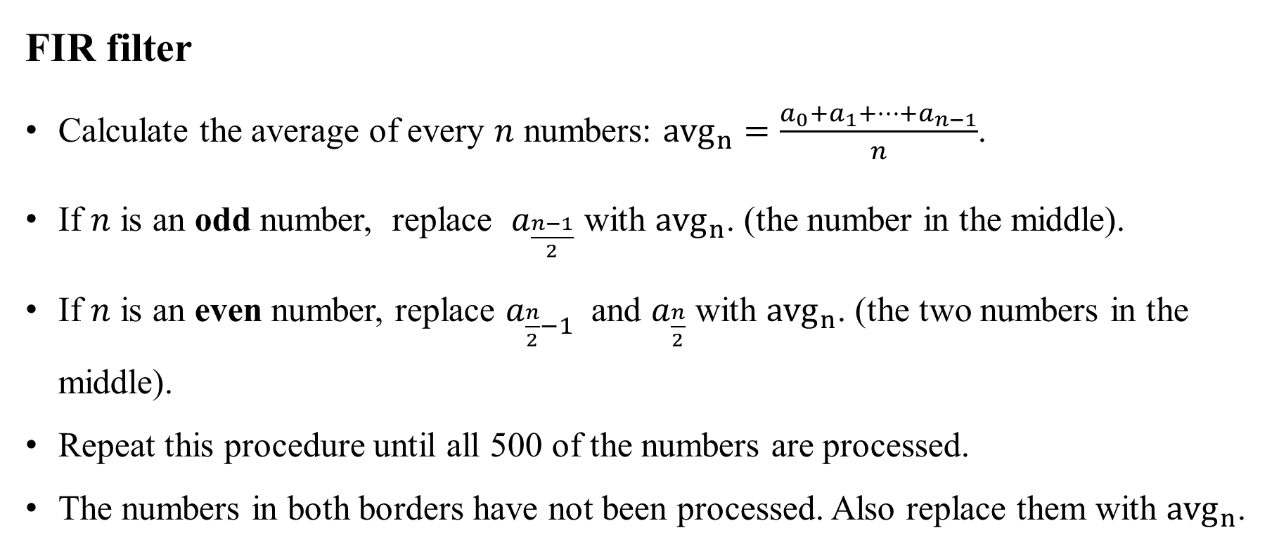
FIR filter
Calculate the average of every $n$ numbers: ${avg}_{n}=\frac{a_{0}+a_{1}+…+a_{n−1}}{n}$.
If $n$ is an odd number, replace $a_{\frac{n−1}{2}}$ with ${avg}_{n}$. (the number in the middle).
If $n$ is an even number, replace $a_{\frac{n}{2}−1}$ and $a_{\frac{n}{2}}$ with ${avg}_{n}$. (the two numbers in the middle).
Repeat this procedure until all 500 of the numbers are processed.
The numbers in both borders have not been processed. Also replace them with ${avg}_{n}$.

Slide 3
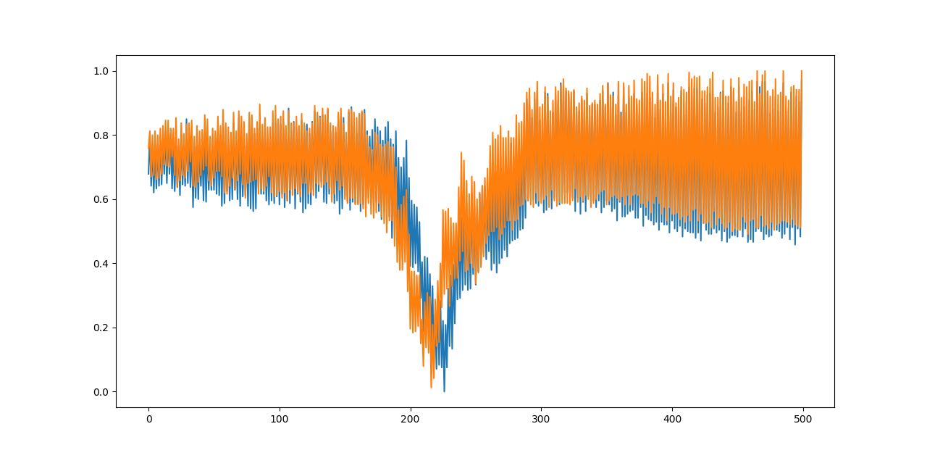
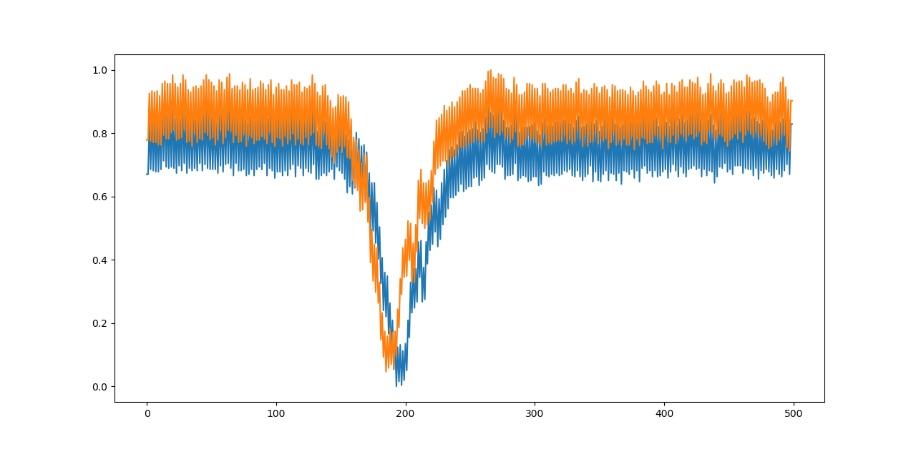
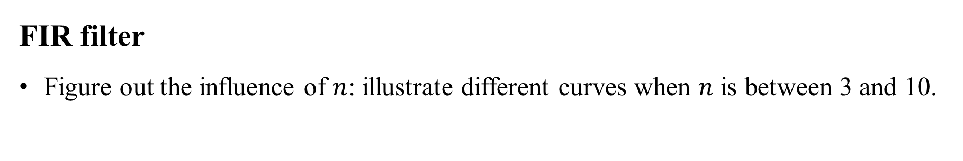

FIR filter
Figure out the influence of $n$: illustrate different curves when $n$ is between 3 and 10.
Not processed
$$n=3$$

Slide 4
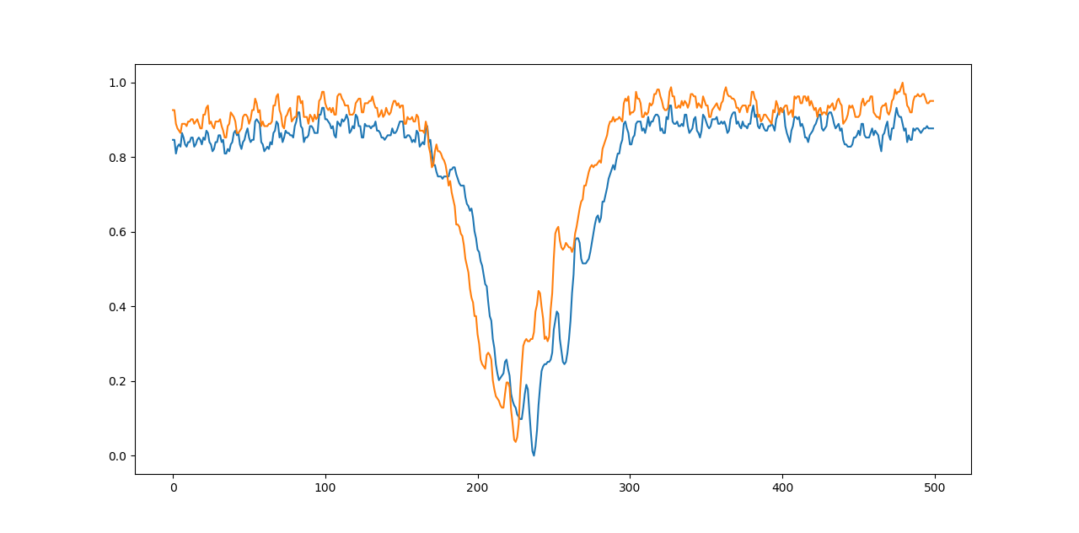
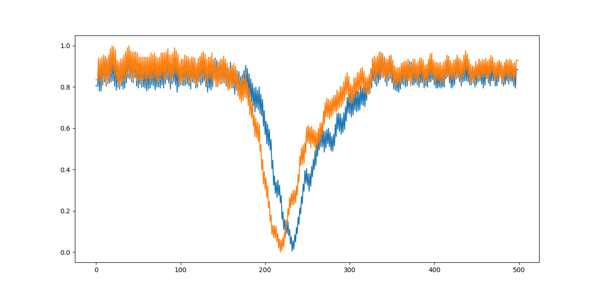
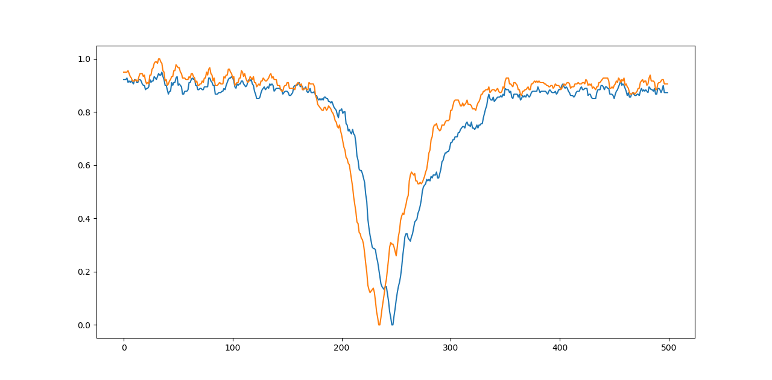
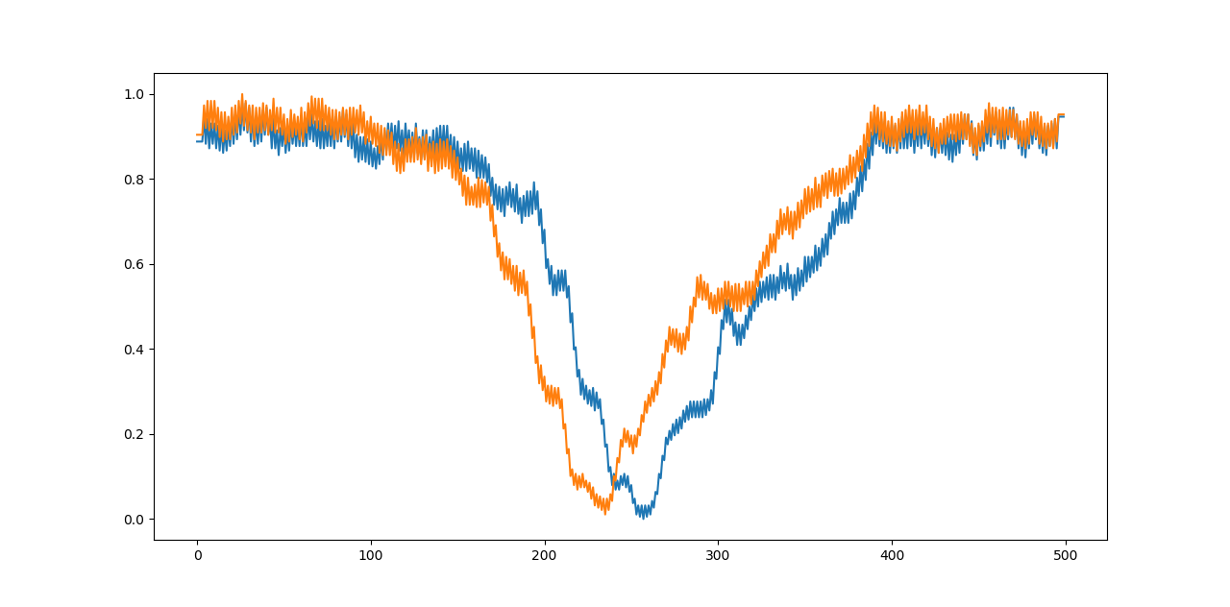




$$n=4$$
$$n=5$$
$$n=6$$
$$n=7$$

Slide 5
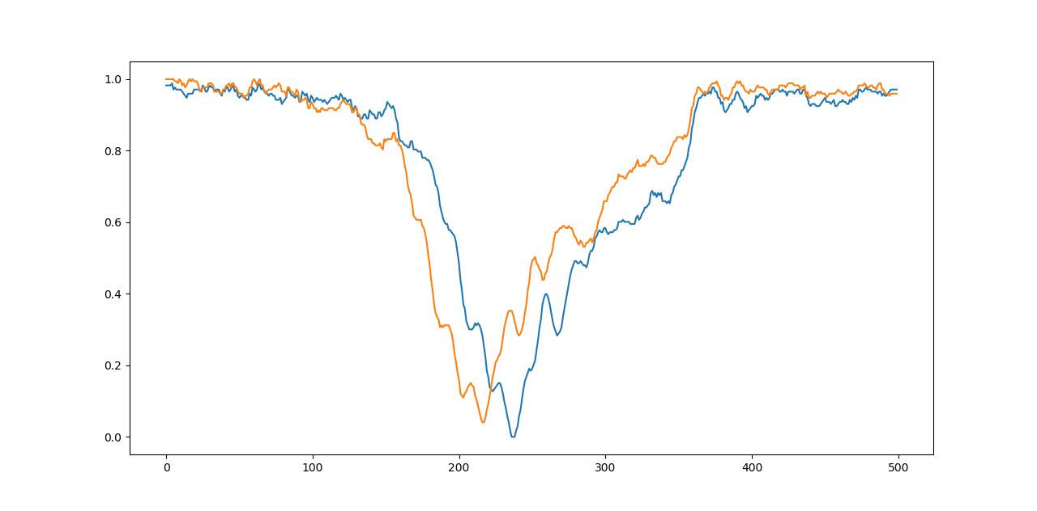
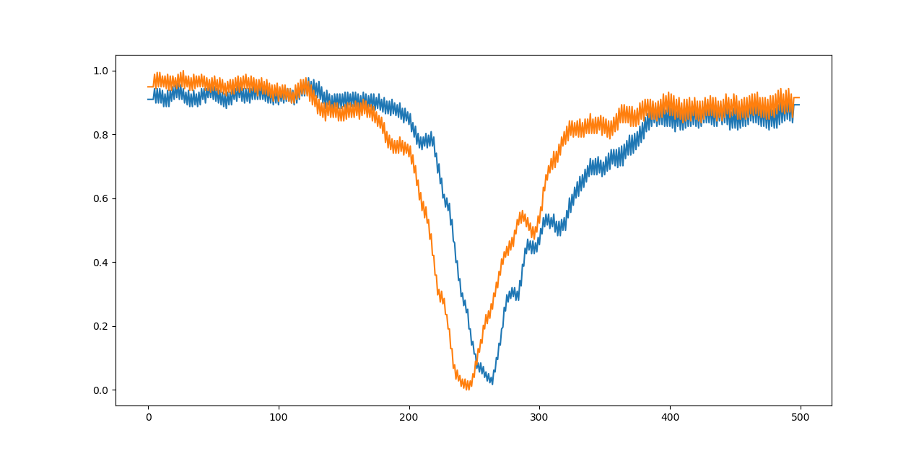
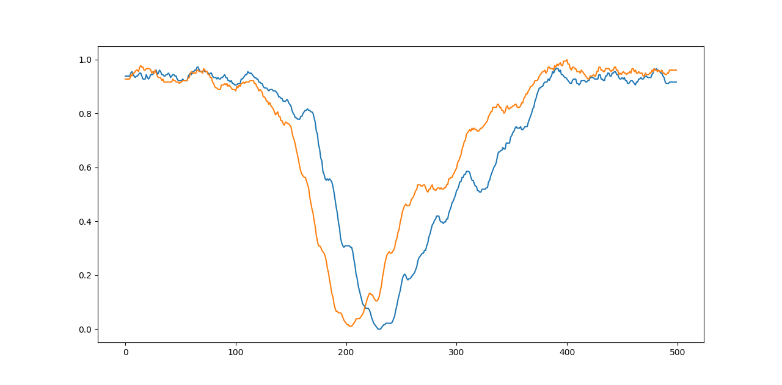
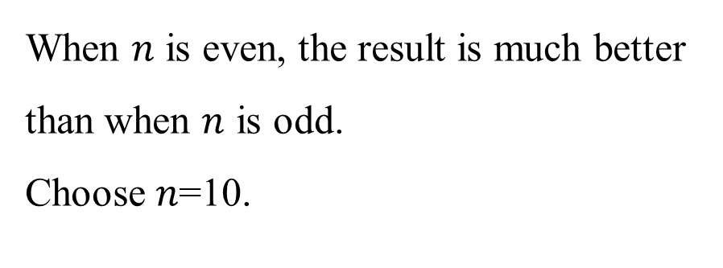



$$n=8$$
$$n=9$$
When $n$ is even, the result is much better than when $n$ is odd.
Choose 𝑛=10.
$$n=10$$

Slide 6
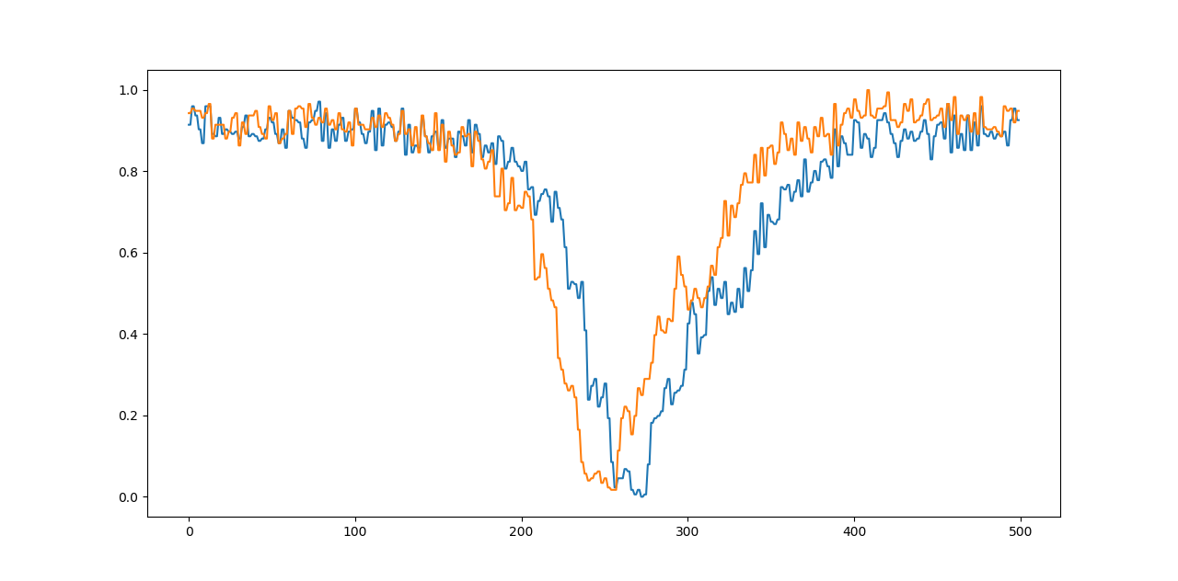
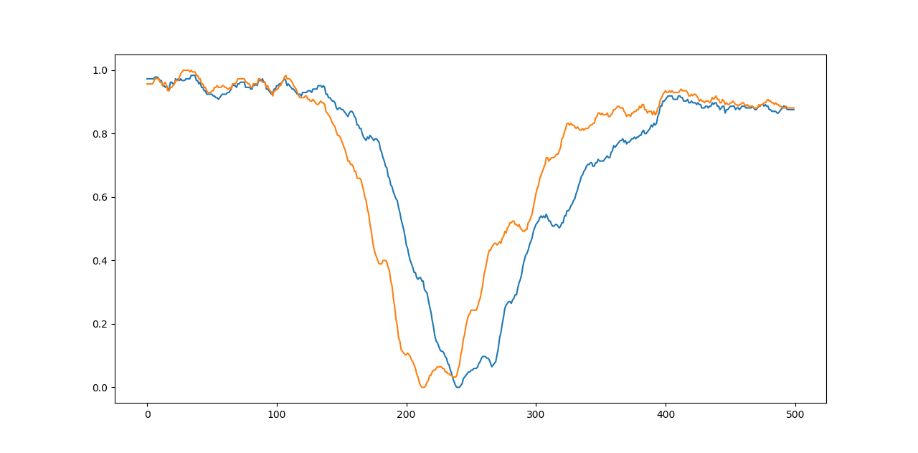

FIR filter compared with last week’s method
Make a gesture in the same environment, using two different methods
Last week’s method
$$n=10$$

Slide 7
尝试中位值限幅滤波：每次先去掉最大最小值再进行中位值滤波
尝试插值法：用numpy库
曲线拟合
Y轴归一化时，将两个通道的数据分开归一化，防止出现两侧照明不均匀影响结果的情况
光照条件对数据造成的影响：宿舍日光灯、暗光、图书馆强光三种情况；如何设计滤波与平滑方式归一化不同情况下的数据？
左手和右手的区别：采集数据
高光强下滑动平均滤波会出现锯齿，考虑进一步平滑处理

