Slide 1
EE -625 Computer Vision Project
Development of a novel method for PCBs fault detection
Rahul Ghosh 120108027
Ashima Jain 120108051

Slide 2
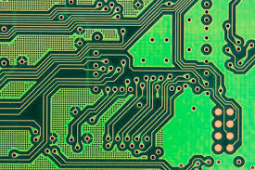
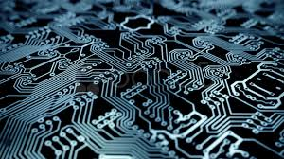
Introduction
With the boost in Electronics industry, the demand for Printed Circuit Boards (PCBs) has soared high. PCBs being cheap, reliable and easy to mount ICs on, have become an important component of the industry. Further, with the increasing miniaturization of the circuits, the intricacies of the PCBs also increases.

Slide 3
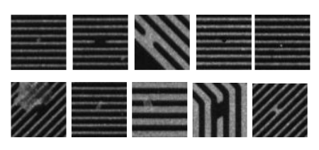
PCB manufacturing is prone to many errors and can lead to defects like open, short, oxidation, dust, contamination, etc. as shown below.

Slide 4
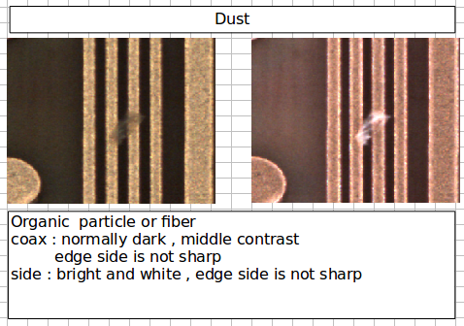
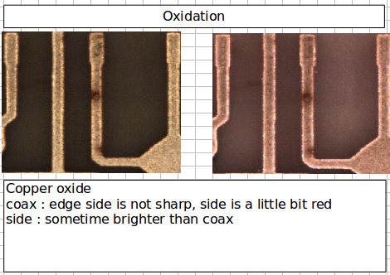
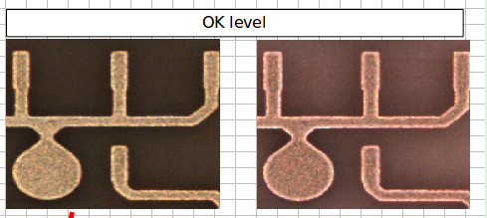
Proposed approach
We hve used 3 classes of PCB: ok level, dust, oxidation. The dataset containes images under 2 different illumination, coax and side.

Slide 5
The method involvles extracting sift features from the images followed by classification into the respective defects using svm.
SIFT - Scale Invariant Feature Transform
It is one of the most popular feature extraction and description algorithms, which extracts blob like feature points and describe them with a scale, illumination, and rotational invariant descriptor. SIFT detects blob like features from the image and describe each and every point with a descriptor that contains 128 numbers. As the output, it gives an array of point descriptors.

Slide 6
Bag-Of-Feature (BoF) Descriptor
BoF is one of the popular visual descriptors used for visual data classification. BoF typically involves in two main steps. First step is obtaining the set of bags of features. We can obtain set of bags for particular features and then use them for creating BoF descriptor. The second step is we cluster the set of given features into the set of bags that we created in first step and then create the histogram taking the bags as the bins. This histogram can be used to classify the image or video frame.
Support Vector Machines (SVM)
A Support Vector Machine (SVM) is a discriminative classifier formally defined by a separating hyperplane. In other words, given labeled training data (supervised learning), the algorithm outputs an optimal hyperplane which categorizes new examples.

Slide 7
After the classification, the fault area is marked on the images. In dust, the image under coax illumination is dark whereas the defect region is very bright in side.The c0 and c1 images of the PCB for which dust is detect are subtracted and turned into greyscale. It is then converted into binary image by thresholding. The resultant image contains thin edges and the fault area. The noise portion is removed by first removing the components connected by less than certain fixed number of pixels following which the image is opened.The remaining white region is the fault area.
Oxidation on the other hand is a little complex as in both the illumination, the fault region is dark. The c0 and c1 components of the PCB are both added and subtracted and their grayscale counterparts obtained. By threshloding, both the images are coverted into binary and then XORed. Following this, the smaller components are removed and finally, the image is opened.

Slide 8
Results
The dataset has 146 instances PCBs having faults that belong to the dust category, 26 that belong to the oxidation category and finally 20 instances of PCBs that do not have any fault. Moreover for each PCB we have two images belonging to two different illuminating conditions differentiated as c0 and c1. We used the c0 images for feature extracting and classification. Following are the results obtained:
Class | Correct | Incorrect
Dust | 52 | 21
Oxidation | 10 | 3
Ok | 8 | 2

Slide 9
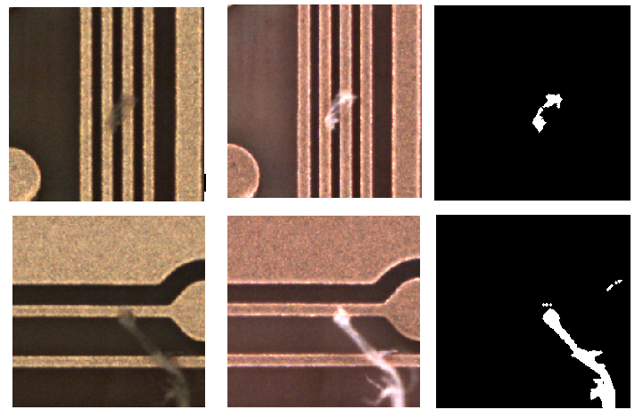
The following figure shows the coax and side illumination and detected fault area in the PCB.

