Slide 1
K-league information web page
Database : Class 502
B889047 윤준호
B893127 서해원
B889069 한정우

Slide 2
Project Members
Set overall project structure & Source code state management
Write PHP Scripts (Back-End) + Develop sub-tools & Infra & script for project
한정우
Write PHP Scripts (Back-End)
Table Design, DA
서해원
Write Web UI Scripts using HTML / CSS / JavaScript
Table Design, DA
윤준호
Table Design, DBA

Slide 3
Project Members

Slide 4

Project Motivation
To make homepage people can know about players and teams from K-league more easier and compact in preparation for the Qatar World Cup
Notes:
While deciding project subject, we consider that Qatar World Cup will be held in Novmeber 20th.
As we search for member of national team, we notice that players running in foreign league( ex)EPL, Laliga… etc ) are well known, but players from K-league are not well known
So we decided and set goal to make homepage people can know about players, teams from K-league

Slide 5














Co-Operation Workflow & Infrastructure
Server Extenal IP
127.0.0.1
http://software.hongik.ac.kr/
Host
SSH
Development Environment
Make development environment with dockerfile : https://github.com/2022-DB-502-Group2-Project/Develop-Test-Env
Editor : Visual Studio Code, Jetbrain PHP Storm
Git & Github
Manage source codes, source codes version, issues for Co-Operation
Link : https://github.com/2022-DB-502-Group2-Project
Notes:
http://61.32.32.181:6043/home/

Slide 6
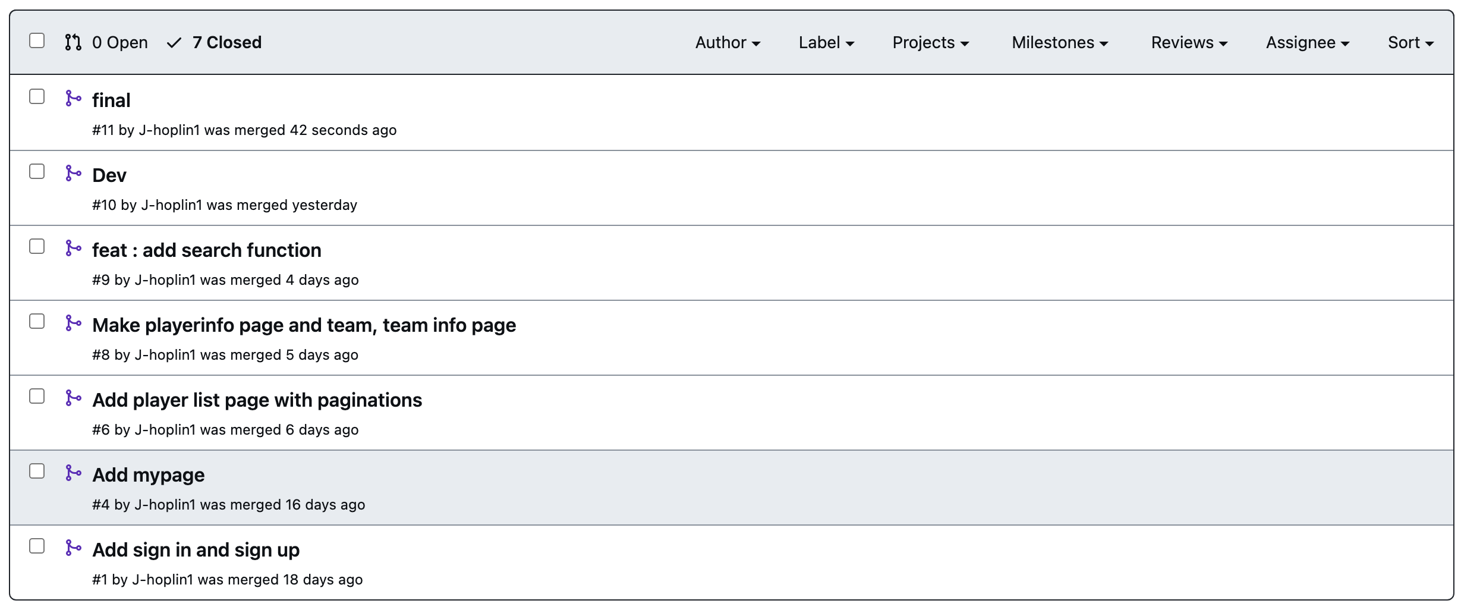
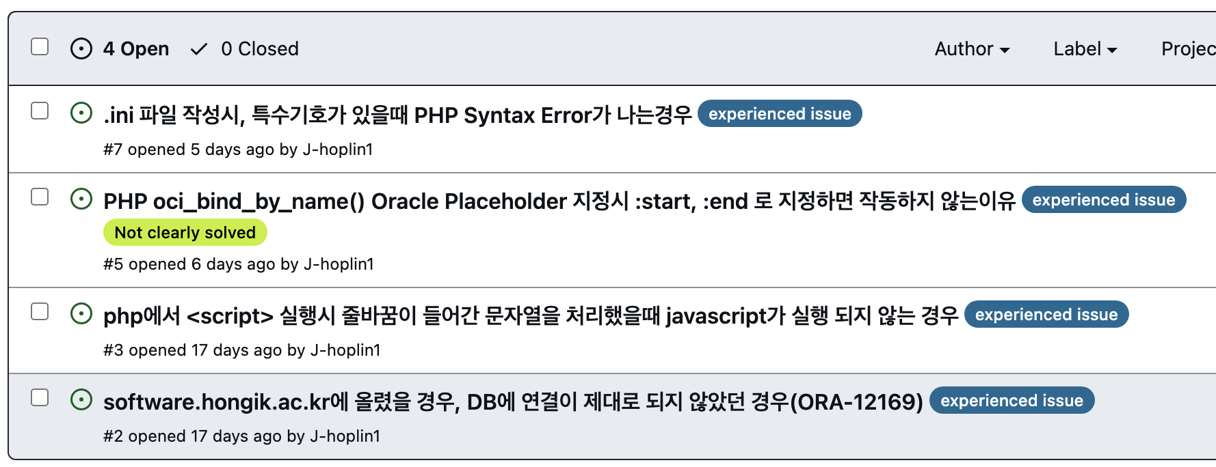
Co-Operation Workflow & Infrastructure
Total 7 Merge-Request & 4 issues while developing web page

Slide 7









Service Architecture
http://software.hongik.ac.kr/
/page.php?key=value
Request
SQL Query
Response
User Experience
203.249.87.57
Query Result
hoplin server-1
SQL Query
User Experience
Query Result
/url
Request
Fail to Implement
Response

Slide 8
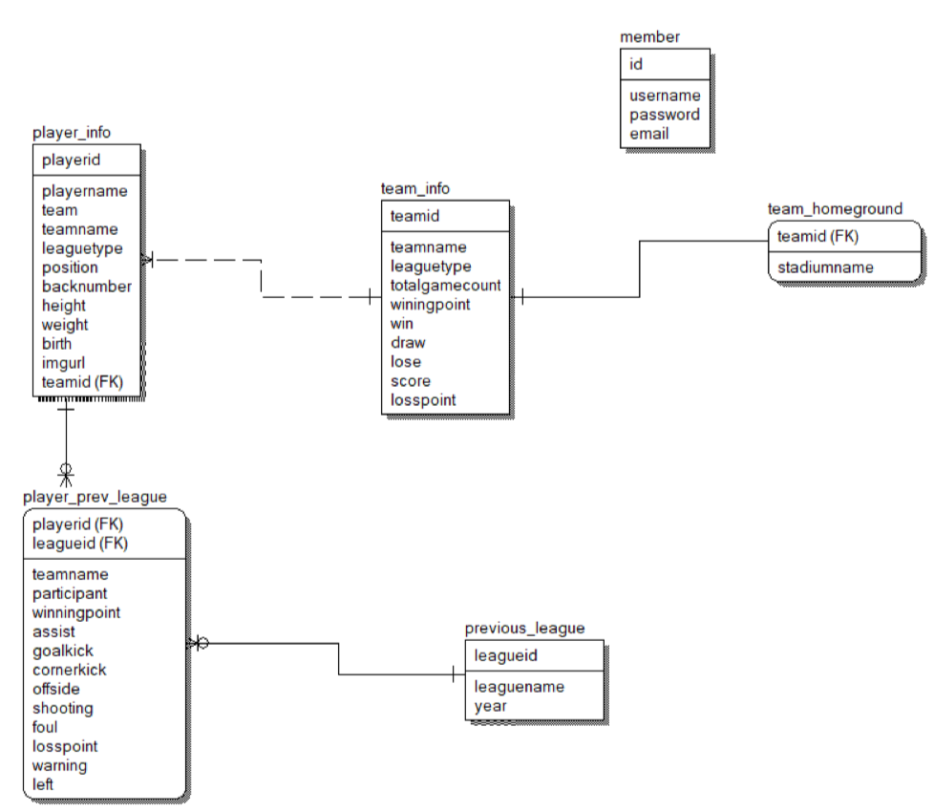
Data : Table ERD
N : 1
1 : 1
Review SQL Query
M : N
Composite Key & Constraint : Foreign Key & On delete CASCADE
Connection table of M : N Relation

Slide 9
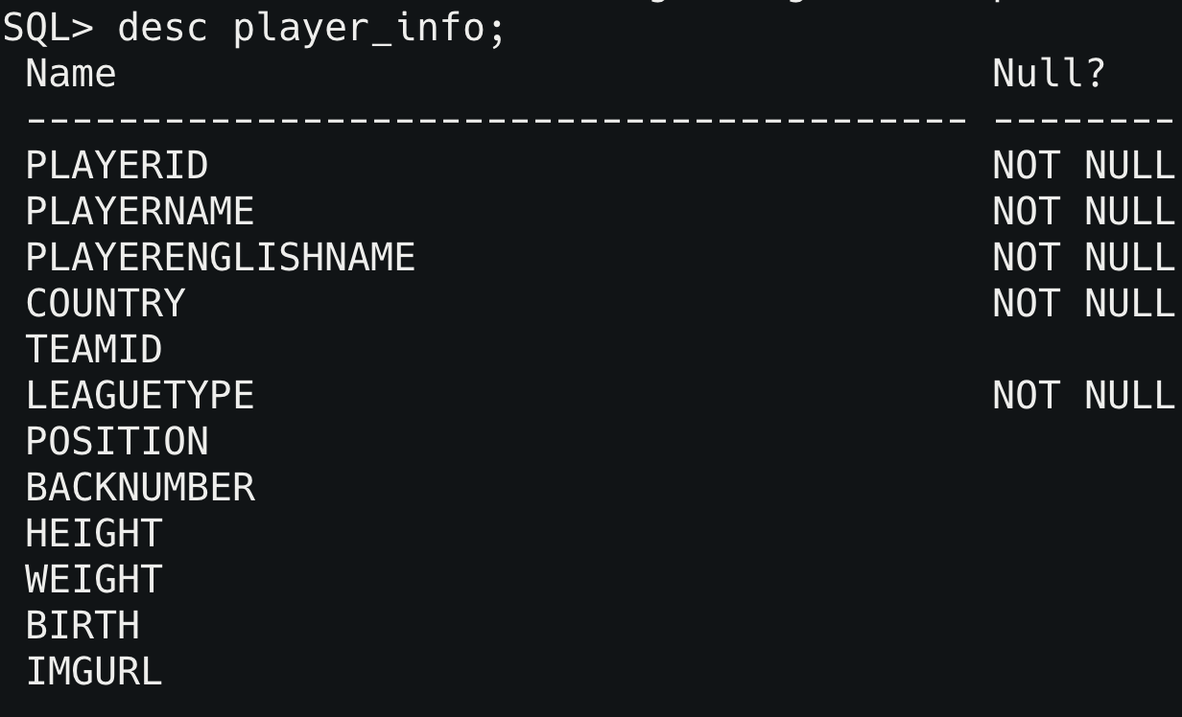
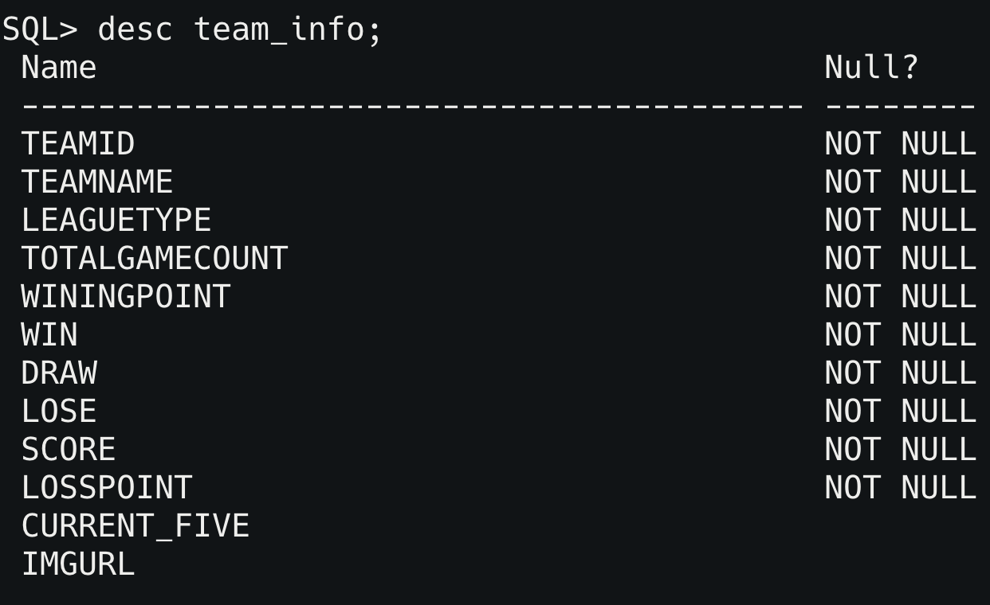
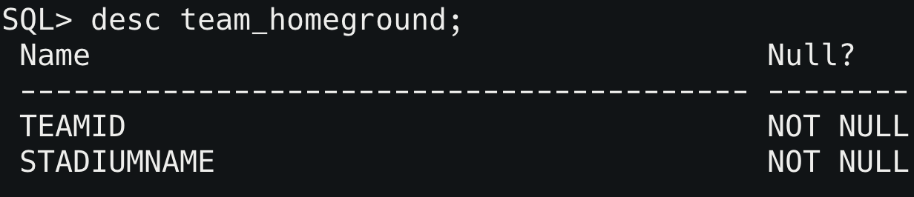
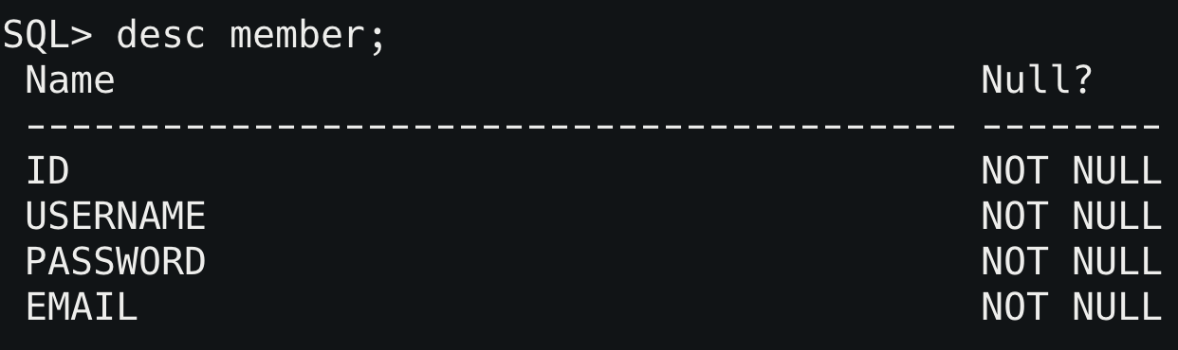
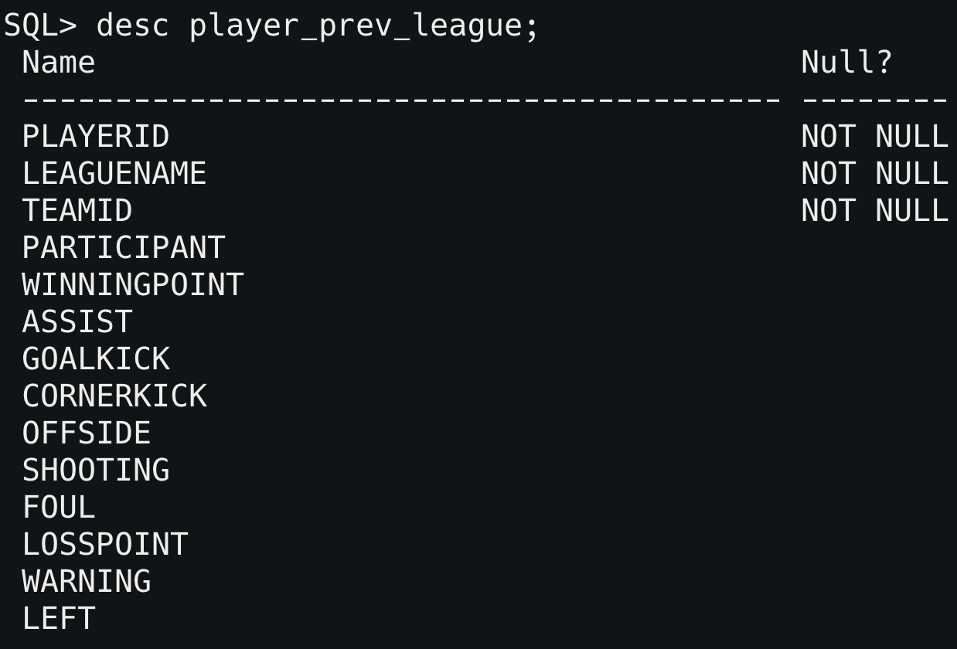
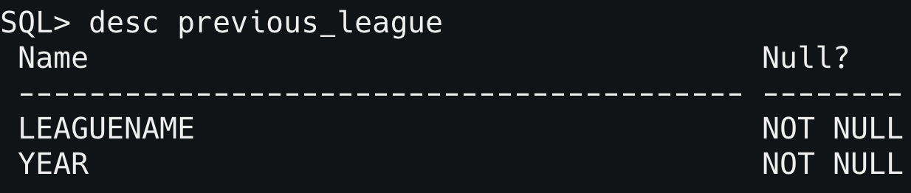
Data : Describe Tables
N : 1
1 : 1
M
M : N
N

Slide 10
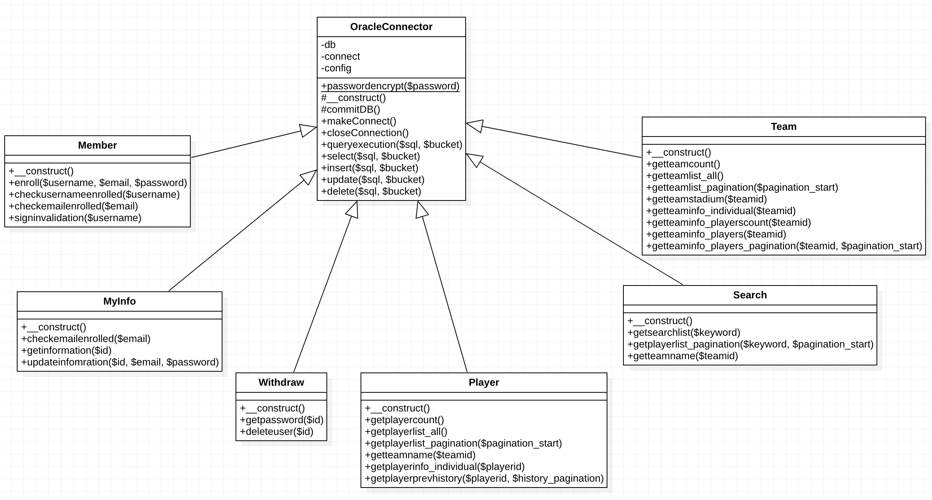
Data : Oracle SQL connector Class Diagram
Review Codes

Slide 11



Database : How do we get datas?
1
2
3
scraper
selenium
pandas
json
bs4
Preprocess Datas
Set uuid(v4) value as player, team id
Set random name instead of Korean name
Refine datas to proper scope not to compromise integrity
Make insert statement by format
Link
Link
Link

Slide 12
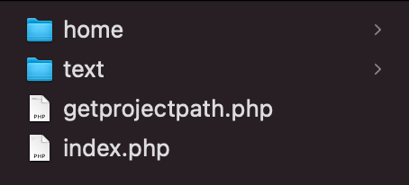
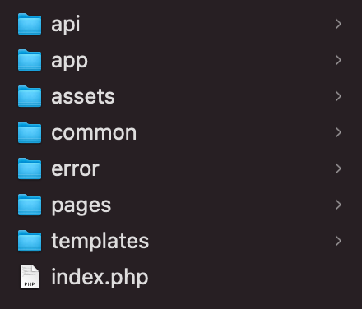
Directory Sturcture : Overall
*Code designed based on Object Oriented Programming
Directory : /
/home : Web source codes
getprojectpath.php : Find project’s real path in Apache section of server
index.php : Redirect to /home/index.php
Directory : /home
index.php : main page of our site
/api : api using PHP. Use self made PHP Rest API Interface
/app : Codes for getting data from Oracle Database
/assets : Assets for service(static resources). Including CSS, JS, config.ini
/common : Global Resources : constant variables, messages, class
/error : Error page(HTTP status 403)
/pages : php pages
/templates : templates for pages

Slide 13

Overall Flow
Total Team List
Team Deatil
Get Information
Total Player List
Player Detail
Main Page
Search Player
Search Result
Logout
Log in
MyPage

Slide 14

Basicflow : To the main page - DB not in used
getprojectpath.php
common.php
- templates/header.php - templates/footer.php
pages/index.php

Slide 15
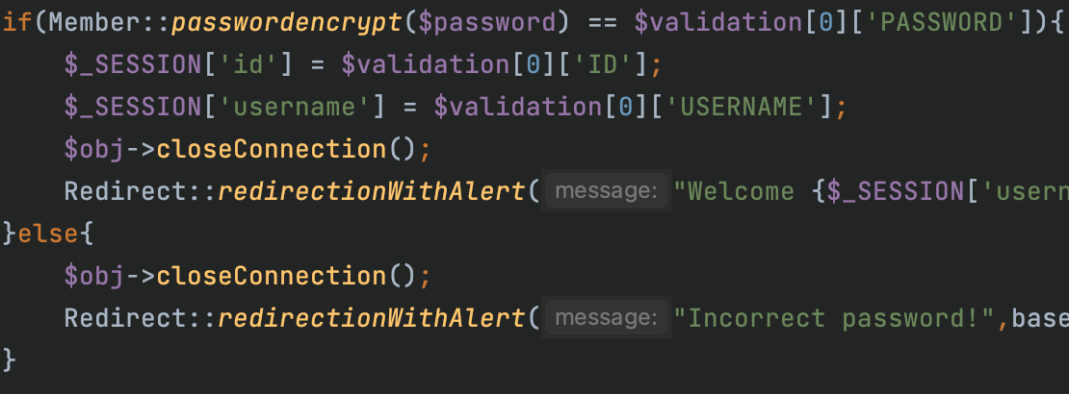
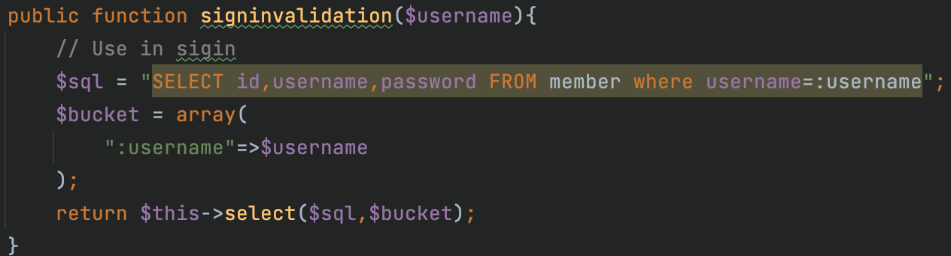
Basicflow : Sign In - DB in used :
login.php
Make one-way encryption about user entered password and compare with password from step 2
If match -> Initialize session with user’s name & user’s id
If unmatch -> Alert sign in fail and redirect to main page
Get password of user from Database
If not exist -> Redirect to main page with alert
If exist -> Get password, user id, user name from Database
User request with
HTTP POST via HTML form
Notes:
User request with POST via HTML form
Get password of user from Database
If not exist -> Redirect to main page
If exist -> Get password, user id, user name
Make one-way encryption about user entered password and compare with password from step 2
If match -> Init session with user’s name & user’s ID and redirect to main page
If unmatch -> Alert about login fail and redirect to main page

Slide 16
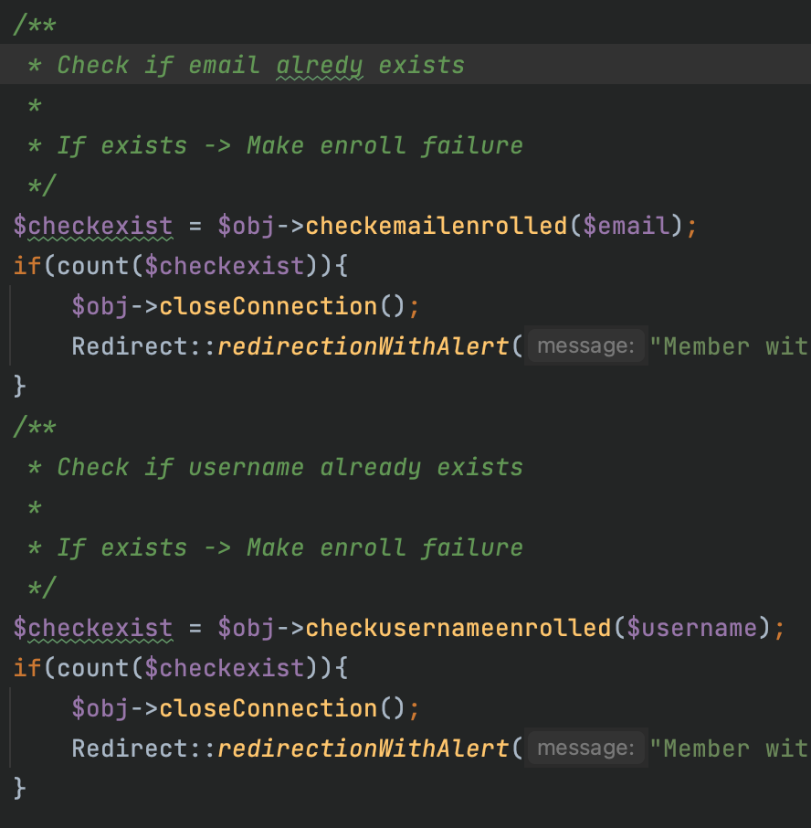
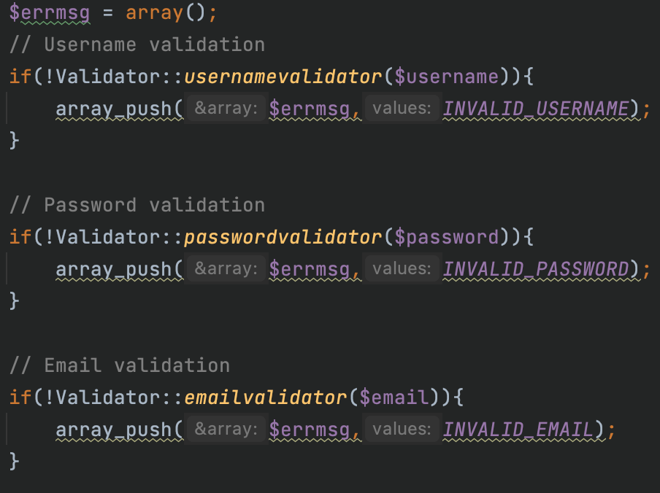
Basicflow : Sign Up - DB in used
login.php
Validate username, password, email pattern
If error message exists at least 1 -> Redirect to sign up page with alert
If not go to next step
Check email and username is already enrolled
If email or username already enrolled, redirect to sign up page with alert
If not enroll user to database
User request with
HTTP POST via HTML form
Notes:
User request with POST via HTML form
Get password of user from Database
If not exist -> Redirect to main page
If exist -> Get password, user id, user name
Make one-way encryption about user entered password and compare with password from step 2
If match -> Init session with user’s name & user’s ID and redirect to main page
If unmatch -> Alert about login fail and redirect to main page

Slide 17
Demonstration
http://software.hongik.ac.kr/b_team/b_team2/

