Slide 1
Classical Theory
Junhui Qian

Slide 2
Content
Introduction
Output
Unemployment
Income Distribution
Interest Rate
Money and Inflation
Exchange Rate

Slide 3
Classical Assumptions
People are individually rational.
Consumers maximize utilities
Firms maximize profits
Prices (including wages and interest rates) are perfectly flexible, ensuring that the economy is in equilibrium all the time.
Markets for final goods/services and factor inputs are competitive.
People have access to perfect information.
Money mainly serves as medium of exchange.
Notes:
Adam Smith writes: "Money is like a road which helps in transporting the goods and services produced in a country to the market, but this road does not itself produce any thing".
John Stuart Mill: “there cannot, in short, be intrinsically a more insignificant thing, in the economy of society than money.”

Slide 4
Macro Implications
Demand automatically accommodates supply.
Look after production, consumption will look after itself.
There is no involuntary unemployment.
There are no severe business cycles.
Money is neutral.

Slide 5
Content
Introduction
Output
Unemployment
Income Distribution
Interest Rate
Money and Inflation
Exchange Rate

Slide 6
Output of an Economy as a Whole
An economy’s output of goods and services depends on:
Aggregate Supply (AS, the supply side)
Quantity of inputs (called the factors of production): labor, capital, land, etc.
The technology that transforms inputs into outputs
Aggregate Demand (AD, the demand side)
Consumption, investment, government expenditure, and net foreign demand

Slide 7
The AD and AS
AD is the “sum” of all demand for goods and services at some price level.
AS is the “sum” of all supply of goods and services at some price level.
Both AD and AS are in the “real” sense: when we say AD or AS changes, it is the quantity of goods and services that changes.
The summation is tricky for heterogeneous goods and services.
The solution: add up the value of these goods and services at constant prices.
Notes:
Another solution is: first add up the value of these goods and services at the current price, then deflate it by the general price level.

Slide 8
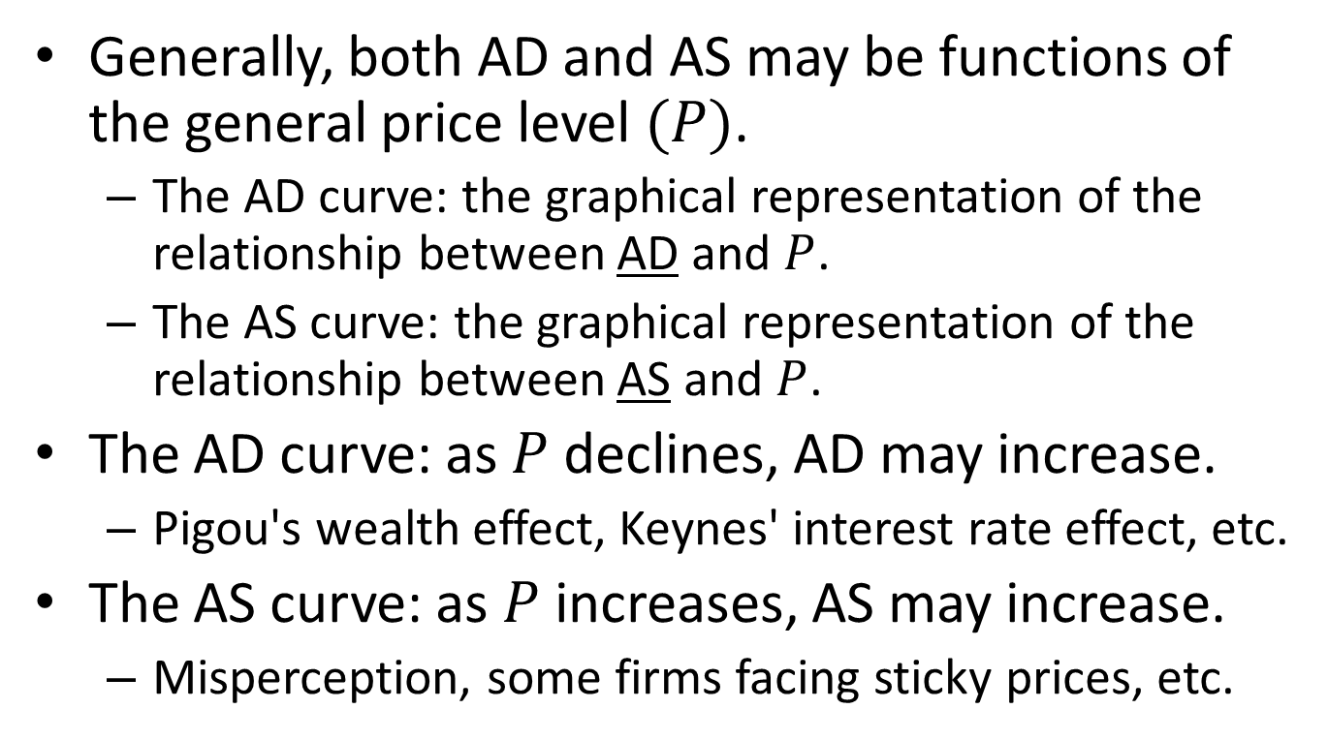
The AD and AS Curves
Generally, both AD and AS may be functions of the general price level $(P)$.
The AD curve: the graphical representation of the relationship between AD and $P$.
The AS curve: the graphical representation of the relationship between AS and $P$.
The AD curve: as $P$ declines, AD may increase.
Pigou's wealth effect, Keynes' interest rate effect, etc.
The AS curve: as $P$ increases, AS may increase.
Misperception, some firms facing sticky prices, etc.
Notes:
In economics, the Pigou effect is the stimulation of output and employment caused by increasing consumption due to a rise in real balances of wealth, particularly during deflation. The term was named after Arthur Cecil Pigou in 1948.
The Keynes effect is the effect that changes in the price level have upon goods market spending via changes in interest rates. As prices fall, a given nominal money supply will be associated with a larger real money supply, causing interest rates to fall and in turn causing investment spending on physical capital to increase.

Slide 9
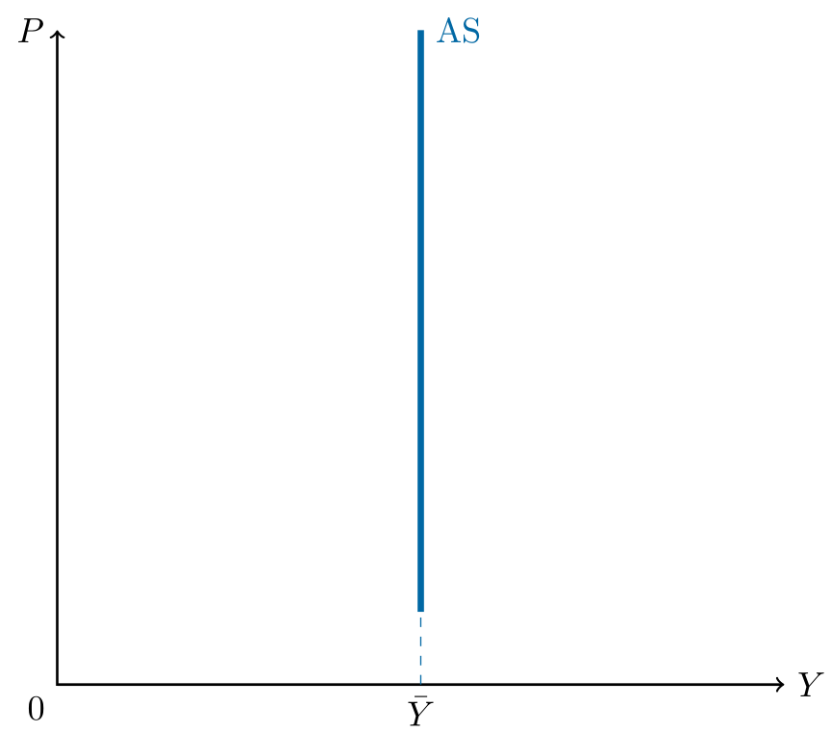
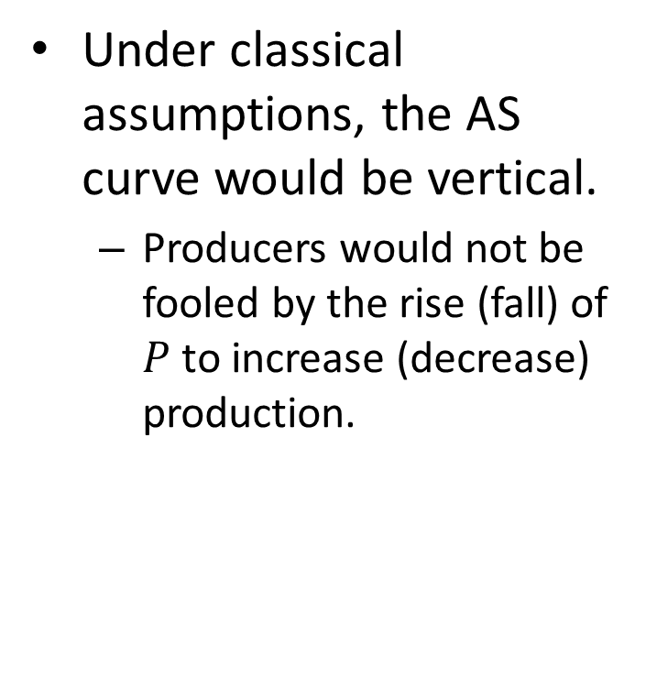
The Classical AS Curve
Under classical assumptions, the AS curve would be vertical.
Producers would not be fooled by the rise (fall) of $P$ to increase (decrease) production.

Slide 10
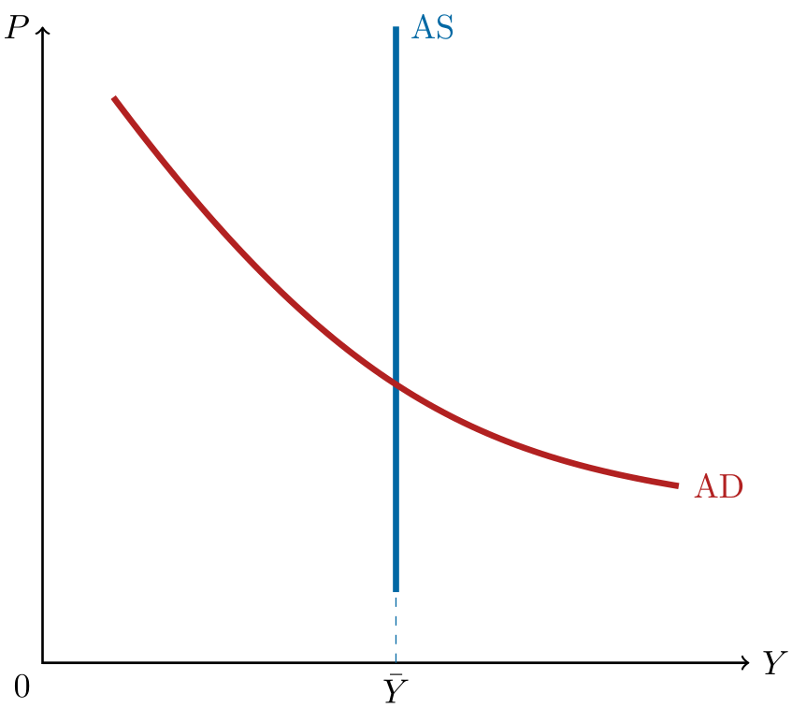
The Classical AD Curve
Under classical assumptions, the AD curve may be downward-sloping.
A lower price level corresponds to a higher purchasing power of money balance (Pigou’s effect).

Slide 11
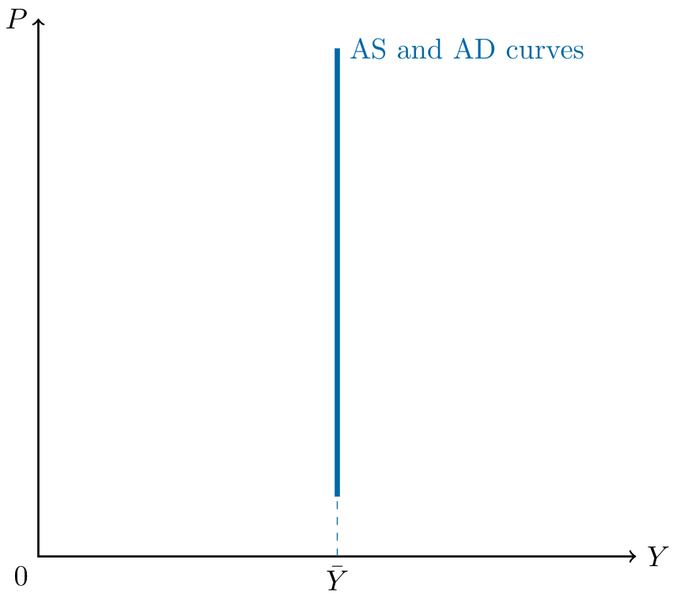
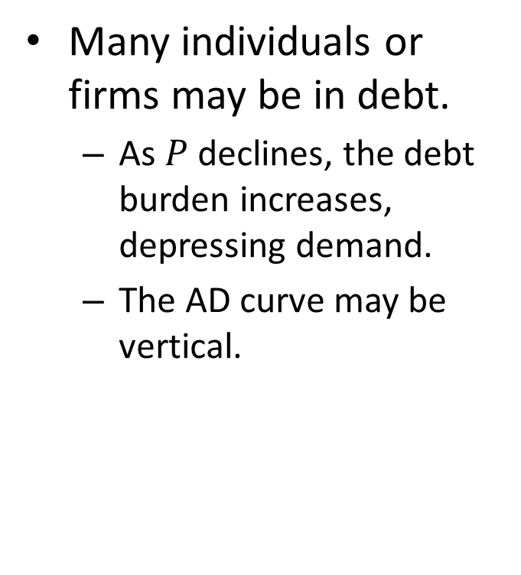
An Argument Against Pigou’s
Many individuals or firms may be in debt.
As $P$ declines, the debt burden increases, depressing demand.
The AD curve may be vertical.

Slide 12
Say’s Law
Say’s Law states: supply creates its own demand.
It necessarily holds in a barter economy.
It does not generally hold in the modern monetary economy.
One implication of Say’s Law: the AD curve coincides with the AS curve at all price level.
The general price level is determined by money supply (quantity theory of money) and is irrelevant to “real” activity of the economy.

Slide 13
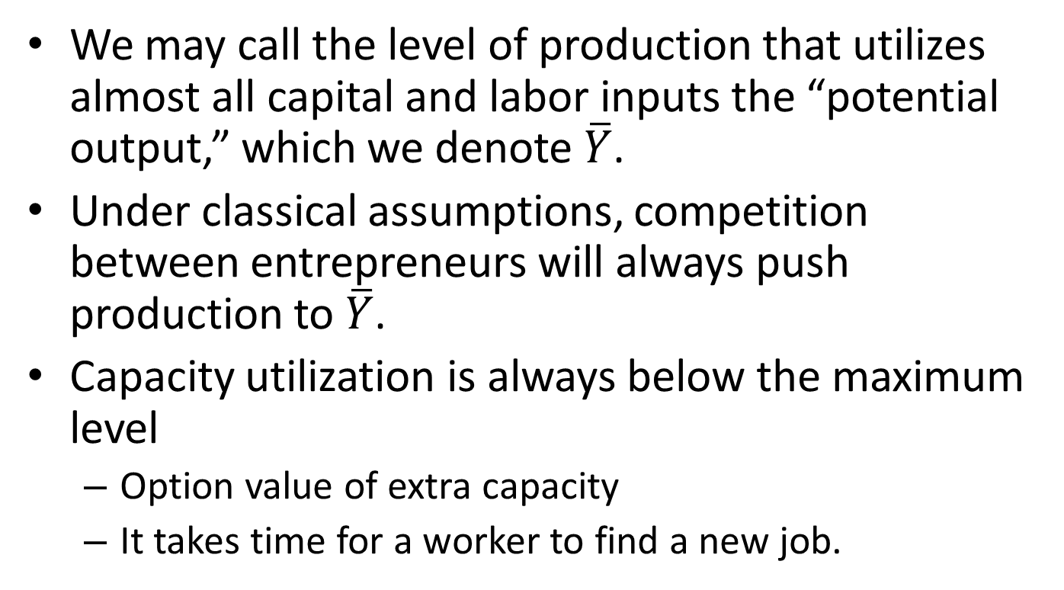
The Output Potential
We may call the level of production that utilizes almost all capital and labor inputs the “potential output,” which we denote $\overline{Y}$.
Under classical assumptions, competition between entrepreneurs will always push production to $\overline{Y}$.
Capacity utilization is always below the maximum level
Option value of extra capacity
It takes time for a worker to find a new job.

Slide 14
Factors of Production
Factors of production are the inputs for producing goods and services.
The two most important factors of productions are capital and labor. (Land is also regarded as a factor of production.)
Capital refers to the set of tools that workers use. We use K to denote the amount of capital.
Labor refers to the time workers spend working. We use L to denote the amount of labor.

Slide 15

A Simplification Assumption
In this chapter we assume that both capital and labor are fixed:
$$K=\overline{K}$$
$$L=\overline{L}$$

Slide 16
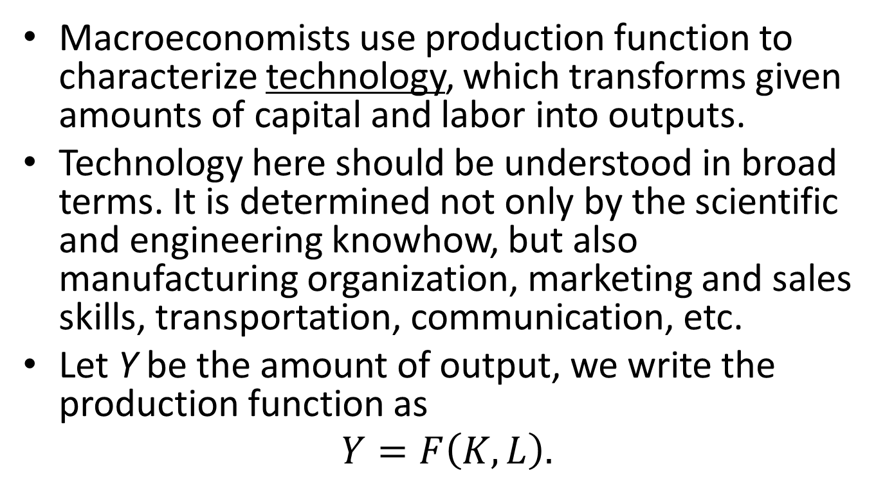
Production Function
Macroeconomists use production function to characterize technology, which transforms given amounts of capital and labor into outputs.
Technology here should be understood in broad terms. It is determined not only by the scientific and engineering knowhow, but also manufacturing organization, marketing and sales skills, transportation, communication, etc.
Let Y be the amount of output, we write the production function as
$$Y=F\left(K,L\right).$$

Slide 17
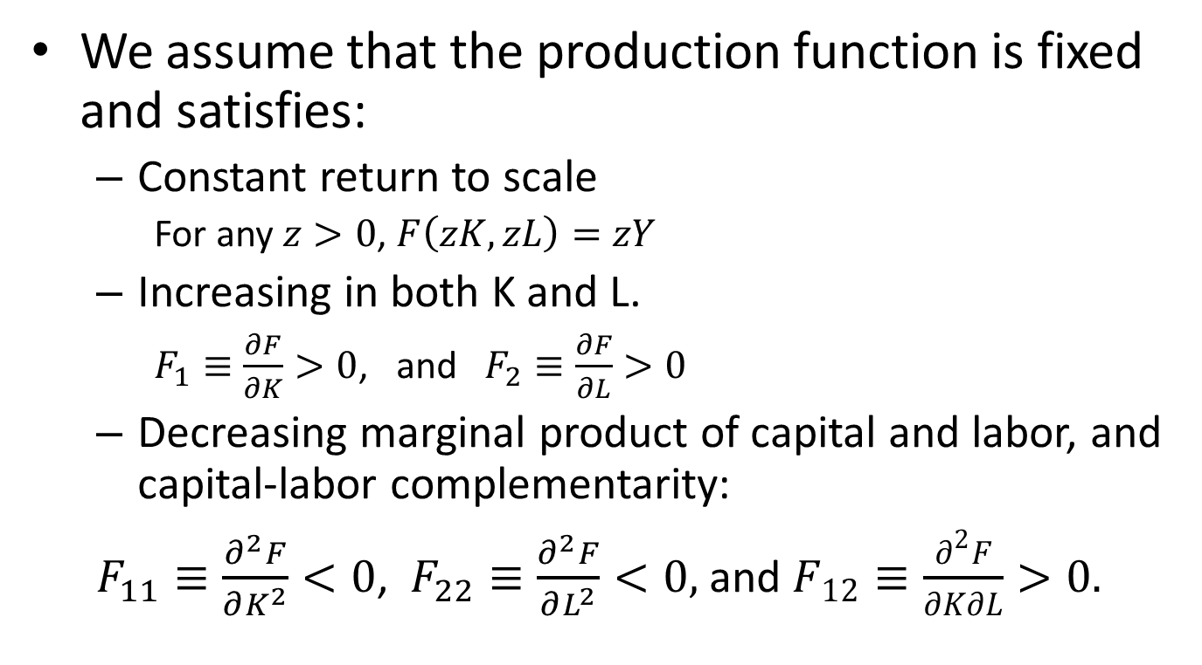
Assumptions on the Production Function
We assume that the production function is fixed and satisfies:
Constant return to scale
For any $z>0$, $F\left(zK,zL\right)=zY$
Increasing in both K and L.
$F_{1}≡\frac{∂F}{∂K}>0$, and $F_{2}≡\frac{∂F}{∂L}>0$
Decreasing marginal product of capital and labor, and capital-labor complementarity:
$F_{11}≡\frac{∂^{2}F}{∂K^{2}}<0$, $F_{22}≡\frac{∂^{2}F}{∂L^{2}}<0,$ and $F_{12}≡\frac{∂^{2}F}{∂K∂L}>0.$
Notes:
The production function characterizes how the economy turns capital and labor into “output”, which includes millions of goods and services. As such, it is reasonable to assume constant return to scale. Otherwise, the performance of an economy would be overwhelmingly depend on its size. Big countries would have advantages in the increasing-return-to-scale world, and small countries would excel in the decreasing-return-to-scale world. In our real world, however, there is no evidence that size plays any crucial role in the contest of economic performance. Both US and Singapore are competitive, and both Pakistan and Bolivia are uncompetitive.
Constant return to scale 可以翻成“规模收益不变”，就是“没有规模效应”的意思。

Slide 18
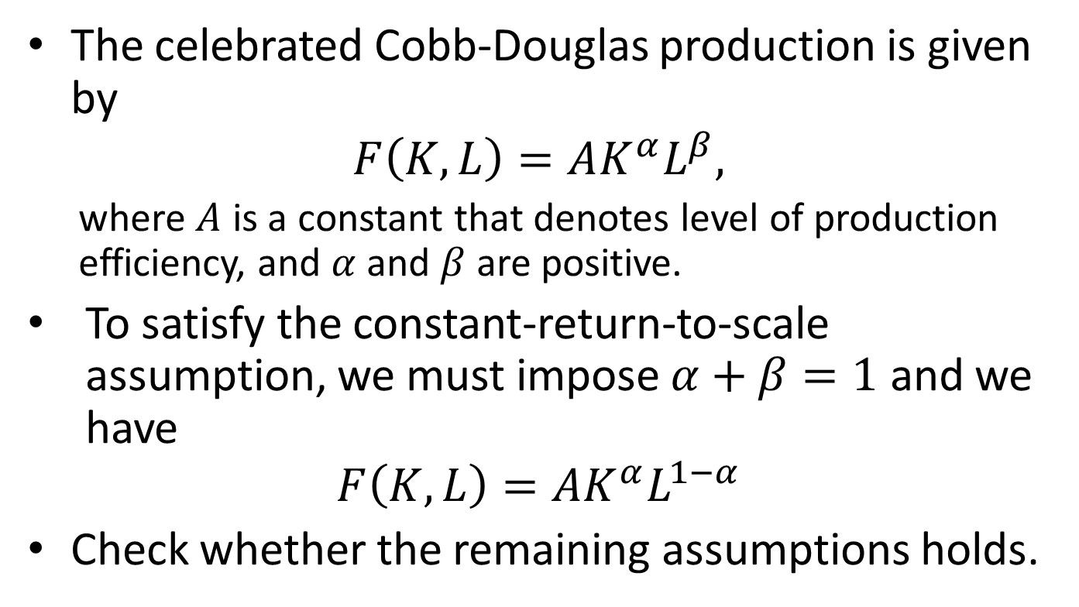
The Cobb-Douglas Production Function
The celebrated Cobb-Douglas production is given by
$$F\left(K,L\right)=AK^{α}L^{β},$$
where $A$ is a constant that denotes level of production efficiency, and $α$ and $β$ are positive.
To satisfy the constant-return-to-scale assumption, we must impose $α+β=1$ and we have
$$F\left(K,L\right)=AK^{α}L^{1−α}$$
Check whether the remaining assumptions holds.

Slide 19
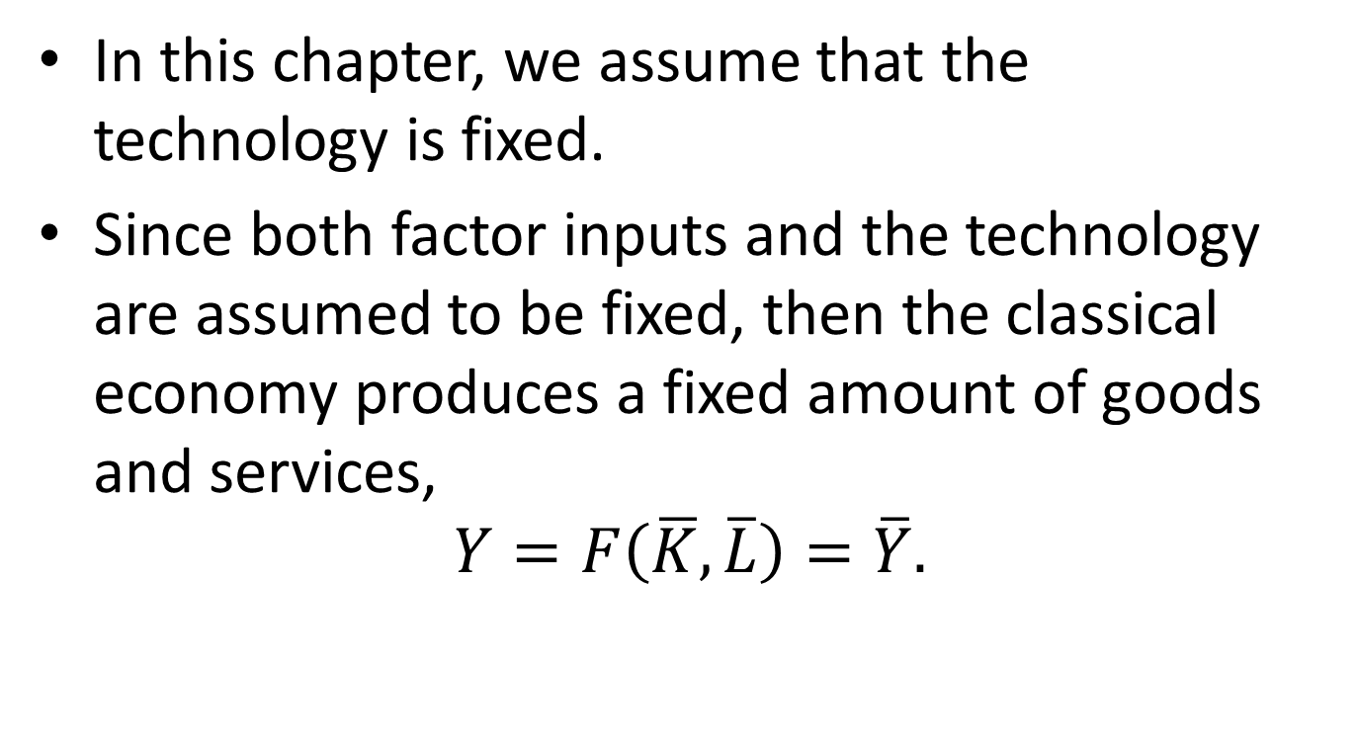
Assumption on Technology
In this chapter, we assume that the technology is fixed.
Since both factor inputs and the technology are assumed to be fixed, then the classical economy produces a fixed amount of goods and services,
$$Y=F\left(\overline{K},\overline{L}\right)=\overline{Y}.$$

Slide 20
Content
Introduction
Output
Unemployment
Income Distribution
Interest Rate
Money and Inflation
Exchange Rate

Slide 21
Unemployment
Under classical assumptions, factor inputs are almost fully employed, hence there is no unemployment problem.
However, the unemployment rate is nonzero even in the idealized classical economy – natural rate of unemployment.

Slide 22
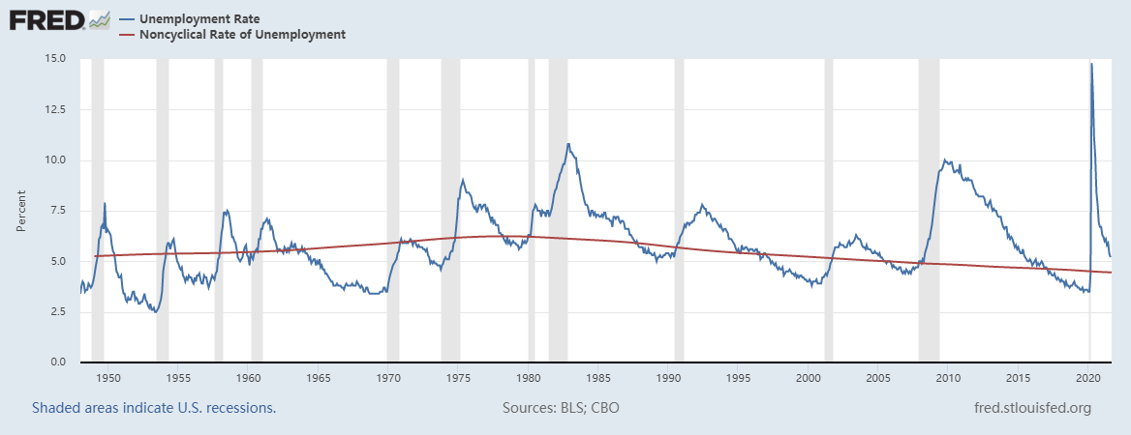
The Unemployment Rate and the Natural Rate of Unemployment in US

Slide 23
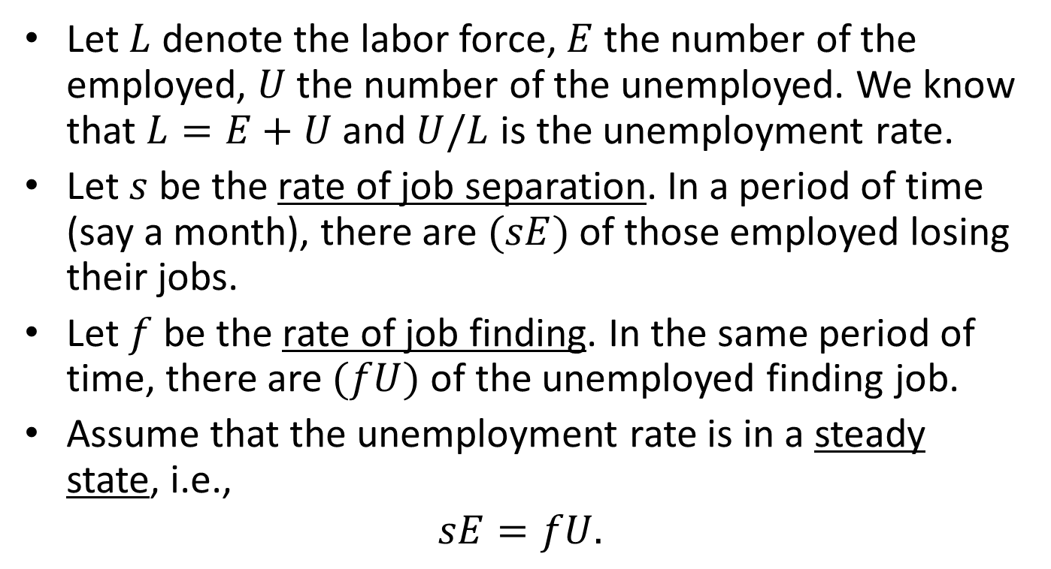
A Model of Natural Unemployment
Let $L$ denote the labor force, $E$ the number of the employed, $U$ the number of the unemployed. We know that $L=E+U$ and $U/L$ is the unemployment rate.
Let $s$ be the rate of job separation. In a period of time (say a month), there are $(sE)$ of those employed losing their jobs.
Let $f$ be the rate of job finding. In the same period of time, there are $(fU)$ of the unemployed finding job.
Assume that the unemployment rate is in a steady state, i.e.,
$$sE=fU.$$

Slide 24
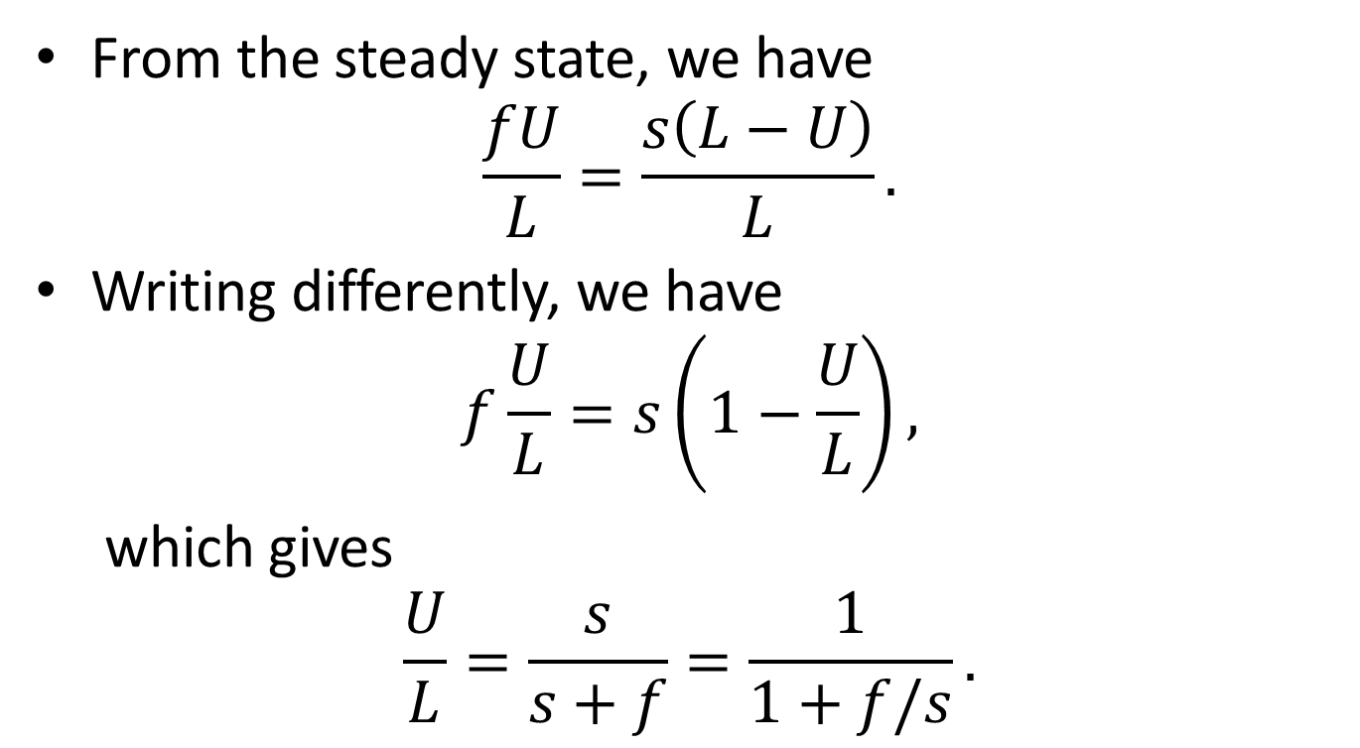
The Natural Unemployment Rate
From the steady state, we have
$$\frac{fU}{L}=\frac{s\left(L−U\right)}{L}.$$
Writing differently, we have
$$f\frac{U}{L}=s\left(1−\frac{U}{L}\right),$$
which gives
$$\frac{U}{L}=\frac{s}{s+f}=\frac{1}{1+f/s}.$$

Slide 25
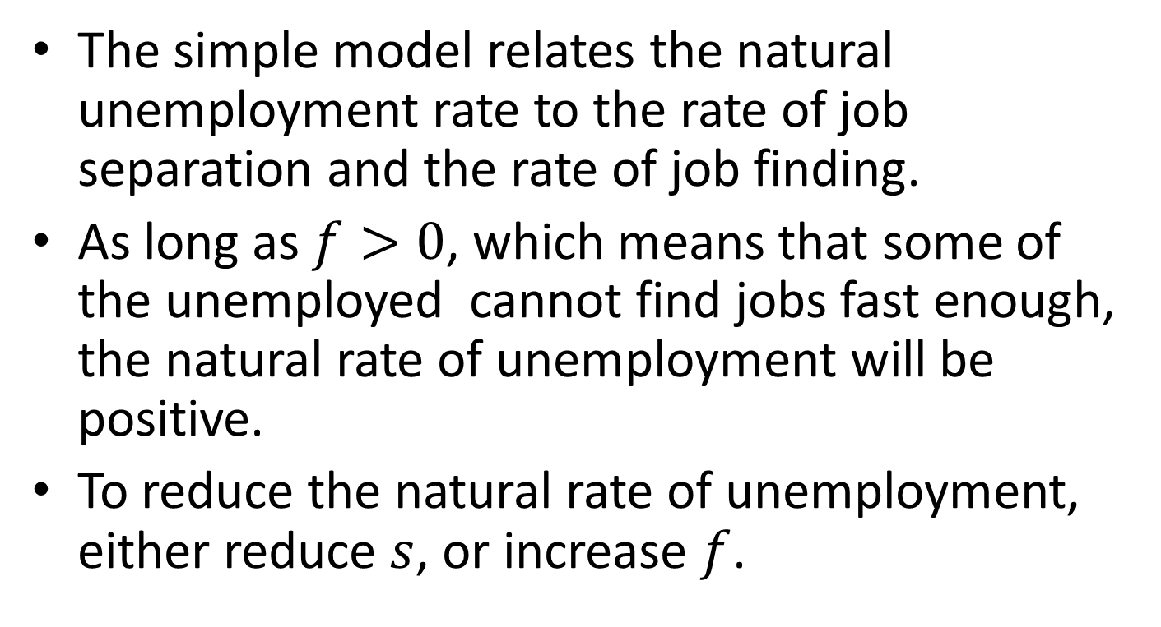
Implications
The simple model relates the natural unemployment rate to the rate of job separation and the rate of job finding.
As long as $f>0$, which means that some of the unemployed cannot find jobs fast enough, the natural rate of unemployment will be positive.
To reduce the natural rate of unemployment, either reduce $s$, or increase $f$.

Slide 26
Frictional Unemployment
It takes time to find a job or find a worker. The unemployment due to this simple fact is called frictional unemployment.
The friction comes from
Heterogeneities of jobs and workers,
Imperfect information,
Imperfect labor mobility,
Sectoral shifts.

Slide 27
How to Reduce Frictional Unemployment
Frictional unemployment is an important component of natural unemployment.
To reduce frictional unemployment, governments usually do the following:
Help disseminate information about jobs.
Provide training programs
The effect of unemployment insurance.
It may contribute to higher natural unemployment.
However, unemployment insurance reduces workers’ uncertainties about their income and also, helps to achieve a better matching between workers and jobs.

Slide 28
Structural Unemployment
The structural unemployment is caused by wage rigidity, the failure of real wage adjustments.
Real wage
Labor supply
Unemployment
Rigid real wage
Labor demand
Labor

Slide 29
Causes of Wage Rigidity
Minimum wage
The minimum wage v.s. earned income tax credit debate
Labor union
“Insiders”, through collective bargaining, achieves to keep their firm’s wage high.
To give more influence to “outsiders”, wage bargaining can take place at national level (e.g., Sweden).
Efficiency wage
High wage reduces labor turnover.
High wage mitigates the problem of adverse selection.
High wage mitigates the problem of moral hazards.
Notes:
The United States federal earned income tax credit or earned income credit (EITC or EIC) is a refundable tax credit for low- to moderate-income working individuals and couples, particularly those with children. The amount of EITC benefit depends on a recipient’s income and number of children.
Avoiding shirking: If it is difficult to measure the quantity or quality of a worker's effort—and systems of piece rates or commissions are impossible—there may be an incentive for him or her to "shirk" (do less work than agreed). The manager thus may pay an efficiency wage in order to create or increase the cost of job loss, which gives a sting to the threat of firing. This threat can be used to prevent shirking (or "moral hazard").—from Wikipedia

Slide 30
Content
Introduction
Output
Unemployment
Income Distribution
Interest Rate
Money and Inflation
Exchange Rate

Slide 31
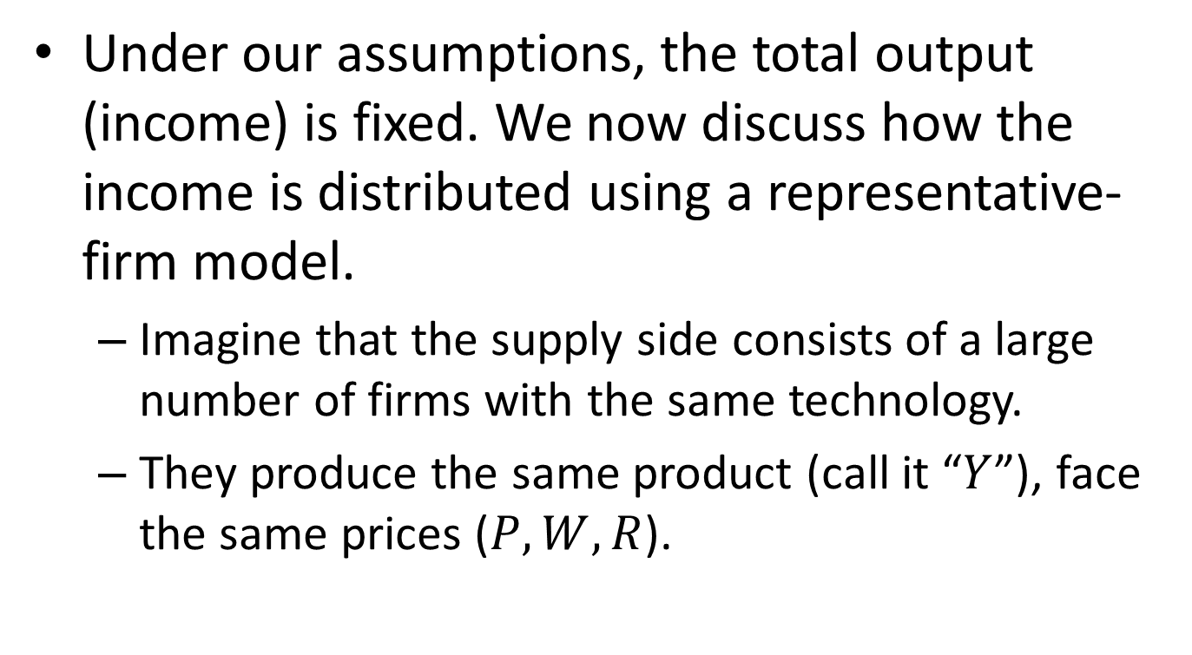
Distribution of Income
Under our assumptions, the total output (income) is fixed. We now discuss how the income is distributed using a representative-firm model.
Imagine that the supply side consists of a large number of firms with the same technology.
They produce the same product (call it “$Y$”), face the same prices ($P, W, R$).

Slide 32
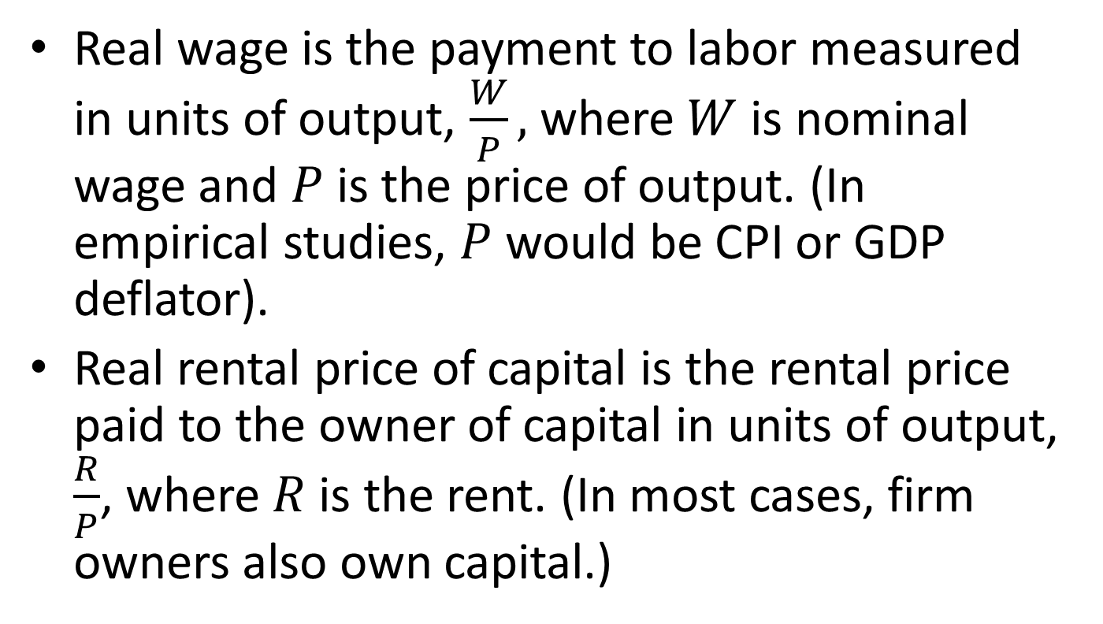
Factor Prices
Real wage is the payment to labor measured in units of output, $\frac{W}{P},$ where $W$ is nominal wage and $P$ is the price of output. (In empirical studies, $P$ would be CPI or GDP deflator).
Real rental price of capital is the rental price paid to the owner of capital in units of output, $\frac{R}{P}$, where $R$ is the rent. (In most cases, firm owners also own capital.)

Slide 33
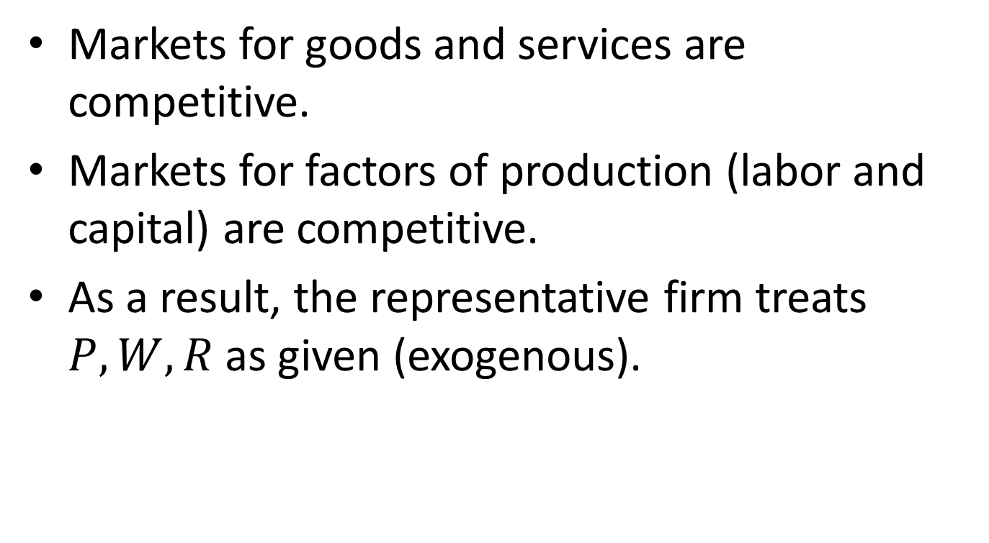
Competitive Markets
Markets for goods and services are competitive.
Markets for factors of production (labor and capital) are competitive.
As a result, the representative firm treats $P, W, R$ as given (exogenous).
Notes:
(A market is competitive if no participants are large enough to affect prices. In other words, all market participants are price takers.)

Slide 34
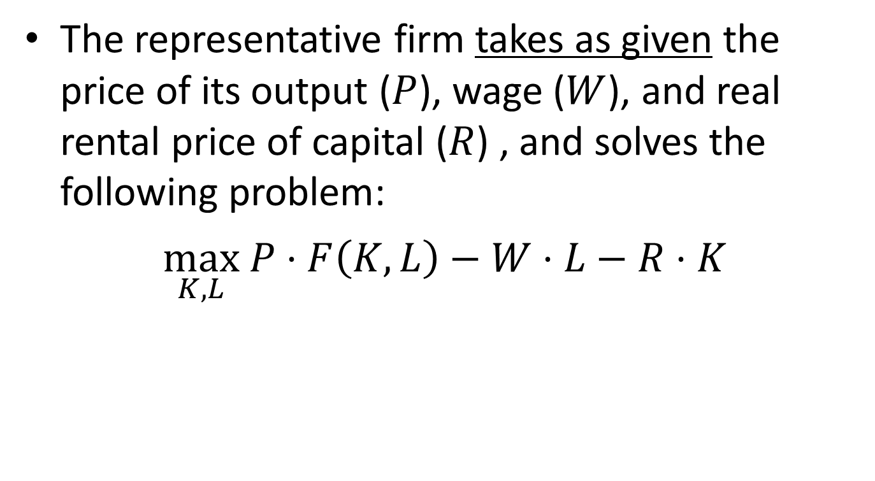
Decisions of A Representative Firm
The representative firm takes as given the price of its output ($P$), wage ($W$), and real rental price of capital ($R$) , and solves the following problem:
$\max_{K,L} P⋅F\left(K,L\right)−W⋅L−R⋅K$

Slide 35
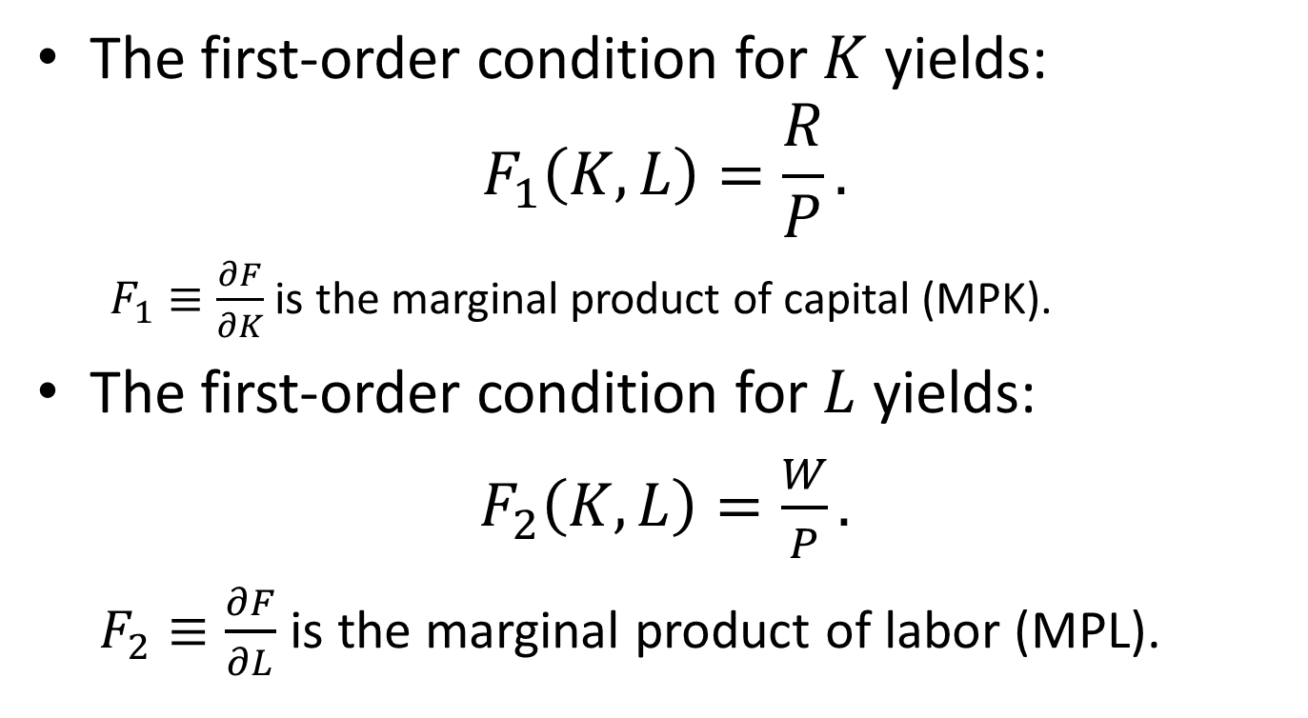
The Solution
The first-order condition for $K$ yields:
$$F_{1}\left(K,L\right)=\frac{R}{P}.$$
$F_{1}≡\frac{∂F}{∂K}$ is the marginal product of capital (MPK).
The first-order condition for $L$ yields:
$F_{2}\left(K,L\right)=\frac{W}{P}.$
$F_{2}≡\frac{∂F}{∂L}$ is the marginal product of labor (MPL).
Notes:
This says that the firm would employ capital up to the point where marginal product of capital (MPK) equals the real rental price of capital.
This says that the firm would employ labor up to the point where marginal product of labor (MPL) equals the real wage.

Slide 36
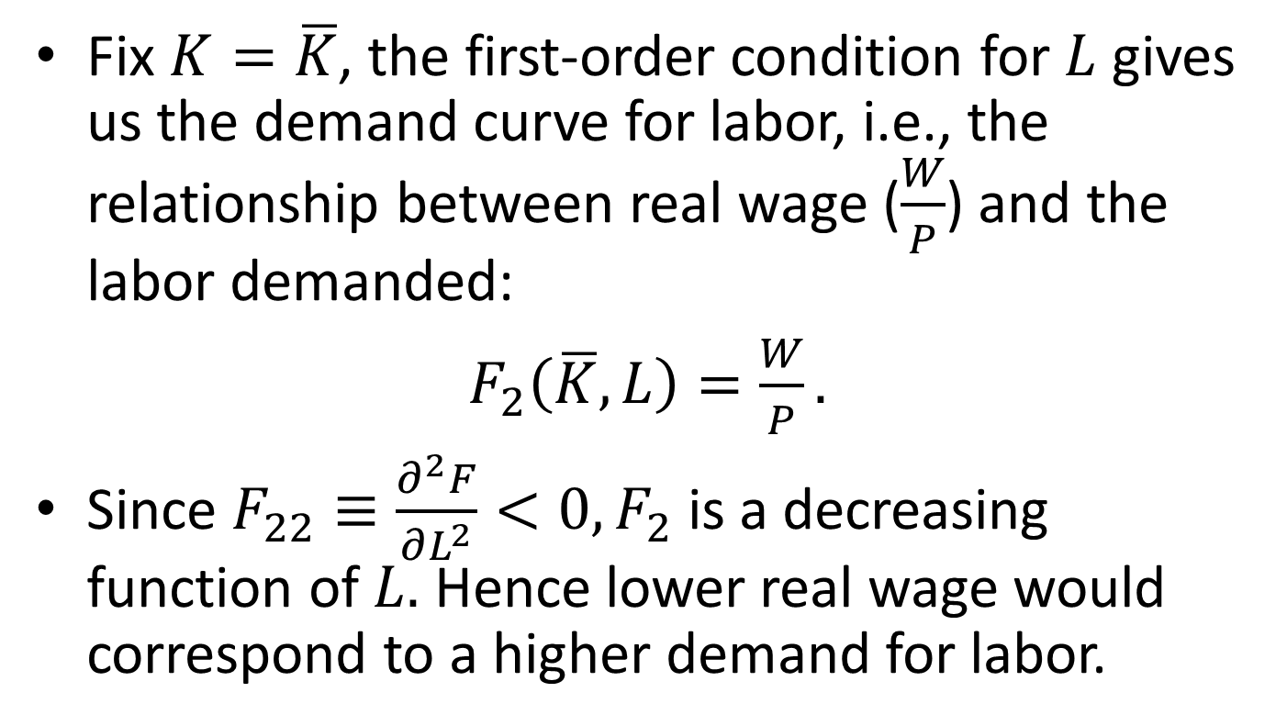
Demand for Labor
Fix $K=\overline{K}$, the first-order condition for $L$ gives us the demand curve for labor, i.e., the relationship between real wage ($\frac{W}{P}$) and the labor demanded:
$F_{2}\left(\overline{K},L\right)=\frac{W}{P}.$
Since $F_{22}≡\frac{∂^{2}F}{∂L^{2}}<0, F_{2}$ is a decreasing function of $L.$ Hence lower real wage would correspond to a higher demand for labor.

Slide 37
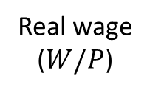

A Labor Demand Curve
Real wage
($W/P$)
Labor ($L$)

Slide 38
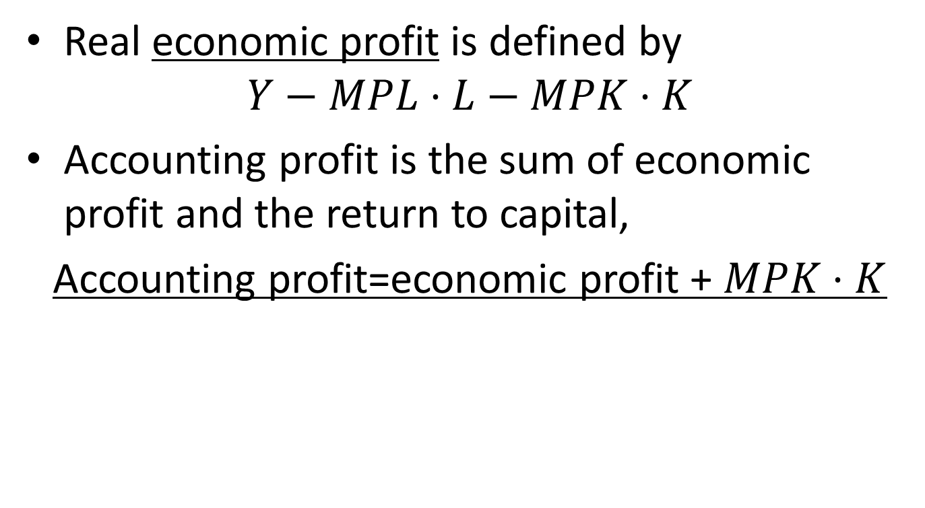
Economic Profit and Accounting Profit
Real economic profit is defined by
$$Y−MPL⋅L−MPK⋅K$$
Accounting profit is the sum of economic profit and the return to capital,
Accounting profit=economic profit + $MPK⋅K$

Slide 39
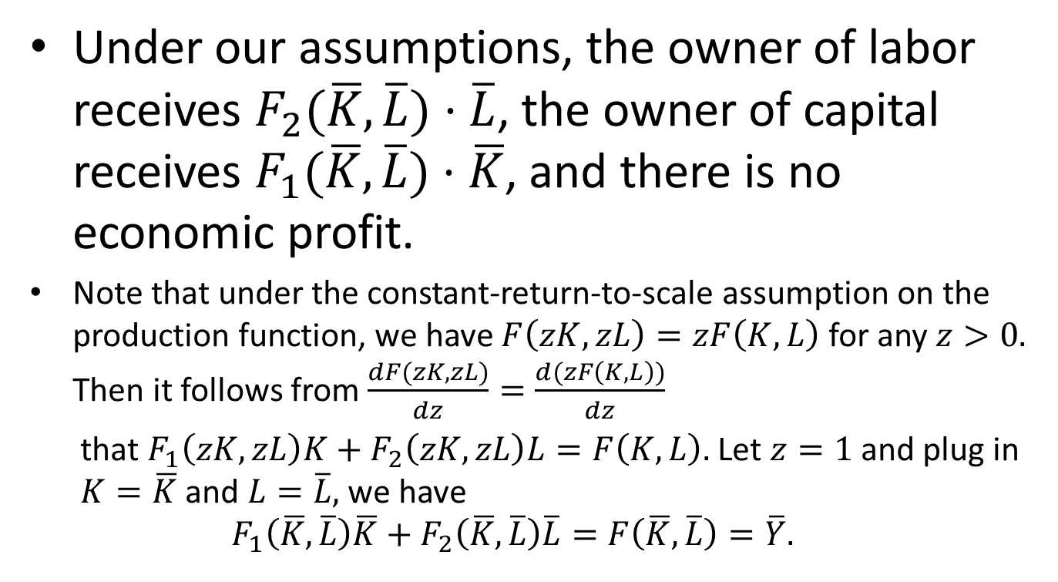
Distribution of National Income
Under our assumptions, the owner of labor receives $F_{2}(\overline{K},\overline{L})⋅\overline{L}$, the owner of capital receives $F_{1}(\overline{K},\overline{L})⋅\overline{K}$, and there is no economic profit.
Note that under the constant-return-to-scale assumption on the production function, we have $F\left(zK,zL\right)=zF\left(K,L\right)$ for any $z>0.$ Then it follows from$\frac{dF(zK,zL)}{dz}=\frac{d(zF\left(K,L\right))}{dz}$
that $F_{1}\left(zK,zL\right)K+F_{2}\left(zK,zL\right)L=F\left(K,L\right).$ Let $z=1$ and plug in $K=\overline{K}$ and $L=\overline{L},$ we have
$$F_{1}\left(\overline{K},\overline{L}\right)\overline{K}+F_{2}\left(\overline{K},\overline{L}\right)\overline{L}=F\left(\overline{K},\overline{L}\right)=\overline{Y}.$$

Slide 40
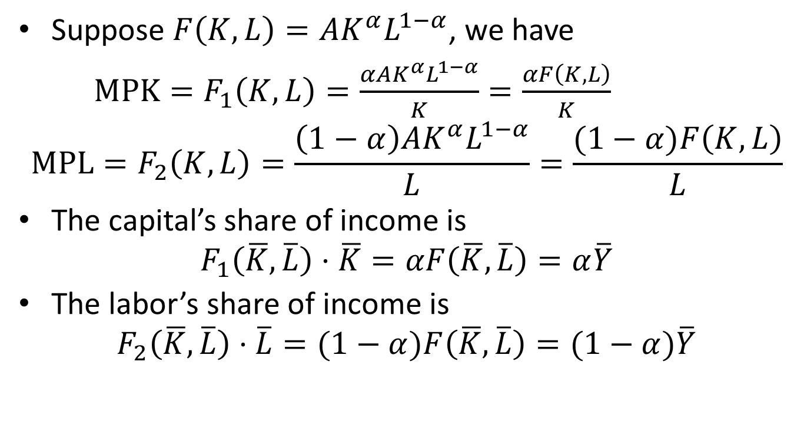
The Cobb-Douglas Economy
Suppose $F\left(K,L\right)=AK^{α}L^{1−α}$, we have
$MPK=F_{1}\left(K,L\right)=\frac{αAK^{α}L^{1−α}}{K}=\frac{αF\left(K,L\right)}{K}$
$${MPL=F}_{2}\left(K,L\right)=\frac{\left(1−α\right)AK^{α}L^{1−α}}{L}=\frac{(1−α)F\left(K,L\right)}{L}$$
The capital’s share of income is
$$F_{1}\left(\overline{K},\overline{L}\right)⋅\overline{K}=αF\left(\overline{K},\overline{L}\right)=α\overline{Y}$$
The labor’s share of income is
$$F_{2}\left(\overline{K},\overline{L}\right)⋅\overline{L}=(1−α)F\left(\overline{K},\overline{L}\right)=(1−α)\overline{Y}$$

Slide 41
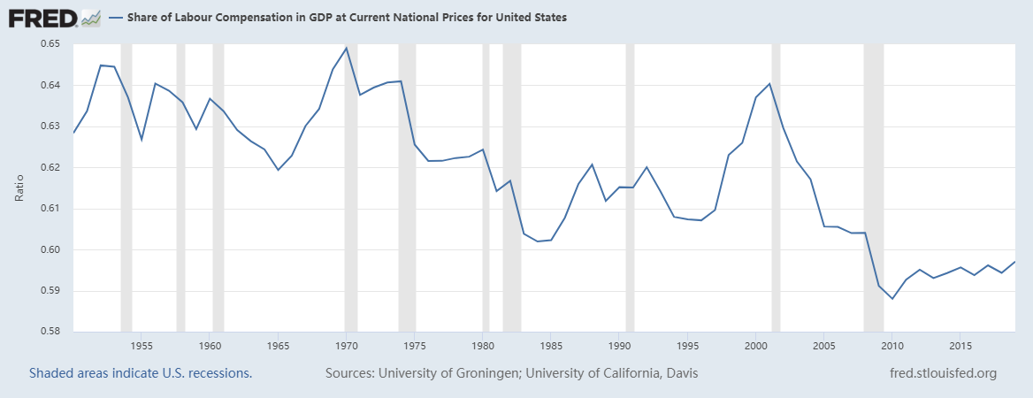
Case Study: Labor’s Share of Income in USA

Slide 42
Case Study: Labor’s Share of Income in China

Slide 43
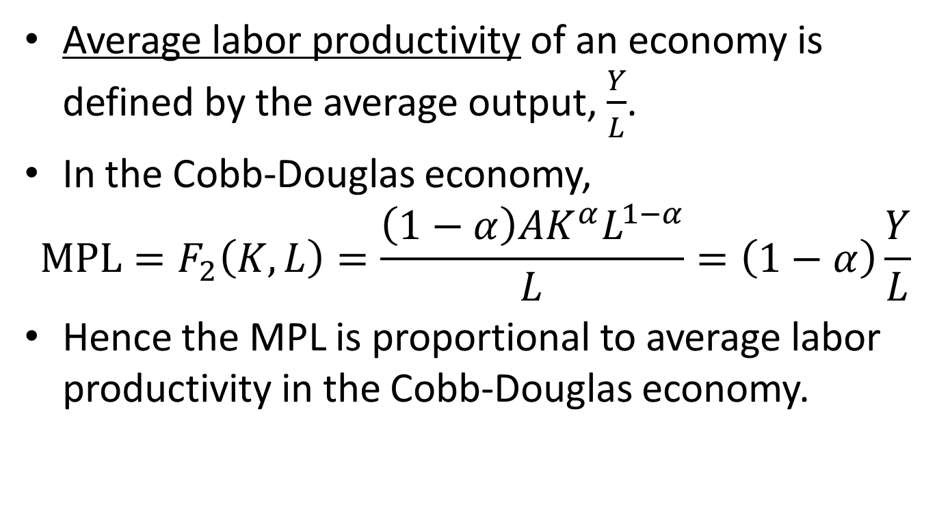
Average Labor Productivity and Real Wage
Average labor productivity of an economy is defined by the average output, $\frac{Y}{L}$.
In the Cobb-Douglas economy,
$${MPL=F}_{2}\left(K,L\right)=\frac{\left(1−α\right)AK^{α}L^{1−α}}{L}=\left(1−α\right)\frac{Y}{L}$$
Hence the MPL is proportional to average labor productivity in the Cobb-Douglas economy.

Slide 44
Case Study: Labor Productivity and Real Wage in USA
 | Growth in labor productivity (%) | Growth in real nonfarm compensation (%)
1959-1972 | 2.8 | 2.3
1973-1994 | 1.6 | 0.7
1995-2007 | 2.7 | 1.6
2008-2019 | 1.3 | 0.8
1959-2019 | 2.1 | 1.3
Why does real wage growth lag behind the labor productivity growth?

Slide 45
Content
Introduction
Output
Unemployment
Income Distribution
Interest Rate
Money and Inflation
Exchange Rate

Slide 46
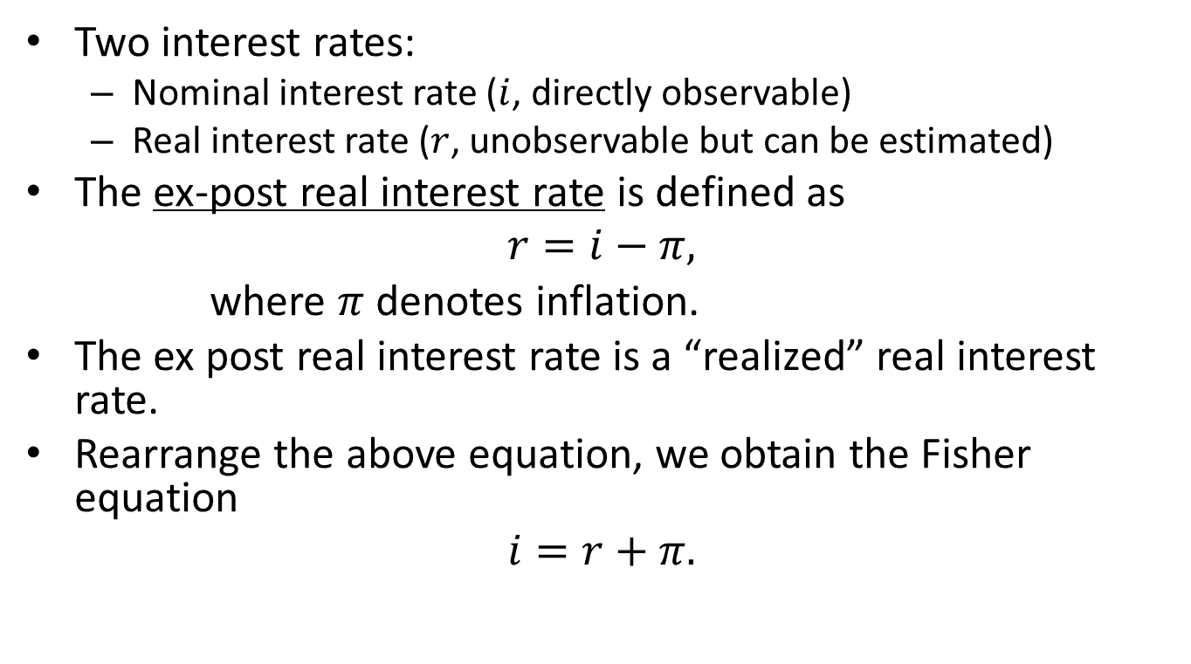
Nominal and Real Interest Rates
Two interest rates:
Nominal interest rate ($i$, directly observable)
Real interest rate ($r$, unobservable but can be estimated)
The ex-post real interest rate is defined as
$$r=i−π,$$
where $π$ denotes inflation.
The ex post real interest rate is a “realized” real interest rate.
Rearrange the above equation, we obtain the Fisher equation
$$i=r+π.$$
Notes:
Without qualification, the interest rate in this course is risk-free.

Slide 47
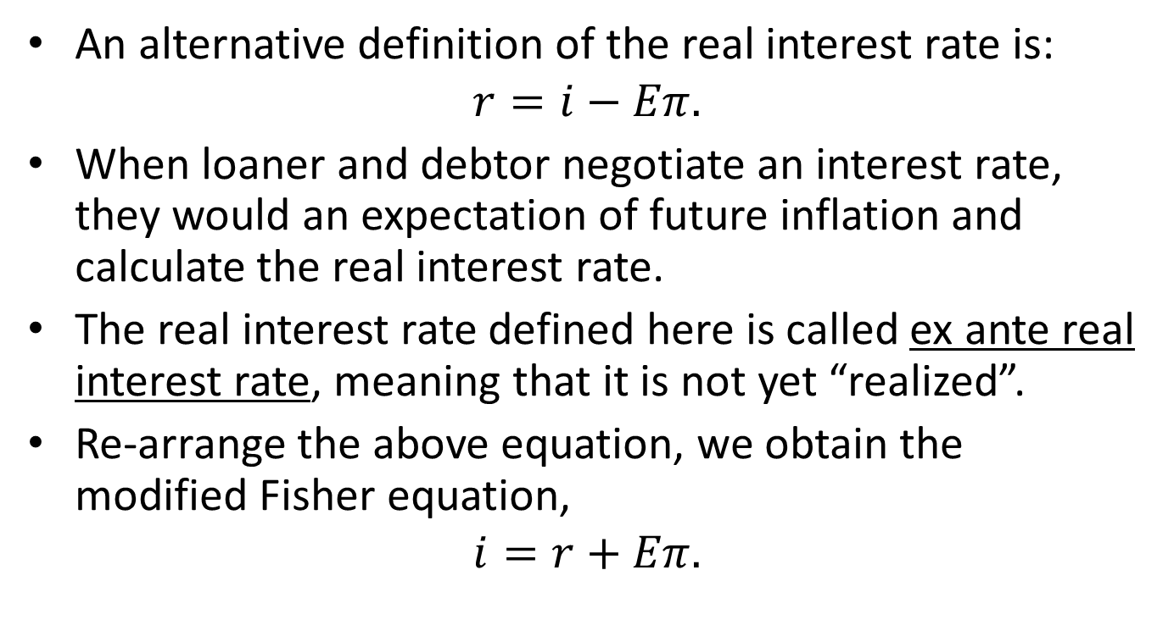
Ex-ante Real Interest Rate
An alternative definition of the real interest rate is:
$$r=i−Eπ.$$
When loaner and debtor negotiate an interest rate, they would an expectation of future inflation and calculate the real interest rate.
The real interest rate defined here is called ex ante real interest rate, meaning that it is not yet “realized”.
Re-arrange the above equation, we obtain the modified Fisher equation,
$$i=r+Eπ.$$

Slide 48
A Classical Model of Real Interest Rate
In the following we present a classical macroeconomic model of real interest rate.
The model contains an equilibrium restriction and a set of behavioral assumptions.
We will use the model to examine the effects of external shocks on a closed economy.
Notes:
Classical economists view the interest rate as a price that brings demand and supply of funds into equilibrium, without much influence from any monetary authority.

Slide 49
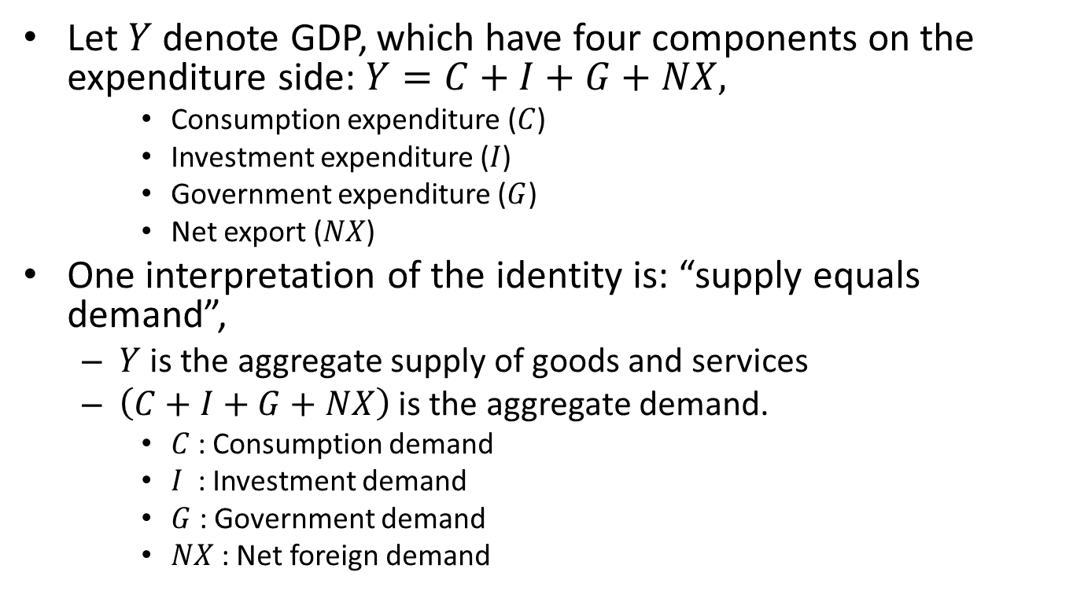
Another Interpretation of the National Income Accounting Identity
Let $Y$denote GDP, which have four components on the expenditure side:$Y=C+I+G+NX,$
Consumption expenditure ($C$)
Investment expenditure ($I$)
Government expenditure ($G$)
Net export ($NX$)
One interpretation of the identity is: “supply equals demand”,
$Y$ is the aggregate supply of goods and services
$\left(C+I+G+NX\right)$ is the aggregate demand.
$C$ : Consumption demand
$I$ : Investment demand
$G$ : Government demand
$NX$ : Net foreign demand

Slide 50
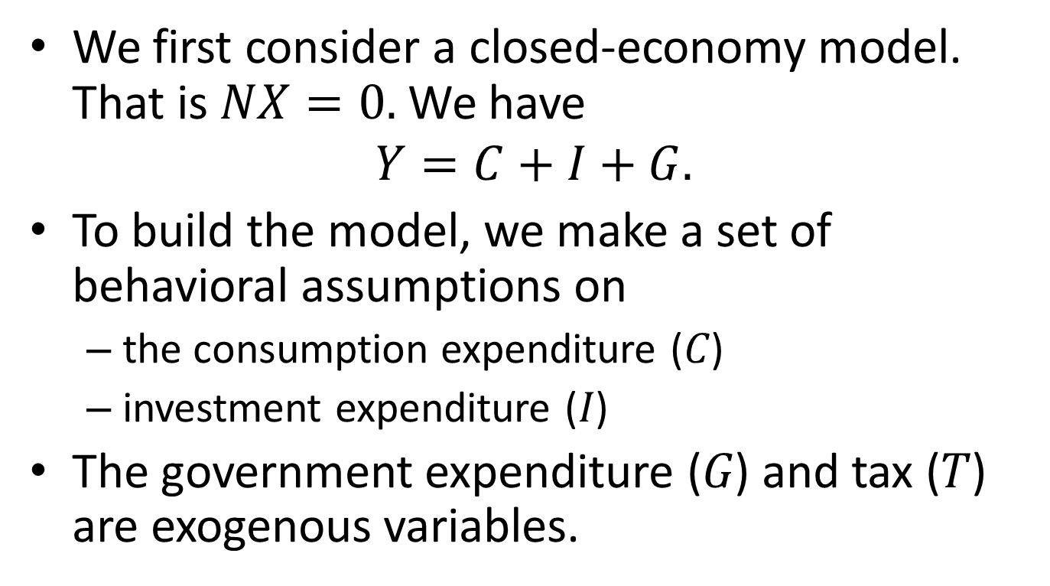
A Simplification: Closed Economy
We first consider a closed-economy model. That is $NX=0.$ We have
$$Y=C+I+G.$$
To build the model, we make a set of behavioral assumptions on
the consumption expenditure ($C$)
investment expenditure ($I$)
The government expenditure ($G$) and tax ($T$) are exogenous variables.

Slide 51
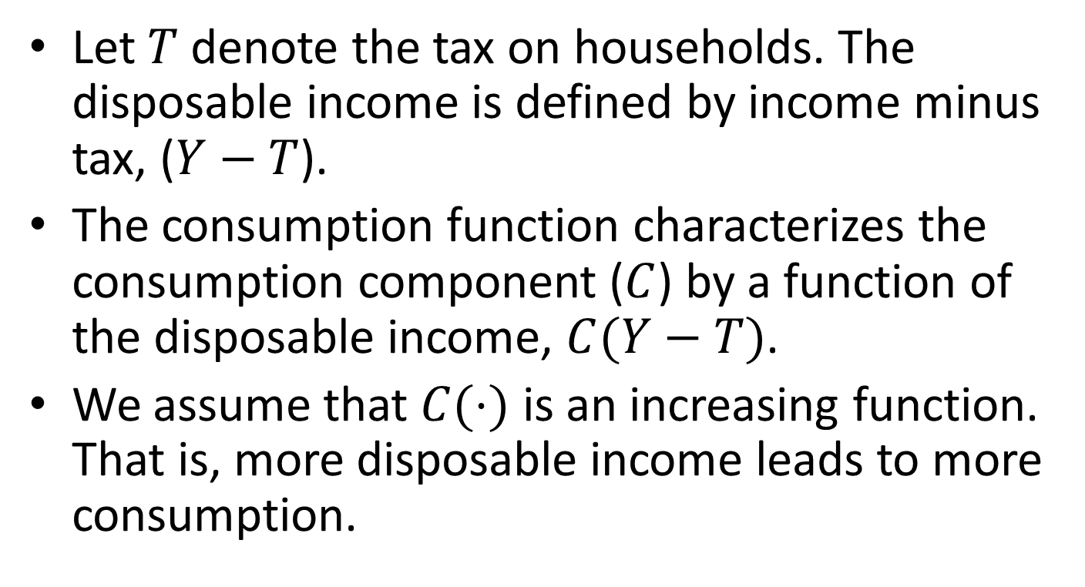
Consumption Function
Let $T$denote the tax on households. The disposable income is defined by income minus tax, ($Y−T$).
The consumption function characterizes the consumption component ($C$) by a function of the disposable income, $C(Y−T)$.
We assume that $C(⋅)$ is an increasing function. That is, more disposable income leads to more consumption.

Slide 52
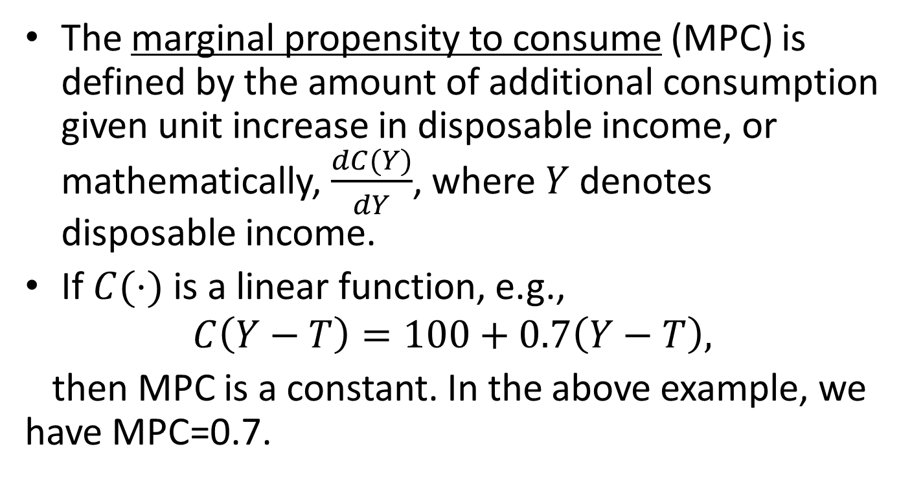
Marginal Propensity to Consume
The marginal propensity to consume (MPC) is defined by the amount of additional consumption given unit increase in disposable income, or mathematically, $\frac{dC(Y)}{dY}$, where $Y$ denotes disposable income.
If $C(⋅)$ is a linear function, e.g.,
$$C\left(Y−T\right)=100+0.7\left(Y−T\right),$$
then MPC is a constant. In the above example, we have MPC=0.7.

Slide 53
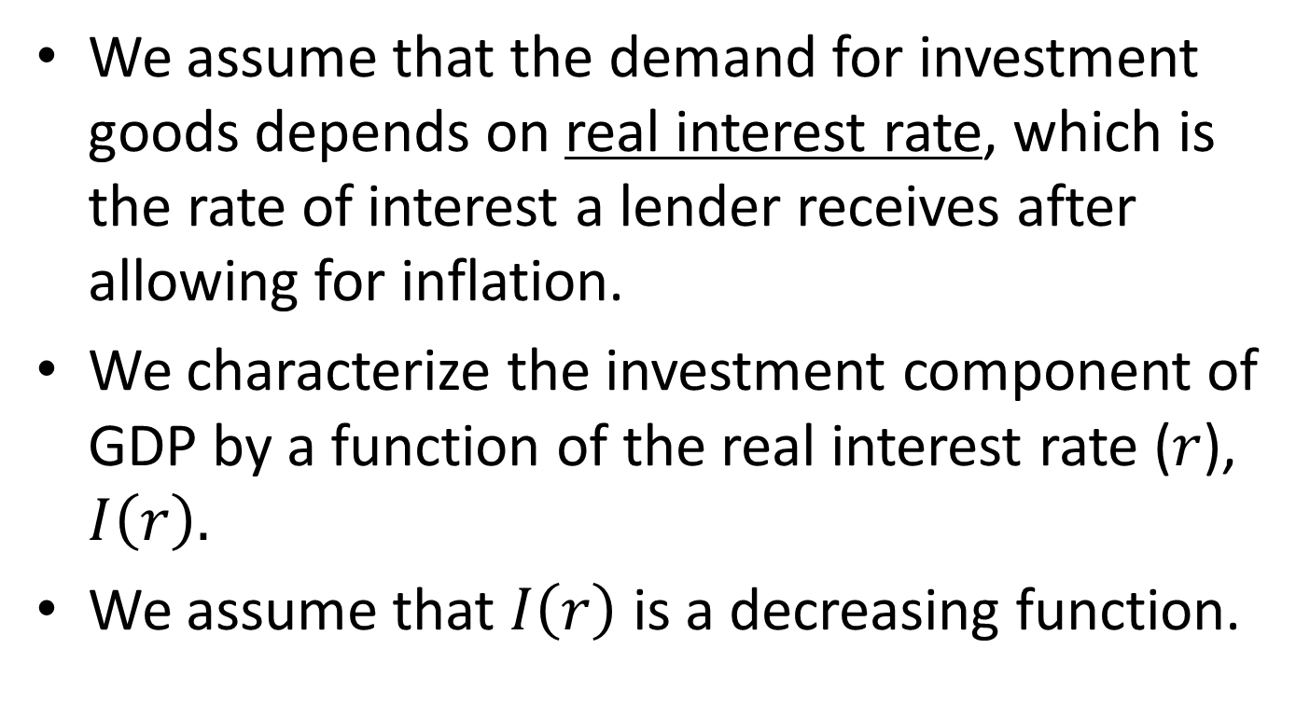
Investment Function
We assume that the demand for investment goods depends on real interest rate, which is the rate of interest a lender receives after allowing for inflation.
We characterize the investment component of GDP by a function of the real interest rate ($r$), $I\left(r\right).$
We assume that $I\left(r\right)$ is a decreasing function.

Slide 54
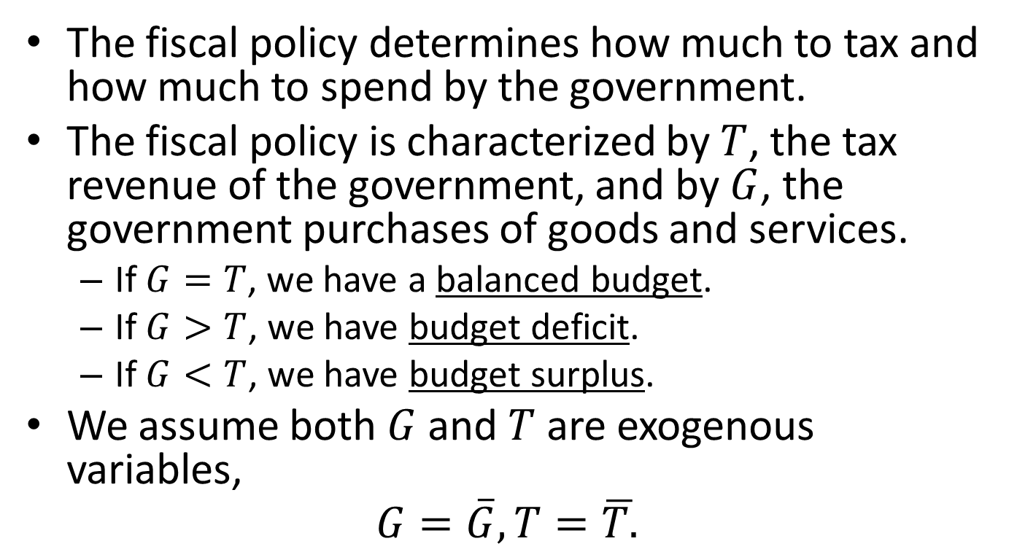
Fiscal Policy
The fiscal policy determines how much to tax and how much to spend by the government.
The fiscal policy is characterized by $T$, the tax revenue of the government, and by $G$, the government purchases of goods and services.
If $G=T$, we have a balanced budget.
If $G>T$, we have budget deficit.
If $G<T$, we have budget surplus.
We assume both $G$ and $T$ are exogenous variables,
$$G=\overline{G}, T=\overline{T.}$$

Slide 55
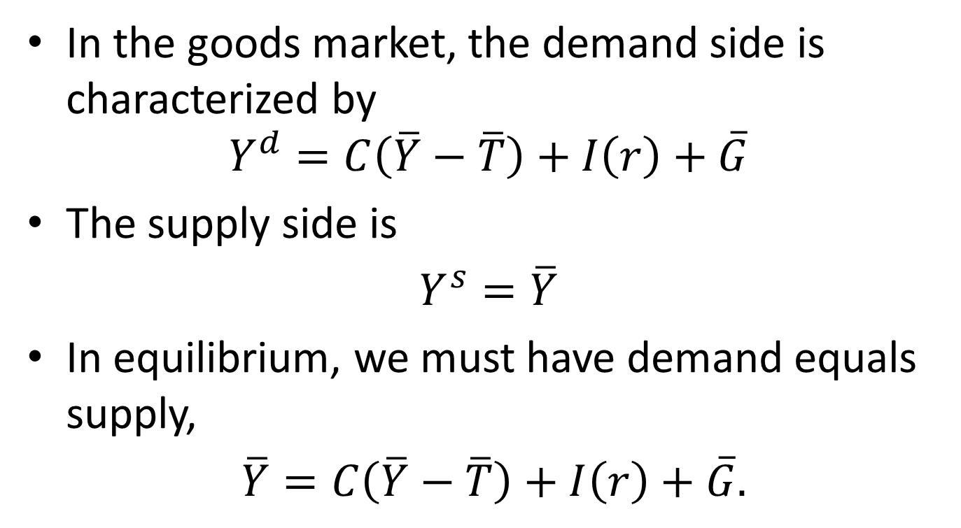
Equilibrium in the Goods Market
In the goods market, the demand side is characterized by
$$Y^{d}=C\left(\overline{Y}−\overline{T}\right)+I\left(r\right)+\overline{G}$$
The supply side is
$Y^{s}=\overline{Y}$
In equilibrium, we must have demand equals supply,
$\overline{Y}=C\left(\overline{Y}−\overline{T}\right)+I\left(r\right)+\overline{G}.$

Slide 56
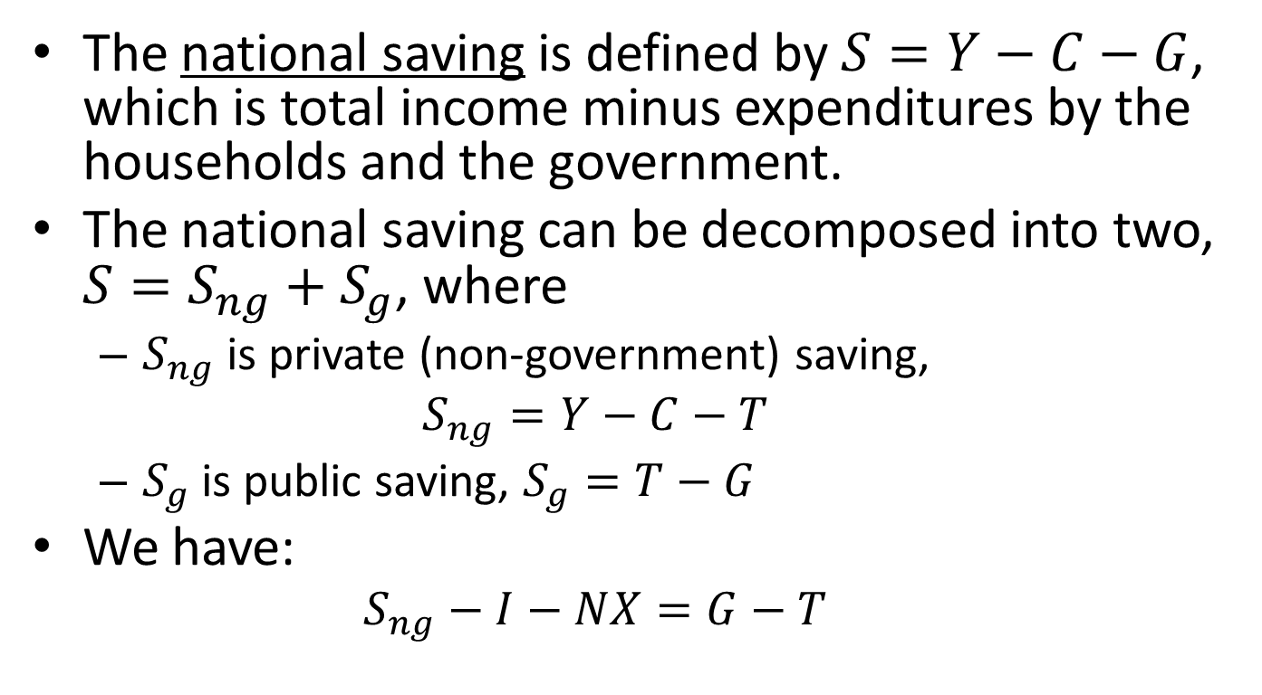
National Saving
The national saving is defined by $S=Y−C−G$, which is total income minus expenditures by the households and the government.
The national saving can be decomposed into two, $S=S_{ng}+S_{g}$, where
$S_{ng}$ is private (non-government) saving,
$$S_{ng}=Y−C−T$$
$S_{g}$ is public saving, $S_{g}=T−G$
We have:
$$S_{ng}−I−NX=G−T$$
Notes:
Based on the above identity, the modern monetary theory states that it is possible for the private sector to accumulate a surplus only if the government has budget deficits. As most private sectors want to accumulate a surplus, MMT economists usually advocate for government budget deficits.

Slide 57
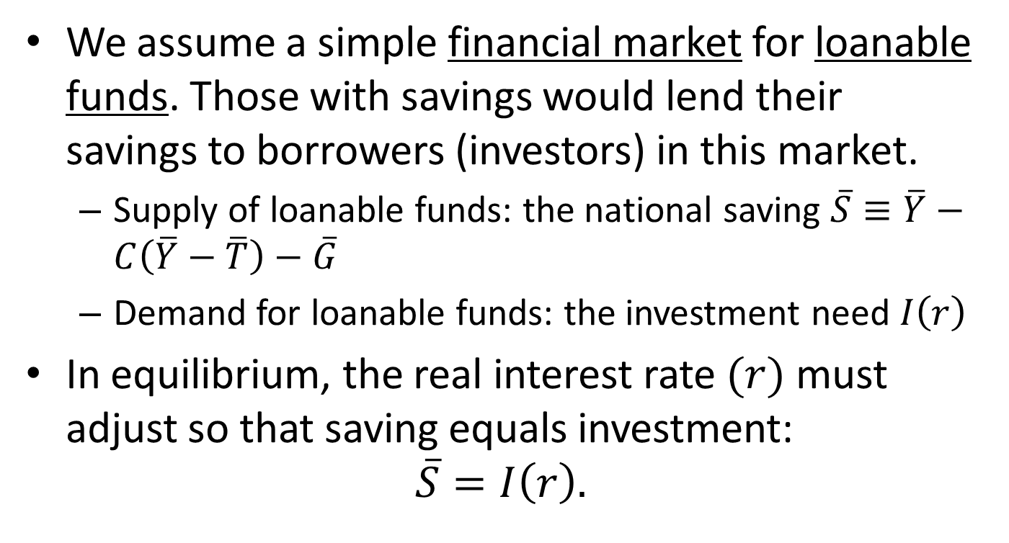
Equilibrium in the Financial Market
We assume a simple financial market for loanable funds. Those with savings would lend their savings to borrowers (investors) in this market.
Supply of loanable funds: the national saving $\overline{S}≡\overline{Y}−C\left(\overline{Y}−\overline{T}\right)−\overline{G}$
Demand for loanable funds: the investment need $I\left(r\right)$
In equilibrium, the real interest rate $(r)$must adjust so that saving equals investment:
$$\overline{S}=I\left(r\right).$$

Slide 58




Determination of Real Interest Rate
Real interest rate $r$
Saving, $S$
Equilibrium real interest rate
Demand for loanable funds, $I(r)$
$$\overline{S}$$
Investment

Slide 59
The Effects of Fiscal Policies
We now use our model to examine the effects of fiscal policies on the economy.
An increase in government spending
A tax reduction

Slide 60

An Increase in Government Spending
Real interest rate $r$
Saving, $S$
Equilibrium real interest rate
$$\overline{S}$$
Investment

Slide 61
The Crowding-Out Effect
The model predicts that an increase in government expenditure would reduce national saving. This leads to higher interest rate and lower investment. Economists would say that government spending “crowds out” the private investment.
What about the effect of tax reduction on the economy?

Slide 62
A Surge in Investment Enthusiasm
A surge in investment enthusiasm implies that, given any real interest rate, the investment demand for the loanable funds would increase.
That is, the demand curve would shift to the right.

Slide 63

Changes in Investment Demand
Real interest rate $r$
Saving, $S$
Equilibrium real interest rate
$$\overline{S}$$
Investment

Slide 64
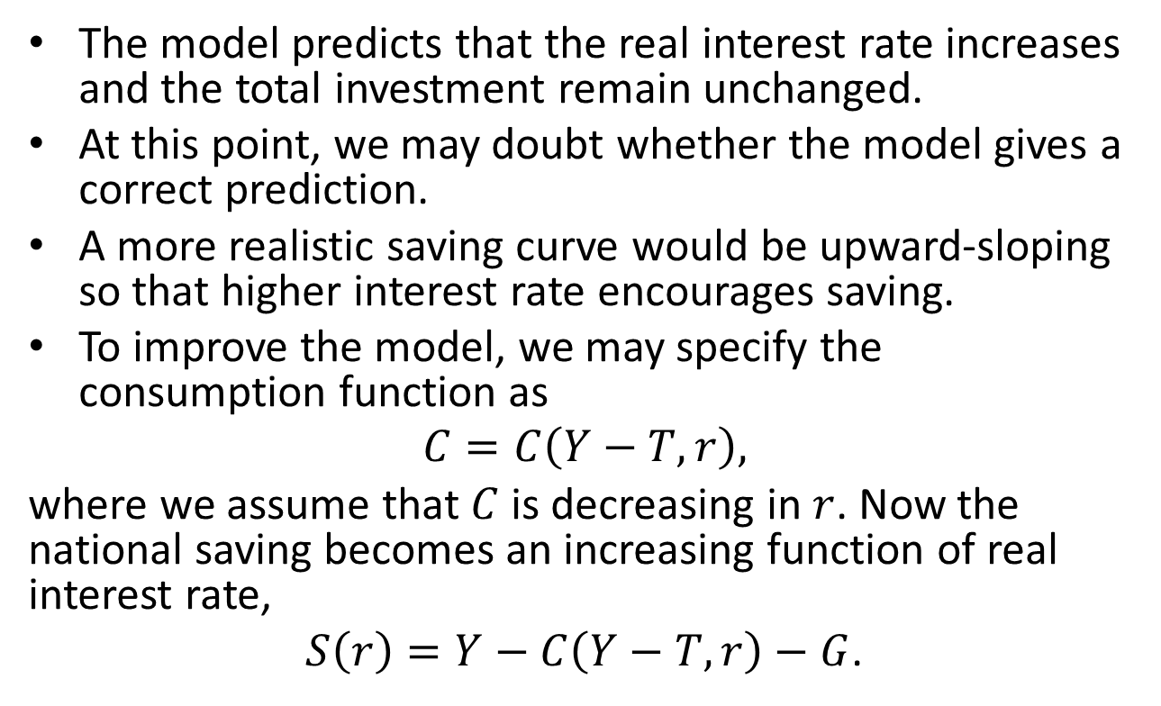
A Modified Model
The model predicts that the real interest rate increases and the total investment remain unchanged.
At this point, we may doubt whether the model gives a correct prediction.
A more realistic saving curve would be upward-sloping so that higher interest rate encourages saving.
To improve the model, we may specify the consumption function as
$$C=C\left(Y−T,r\right),$$
where we assume that $C$ is decreasing in $r$. Now the national saving becomes an increasing function of real interest rate,
$S\left(r\right)=Y−C\left(Y−T,r\right)−G$.
Investment

Slide 65


A More Realistic Saving Curve
Real interest rate $r$
Saving, $S(r)$
Equilibrium real interest rate
Investment
Notes:
Now a boost in investment demand would lead to higher investment as well as a higher interest rate.

Slide 66
Content
Introduction
Output
Unemployment
Income Distribution
Interest Rate
Money and Inflation
Exchange Rate

Slide 67
Money
Money is the stock of assets that can be readily used to make transactions.
Functions of money:
Store of value
Unit of account
Medium of exchange
Types of money:
Commodity money (gold, silver)
Fiat money

Slide 68
How Fiat Money Comes About
Transactions using commodity money (say gold) is costly.
To reduce transaction cost, a bank may mint gold coins of known purity and weight.
To further reduce cost, the bank may issue gold certificates, which can be redeemed for gold. The gold certificate becomes gold-backed money.
The need for transactions is unlimited, but the supply of gold is limited. Hence the limited supply of gold has a deflationary effect on the economy, if the bank sticks to the gold standard of money.
If people do not care about the option of redeeming gold, however, the bank can issue certificates that are not backed by gold in vault. The modern central bank does exactly this, and these certificates are fiat money.
Fiat money is valued because people expect it’s valued by everyone else.

Slide 69
Case Studies
Money in a POW (prison of war) Camp
Money on the Island of Yap

Slide 70
Monetary Policy
Monetary policy is the process by which the monetary authority of a country controls the supply of money, often targeting an interest rate for the purpose of promoting economic growth and stability.
The monetary authority in China is People’s Bank of China (PBC), that in USA is the Federal Reserve (the Fed).

Slide 71
Seigniorage: Another Reason for Printing Money
In normal times, the central bank increase money supply to accommodate increasing demand for money.
At the same time, by printing money, the central bank contributes revenue to the government, often by purchasing government bonds. The revenue from printing money is called seigniorage, or “inflation tax”.
In normal times, seigniorage is moderate. In some extreme situations (war, hyperinflation, etc), seigniorage may contribute the majority of government revenue.

Slide 72
Money in Modern Economy
Money in a modern economy may include:
Cash
Demand deposits
Saving deposits
Money market funds

Slide 73
How Money Supply is Measured in USA
Measures of Money Stock |  | Amount (billion USD)
 | Assets included | 2008 | 2014
C | Currency | 818.9 | 1254.1
M1 | Currency plus demand deposits, traveler's checks, and other checkable deposits | 1631.9 | 2973.4
M2 | M1 plus retail money market mutual fund balances, saving deposits (including money market deposit accounts), and small time deposits. | 8207.5 | 11714.3

Slide 74
How Money Supply is Measured in China
M0：流通中现金，即在银行体系以外流通的现金；2019年末，中国M0为9.3万亿。
M1：狭义货币供应量，即M0＋活期存款；2019年末，中国M1为57.6万亿。
M2：广义货币供应量，即M1＋准货币；其中准货币指企事业单位定期存款、自筹基本建设存款、个人储蓄存款和其他存款。2019年末，中国M2为198.6万亿。

Slide 75
Case Study: M2/GDP Ratio
The ratios of M2/GDP differ across economies.
Generally speaking, M2/GDP is high in economies where banks dominate the financial sectors.
 | M2/GDP (%, 2019)
China | 199
USA | 93
Japan | 255
World | 126

Slide 76
Inflation
Definition: Inflation is a sustained increase in the general price level of goods and services in an economy over a period of time.
Measurement: CPI and GDP deflator.
Relationship between money and inflation: Inflation erodes purchasing power of money.

Slide 77
Costs of Inflation
Expected Inflation
Shoeleather cost
Menu cost
Relative price distortion
Unfair tax treatment
General inconveniences
Unexpected inflation
Arbitrary redistributions of purchasing power
Increased uncertainty

Slide 78
One Benefit of Inflation
Nominal wages are rarely reduced, even when the equilibrium real wage falls.
Inflation allows the real wages to reach equilibrium levels without nominal wage cuts.
Therefore, moderate inflation improves the functioning of labor markets

Slide 79
Hyperinflation
Definition: Inflation exceeds 50% per month
All the costs of moderate inflation described above become HUGE under hyperinflation.
Money ceases to function as a store of value, and may not serve its other functions (unit of account, medium of exchange).
People may have to barter or use a stable foreign currency.

Slide 80
Case Study: Hyperinflation in Nationalist China

Slide 81
Case Study: Hyperinflation in Nationalist China

Slide 82
What Causes Hyperinflation?
An easy answer is: hyperinflation is caused by excessive money supply growth.
When the central bank prints money, the price level rises. If it prints money rapidly enough, the result is hyperinflation.
But why do central bank print money? It’s the fiscal problem, in most cases!
How can hyperinflation be halted? Fiscal reform in most cases.

Slide 83
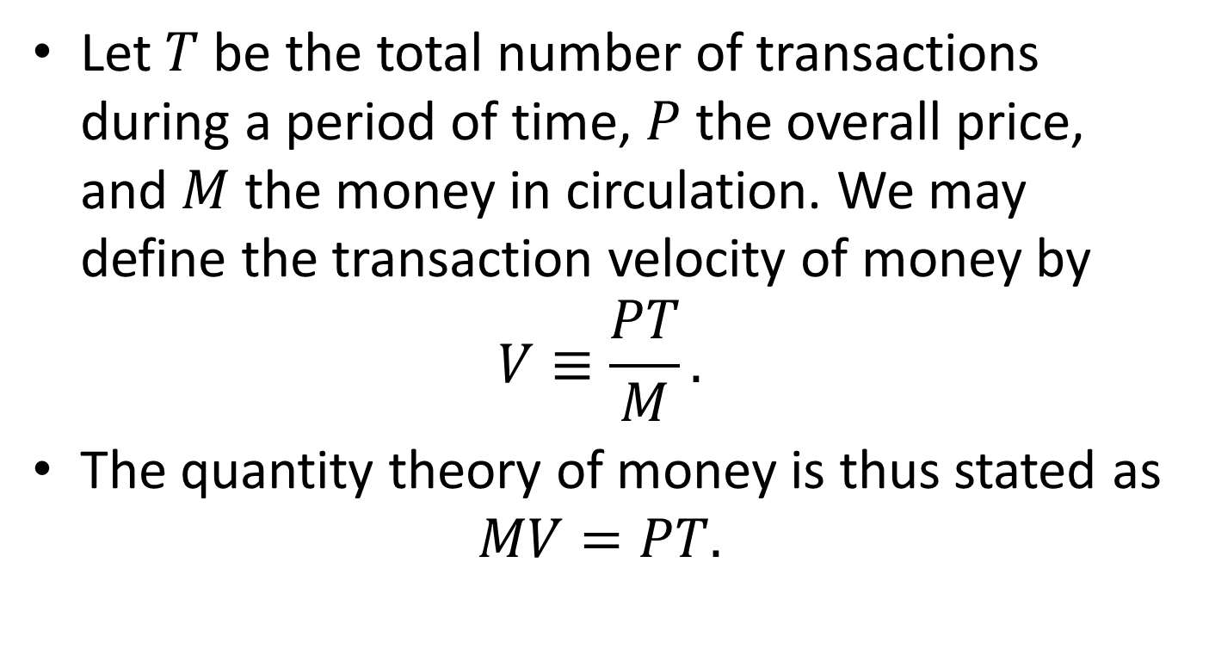
Quantity Theory of Money: From The Perspective of Transactions
Let $T$ be the total number of transactions during a period of time, $P$ the overall price, and $M$ the money in circulation. We may define the transaction velocity of money by
$$V≡\frac{PT}{M}.$$
The quantity theory of money is thus stated as
$$MV=PT.$$

Slide 84
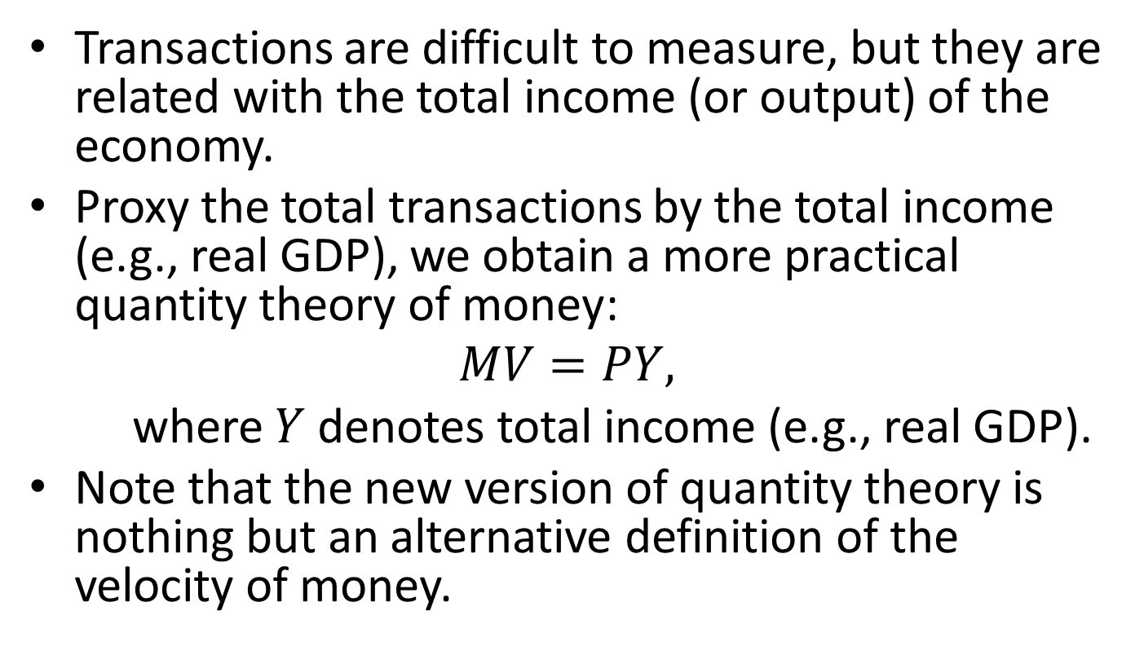
Quantity Theory of Money: From The Perspective of Income
Transactions are difficult to measure, but they are related with the total income (or output) of the economy.
Proxy the total transactions by the total income (e.g., real GDP), we obtain a more practical quantity theory of money:
$$MV=PY,$$
where $Y$ denotes total income (e.g., real GDP).
Note that the new version of quantity theory is nothing but an alternative definition of the velocity of money.

Slide 85
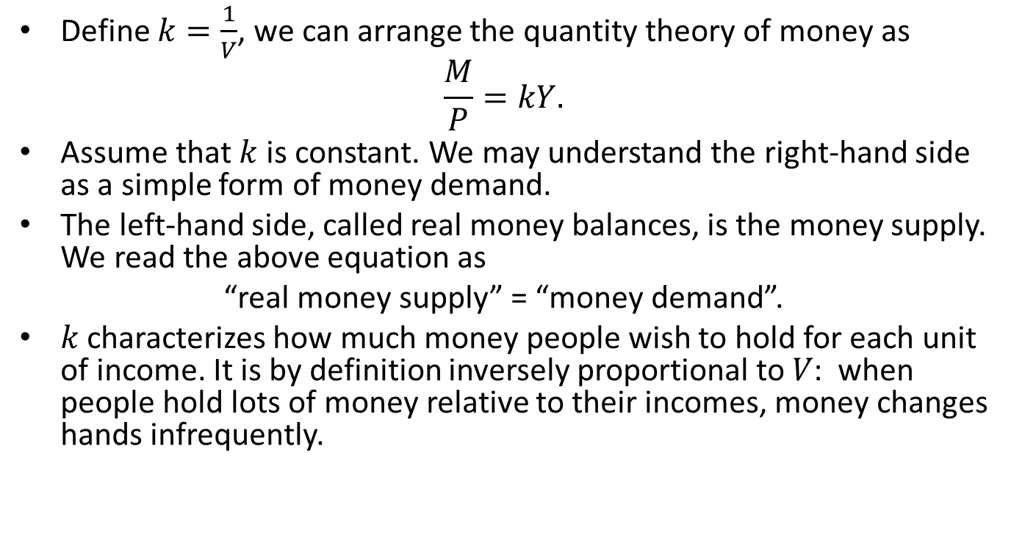
Quantity Theory of Money: From The Perspective of Money Demand and Supply
Define $k=\frac{1}{V}$, we can arrange the quantity theory of money as
$$\frac{M}{P}=kY.$$
Assume that $k$ is constant. We may understand the right-hand side as a simple form of money demand.
The left-hand side, called real money balances, is the money supply. We read the above equation as
“real money supply” = “money demand”.
𝑘 characterizes how much money people wish to hold for each unit of income. It is by definition inversely proportional to 𝑉: when people hold lots of money relative to their incomes, money changes hands infrequently.

Slide 86
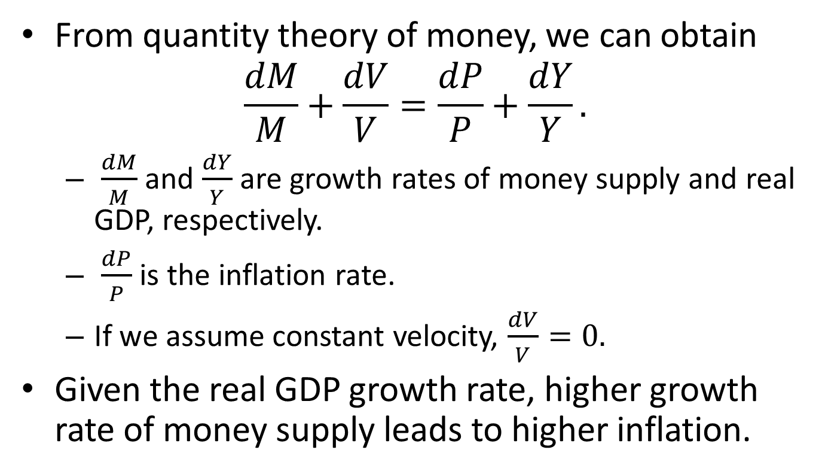
Money and Inflation
From quantity theory of money, we can obtain
$$\frac{dM}{M}+\frac{dV}{V}=\frac{dP}{P}+\frac{dY}{Y}.$$
$\frac{dM}{M}$ and $\frac{dY}{Y}$ are growth rates of money supply and real GDP, respectively.
$\frac{dP}{P}$ is the inflation rate.
If we assume constant velocity, $\frac{dV}{V}=0.$
Given the real GDP growth rate, higher growth rate of money supply leads to higher inflation.

Slide 87
Case Study: M2 Growth and Inflation in China

Slide 88
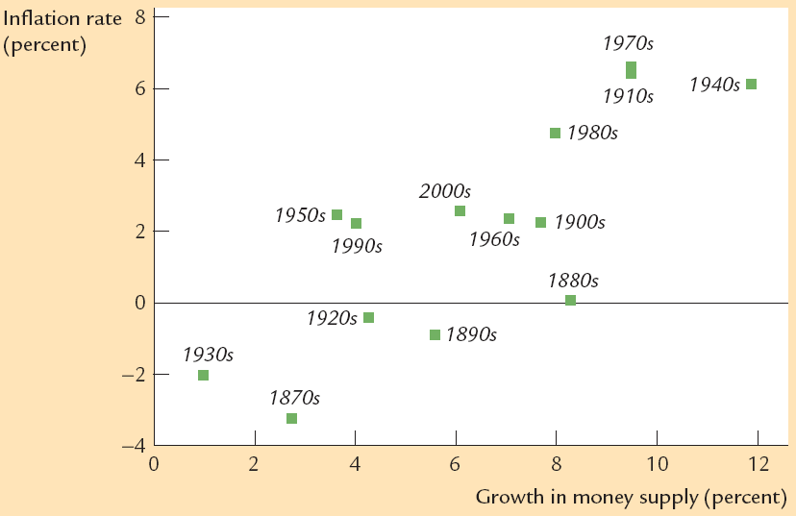
Case Study: U.S. Inflation and Money Growth

Slide 89
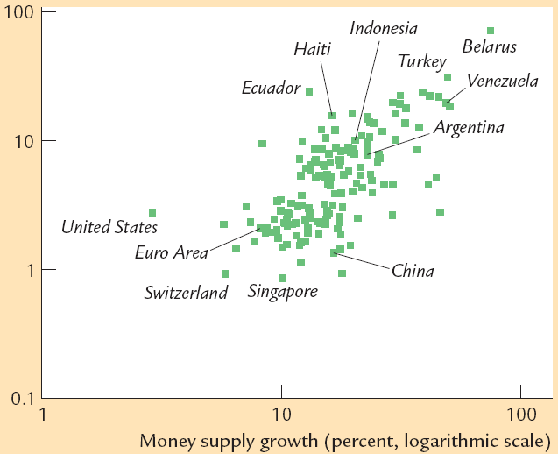
Case Study: Money Growth and Inflation Across Countries

Slide 90
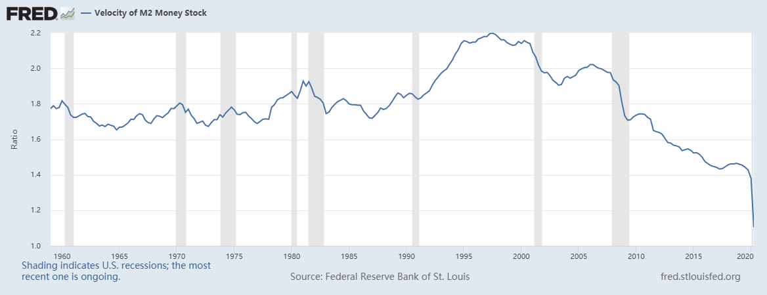
Case Study: Money Velocity of USA

Slide 91
Case Study: Money Velocity of China

Slide 92
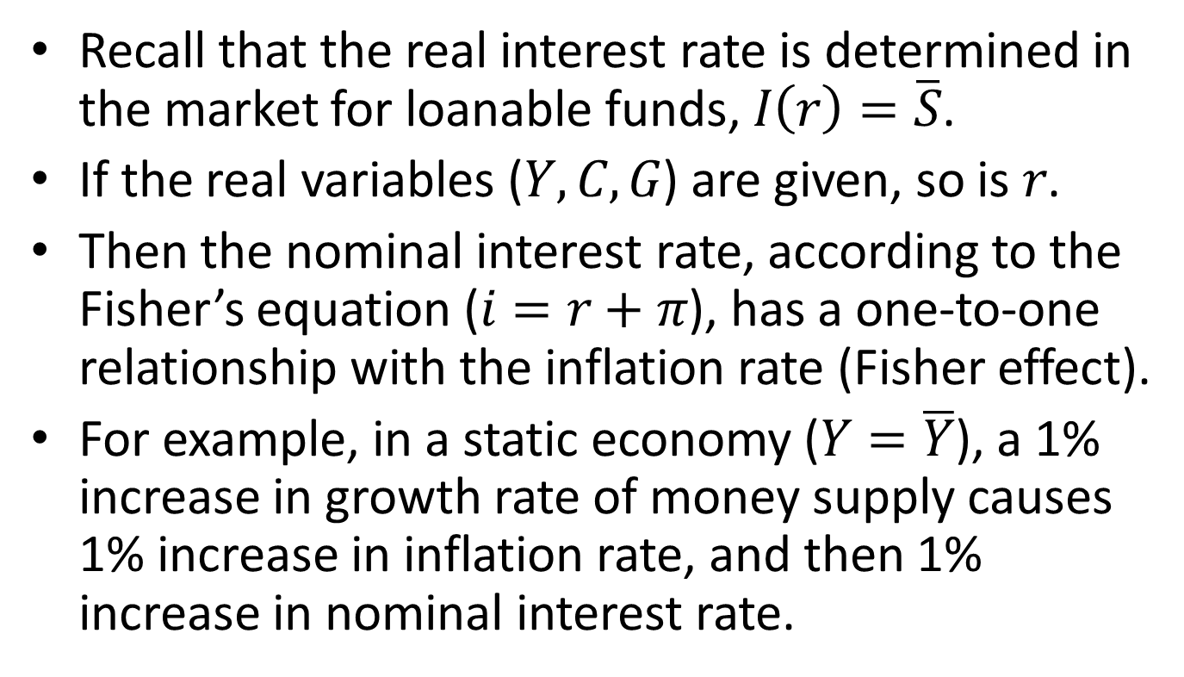
Inflation and Nominal Interest Rate
Recall that the real interest rate is determined in the market for loanable funds, $I\left(r\right)=\overline{S}$.
If the real variables ($Y, C, G$) are given, so is$r$.
Then the nominal interest rate, according to the Fisher’s equation ($i=r+π$), has a one-to-one relationship with the inflation rate (Fisher effect).
For example, in a static economy ($Y=\overline{Y}$), a 1% increase in growth rate of money supply causes 1% increase in inflation rate, and then 1% increase in nominal interest rate.

Slide 93
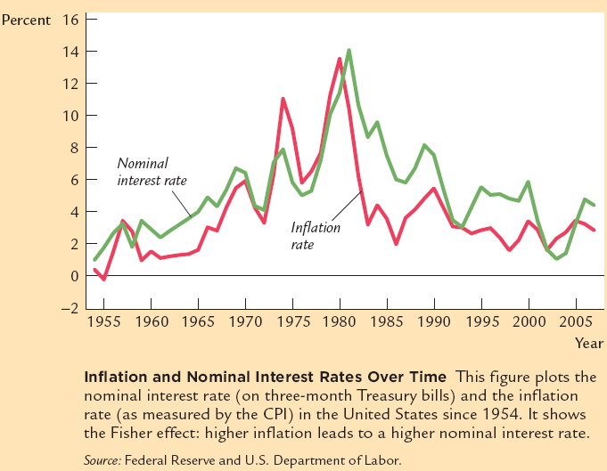
Case Study: Inflation and Nominal Interest Rate in USA

Slide 94
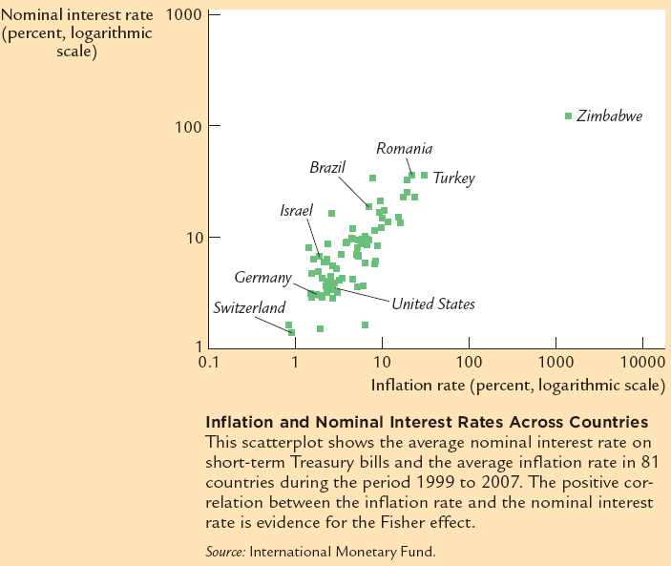
Case Study: Inflation and Nominal Interest Rate Across Countries

Slide 95

An Integrated Model
The classical AD-AS model:
$$Y=\overline{Y}$$
The classical model of real interest rate:
$$Y=C\left(Y−T\right)+I\left(r\right)+G$$
The quantity theory of money:
$$\frac{M}{P}=kY$$
The Fisher equation:
$$i=r+π$$

Slide 96

Classical Dichotomy
Real variables can be fully studied without considering money.
$Y, r$, unemployment rate, etc.
Money only influences the nominal values.
Price level, nominal GDP, nominal interest rate, etc.
The idea of separating real from nominal analysis is called the classical dichotomy.
If the classical dichotomy holds, we also say that money is neutral.

Slide 97

Criticism of the Classical Dichotomy
The model of money demand is too simplistic. Money demand may well depend on other factors than $Y$. For example, interest rate, consumer and investor confidence, debt level, etc. Indeed, money velocity is very unstable in history.
The quantity theory of money implies that monetary policy is irrelevant. However, it is quite evident that monetary policy has real effects on outputs.

Slide 98
Content
Introduction
Output
Unemployment
Income Distribution
Interest Rate
Money and Inflation
Exchange Rate

Slide 99
The Open Economy
An open economy trades with other economies in the world.
In this part of the lecture, we discuss
The international flows of goods and capital
Exchange rate
A model of small open economy
A model of large open economy

Slide 100

The Importance of Trade

Slide 101
How China Depends on Trade

Slide 102

Net Export
In an open economy, domestic spending need not equal its output of goods and services. The difference is the net export, which is the export of domestic goods and services minus the import of foreign goods and services. In short,
$$Y−\left(C+I+G\right)=NX=EX−IM,$$
where $Y$ is output, $\left(C+I+G\right)$ is domestic spending, $NX$ stands for net export, $EX$ is export, and $IM$ is import.
If the domestic spending is less than the output, then $NX>0$ and it is lent to foreigners. If the domestic spending exceeds the output, then $NX<0$ and the country borrows $\left(−NX\right)$ from abroad.
Net export is also called trade balance.

Slide 103
Current Account
Trade balance is the most important part of the current account. We have
CA = trade balance + net factor income + net cash transfer
Current account surplus: if CA>0
Current account deficit: if CA<0
In this course we ignore net factor income and cash transfer and treat current account balance as the same thing as trade balance.
Notes:
It is called the current account as it (mainly) records transactions of goods/services for the purpose of current consumption/investment. The capital account records the net change in financial assets, which are future claims.

Slide 104

The Recent Trend of China’s Current Account

Slide 105

Capital Flow
The flow of goods and services is mirrored by capital flow. Let $S=Y−(C+G)$ be the national saving, we have
If$S−I=NX>0$, the country lend its surplus saving to foreigners.
If $S−I=NX<0$, then the country borrows $\left(−NX\right)$, the saving deficit, from abroad.
We call $(S−I)$ net capital outflow. The net capital outflow always equals the net export.

Slide 106
An Imagined Example
If BYD sells an electric car to a US consumer for $10,000, how does the sale change China’s trade and capital flow?
Notes:
The Chinese export rises by $10,000.
If BYD invests the $10,000 in US stocks or bonds, then capital outflow rises by $10,000. The same is true even if BYD keeps the cash.
If BYD converts the $10,000 into RMB at a local bank, then the local bank also has to do something about it. If the local bank sells the dollar to PBC, and PBC uses the $10,000 to purchase US treasury bills, we still see $10,000 rise in capital outflow.

Slide 107
Capital Account
Capital flow is recorded in the capital account (or financial account) of the balance of payments.
We have the following identity of the balance of payments:
Current account + capital account + statistical error = 0
In theoretical analysis, we may ignore the statistical error. Thus a current account surplus (positive ) is exactly matched by a capital account deficit.
Notes:
The capital account records the net change in ownership of foreign assets.

Slide 108
Exchange Rate
The exchange rate (also known as foreign-exchange rate, or forex rate) between two currencies is the rate at which one currency will be exchanged for another.
We may express the exchange rate in units of foreign currency per the domestic currency. For example, the exchange rate of Korean Won is currently around 175 Won/Yuan.
The exchange rate may also be in units of domestic currency per foreign currency. For example, the exchange rate of USD is currently around 7 Yuan/USD.

Slide 109
The Convention
In this course, we adopt the convention that the exchange rate is in units of foreign currency per the domestic currency (Yuan).
Under this convention, a rise in the exchange rate is called an appreciation of RMB; a fall in the exchange rate is called a depreciation.
Appreciation is also called strengthening, while depreciation is also called weakening.

Slide 110
Case Study: RMB Exchange Rate

Slide 111
Case Study: The USD Index

Slide 112

Real Exchange Rate
The real exchange rate is the purchasing power of a currency relative to another at current exchange rates and prices.
Let $e$be the nominal exchange rate, $P$ the domestic price level, $P^{∗}$ the foreign price level. Then the real exchange rate is defined by
$ε=\frac{eP}{P^{∗}}.$

Slide 113

Purchasing Power Parity
If $ε=1$, we say that the exchange rates are at purchasing power parity. Theoretically, PPP is implied by “the law of one price”.
If $ε>1$, the domestic currency is over-valued in terms of purchasing power.
If $ε<1$, the domestic currency is under-valued in terms of purchasing power.

Slide 114

An Example
Suppose both China and USA produce and consume one good, the Big Mac.
The Big Mac costs 20 Yuan in China and 4 USD in USA. The nominal exchange rate is 6 RMB/USD.
Then the real exchange rate between China and USA is
$\frac{1}{6}⋅\frac{20}{4}=\frac{5}{6}$.
Since the real exchange rate is less than 1, we say that PPP does not hold and RMB is undervalued: One Chinese Big Mac costs 5/6 of what an American Big Mac costs.

Slide 115

The Implications of PPP
If PPP holds, we have
$$e_{t}=\frac{P_{t}^{∗}}{P_{t}}.$$
Taking log difference, we have
$$\log{\frac{e_{t}}{e_{t−1}}}=π_{t}^{∗}−π_{t},$$
where $π_{t}^{∗}$ and $π_{t}$ are foreign and domestic inflations, respectively.
PPP implies that if foreign inflation is higher than domestic inflation, the domestic currency would appreciate by the inflation gap ($π_{t}^{∗}−π_{t}$).
Notes:
Note that $\log{\frac{e_{t}}{e_{t−1}}}≈\frac{Δe_{t}}{e_{t−1}}$ .

Slide 116

Interest Rate Parity
If we further assume a common real interest rate, then we have
$$\log{\frac{e_{t}}{e_{t−1}}}=i_{t}^{∗}−i_{t}.$$
This says that if foreign nominal interest rate is higher than the domestic one, the domestic currency tends to appreciate.
This equation is often called “uncovered interest rate parity”.
Notes:
The common real interest rate implies that there are arbitrage opportunities in investing.

Slide 117
Why PPP May Not Hold
PPP must hold if the “law of one price” applies.
However, PPP may not hold, especially in the short term, since
Not all goods are tradable.
There are trading barriers and trading costs.
In the long run, however, PPP roughly holds.

Slide 118

Case Study: Long-Term Validity of PPP

Slide 119

A Model of Small Open Economy
Assumptions:
Capital is perfectly mobile across borders.
The real interest rate is determined in the world market, $r^{∗}.$
The net export is a decreasing function of the real exchange rate ($ε$).
In the foreign exchange market, the supply of foreign currencies are the net export, and the demand is the net capital outflow ($F$), or excess national saving.
In equilibrium,
$F(r^{∗})=S−I\left(r^{∗}\right)=NX\left(ε\right).$
Notes:
The lower the real exchange rate, the less expensive are domestic goods and services relative to foreign ones, thus larger net export.

Slide 120



The Equilibrium of Foreign Exchange Market
Real exchange rate $ε$
Excess saving, $S−I$
Equilibrium real exchange rate
$$X(ε)$$
Net export

Slide 121
Thought Experiments on A Small Open Economy
How might the real exchange rate be affected by the following?
Expansionary fiscal policy at home
A rise in the world interest rate
The effect of protectionist trade policy
The effect of financial market development

Slide 122
The Determinants of Nominal Exchange Rate
Nominal exchange rate is fixed in some economies.
Under PPP, nominal exchange rate is solely determined by the domestic and the foreign price levels.
In reality, nominal exchange rate for those economies with floating exchange rates depend on many factors including interest rates, growth prospects, etc., as well as inflation expectations.

Slide 123

A Model of Large Open Economy
Assumptions:
Capital is perfectly mobile across borders.
The net capital outflow of the large economy influences the world interest rate $r$: $F\left(r\right)$ is decreasing in $r$.
The net export is a decreasing function of the real exchange rate ($ε$).
Two markets:
The market for loanable funds
The forex market
In equilibrium, we have
$$S=I\left(r\right)+F\left(r\right)$$
$$X\left(ε\right)=F(r)$$
$r$ and $ε$ are simultaneously determined in the market for loanable funds and the forex market.
Notes:
The reason why F(r) is decreasing: net capital outflow of a large economy would depress world interest rate.

Slide 124






The Model of Large Open Economy
Real exchange rate $ε$
$$S=I(r)+F(r)$$
$$X\left(ε\right)=F(r)$$
Equilibrium real exchange rate $ε^{∗}$
Equilibrium real exchange rate $r^{∗}$
World interest rate $r$

Slide 125

Thought Experiments on A Large Open Economy
How would $r$ and $ε$ change if the following happens?
A fiscal stimulus (tax reduction or increased government spending)
An protectionist shock
Notes:
S = I(r) + F(r)
NX(e) = F(r)
A fiscal stimulus reduces national saving, which leads to higher r. Less net capital outflow reduces demand for foreign currency, the domestic currency appreciates.
A tax incentive for investment right-shifts the investment curve, leading to higher r. The rest is the same as above.
An import restriction increases net export, right-shifting the NX curve. The domestic currency appreciates. r remains.

Slide 126



Fiscal Stimulus
Real exchange rate $ε$
$$S=I(r)+F(r)$$
$$X\left(ε\right)=F(r)$$
Equilibrium real exchange rate $ε^{∗}$
Equilibrium real exchange rate $r^{∗}$
World interest rate $r$

Slide 127
Protectionist Shock
Real exchange rate $ε$
$$S=I(r)+F(r)$$
$$X\left(ε\right)=F(r)$$
Equilibrium real exchange rate $ε^{∗}$
Equilibrium real exchange rate $r^{∗}$
World interest rate

