Slide 1
Economic Growth
Junhui Qian

Slide 2
Content
Overview
Solow Model I (accumulation of capital and population growth )
Solow Model II (considering technological progress)
Endogenous growth models
Economic growth accounting
Other growth topics

Slide 3
The Importance of Economic Growth
For poor countries, a stagnant economy means a persistent absolute poverty.
In relative terms, a slight but persistent difference in growth rate results in huge income gaps.
The following table illustrates how three different growth rates (from the same income per cap, 100 ) lead to starkly different outcomes.
Years | 0 | 10 | 30 | 100
1% | 100 | 110.5 | 134.8 | 270.5
3% | 100 | 134.4 | 242.7 | 1921.9
8% | 100 | 215.9 | 1006.3 | 219976.1

Slide 4
Growth Performances of 143 Economies

Slide 5




Growth and Fluctuations
Output
$${\overline{Y}}_{t}$$
$$Y_{t}$$
$$Y_{t}−{\overline{Y}}_{t}$$
$$t$$

Slide 6
Content
Overview
Solow Model I (accumulation of capital and population growth )
Solow Model II (considering technological progress)
Endogenous growth models
Economic growth accounting
Other growth topics

Slide 7
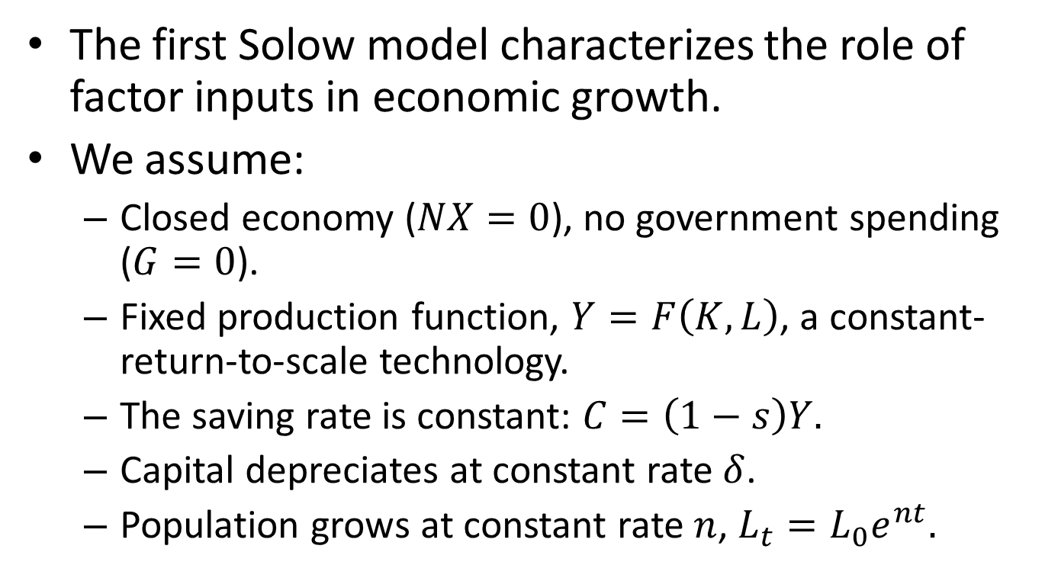
Solow Model I
The first Solow model characterizes the role of factor inputs in economic growth.
We assume:
Closed economy ($NX=0$), no government spending ($G=0$).
Fixed production function, $Y=F\left(K,L\right)$, a constant-return-to-scale technology.
The saving rate is constant: $C=\left(1−s\right)Y.$
Capital depreciates at constant rate $δ$.
Population grows at constant rate $n$, $L_{t}=L_{0}e^{nt}.$

Slide 8
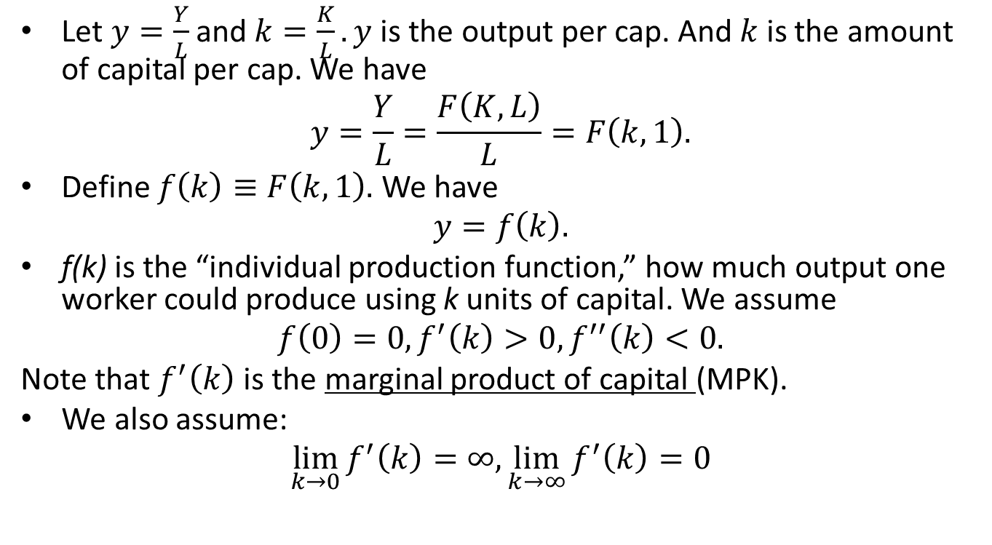
The Per Capita Output
Let $y=\frac{Y}{L}$ and $k=\frac{K}{L}. y$is the output per cap. And $k$is the amount of capital per cap. We have
$$y=\frac{Y}{L}=\frac{F\left(K,L\right)}{L}=F\left(k,1\right).$$
Define $f\left(k\right)≡F\left(k,1\right).$ We have
$$y=f\left(k\right).$$
f(k) is the “individual production function,” how much output one worker could produce using k units of capital. We assume
$$f\left(0\right)=0, f^{′}\left(k\right)>0, f^{′′}\left(k\right)<0.$$
Note that $f^{′}\left(k\right)$ is the marginal product of capital (MPK).
We also assume:
$$\lim_{k→0}{f^{′}\left(k\right)=∞, \lim_{k→∞}{f^{′}\left(k\right)=0}}$$
Notes:
f: 人均生产函数，个体生产函数

Slide 9
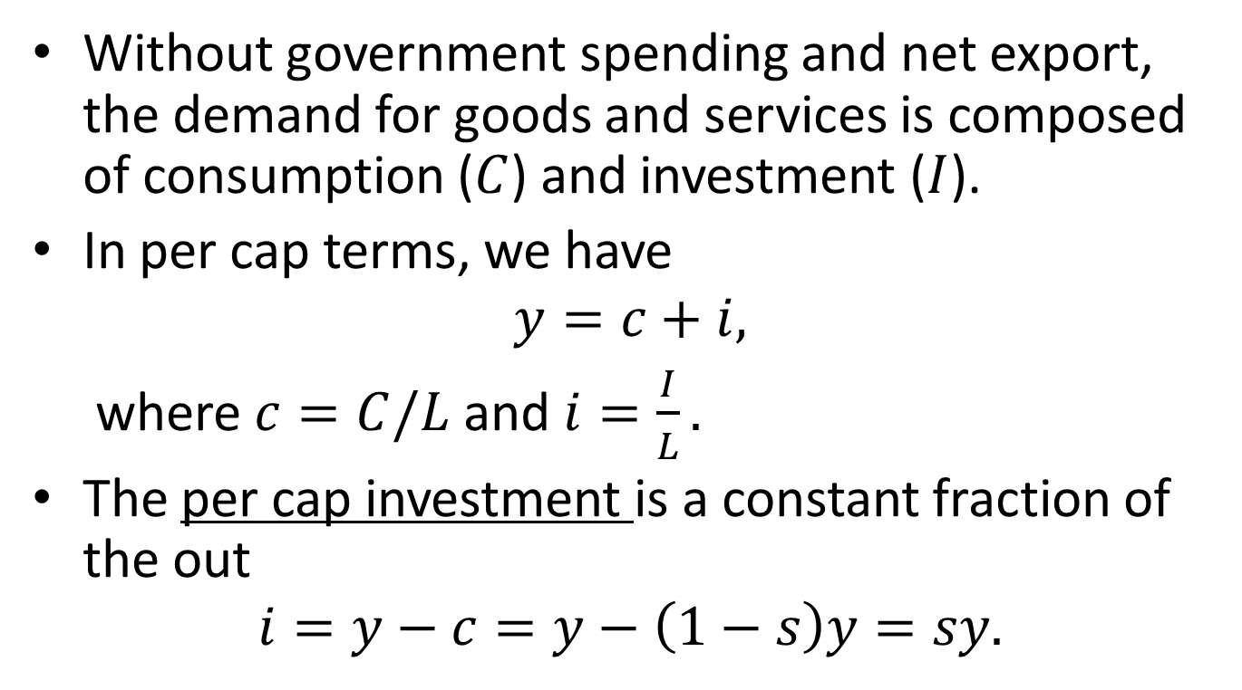
The Per Capita Demand
Without government spending and net export, the demand for goods and services is composed of consumption ($C$) and investment ($I$).
In per cap terms, we have
$$y=c+i,$$
where $c=C/L$ and $i=\frac{I}{L}.$
The per cap investment is a constant fraction of the out
$$i=y−c=y−\left(1−s\right)y=sy.$$

Slide 10
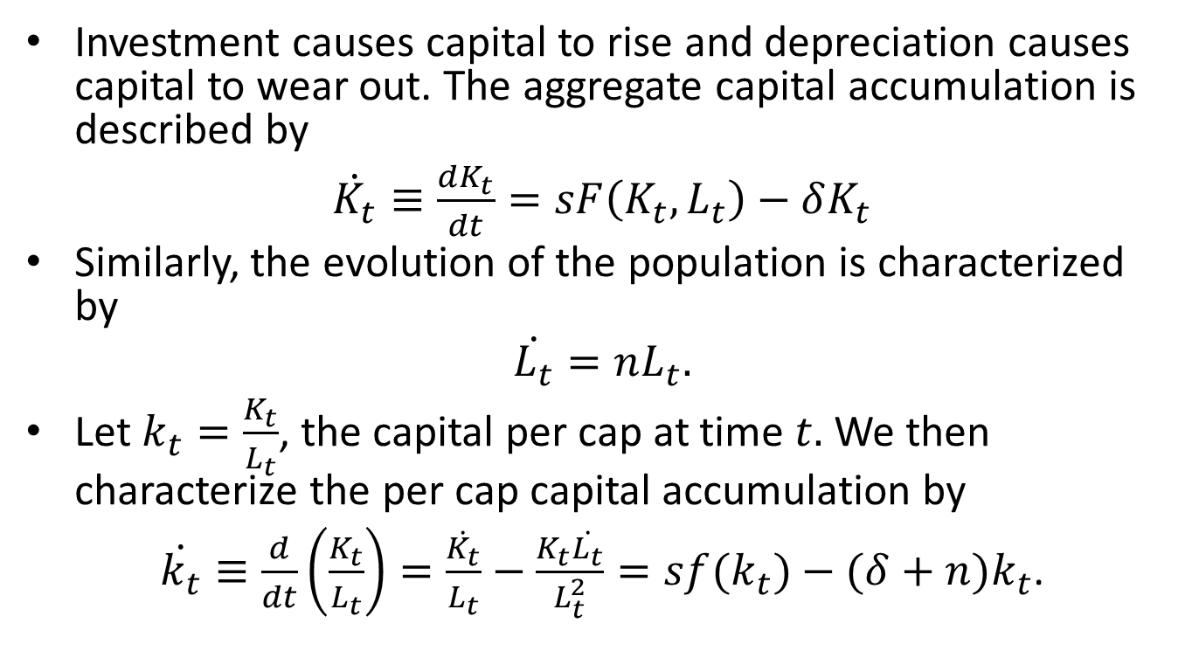
Accumulation of Capital
Investment causes capital to rise and depreciation causes capital to wear out. The aggregate capital accumulation is described by
$\dot{K_{t}}≡\frac{dK_{t}}{dt}=sF\left(K_{t},L_{t}\right)−δK_{t}$
Similarly, the evolution of the population is characterized by
$$\dot{L_{t}}=nL_{t}.$$
Let $k_{t}=\frac{K_{t}}{L_{t}}$, the capital per cap at time $t.$ We then characterize the per cap capital accumulation by
$\dot{k_{t}}≡\frac{d}{dt}\left(\frac{K_{t}}{L_{t}}\right)=\frac{\dot{K_{t}}}{L_{t}}−\frac{K_{t}\dot{L_{t}}}{L_{t}^{2}}=sf(k_{t})−(δ+n)k_{t}$.
Notes:
Saving increases the per cap capital (k), depreciation decreases k, and population growth dilutes k.

Slide 11
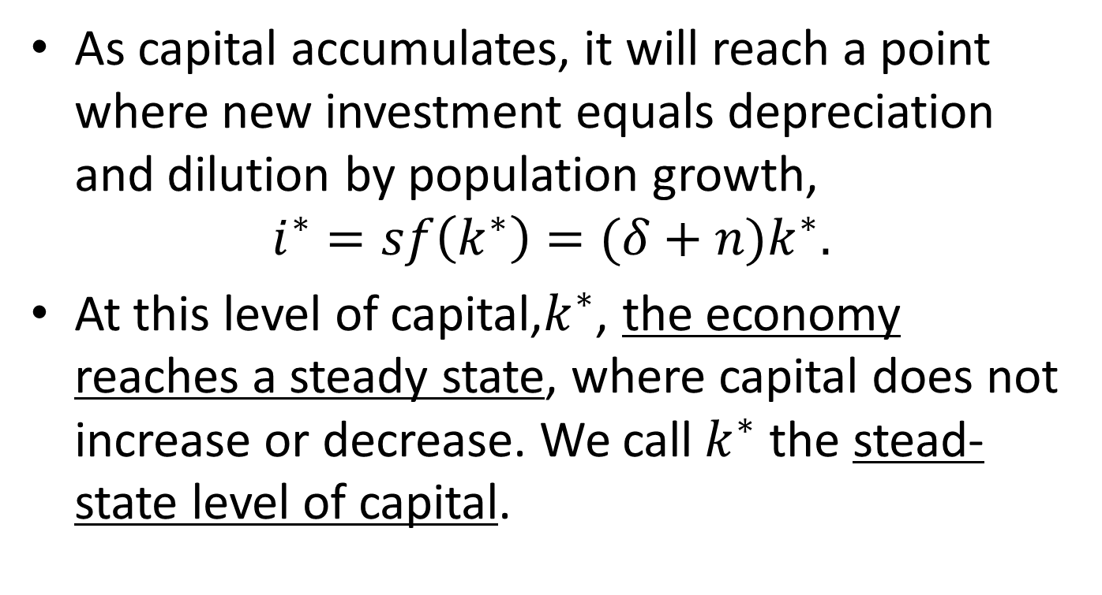
Steady-State Level of Capital
As capital accumulates, it will reach a point where new investment equals depreciation and dilution by population growth,
$$i^{∗}=sf\left(k^{∗}\right)=(δ+n)k^{∗}.$$
At this level of capital,$k^{∗}$, the economy reaches a steady state, where capital does not increase or decrease. We call$k^{∗}$ the stead-state level of capital.
Notes:
Note that population growth has an analogous effect on steady-state capital stock as depreciation. Both reduce per capita capital stock.
Steady-state: 稳态
$k^{∗}$：人均资本存量

Slide 12




A Graphic Illustration
Investment
Depreciation
$$(δ+n)k$$
s$f(k)$
$$k$$
$$k^{∗}$$

Slide 13
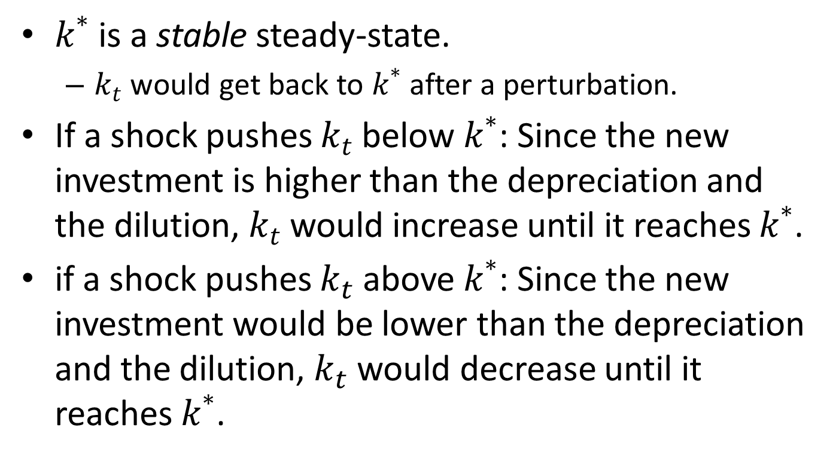
Stability of Steady-State
$k^{∗}$ is a stable steady-state.
$k_{t}$ would get back to $k^{∗}$ after a perturbation.
If a shock pushes $k_{t}$ below $k^{∗}$: Since the new investment is higher than the depreciation and the dilution, $k_{t}$ would increase until it reaches $k^{∗}$.
if a shock pushes $k_{t}$ above $k^{∗}$: Since the new investment would be lower than the depreciation and the dilution, $k_{t}$ would decrease until it reaches $k^{∗}$.

Slide 14
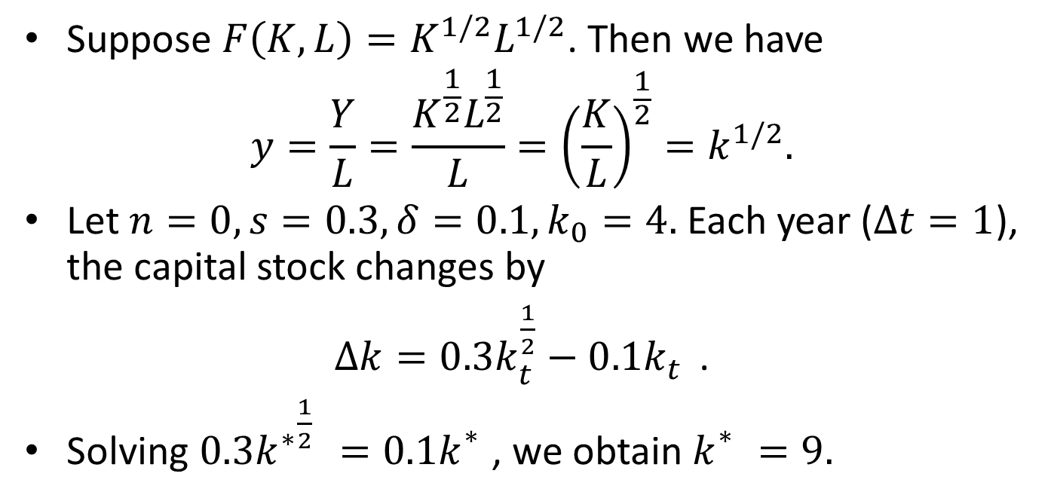
An Example
Suppose $F\left(K,L\right)=K^{1/2}L^{1/2}$. Then we have
$$y=\frac{Y}{L}=\frac{K^{\frac{1}{2}}L^{\frac{1}{2}}}{L}={\left(\frac{K}{L}\right)}^{\frac{1}{2}}=k^{1/2}.$$
Let $n=0,s=0.3, δ=0.1, k_{0}=4.$ Each year ($Δt=1$), the capital stock changes by
$Δk=0.3k_{t}^{\frac{1}{2}}−0.1k_{t}^{}$.
Solving $0.3{k^{∗}}_{}^{\frac{1}{2}}=0.1k_{}^{∗}$, we obtain $k_{}^{∗}=9.$

Slide 15
Approaching the Steady State: A Numerical Illustration
Assumptions: $y=k^{1/2}$, s=0.3, $δ=0.1$, $k_{0}=4.$

Slide 16
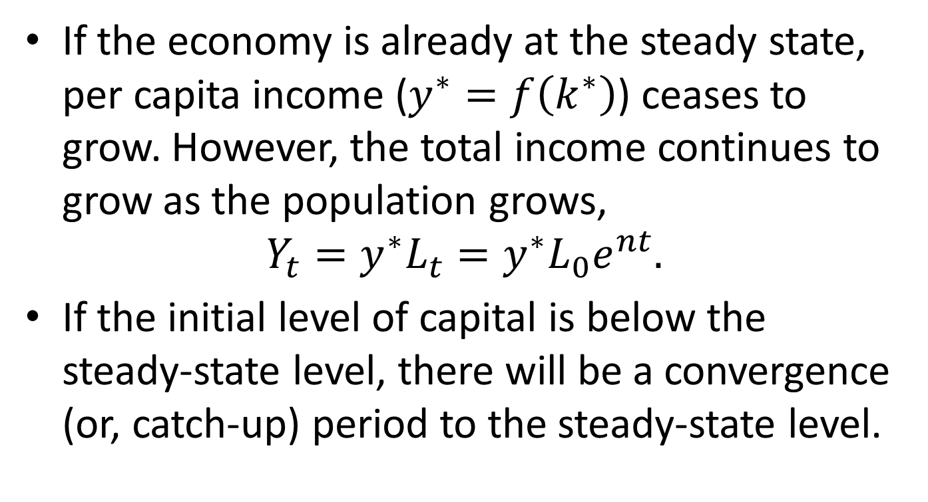
Implications of Solow Model I
If the economy is already at the steady state, per capita income ($y^{∗}=f\left(k^{∗}\right)$) ceases to grow. However, the total income continues to grow as the population grows,
$$Y_{t}=y^{∗}L_{t}=y^{∗}L_{0}e^{nt}.$$
If the initial level of capital is below the steady-state level, there will be a convergence (or, catch-up) period to the steady-state level.

Slide 17
Case Studies
The economic miracle of Japan and Germany since the end of the World War II.
The economic miracle of China since 1978.

Slide 18
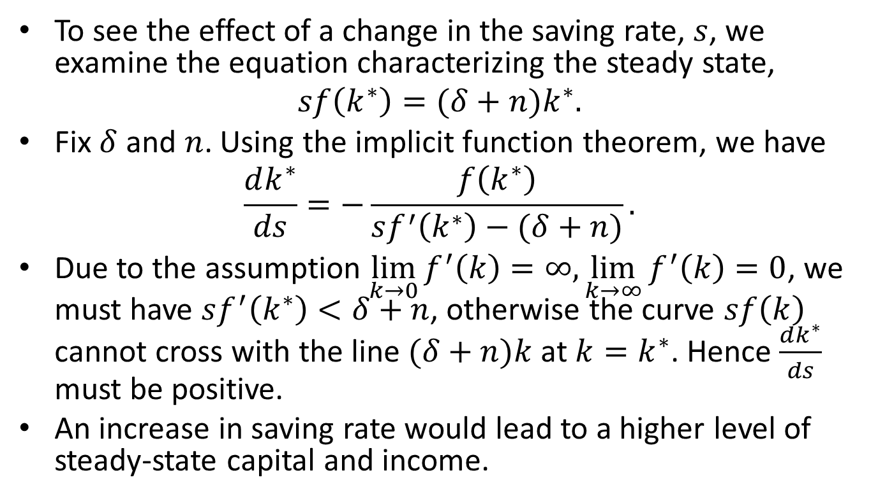
The Role of Saving
To see the effect of a change in the saving rate, $s$, we examine the equation characterizing the steady state,
$$sf\left(k^{∗}\right)=(δ+n)k^{∗}.$$
Fix $δ$and $n$. Using the implicit function theorem, we have
$$\frac{dk^{∗}}{ds}=−\frac{f\left(k^{∗}\right)}{sf^{′}\left(k^{∗}\right)−(δ+n)}.$$
Due to the assumption $\lim_{k→0}{f^{′}\left(k\right)=∞, \lim_{k→∞}{f^{′}\left(k\right)=0}}$, we must have $sf^{′}\left(k^{∗}\right)<δ+n$, otherwise the curve $sf\left(k\right)$ cannot cross with the line $(δ+n)k$ at $k=k^{∗}$. Hence $\frac{dk^{∗}}{ds}$ must be positive.
An increase in saving rate would lead to a higher level of steady-state capital and income.

Slide 19





A Graphic Illustration
Investment
Depreciation
$$(δ+n)k$$
$$s_{2}f(k)$$
$$s_{1}f(k)$$
$$k$$
$$k_{1}^{∗}$$
$$k_{2}^{∗}$$

Slide 20
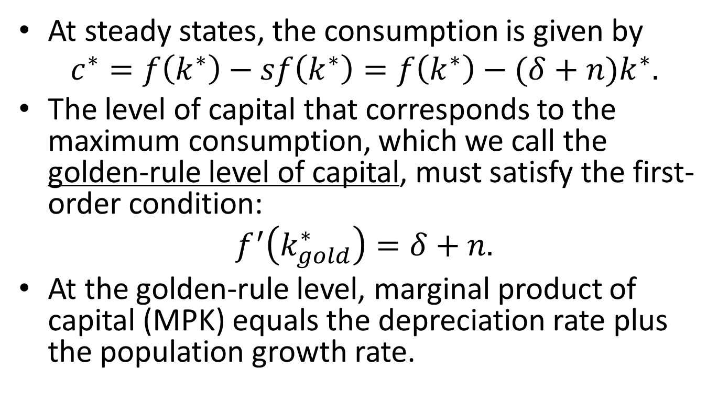
The Golden-Rule Level of Capital
At steady states, the consumption is given by
$$c^{∗}=f\left(k^{∗}\right)−sf\left(k^{∗}\right)=f\left(k^{∗}\right)−(δ+n)k^{∗}.$$
The level of capital that corresponds to the maximum consumption, which we call the golden-rule level of capital, must satisfy the first-order condition:
$$f^{′}\left(k_{gold}^{∗}\right)=δ+n.$$
At the golden-rule level, marginal product of capital (MPK) equals the depreciation rate plus the population growth rate.
Notes:
资本存量的黄金率水平

Slide 21





A Graphic Illustration
Steady-state output (depreciation)
$$\left(δ+n\right)k^{∗}$$
$$f(k^{∗})$$
$$c_{gold}^{∗}$$
$$k^{∗}$$
$$k_{gold}^{∗}$$

Slide 22
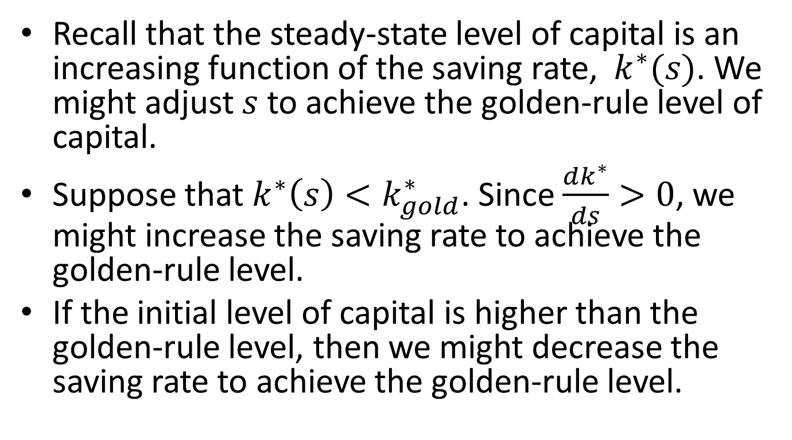
How The Golden-Rule Level of Capital Might Be Achieved
Recall that the steady-state level of capital is an increasing function of the saving rate, $k^{∗}(s)$. We might adjust $s$ to achieve the golden-rule level of capital.
Suppose that $k^{∗}\left(s\right)<k_{gold}^{∗}$. Since $\frac{dk^{∗}}{ds}>0$, we might increase the saving rate to achieve the golden-rule level.
If the initial level of capital is higher than the golden-rule level, then we might decrease the saving rate to achieve the golden-rule level.

Slide 23
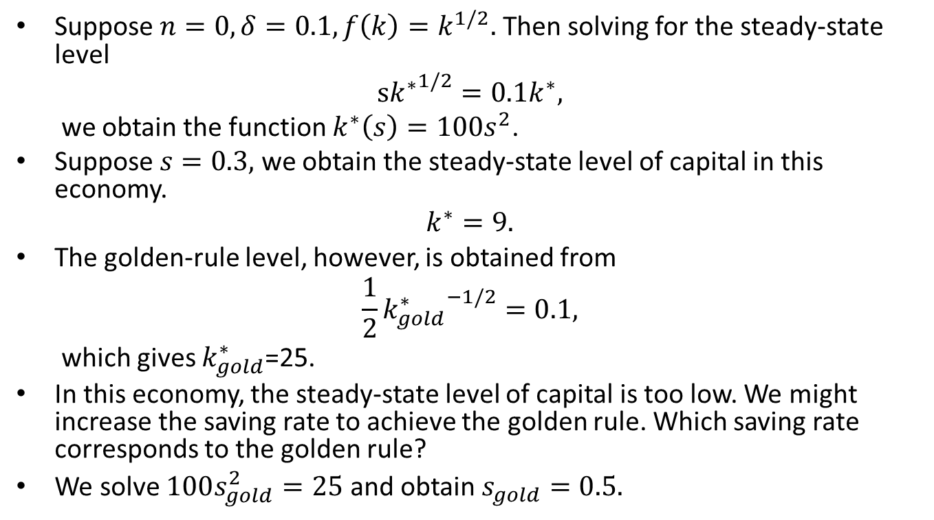
An Example
Suppose $n=0,δ=0.1, f\left(k\right)=k^{1/2}.$ Then solving for the steady-state level
$$s{k^{∗}}^{1/2}=0.1k^{∗},$$
we obtain the function $k^{∗}\left(s\right)=10{0s}^{2}$.
Suppose $s=0.3,$ we obtain the steady-state level of capital in this economy.
$$k^{∗}=9.$$
The golden-rule level, however, is obtained from
$$\frac{1}{2}{k_{gold}^{∗}}^{−1/2}=0.1,$$
which gives $k_{gold}^{∗}$=25.
In this economy, the steady-state level of capital is too low. We might increase the saving rate to achieve the golden rule. Which saving rate corresponds to the golden rule?
We solve $100s_{gold}^{2}=25$ and obtain $s_{gold}=0.5.$

Slide 24
Dealing with Too Little Capital

Slide 25
Approaching The Golden Rule

Slide 26
Dealing with Too Much Capital

Slide 27
Approaching The Golden Rule

Slide 28
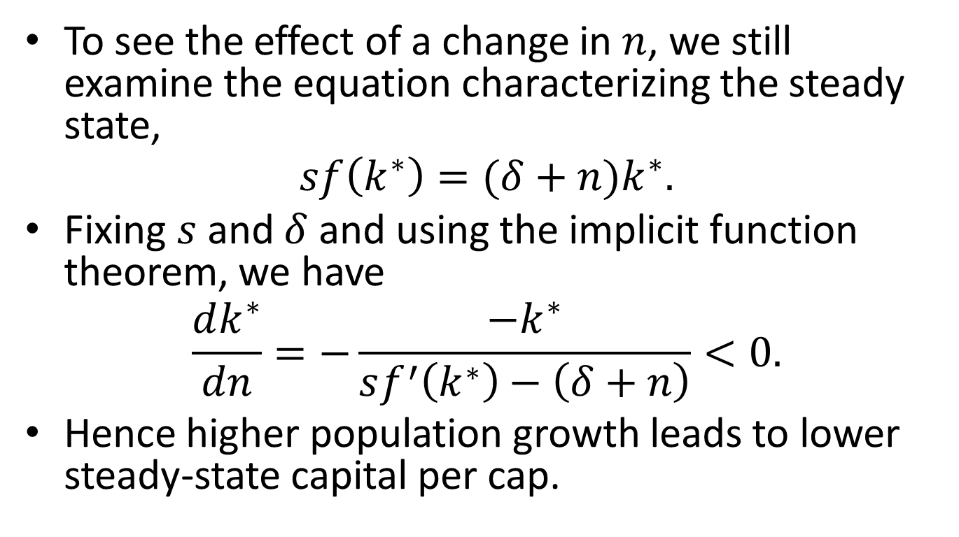
The Effect of Population Growth
To see the effect of a change in $n$, we still examine the equation characterizing the steady state,
$$sf\left(k^{∗}\right)=(δ+n)k^{∗}.$$
Fixing $s$ and $δ$ and using the implicit function theorem, we have
$$\frac{dk^{∗}}{dn}=−\frac{{−k}^{∗}}{sf^{′}\left(k^{∗}\right)−\left(δ+n\right)}<0.$$
Hence higher population growth leads to lower steady-state capital per cap.

Slide 29





A Graphic Illustration
Investment
Depreciation
$$(δ+n_{2})k$$
$$(δ+n_{1})k$$
$$sf(k)$$
$$k$$
$$k_{2}^{∗}$$
$$k_{1}^{∗}$$

Slide 30
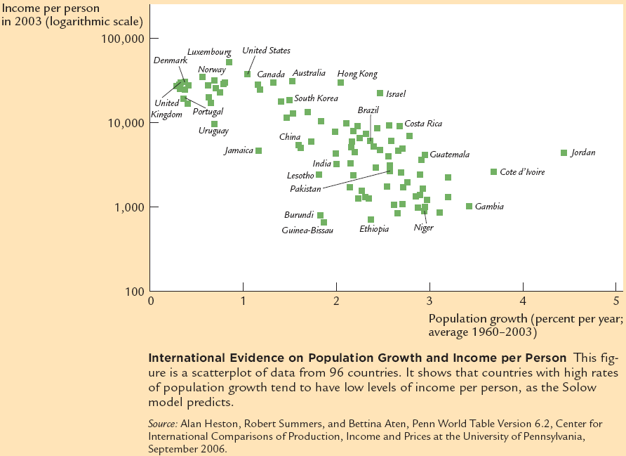
Case Study: Population Growth v.s. Per Capita Income
Notes:
This is a misleading case study. It only shows the negative correlation between income and pop growth. This does not prove causality from higher pop growth to lower income. Population growth is itself endogenous. People in wealthy countries tend to have less children.

Slide 31
Content
Overview
Solow Model I (accumulation of capital and population growth )
Solow Model II (considering technological progress)
Endogenous growth models
Economic growth accounting
Other growth topics

Slide 32
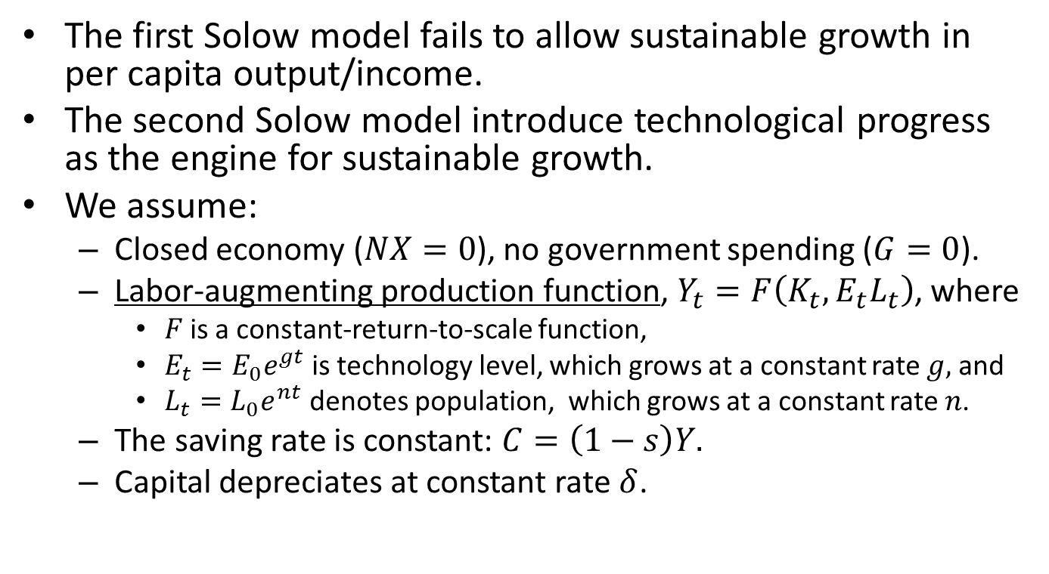
Solow Model II
The first Solow model fails to allow sustainable growth in per capita output/income.
The second Solow model introduce technological progress as the engine for sustainable growth.
We assume:
Closed economy ($NX=0$), no government spending ($G=0$).
Labor-augmenting production function, $Y_{t}=F\left(K_{t},E_{t}L_{t}\right)$, where
$F$is a constant-return-to-scale function,
$E_{t}=E_{0}e^{gt}$ is technology level, which grows at a constant rate $g,$ and
$L_{t}=L_{0}e^{nt}$ denotes population, which grows at a constant rate $n$.
The saving rate is constant: $C=\left(1−s\right)Y.$
Capital depreciates at constant rate $δ$.
Notes:
Labor-augmenting: 劳动改善型

Slide 33
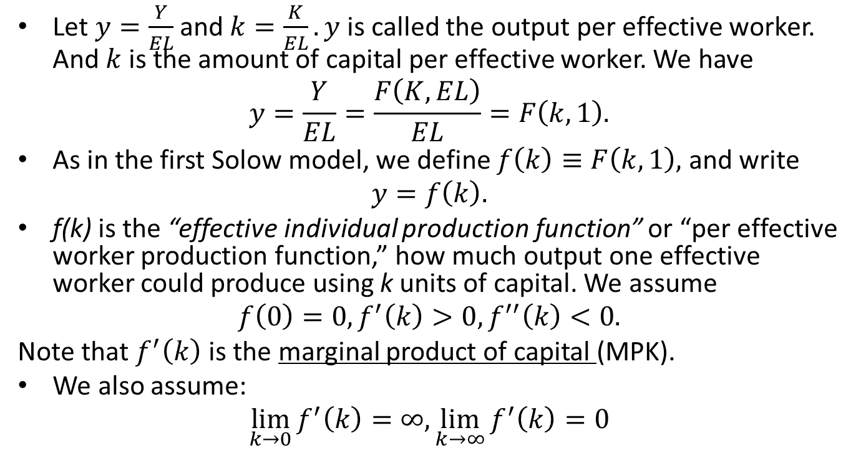
Output Per Effective Worker
Let $y=\frac{Y}{EL}$ and $k=\frac{K}{EL}. y$is called the output per effective worker. And $k$is the amount of capital per effective worker. We have
$$y=\frac{Y}{EL}=\frac{F\left(K,EL\right)}{EL}=F\left(k,1\right).$$
As in the first Solow model, we define $f\left(k\right)≡F\left(k,1\right),$ and write
$$y=f\left(k\right).$$
f(k) is the “effective individual production function” or “per effective worker production function,” how much output one effective worker could produce using k units of capital. We assume
$$f\left(0\right)=0, f^{′}\left(k\right)>0, f^{′′}\left(k\right)<0.$$
Note that $f^{′}\left(k\right)$ is the marginal product of capital (MPK).
We also assume:
$$\lim_{k→0}{f^{′}\left(k\right)=∞, \lim_{k→∞}{f^{′}\left(k\right)=0}}$$
Notes:
output per effective worker：有效人均产出
“per effective worker production function”: 有效人均生产函数
effective individual production function: 有效个体生产函数

Slide 34
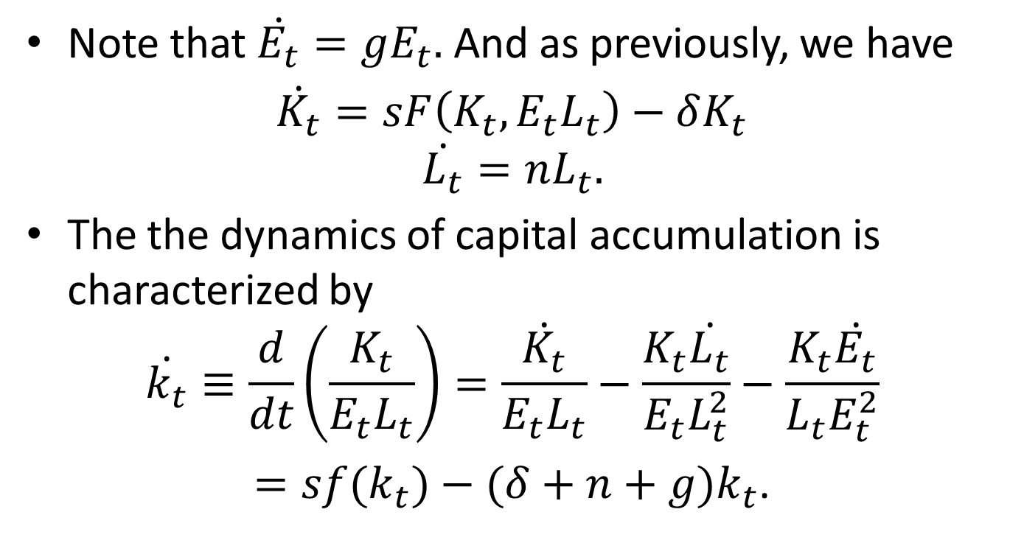
The Accumulation of Capital
Note that $\dot{E_{t}}=gE_{t}.$ And as previously, we have
$\dot{K_{t}}=sF\left(K_{t},{E_{t}L}_{t}\right)−δK_{t}$
$$\dot{L_{t}}=nL_{t}.$$
The the dynamics of capital accumulation is characterized by
$$\dot{k_{t}}≡\frac{d}{dt}\left(\frac{K_{t}}{{E_{t}L}_{t}}\right)=\frac{\dot{K_{t}}}{E_{t}L_{t}}−\frac{K_{t}\dot{L_{t}}}{E_{t}L_{t}^{2}}−\frac{K_{t}\dot{E_{t}}}{L_{t}E_{t}^{2}}$$
$=sf(k_{t})−(δ+n+g)k_{t}$.

Slide 35
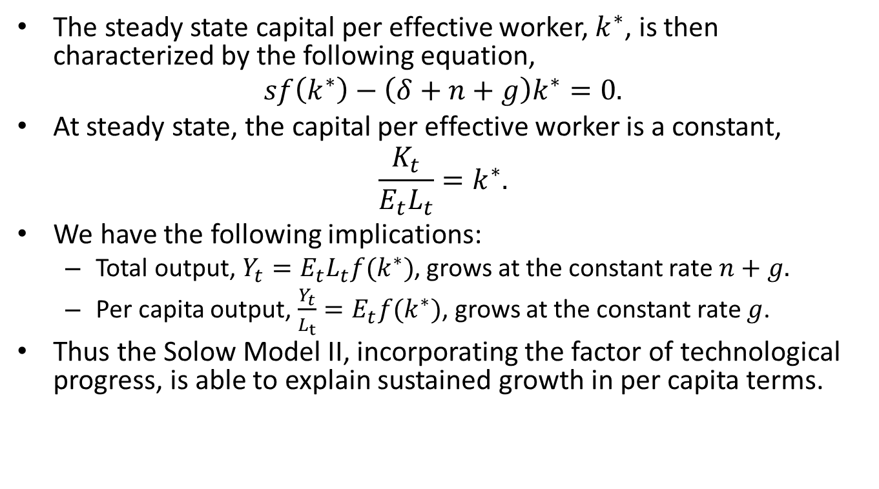
The Steady State
The steady state capital per effective worker, $k^{∗}$, is then characterized by the following equation,
$$sf\left(k^{∗}\right)−\left(δ+n+g\right)k^{∗}=0.$$
At steady state, the capital per effective worker is a constant,
$$\frac{K_{t}}{E_{t}L_{t}}=k^{∗}.$$
We have the following implications:
Total output, $Y_{t}=E_{t}L_{t}f(k^{∗})$, grows at the constant rate $n+g.$
Per capita output, $\frac{Y_{t}}{L_{t}}=E_{t}f(k^{∗})$, grows at the constant rate $g$.
Thus the Solow Model II, incorporating the factor of technological progress, is able to explain sustained growth in per capita terms.

Slide 36
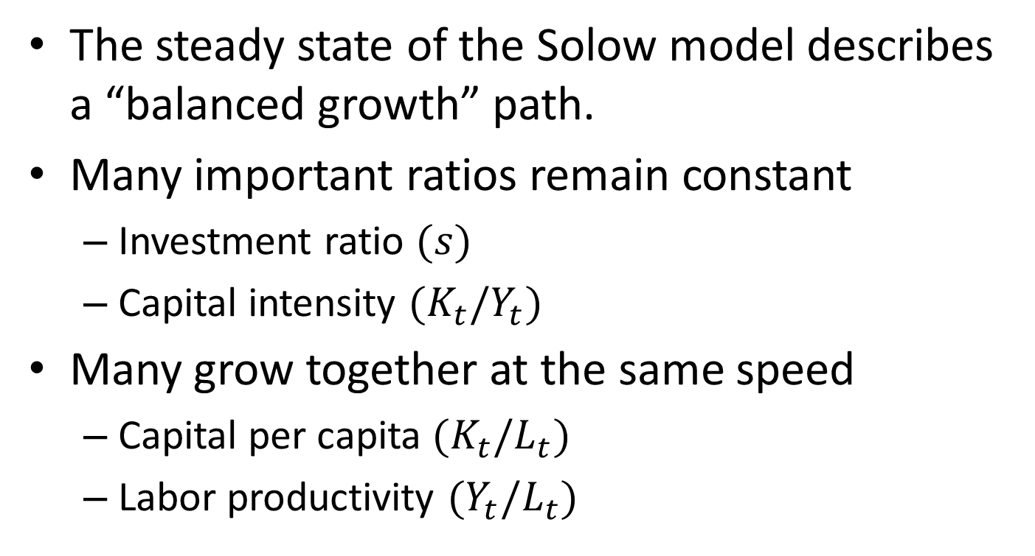
Balanced Growth Path
The steady state of the Solow model describes a “balanced growth” path.
Many important ratios remain constant
Investment ratio $(s)$
Capital intensity $(K_{t}/Y_{t})$
Many grow together at the same speed
Capital per capita $(K_{t}/L_{t})$
Labor productivity $(Y_{t}/L_{t})$

Slide 37
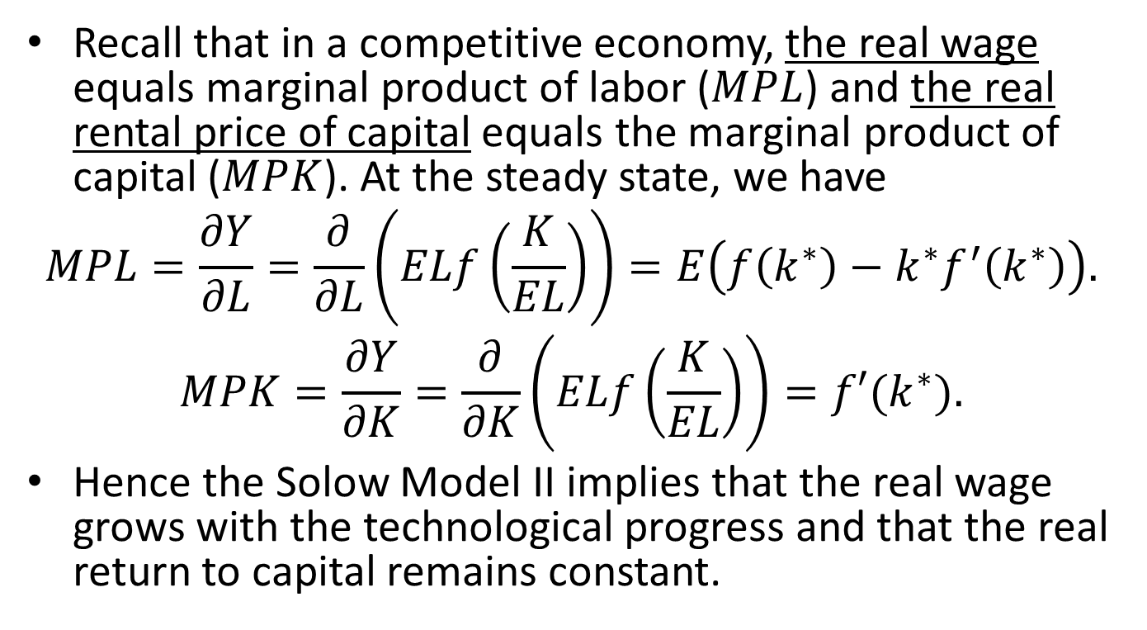
Real Wage and Real Rental Price of Capital
Recall that in a competitive economy, the real wage equals marginal product of labor ($MPL$) and the real rental price of capital equals the marginal product of capital ($MPK$). At the steady state, we have
$$MPL=\frac{∂Y}{∂L}=\frac{∂}{∂L}\left(ELf\left(\frac{K}{EL}\right)\right)=E\left(f\left(k^{∗}\right)−k^{∗}f^{′}\left(k^{∗}\right)\right).$$
$$MPK=\frac{∂Y}{∂K}=\frac{∂}{∂K}\left(ELf\left(\frac{K}{EL}\right)\right)=f′(k^{∗}).$$
Hence the Solow Model II implies that the real wage grows with the technological progress and that the real return to capital remains constant.

Slide 38
Exercises
What would be the impact of an increase in saving rate on the steady-state capital per capita?
What would be the Golden-rule level of capital per effective worker?

Slide 39
Content
Overview
Solow Model I (accumulation of capital and population growth )
Solow Model II (considering technological progress)
Endogenous growth models
Economic growth accounting
Other growth topics

Slide 40
What Endogenous Models Do
In the Solow model, technological progress is assumed.
Endogenous models treat the technology progress as an outcome of economic activities, or in other words, as an endogenous process.
In this part of the lecture, we introduce two simple endogenous models.
A basic AK model
Two-sector model

Slide 41
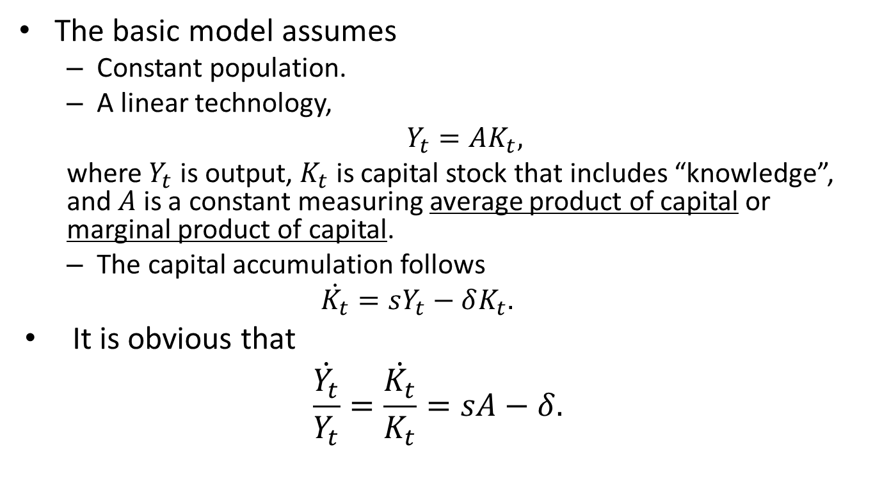
The AK Model
The basic model assumes
Constant population.
A linear technology,
$Y_{t}=AK_{t},$
where $Y_{t}$ is output, $K_{t}$ is capital stock that includes “knowledge”, and $A$ is a constant measuring average product of capital or marginal product of capital.
The capital accumulation follows
$$\dot{K_{t}}=sY_{t}−δK_{t}.$$
It is obvious that
$$\frac{\dot{Y_{t}}}{Y_{t}}=\frac{\dot{K_{t}}}{K_{t}}=sA−δ.$$

Slide 42
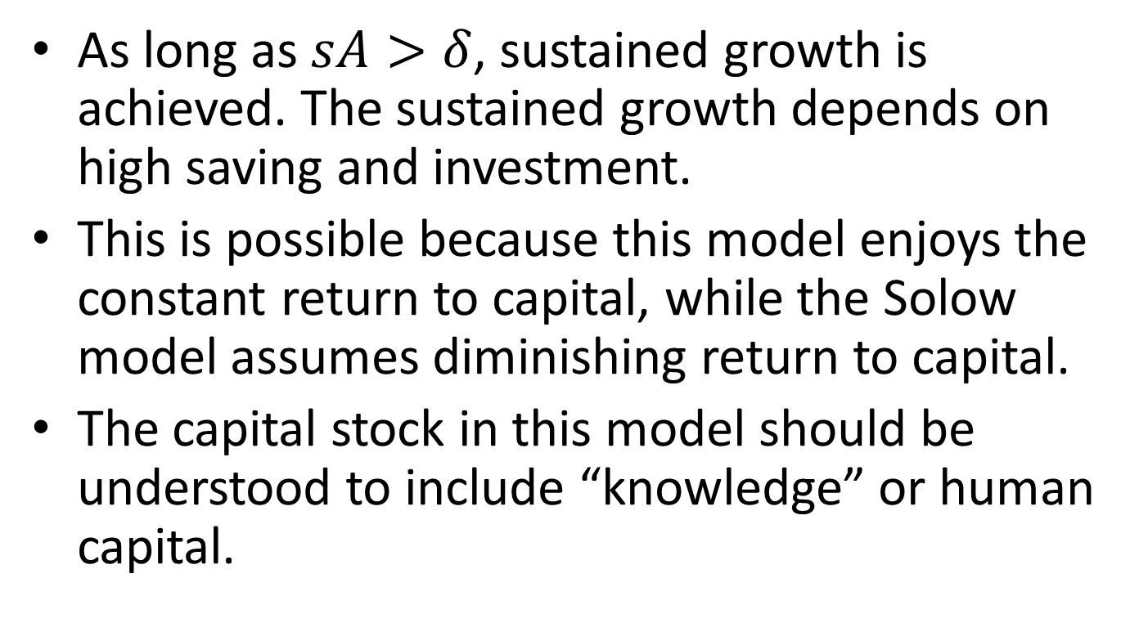
The Implication
As long as $sA>δ$, sustained growth is achieved. The sustained growth depends on high saving and investment.
This is possible because this model enjoys the constant return to capital, while the Solow model assumes diminishing return to capital.
The capital stock in this model should be understood to include “knowledge” or human capital.

Slide 43
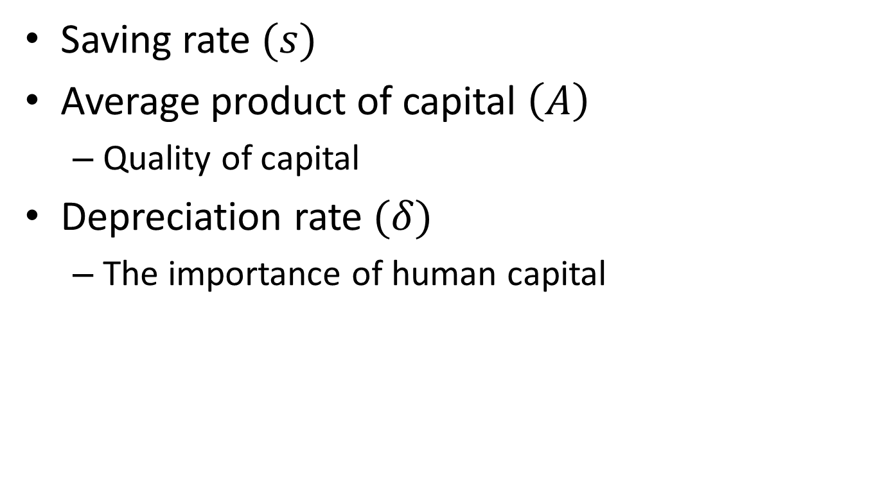
What Determines Growth Rate
Saving rate $(s)$
Average product of capital $\left(A\right)$
Quality of capital
Depreciation rate $(δ)$
The importance of human capital

Slide 44
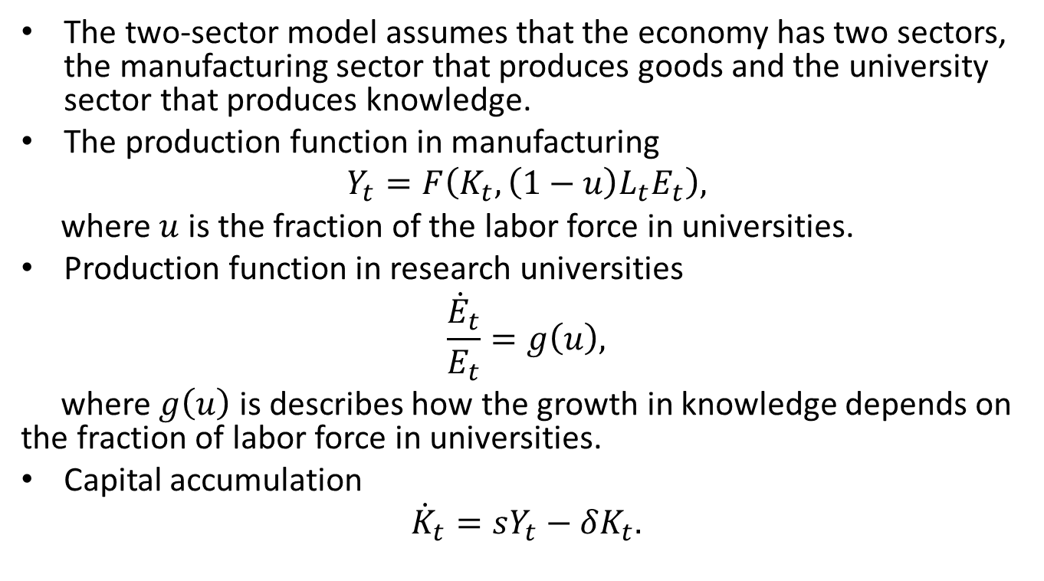
A Two-Sector Model
The two-sector model assumes that the economy has two sectors, the manufacturing sector that produces goods and the university sector that produces knowledge.
The production function in manufacturing
$$Y_{t}=F\left(K_{t},\left(1−u\right)L_{t}E_{t}\right),$$
where $u$ is the fraction of the labor force in universities.
Production function in research universities
$$\frac{{\dot{E}}_{t}}{E_{t}}=g\left(u\right),$$
where $g\left(u\right)$ is describes how the growth in knowledge depends on the fraction of labor force in universities.
Capital accumulation
$${\dot{K}}_{t}=sY_{t}−δK_{t}.$$
Notes:
The steady-state is characterized by $sf\left(k^{∗},u\right)=\left(δ+n+g\left(u\right)\right)k^{∗}$, where $f\left(k,u\right)=F(k,1−u)$

Slide 45
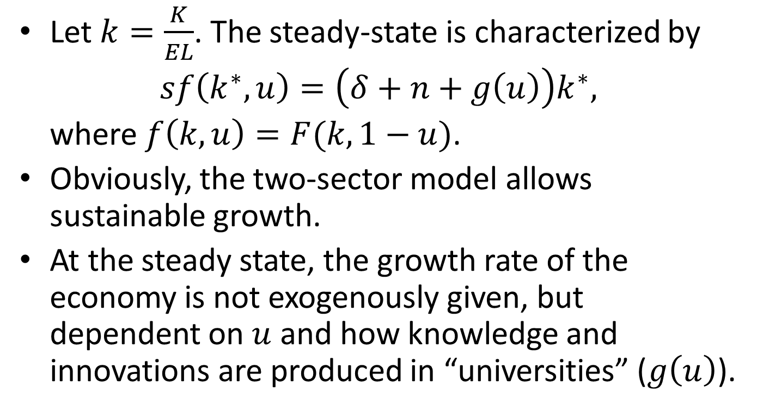
The Steady State
Let $k=\frac{K}{EL}$. The steady-state is characterized by
$sf\left(k^{∗},u\right)=\left(δ+n+g\left(u\right)\right)k^{∗},$
where $f\left(k,u\right)=F(k,1−u)$.
Obviously, the two-sector model allows sustainable growth.
At the steady state, the growth rate of the economy is not exogenously given, but dependent on $u$ and how knowledge and innovations are produced in “universities” ($g\left(u\right)$).

Slide 46
Content
Overview
Solow Model I (accumulation of capital and population growth )
Solow Model II (considering technological progress)
Endogenous growth models
Economic growth accounting
Other growth topics

Slide 47
Accounting for Economic Growth
Where does economic growth come from?
Increases in the factors of production
Capital (K)
Labor (L)
Technological progress
How much does each element contribute to economic growth?
In particular, if the growth comes not from technological progress, it would be considered “bad” growth, which is not sustainable.

Slide 48
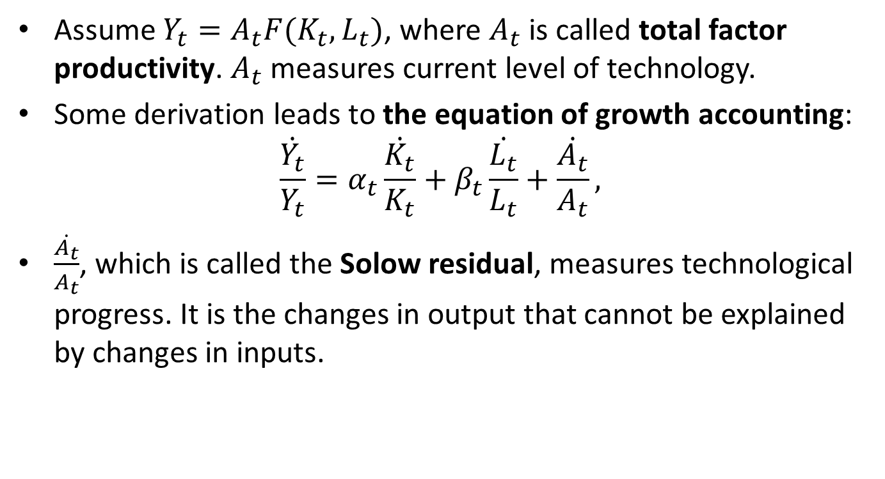
Technological Progress
Assume $Y_{t}=A_{t}F(K_{t},L_{t})$, where $A_{t}$ is called total factor productivity. $A_{t}$ measures current level of technology.
Some derivation leads to the equation of growth accounting:
$$\frac{\dot{Y_{t}}}{Y_{t}}=α_{t}\frac{\dot{K_{t}}}{K_{t}}+β_{t}\frac{\dot{L_{t}}}{L_{t}}+\frac{\dot{A_{t}}}{A_{t}},$$
$\frac{\dot{A_{t}}}{A_{t}}$, which is called the Solow residual, measures technological progress. It is the changes in output that cannot be explained by changes in inputs.
Notes:
Contrast total factor productivity to labor productivity Y/L

Slide 49
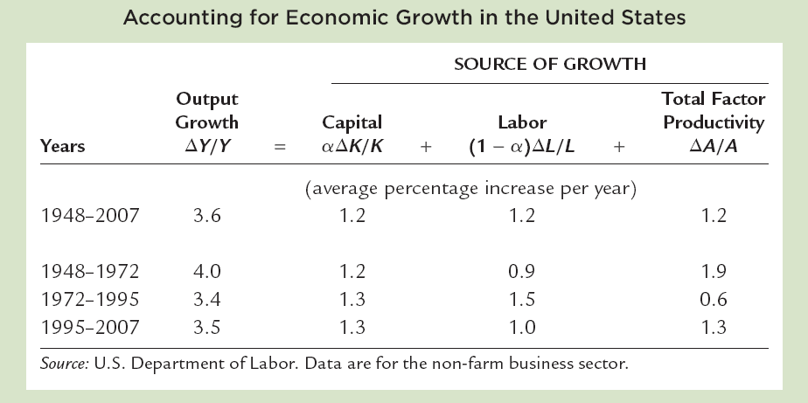
Case Study: Source of Growth in US

Slide 50
Content
Overview
Solow Model I (accumulation of capital and population growth )
Solow Model II (considering technological progress)
Endogenous growth models
Economic growth accounting
Other growth topics

Slide 51
Creative Destruction
In Capitalism, Socialism, and Democracy by Joseph Schumpeter (1883-1950), economic growth is achieved in a process of creative destruction.
Entrepreneurs come up with new products, new technology, new managerial and marketing ideas, and other innovations, which would drive uncreative incumbents out of the market.
These entrepreneurs would become the new incumbents. A new generation of entrepreneurs enter the market with new ideas…

Slide 52
Necessary Conditions for Creative Destruction
Entrepreneurs
Economic freedom
Inclusive society
Market economy
Let market pick “winners”
Ensure a level “playground”
Market should be big enough

Slide 53
Limits of Creative Destruction
Monopoly
Social gain is not guaranteed.
Gain is not evenly distributed.

Slide 54
To Rein In Creative Destruction
The government has responsibility to rein in creative destruction and avoid its excesses.
Anti-monopoly
Actively update and enforce laws to ensure a level playing ground
Welfare programs to help losers

Slide 55
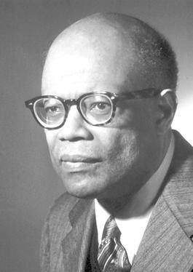
The Lewis Model
This is named after British economist Arthur Lewis (1915-1991), who was best known for his theory of economic development.

Slide 56
Lewis Assumptions
In the Lewis model, there are two sectors in an under-developed economy: capitalist and subsistence. The latter is endowed with an unlimited supply of labor.
MPL in the subsistence sector is around zero.
Employing only a small fraction of population, the industrial sector maintains a high MPL (real wage), as long as the real wage in the countryside is zero.
Although higher than in the subsistence sector, the industrial wage is low compared with the level in high-income countries.

Slide 57
Why not expand employment until the MPL reaches zero?
Labor is not available at a zero wage.
To attract labor from the countryside, the industrialists must offer higher wages
To offset Higher living costs in the city
To elevate social image of industrial workers
Industrialists are also willing to pay more than MPL.
“efficiency wage”
It’s normal for the rich, in ancient times, to pay high wages to their servants.

Slide 58
The Lewis Model
Real Wage
N
Q
P
O
M
R
Employment

Slide 59
Industrialization
The capitalist sector uses cheap labor from the subsistence sector, resulting in high return to capital.
They reinvest their profit and accumulate more capital, leading to higher demand for labor.
Hence more migration into the industrial sector, more profit for the industrialists to invest. The economic development thus goes into a virtual cycle.
As more and more people work in the industrial sector, the average labor productivity increases, hence “technological progress”.

Slide 60
Industrialization in the Lewis Model
Real Wage
N
Q
P
P’
Employment
O
M
M’
R
R’

Slide 61
Urbanization
As more and more people migrate to the city for industrial jobs, “urbanization” takes place.
Urbanization may progress faster than industrialization.
Slums, petty trade, “reserve army of labor”

Slide 62
Lewis Turning Point
As soon as the excess labor in the subsistence sector is fully absorbed in the capitalist sector, wages start to rise. This is called the Lewis Turning Point.
More balanced growth after LTP.
Investment growth declines
Consumption picks up as real wages rise
Less dependent on foreign demand

Slide 63
China’s Experience

Slide 64
Migration, Outsourcing, and International Trade
The Lewis model describes a non-steady state, where return to labor is not equalized (in capitalist and subsistence sectors).
To equalize the return to labor:
labor to capital (migration to industrialized countries or regions)
capital to labor (outsourcing, globalization of supply chain, industrialization of the third-world)
International trade is a substitute of factor mobility.
Notes:
Reading: International Trade and Factor Mobility, International Economics, Robert A. Mundell, New York: Macmillan, 1968, pp. 85-99.

Slide 65
Industrialization and De-industrialization
The Lewis model implies both urbanization and industrialization for one developing economy.
Internationally, industrialization have peaked in some advanced countries.
Manufacturing may be outsourced to developing countries
Service is an increasingly important sector.
Notes:
To equalize the return to labor: labor to capital (migration to industrialized countries or regions), capital to labor (industrialization)
The Lewis model can be thought of as generalizing the Solow model without technological progress. Before reaching the Lewis turning point, the economy is not in steady-state. And this period can be very long, in which both capital and industrial labor increases.
To maintain high return to labor in the capitalist sector, external market for industrial goods is required. Otherwise, stagnant wage could not support expanding consumption of industrial goods.
The Lewis model implies that before the turning point, real wage should stagnate and the labor’s share of national income should decline. No evidence, however, supports these.
The Lewis model also implies urbanization, which has empirical support.

Slide 66
Kuznets Curve
This is named after Jewish-American economist Simon Kuznets (1901-1985).
The Kuznets curve is a conjecture that as an economy grows, the market force first increases and then decreases inequality (e.g., Gini coefficient).
Inequality
Income per capita
Notes:
The Kuznets curve conjecture is related with the Lewis model. In the first stage, wages are kept low and wealth is concentrated in capitalists. After the Lewis turning point, wages start to rise and inequality may decline.

Slide 67
Environmental Kuznets Curve
The Environment Kuznets curve is a conjecture that as an economy grows, the natural environment first deteriorates, due to industrial pollution, and then get better, due to an increasing public awareness and state regulation.
Pollution
Income per capita

