Slide 1
Stabilization Policies
Junhui Qian

Slide 2
Content
Fiscal
Automatic fiscal stabilizers
Discretionary fiscal policy
Monetary policy
Financial stability

Slide 3
Automatic fiscal stabilizers
Tax stabilizers
Personal income tax, progressiveness
EIT, VAT, or BT
Spending stabilizers
Unemployment insurance
Other social security payments (e.g., benefits for retirees)
Notes:
EIT (enterprise income tax): 企业所得税
VAT (value-added tax): 增值税
BT (business tax): 营业税

Slide 4
The Attraction of Automatic Stabilizers
They work automatically, without any delay, and throughout the cycles.
In contrast, discretionary policies are often delayed responses.
The more stabilizers, the better.
The less “destabilizers”, the better.

Slide 5
Discretionary Fiscal Policy
A discretionary policy is based on the judgment of policymakers under a particular situation.
Direct government expenditure
Spending on infrastructure, public health, security, education, etc.
Timing is important
Tax cuts or incentives

Slide 6
Deficit and Debt
Budget deficit is a flow, and debt is a stock.
It is not necessary for a government to “make ends meet”.
Government budget deficit is net income to the private sector.
An increase in government debt is an increase in asset held by the private sector.
Fiscal policies should be judged by the effects on the economy, not by whether the budget is balanced.

Slide 7
Ricardian Equivalence
Since the government has to pay off the debt, the choice is “tax now or tax later”.
“Ricardian Equivalence” says that, under some stringent conditions, this choice does not matter.
Tax cuts would fail to stimulate demand.
Notes:
People often take myopic views of the tax burden.
For short-lived men, a tax cut financed by long-term bonds is definite gain.
For people with credit contraints, tax cut is a low-interest-rate “inclusive” loan.
The government does not have to pay off all its debt.

Slide 8
Perils of Debt
Interest costs may become a burden.
Domestic debt
Foreign debt
Risk of currency crisis

Slide 9
Content
Fiscal
Automatic fiscal stabilizers
Discretionary fiscal policy
Monetary policy
Financial stability

Slide 10
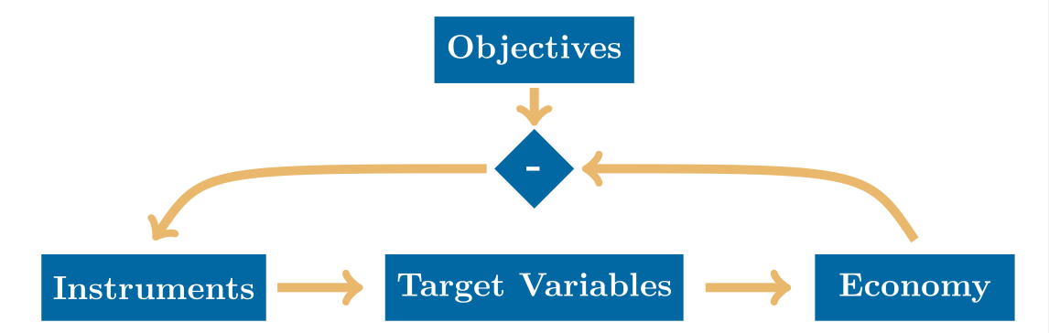
Monetary Instruments, Target Variable, and Objectives

Slide 11
Objectives
Price stability
Inflation-targeting
Full employment
Economic growth
Financial market stability
Exchange-rate stability.

Slide 12
Target Variables
Intermediate target variables refer to variables that are vitally important to the economy and that are manipulable by the monetary authority.
Money supply
Short-term money market interest rate (short rate)

Slide 13
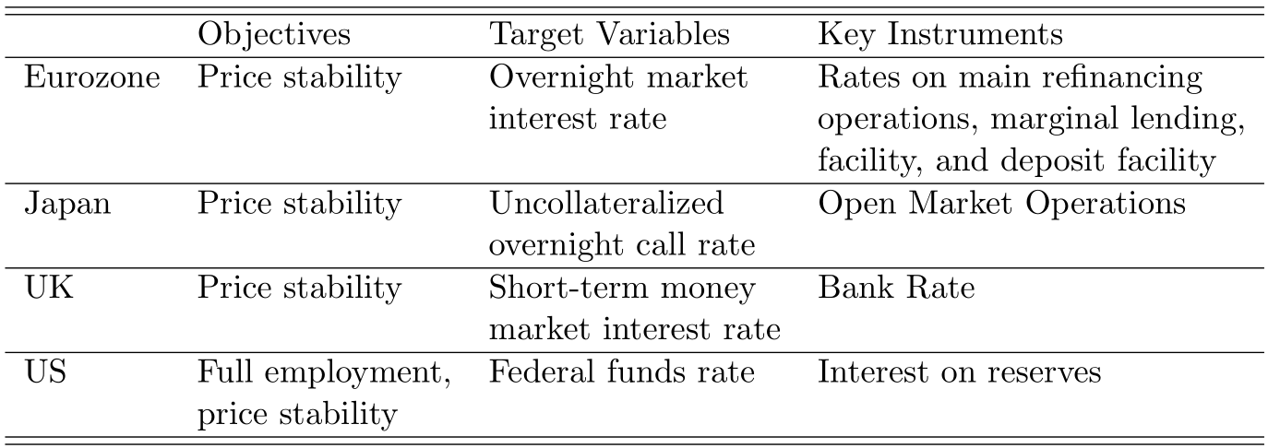
Objectives, Target Variables, and Instruments of Major Central Banks

Slide 14
Instruments
Open Market Operations (OMO)
Asset purchase/sale, repo/reverse repo
Reserve Requirement
Interest on Reserves (IOR)
Standing Lending Facilities (SLF)
Medium-term Lending Facility (MLF)
Forward Guidance
Window Guidance

Slide 15
Interest Rate Corridor
Interest rate corridor (or channel) is now a common operating framework for central banks to control the short rate.
The ceiling: the interest rate at which the central bank is ready to lend to banks.
The floor: the interest rate at which the central bank is ready to borrow from banks.

Slide 16
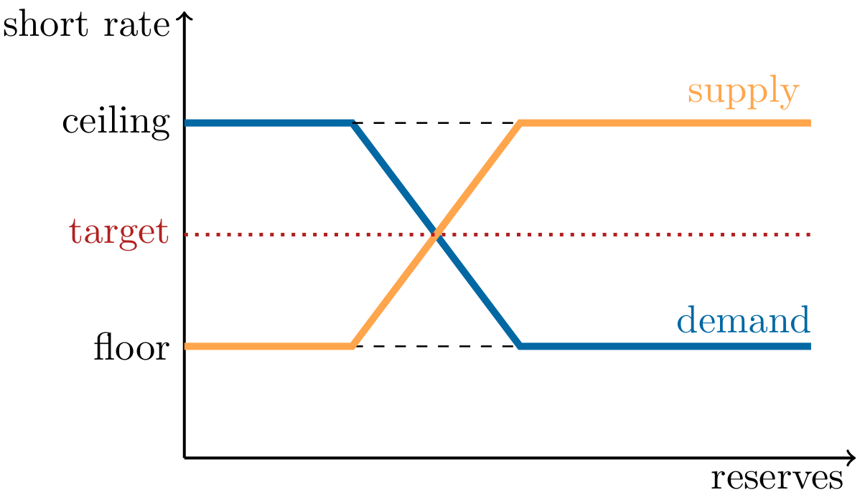
Interest Rate Corridor

Slide 17
Unconventional Monetary Policy
A key characteristic of the unconventional
central banking since 2008 is that the central bank ensures ample supply of reserves.
In the age of ample reserves, the corridor system reduces to the floor system.
OMO becomes less important, while the interest rate on reserves becomes the key instrument.

Slide 18
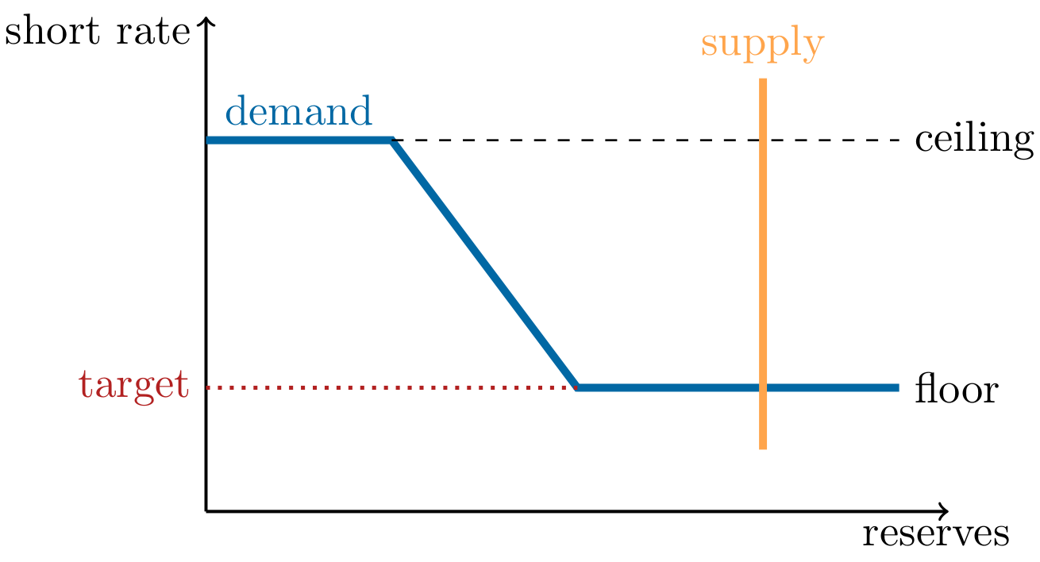
The Corridor System in the Age of Ample Reserves

Slide 19
Monetary Policy Rule
A monetary policy rule characterizes how a central bank responds, by manipulating the target variable, responds to changes in economic conditions.
An empirical relation between the target variable and economic objectives (e.g., inflation and unemployment).
If such a relationship is relatively stable, the rule may give some guidance for central bankers.

Slide 20
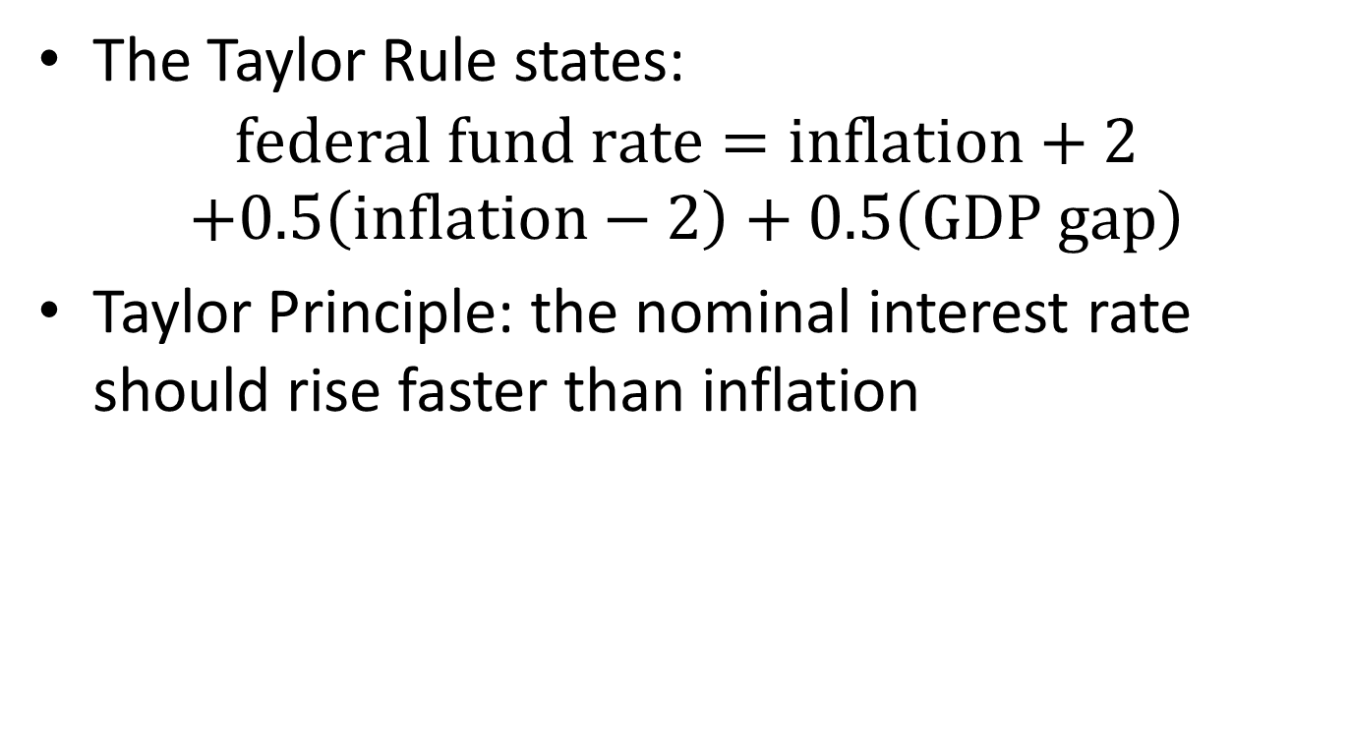
The Taylor rule
The Taylor Rule states:
$$federal fund rate=inflation+2$$
$$+0.5\left(inflation−2\right)+0.5\left(GDP gap\right)$$
Taylor Principle: the nominal interest rate should rise faster than inflation

Slide 21
Monetary Policy Transmission
Interest-rate channel
Exchange-rate channel
Credit channel
Risk-appetite channel
Asset-price channel
Wealth effect, borrowing constraints
Expectation channel

Slide 22
Content
Fiscal
Automatic fiscal stabilizers
Discretionary fiscal policy
Monetary policy
Financial stability
Lender of Last Resort
Macroprudential Policy

Slide 23
For the Sake of Financial Stability
When a financial crisis erupts, the government
often has to intervene and acts as the savior.
“lender of last resort”
And to prevent the next crisis, the government has to strengthen regulation and oversight.
“macroprudential policy”

Slide 24
Lender of Last Resort
Financial crises usually involve “runs” on financial institutions.
Commercial banks, investment banks, shadow banks
If the market suspects the viability of an institution, then no one would be willing to lend to the institution. Even if the institution is otherwise healthy, it will fail due to the lack of liquidity.
Only the central bank is able to intervene.
In 2008, the Fed intervened aggressively, saving a number of well-known investment banks and insurance companies from failure.

Slide 25
Moral Hazard
The possibility of central bank assistance, may encourage financial institutions to take excessive risks, paving the way for future crises.
Managers may go out of their ways to expand the balance sheet, hoping that their institutions to become “too big to fail”.
The central bank may threaten that it won’t save those institutions that have taken excessive risks.
Time-inconsistency problem

Slide 26
Content
Fiscal
Automatic fiscal stabilizers
Discretionary fiscal policy
Monetary policy
Financial stability
Lender of Last Resort
Macroprudential Policy

Slide 27
Macroprudential Policy
Macroprudential policies refer to rules and actions that promote the stability of the financial system as a whole.
In contrast, we may call supervisory or regulatory policies for individual financial institutions “microprudential policies”.

Slide 28
Macroprudential Policies
Rules on Leverage
Banks, consumers (home buyers)
Financial Market Entry
Externality of financial business
Limiting Speculations
Stock market
Housing market

Slide 29
End-of-Course Remarks
Models simplify. A good model is one that omits unnecessary details and focuses on the main question.
Time horizon matters. In the long run, prices adjust flexibly and the classical theory roughly holds; while in the short-run, price rigidity produces real effects of monetary and fiscal policies.
Macroeconomic conditions change, and there are no time-invariant answers, even for the same question.
Familiarity with data and history is the key to applying models and understanding our economy.

Slide 30
End-of-Course Remarks
Both the government and the market are important. The government plays important roles not only in stabilization policies, but also long-term development.
Monetary and fiscal policies matter, not only for textbook reasons (nominal rigidity), but also for other reasons such as balance sheet effect, wealth effect, change of expectation, and so on.
Investment alone does not bring prolonged economic growth. For an under-developed country, market-friendly reform, political stability, education, social trust and mobilization all contribute to growth.

Slide 31
谢谢大家，保持联系！

