Slide 1

IE415: CONTROL OF AUTONOMOUS SYSTEMS
TUNING PID CONTROLLERS USING TD3-RL FOR NONLINEAR SYSTEMS
Name: Jeet Patel
ID: 202201216
Prof. Sujay Kadam

Slide 2

MOTIVATION
FOR CHOOSING THIS TOPIC

Slide 3
INTRODUCTION
Brief overview of PID controllers and their significance in control systems.
Proportional: Responds to current error.
Integral: Addresses accumulated error over time.
Derivative: Predicts and compensates for future error changes.
Challenges in tuning PID for nonlinear systems.
Nonlinearity
Dynamic Changes
Manual Tuning
Motivation for using Reinforcement Learning (RL) and TD3 algorithm
Adaptability
Optimal Control
Automation

Slide 4

OBJECTIVE
Simulate and evaluate the performance of RL-tuned PID controllers.
Compare RL-based tuning with conventional PID tuning.
Apply the TD3 algorithm to train a PID controller for a mass-spring-damper system.

Slide 5
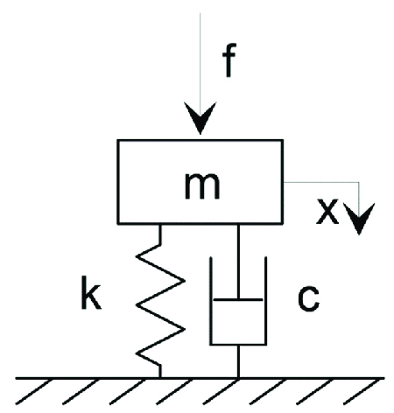
SYSTEM DESCRIPTION
Behavior:
Spring: Resists displacement proportionally (kx).
Damper: Opposes velocity (cx’) for stability.
Mass: Reacts to applied forces with acceleration (mx”).
mx” + cx’ + kx = F
Purpose:
Models real-world systems like car suspensions or robotic joints.
Used to analyze dynamic responses to various inputs (e.g., step, sinusoidal).
Control Objective:
Achieve stable performance with minimal overshoot and fast settling by controlling the force F.

Slide 6
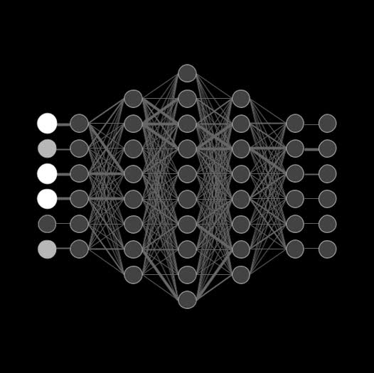
REINFORCEMENT LEARNING OVERVIEW

Slide 7
RL CONCEPTS
Agent:
The decision-maker that learns to optimize control by interacting with the environment.
Environment:
The system or process the agent interacts with (e.g., mass-spring-damper system).
Policy:
Probability of selecting a possible action given a state and reward.
State:
A representation of the system's current condition (e.g., position, velocity).
Action:
The control input applied by the agent to influence the environment (e.g., force).
Reward:
Feedback signal guiding the agent's learning, based on the desirability of its actions.

Slide 8
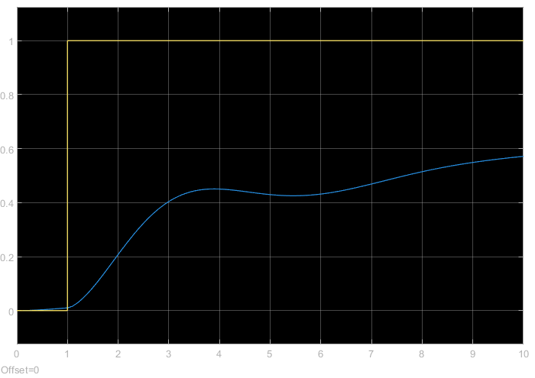
TD3 ALGORITHM
Twin Delayed Deep Deterministic Policy Gradient
DDPG shortcomings: i. Overestimation bias
ii. Numerical instability
Replay Buffer
To reduce Overestimation bias in: DDPG TD3 uses three techniques
Clipped double Q-learning
Target policy smoothing
Delayed policy and target updates

Slide 9
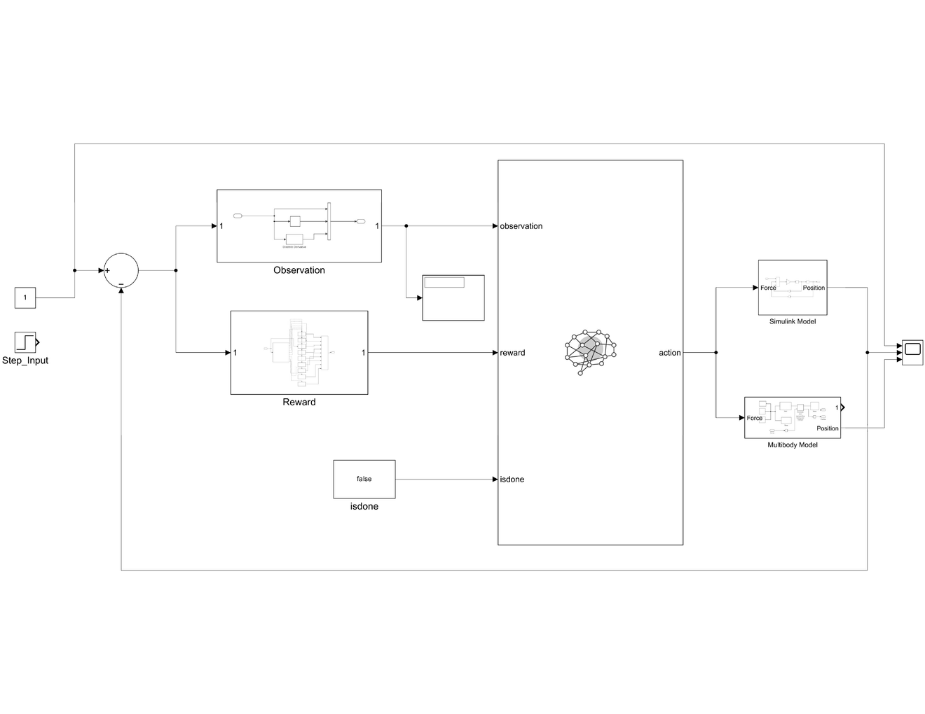
SIMULATION SETUP
Simulink model components:
Observation block: Outputs P, I, D.
Reward block: Implements the designed reward function.
RL Agent: Uses TD3 to adjust KP, KI, KD.
Training parameters:
Episodes: 500
Mini-batch size: 128
Discount factor: 0.97
Learning rates for actor and critic.

Slide 10
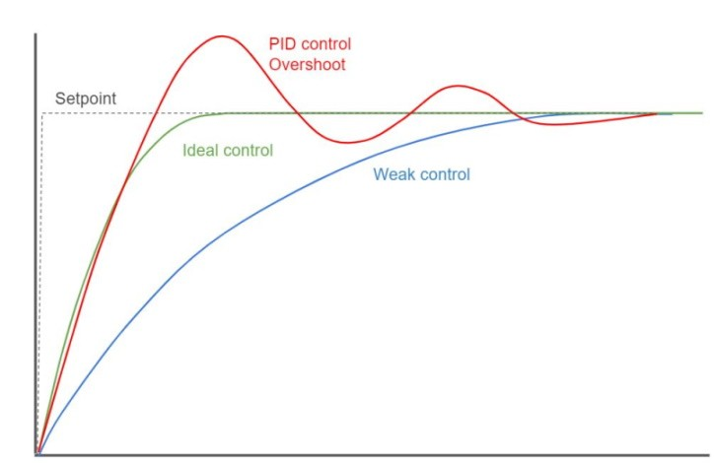
REWARD FUNCTION DESIGN
Reward components:
Penalty for overshooting: −2000.
Penalty for weak control: -100
Reward for staying within target: +3.
Penalty for undesirable ranges.
Specific rewards for fine-tuned output ranges.
Penalty for large deviations.

Slide 11
RESULTS
I: Conventional PID Tuning
II: RL-Tuned PID

Slide 12
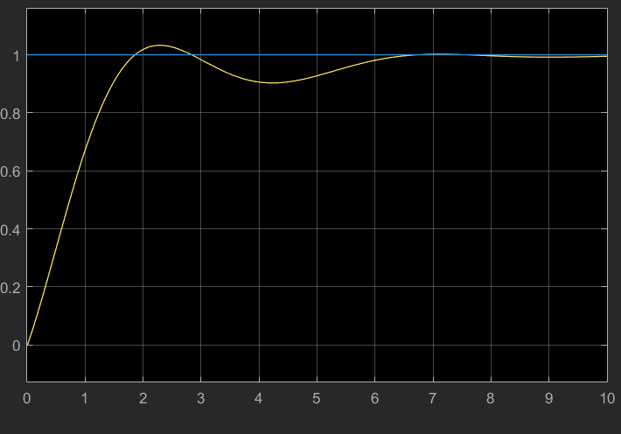
I: CONVENTIONAL PID TUNING

Slide 13
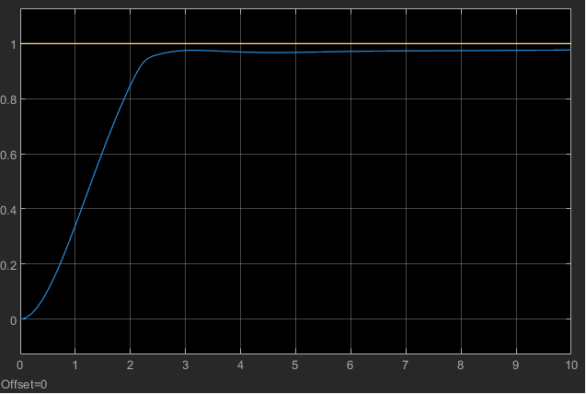
II: RL-TUNED PID
Trail: 18

Slide 14
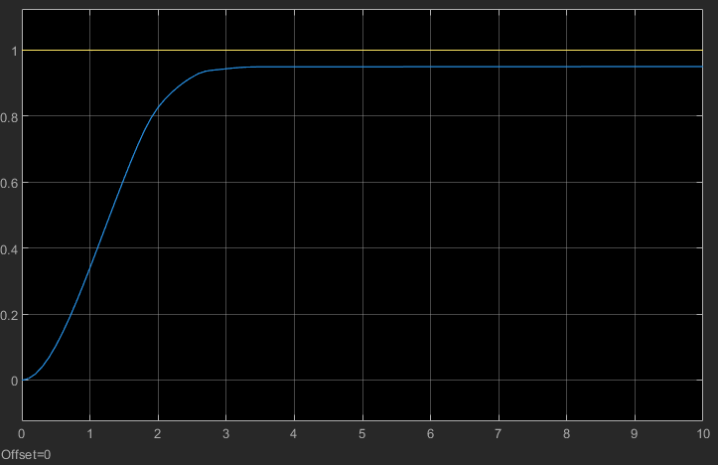
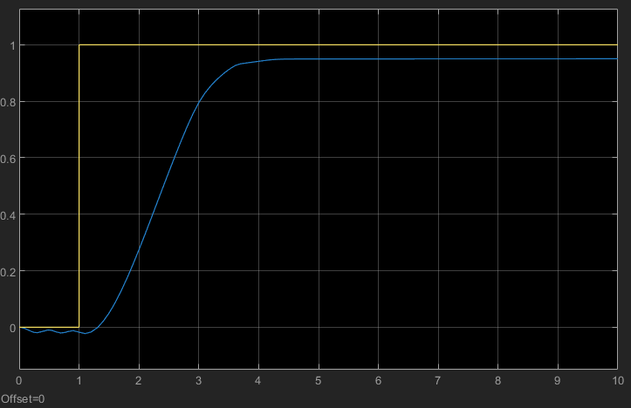
II: RL-TUNED PID
Trail: 23

Slide 15
COMPARISON
Comparison Points:
Overshoot
Settling time
Adaptability
TD3's Advantages in Dynamic Environments:
Reduced Overestimation Bias
Stable Policy Updates
Smooth Control

Slide 16
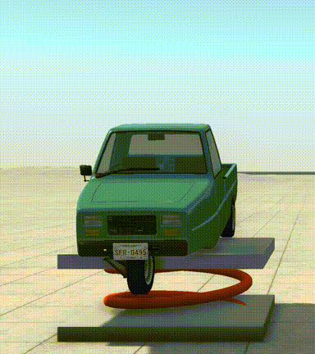
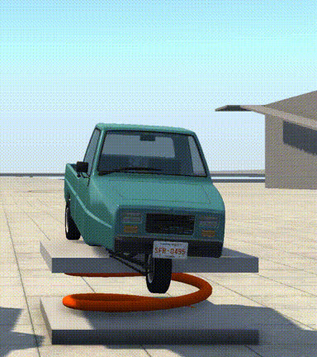
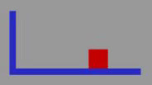
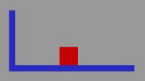
COMPARISON
Conventional PID Controller
RL-Tunned PID Controller
Example
Simscape
Model

Slide 17
CONCLUSION

Slide 18
REFERENCES
"Tuning of PID Controllers Using Reinforcement Learning for Nonlinear Systems Control” - Gheorghe Bujgoi and Dorin Sendrescu
Simscape Model From Matlab’s Community File Exchange - Link
MATLAB and Simulink documentation
Reinforcement Learning Onramp

Slide 19


