Slide 1

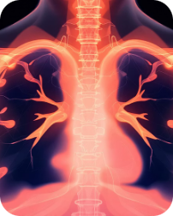
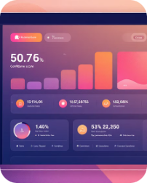

MVP Overview — What the System Does
Image Upload & Preview
AI Prediction Engine
Modular Architecture
Users can upload DICOM or PNG chest X‑rays. The UI performs client-side validation, shows a preview thumbnail, displays image metadata (study date, modality, patient ID obfuscated), and allows quick window/level adjustments for basic review before submission.
Backend model processes the image to predict pneumonia presence. Returns: class label(s), softmax probability/confidence, and a saliency heatmap (Grad‑CAM style) to support explainability and clinical review.
Frontend
Angular web application for upload, preview, and results review.
Backend
Python / FastAPI service for authentication, orchestration, and audit logging.
Results Visualization
Backend API Integration
Results page combines the original X‑ray, heatmap overlay toggle, numeric confidence, and an interpretive summary (e.g., "Findings consistent with pneumonia — confidence 87%"). Includes exportable PDF report and structured JSON for EHR ingestion.
RESTful FastAPI endpoints handle uploads, trigger model inference, serve results, and manage audit logs. Token-based auth (JWT), role-based access, and event logging enable secure clinical workflows and traceability.
ML Model
Inference service that returns prediction, confidence, and heatmap explainability.
The system flow moves from clinician upload in the frontend to FastAPI processing and ML inference, then returns structured results back to the UI for review and export.
Key nonfunctional priorities: clinical safety (audit trail, data anonymization), latency under acceptable clinical thresholds (target inference < 5s for optimized model), and robust error handling for corrupted or incomplete studies.

Slide 2
Summary, Next Steps & Team
Key Deliverable & Success Factors
Next Steps
MVP: Full system from X-ray upload to AI inference and results visualization.
Critical Success Factors: Clinical safety, robust model performance, and user trust in results.
Action: Approve controlled pilot, kickoff the week of next Monday.
Dependencies: Secure pilot approval, allocate necessary compute resources, and schedule clinical reviewer time.
Team Contributions
Team Member
Key Contributions
Ahmed Gamal Abdelfattah
Backend API Development, Frontend Implementation, UI Design
Habiba Ayman Amin
AI Model Development, Training Pipeline Optimization, Data Preprocessing
Momen Elsayed
AI Model Development, Training Pipeline Optimization, Data Preprocessing
Sara Mostafa Ali
Backend API Development, Frontend Implementation, UI Design

