Slide 1

Zewail City of Science and Technology
Chest X-ray Pneumonia Detection System
Graduation Project Defense - School of CSAI - June 2026
Submitted by
Moamen Elsayed Elsharkawy (202202015) Habiba Ayman Amin (202202088)
Ahmed Gamal Abdelfattah (202201638) Sara Mostafa Ali (202201305)
Supervisor: Prof. Dr. Khaled Mostafa | Team Number: 19

Slide 2
Problem Statement
• Pneumonia is a leading cause of illness and death worldwide; the chest X-ray is the first-line tool to detect it.
• Radiograph volume far exceeds the number of radiologists available to read them.
• Manual reading is slow, depends on scarce expertise, and is vulnerable to fatigue and missed cases.
• A missed pneumonia (false negative) is the most dangerous error.
• Need: a fast, accessible screening aid that flags and localizes pneumonia while keeping the doctor in control.
Chest X-ray Pneumonia Detection System | Team 19 | CSAI, Zewail City
2 / 15

Slide 3
Motivation and Objectives
Motivation
• Shorten time-to-diagnosis and reduce missed cases with an AI second reader.
• Take research-grade models all the way to a usable, secure clinical product.
Objectives
• Train and rigorously evaluate models for pneumonia detection and localization.
• Deliver a secure, multi-user web app with patient management and history.
• Provide visual explainability with every prediction.
• Keep the work reproducible, documented, and maintainable.
Chest X-ray Pneumonia Detection System | Team 19 | CSAI, Zewail City
3 / 15

Slide 4
Literature and Existing Solutions
• CNNs (CheXNet/DenseNet) reach near radiologist-level pneumonia classification on chest X-rays.
• Detection adds localization: two-stage Faster R-CNN (accurate) vs one-stage YOLO (fast).
• RSNA Pneumonia Detection Challenge is the standard benchmark (~26,684 labeled radiographs).
• Commercial tools (Lunit, Aidoc, qure.ai) exist but are closed and expensive; academic prototypes rarely ship.
Our gap: a transparent, explainable, end-to-end, self-hostable screening tool, evaluated honestly and leak-free.
Chest X-ray Pneumonia Detection System | Team 19 | CSAI, Zewail City
4 / 15

Slide 5
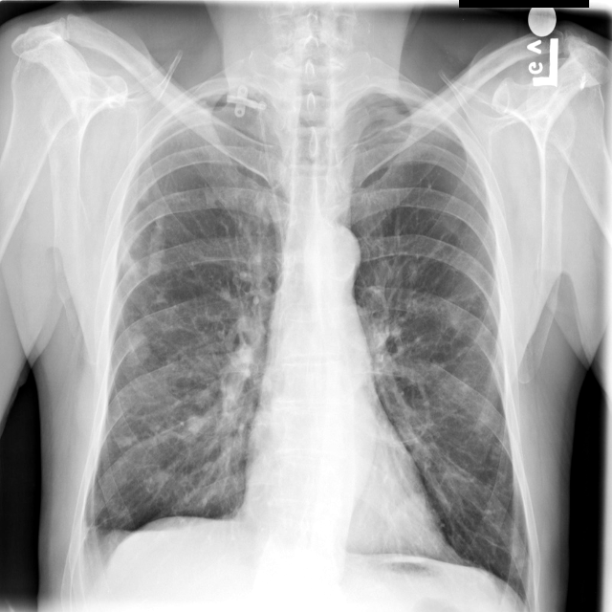
Proposed Solution
• A doctor-facing web app: sign in, manage patients, upload an X-ray, get a reading.
• Returns: pneumonia decision, bounding box, confidence, and an explainability heatmap.
• Five models behind one registry; Faster R-CNN is the deployed default.
• Every analysis is stored per patient for later review.
• The physician confirms every result (decision support, not autonomous).
Sample detector output
Chest X-ray Pneumonia Detection System | Team 19 | CSAI, Zewail City
5 / 15

Slide 6
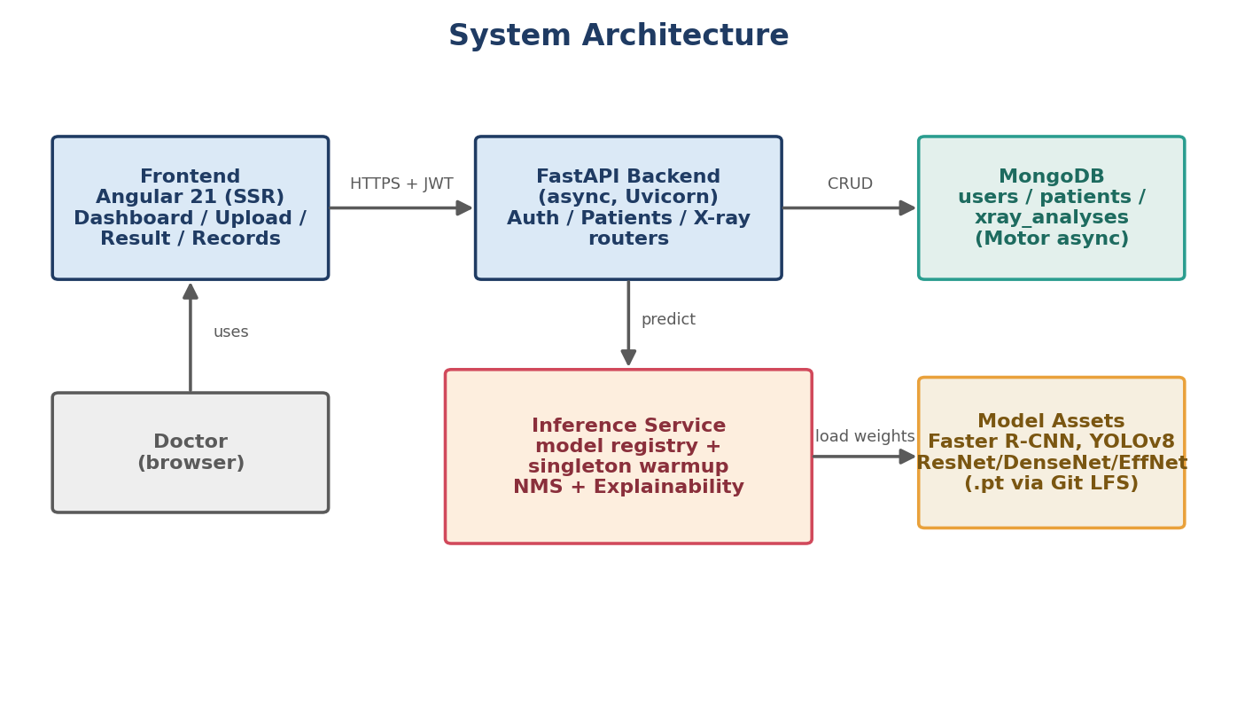
System Architecture
Chest X-ray Pneumonia Detection System | Team 19 | CSAI, Zewail City
6 / 15

Slide 7
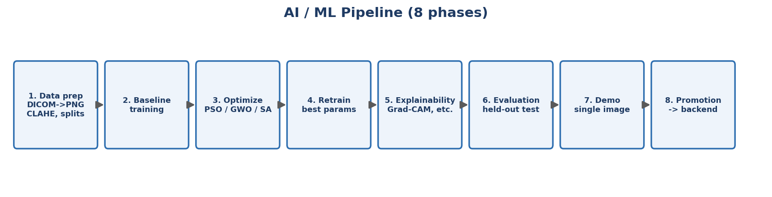
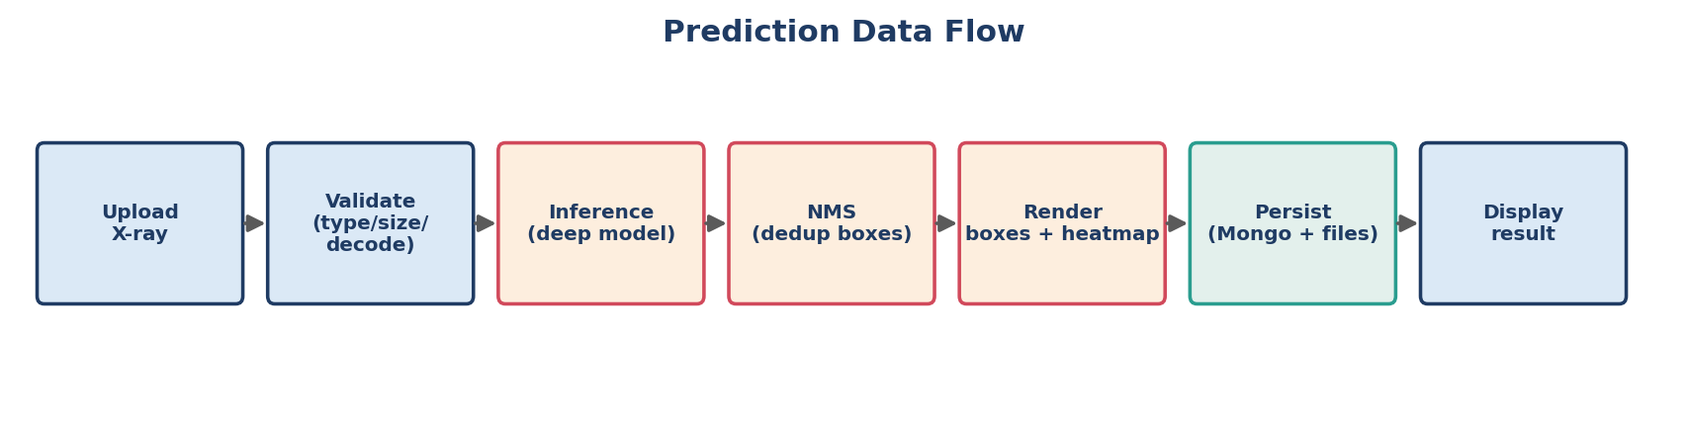
Methodology - AI Pipeline
Chest X-ray Pneumonia Detection System | Team 19 | CSAI, Zewail City
7 / 15

Slide 8
Main Features
• Secure doctor accounts (JWT + bcrypt), per-user data isolation.
• Patient record management and persistent analysis history.
• X-ray upload with drag-and-drop and live preview.
• Automated decision + bounding-box localization + confidence score.
• Explainability heatmaps (Grad-CAM and related) on every prediction.
• Multiple models behind one registry; auto-generated Swagger API docs.
Chest X-ray Pneumonia Detection System | Team 19 | CSAI, Zewail City
8 / 15

Slide 9
Technical Implementation
• Frontend: Angular 21 with server-side rendering, route guards, central state + API service.
• Backend: FastAPI (fully async), lifespan startup that connects Mongo and warms the model.
• Inference service: model registry + single-load warmup + NMS + six explainability methods.
• Database: MongoDB (Motor) with users / patients / xray_analyses and indexes.
• Security: JWT, bcrypt, CORS, strict input validation, production secret-key guard.
• Models served from disk via Git LFS; inference runs on CPU or GPU.
Chest X-ray Pneumonia Detection System | Team 19 | CSAI, Zewail City
9 / 15

Slide 10
Testing and Evaluation
• Backend unit + integration tests (pytest), including per-user access-control tests.
• Preflight asset checker and an end-to-end inference smoke test.
• Metrics: AUC, precision, recall (sensitivity), specificity, F1, confusion matrix; mAP for detection.
Experimental setup
RSNA dataset, DICOM->PNG, patient-wise split (20% held-out test: 4,135 normal / 1,202 pneumonia).
Kaggle GPU (P100/T4), mixed-precision training, augmentation, early stopping.
Chest X-ray Pneumonia Detection System | Team 19 | CSAI, Zewail City
10 / 15

Slide 11
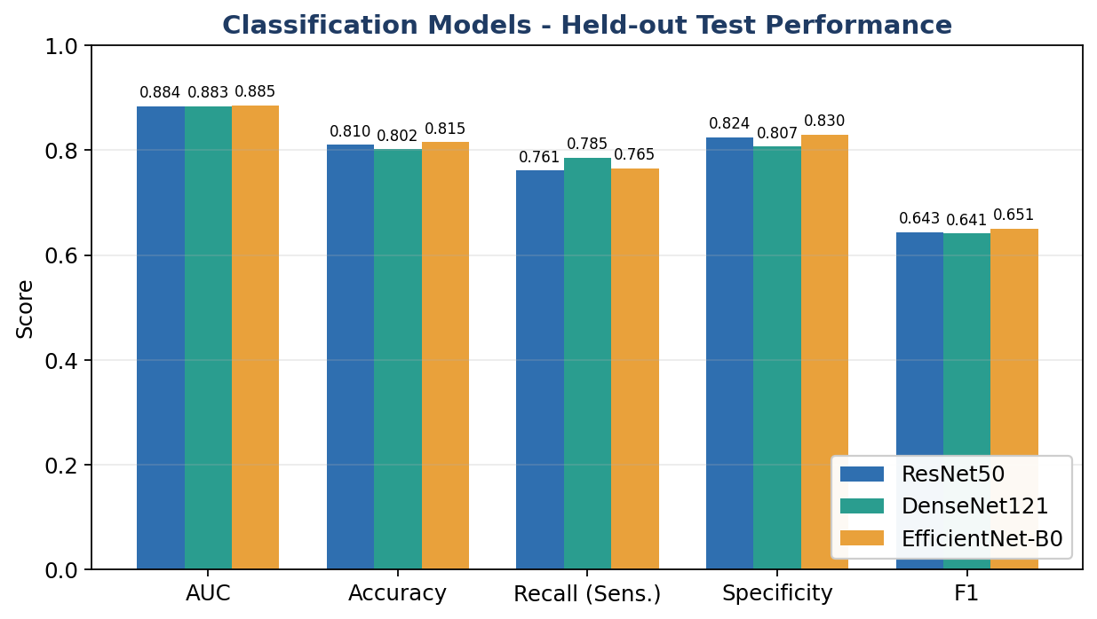
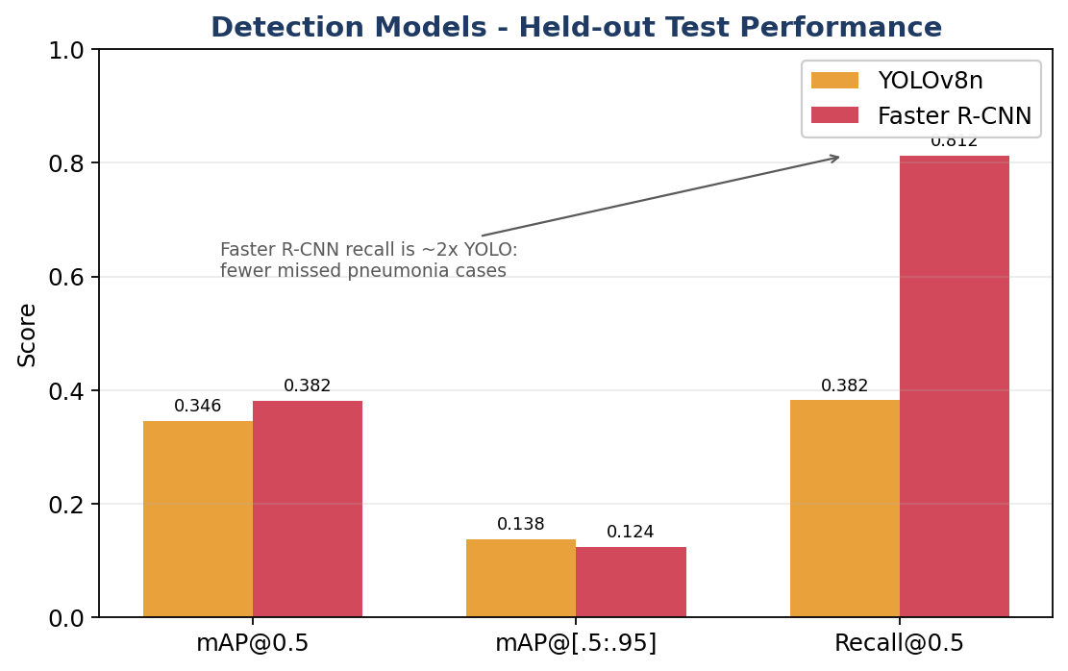
Results (held-out test set)
Best classifier EfficientNet-B0: AUC 0.886. Deployed detector Faster R-CNN: recall 0.812 (mAP@0.5 0.381).
Recall is prioritized because a missed pneumonia is the costly error. Numbers are honest and leak-free.
Chest X-ray Pneumonia Detection System | Team 19 | CSAI, Zewail City
11 / 15

Slide 12
Challenges and Lessons Learned
• Found and fixed a patient-level data leak that had inflated early scores (patient-wise splitting).
• Served several large models efficiently with a single-load registry and warmup.
• Made detector predictions explainable (Eigen-CAM, occlusion) where standard saliency does not apply.
• Lesson: lightweight PSO/GWO/SA proxy search did not beat a tuned baseline (a real, useful finding).
• Lesson: honest evaluation and the clinically meaningful metric matter more than a headline number.
Chest X-ray Pneumonia Detection System | Team 19 | CSAI, Zewail City
12 / 15

Slide 13
Conclusion
• Delivered a complete, working, explainable full-stack pneumonia screening system.
• Five models rigorously and honestly evaluated; AUC 0.886 (classification), recall 0.812 (deployed detector).
• Secure, multi-user, reproducible, and competitive with the published literature.
• Demonstrates the full path from research model to usable clinical product.
Chest X-ray Pneumonia Detection System | Team 19 | CSAI, Zewail City
13 / 15

Slide 14
Future Work
• Containerize with Docker Compose and add a CI/CD pipeline for one-command deployment.
• Add structured logging, metrics, monitoring, and model-drift detection in production.
• Out-of-distribution detection to reject non-chest or low-quality images.
• Extend to multi-finding detection; validate on additional, more diverse datasets.
• Pursue clinical validation and the regulatory path toward a certified tool.
Chest X-ray Pneumonia Detection System | Team 19 | CSAI, Zewail City
14 / 15

Slide 15
Thank You
Questions and Discussion
Chest X-ray Pneumonia Detection System - Team 19
School of CSAI, Zewail City of Science and Technology - June 2026

