Slide 1
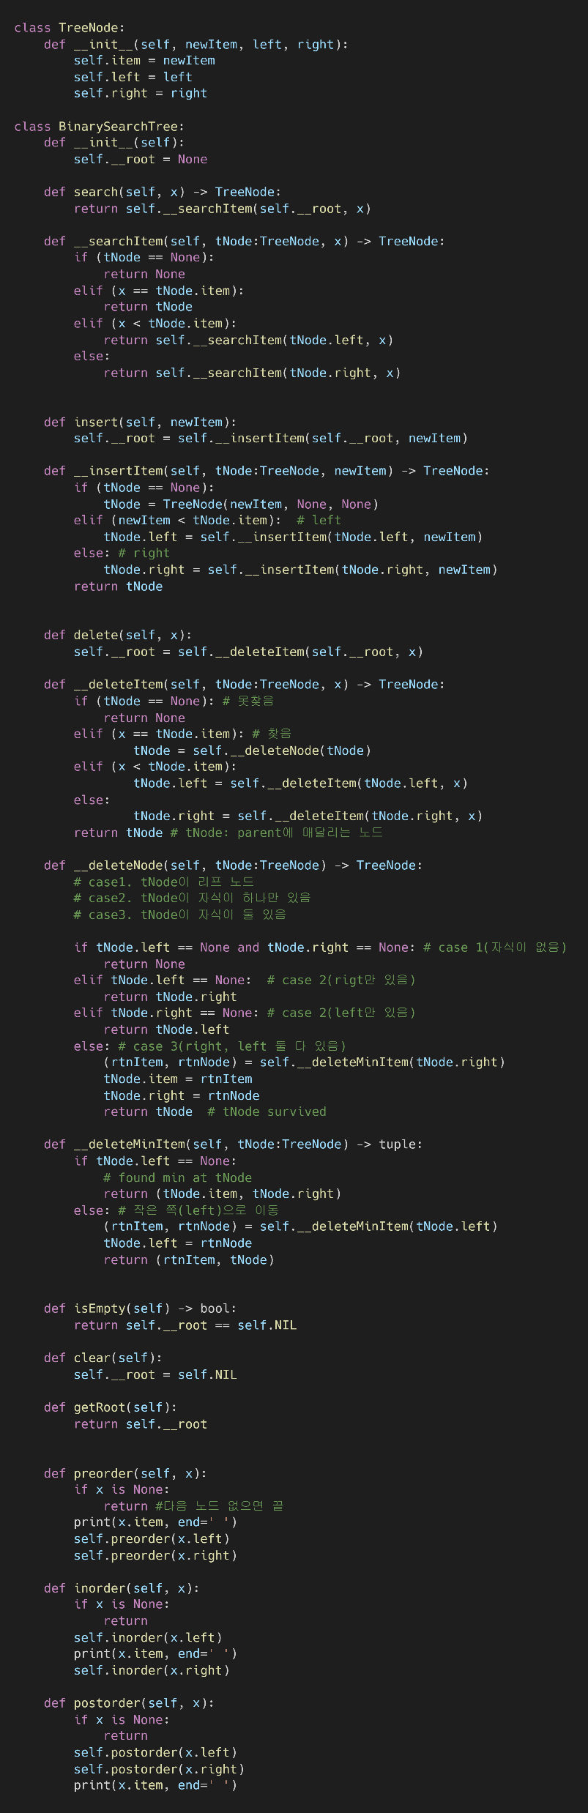
▼ binarySearchTree.py

Slide 2
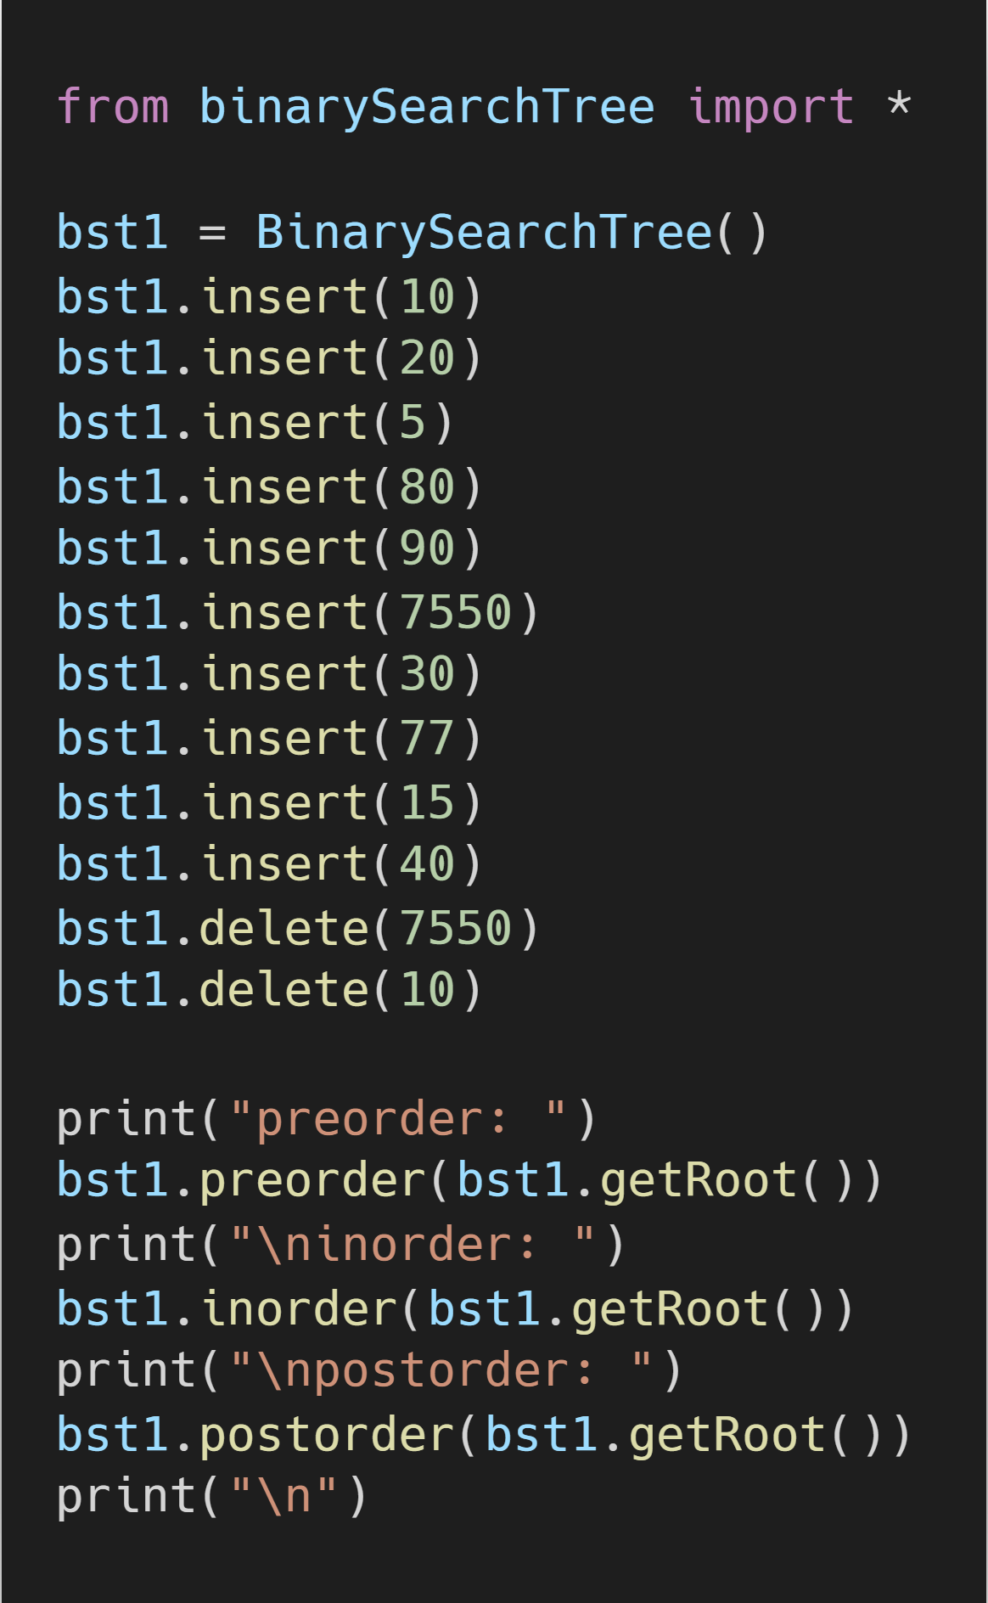
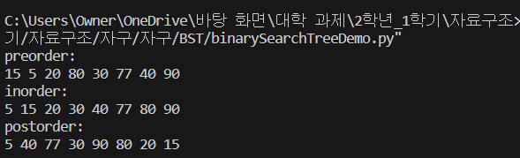
binarySearchTreeDemo.py ▶
▲ binarySearchTree.py
binarySearchTreeDemo.py 실행 결과 ▶

