Slide 1
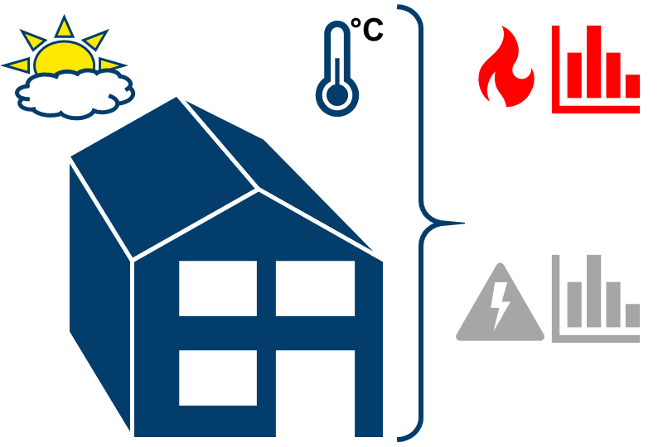



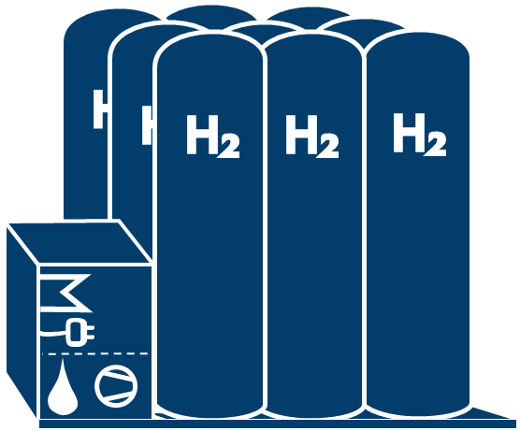
Heat
Battery storage
PV-System
Electricity
Load profiles
or
Residential building model
Seasonal hydrogen storage (incl. CHP)
Demand
Heat pump
Framework
Thermal
stratified storage
CHP-System
Gas grid
Electricity grid

