Slide 1
Database system Introduction
What is Database Systems?
Database system concepts
Database Applications
Purpose of Database Systems
Data Modeling
Data Models
Data abstraction
Database Design
Database Languages
DBMS System Structure
Storage manager
Query processing
Transaction manager
Database and Application Architectures
Database Users
History of Database Systems

Slide 2
Database System Concepts
Database System contains information about a particular organization
Collection of interrelated data
Set of programs to access the data
An environment that is both convenient and efficient to use
Database
Collection of interrelated data (about a particular Reason)
Highly valuable
Relatively large --need Well organized
Accessed by multiple users and applications, often at the same time.
Safety of the information stored, despite system crash or unauthorized access
DBMS is a software: Set of programs to access the data
Be able to manage databases.
Provides an environment that is both convenient and efficient to use.

Slide 3
Database Applications
Enterprise Information
Sales: customers, products, purchases
Accounting: payments, receipts, assets
Human Resources: Information about employees, salaries, payroll taxes.
Manufacturing: management of production, inventory, orders, supply chain.
Banking and finance
customer information, accounts, loans, and banking transactions.
Credit card transactions
Finance: sales and purchases of financial instruments (e.g., stocks and bonds; storing real-time market data
Universities: Teacher, student, registration, grades
Airlines: reservations, schedules
Telecommunication: records of calls, texts, and data usage, generating monthly bills, maintaining balances on prepaid calling cards

Slide 4
Database Applications
Web-based services
Online retailers: order tracking, customized recommendations
Online advertisements
Document databases
Navigation systems: For maintaining the locations of varies places of interest along with the exact routes of roads, train systems, buses, etc.
Social medias likes WeChat: Contacts, messages, group chats, hongbao, payments,
Use of database grew fast in four decades
A: Since the early days, very few people interacted directly with database system, custom did not know the backend database, they got printed report, etc.
B: Later, Some customs access system via phone interface.
C: Starting from late 90s, Direct user access via Internet.
A and C are most common used nowadays

Slide 5
Purpose of Database Systems
In the early days, database applications were built on top of file systems
Thanking about the computing architecture in early days?
Drawbacks of using file systems to store data:
Data redundancy and inconsistency
Multiple file formats, duplication of information in different files
Difficulty in accessing data
Need to write a new program to carry out each new task
Data isolation — multiple files and formats
Integrity problems
Integrity constraints (e.g. account balance > 0) been hard coded in the program.
Hard to add new constraints or change existing ones

Slide 6
Purpose of Database Systems (Cont.)
Drawbacks of using file systems (cont.)
Atomicity of updates
Failures may leave database in an inconsistent state with partial updates carried out
E.g. transfer of funds from one account to another should either complete or not happen at all
Concurrent access by multiple users
Concurrent accessed needed for performance
Uncontrolled concurrent accesses can lead to inconsistencies
E.g. Two people reading a balance (say 100) and updating it by withdrawing money (say 50 each) at the same time
Security problems
Data access authorization
Data recovery while some incidents occurs.
e.g. server crash, disk failure, fire disaster, earthquake, etc.
Database systems offer solutions to all the above problems

Slide 7
University Database Example
We will be using a university database to illustrate all the concepts
Data consists of information about:
Students
Instructors
Classes
Application program examples:
Add new students, instructors, and courses
Register students for courses, and generate class rosters
Assign grades to students, compute grade point averages (GPA) and generate transcripts
Notes:
7

Slide 8
View of Data
A database system is a collection of interrelated data and a set of programs that allow users to access and modify these data.
A major purpose of a database system is to provide users with an abstract view of the data.
Data models
A collection of conceptual tools for describing data, data relationships, data semantics, and consistency constraints.
Data abstraction
Hide the complexity of data structures to represent data in the database from users through several levels of data abstraction.
Notes:
8

Slide 9
Data Models
A collection of conceptual tools for describing
data
data relationships
data semantics
data constraints
Entity-Relationship model
Relational model
Object-based data models (Object-oriented and Object-relational)
Semi-structured data model (XML)
Other older models:
Network model
Hierarchical model
Tired closely to the physical level
Higher performance
Much difficult to program.

Slide 10
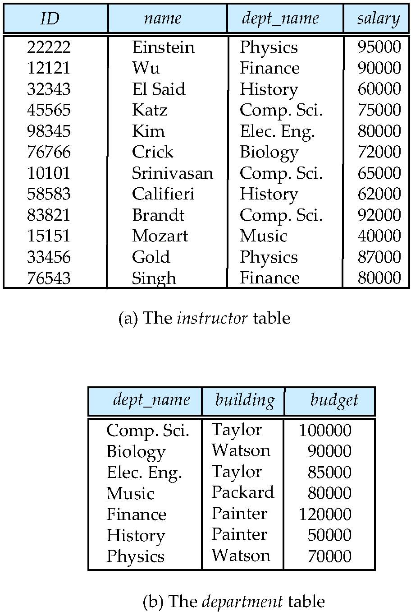

Relational Model
Models a database as a collection of tables.
All the data is stored in various tables.
Each table represent either an “object” or “relationship” among the “object”s
Example of tabular data in the relational model
Columns
Rows
Ted Codd Turing Award 1981
Notes:
10

Slide 11
A Sample Relational Database
Notes:
11

Slide 12
Object-Based Data Models*
Relational model: flat, atomic value, no complex type, etc.
Object Oriented Data Model
Seamlessly integrate with programing languages, C++/Java/C
Weak support in declarative access to data
High performance
Object-Relational Data Model
Extend the relational data model by including object orientation and constructs to deal with added data types.
Allow attributes of tuples to have complex types, including non-atomic values such as nested relations.
Preserve relational foundations, in particular the declarative access to data, while extending modeling power.
Provide upward compatibility with existing relational languages.

Slide 13
XML: Extensible Markup Language*
Defined by the WWW Consortium (W3C)
Originally intended as a document markup language not a database language
The ability to specify new tags, and to create nested tag structures made XML a great way to exchange data, not just documents
XML has become the basis for all new generation data interchange formats.
A wide variety of tools is available for parsing, browsing and querying XML documents/data

Slide 14
Data Abstraction
Why and What is Data Abstraction?
A database system is a collection of data, and a set of program to allow users to access the data;
A major purpose of a database system is to provide users with an abstract view of the data
Easily understood by human;
Easily accessed by application program;
Hidden certain detail of how data been stored and maintained.
Levels of Abstraction
Instances and Schemas

Slide 15
Levels of Abstraction
Physical level: Describes HOW the data are stored.
Logical level: Describes WHAT data are stored in database, and the relationships exists among the data. And don’t care about how the data been stored.
type instructor = record
ID : string; name : string; dept_name : string; salary : integer;
end;
View level: Describes WHAT data could be accessed by application programs. View can hide details of data types, and hide information (e.g., salary) for security and privacy purposes.

Slide 16
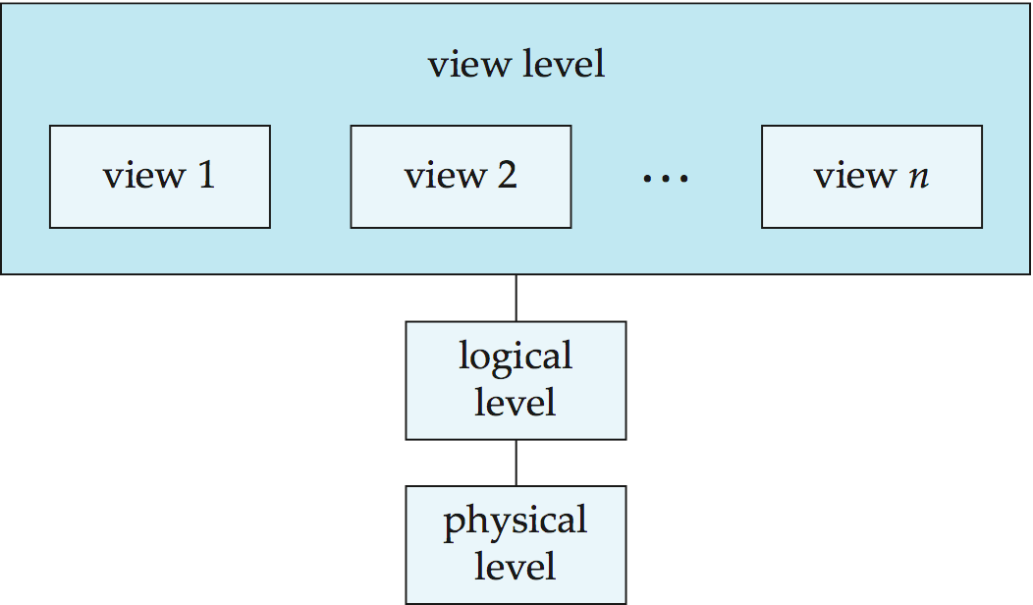
Levels of Abstraction
Program 1
Program 2
Program n

Slide 17
Instances and Schemas
Similar to types and variables in programming languages
Schema – the logical structure of the database
e.g., the database consists of information about a set of customers and accounts and the relationship between them)
Analogous to type information of a variable in a program
Instance – the actual content of the database at a particular point in time
Analogous to the value of a variable
However, the concept of database Instance is rare used.
Database Schemas
Physical schema: database design at the physical level
Logical schema: database design at the logical level
External schema(subschema): database design at the view level.

Slide 18
Data Independency
Physical Data Independence – the ability to modify the physical schema without changing the logical schema
Applications depend on the logical schema, not necessary to care about how the data been stored.
DBMS would take the most work at the physical level.
Logical Data Independence – the ability to modify the logical schema without changing the external schema
Applications depend on the external schema, avoid rewriting the program while the logical schema been modified in future.
In many cases, some of the application even don’t know the change of the database logical schema.

Slide 19
Database Design
Database design mainly involves the design of the database schema :
Logical Design – Deciding on the database logical schema. Database design requires that we find a “good” collection of relation schemas.
Business decision – What attributes should we record in the database?
Computer Science decision – What relation schemas should we have and how should the attributes be distributed among the various relation schemas?
Physical Design – Deciding on the physical layout of the database
Indexing
Partition
Notes:
19

Slide 20
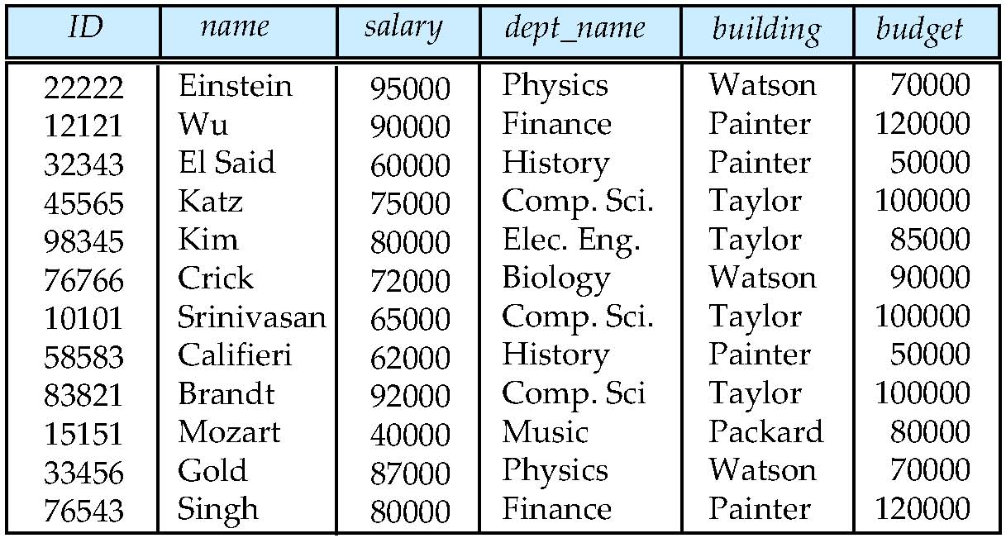
Database Design (Cont.)
Is there any problem with this relation?
If we want to change the budget of Physics department?
If Mr. Crick resigned from the university?
If a new department “Math” been created?
What’s the exact meaning of the “building”?
Notes:
20

Slide 21
Design Approaches
Need to come up with a methodology to ensure that each of the relations in the database is “good”
Two ways of doing so:
Entity Relationship Model (Chapter 6)
Models an enterprise as a collection of entities and relationships
Represented diagrammatically by an entity-relationship diagram:
Normalization Theory (Chapter 7)
Formalize what designs are bad, and test for them
Notes:
21

Slide 22
Database Languages
Data Definition Language
Data Manipulation Language
Database Access from Application Programs

Slide 23
Data Definition Language (DDL)
Specification notation for defining the database schema
Example: create table instructor ( ID char(5), name varchar(20), dept_name varchar(20), salary numeric(8,2))
DDL compiler generates a set of tables stored in a data dictionary
Data dictionary contains metadata (i.e., data about data)
Database schema
Data storage and definition language
Specifies the storage structure and access methods used
Integrity constraints
Primary key (ID uniquely identifies instructors)
Referential integrity (references constraint in SQL)
Assertions
Authorization
Who can access what

Slide 24
Data Manipulation Language (DML)
Data Manipulation is:
The retrieval of information stored in the database;
The insertion/deletion of information into/from the database;
The modification of information stored in the database.
Language for accessing and manipulating the data organized by the appropriate data model
DML also known as query language
Two classes of languages
Procedural – user specifies what data is required and how to get those data
Nonprocedural – user specifies what data is required without specifying how to get those data

Slide 25
SQL Query Language
SQL: Structured Query Language
Most widely used database non-procedural language
Example: Find the instructor ID and department name of all instructors associated with a department with budget of greater than $95000.
select instructor.ID, department.dept_name from Instructor, department where instructor.depart_name=department.dept_name and
department.budget > 95000

Slide 26
Database Access from Application Programs
SQL is NOT a Turing machine equivalent language
To be able to compute complex functions SQL is usually embedded in some higher-level language
The Database application programs are Usually written in:
Database Language
A Host language , such Java, C/C++/C#, VB, Cobol, Delphi…
The ways to combine Database and Host languages:
By providing an program interface, such as: ODBC/JDBC
By extending the host language to embed DML.

Slide 27
Database Engine
A DBMS is partitioned into modules that deal with each of the responsibilities of the overall system.
The functional components of a DBMS can be divided into
The storage manager,
The query processor component,
The transaction management component.
Notes:
27

Slide 28
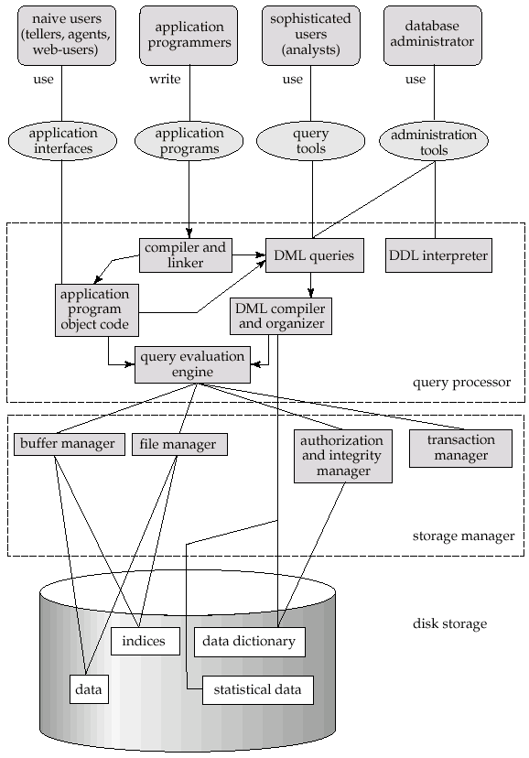
Overall DBMS System Structure
Transaction
Manager

Slide 29
Storage Management
Storage manager is a program module that provides the interface between the low-level data stored in the database and the application programs and queries submitted to the system.
The storage manager is responsible to the following tasks:
efficient storing, retrieving and updating of data
File manager: interaction with the OS file system
Buffer manager
Data dictionary
Issues:
Authorization and integrity
File organization and storage access
Indexing and hashing

Slide 30
Query Processor
The query processor components include:
DDL interpreter -- interprets DDL statements and records the definitions in the data dictionary.
DML compiler -- translates DML statements in a query language into an evaluation plan consisting of low-level instructions that the query evaluation engine understands.
The DML compiler performs query optimization; that is, it picks the lowest cost evaluation plan from among the various alternatives.
Query evaluation engine -- executes low-level instructions generated by the DML compiler.
Notes:
30

Slide 31
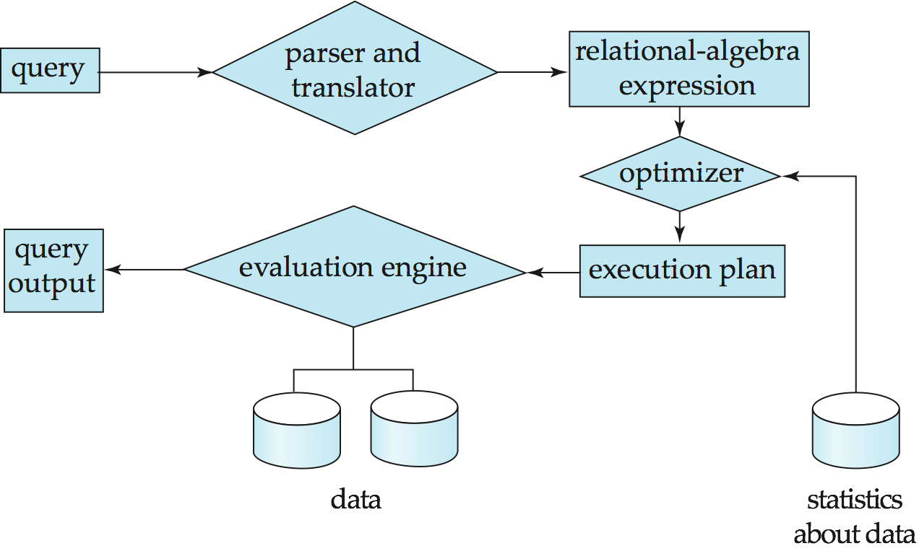
Query Processing
1. Parsing and translation
2. Optimization
3. Evaluation
Notes:
31

Slide 32
Query Optimization
Alternative ways of evaluating a given query
Equivalent expressions
Different algorithms for each operation
Cost difference between a good and a bad way of evaluating a query can be enormous
Need to estimate the cost of operations
Depends critically on statistical information about relations which the database must maintain
Need to estimate statistics for intermediate results to compute cost of complex expressions

Slide 33
Transaction Management
What if
The system fails?
More than one user is concurrently updating the database
A transaction is a collection of operations that performs a single logical function in a database application
Atomicity: All the operations must happen in entirety or not at all
Consistency: preserve the consistency of the database
Isolation: Does not affect the execution of other transaction
Durability: After the successful execution, all the modification to database must be persist.
Transaction-management component ensures that the database remains in a consistent (correct) state despite system failures (e.g., power failures and operating system crashes) and transaction failures.
Concurrency-control manager controls the interaction among the concurrent transactions, to ensure the consistency of the database.

Slide 34
Database Architecture
Centralized databases
One to a few cores, shared memory
Parallel databases
Many core shared memory
Shared disk
Shared nothing
Distributed databases
Geographical distribution
Schema/data heterogeneity
Notes:
34

Slide 35
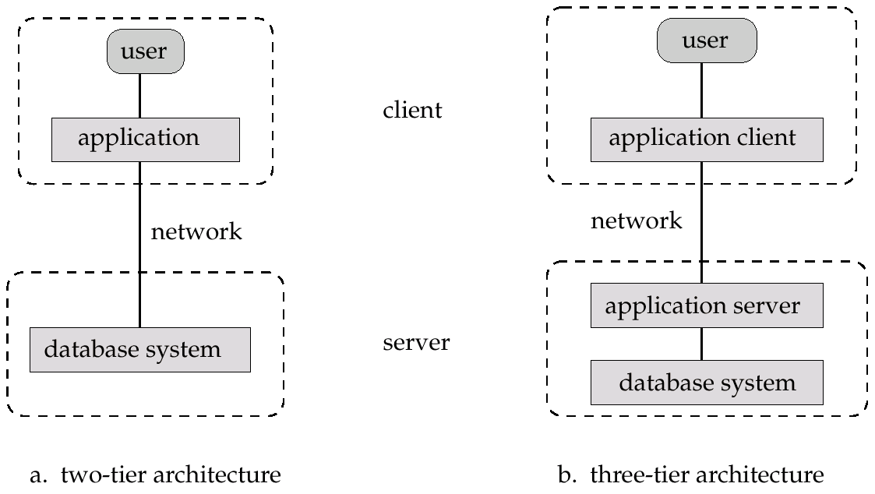
Application Architectures
Two-tier architecture: E.g. client programs using ODBC/JDBC to communicate with a database
Three-tier architecture: E.g. web-based applications, and applications built using “middleware”

Slide 36
Database Users
Users are differentiated by the way they expect to interact with
the system
Naïve users – invoke one of the permanent application programs that have been written previously
Examples, people accessing database over the web, bank tellers, students
Application programmers – computer professionals who write application programs to interact with database system
Sophisticated users – interact with database system without writing programs, using tools or query language to access system.
Specialized users – write specialized database applications that do not fit into the traditional data processing framework. For example, CAD system, Expert system, etc.
Database Administrator – a powerful user has the central control over the database system.

Slide 37
Database Administrator
Have central control to the database system.
The database administrator has a good understanding of the enterprise’s information resources and needs.
Database administrator's duties include:
Schema definition
Specifying integrity constraints
Storage structure and access method definition
Schema and physical organization modification
Granting of authorization for data access
Routine maintenance
Periodically backing up the data base
Ensuring enough free disk space
Monitoring performance and responding to changes in requirements

Slide 38
History of Database Systems
1950s and early 1960s:
Data processing using magnetic tapes for storage
Tapes provide only sequential access
Punched cards for input
Late 1960s and 1970s:
Hard disks allow direct access to data
Network and hierarchical data models in widespread use
Ted Codd defines the relational data model
Codd win the ACM Turing Award for this work
IBM Research begins System R prototype
UC Berkeley begins Ingres prototype
High-performance (for the era) transaction processing

Slide 39
History (cont.)
1980s:
Research relational prototypes evolve into commercial systems
SQL becomes industrial standard
Initial Object-oriented database systems
1990s:
Parallel and distributed database systems
Large decision support and data-mining over large data warehouses
Emergence of Web commerce
Very high performance, reliability and availability

Slide 40
History (cont.)
2000s:
Semi-structured data became increasingly important, XML for data exchange among different applications.
Open-source database systems (PostgreSQL and MySQL) widely used.
Big data storage systems
“NoSQL” systems.
Big data analysis: beyond SQL
Map reduce and friends
2010s
SQL reloaded
SQL front end to Map Reduce systems
Massively parallel database systems
Multi-core main-memory databases
Cloud native systems

Slide 41
End of Chapter 1
Notes:
41

