Slide 1
Relational Model
Structure of Relational Databases
Relational Algebra
Fundamental Relational Algebra Operations
Additional Relational Algebra Operations
Extended Relational Algebra Operations

Slide 2
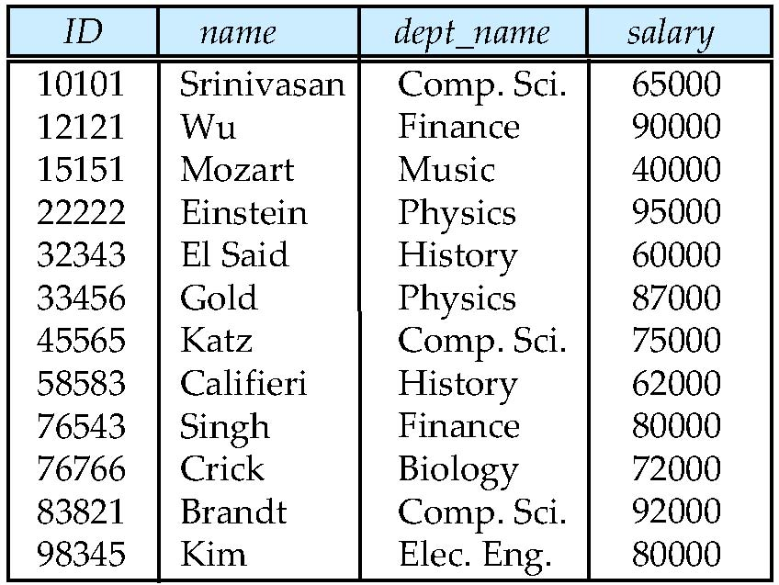
A Relation: A Table
attributes
(or columns)
tuples
(or rows)
The Instructor Relation

Slide 3
Relational Database
Database is a collection of data
A relational database consists of a collection of tables.
Each table is assigned a unique name.
A row in a table represents a relationship among a set of values.
A table is a collection of such relationship.
Relational data model is the primary data model for commercial data-processing applications.
Because of its simplicity
Easy use for programmer
Hard job for DBMS software.
What is Data Model:
To describe: Data, Data relalationship, Data Semantices, Data Constraints

Slide 4
Basic Structure
Formally, given sets D₁, D₂, …. D_{n} , A relation r is a subset of D₁ x D₂ x … x D_{n} Thus a relation is a set of n-tuples (a₁, a₂, …, a_{n}) where a_{i} ∈ D_{i}
Example: if
Dept-name = { Biology, Comp.Sci, Finance, History } Building = {Watson, Taylor, Painter} Budget = {90000, 120000, 50000} Then r = { (Biology, Watson, 90000), (Comp.Sci, Taylor, 120000), (Finance, Painter, 120000), (History, Painter, 50000)
}
is a relation over Dept-name x Building x Budget

Slide 5
Attribute Types
A_{i} : Each attribute of a relation has a name
D_{i} : The set of allowed values for each attribute is called the domain of the attribute
Attribute values in a relation are (normally) required to be atomic , that is, indivisible
Can NOT assuming part of a value has specific meaning, E.g. the student ID only represents the unique id of a student, but not other information, major/year of registration, etc.
E.g. Phone number(s) of a instructor
The special value null is a member of every domain
The null value causes complications in the definition of many operations

Slide 6
Relation Schema and Instance
R = (A₁, A₂, …, A_{n} ) is a relation schema, while
A₁, A₂, …, A_{n} are attributes
Example: Instructor-Schema = (ID, name, dept_name, salary)
r(R) is a relation on the relation schema R
E.g. instructor (Instructor-Schema)
The values of a relation may be different time to time
The current values (relation instance) of a relation are specified by a table
An element t of r is a tuple, represented by a row in a table
People often use the same name for the schema and relation.

Slide 7
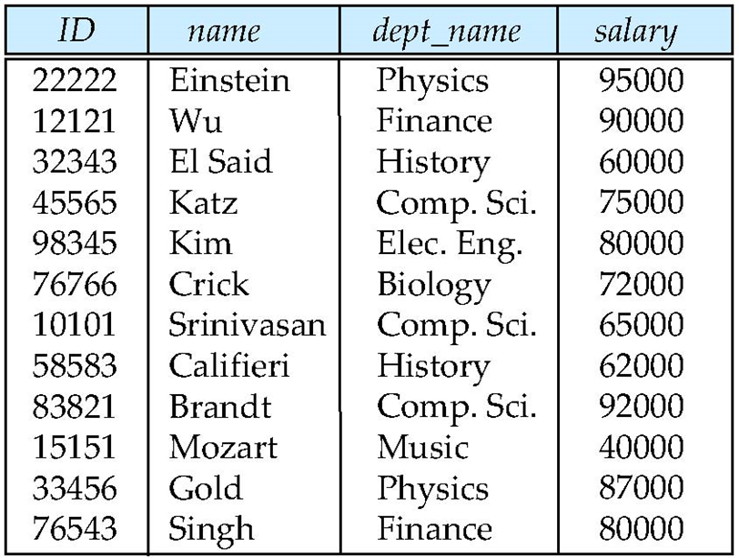
Relations are Unordered
Order of tuples (row) is irrelevant (may be stored in an arbitrary order)
E.g. account relation with unordered tuples
Logically, Order of attributes (column) is irrelevant

Slide 8
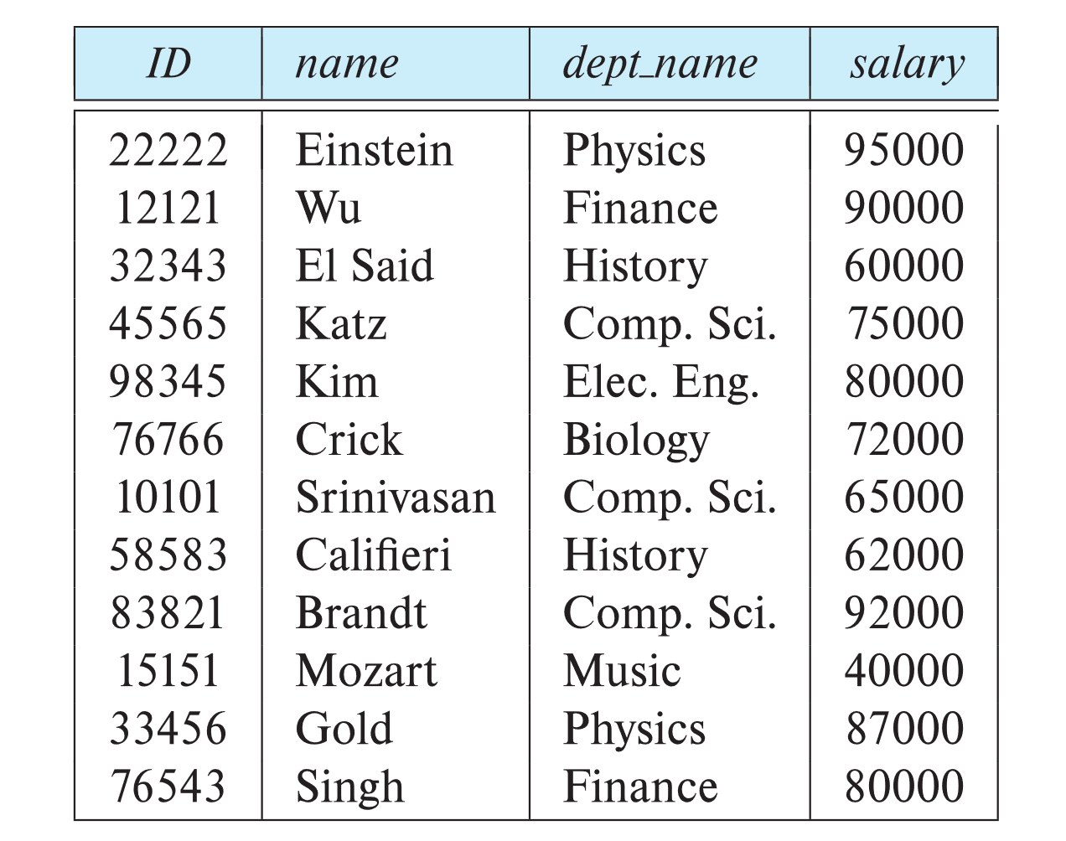
Database Schema
Database schema -- is the logical structure of the database.
Database instance -- is a snapshot of the data in the database at a given instant in time.
Example:
schema: instructor (ID, name, dept_name, salary)
Instance:

Slide 9
The concepts of Keys
A database consists of multiple relations
Database = Set of relations
How to specify a tuple within a given relation is distinguished?
How to represents a relationship among the relations?
The concepts of Keys
Super key (or Key)
Candidate key
Primary Key
Foreign Key

Slide 10
Keys
Let K ⊆ R
K is a superkey of R if values for K are sufficient to identify a unique tuple of each possible relation r(R)
By “possible r” we mean a relation r that could exist in the enterprise we are modeling.
Example:
{ID} and {ID, name} are both superkeys of instructor , if no two instructors can possibly have the same ID.
{name} is not a superkey of Instructor
K is a candidate key if K is minimal
Formal definition: if K is a superkey of R, and any subset of K is not a superkey of R, then K is a candidate K of R
Example: {ID } is a candidate key for Instructor.

Slide 11
Primary Key
It is possible to have more than one candidate key.
E.g. {ID} and {email-address} are both unique, can serve as candidate key for Instructor.
Primary key: a candidate key chosen as the principal means of identifying tuples within a relation
Should choose an attribute whose value never, or very rarely, changes.
E.g. email address is unique, but may change
Primary key is chosen by me, which one do I like?

Slide 12
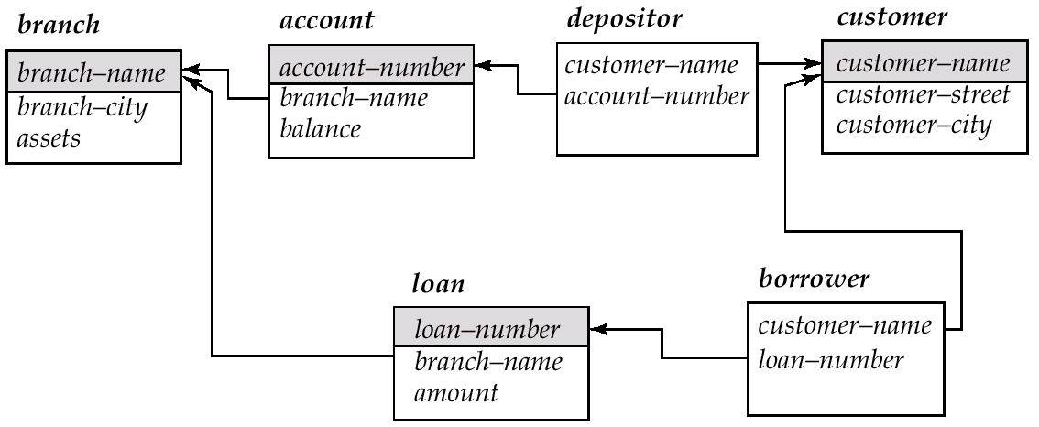
Schema Diagram for the Banking Enterprise
Foreign Key: The attributes of a relation schema r1 is the primary key of another relation schema r2. The attributes is called a foreign key from r1, referencing r2.
The attribute branch-name in Account is a foreign key referencing Branch.
Only values occurring in the primary key attribute of the Referenced relation may occur in the foreign key attribute of the Referencing relation

Slide 13
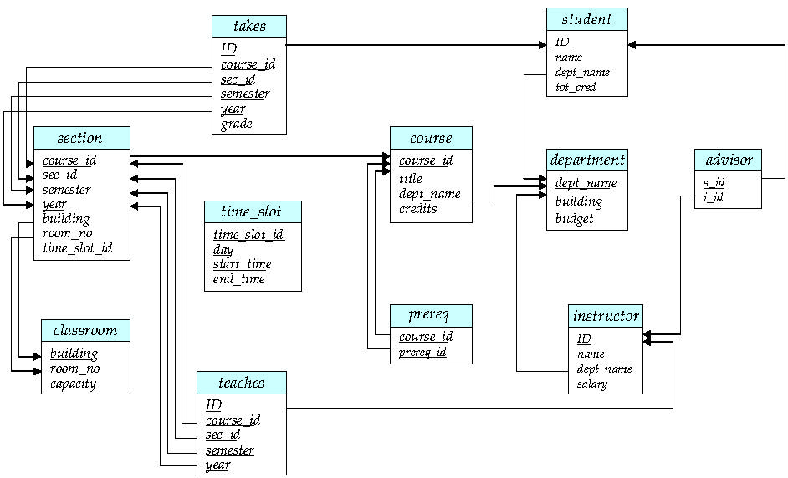
Schema Diagram for University Database
A key

Slide 14
Relational Query Languages
Language in which user requests information from the database.
Categories of languages
Procedural: The user instructs the system to perform a sequences of operations on the database.
non-procedural: The user describes the desired information without giving a specified procedure for obtaining that information.
“Pure” languages: are equivalent in computing power
Relational Algebra Procedural
Tuple Relational Calculus Non-Procedural
Domain Relational Calculus Non-Procedural
Pure languages form underlying basis of query languages that people use.

Slide 15
Relational Algebra
Procedural language
Six fundamental operators
select
project
union
set difference
Cartesian product
rename
The operators take two or more relations as inputs and give a new relation as a result.
The operators could be combined as needed to perform a sophisticated query to the database.

Slide 16
Select Operation – Example
Relation r
A
B
C
D
α
α
β
β
α
β
β
β
1
5
12
23
7
7
3
10
σ_{A=B ^ D > 5} (r)
A
B
C
D
α
β
α
β
1
23
7
10

Slide 17
Select Operation
Notation: σ _{p}(r)
p is called the selection predicate
Defined as:
σ_{p}(r) = {t | t ∈ r and p(t)}
Where p is a formula in propositional calculus consisting of terms connected by : ∧ (and), ∨ (or), ¬ (not) Each term is one of:
<attribute> op <attribute> or <constant>
where op is one of: =, ≠, >, ≥. <. ≤
Example of selection: σ _{dept_name=“Physics”}(instructor)

Slide 18
Project Operation
A unary operation that returns its argument relation, with certain attributes left out.
Notation: ∏_{A1, A2, …, Ak} (r)
where A₁, A₂ are attribute names and r is a relation name.
The result is defined as the relation of k columns obtained by erasing the columns that are not listed
Duplicate rows removed from result, since relations are sets

Slide 19
Project Operation – Example
A
B
C
Relation r:
α
α
β
β
10
20
30
40
1
1
1
2
A
C
A
C
∏_{A,C} (r)
α
α
β
β
1
1
1
2
α
β
β
1
1
2
=

Slide 20
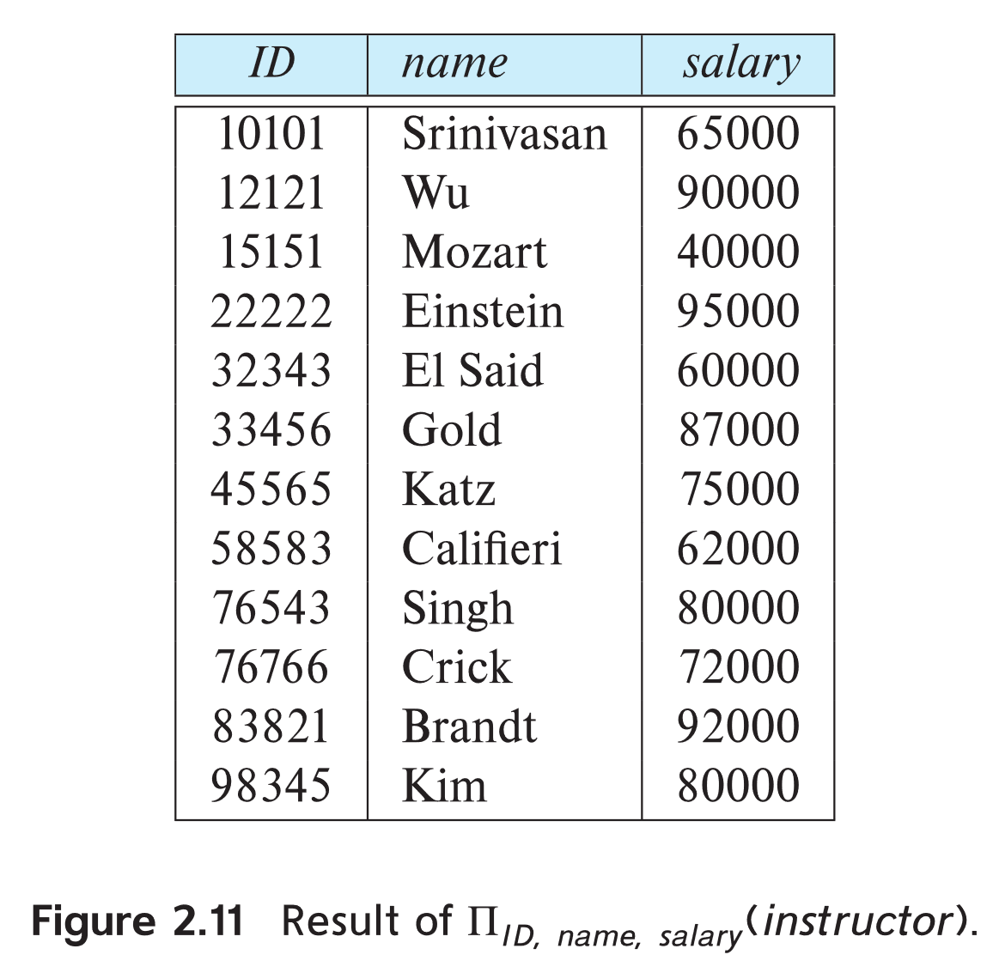
Project Operation Example
Example: eliminate the dept_name attribute of instructor
Query: ∏_{ID, name, salary} (instructor)
Result:

Slide 21
Composition of Relational Operations
The result of a relational-algebra operation is relation and therefore of relational-algebra operations can be composed together into a relational-algebra expression.
Consider the query -- Find the names of all instructors in the Physics department.
∏_{name}(σ _{dept_name} _{=“Physics”} (instructor))
Instead of giving the name of a relation as the argument of the projection operation, we give an expression that evaluates to a relation.

Slide 22
Cartesian-Product Operation
The Cartesian-product operation (denoted by X) allows us to combine information from any two relations.
Notation r x s
Defined as:
r x s = {t q | t ∈ r and q ∈ s}
Assume that attributes of r(R) and s(S) are disjoint. (That is, R ∩ S = ∅).
If attributes of r(R) and s(S) are not disjoint, then renaming must be used.

Slide 23
Cartesian-Product Operation-Example
A
B
C
D
E
Relations r, s:
α
β
1
2
α
β
β
γ
10
10
20
10
a
a
b
b
r
s
r x s:
A
B
C
D
E
α
α
α
α
β
β
β
β
1
1
1
1
2
2
2
2
α
β
β
γ
α
β
β
γ
10
19
20
10
10
10
20
10
a
a
b
b
a
a
b
b

Slide 24
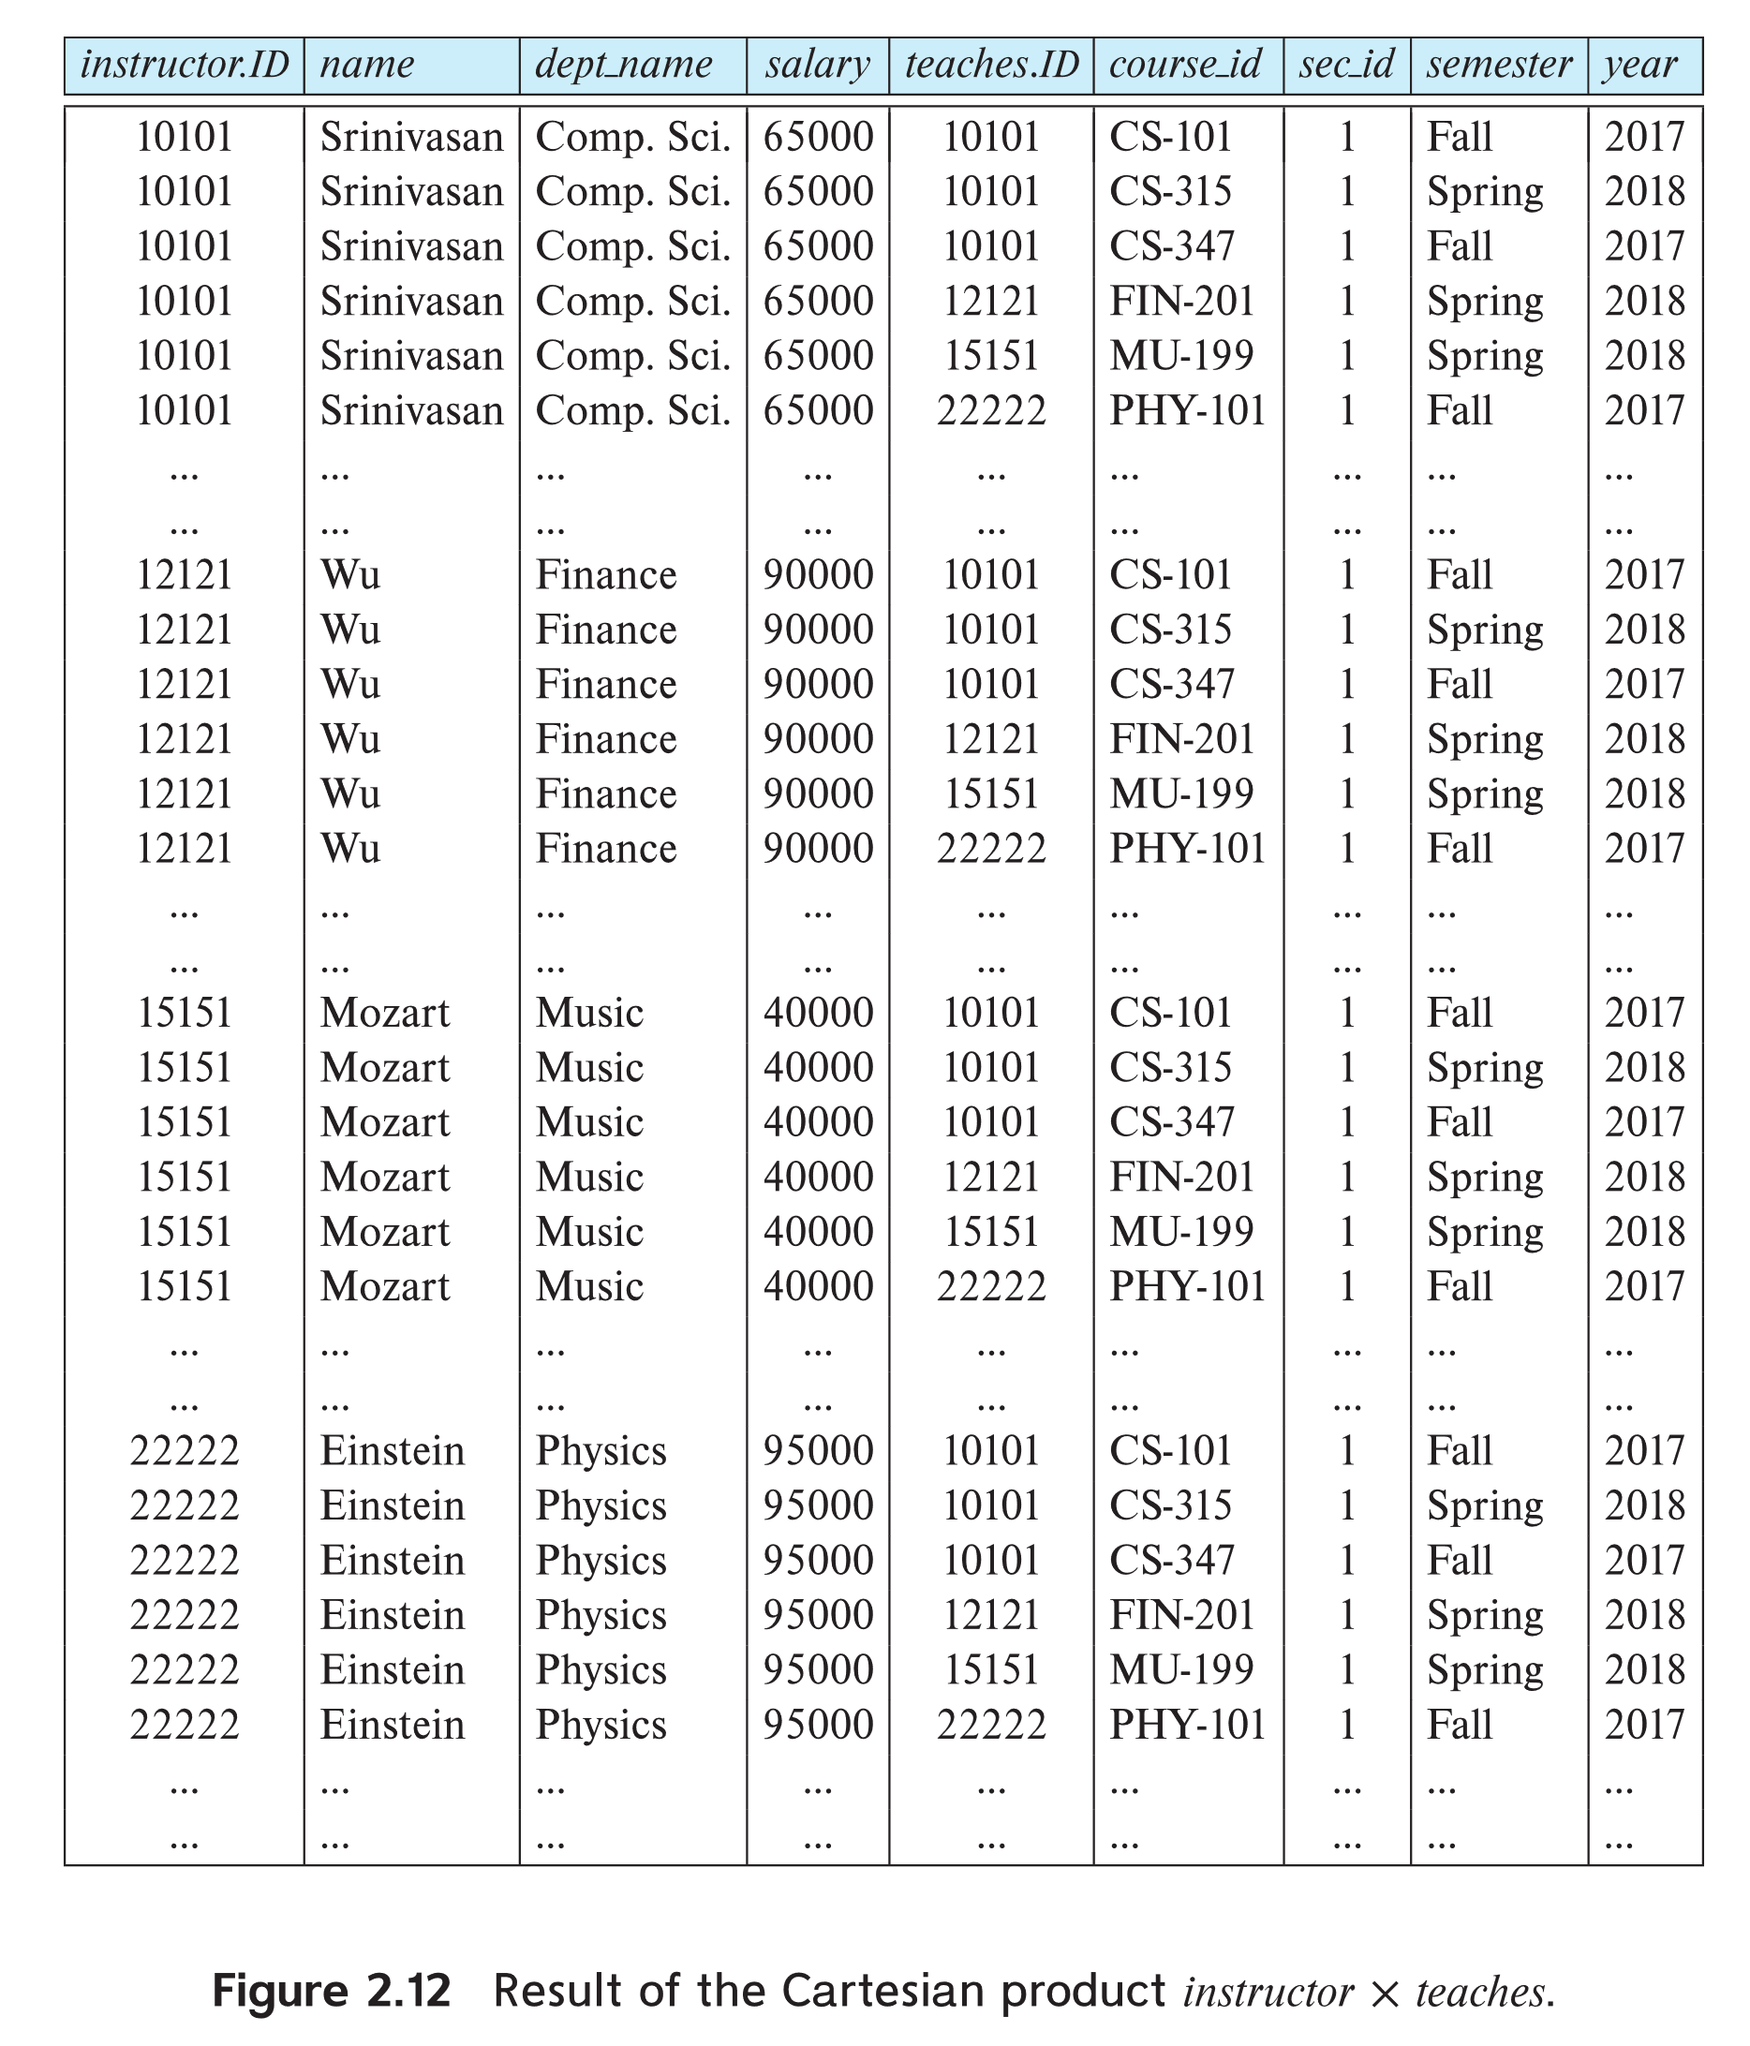
The instructor X teaches table

Slide 25
Set Union Operation
The union operation allows us to combine two relations
Notation: r ∪ s
Defined as:
r ∪ s = {t | t ∈ r or t ∈ s}
For r ∪ s to be valid.
1. r, s must have the same arity (same number of attributes)
2. The attribute domains must be compatible (e.g., 2nd column of r deals with the same type of values as does the 2nd column of s)
Example: to find all courses taught in the Fall 2017 semester, or in the Spring 2018 semester, or in both ∏_{course_id} (σ _{semester=“Fall” Λ year=2017} (section)) ∪ ∏_{course_id} (σ _{semester=“Spring” Λ year=2018} (section))

Slide 26
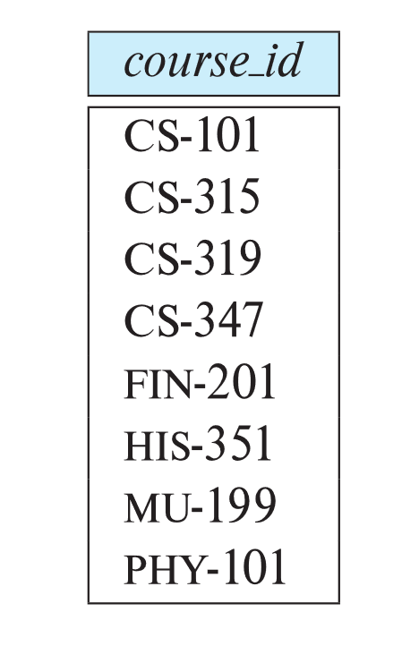
Union Operation (Cont.)
Result of: ∏_{course_id} (σ _{semester=“Fall” Λ year=2017} (section)) ∪ ∏_{course_id} (σ _{semester=“Spring” Λ year=2018} (section))

Slide 27

Set Difference Operation
Notation r – s
Defined as:
r – s = {t | t ∈ r and t ∉ s}
Set differences must be taken between compatible relations.
r and s must have the same arity
attribute domains of r and s must be compatible
Example: to find all courses taught in the Fall 2017 semester, but not in the Spring 2018 semester ∏_{course_id} (σ _{semester=“Fall” Λ year=2017} (section)) − ∏_{course_id} (σ _{semester=“Spring” Λ year=2018} (section))

Slide 28
Set Difference Operation – Example
Relations r, s:
A
B
A
B
α
α
β
1
2
1
α
β
2
3
s
r
r – s:
A
B
α
β
1
1

Slide 29
Rename Operation
The results of relational-algebra expressions do not have a name that we can use to refer to them. The rename operator, ρ , is provided for that purpose
The expression:
ρ _{x} (E) returns the expression E under the name X
To refer to a relation by more than one name
Relations r
r x ρ_{s}(r)

Slide 30
Rename Operation
If a relational-algebra expression E has arity n, then
ρ_{x} _{(A1, A2, …, An)} (E)
returns the result of expression E under the name X, and with the attributes renamed to A1, A2, …., An.

Slide 31
Formal Definition of Relational Algebra
A basic expression in the relational algebra consists of either one of the following:
A relation in the database
A constant relation
Let E₁ and E₂ be relational-algebra expressions; the following are all relational-algebra expressions:
E₁ ∪ E₂
E₁ - E₂
E₁ x E₂
σ_{p} (E₁), P is a predicate on attributes in E₁
∏_{s}(E₁), S is a list consisting of some of the attributes in E₁
ρ _{x} (E₁), x is the new name for the result of E₁

Slide 32
Additional Operations
We define additional operations that do not add any power to the relational algebra, but that simplify common queries.
Set intersection
Natural Join and Theta Join
Outer Join
Assignment
Division

Slide 33
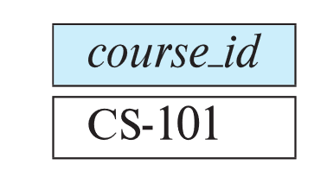
Set-Intersection Operation
The set-intersection operation allows us to find tuples that are in both the input relations.
Notation: r ∩ s
Assume:
r, s have the same arity
attributes of r and s are compatible
Note: r ∩ s = r - (r - s)
Example: Find the set of all courses taught in both the Fall 2017 and the Spring 2018 semesters.
∏_{course_id} (σ _{semester=“Fall” Λ year=2017} (section)) ∩ ∏_{course_id} (σ _{semester=“Spring” Λ year=2018} (section))

Slide 34
Natural-Join Operation
Notation: r s
Let r and s be relations on schemas R and S respectively. The result is a relation on schema R ∪ S which is obtained by considering each pair of tuples t_{r} from r and t_{s} from s.
If t_{r} and t_{s} have the same value on each of the attributes in R ∩ S, a tuple t is added to the result, where
t has the same value as t_{r} on r
t has the same value as t_{s} on s
Example:
R = (A, B, C, D)
S = (E, B, D)
Result schema = (A, B, C, D, E)
r s is defined as:
∏_{r.A, r.B, r.C, r.D, s.E} (σ_{r.B = s.B r.D = s.D} (r x s))

Slide 35
Natural Join Operation – Example
Relations r, s:
A
B
C
D
B
D
E
α
β
γ
α
δ
1
2
4
1
2
α
γ
β
γ
β
a
a
b
a
b
1
3
1
2
3
a
a
a
b
b
α
β
γ
δ
∈
r
s
r s
A
B
C
D
E
α
α
α
α
δ
1
1
1
1
2
α
α
γ
γ
β
a
a
a
a
b
α
γ
α
γ
δ

Slide 36
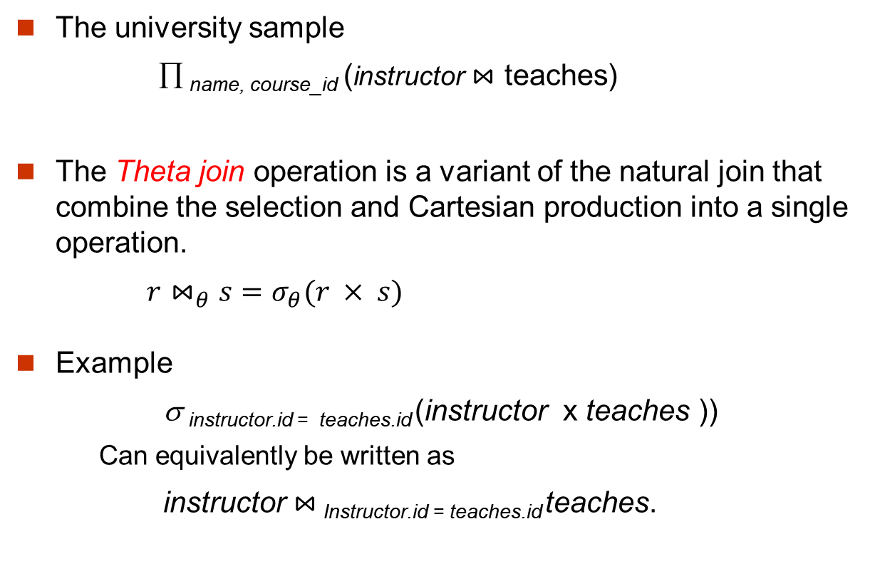
Join Operation (Cont.)
The university sample
∏ _{name, course_id} (instructor $⋈$ teaches)
The Theta join operation is a variant of the natural join that combine the selection and Cartesian production into a single operation.
$r⋈_{θ}s=σ_{θ}(r × s)$
Example
σ _{instructor.id = teaches.id} (instructor x teaches ))
Can equivalently be written as
instructor $⋈_{ }$_{Instructor.id = teaches.id} teaches.

Slide 37

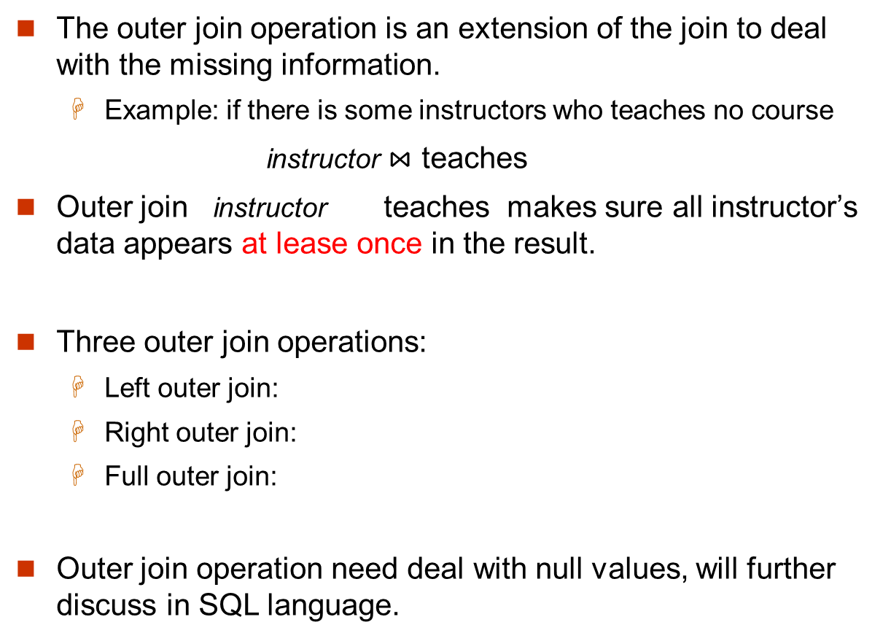
Outer Join Operation
The outer join operation is an extension of the join to deal with the missing information.
Example: if there is some instructors who teaches no course
instructor $⋈$ teaches
Outer join instructor teaches makes sure all instructor’s data appears at lease once in the result.
Three outer join operations:
Left outer join:
Right outer join:
Full outer join:
Outer join operation need deal with null values, will further discuss in SQL language.

Slide 38
The Assignment Operation
It is convenient at times to write a relational-algebra expression by assigning parts of it to temporary relation variables.
The assignment operation is denoted by ← and works like assignment in a programming language.
Example: Find all instructor in the “Physics” and Music department. Physics ← σ _{dept_name=“Physics”} (instructor)
Music ← σ _{dept_name=“Music”} (instructor)
Physics r ∪ Music
With the assignment operation, a query can be written as a sequential program consisting of a series of assignments followed by an expression whose value is displayed as the result of the query.
May use temporary variable in subsequent expressions.

Slide 39
Division Operation
r ÷ s
Suited to queries that include the phrase “for all”.
Let r and s be relations on schemas R and S respectively where
R = (A₁, …, A_{m}, B₁, …, B_{n})
S = (B₁, …, B_{n})
The result of r ÷ s is a relation on schema
R – S = (A₁, …, A_{m})
r ÷ s = { t | t ∈ ∏ _{R-S}(r) ∧ ∀ u ∈ s ( tu ∈ r ) }
Where tu means the concatenation of tuples t and u to produce a single tuple

Slide 40
Division Operation – Example
A
B
Relations r, s:
B
α
α
α
β
γ
δ
δ
δ
∈
∈
β
1
2
3
1
1
1
3
4
6
1
2
1
2
s
r ÷ s:
A
r
α
β

Slide 41
Another Division Example
Relations r, s:
A
B
C
D
E
D
E
α
α
α
β
β
γ
γ
γ
a
a
a
a
a
a
a
a
α
γ
γ
γ
γ
γ
γ
β
a
a
b
a
b
a
b
b
1
1
1
1
3
1
1
1
a
b
1
1
s
r
r ÷ s:
A
B
C
α
γ
a
a
γ
γ

Slide 42
Division Operation (Cont.)
Property
Let q = r ÷ s
Then q is the largest relation satisfying q x s ⊆ r
Definition in terms of the basic algebra operation Let r(R) and s(S) be relations, and let S ⊆ R
r ÷ s = ∏_{R-S} (r) –∏_{R-S} ( (∏_{R-S} (r) x s) – ∏_{R-S,S}(r))
To see why
∏_{R-S,S}(r) simply reorders attributes of r
∏_{R-S}(∏_{R-S} (r) x s) – ∏_{R-S,S}(r)) gives those tuples t in ∏_{R-S} (r) such that for some tuple u ∈ s, tu ∉ r.

Slide 43
Example Queries
Find the students who learned course “Database system” and “Advanced programing”
Query 1
∏_{ID} (σ_{title = “Database system”} (takes course )) ∩
∏_{ID} (σ_{title = “Advanced Programing”} (takes course ))
Query 2
∏_{ID, title}(takes course) ÷ ρ_{temp(title)} ({(“Database System” ), (“Advanced Programming” )})

Slide 44
Example Queries
Find the students who learned all the courses in “Comp.Sci” department.
∏_{ID, course_id}(takes ) ÷ ∏_{course_id} (σ_{tdept_name = “Comp.Sci”} (course））

Slide 45
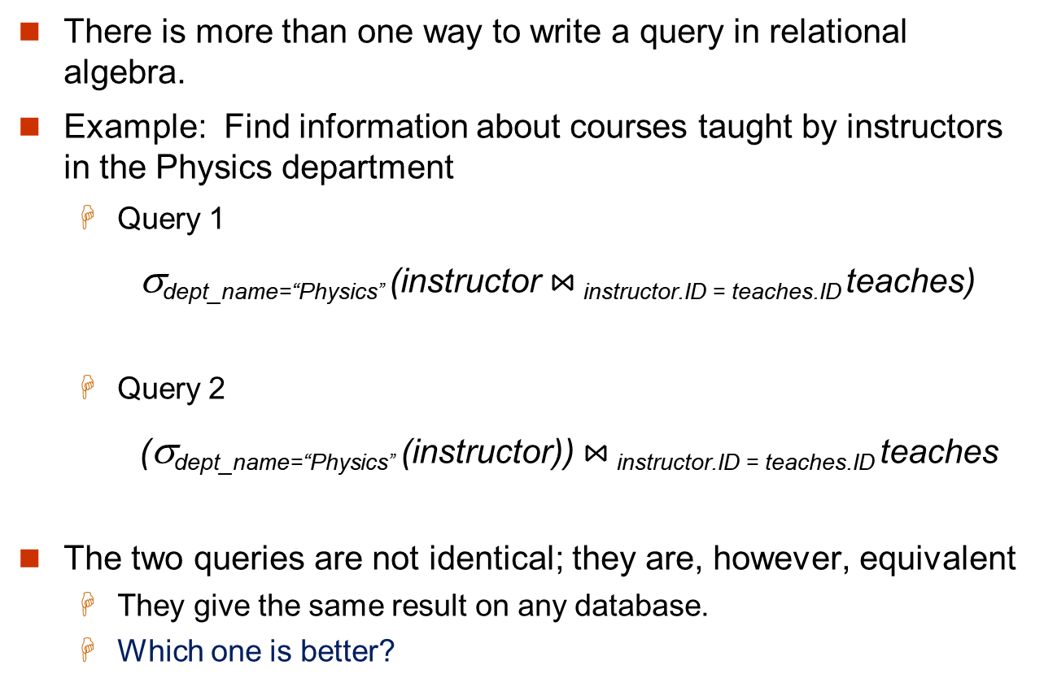
Equivalent Queries
There is more than one way to write a query in relational algebra.
Example: Find information about courses taught by instructors in the Physics department
Query 1
σ_{dept_name=“Physics”} (instructor $⋈_{ }$_{instructor.ID = teaches.ID} teaches)
Query 2
(σ_{dept_name=“Physics”} (instructor)) $⋈_{ }$_{instructor.ID = teaches.ID} teaches
The two queries are not identical; they are, however, equivalent
They give the same result on any database.
Which one is better?

Slide 46
Example Queries
Find the instructor who has the highest salary
Self join: Rename instructor relation as d
The query is:
∏ _{id, name}(instructor) - ∏_{instructor.id, instructor.name}
(σ_{instructor.salary < d.salary} (instructor x ρ_{d} (instructor)))

Slide 47
Extended Relational-Algebra Operations*
Some of the data query needs could not be expressed using the basic relational algebra. Therefore, some additional operations been defined.
Generalized projection, allowing calculations
∏ _{ID, name, dept_name,salary/12} (instructor)
Aggregations
Aggregation functions take a collection of values and return a single value as a result.

Slide 48
Aggregation Operations*
Notation
_{G1,G2,…,Gn} G _{F1(A1),F2(A2),…,Fm(Am)} (E)
All tuples in a group has the same value for G1,G2,…, Gn
Tuples in different groups has different values for G1,G2,…, Gn
For each group, has one tuple in the result. Fi are aggregation functions.
Aggregation functions including SUM/MAX/MIN/AVG/COUNT
Examples
G _{sum(salary)} (instructor)
_{dept_name}G _{sum(salary)} (instructor)
G _{count-distinct(ID)} (σ _{semester=“Spring” ^ year=2010} (teaches ))

