Slide 1
SQL – Lecture 1
Introduction
Data Definition Language
Data Manipulation Language (1)
Basic Structure
Set Operations
Aggregate Functions
Null Values
Join expressions
Notes:
1

Slide 2
Introduction
SQL: Structured Query Language
Most widely used database language today.
Although it is named a “Query Language”, It can do much more than just query in database, including data definition, data manipulate, specify security constraints, etc.
History of SQL
1975～1979， IBM System R, Original named Sequel
1986， SQL-86
1989， SQL-89
1992， SQL-92 (Most widely implemented)
1999， SQL-99（SQL3）
2003， SQL:2003
SQL:2006, SQL:2008
Commercial systems offer most, if not all, SQL-92 features, plus varying features from later standards and special proprietary features.
Not all examples here may work on your particular system.

Slide 3
SQL Parts
The SQL language has several parts
Data-definition language (DDL)
View definition
Integrity
Interactive data-manipulation languages (DML)
Database Control Language (DCL)
Transaction control
Authorization
Embedded SQL and dynamic SQL

Slide 4
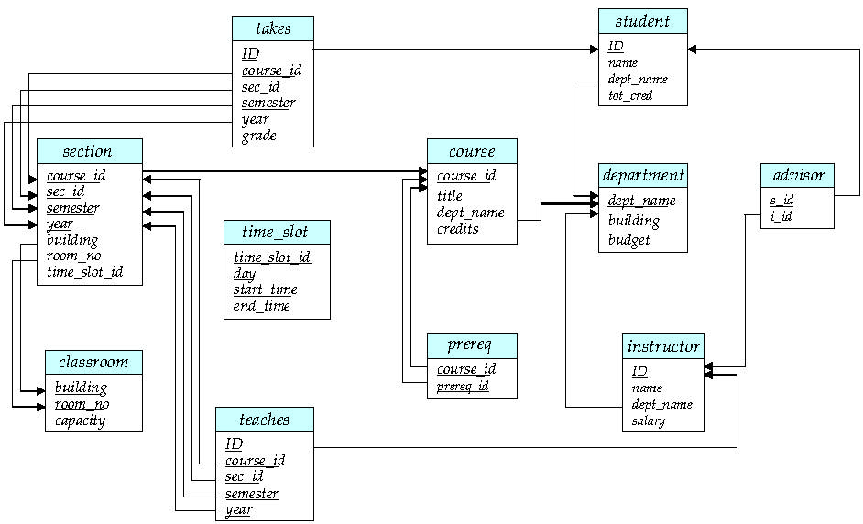
Schema Diagram for University Database
A key

Slide 5
Data Definition Language (DDL)
DLL provides the definition of relations, it allows the specification of not only a set of relations but also the following information:
The schema for each relation.
The domain of values associated with each attribute.
Integrity constraints
Security and authorization information for each relation.
The set of indices to be maintained for each relations.
The physical storage structure of each relation on disk.
Basic structure…
A little of physical structure…

Slide 6
Domain Types in SQL
char(n). Fixed length character string, with user-specified length n.
varchar(n). Variable length character strings, with user-specified maximum length n.
int. Integer (a finite subset of the integers that is machine-dependent).
smallint. Small integer (a machine-dependent subset of the integer domain type).
numeric(p,d). Fixed point number, with user-specified precision of p digits, with d digits to the right of decimal point. . (ex., numeric(3,1), allows 44.5 to be stores exactly, but not 444.5 or 0.32)
real, double precision. Floating point and double-precision floating point numbers, with machine-dependent precision.
float(n). Floating point number, with user-specified precision of at least n digits.
Null values are allowed in all the domain types. Declaring an attribute to be not null prohibits null values for that attribute.

Slide 7
Date/Time Types in SQL (Cont.)
date. Dates, containing a (4 digit) year, month and date
E.g. date ‘2007-9-23’
time. Time of day, in hours, minutes and seconds.
E.g. time ’09:00:30’ time ’09:00:30.75’
timestamp: date plus time of day
E.g. timestamp ‘2007-9-23 09:00:30.75’
Interval: period of time
E.g. Interval ‘1’ day
Subtracting a date/time/timestamp value from another gives an interval value
Interval values can be added to date/time/timestamp values
Can extract values of individual fields from date/time/timestamp
E.g. extract (year from r.starttime)
Can cast string types to date/time/timestamp
E.g. cast <string-valued-expression> as date
E.g. cast <string-valued-expression> as time

Slide 8
Create Table Construct
An SQL relation is defined using the create table command:
create table r (
A₁ D₁, A₂ D₂, ..., A_{n} D_{n}, (integrity-constraint₁), ..., (integrity-constraint_{k}))
r is the name of the relation
each A_{i} is an attribute name in the schema of relation r
D_{i} is the data type of values in the domain of attribute A_{i}
Example:
create table instructor ( ID char(5), name varchar(20), dept_name varchar(20), salary numeric(8,2))

Slide 9
Integrity Constraints in Create Table
Types of integrity constraints
primary key (A₁, ..., A_{n} ) : Any Primary key is not null
foreign key (A_{m}, ..., A_{n} ) references r
not null
SQL prevents any update to the database that violates an integrity constraint.
Example:
create table instructor ( ID char(5), name varchar(20) not null, dept_name varchar(20), salary numeric(8,2), primary key (ID), foreign key (dept_name) references department);

Slide 10
Few More Relation Examples
create table student ( ID varchar(5), name varchar(20) not null, dept_name varchar(20), tot_cred numeric(3,0), primary key (ID),
foreign key (dept_name) references department);
create table takes ( ID varchar(5), course_id varchar(8), sec_id varchar(8), semester varchar(6), year numeric(4,0), grade varchar(2),
primary key (ID, course_id, sec_id, semester, year) ,
foreign key (ID) references student, foreign key (course_id, sec_id, semester, year) references section);
create table course ( course_id varchar(8), title varchar(50), dept_name varchar(20), credits numeric(2,0),
primary key (course_id),
foreign key (dept_name) references department);

Slide 11
Drop and Alter Table Constructs
The drop table command deletes all information about the dropped relation from the database.
The alter table command is used to add attributes to an existing relation. All tuples in the relation are assigned null as the value for the new attribute. The form of the alter table command is
alter table r add A D
where A is the name of the attribute to be added to relation r and D is the domain of A.
The alter table command can also be used to drop attributes of a relation alter table r drop A where A is the name of an attribute of relation r
Dropping of attributes not supported by many databases

Slide 12
Basic Structure of SQL Queries
A typical SQL query has the form: select A₁, A₂, ..., A_{n} from r₁, r₂, ..., r_{m} where P
A_{i}s represent attributes: that desired in the result of the query
r_{i}s represent relations : to be scanned in the evaluation of the query
P is a predicate : selection criteria to be satisfied.
This query is equivalent to the relational algebra expression.
∏_{A1, A2, ..., An}(σ_{P} (r₁ x r₂ x ... x r_{m}))
The result of an SQL query is a relation (can be duplicated!).
Notes:
2

Slide 13
The select Clause
The select clause list the attributes desired in the result of a query
corresponds to the projection operation of the relational algebra
E.g. Find the names of all instructors select name from instructor
An asterisk in the select clause denotes “all attributes”
select * from instructor
NOTE: SQL names are case insensitive, meaning you can use upper case or lower case.
E.g., Name ≡ NAME ≡ name
You may wish to use upper case in places where we use bold font.
∏_{name}(instructor)
Notes:
3

Slide 14
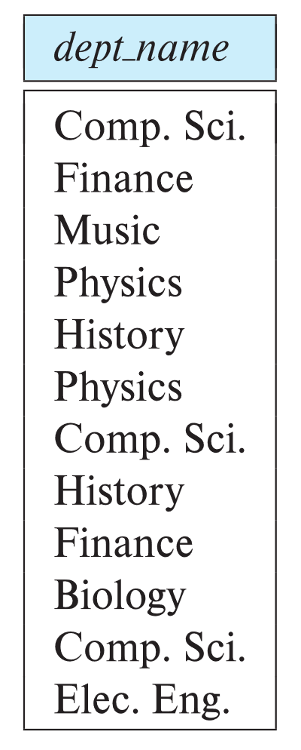
The select Clause (Cont.)
SQL allows duplicates in relations as well as in query results.
To force the elimination of duplicates, insert the keyword distinct after select.
Find the department names of all instructors, and remove duplicates
select distinct dept_name from instructor
The keyword all specifies that duplicates not be removed.
select all dept_name from instructor
The keyword ‘all’ is useless, because it is default
Notes:
4

Slide 15
The select Clause (Cont.)
An attribute can be a literal with no from clause
select ‘437’
Results is a table with one column and a single row with value “437”
Can give the column a name using:
select ‘437’ as FOO
An attribute can be a literal with from clause
select ‘A’ from instructor
Result is a table with one column and N rows (number of tuples in the instructors table), each row with value “A”
Notes:
5

Slide 16
The select Clause (Cont.)
The select clause can contain arithmetic expressions involving the operation, +, –, ∗, and /, and operating on constants or attributes of tuples.
The query:
select ID, name, salary/12 from instructor
would return a relation that is the same as the instructor relation, except that the value of the attribute salary is divided by 12.
Can rename “salary/12” using the as clause:
select ID, name, salary/12 as monthly_salary from instructor
Notes:
5

Slide 17
The where Clause
The where clause specifies conditions that the result must satisfy
Corresponds to the selection predicate of the relational algebra.
To find all instructors in Comp. Sci. dept
select name from instructor where dept_name = ‘Comp. Sci.'
Comparison results can be combined using the logical connectives and, or, and not
To find all instructors in Comp. Sci. dept with salary > 80000
select name from instructor where dept_name = ‘Comp. Sci.' and salary > 80000
Comparisons can be applied to results of arithmetic expressions.
Notes:
6

Slide 18
Where Clause Predicates
SQL includes a between comparison operator
Example: Find the names of all instructors with salary between $90,000 and $100,000 (that is, ≥ $90,000 and ≤ $100,000)
select name from instructor where salary between 90000 and 100000
Tuple comparison
select name, course_id from instructor, teaches where (instructor.ID, dept_name) = (teaches.ID, ’Biology’);
Equivalent to:
select name, course_id from instructor, teaches where instructor.ID = teaches.ID and dept_name =’Biology’;
Notes:
7

Slide 19
The from Clause
The from clause lists the relations involved in the query
Corresponds to the Cartesian product operation of the relational algebra.
Find the Cartesian product instructor X teaches
select ∗ from instructor, teaches
generates every possible instructor – teaches pair, with all attributes from both relations.
For common attributes (e.g., ID), the attributes in the resulting table are renamed using the relation name (e.g., instructor.ID)
Cartesian product not very useful directly, but useful combined with where-clause condition (selection operation in relational algebra).
Notes:
8

Slide 20
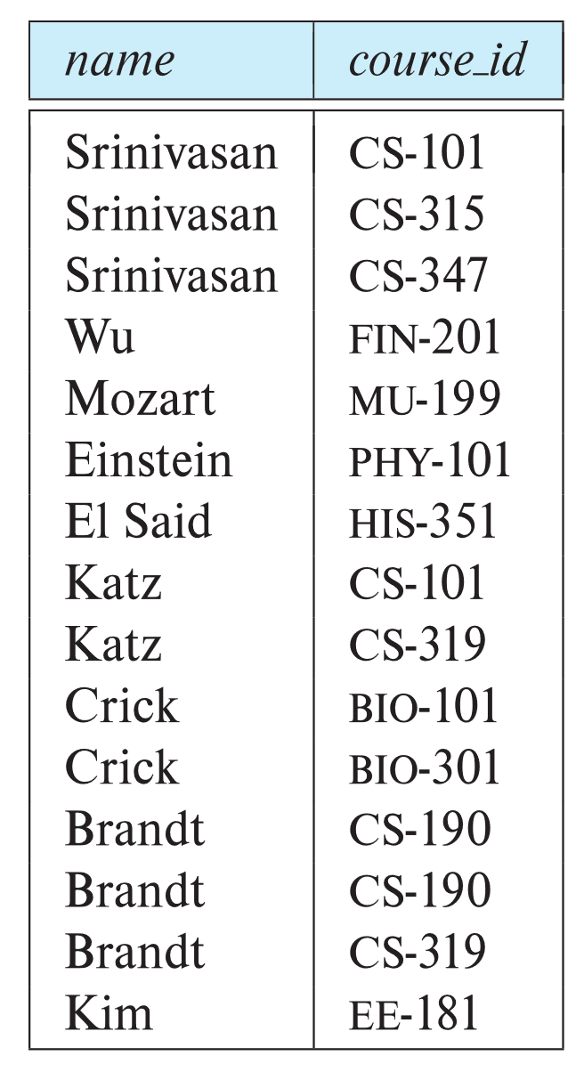
Examples
Find the names of all instructors who have taught some course and the course_id
select name, course_id from instructor , teaches where instructor.ID = teaches.ID
Find the names of all instructors in the Art department who have taught some course and the course_id
select name, course_id from instructor , teaches where instructor.ID = teaches.ID and instructor. dept_name = 'Art'
Notes:
9

Slide 21
The Rename Operation
The SQL allows renaming relations and attributes using the as clause: old-name as new-name
Find the names of all instructors in the Art department who have taught some course and the course title
select instructor.ame as teacher-name, course.title as course-title from instructor , teaches, course where instructor.ID = teaches.ID and teaches.course_id = course.course_id and instructor. dept_name = ‘Art’
Notes:
9

Slide 22
Tuple Variables
Tuple variables are defined in the from clause via the use of the as clause.
Find the names of all instructors in the Art department who have taught some course and the course_id
select T.name, C.course_id from instructor as T , teaches as C where T.ID = C.ID and T. dept_name = ‘Art’
Find the names of all instructors who have a higher salary than some instructor in ‘Comp. Sci’.
select distinct T.name from instructor as T, instructor as S where T.salary > S.salary and S.dept_name = ‘Comp. Sci.’
Keyword as is optional and may be omitted instructor as T ≡ instructor T
Notes:
10

Slide 23
String Operations
SQL includes a string-matching operator for comparisons on character strings. The operator “like” uses patterns that are described using two special characters :
percent (%). The % character matches any substring.
underscore (_). The _ character matches any character.
Find the names of all instructors whose name includes the substring “dar”.
select name from instructor where name like '%dar%'
Match the string “100%”
like ‘100 \%' ---escape '\'

Slide 24
String Operations (Cont.)
Patterns are case sensitive.
Pattern matching examples:
‘Intro%’ matches any string beginning with “Intro”.
‘%Comp%’ matches any string containing “Comp” as a substring.
‘_ _ _’ matches any string of exactly three characters.
‘_ _ _ %’ matches any string of at least three characters.
SQL supports a variety of string operations such as
concatenation (using “||”)
converting from upper to lower case (and vice versa)
finding string length, extracting substrings, etc.

Slide 25
Ordering the Display of Tuples
SQL query does not assure any order of query result in default.
List in alphabetic order the names of all instructors
select distinct name from instructor order by name
We may specify desc for descending order or asc for ascending order, for each attribute; ascending order is the default.
Example: order by name desc
Can sort on multiple attributes
Example: order by dept_name desc , name asc

Slide 26
Duplicates
In relations with duplicates, SQL can define how many copies of tuples appear in the result.
Multiset versions of some of the relational algebra operators – given multiset relations r₁ and r₂:
1. σ_{θ} (r): If there are c₁ copies of tuple t₁ in r₁, and t₁ satisfies selections σ_{θ,}, then there are c₁ copies of t₁ in σ_{θ} (r₁).
2. Π_{A}(t₁): For each copy of tuple t₁ in r₁, there is a copy of tuple Π_{A}(t₁) in Π_{A}(r₁) where Π_{A}(t₁) denotes the projection of the single tuple t₁.
3. r₁ x r₂: If there are c₁ copies of tuple t₁ in r₁ and c₂ copies of tuple t₂ in r₂, there are c₁ x c₂ copies of the tuple t₁. t₂ in r₁ x r₂

Slide 27
Duplicates (Cont.)
Example: Suppose multiset relations r₁ (A, B) and r₂ (C) are as follows:
r₁ = {(1, a) (2,a)} r₂ = {(2), (3), (3)}
Then Π_{B}(r₁) would be {(a), (a)}, while Π_{B}(r₁) x r₂ would be
{(a,2), (a,2), (a,3), (a,3), (a,3), (a,3)}
SQL duplicate semantics:
select A₁,, A₂, ..., A_{n} from r₁, r₂, ..., r_{m} where P
is equivalent to the multiset version of the expression:
Π _{A1,, A2, ..., An}(σ_{P} (r₁ x r₂ x ... x r_{m}))

Slide 28
Set Operations
The set operations union, intersect, and except operate on relations and correspond to the relational algebra operations ∪, ∩, −.
Each of the above operations automatically eliminates duplicates; to retain all duplicates use the corresponding multiset versions union all, intersect all and except all. Suppose a tuple occurs m times in r and n times in s, then, it occurs:
m + n times in r union all s
min(m,n) times in r intersect all s
max(0, m – n) times in r except all s

Slide 29
Set Operations
Find courses that ran in Fall 2019 or in Spring 2020
(select course_id from section where sem = ‘Fall’ and year = 2019) union (select course_id from section where sem = ‘Spring’ and year = 2020)
Find courses that ran in Fall 2019 and in Spring 2020
(select course_id from section where sem = ‘Fall’ and year = 2019) intersect (select course_id from section where sem = ‘Spring’ and year = 2020)
Find courses that ran in Fall 2019 but not in Spring 2020
(select course_id from section where sem = ‘Fall’ and year = 2019) except (select course_id from section where sem = ‘Spring’ and year = 2020)

Slide 30
An example
Find the instructor who has the highest salary
The query is:
∏ _{id, name}(instructor) - ∏_{instructor.id, instructor.name}
(σ_{instructor.salary < d.salary} (instructor x ρ_{d} (instructor)))
SQL Query
select id, name from instructor
except
select T.id, T.name from instructor as T, instructor as D where T.salary < D.salary
Notes:
9

Slide 31
Aggregate Functions
These functions operate on the multiset of values of a column of a relation, and return a value
avg: average value min: minimum value max: maximum value sum: sum of values count: number of values

Slide 32
Aggregate Functions (Cont.)
Find the average salary of instructors in the Computer Science department
select avg (salary) from instructor where dept_name= ’Comp. Sci.’;
Find the total number of instructors who teach a course in the Spring 2018 semester
select count (distinct ID) from teaches where semester = ’Spring’ and year = 2018;
Find the number of tuples in the course relation
select count (*) from course;

Slide 33
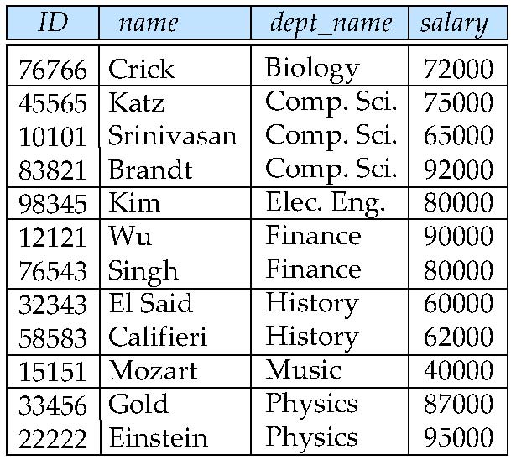
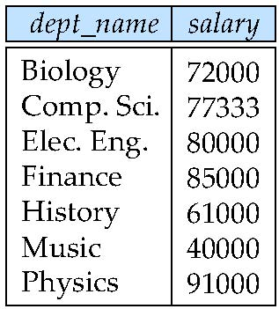
Aggregate Functions – Group By
Find the average salary of instructors in each department
select dept_name, avg (salary) as avg_salary from instructor group by dept_name;
avg_salary

Slide 34
Aggregate Functions – Group By
Find the number of instructors in each department who teach a course in the Spring 2010 semester.
select dept_name, count ( distinct ID) as instr_count from instructor, teaches where instructor.ID = teaches.ID and semester = ‘Spring’ and year = 2010 group by dept_name
Note: Attributes in select clause outside of aggregate functions must appear in group by list

Slide 35
Aggregate Functions – Having Clause
Find the names and average salaries of all departments whose average salary is greater than 42000.
select dept_name, avg (salary)
from instructor
group by dept_name
having avg (salary) > 42000;
Having clause vs. Where clause
predicates in the having clause are applied after the formation of groups whereas predicates in the where clause are applied before forming groups
Apply where predicates -> form groups -> apply having predicates
predicates in the having clause are applied to each group whereas predicates in the where clause are applied to each tuple.

Slide 36
Null Values
It is possible for tuples to have a null value, denoted by null, for some of their attributes
null signifies an unknown value or that a value does not exist.
The result of any arithmetic expression involving null is null
E.g. 5 + null returns null
The predicate is null can be used to check for null values.
Example: Find all instructors whose salary is null.
select name from instructor where salary is null
The predicate is not null succeeds if the value on which it is applied is not null.

Slide 37
Null Values and Three Valued Logic
Three values – true, false, unknown
Any comparison with null returns unknown (other than predicates is null and is not null)
E.g. 5 < null or null <> null or null = null
Three-valued logic using the truth value unknown:
OR: (unknown or true) = true, (unknown or false) = unknown (unknown or unknown) = unknown
AND: (true and unknown) = unknown, (false and unknown) = false, (unknown and unknown) = unknown
NOT: (not unknown) = unknown
“P is unknown” evaluates to true if predicate P evaluates to unknown
Result of where clause predicate is treated as false if it evaluates to unknown

Slide 38
Special treatment of Null Values
Null Values and Aggregates
select sum (salary ) from instructor
Above statement ignores null amounts, and return the total salary
All aggregate operations except count(*) ignore tuples with null values on the aggregated attributes
What if collection has only null values?
count returns 0
all other aggregates return null
Null Values and select distinct
When a query use select distinct clause, to remove duplicated tuples. When comparing the corresponding attributes from two tuples, the values are treated as identical if one of the following:
the both values are not null and equal in value
or both are null.

Slide 39
Joined Relations
Join operations take two relations and return as a result another relation.
A join operation is a Cartesian product which requires that tuples in the two relations match (under some condition). It also specifies the attributes that are present in the result of the join
The join operations are typically used as subquery expressions in the from clause
Three types of joins:
Natural join
Inner join
Outer join

Slide 40
Join Expression
Join expressions are introduced to make some SQL query easier to understand.
Select name, course_id from instructor, teaches
where instructor.ID = teaches.ID
Could be simplified as:
Select name, course_id from instructor nature join teaches
Or :
Select name, course_id from instructor join teaches using (ID)

Slide 41
Join Conditions
The ON condition allows a general predicate over the relations being joined.
Select * from student join takes on student.ID = takes.ID
Is equivalent to
Select *
from student, takes
where student.ID = takes.ID

Slide 42
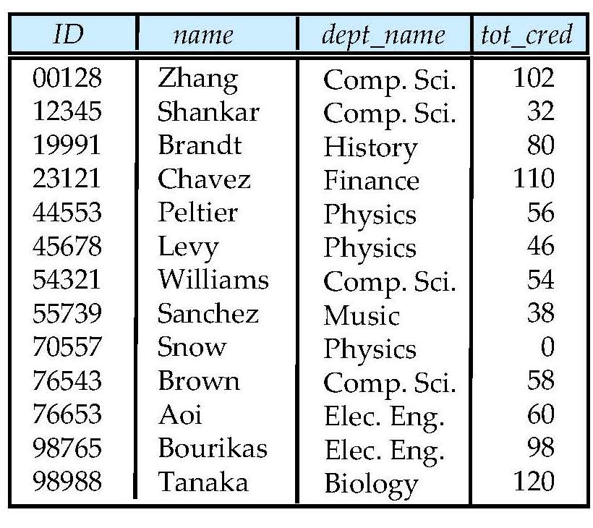
Student Relation

Slide 43
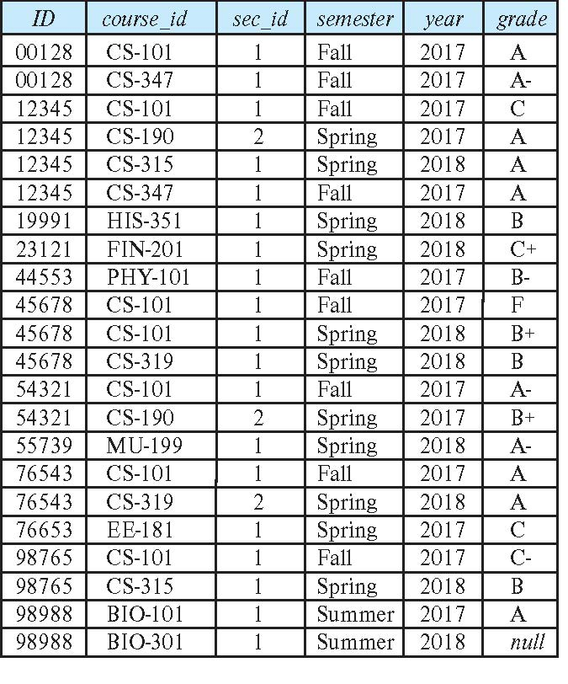
Takes Relation

Slide 44
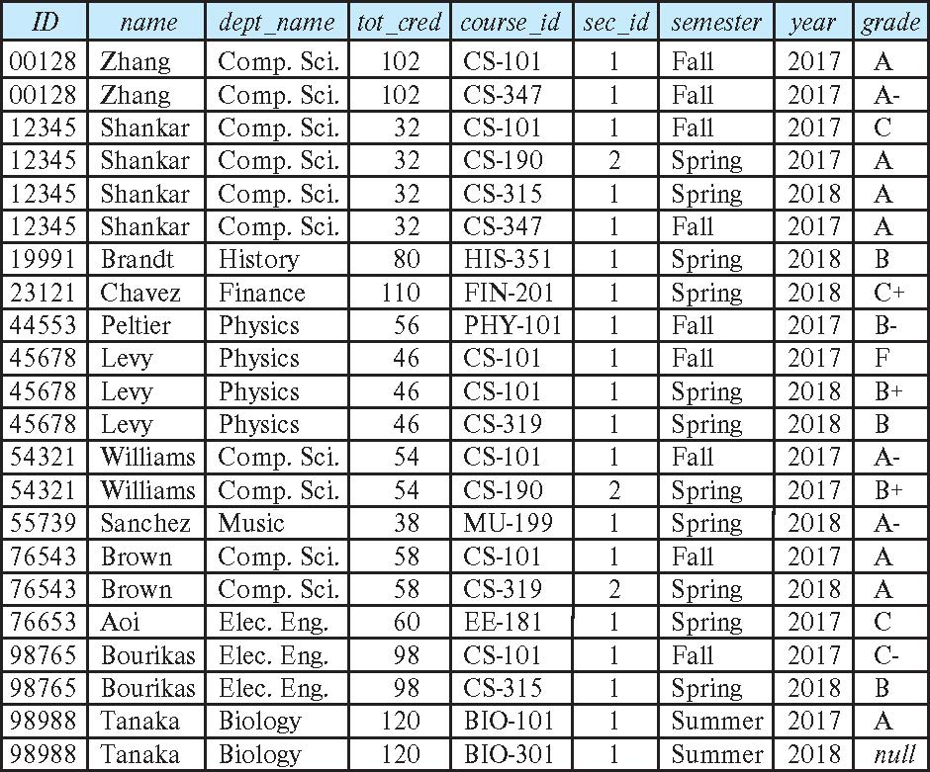
student natural join takes

Slide 45
Dangerous in Natural Join
Beware of unrelated attributes with same name which get equated incorrectly
Example -- List the names of students instructors along with the titles of courses that they have taken
Correct version
select name, title from student natural join takes, course where takes.course_id = course.course_id;
Incorrect version
select name, title from student natural join takes natural join course;
This query omits all (student name, course title) pairs where the student takes a course in a department other than the student's own department. (dept_name, course_id)
The correct version (above), correctly outputs such pairs.

Slide 46
Natural Join with Using Clause
To avoid the danger of equating attributes erroneously, we can use the “using” construct that allows us to specify exactly which columns should be equated.
Query example
select name, title from (student natural join takes) join course using (course_id)

Slide 47
Outer Join
An extension of the join operation that avoids loss of information.
E.g. To list all students along with the course they have taken.
E.g. To list all instructors along with the course they teach.
Computes the join and then adds tuples form one relation that does not match tuples in the other relation to the result of the join.
Left Outer Join
Right Outer Join
Full Outer Join
Uses null values.

Slide 48
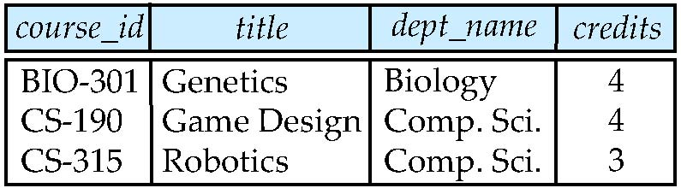
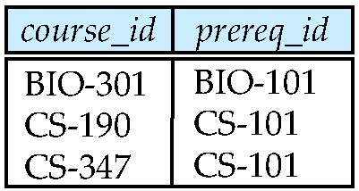
Join operations – Example
Relation course
Relation prereq
Observe that prereq information is missing for CS-315 and
course information is missing for CS-437

Slide 49
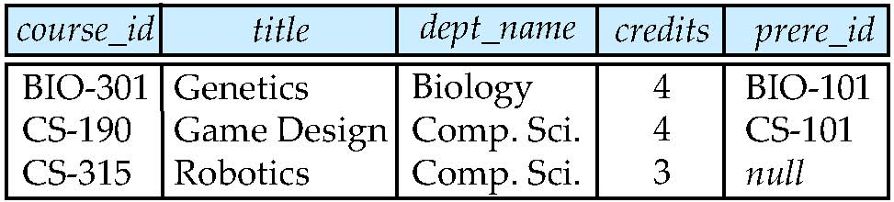
Left Outer Join
course natural left outer join prereq

Slide 50
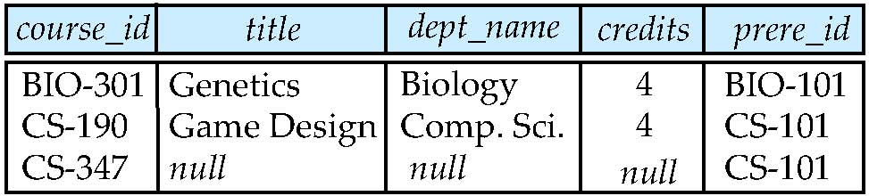
Right Outer Join
course natural right outer join prereq

Slide 51
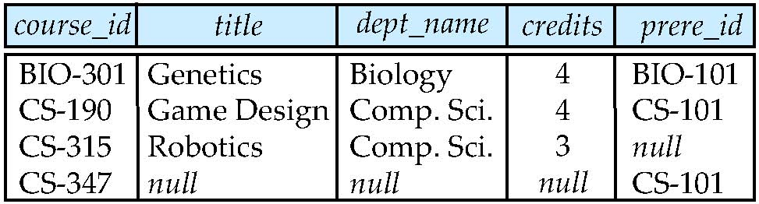
Full Outer Join
course natural full outer join prereq

Slide 52
Joined Relations
Join operations take two relations and return as a result another relation.
The join operations are typically used as subquery expressions in the from clause
Join condition – defines which tuples in the two relations match, and what attributes are present in the result of the join.
Join type – defines how tuples in each relation that do not match any tuple in the other relation (based on the join condition) are treated.
Join Types
Join Conditions
inner join
left outer join
right outer join
full outer join
natural
on <predicate>
using (A₁, A₂, ..., A_{n})

Slide 53
The end of the lecture

