Slide 1
Relational Database Design
Introduction of Relational Database Design
Atomic Domains and First Normal Form
Decomposition
Functional Dependency
Boyce-Codd Normal Form
Third Normal Form
Canonical Cover
Multi-Value Dependency and 4NF
Overall Database Design Process

Slide 2
Introduction
The goal of a relational database design is to generate a set of relation schemas that allows us
To store information without unnecessary redundancy
To retrieve information easily
This is accomplished by designing schemas that are in an appropriate normal form.
Basically, it is how to general a good relation schemas to represent an enterprise database.

Slide 3
The University Schema
classroom(building, room_number, capacity)
department(dept_name,building,budget)
course(course_id,title,dept_name,credit)
instructor(ID,name,dept_name,salary)
teaches(ID,course_id,sec_id,semester,year)
student(ID,name,dept_name,tot_cred)
sec_class(sec_id, building, room_number)
section(course_id, sec_id, semester, year, building, room_number)
instr_dept (ID, name, salary, dept_name, building, budget )
prereq(course_id,prereq_id)
time_slot(time_slot_id,day,start_time)
advisor(s_id,i_id)
takes(ID,course_id,sec_id, semester,year, grade)
This is
1NF

Slide 4
First Normal Form
Domain is atomic if its elements are considered to be indivisible units
Examples of non-atomic domains:
Set of names, composite attributes
Identification numbers like CS101 that can be broken up into parts
A relational schema R is in first normal form if the domains of all attributes of R are atomic
Non-atomic values complicate storage and encourage redundant (repeated) storage of data
E.g. Set of course stored with each student
We assume all relations are in first normal form

Slide 5
First Normal Form (Contd.)
Atomicity is actually a property of how the elements of the domain are used.
E.g. Strings would normally be considered indivisible
Suppose that students are given roll numbers which are strings of the form CS0012 or EE1127
If the first two characters are extracted to find the department, the domain of roll numbers is not atomic.
Doing so is a bad idea: leads to encoding of information in application program rather than in the database.

Slide 6
The University Schema
classroom(building, room_number, capacity)
department(dept_name,building,budget)
course(course_id,title,dept_name,credit)
instructor(ID,name,dept_name,salary)
teaches(ID,course_id,sec_id,semester,year)
student(ID,name,dept_name,tot_cred)
sec_class(sec_id, building, room_number)
section(course_id, sec_id, semester, year, building, room_number)
instr_dept (ID, name, salary, dept_name, building, budget )
prereq(course_id,prereq_id)
time_slot(time_slot_id,day,start_time)
advisor(s_id,i_id)
takes(ID,course_id,sec_id, semester,year, grade)
Is this a
good design?

Slide 7
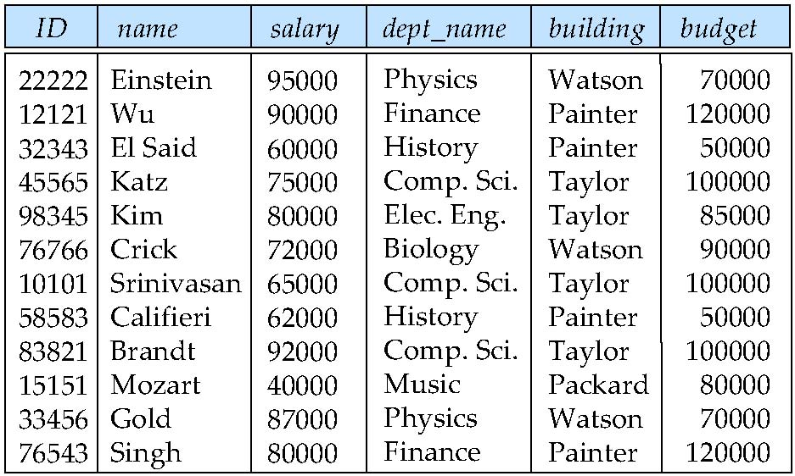
Design Alternative: Larger Schema?
Suppose we combine instructor and department into inst_dept
(No connection to relationship set inst_dept)
Result is possible repetition of information

Slide 8
Problems of repetition
Redundancy:
Data for building, budget are repeated for each instructor
Wastes space
Complicates updating
introducing possibility of inconsistency of budget value
Null values – Difficult to insert
Cannot store information about a department if no instructor exist
Can use null values, but they are difficult to handle.
Null values – Difficult to remove some information
Cannot delete the last instructor record for a department. Otherwise, the basic information of the department is removed.
Can use null values, but they are difficult to handle.

Slide 9
A Combined Schema Without Repetition
Consider combining relations
sec_class(sec_id, building, room_number) and
section(course_id, sec_id, semester, year)
into one relation
section(course_id, sec_id, semester, year, building, room_number)
No repetition in this case

Slide 10
Design Alternative: Smaller schemas?
Suppose we had started with inst_dept. How would we know to split up (decompose) it into instructor and department?
instr_dept (ID, name, salary, dept_name, building, budget )
Write a rule “if there were a schema (dept_name, building, budget), then dept_name would be a candidate key”
Denote as a functional dependency (will define later):
dept_name → building, budget
Observations of such rules will lead to a good decomposition of relation schemas.
In inst_dept, because dept_name is not a candidate key, the building and budget of a department may have to be repeated. This indicates the need to decompose inst_dept.

Slide 11
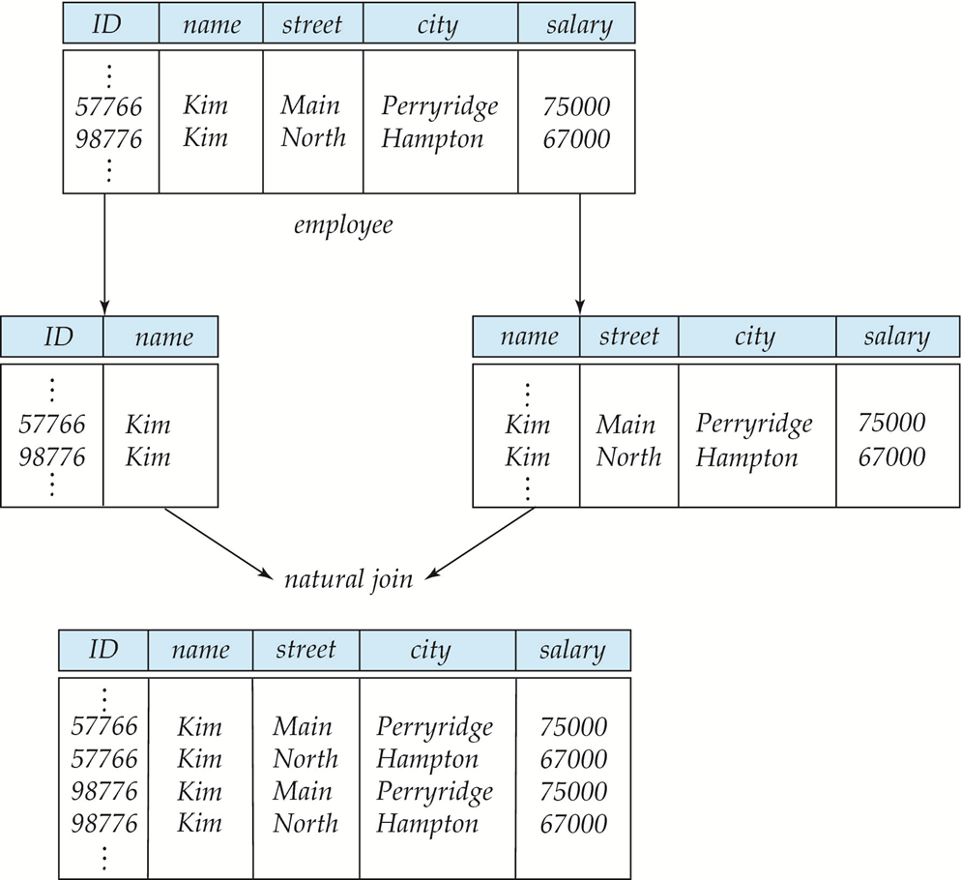
A Lossy Decomposition
Not all decompositions are good. Suppose we decompose employee into
employee1 = (id, name)
employee2 = (name, street,city,salary)
lossy decomposition: cannot reconstruct the original employee relation :

Slide 12
Pitfalls in Relational Database Design
Relational database design requires that we find a “good” collection of relation schemas. A bad design may lead to
Repetition of Information.
Inability to represent certain information.
Design Goals:
Avoid redundant data as much as possible.
Ensure that relationships among attributes are represented
Facilitate the checking of updates for violation of database integrity constraints.

Slide 13
Decomposition
Decomposition is the majority way of creating “good” relation schemas from initial relation schema design.
What is a good decomposition?
How can we know when/how to split a relation?
Combining several relations to a single one is also one possible way of creating a “good” relation schema, but only use for some particular situations, for example, two relations have same primary keys, and there are no other relationship cross the attributes among the relations. Usually, it is quiet straightforward.
What is a good decomposition?
Lossless-Join
Dependency preservations: preserve the relationship among attributes.

Slide 14
Lossless-Join Decomposition
An original schema R been split up to two relations R1 and R2
All attributes of an original schema (R) must appear in the decomposition (R₁, R₂):
R = R₁ ∪ R₂
Lossless-join decomposition. For all possible relations r on schema R
r = ∏_{R1} (r) ∏_{R2} (r)

Slide 15
Example of Lossless-Join Decomposition
Decomposition of R = (A, B, C) R₁ = (A, B) R₂ = (B, C)
A
B
C
A
B
B
C
α
β
1
2
A
B
α
β
1
2
1
2
A
B
1
1
1
r
∏_{A,B}(r)
∏_{B,C}(r)
∏_{A,B} (r) ∏_{B,C} (r)
A
B
C
不能用来证明成立！
α
β
1
2
A
B

Slide 16
Example of Non Lossless-Join Decomposition
Decomposition of R = (A, B) R₂ = (A) R₂ = (B)
A
B
A
B
α
α
β
1
2
1
α
β
1
2
∏_{A}(r)
∏_{B(r)}
r
∏_{A} (r) ∏_{B} (r)
A
B
可以用来证伪
α
α
β
β
1
2
1
2

Slide 17
Normalization Theory
Decide whether a particular relation R is in “good” form.
In the case that a relation R is not in “good” form, decompose it into a set of relations {R₁, R₂, ..., R_{n}} such that
each relation is in good form
the decomposition is a lossless-join decomposition
What is a good form?
Our theory is based on:
functional dependencies
multivalued dependencies

Slide 18
Functional Dependencies
There are usually a variety of constraints (rules) on the data in the real world.
For example, some of the constraints that are expected to hold in a university database are:
Students and instructors are uniquely identified by their ID.
Each student and instructor has only one name.
Each instructor and student is (primarily) associated with only one department.
Each department has only one value for its budget, and only one associated building.

Slide 19
Functional Dependencies (Cont.)
A legal instance of a database is one where all the relation instances are legal instances
An instance of a relation that satisfies all such constraints is called a legal instance of the relation;
The logical meaning of functional dependency: Constraints on the set of legal relations require that the value for a certain set of attributes determines uniquely the value for another set of attributes.
A functional dependency is a generalization of the notion of a key.

Slide 20
Functional Dependencies Definition
Let R be a relation schema
α ⊆ R and β ⊆ R
The functional dependency
α → β holds on R if and only if for any legal relations r(R), whenever any two tuples t₁ and t₂ of r agree on the attributes α, they also agree on the attributes β. That is,
t₁[α] = t₂ [α] ⇒ t₁[β ] = t₂ [β ]
Example: Consider r(A,B) with the following instance of r.
On this instance, A → B does NOT hold, but B → A does hold.
4
1 5
3 7

Slide 21
Closure of a Set of Functional Dependencies
Given a set F set of functional dependencies, there are certain other functional dependencies that are logically implied by F.
E.g. If A → B and B → C, then we can infer that A → C
The set of all functional dependencies logically implied by F is the closure of F.
We denote the closure of F by F⁺.
F⁺ is a superset of F.

Slide 22
Keys and Functional Dependencies
K is a superkey for relation schema R if and only if K → R
K is a candidate key for R if and only if
K → R, and
for no α ⊂ K, α → R
Functional dependencies allow us to express constraints that cannot be expressed using superkeys.
Consider the schema:
inst_dept (ID, name, salary, dept_name, building, budget )
We expect these functional dependencies to hold:
ID → building, salary
and dept_name → building
but would not expect the following to hold:
dept_name → salary
dept_name is not the superkey for inst_dept

Slide 23
Use of Functional Dependencies
We use functional dependencies to:
test relations to see if they are legal under a given set of functional dependencies.
If a relation r is legal under a set F of functional dependencies, we say that r satisfies F.
specify constraints on the set of legal relations
We say that F holds on R if all legal relations r on R satisfy F.
Note: A specific instance of a relation schema may satisfy a functional dependency even if the functional dependency does not hold on all legal instances. For example
For example, a specific instance of instructor may, by chance, satisfy name → ID.

Slide 24
Trivial Functional Dependencies
A functional dependency is trivial if it is satisfied by all instances of a relation
E.g.
ID, name → ID
name → name
In general, α → β is trivial if β ⊆ α

Slide 25
Armstrong’s Axioms
We can find all of F⁺ by applying Armstrong’s Axioms:
if β ⊆ α, then α → β (reflexivity)
if α → β, then γ α → γ β (augmentation)
if α → β, and β → γ, then α → γ (transitivity)
These rules are
sound (generate only functional dependencies that actually hold)
complete (generate all functional dependencies that hold).
Addition rules (they are correct under Armstrong’s Axioms)
If α → β and α → γ, then α → βγ (Union)
If α → βγ, then α → β and α → γ (Decomposition)
If α → β and γβ → δ, then γ α → δ (Pseudotransitivity)

Slide 26
Example
R = (A, B, C, G, H, I) F = { A → B A → C CG → H CG → I B → H}
some members of F⁺
A → H
by transitivity from A → B and B → H
AG → I
by augmenting A → C with G, to get AG → CG and then transitivity with CG → I
CG → HI
from CG → H and CG → I : “union rule” can be inferred from
definition of functional dependencies, or
Augmentation of CG → I to infer CG → CGI, augmentation of CG → H to infer CGI → HI, and then transitivity
A
B
C
H
G
I

Slide 27
Closure of Attribute Sets
Given a set of attributes α, define the closure of α under F (denoted by α⁺) as the set of attributes that are functionally determined by α under F:
α → β is in F⁺ ⬄ β ⊆ α⁺
Algorithm to compute α⁺, the closure of α under F
result := α; while (changes to result) do for each β → γ in F do begin if β ⊆ result then result := result ∪ γ end

Slide 28
Example of Attribute Set Closure
R = (A, B, C, G, H, I)
F = {A → B A → C CG → H CG → I B → H}
(AG)⁺
1. result = AG
2. result = ABCG (A → C and A → B)
3. result = ABCGH (CG → H and CG ⊆ AGBC)
4. result = ABCGHI (CG → I and CG ⊆ AGBCH)
Is AG a candidate key?
Is AG a super key?
Does AG → R?
Is any subset of AG a superkey?
Does A⁺ → R?
Does G⁺ → R?
A
B
C
H
G
I

Slide 29
Uses of Attribute Closure
There are several uses of the attribute closure algorithm:
Testing for superkey:
To test if α is a superkey, we compute α^{+,} and check if α⁺ contains all attributes of R.
Testing functional dependencies
To check if a functional dependency α → β holds (or, in other words, is in F⁺), just check if β ⊆ α⁺.
That is, we compute α⁺ by using attribute closure, and then check if it contains β.
Is a simple and cheap test, and very useful
Computing closure of F
For each γ ⊆ R, we find the closure γ⁺, and for each S ⊆ γ⁺, we output a functional dependency γ → S.

Slide 30
Goal — Devise a Theory for the Following
Decide whether a particular relation R is in “good” form.
In the case that a relation R is not in “good” form, decompose it into a set of relations {R₁, R₂, ..., R_{n}} such that
each relation is in good form
the decomposition is a lossless-join decomposition
What is a good form?
Our theory is based on:
functional dependencies
multivalued dependencies
BCNF

Slide 31
Lossless-join Decomposition
An original schema R been split up to two relations R1 and R2
All attributes of an original schema (R) must appear in the decomposition (R₁, R₂):
R = R₁ ∪ R₂
Assume F holds on R, the decomposition of R into R₁ and R₂ is lossless join if and only if at least one of the following dependencies is in F⁺:
R₁ ∩ R₂ → R₁
R₁ ∩ R₂ → R₂
Primary Key vs. Foreign Key

Slide 32
Example
R = (A, B, C) F = {A → B, B → C , A → C)
R₁ = (A, B), R₂ = (B, C)
Lossless-join decomposition:
R₁ ∩ R₂ = {B} and B → BC
R₁ = (A, B), R₂ = (A, C)
Lossless-join decomposition:
R₁ ∩ R₂ = {A} and A → AB
cannot preserve B → C

Slide 33
Boyce-Codd Normal Form
A relation schema R is in BCNF with respect to a set F of functional
dependencies if for all functional dependencies in F⁺ of the form
α → β, where α ⊆ R and β ⊆ R, at least one of the following holds:
α  → β is trivial (i.e., β ⊆ α)
α is a superkey for R
Example schema not in BCNF:
instr_dept (ID, name, salary, dept_name, building, budget )
because dept_name→ building, budget holds on instr_dept,
but dept_name is not a superkey

Slide 34
Example
R = (A, B, C) F = {A → B B → C} Key = {A}
R is not in BCNF
Decomposition R₁ = (A, B), R₂ = (B, C)
R₁ and R₂ in BCNF
Lossless-join decomposition
Good composition!

Slide 35
Testing for BCNF
To check if a non-trivial dependency α →β causes a violation of BCNF
1. compute α⁺ (the attribute closure of α), and
2. verify that it includes all attributes of R, that is, it is a superkey of R.
Simplified test: To check if a relation schema R with a given set of functional dependencies F is in BCNF, it suffices to check only the dependencies in the given set F for violation of BCNF, rather than checking all dependencies in F⁺.
We can show that if none of the dependencies in F causes a violation of BCNF, then none of the dependencies in F⁺ will cause a violation of BCNF either.
However, using only F is incorrect when testing a relation in a decomposition of R
E.g. Consider R (A, B, C, D), with F = { A →B, B →C}
Decompose R into R₁(A,B) and R₂(A,C,D)
Neither of the dependencies in F contain only attributes from (A,C,D) so we might be mislead into thinking R₂ satisfies BCNF.
In fact, dependency A → C in F⁺ shows R₂ is not in BCNF.

Slide 36
BCNF Decomposition Algorithm
result := {R}; done := false; compute F⁺; while (not done) do if (there is a schema R_{i} in result that is not in BCNF) then begin let α  → β be a nontrivial functional dependency that holds on R_{i} such that α  → R_{i} is not in F⁺, and α ∩ β = ∅; result := (result – R_{i}) ∪ (R_{i} – β) ∪ (α, β ); end else done := true;
Note: each R_{i} is in BCNF, and decomposition is lossless-join.
α  → β is bad?

Slide 37
Example of BCNF Decomposition
Example schema not in BCNF:
instr_dept (ID, name, salary, dept_name, building, budget )
dept_name → building, budget
holds on instr_dept, but dept_name is not a superkey
Decomposing
α = dept_name
β = building, budget
and inst_dept is replaced by
(α U β ) = ( dept_name, building, budget )
( R - ( β - α ) ) = ( ID, name, salary, dept_name )

Slide 38
Another Example
class (course_id, title, dept_name, credits, sec_id, semester, year, building, room_number, capacity, time_slot_id)
course_id→ title, dept_name, credits
building, room_number→capacity
course_id, sec_id, semester, year→building, room_number, time_slot_id
A candidate key {course_id, sec_id, semester, year}.
BCNF Decomposition:
course_id→ title, dept_name, credits holds
but course_id is not a superkey.
We replace class by:
course(course_id, title, dept_name, credits)
class-1 (course_id, sec_id, semester, year, building, room_number, capacity, time_slot_id)

Slide 39
BCNF Decomposition (Cont.)
course is in BCNF
How do we know this?
building, room_number→capacity holds on class-1
but {building, room_number} is not a superkey for class-1.
We replace class-1 by:
classroom (building, room_number, capacity)
section (course_id, sec_id, semester, year, building, room_number, time_slot_id)
classroom and section are in BCNF.

Slide 40
Testing Decomposition for BCNF
To check if a relation R_{i} in a decomposition of R is in BCNF,
Either test R_{i} for BCNF with respect to the restriction of F ⁺ to R_{i} (that is, all FDs in F⁺ that contain only attributes from R_{i})
or use the original set of dependencies F that hold on R, but with the following test:
for every set of attributes α ⊆ R_{i}, check that α⁺ (the attribute closure of α) either includes no attribute of R_{i}- α, or includes all attributes of R_{i}.
If the condition is violated by some α → β in F ⁺, the dependency α → (α⁺ - α ) ∩ R_{i} can be shown to hold on R_{i}, and R_{i} violates BCNF.
We use above dependency to decompose R_{i}

Slide 41
Is there any problem of decomposition?
The following example:
R = (J, K, L) F = {JK → L, L → K} Two candidate keys = JK and JL
R is not in BCNF
It can be decomposed into BCNF:
R1 = (L,K) with {L→K}
R2 = (J, L)
However, can not reproduce the functional dependency:
JK → L
Testing for JK → L requires a join

Slide 42
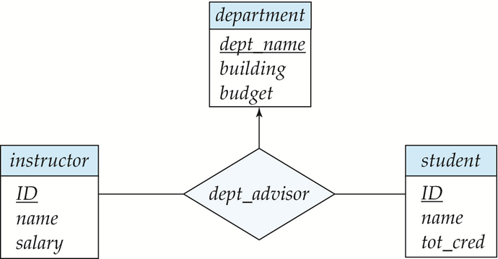
Real word sample
Revise the advisor relationship.
The E-R diagram specifies the constraint that “a student may have more than one advisor, but at most one in a given department”
There’s another constraint that “an instructor can act as advisor for only a single department”.
Relation dept_advisor:
dept_advisor (s_ID, i_ID, dept_name) F = {s_ID, dept_name → i_ID, i_ID → dept_name}
Two candidate keys: (s_ID, dept_name) and (i_ID, s_ID)
dept_advisor is not in BCNF
i_ID is not a superkey
Any decomposition of dept_advisor can not reproduce: s_ID, dept_name → i_ID

Slide 43
Dependency Preservation
Let F_{i} be the set of dependencies F ⁺ that include only attributes in R_{i}.
A decomposition is dependency preserving, if
(F₁ ∪ F₂ ∪ … ∪ F_{n} )⁺ = F ⁺
Note that if a decomposition is NOT dependency preserving then checking updates for violation of functional dependencies may require computing joins, which is expensive.
Using the above definition, testing for dependency preservation take exponential time.

Slide 44
Testing for Dependency Preservation
To check if a dependency α→β is preserved in a decomposition of R into R₁, R₂, …, R_{n} we apply the following simplified test (with attribute closure done w.r.t. F)
result = α while (changes to result) do for each R_{i} in the decomposition t = (result ∩ R_{i})⁺ ∩ R_{i} result = result ∪ t
If result contains all attributes in β, then the functional dependency α → β is preserved.
We apply the test on all dependencies in F to check if a decomposition is dependency preserving
This procedure takes polynomial time, instead of the exponential time required to compute F⁺ and (F₁ ∪ F₂ ∪ … ∪ F_{n})⁺

Slide 45
Example
R = (A, B, C) F = {A → B, B → C)
R is not in BCNF
Decomposition: R₁ = (A, B), R₂ = (B, C)
Lossless-join decomposition:
R₁ ∩ R₂ = {B} and B → BC
Dependency preserving
Decomposition: R₁ = (A, B), R₂ = (A, C)
Lossless-join decomposition:
R₁ ∩ R₂ = {A} and A → AB
Not dependency preserving (cannot check B → C without computing R₁ R₂)

Slide 46
Normalization Using Functional Dependencies
When we decompose a relation schema R with a set of functional dependencies F into R₁, R₂,.., R_{n} we want
No redundancy: Each relation is in good form
Lossless-join decomposition:
Otherwise decomposition would result in information loss.
Dependency preservation
Otherwise checking updates for violation of functional dependencies may require computing joins, which is expensive.

Slide 47
Third Normal Form: Motivation
There are some situations where
BCNF is not dependency preserving, and
efficient checking for FD violation on updates is important
Solution: define a weaker normal form, called Third Normal Form.
Allows some redundancy (with resultant problems; we will see examples later)
But FDs can be checked on individual relations without computing a join.
There is always a lossless-join, dependency-preserving decomposition into 3NF.

Slide 48
Third Normal Form
A relation schema R is in third normal form (3NF) if for all:
α → β in F⁺ at least one of the following holds:
α → β is trivial (i.e., β ∈ α)
α is a superkey for R
Each attribute A in β – α is contained in a candidate key for R.
NOTE: each attribute may be in a different candidate key)
Some times, such attribute A is called key-attribute.
If a relation is in BCNF it is in 3NF (since in BCNF one of the first two conditions above must hold).
Third condition is a minimal relaxation of BCNF to ensure dependency preservation (will see why later).
Only non key-attributes are required to be dependent with candidate key.

Slide 49
3NF Example
Example
R = (J, K, L) F = {JK → L, L → K}
Two candidate keys: JK and JL
R is in 3NF
JK → L JK is a superkey L → K K is contained in a candidate key
There is some redundancy in 3NF
Need to use null values in some case
e.g., to represent the relationship l₂, k₂ where there is no corresponding value for J
J
L
K
j₁
j₂
j₃
null
l₁
l₁
l₁
l₂
k₁
k₁
k₁
k₂

Slide 50
Another 3NF Sample
Revise the advisor relationship.
The E-R diagram specifies the constraint that “a student may have more than one advisor, but at most one in a given department”
There’s another constraint that “an instructor can act as advisor for only a single department”.
Relation dept_advisor:
dept_advisor (s_ID, i_ID, dept_name) F = {s_ID, dept_name → i_ID, i_ID → dept_name}
Two candidate keys: (s_ID, dept_name) and (i_ID, s_ID)
R is in 3NF
i_ID → dept_name,
dept_name is contained in a candidate key

Slide 51
Testing for 3NF
Optimization: Need to check only FDs in F, need not check all FDs in F⁺.
Use attribute closure to check, for each dependency α → β, if α is a superkey.
If α is not a superkey, we have to verify if each attribute in β is contained in a candidate key of R
this test is rather more expensive, since it involve finding candidate keys
testing for 3NF has been shown to be NP-hard
Interestingly, decomposition into third normal form can be done in polynomial time

Slide 52
Concept of Canonical Cover
Sets of functional dependencies may have redundant dependencies that can be inferred from the others
For example: A → C is redundant in: {A → B, B → C, A→ C}
Parts of a functional dependency may be redundant
E.g.: on RHS: {A → B, B → C, A → CD} can be simplified to {A → B, B → C, A → D}
E.g.: on LHS: {A → B, B → C, AC → D} can be simplified to {A → B, B → C, A → D}
Intuitively, a canonical cover of F is a “minimal” set of functional dependencies equivalent to F, having no redundant dependencies or redundant parts of dependencies

Slide 53
Extraneous Attributes-LHS
Removing an attribute from the left side of a functional dependency could make it a stronger constraint.
For example, if we have AB → C and remove B, we get the possibly stronger result A → C.
A → C logically implies AB → C,
but AB → C does not, on its own, logically imply A → C
But, depending on what our set F of functional dependencies happens to be, we may be able to remove B from AB → C safely.
For example, suppose that F = {AB → C, A → D, D → C}
Then we can show that F logically implies A → C, making extraneous in AB → C.
F logically implies {A → C, A → D, D → C}

Slide 54
Extraneous Attributes - RHS
Removing an attribute from the right side of a functional dependency could make it a weaker constraint.
For example, if we have AB → CD and remove C, we get the possibly weaker result AB → D.
It may be weaker because using just AB → D, we can no longer infer AB → C.
But, depending on what our set F of functional dependencies happens to be, we may be able to remove C from AB → CD safely.
For example, suppose that F = { AB → CD, A → C }
We can show that even after replacing AB → CD by AB → D, we can still infer AB → C and thus AB → CD.
{ AB → D, A → C } logically implies F

Slide 55
Extraneous Attributes - Definition
An attribute of a functional dependency α → β in F is extraneous if we can remove it from α → β without changing F ⁺
Consider a set F of functional dependencies and the functional dependency α → β in F.
LHS: Attribute A is extraneous in α, if A ∈ α and F logically implies (F – {α → β}) ∪ {(α – A) → β}.
RHS: Attribute B is extraneous in β, if B ∈ β (F – {α → β}) ∪ {α →(β – B)} logically implies F.
Note: implication in the opposite direction is trivial in each of the cases above, since a “stronger” functional dependency always implies a weaker one
(α – A) → β is stronger then α → β
α → β is stronger then α → (β – B)

Slide 56
Extraneous Attributes - Samples
Sample 1: Let F = {A → C, AB → C }
B is extraneous in AB → C because {A → C, AB → C} logically implies A → C (I.e. the result of dropping B from AB → C).
Sample2: Let F = {A → C, AB → CD}
C is extraneous in AB → CD since AB → C can be inferred even after deleting C
Sample 3: Let F = {AB → CD, A → E, E → C }
To check if C is extraneous in AB → CD, we:
Compute the closure of AB under F' = {AB → D, A → E, E → C}
The closure is ABCDE, which includes CD
This implies that C is extraneous

Slide 57
Testing if an Attribute is Extraneous
Consider a set F of functional dependencies and the functional dependency α → β in F.
To test if attribute A ∈ α is extraneous in α
compute ({α} – A)⁺ using the dependencies in F
check that ({α} – A)⁺ contains β; if it does, A is extraneous in α
To test if attribute B ∈ β is extraneous in β
compute α⁺ using only the dependencies in F’ = (F – {α → β}) ∪ {α →(β – B)},
check that α⁺ contains B; if it does, B is extraneous in β

Slide 58
Canonical Cover
A canonical cover for F is a set of dependencies F_{c} such that
F logically implies all dependencies in F_{c,} and
F_{c} logically implies all dependencies in F, and
No functional dependency in F_{c} contains an extraneous attribute, and
Each left side of functional dependency in F_{c} is unique.
To compute a canonical cover for F: F_{c} = F repeat Use the union rule to replace any dependencies in F_{c} α₁ → β₁ and α₁ → β₂ with α₁ → β₁ β₂ Find a functional dependency α → β in F_{c} with an extraneous attribute either in α or in β /* Note: test for extraneous attributes done using F_{c,} not F*/ If an extraneous attribute is found, delete it from α → β until F_{c} does not change
Note: Union rule may become applicable after some extraneous attributes have been deleted, so it has to be re-applied

Slide 59
Computing a Canonical Cover
R = (A, B, C) F = {A → BC, B → C, A → B, AB → C}
Combine A → BC and A → B into A → BC
Set is now {A → BC, B → C, AB → C}
A is extraneous in AB → C
Check if the result of deleting A from AB → C is implied by the other dependencies
Yes: in fact, B → C is already present!
Set is now { A → BC, B → C }
C is extraneous in A → BC
Check if A → C is logically implied by A → B and the other dependencies
Yes: using transitivity on A → B and B → C.
Can use attribute closure of A in more complex cases
The canonical cover is: { A → B, B → C }
Canonical cover might not be unique (see the sample in text book, page 327)
F = { A → BC, B → AC, C → AB }
F_{c} = { A → B, B → C, C → A } or {A → B, B → AC, C → B} or …..

Slide 60
3NF Decomposition Algorithm
Let F_{c} be a canonical cover for F; i := 0; for each functional dependency α → β in F_{c} do if none of the schemas R_{j}, 1 ≤ j ≤ i contains α β then begin i := i + 1; R_{i} := α β end if none of the schemas R_{j}, 1 ≤ j ≤ i contains a candidate key for R then begin i := i + 1; R_{i} := any candidate key for R; end /* Optionally, remove redundant relations */
repeat if any schema R_{j} is contained in another schema R_{k} then /* delete R_{j} */ R_{j} = R;; i=i-1; return (R₁, R₂, ..., R_{i})

Slide 61
3NF Decomposition Algorithm (Cont.)
Above algorithm ensures:
each relation schema R_{i} is in 3NF
decomposition is dependency preserving and lossless-join
The algorithm can be implemented in polynomial time.

Slide 62
Comparison of BCNF and 3NF
It is always possible to decompose a relation into relations in 3NF and
the decomposition is lossless
the dependencies are preserved
It is always possible to decompose a relation into relations in BCNF and
the decomposition is lossless
it may not be possible to preserve dependencies.

Slide 63
Design Goals
Goal for a relational database design is:
BCNF.
Lossless join.
Dependency preservation.
If we cannot achieve this, we accept one of
Lack of dependency preservation
Redundancy due to use of 3NF
Interestingly, SQL does not provide a direct way of specifying functional dependencies other than superkeys.
Can specify FDs using assertions, but they are expensive to test
Even if we had a dependency preserving decomposition, using SQL we would not be able to efficiently test a functional dependency whose left hand side is not a key.

Slide 64
Is BCNF a perfect normal form?
There are database schemas in BCNF that do not seem to be sufficiently normalized
Consider a database
classes (course, teacher, book )
such that (c, t, b) ∈ classes means that t is qualified to teach c, and b is a required textbook for c
The database is supposed to list for each course the set of teachers any one of which can be the course’s instructor, and the set of books, all of which are required for the course (no matter who teaches it).

Slide 65
How good is BCNF?
course
teacher
book
database
database
database
database
database
database
operating systems
operating systems
operating systems
operating systems
Avi
Avi
Hank
Hank
Sudarshan
Sudarshan
Avi
Avi
Pete
Pete
DB Concepts
Ullman
DB Concepts
Ullman
DB Concepts
Ullman
OS Concepts
Stallings
OS Concepts
Stallings
classes
There are no non-trivial functional dependencies and therefore the relation is in BCNF
Insertion anomalies – i.e., if Marilyn is a new teacher that can teach database, two tuples need to be inserted
(database, Marilyn, DB Concepts) (database, Marilyn, Ullman)

Slide 66
Further decomposition
Therefore, it is better to decompose classes into:
course
teacher
database
database
database
operating systems
operating systems
Avi
Hank
Sudarshan
Avi
Jim
teaches
course
book
database
database
operating systems
operating systems
DB Concepts
Ullman
OS Concepts
Shaw
text
This suggests the need for higher normal forms, such as Fourth Normal Form (4NF).

Slide 67
Multivalued Dependencies (MVDs)
Let R be a relation schema and let α ⊆ R and β ⊆ R. The multivalued dependency
α →→ β
holds on R if in any legal relation r(R), for all pairs for tuples t₁ and t₂ in r such that t₁[α] = t₂ [α], there exist tuples t₃ and t₄ in r such that:
t₁[α] = t₂ [α] = t₃ [α] = t₄ [α] t₃[β] = t₁ [β] t₃[R – β] = t₂[R – β] t₄ [β] = t₂[β] t₄[R – β] = t₁[R – β]

Slide 68
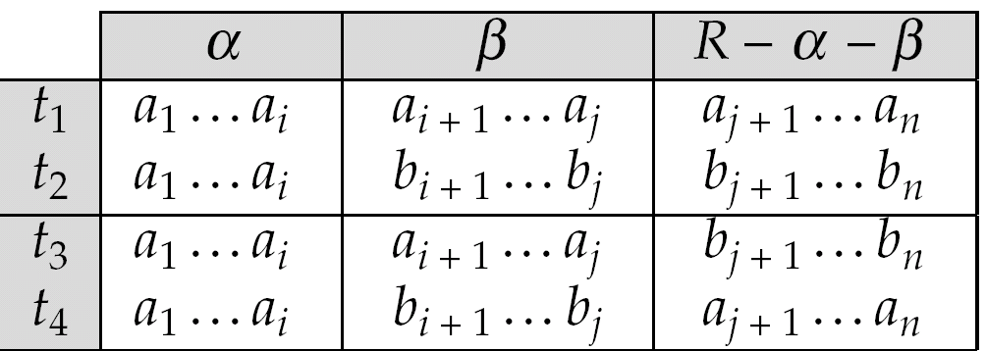
MVD (Cont.)
Tabular representation of α →→ β

Slide 69
Example
Let R be a relation schema with a set of attributes that are partitioned into 3 nonempty subsets.
Y, Z, W
We say that Y →→ Z (Y multidetermines Z ) if and only if for all possible relations r (R )
< y₁, z₁, w₁ > ∈ r and < y₁, z₂, w₂ > ∈ r
then
< y₁, z₁, w₂ > ∈ r and < y₁, z₂, w₁ > ∈ r
Note that since the behavior of Z and W are identical it follows that
Y →→ Z if Y →→ W

Slide 70
Example (Cont.)
In our example:
course →→ teacher course →→ book
The above formal definition is supposed to formalize the notion that given a particular value of Y (course) it has associated with it a set of values of Z (teacher) and a set of values of W (book), and these two sets are in some sense independent of each other.
Note:
If Y → Z then Y →→ Z
Indeed we have (in above notation) Z₁ = Z₂

Slide 71
Fourth Normal Form
A relation schema R is in 4NF with respect to a set D of functional and multivalued dependencies if for all multivalued dependencies in D⁺ of the form α →→ β, where α ⊆ R and β ⊆ R, at least one of the following hold:
α →→ β is trivial (i.e., β ⊆ α or α ∪ β = R)
α is a superkey for schema R
If a relation is in 4NF it is in BCNF
Note: The closure D⁺ of D is the set of all functional and multivalued dependencies logically implied by D.

Slide 72
4NF Decomposition Algorithm
result: = {R}; done := false; compute D⁺; Let D_{i} denote the restriction of D⁺ to R_{i}
while (not done) if (there is a schema R_{i} in result that is not in 4NF) then begin
let α →→ β be a nontrivial multivalued dependency that holds on R_{i} such that α → R_{i} is not in D_{i}, and α∩β=φ; result := (result - R_{i}) ∪ (R_{i} - β) ∪ (α, β); end else done:= true;
Note: each R_{i} is in 4NF, and decomposition is lossless-join
Same as BCNF decomposition

Slide 73
Other Normal Forms
2NF
Non key-attributes are required to be NOT partially dependent with candidate key, and can be dependent with other attributes.
Example 1: AB -> D, A-> C is not 2NF
Example 2: A-> B, B-> C is 2NF but not 3NF/BCNF
1NF/2NF/3NF/BCNF
1NF: Does not have any requirement on functional dependency.
2NF: Non key-attributes are required to be NOT partially dependent with candidate key; no restriction to key-attribute.
3NF: ALL non key-attributes are required to be dependent with candidate key, no restriction to key-attribute.
BCNF: ALL attributes are required to be dependent with candidate key.

Slide 74
Further Normal Forms
join dependencies generalize multivalued dependencies
lead to project-join normal form (PJNF) (also called fifth normal form)
A class of even more general constraints, leads to a normal form called domain-key normal form.
Problem with these generalized constraints: are hard to reason with, and no set of sound and complete set of inference rules exists.
Hence rarely used

Slide 75
Overall Database Design Process
We have assumed schema R is given
R could have been generated when converting E-R diagram to a set of tables.
R could have been a single relation containing all attributes that are of interest (called universal relation).
Normalization breaks R into smaller relations.
R could have been the result of some ad hoc design of relations, which we then test/convert to normal form.

Slide 76
ER Model and Normalization
When an E-R diagram is carefully designed, identifying all entities correctly, the tables generated from the E-R diagram should not need further normalization.
However, in a real (imperfect) design there can be FDs from non-key attributes of an entity to other attributes of the entity
Example: an employee entity with attributes dept_name and building, and a functional dependency dept_name→ building
Good design would have made department an entity
A relationship set involving more than two entity sets may result in a schema that may not be in a desirable normal form. but rare --- most relationships are binary

Slide 77
Denormalization for Performance
Occasionally, May want to use non-normalized schema for performance
For example, displaying prereqs along with course_id, and title requires join of course with prereq
Alternative 1: Use denormalized relation containing attributes of course as well as prereq with all above attributes
faster lookup
extra space and extra execution time for updates
extra coding work for programmer and possibility of error in extra code
Alternative 2: use a materialized view defined as course prereq
Benefits and drawbacks same as above, except no extra coding work for programmer and avoids possible errors

Slide 78
Other Design Issues
Some aspects of database design are not caught by normalization
Examples of bad database design, to be avoided:
Instead of earnings (company_id, year, amount ), use
earnings_2004, earnings_2005, earnings_2006, etc., all on the schema (company_id, earnings).
Above are in BCNF, but make querying across years difficult and needs new table each year
company_year(company_id, earnings_2004, earnings_2005, earnings_2006)
Also in BCNF, but also makes querying across years difficult and requires new attribute each year.
Is an example of a crosstab, where values for one attribute become column names
Used in spreadsheets, and in data analysis tools

Slide 79
End of Lecture

