Slide 1
TECH HEROES
PROJECT : P4
1

Slide 2

A
Word Cloud Generator :
You need to build a Word Cloud Generator. The generator takes in a dynamic collection of documents (i.e., new documents keep coming in) and creates a word cloud based on the frequency of unique words in the document. The generator starts with an initial collection of N documents. You can control the generator to only the top k most frequently used words. You should also be able to stop the generator from selecting a pre-defined set of words W.
.
.

Slide 3
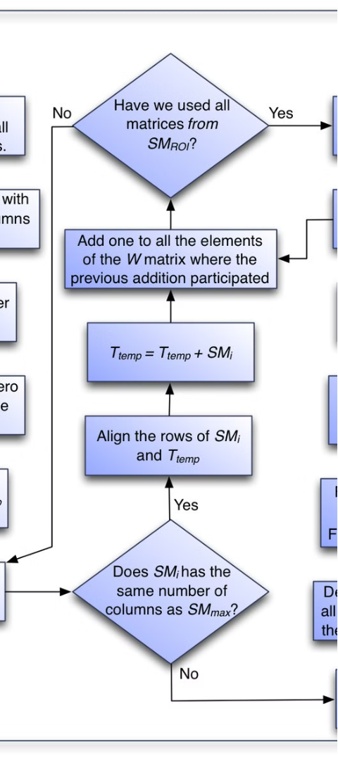
Algorithmic Approach
1
Take data from user
Gather the text data and prepare it for processing.
2
Doubly Linked List
a Doubly Linked List to store and manage the unique words and their counts.
3
Checking Processing
Analyze each word, checking for its existence in the Linked List and updating the count accordingly.

Slide 4


Handling New Words
1
Traverse the Linked List
2
Create a New Node
Check if the current word already exists in the Linked List.
If the word is not found, create a new node and insert it into the Linked List.
3
Update Word Count
If the word is found, increment the count stored in the corresponding node.

Slide 5
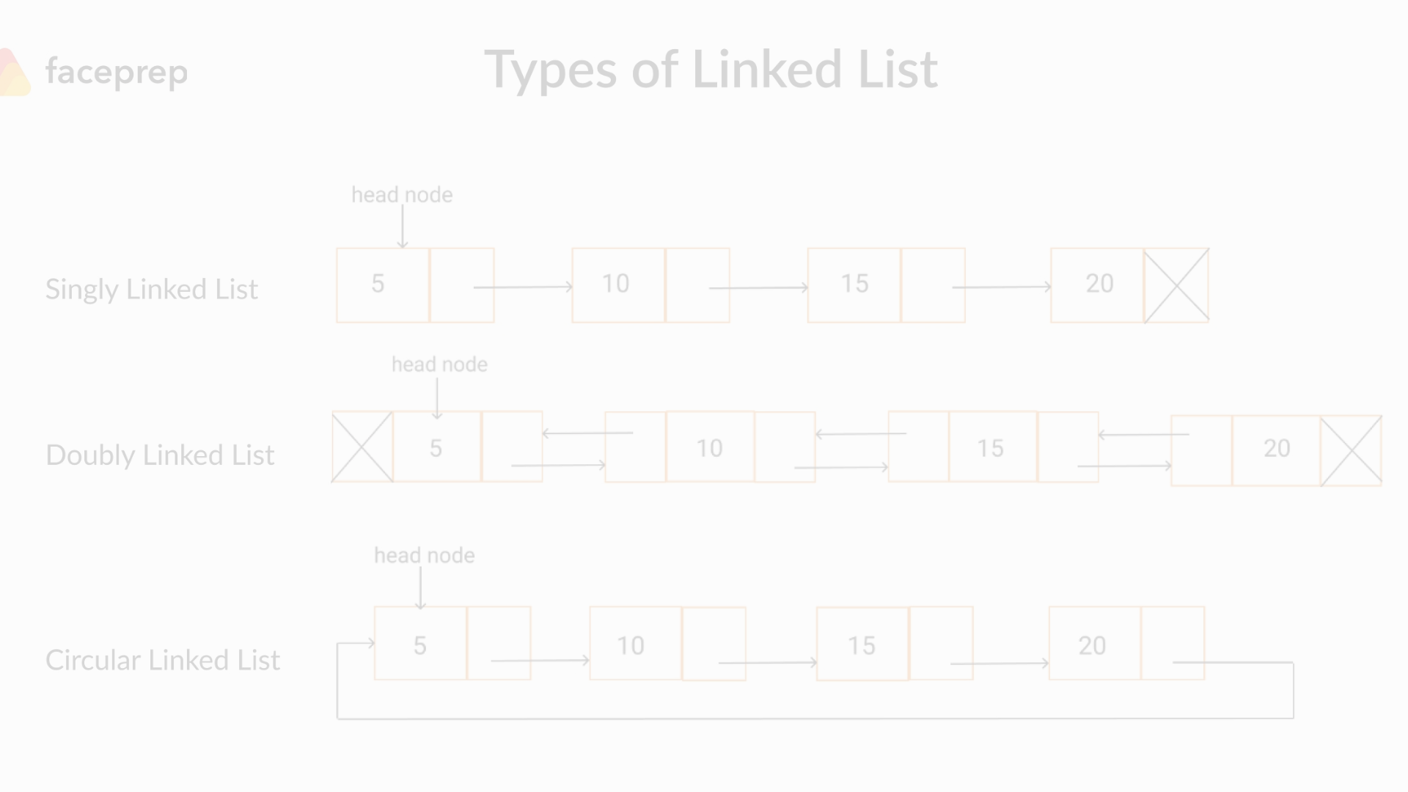



Checking for Existing Words
Traverse the List
Compare the Word
Return the Node
Start at the head of the Doubly Linked List and traverse through the nodes.
Compare the current word with the word stored in each node.
If a match is found, return the corresponding node; otherwise, return null.

Slide 6
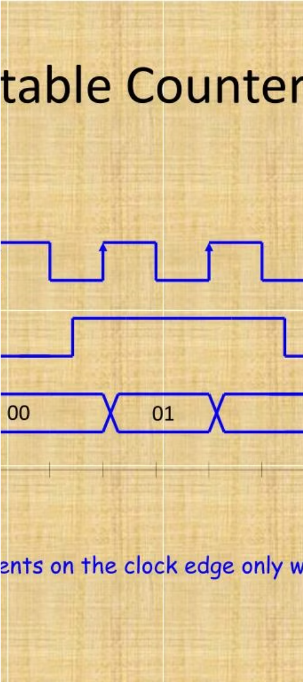
Incrementing Word Count
Retrieve the Node
Update the Count
Locate the node in the Doubly Linked List that corresponds to the current word.
Increment the count stored in the node, reflecting the increased frequency of the word.
Maintain Ordering
Reposition the node within the Linked List to maintain the correct ordering based on word count.

Slide 7
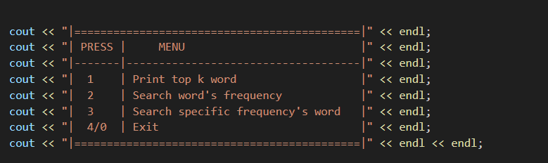
After Making Linkedlist
Give more option to user :
Print top k word
Search Specific word’s frequency
Search Specific frequency ’s words

Slide 8
Data Structure: Doubly Linked List
Bi-directional Navigation
Efficient Insertions
Flexible Modifications
New words can be seamlessly added to the Linked List, maintaining the overall structure and ordering.
Updating word counts or removing words can be easily accomplished within the Doubly Linked List framework.
The Doubly Linked List allows for easy traversal in both forward and backward directions, simplifying the process of managing word data.

Slide 9

Time Complexity :
O(N) For Add Data In Linked-list .
O(M log(M)) For Sorting Top K Word In Vectors
O(K) For Print Top K Word .
O(K) For Search Specific Word's Frequency .
O(K) For Search Specific Word's Frequency .
O(N/2) Because For We Have To Travel In Full Linked List .

Slide 10


Space Complexity :
O(K) For Add Data In Linkedlist, Where K < N . Beacuse Some Node Will Repeat Then We Only Plus Count So All Data Will Not Add
O(N) For Add Data In Vector.

Slide 11
VIDEO LINK : Click here

Slide 12
THANK YOU

