Slide 1
IT205-Data Structure
P9.TV Channel Scheduler

Slide 2
Problem(P9. TV Channel Scheduler):
You are to build a TV Channel Scheduler. The Scheduler works for family members who want to record their favorite TV series so that they can watch them later and get notified by the Scheduler when they have time (it knows their availability slots - randomly initialized). There are N members in a family, each having their favorite series out of a total of M. Multiple members may love the same series. However, the Scheduler cannot schedule a series if there is a conflict of interest. Also, members want to get on time for p slots. The Scheduler needs to minimize total episode misses.
Input data will be a file (can be txt or xls) with records in the format:
Family member name
Availability slots (will be a set of time intervals for each of 7 days)
Set (S) of favorite TV series (S <= M)
Conflict of interest means two or more overlapping intervals
“Also, members want to get on time for p slots”: This means for at least p slots (out of S), every member wants to be on time and not wait.

Slide 3
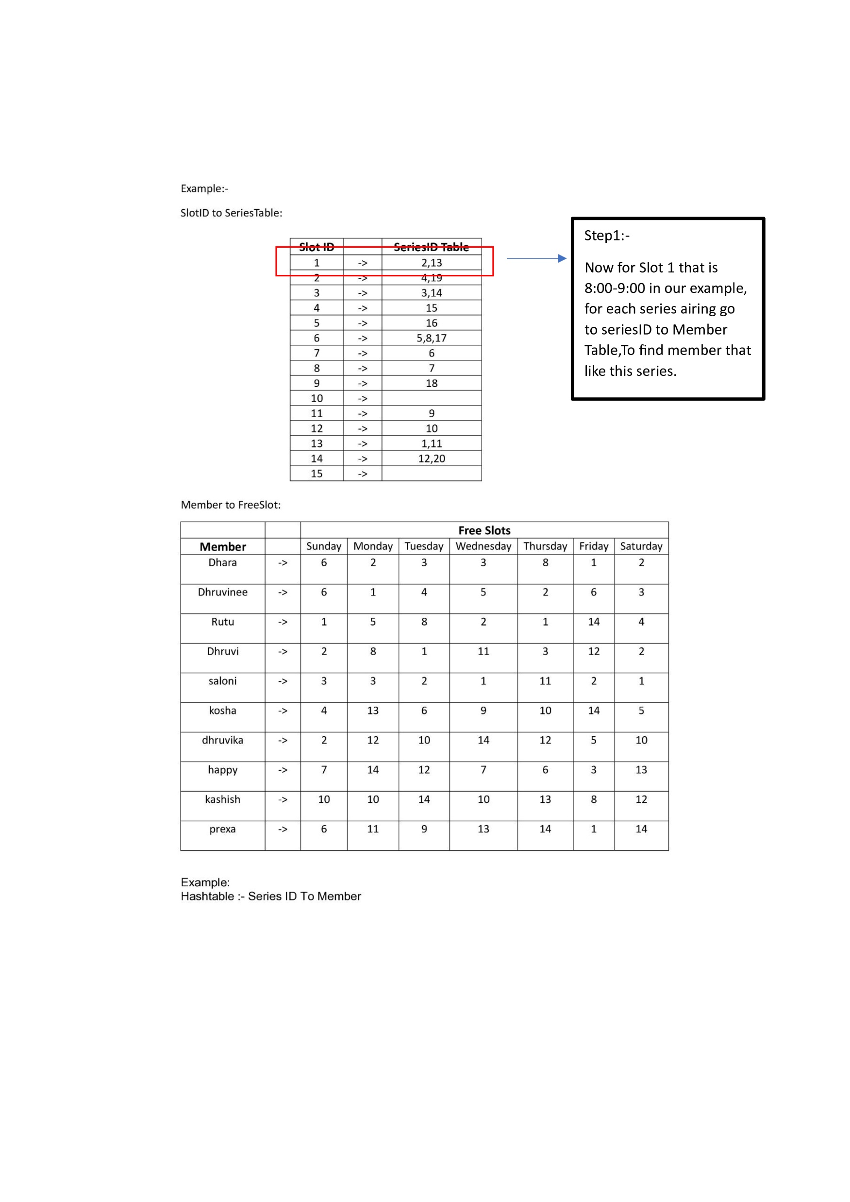
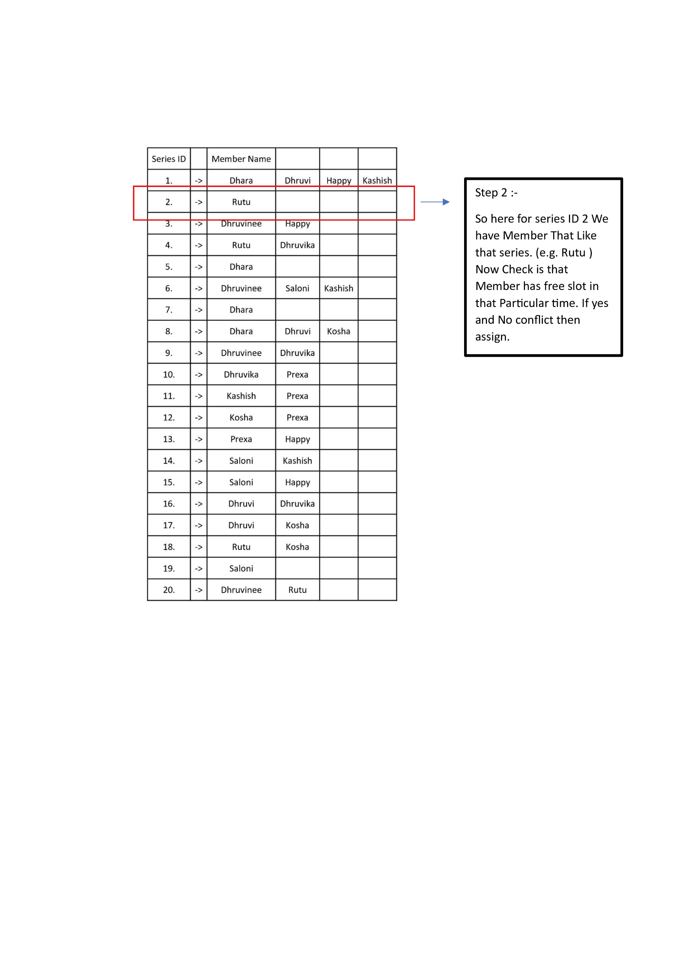
Algorithm
As shown in the picture we have made hashtables, such that for any series ID the table will lookup and find the member that likes that series and has a free slot, if it does then it will assign the member to a particular slot. Furthermore, it also checks conflicts that are 2 or more members having different favourite series and same free slot with series premiering in the slot.

Slide 4
Data Structure Chosen
Vectors: Vectors are used because of their dynamically resizing and efficient access of the elements.
Hash Table: It is used because it gave constant time for searching the particular series. As in our case we can easily look up upon the series premiering in particular slot as well as can easily find the member with another hash table.
Priority Queue: We have used priority queue for scheduling recorded series. Giving higher priority to member having watched less series, to minimize total number of misses.

Slide 5
Time Complexity
Reading Inputs: O(M) , Where M denotes the number of element in Input File
HashTable class Insertion : O(M) , M denotes Number of elements to be inserted.
TVSchedule Function : O(D*S*L*Log L) , Where D is number of days(7), S is Number of Slots Per Day(15 in our example) , L is Number of Members in each Slots.
Notification Function : O(D*S), Where D is number of days(7), S is Number of Slots Per Day(15 in our example).
Schedule Recorded Function: O(D*S*L*Log L) , Where D is number of days(7), S is Number of Slots Per Day(15 in our example) , L is Number of Members in each Slots.
Sorting Function : O(D*L*Log L), Where D denotes number of Days(7) and L denotes Member Schedules in that Day.
Printing Function : O(S) , and S denotes Total Number of Scheduled Slots.
Total Complexity : O(D*S*L*Log L) [ Maximum of all this functions]

Slide 6
Space Complexity
vector<series> : O(N) , Where M is Number of TV Series.
vector<Member> : O(M) , Where M is Number of Members.
HashTable SeriesTable : O(N) , Maximum Number of elements inserted in the table.
vector<slot> : O(D*S) ,Where D is Number of Day and S is Number of Slot per Day.
vector<vector<bool> assignStatus : O(D*S) , Where D is Number of Day and S is Number of Slot per Day.
vector<TVShow> tv :O(D*S) [for worst case], it depends on number of slots Scheduled per day.
PriorityQueue : O(L) , Where L is the average Number of Member in each slot.

Slide 7
Video of the output:
Link to the video.

Slide 8
THANK YOU

