Slide 1
DETECTive: ML-driven Automatic Test Pattern Prediction
Faults in Digital Circuits — A GNN+LSTM Approach to ATPG
Prasham Shah | Dhruvi Jobanputra April 2026
BTech Mini Project
VLSI Testing and Validation Dhirubhai Ambani University

Slide 2
Block 1 — Traditional ATPG & Motivation

Slide 3
Why ATPG?
Every fabricated chip must be tested for manufacturing defects before shipment
Defects are modelled as logical faults on internal nets; test patterns must expose them at primary outputs
Automatic Test Pattern Generation (ATPG) solves this via deterministic search — D-Algorithm, PODEM, FAN
Bottleneck: the search space scales as 2^{NPI} ; for industrial designs (N_{PI} > 10⁴) this is intractable without strong heuristics

Slide 4
Stuck-at Faults — The Standard Fault Model
Stuck-at Fault Model
A net is permanently tied to a logic value, regardless of the driving gate
SA0: net stuck at logic 0
SA1: net stuck at logic 1
Captures opens and shorts to power / ground
Two requirements for detection:
Activate — drive the faulty net to the opposite
value in the fault-free machine
Propagate — sensitise a path from fault site to a primary output
A
AND
Z
B
SA0
Fault on output net Z: activate by A=1, B=1
(good Z=1, faulty Z=0)

Slide 5
The Exponential Problem
Why simple searching fails
For N_{PI} inputs, there are 2^{NPI} possible test patterns
ISCAS-85 c1908 has 33 PIs ⇒ Total search space of 2³³ ≈ 8.6 × 10⁹ patterns
Modern chips have N_{PI} > 10⁴ (more patterns than atoms in the universe)
Testing every fault across thousands of gates becomes impossible
Traditional ATPG Solutions
Use smart search trees to find patterns instead of guessing randomly
Evolution of tools: D-Algorithm → PODEM → FAN (each faster than the last)
The Limit: They are all
”brute-force” at heart; they still slow down exponentially on complex chips

Slide 6
D-Algorithm — Roth, 1966
Roth’s D-Algebra represents good and faulty machine values simultaneously on every net.
Derivation flow for any PDCF
Goal — determine the discrepancy required at the gate output for the given fault
Singular Cover row — pick the gate-truth-table row whose output matches the goal
Good vs. Faulty Evaluation — evaluate the same input under fault-free and faulty machines
Final Vector — encode the (good, faulty) pair as a single D-algebra symbol
D-Frontier: The set of gates whose inputs carry a fault
The five values
0 | good = 0, faulty = 0
1 | good = 1, faulty = 1
D | good = 1, faulty = 0
D | good = 0, faulty = 1
X | unknown / don’t care
(D or D¯) but whose outputs are currently unassigned (X). It defines the potential paths for fault propagation.
4

Slide 7
PDCF Derivation — 2-Input AND Gate, Output SA0
Primitive D-Cube of Failure (PDCF): the minimal input assignment that produces D at the gate output for a given fault.
Step-by-step derivation:
1. Goal. Force the good machine output to 1 so that SA0 produces a discrepancy:
Z_{good} = 1, =⇒ Z = D
Zfaulty = 0
Singular Cover row. Pick the AND truth-table row giving 1: (A, B, Z) = (1, 1, 1).
Good vs. Faulty Evaluation. Z_{good} = A ∧ B = 1, while Z_{faulty} = 0 by SA0.
Final Vector. The pair (1, 0) is encoded as the symbol D.
PDCF for AND-gate output SA0
A = 1, B = 1 =⇒ Z = D

Slide 8
Working of D-Algorithm
Four phases, looped until detection or contradiction:
Fault Activation — apply the PDCF at the fault site, placing D or D
D-Drive (Forward) — pick a gate on the D-frontier, apply its propagation D-cube to push the fault effect toward a primary output
Line Justification (Backward) — recursively justify any required 0/1 assignments by setting upstream lines
Backtrack on Conflict — if any line is forced to two contradictory values, undo the last decision and try the alternative
Why it explodes
Nested justifications on internal lines, plus value conflicts at reconvergence stems, trigger exponential backtracking.

Slide 9
Limitations of D-Algorithm
The first complete ATPG algorithm
Operates on any signal line (internal or PI)
Two phases: D-drive (push D toward outputs) and consistency check (justify required values back to PIs)
Provably complete — finds a test if one exists
Foundation for all later structural ATPG
The cost
Decisions on internal nets often conflict with PI assignments
Backtracking grows exponentially
with reconvergent fanout
Justification often dominates runtime
Worst-case complexity
Reconvergent circuits push runtime exponential — motivating the move to PI-only decisions (PODEM) and structural headlines (FAN).

Slide 10
Classical ATPG: PODEM (Goel, 1981)
The Breakthrough: Instead of guessing internal wire values, restrict every decision strictly to the Primary Inputs. Let deterministic forward simulation handle the rest.
Why this changes everything
The search space collapses from 2^{k} (all internal gates) down to 2^{n} (primary inputs).
Since n ≪ k, this physically prevents the exponential explosions seen in the
D-Algorithm.
Forward simulation only: No more guessing internal wire values that lead to logical conflicts.
Two key heuristics
Objective: Identify a target (e.g., ”activate the fault” or ”push the D-Frontier forward”).
Backtrace: Walk backward from that target, through the logic gates, until a free Primary Input is found.

Slide 11
Working of PODEM — The X-Path Check
The Search Loop
Identify a target objective.
Backtrace to find an unassigned Primary Input.
Assign a 0 or 1 to that input and forward-simulate the circuit.
Check: Did the fault signal move closer to the output?
If not, backtrack and flip the input value.
The X-Path Check (The Safety Net)
Before making deep decisions, PODEM runs a quick Breadth-First Search (BFS) forward from the fault signal.
It checks if a physical path of unassigned gates (X) still exists to the output.
If the signal is trapped, it stops and backtracks immediately.

Slide 12
Worked PODEM Example — 4-Gate Circuit
Circuit Logic: y = NOT(AND(AND(a, b), OR(c, d)))
Target Fault: Inner AND-gate output stuck-at-0.
Step | Objective | PI Assignment & State
1 | Activate fault: {n₁, 1} | [a = 1]
2 | Continue activation: {n₁, 1} | [a = 1, b = 1] ⇒ Fault active (D)
3 | Propagate via AND (require OR= 1) | [a = 1, b = 1, c = 1]
4 | X-Path Check | Confirms PO (y) remains reachable
5 | Final Simulation | Output y = D¯ (Fault Detected)
Final Test Vector
(a = 1, b = 1, c = 1, d = X) — The 1-bit don’t-care (X) is preserved, demonstrating algorithm efficiency.

Slide 13
Limitations of PODEM
The Wall: While PODEM drastically reduces the search space, it still relies on blind primary input assignments. This creates bottlenecks in modern, complex designs.
Where PODEM struggles
Reconvergent Fanout: When paths split and rejoin, assigning an input to help one branch often inadvertently sabotages the other. Inefficient Backtracking: PODEM might discover a conflict deep inside the circuit, but it is forced to walk all the way back to the primary inputs to fix it.
The Next Step
To solve these inefficiencies, the industry transitioned to FAN (Fan-out Oriented Test Generation), which stops backtracing at internal ”headlines” to catch conflicts much earlier.

Slide 14
FAN — Fanout-Oriented Algorithm
Building on PODEM, FAN further reduces backtracking by exploiting circuit topology.
FAN Algorithm (Fujiwara & Shimono, 1983)
FAN = Fanout-Oriented Algorithm
→ Designed to reduce backtracking in ATPG
Improves over D-Algorithm
→ Uses circuit structure to guide search
Classifies circuit wires into:
Fanout points → signal splits into multiple paths
Bound lines → affected by reconvergence
Free lines → no reconvergence (easy to handle)
Headlines → boundary where backtracking is limited

Slide 15
Working of FAN
Fault Assignment & Implication
→ Assign fault and propagate values forward / backward
Unique Sensitisation
→ If only one path exists, assign non-controlling values directly
Multiple Backtrace (Smart Decision)
→ Uses voting + SCOAP to choose the best input
X-Path Check
→ Avoids paths that cannot reach an output
Free Line Justification
→ Solve simple regions without backtracking
The classical-ATPG ceiling
Even with FAN’s heuristics, runtime grows super-linearly with circuit size. Industrial tools are FAN descendants and remain the bottleneck in modern test flows.

Slide 16
Motivation: Why we need ATPP?
The Old Way: Classical Search
Signals split and rejoin due to reconvergence. A choice made at one gate often breaks a requirement at another.
The algorithm is forced to backtrack, undoing its work and guessing again thousands of times.
Computation time explodes exponentially as chips get more complex.
The New Way: ATPP Prediction
Instead of guessing and checking, we analyze the circuit structure as a whole.
A neural network outputs the entire test pattern in a single forward pass.
Eliminating backtracking keeps the runtime flat and predictable, even for deep logic.
From Search to Intelligence
Traditional ATPG burns time on blind search. DETECTive uses machine learning to understand circuit intent, replacing millions of guesses with one smart prediction.
Click here to view ATPG vs. ATPP Search Complexity Animation

Slide 17
Block 2 — ATPP Architecture

Slide 18
ATPP — Replacing Search with Prediction
Automatic Test Pattern Prediction (ATPP) is a learned mapping that takes a faulted netlist and outputs a fault-exposing input pattern in one pass.
There is no backtracking and no decision tree. A feed-forward neural network produces the answer directly.
The Pipeline: GNN encoder (graph → node embeddings) + Two LSTMs (variable paths
→ fixed vectors) + MLP (cone → PI prediction).
The model is trained on synthetic 4-PI circuits using brute-force enumeration (2⁴ = 16 combinations) to provide exact ground-truth patterns.
The Core Shift
Classical ATPG searches a decision tree and backtracks on conflicts. ATPP predicts the pattern directly from the physical structure of the circuit.

Slide 19
Circuit as a Graph
Step 1: Convert the gate-level netlist into a format the neural network can see.
Graph G = (V, E)
Each gate and primary input becomes a node.
Each wire becomes a directed edge pointing from the driver to the driven gate.
Edges strictly follow the combinational signal flow.
Why build a graph?
It captures the true circuit topology without flattening it into a rigid matrix.
It allows the neural network to pass information along the exact same paths the electrical signals travel.
Data Shape Tracker
We now have a mathematical graph containing N nodes.

Slide 20
Node Feature Tensor — Giving the Graph Meaning
Step 2: Attach a mathematical feature vector to every single node.
The 11 dimensions per node:
9 dimensions: A one-hot encoding of the gate type (INPUT, AND, NAND, OR, NOR, XOR, XNOR, NOT, BUF).
1 dimension: ln(1 + fanout). Log-scaling prevents high-fanout nets from blowing up our gradients during training.
1 dimension: The is_faulty flag. It is set to 1.0 specifically on the fault site and 0 everywhere else. This is the anchor that tells the network exactly where to focus.
Data Shape Tracker
The graph is now represented by an input tensor X ∈ R^{N×11}. Every single one of the N nodes carries 11 distinct features.

Slide 21
GNN Encoder — Graph Attention and Convolution
Step 3: Process the graph so the gates understand their local neighborhoods.
1× GAT layer (Graph Attention)
Learns importance weights for each path.
Fan-out is asymmetric; not all branches are useful. GAT pays selective attention to paths that actually propagate the fault.
2× GCN layers (Graph Convolution)
Smooths and diffuses the feature data across the graph.
Two layers extend the receptive field, ensuring each node is aware of its 2-hop neighborhood.
Data Shape Tracker
The GNN processes the raw X ∈ R^{N×11} input and generates rich spatial embeddings. The new tensor shape is H ∈ R^{N×32}.

Slide 22
Path Extraction — Bridging Graph to Sequence
Step 4: Extract physical routes from the spatial graph to prepare data for LSTM processing.
Tracing the Routes (Hybrid BFS+DFS)
Activation Paths: BFS finds the shortest PI-to-fault path; capped DFS gathers additional routes.
Propagation Paths: BFS identifies the fastest path to any PO; DFS ”tops up” the remaining budget.
Result: A sequence of Gate IDs representing continuous electrical paths.
Budgeting and Constraints
Path Cap: Restricted to 10 activation and 10 propagation paths (First-found wins).
Search Guard: DFS limited to a 500-node horizon to prevent exponential blow-up.
Data Shape Tracker
Static Graph (H ∈ R^{N×32}) −→ Sequential Paths (S ∈ R^{1×L×32}).

Slide 23
Two LSTMs — Handling Variable Length Paths
Step 5: Extract paths and compress them. A path can be 3 gates long or 30 gates long. Neural networks require fixed sizes, so the LSTM compresses this variable length (L) into a static vector.
Activator LSTM
Consumes activation paths (PI → fault site).
We must append the specific fault-type bit (SA0 / SA1) to the final hidden state so the network knows what value to force.
Propagator LSTM
Consumes propagation paths (fault site
→ PO).
No fault-type is needed here, because propagating an error is fault-agnostic once excited.
Data Shape Tracker
The LSTM takes variable-length sequences (R^{1×L×32}). The Activator outputs a fixed R³³ vector. The Propagator outputs a fixed R³² vector.

Slide 24
Cone Embedding — Fusing the Physical Context
Step 6: A fault might have hundreds of possible paths. We cap extraction at 10 activation paths and 10 propagation paths to create a single, unified descriptor.
Activation slot: 10 paths × 33 dimensions = 330
Propagation slot: 10 paths × 33 dimensions = 330
If a fault has fewer than 10 paths, we zero-pad the missing slots. This guarantees our network always receives the exact same input size.
Data Shape Tracker
We concatenate these slots to form the Cone Matrix: C ∈ R⁶⁶⁰.
The Final MLP Predictor
660
NPI
C ∈ R −→ MLP −→ p^ ∈ [0, 1]
The MLP reduces the 660-dimension cone into our final prediction: the probability that each Primary Input should be a 1 or a 0.

Slide 25
Multi-Oracle Challenge — Dynamic Target Selection
Problem: for a single fault, many valid test patterns exist. A fixed target would penalise the model for predicting a different but equally valid pattern.
Solution: Dynamic Target Selection
Maintain the pool T = {t⁽¹⁾, t⁽²⁾, . . . } of all valid patterns per fault (from brute-force enumeration)
At each training step, select the target with minimum Hamming distance to the current prediction:
⋆
^
t = arg min d p, t
t∈T
H
Compute the loss against t⋆ rather than a fixed reference
Effect on training
The model is penalised only relative to the closest valid solution. Gradient direction stays consistent across epochs and convergence stabilises.

Slide 26
The Loss Function — Binary Cross-Entropy
Each PI bit is an independent Bernoulli prediction; Binary Cross-Entropy is applied over all N_{PI} bits.
BCE loss
^{N}PI h i L_{BCE} = − ^{Σ} y_{i} log(p_{i}) + (1 − y_{i}) log(1 − p_{i}) i=1 where y_{i} ∈ {0, 1} is the (dynamically selected) target bit and p_{i} ∈ (0, 1) is the model’s predicted probability.
Why this loss
Each PI is a binary decision ⇒ Bernoulli output ⇒ BCE is the natural choice
Penalises confident wrong predictions strongly; light penalty for confident correct
Provides stable gradients across epochs — the property required for bit-wise classification

Slide 27
Training Convergence — Why 100 Epochs, Not 1000
Observed dynamics
Best validation bit-accuracy: 83.58% at epoch 40
Train accuracy keeps climbing:
0.90 → 0.93 over epochs 40–100
Val pinned at ∼ 0.83 for the remaining 60 epochs
Train–val gap: textbook overfit
Why this is fine
The paper trains 1000 epochs but never publishes a convergence curve
The model reaches its natural ceiling at epoch 40
Continuing past ep 40 only widens the train–val gap — no accuracy gain
Best-epoch checkpoint is the reported model
Per-cell vs. pool average
The paper’s “> 90%” is a per-cell mean over Fig 5a buckets. The val pool mixes all depths 4–30. On shallow buckets the model already hits 93–100% — 0.83 is the overall pool average dragged down by the deepest buckets.

Slide 28
Block 3 — Results & Honest Limitations

Slide 29
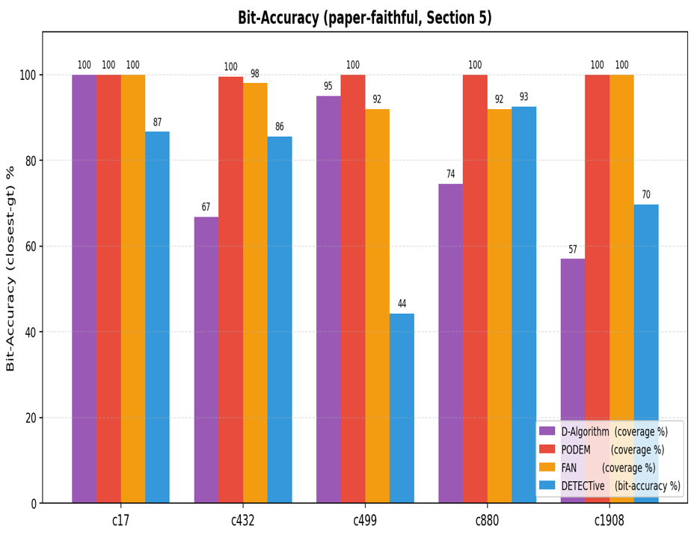
Synthetic Grid — Paper Fig 5a Replication
Synthetic test set: held-out combinational circuits varying input width and depth.
Figure 1: Per-bucket bit-accuracy across (circuit-size × depth) on the val set.
Headline numbers
Pool average: 83.58% (val, n = 3,000). Shallow buckets (input_size 4, depth ≤ 8): 93–100% — matches paper-grade Fig 5a per-cell numbers.
Performance remains strongest in low-depth regimes, with mild degradation as circuit complexity increases.

Slide 30
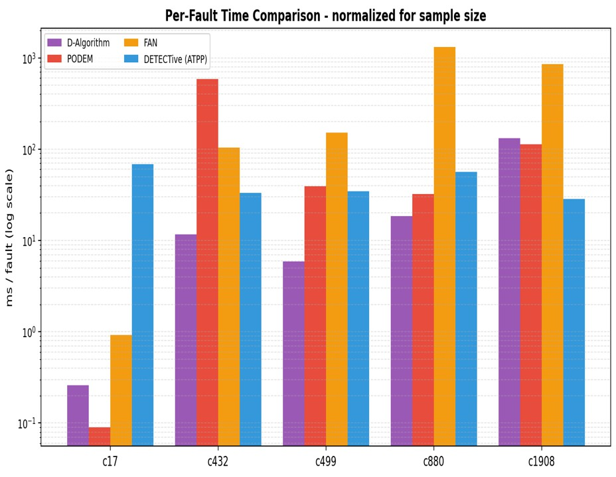
Runtime — The O(1) Forward Pass
Classical ATPG (PODEM, D-Algorithm, FAN): runtime per fault scales with circuit depth and reconvergent fanout, dominated by backtracking.
ATPP: once trained, prediction is a single forward pass — a constant-time operation per fault, independent of circuit-specific search complexity.
Figure 2: Per-fault runtime (ms) across the 4-way comparison on ISCAS-85.
Measured speedup
17.6 × faster than PODEM, measured on c432
Constant-time inference eliminates backtracking overhead, explaining the large empirical speedup.

Slide 31
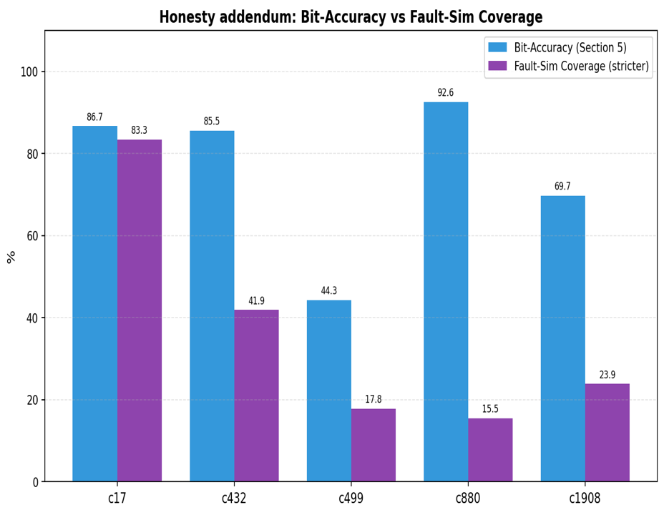
Generalisation to ISCAS-85 — Bit-Accuracy
Transfer test: model trained on synthetic 4-PI circuits, evaluated on real ISCAS-85 designs scaling up to c1908 (∼360 gates).
Figure 3: Bit-accuracy on c17, c432, c499, c880, c1908.
ATPP bit-accuracy by circuit
Circuit | c17 | c432 | c499 | c880 | c1908
Bit-acc | 86.7% | 85.5% | 44.3% | 92.6% | 69.7%
Range 44–93% — the c499 and c1908 dips reflect heavy XOR reconvergence and deep paths, consistent with the trend in Fig. 7b.

Slide 32
Bit-Acc vs. Fault-Sim Coverage — The Honesty Slide
Two metrics, both measured. Bit-accuracy is the paper-faithful metric (Section 5). Fault-sim coverage is stricter — does the predicted pattern actually expose the fault under simulation?
Comparative measurements on ISCAS-85
Circuit Bit-Accuracy (%) Fault-Sim Coverage (%) c17 86.7 83.3 c432 85.5 41.9 c499 44.3 17.8 c880 92.6 15.5 c1908 69.7 23.9
The paper itself acknowledges this trade-off
“DETECTive is trained to generate a single test pattern …prioritising it rather than aiming for broader fault coverage.” — DETECTive paper, Section 5.

Slide 33
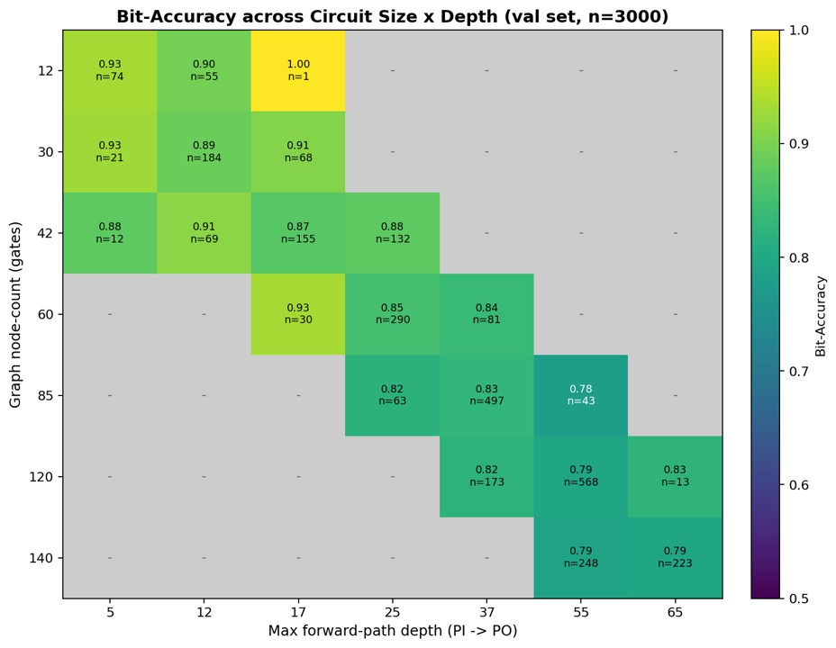
Limitation 1 — Depth Degradation
LSTM depth degradation: a path of length L is compressed to R³², and early-step information fades as L grows.
Figure 4: Bit-accuracy vs. activation-path length (fault depth) on the val set.
Smooth degradation: ≈ 0.89 at depth 1 →≈ 0.78 at depth 25
Effective memory horizon decays as path length grows — a known property of recurrent encoders
Suggests future use of attention mechanisms or hierarchical pooling for deeper circuits
Information from early timesteps is progressively compressed, limiting long-range dependency capture.
29

Slide 34
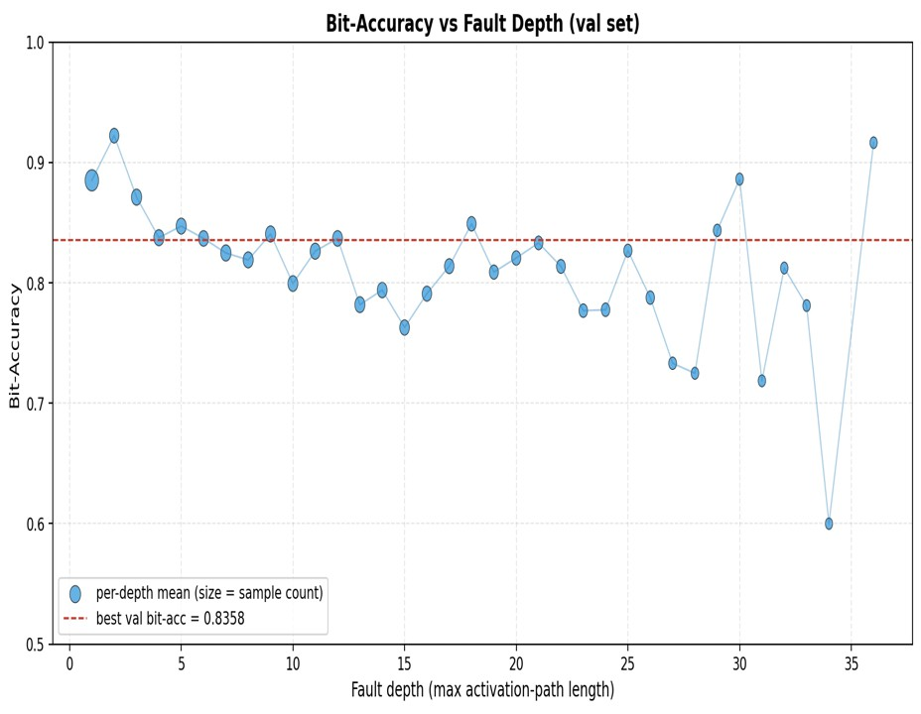
Limitation 2 — Reconvergent Fanout (c499)
The hardest ISCAS-85 case: c499 is XOR-tree heavy with the highest reconvergence ratio in the tested suite.
Figure 5: Bit-Accuracy vs. Fault Depth (Validation Set)
Cone C ∈ R⁶⁶⁰ is a flat concatenation of 20 path slots
Heavy reconvergence ⇒ paths share long prefixes / suffixes; slot embeddings become correlated
Result: 44.3% bit-accuracy on c499 vs. 92.6% on the structurally similar but less reconvergent c880
A set-equivariant aggregator (DeepSets, attention pooling) would respect path interchangeability
Correlated path embeddings reduce effective feature diversity, degrading generalisation.
30

Slide 35
Future Enhancements and Scalability
Two directions extend this work and directly target the limitations identified above.
SCOAP Parameter Integration
Incorporate Sandia Controllability / Observability Analysis Program (SCOAP) metrics to rank the extracted paths
Instead of arbitrary selection, the model prioritises the most “testable” paths for the top-10 budget
Reduces slot noise in the cone embedding and improves LSTM convergence on deep circuits
Ensemble Modeling
Implement the paper’s ensemble approach by training multiple DETECTive instances with different random seeds
Aggregating predictions across models can boost fault coverage by up to 12%
Compensates for single-instance prediction errors on hard cases (c499, c1908)
Mapped to this work’s limitations
SCOAP addresses depth degradation (Limitation 1) by directing the LSTM toward informative paths. Ensembles address reconvergence (Limitation 2) by averaging out
31

Slide 36
Conclusion — A Paradigm Shift
A New Way of Testing: We successfully transitioned from manual search to intelligent structural prediction.
Traditional vs. Proposed
Classical Search: Spends massive time navigating decision trees and undoing mistakes (backtracking).
Our Approach (ATPP): Analyzes the circuit structure as a whole to predict the test pattern in one direct pass.
Key Project Outcomes
Proved that Graph Attention (GAT) can effectively learn path importance in digital logic.
Successfully handled complex,
variable-length paths using a dual-LSTM architecture.
The Impact
Significant Speedup: Achieved a 17.6× speed increase over PODEM on industrial benchmarks.
High Reliability: Delivered 83.58% overall accuracy, reaching nearly 100% on common circuit depths.
32

Slide 37
Thank you
Questions & discussion welcome

