Slide 1










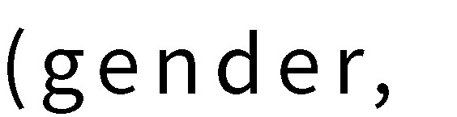
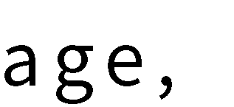
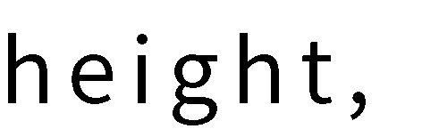


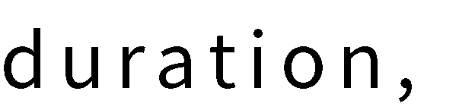

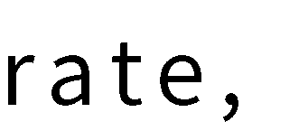

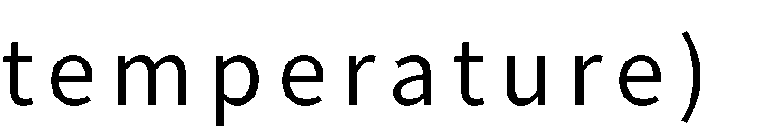



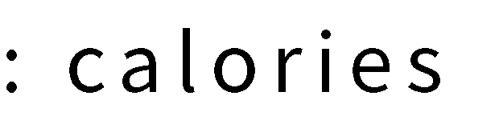


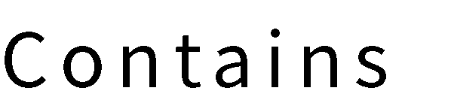
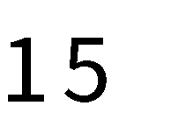

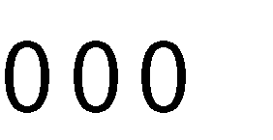
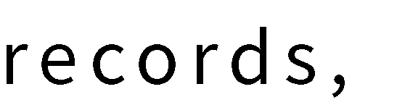
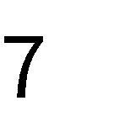

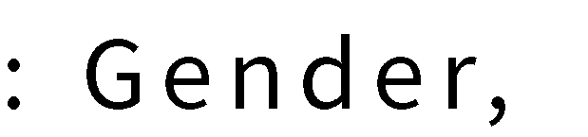
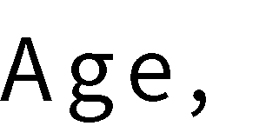
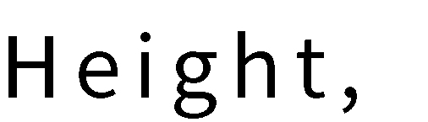

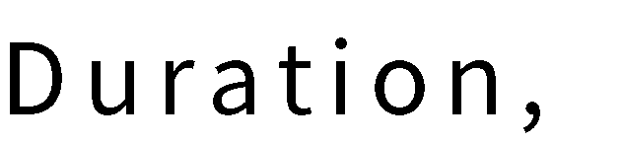
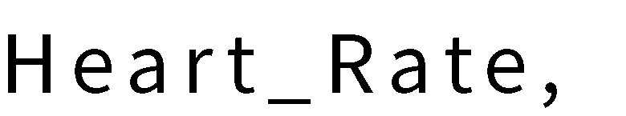

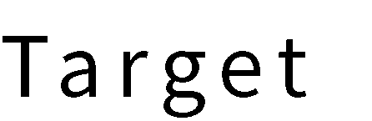
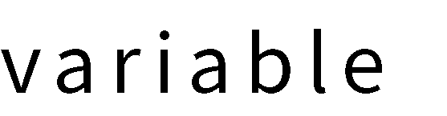
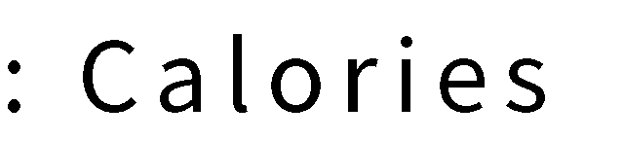
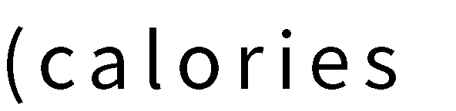
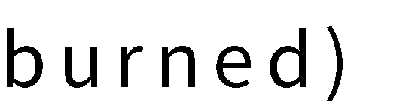


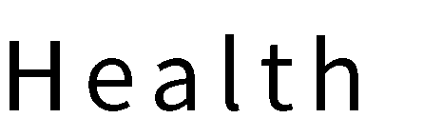
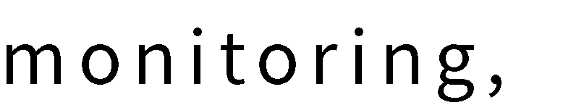




Slide 2


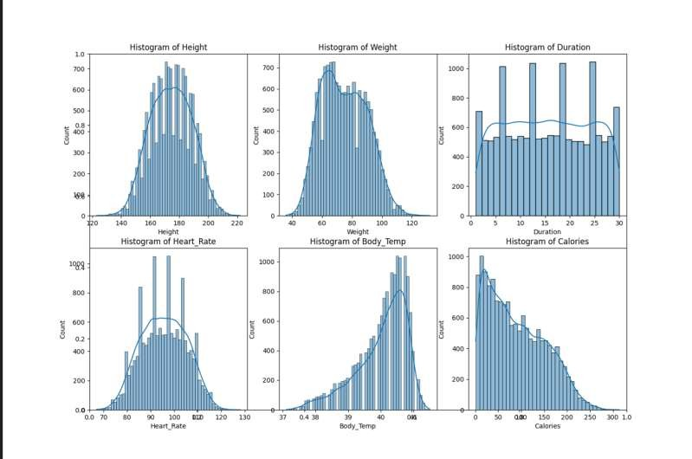
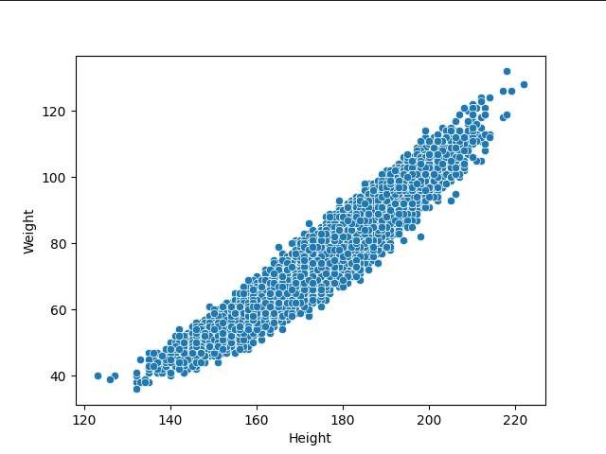

Slide 3
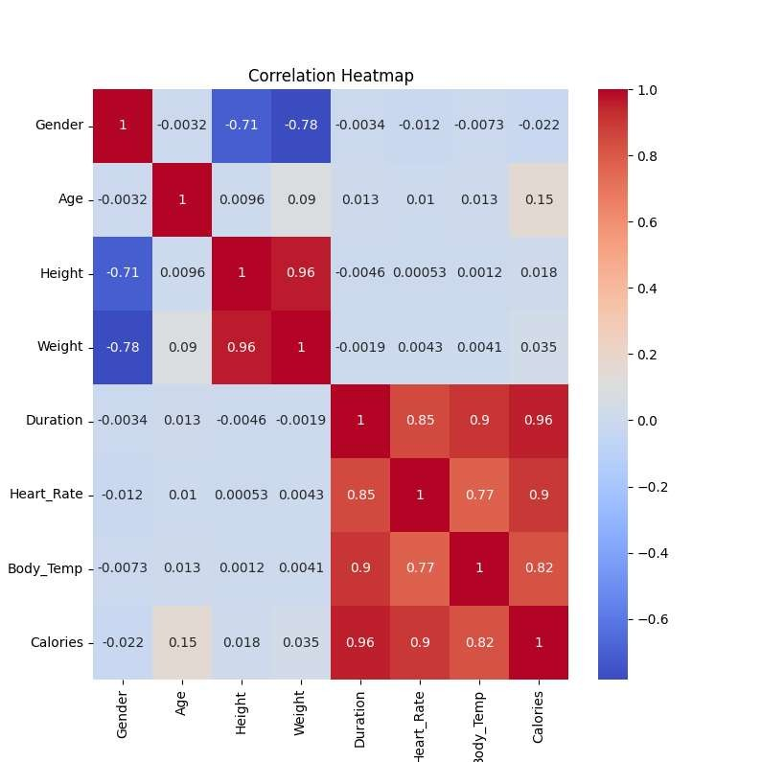
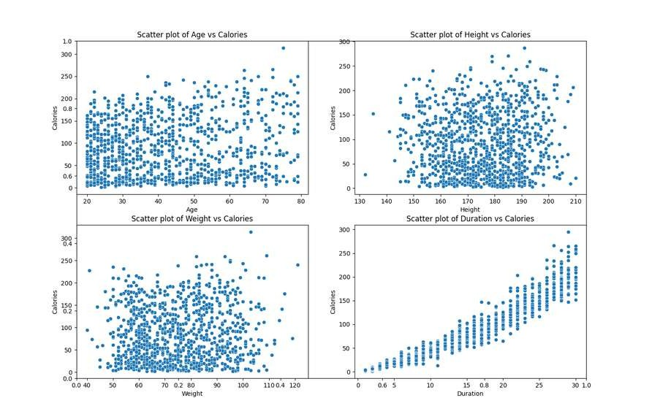







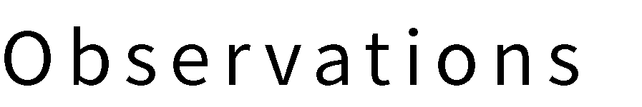
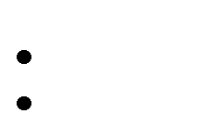

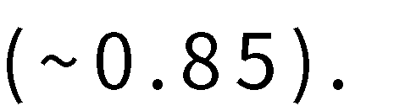


Slide 4
Methodologies
√
DATA PREPROCESSING
√
MODEL SELECTION AND HYPERPARAMETER TUNING
Feature Scaling:
Numerical features (Age, Height, Weight, Duration, Heart_Rate, Body_Temp) are standardised using
StandardScaler
Dataset Segmentation:
80% training set, 20% test set (42 random seeds).
Models used:
Linear regression, Ridge regression, Lasso regression
Random Forest, XGBoost, Neural Networks (MLP)
Hyperparameter Tuning:
Optimise hyperparameters using GridSearchCV (5 fold cross validation).

Slide 5

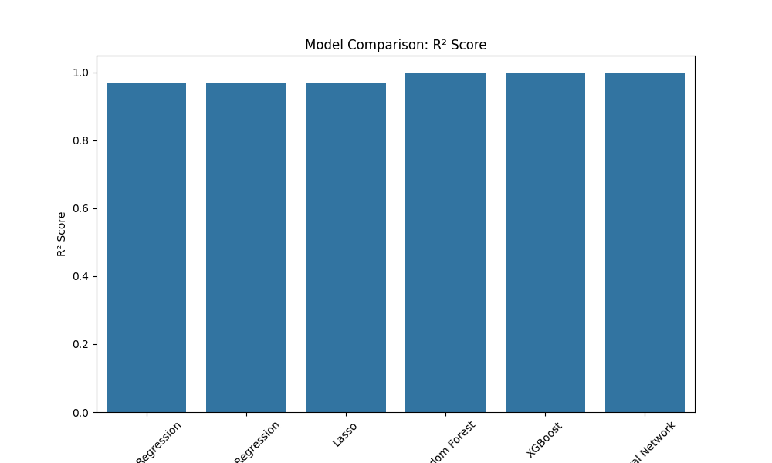
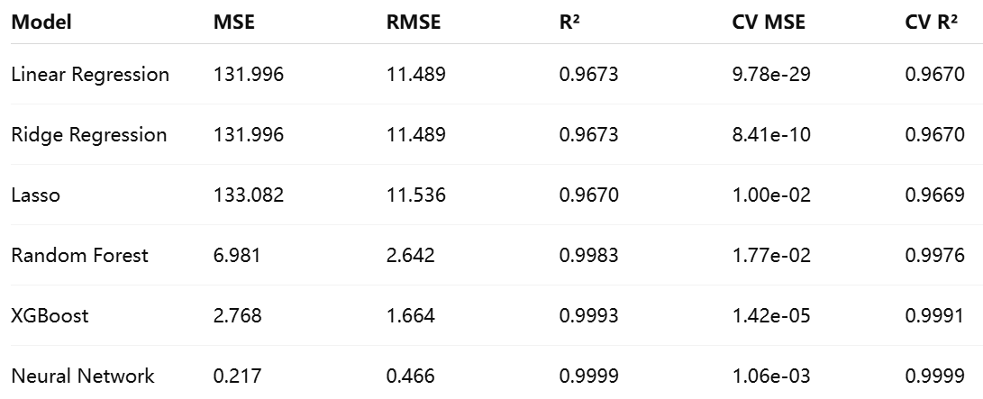
PERFORMANCE INDICATORS

Slide 6
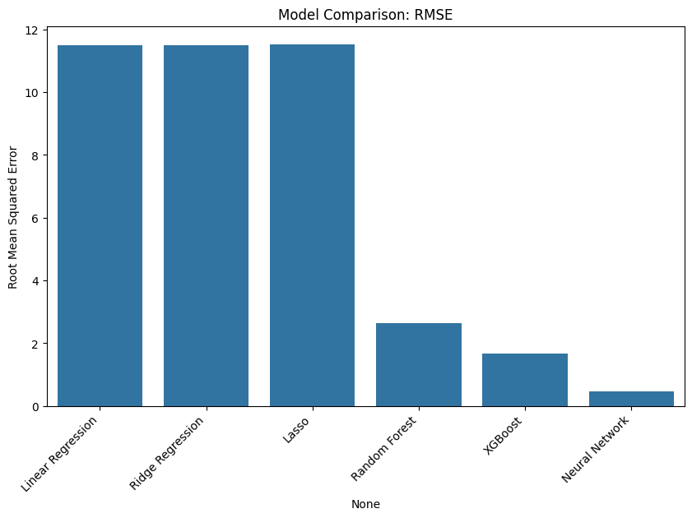
Results: comparison of model performance
Observation：
The neural network performed best (R²=0.9998, RMSE=0.79).
XGBoost was next best (R²=0.9991, RMSE=1.664).

Slide 7


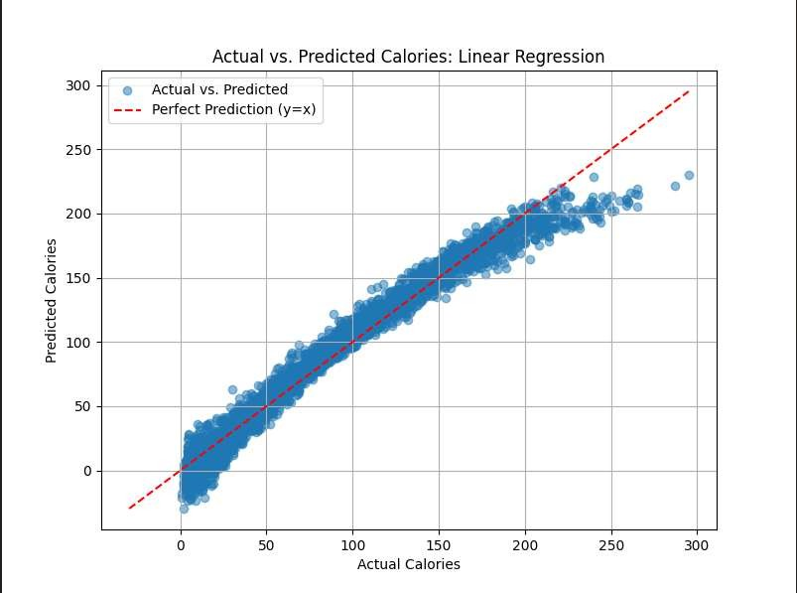
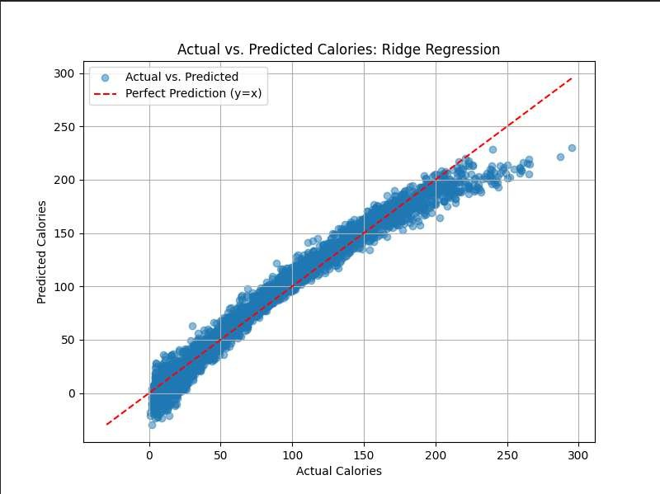

Slide 8
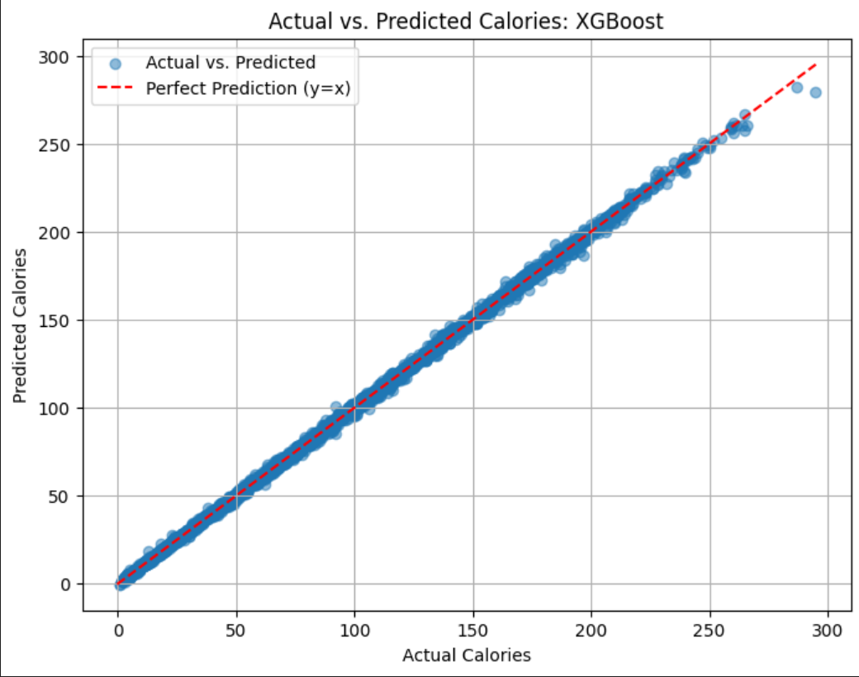
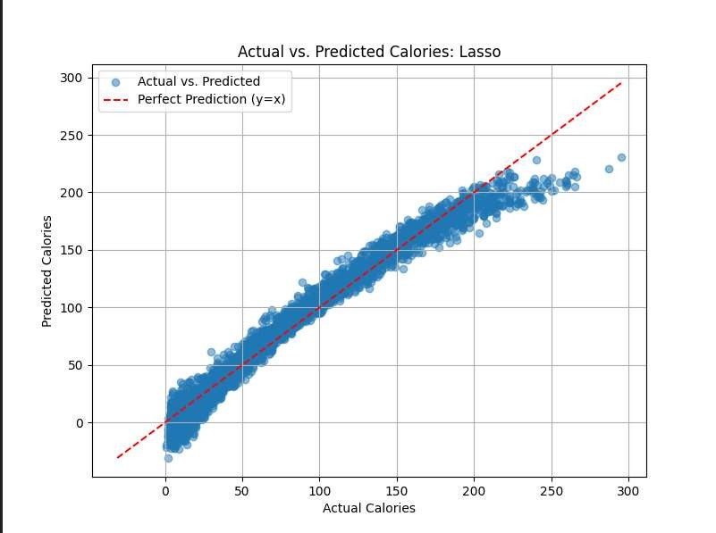

Slide 9
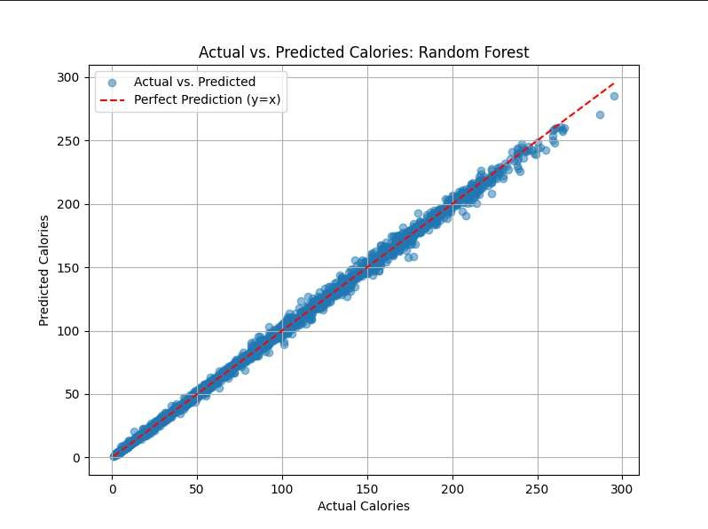
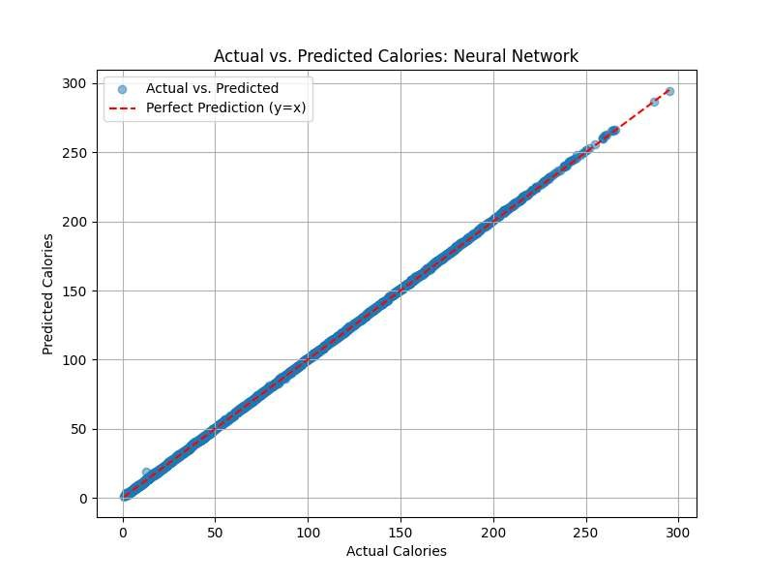

Slide 10
Linear models (Linear, Ridge, Lasso):
Errors fluctuate widely and show significant systematic bias.
This indicates that these models fail to adequately capture the complex relationships in the data and suffer from underfitting.
Random Forest and XGBoost:
The margin of error is significantly reduced.
The predictions are more accurate, suggesting that these tree models are better at modelling non-linear relationships.
Neural Network:
Little to no visible error.
The error curve is very close to the zero line, indicating the best fit and extremely high accuracy.

Slide 11
DISCUSSION: MODELLING PERFORMANCE ANALYSIS
Neural Networks and XGBoost and Random Forests:
Capturing non-linear relationships with excellent performance (R²>0.997).
Higher computational cost and long training time.
Linear regression type models :
Simple and explanatory, but assumes a linear relationship and limited performance (R² ≈ 0.967).
Performs poorly on non-linear patterns (e.g. Age and Calories).
CV MSE Exception.
Cross-validation MSE values are abnormally small (e.g., 9.78e-29), there may be a data preprocessing problem that requires further examination.

Slide 12



