Slide 1




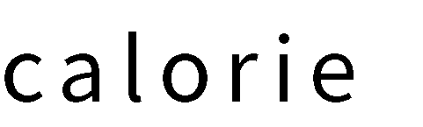





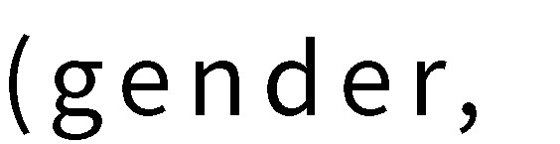
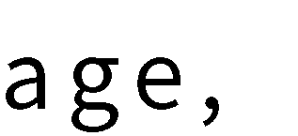
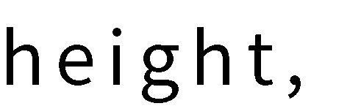


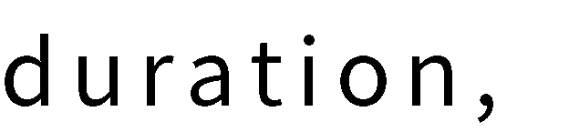
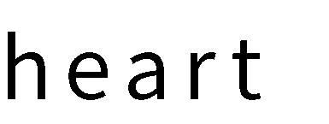
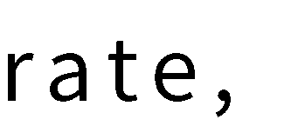

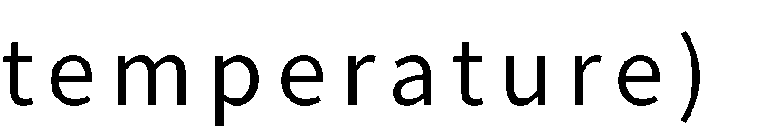



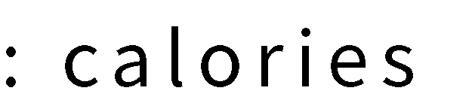


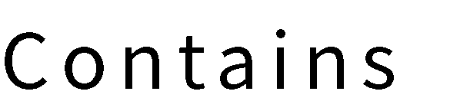
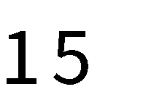

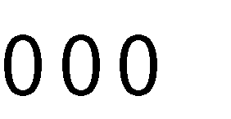
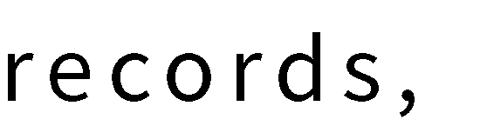
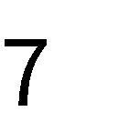

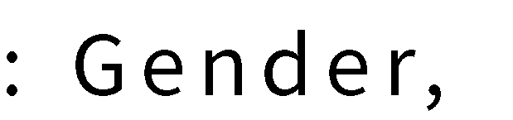
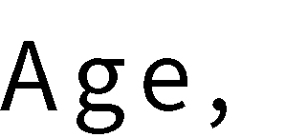
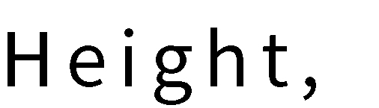

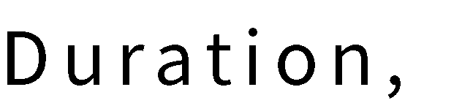
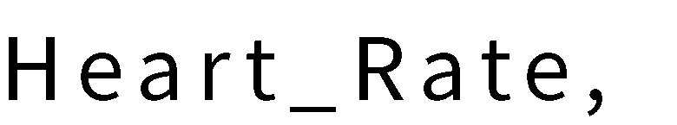

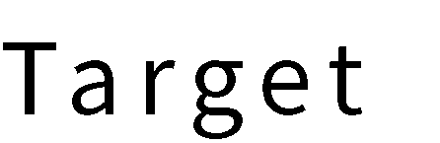
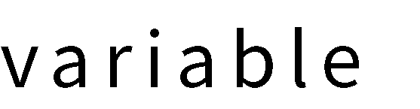
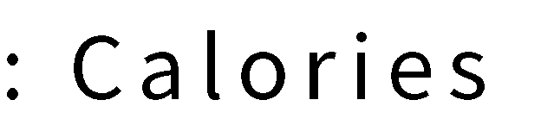
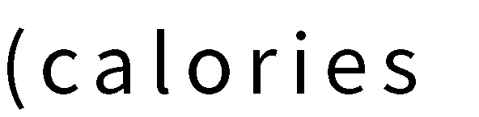
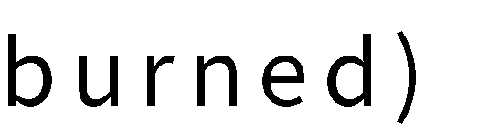


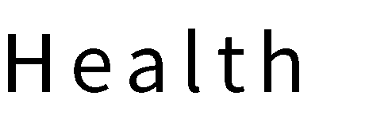
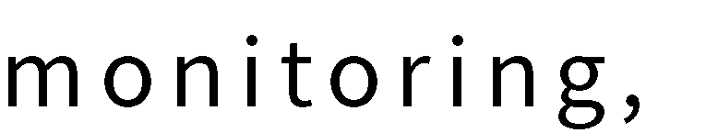




Slide 2


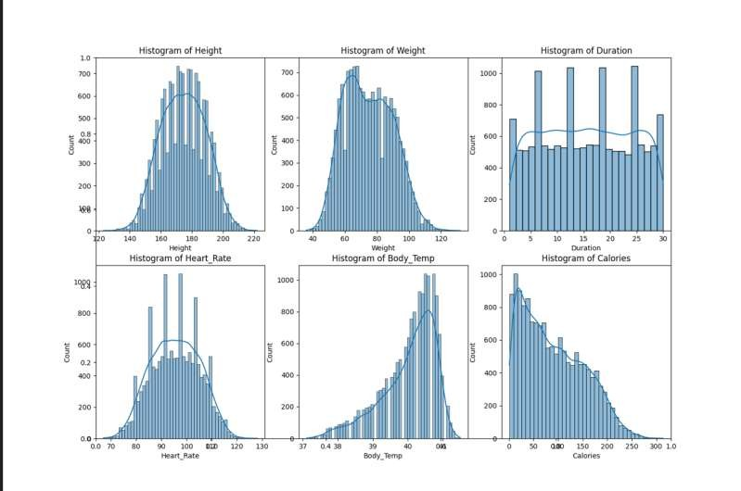
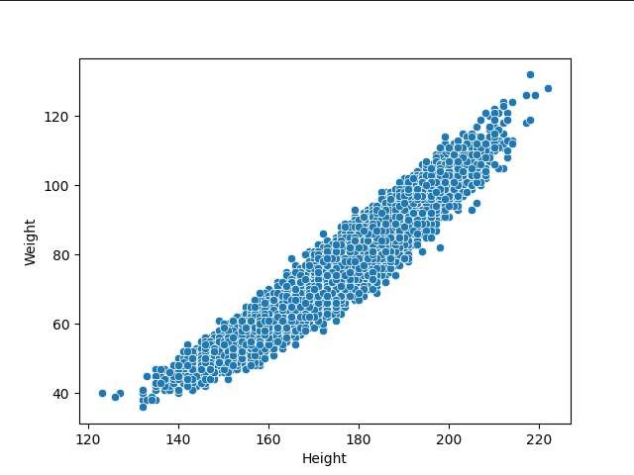

Slide 3
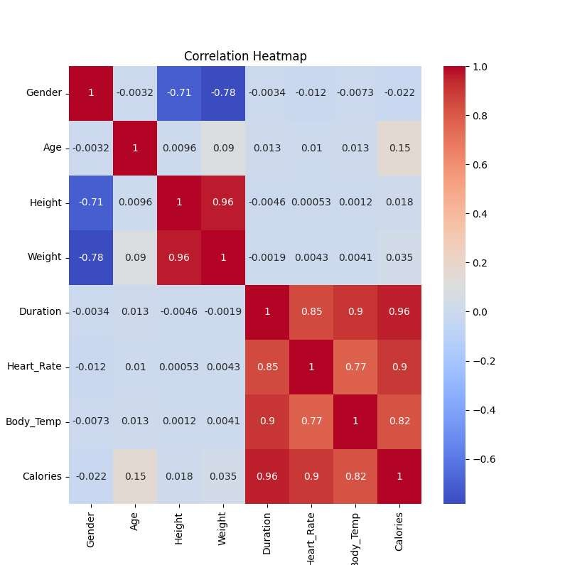
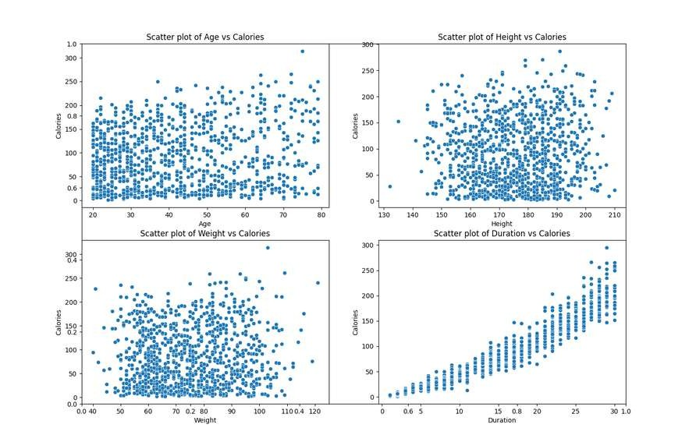







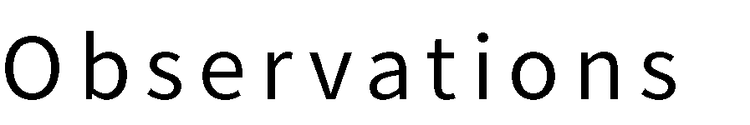
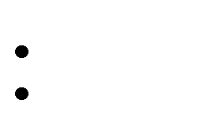

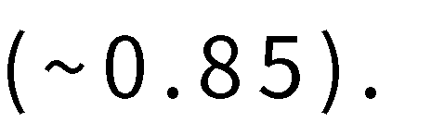


Slide 4
Methodologies
√
DATA PREPROCESSING
√
MODEL SELECTION AND HYPERPARAMETER TUNING
Feature Scaling:
Numerical features (Age, Height, Weight, Duration, Heart_Rate, Body_Temp) are standardised using
StandardScaler
Dataset Segmentation:
80% training set, 20% test set (42 random seeds).
Models used:
Linear regression, Ridge regression, Lasso regression
Random Forest, XGBoost, Neural Networks (MLP)
Hyperparameter Tuning:
Optimise hyperparameters using GridSearchCV (5 fold cross validation).

Slide 5
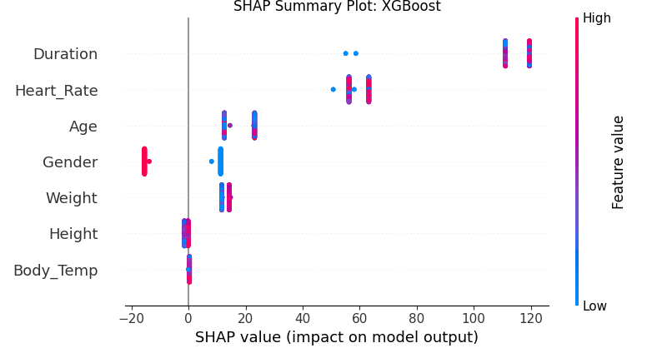
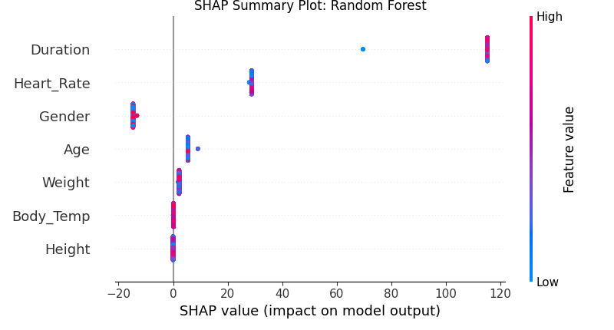
Characteristic importance analysis
XGBoost SHAP :
"Duration has the greatest impact on model output (SHAP values range from -20 to 120), with high values (red) positively affecting prediction and low values (blue) negatively. heart_Rate and Age are also important features."
Random Forest SHAP:
"Similar to XGBoost, Duration is most important, but the narrower distribution of SHAP values suggests that Random Forest handles feature effects more smoothly."

Slide 6
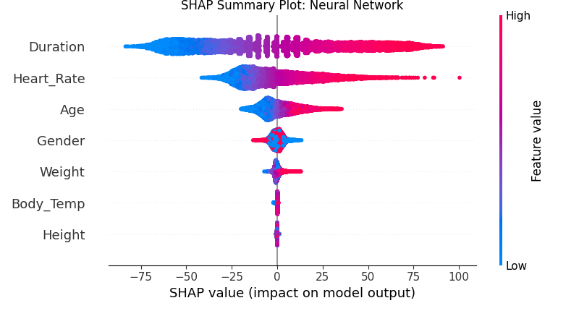
Characteristic importance analysis
Neural Network SHAP :
"Neural networks are more sensitive to Duration (SHAP values range from -75 to 100) and have smoother distributions, reflecting their strong nonlinear modelling capabilities."

Slide 7

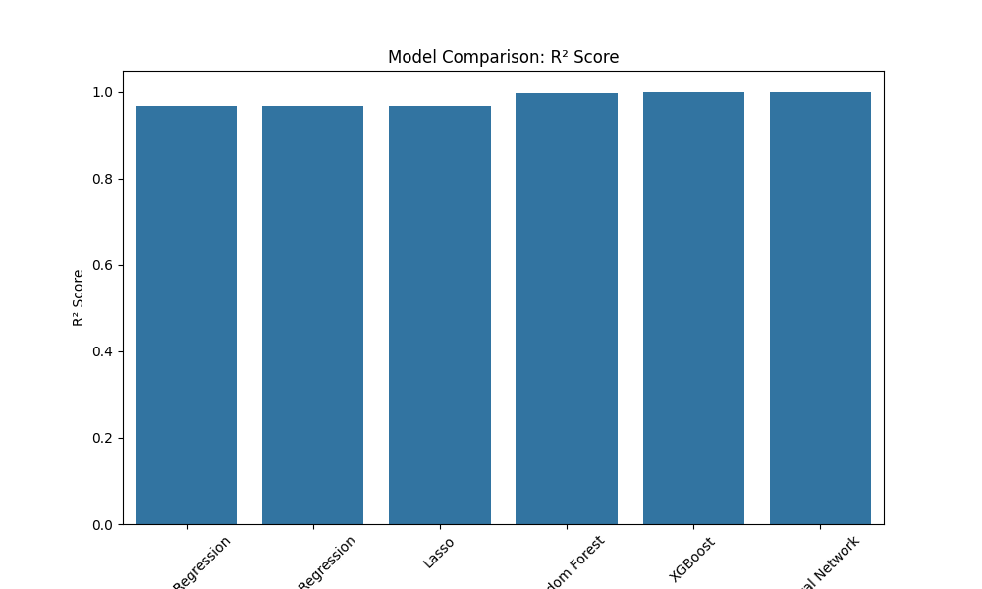
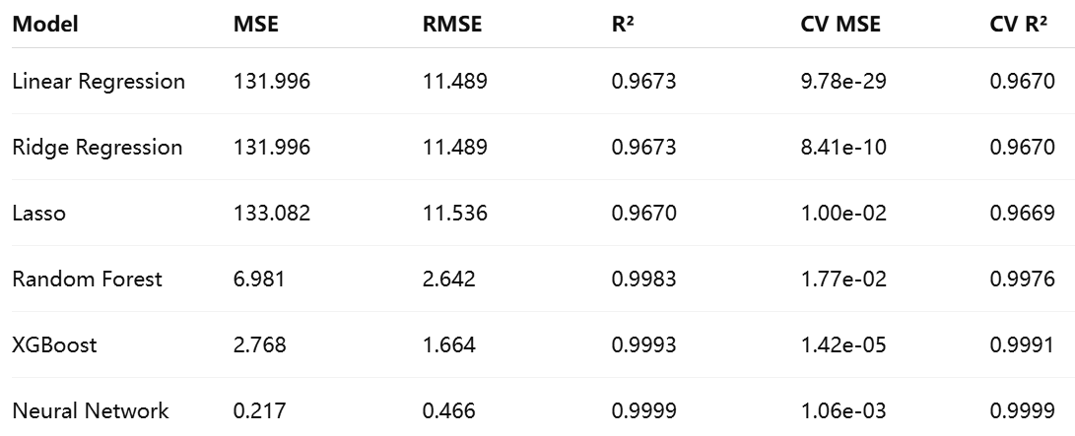
PERFORMANCE INDICATORS

Slide 8
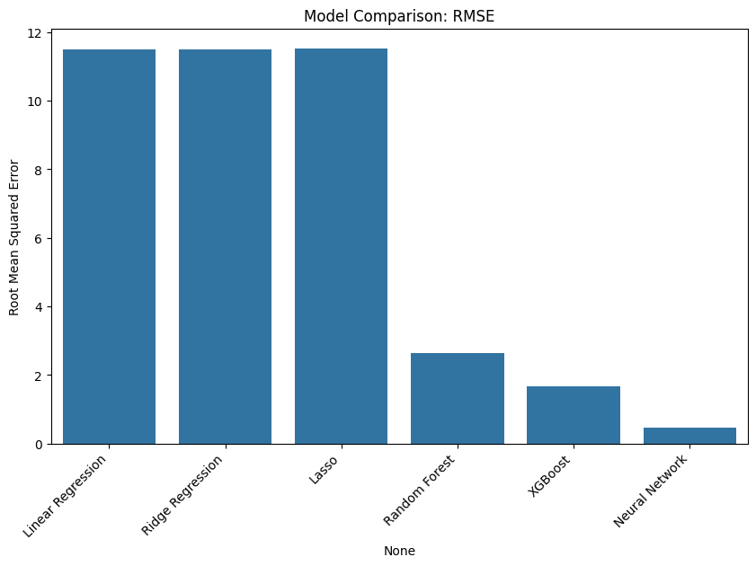
Results: comparison of model performance
Observation：
The neural network performed best (R²=0.9998, RMSE=0.79).
XGBoost was next best (R²=0.9991, RMSE=1.664).

Slide 9


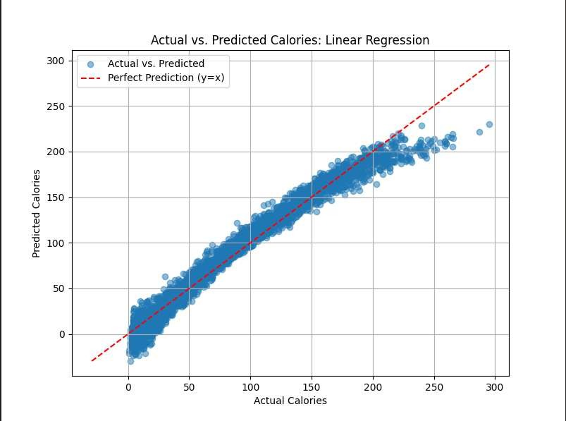
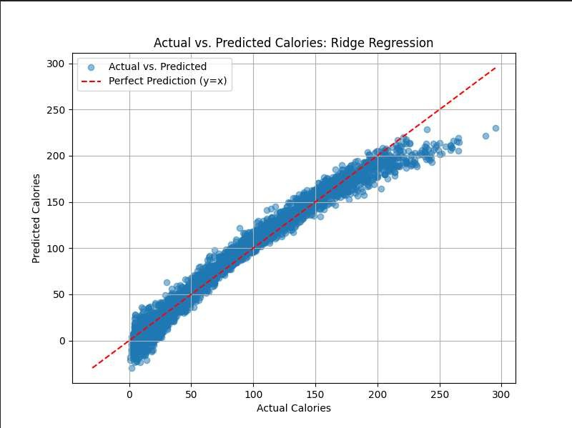

Slide 10
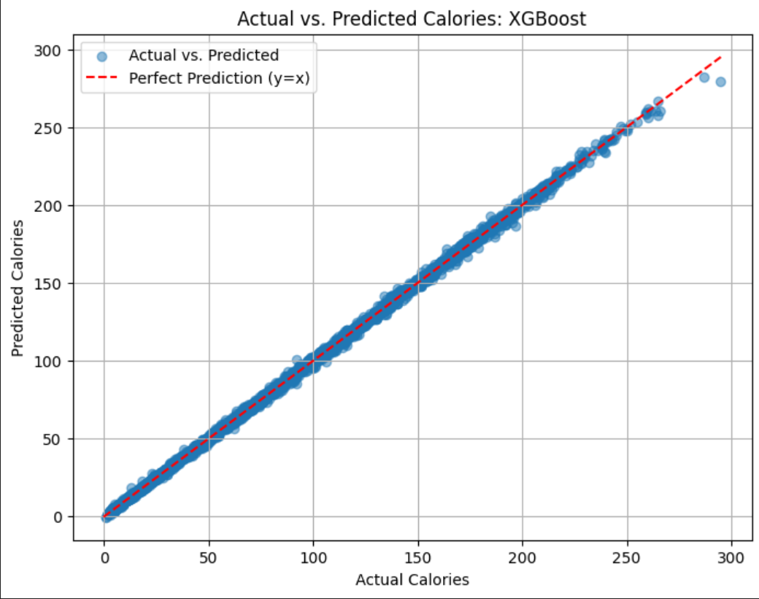
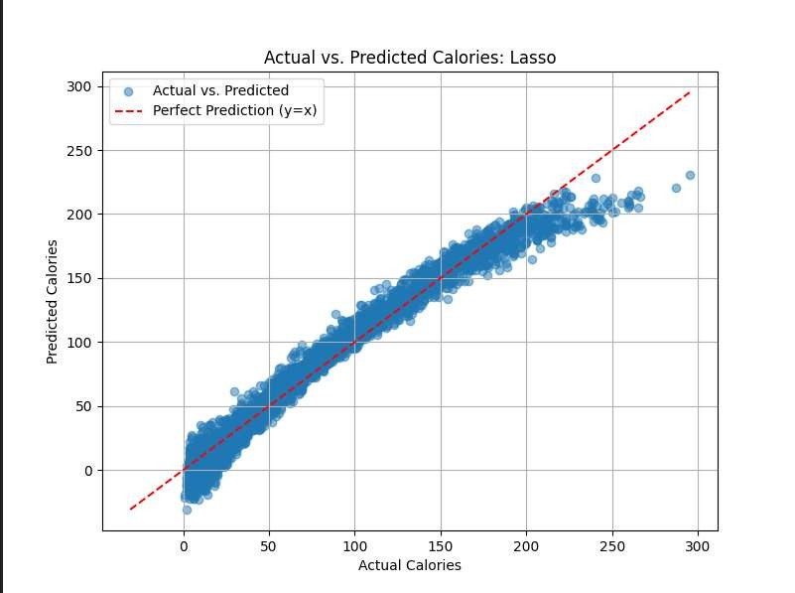

Slide 11
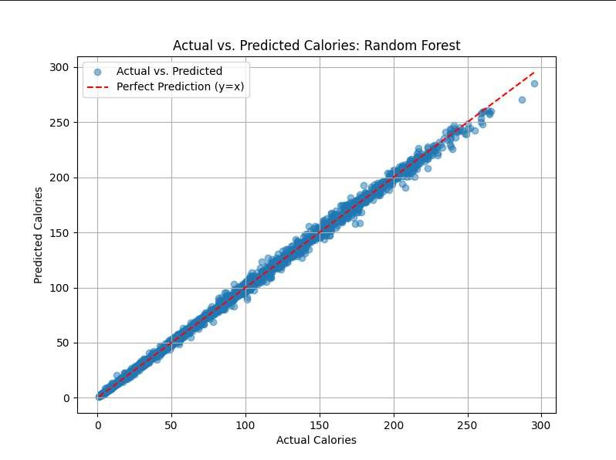
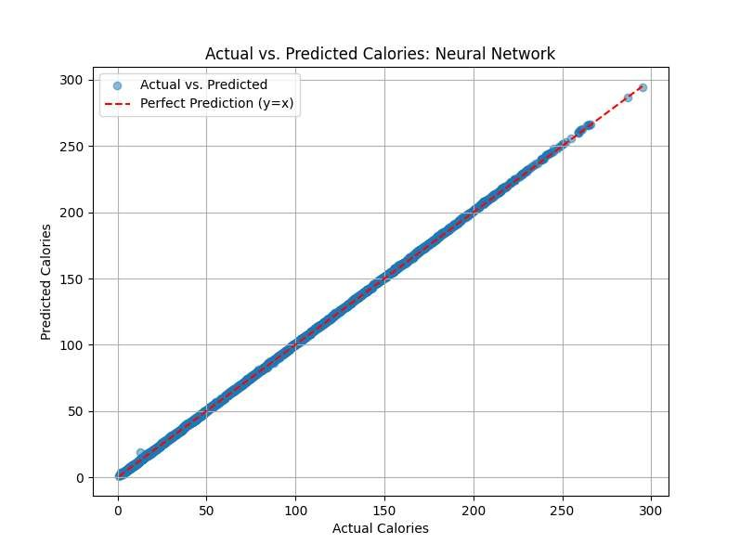

Slide 12
Linear models (Linear, Ridge, Lasso):
Errors fluctuate widely and show significant systematic bias.
This indicates that these models fail to adequately capture the complex relationships in the data and suffer from underfitting.
Random Forest and XGBoost:
The margin of error is significantly reduced.
The predictions are more accurate, suggesting that these tree models are better at modelling non-linear relationships.
Neural Network:
Little to no visible error.
The error curve is very close to the zero line, indicating the best fit and extremely high accuracy.

Slide 13
DISCUSSION: MODELLING PERFORMANCE ANALYSIS
Neural Networks and XGBoost and Random Forests:
Capturing non-linear relationships with excellent performance (R²>0.997).
Higher computational cost and long training time.
Linear regression type models :
Simple and explanatory, but assumes a linear relationship and limited performance (R² ≈ 0.967).
Performs poorly on non-linear patterns (e.g. Age and Calories).
CV MSE Exception.
Cross-validation MSE values are abnormally small (e.g., 9.78e-29), there may be a data preprocessing problem that requires further examination.

Slide 14



