Slide 1
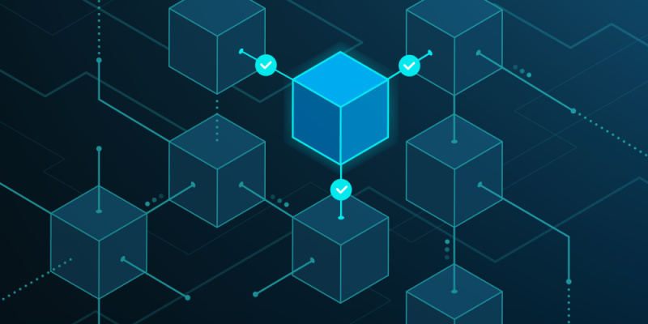
LEVERAGING BLOCKCHAIN TECHNIQUES FOR PREDICTING AND TRANSMITTING DATA IN A PERVASIVE
ENVIRONMENT
Karan Sharma (202318018)
Aditya Tripathi (202318046)
Anurag Choudhury (202318059)

Slide 2
introduction
Blockchain is a distributed ledger technology that enables the creation of a secure and transparent record of transactions and data across a network of computers. It operates as a decentralized database managed by multiple participants (known as nodes) rather than being stored in a central location.

Slide 3
core principles of blockchain
Decentralization: Data is stored across multiple computers (nodes) in a network rather than a single central authority.
Transparency: The entire transaction history and data stored on a blockchain are visible to all participants in the network.
Immutability: Once data is recorded on the blockchain, it's extremely difficult to alter or delete it due to cryptographic techniques like hashing and consensus mechanisms.
Security: Blockchains use cryptographic techniques to secure transactions and prevent unauthorized changes to the data.

Slide 4
How blockchain works
As each transaction occurs, it is recorded as a “block” of data
Those transactions show the movement of an asset that can be tangible (a product) or intangible (intellectual). The data block can record the information of your choice: who, what, when, where, how much and even the condition — such as the temperature of a food shipment.
Each block is connected to the ones before and after it
These blocks form a chain of data as an asset moves from place to place or ownership changes hands. The blocks confirm the exact time and sequence of transactions, and the blocks link securely together to prevent any block from being altered or a block being inserted between two existing blocks.
Transactions are blocked together in an irreversible chain: a blockchain
Each additional block strengthens the verification of the previous block and hence the entire blockchain. This renders the blockchain tamper-evident, delivering the key strength of immutability. This removes the possibility of tampering by a malicious actor — and builds a ledger of transactions you and other network members can trust.

Slide 5
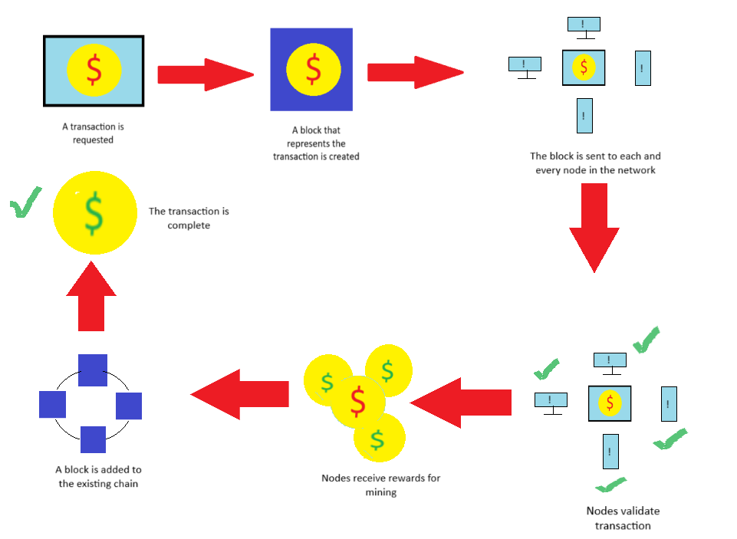
working

Slide 6
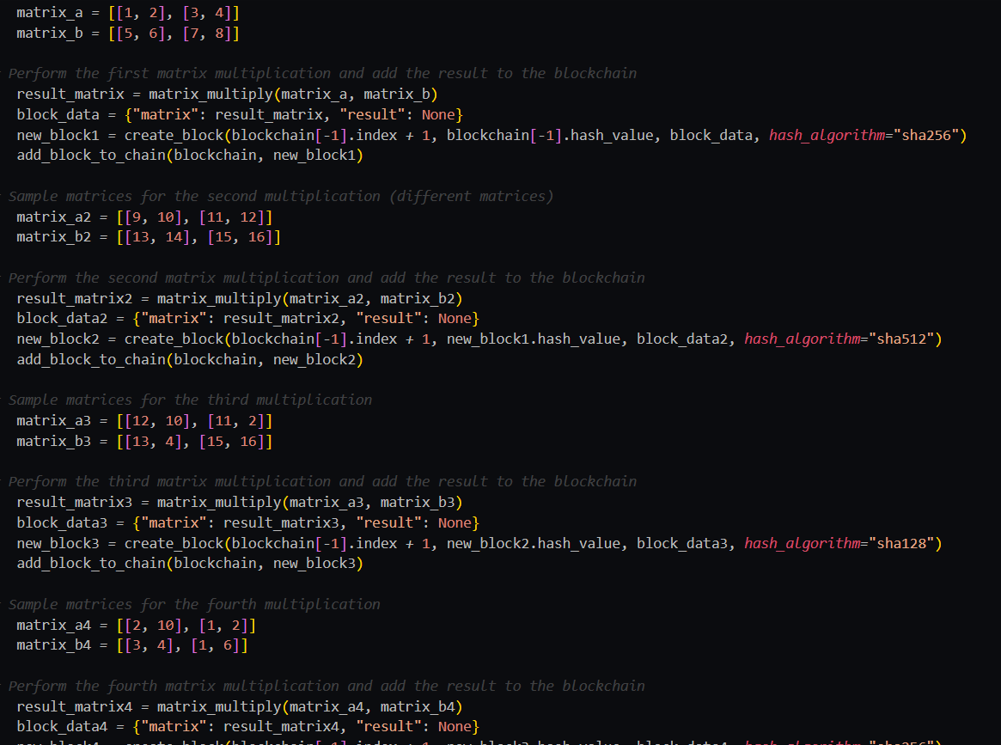
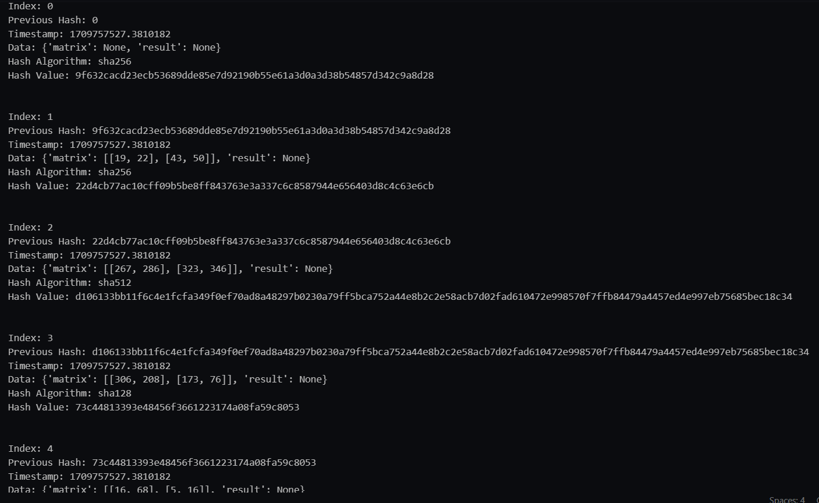
Code snippet
Matrix multiplication in different nodes by using different hashing algorithms

Slide 7
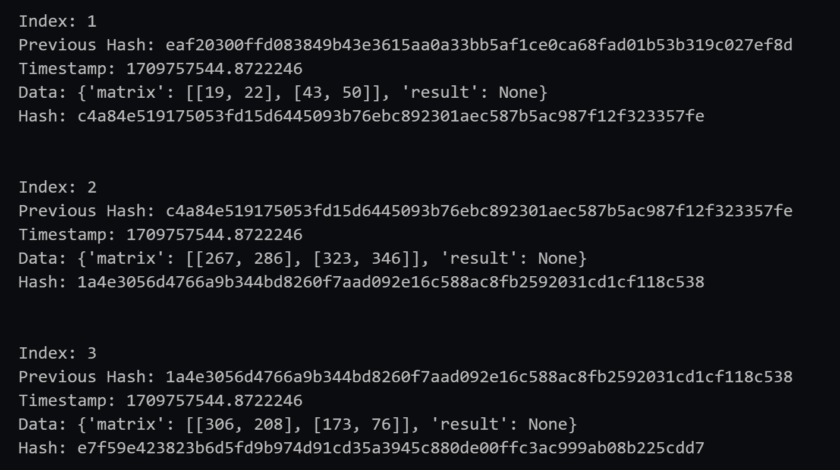
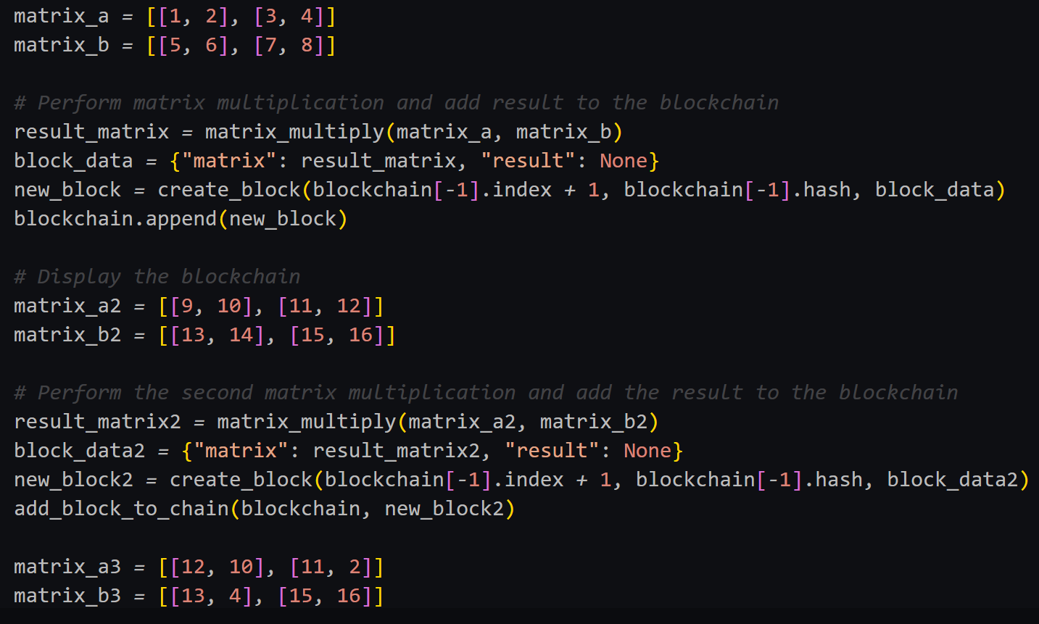
Matrix multiplication in different nodes by using SHA-256

Slide 8
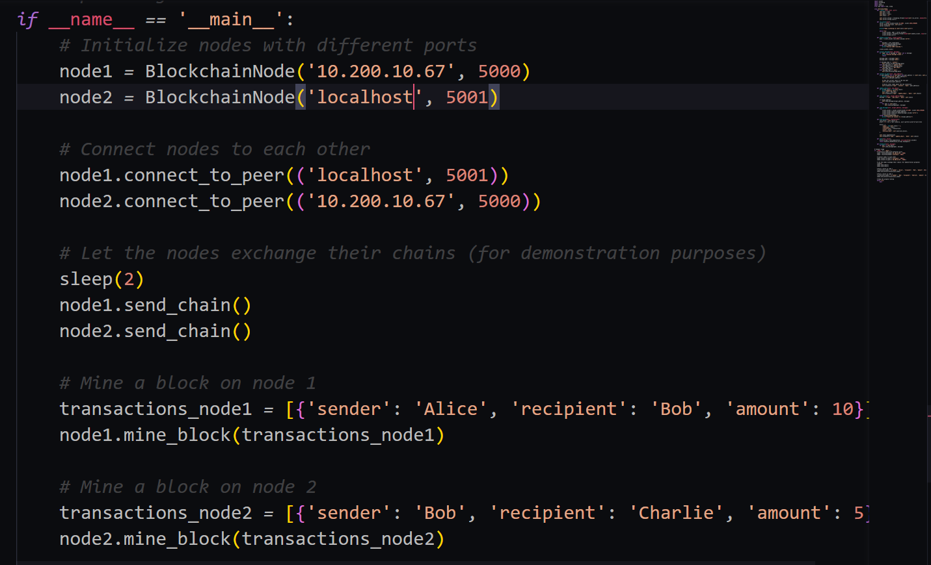
Connecting two nodes in a network

Slide 9
Components of blockchain
Node: In the blockchain network, a node is essentially a device or computer that participates in maintaining the network by storing a copy of the blockchain, validating and relaying transactions, and in some cases, mining new blocks. Nodes communicate with each other to maintain a consistent, shared ledger of transactions.
Ledger: The ledger in the context of blockchain refers to a decentralized and distributed database that contains a record of all transactions across the network. It's a digital record keeping track of all the transactions made on the blockchain. The ledger is maintained by all the nodes in the network, and it's often organized in blocks that are linked together chronologically (hence the term blockchain).
Wallet: A blockchain wallet is a software application or a physical device used to store, manage, and interact with cryptocurrencies. It contains pairs of public and private cryptographic keys enabling users to send and receive cryptocurrencies, check their balance, and manage their holdings on the blockchain.
Nonce: A nonce is a random or semi-random number used in the process of mining to find a valid block hash. Miners try different nonce values when hashing a block's data to meet a specific condition (such as having a hash with a certain number of leading zeros). The nonce is a variable parameter added to the block to produce a hash within the required parameters, and finding the right nonce is essential to creating a valid block.
Hash: In the context of blockchain, a hash is a fixed-length alphanumeric string generated by applying a cryptographic hash function to input data. This function converts an input (which could be a block of transactions or other data) into a unique string of characters of a fixed length. Hashes play a crucial role in maintaining the integrity of the blockchain by linking blocks together. Any change in the input data will produce a completely different hash output.

Slide 10
Some important terms
Smart Contracts: These are self-executing contracts with predefined conditions written in code. They automatically execute and enforce terms of agreements when conditions are met, without requiring intermediaries.
Proof of Work (PoW) is a consensus mechanism used in blockchain networks to achieve agreement on the state of the distributed ledger. It's a crucial component that ensures the security and immutability of the blockchain. Bitcoin, the first and most well-known cryptocurrency, uses PoW as its consensus mechanism.
Proof of Stake (PoS) is a consensus mechanism utilized in blockchain networks to achieve agreement on the state of the ledger without relying on the energy-intensive computational puzzles of Proof of Work (PoW). In PoS, validators are selected to create and validate new blocks based on the number of cryptocurrency tokens they hold and are willing to "stake" as collateral. Validators are chosen in a deterministic manner, typically based on the amount of tokens they have at stake, and their role is to verify transactions and create blocks

