Slide 1
LEVERAGING BLOCKCHAIN TECHNIQUES FOR PREDICTING AND TRANSMITTING DATA IN A PERVASIVE
ENVIRONMENT

Slide 2
INTRODUCTION
Blockchain is a distributed ledger technology that enables the creation of a secure and transparent record of transactions and data across a network of computers. It operates as a decentralized database

Slide 3
Working:
Transaction Creation: Transactions are created and verified by participants in the network.
Block Formation: Verified transactions are grouped into a block.
Block Addition: The block is added to the existing blockchain through a consensus mechanism, ensuring agreement among network participants.
Blockchain Update: The blockchain is updated across all nodes in the network, creating a transparent and immutable record of transactions.

Slide 4
Verification of Transaction
Consensus algorithms : They are designed to achieve agreement among network participants in a decentralized manner and helps in verifying the validity of transaction. Examples: - Proof of Work (PoW), Proof of Stake (PoS)
Smart contracts They are self-executing contracts with the terms of the agreement directly written into code.They automatically execute actions when predefined conditions are met, without the need for intermediaries.

Slide 5
Security
Hash Functions: These convert input data into a fixed-size string of bytes, which uniquely represents the input. Hashes are used to link blocks together. Any change in the input data will result in a completely different hash, making it easy to detect tampering.
Examples :- Sha -256 , Sha - 512

Slide 6
Our work
This project explores the intersection of blockchain technology and encryption, aiming to understand how different types of encryption impact blockchain performance and data integrity.

Slide 7
Node Setup and Blockchain Creation
Nodes were set up on the same computer to create a blockchain. Matrix multiplication was injected as the data to be stored in the blockchain.
The same type of hash encryption was applied to the blockchain, and then different hash functions were tested. The timing of these processes was recorded to analyze their efficiency.
The blockchain's integrity was verified by observing how the block had changed using hash functions. This demonstrated the impact of encryption on blockchain security

Slide 8
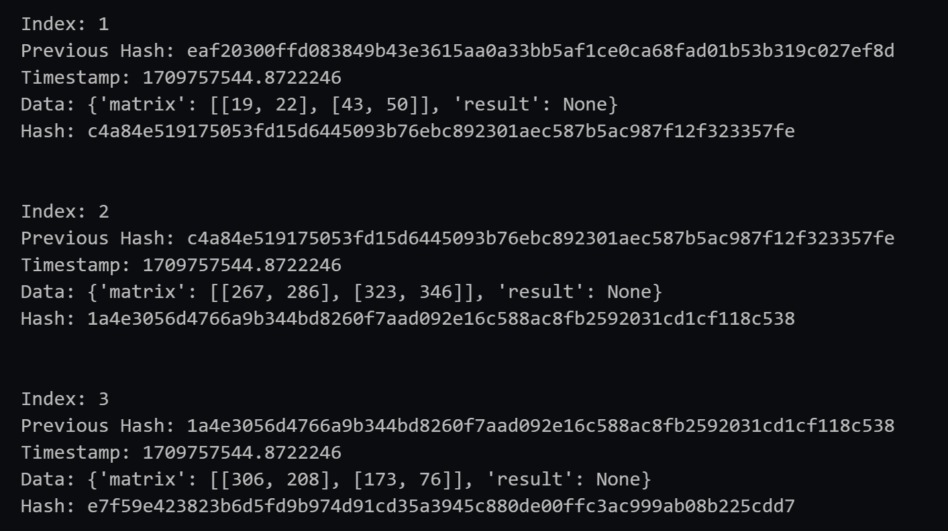
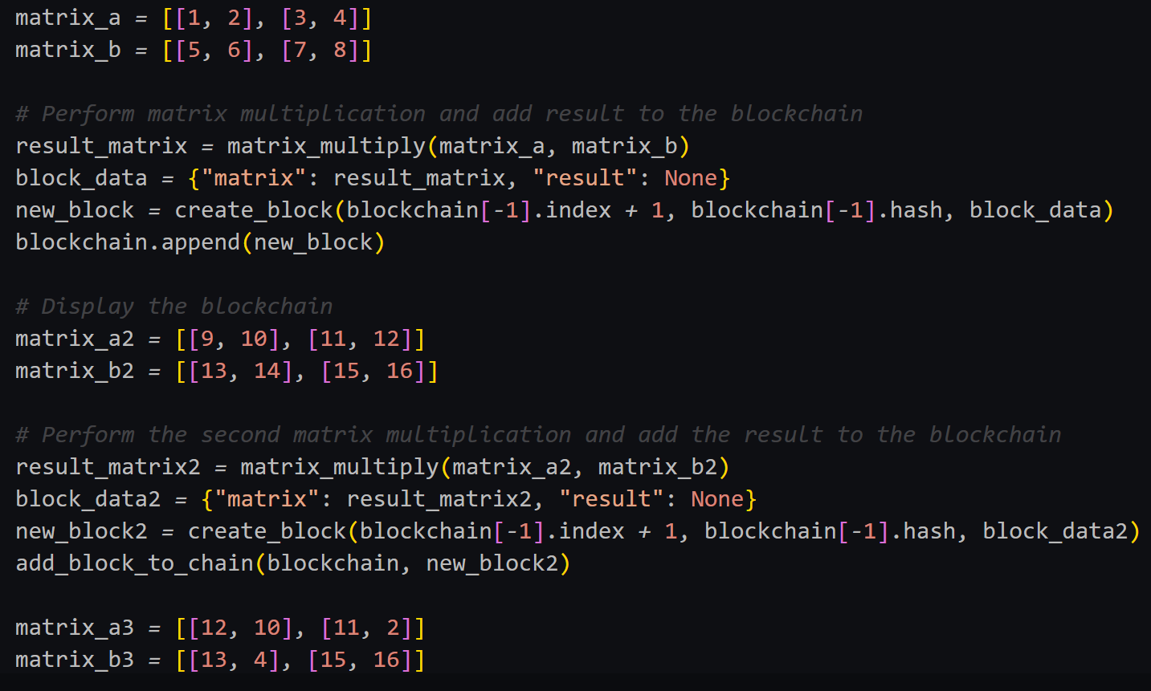
Using Sha - 256

Slide 9
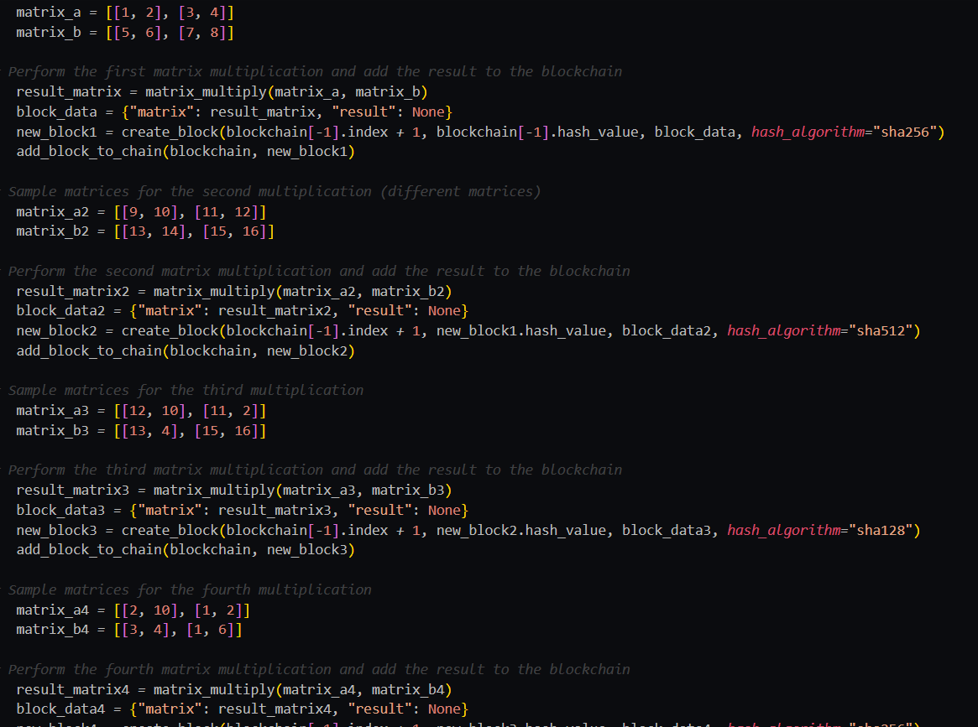
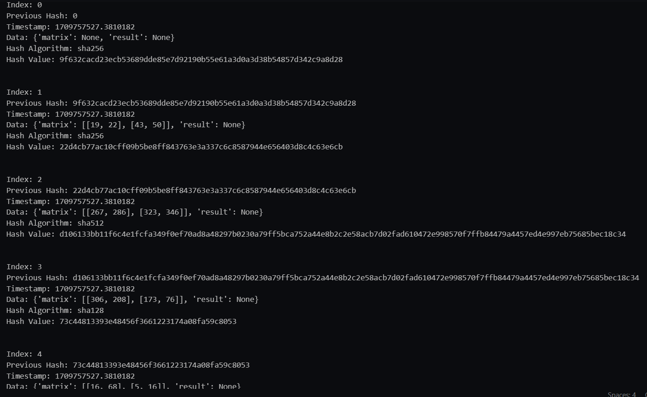
Different Hashing Algorithm

Slide 10
Interacting Nodes on Different Computers
Different computers were used as nodes to demonstrate interaction. Matrix multiplication data injected into one node was reflected in the blockchain, showing the interconnectedness of nodes.
Smart contracts were used to automatically update the blockchain ledger. This streamlined the ledger update process and demonstrated the potential of smart contracts in blockchain applications.
We again applied the different Hash Functions and Verified the changes.

Slide 11

Index 1
Hash :6968695FHA45992ABF5
Message: ‘welcome’
Timestamp : 12ms
Transaction: 500$
Information: Amount needed
Node 1
Index 2
Hash: 120494858AFD49495ABC
Previous Hash:6968695FHA4599
Message: ‘hello’
Timestamp: 23ms
Transaction: 500$
Information: Amount Received
Index 3
Hash: 9587490357ABBDF484B4
Previous Hash: 120494858AFD4
Message: ‘hi’
Timestamp: 17ms
Transaction: 300$
Information: Amnt Transferred
Node 2
Node 3

Slide 12
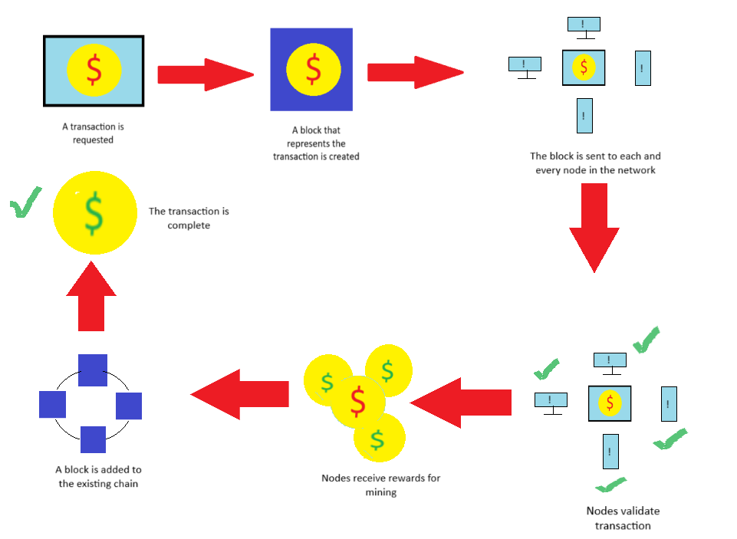

Slide 13
Result
We successfully verified that different encryption methods can work within the same blockchain. This flexibility allows for optimal utilization of different computer processing capacities, enhancing the overall efficiency of the blockchain network.

Slide 14
Conclusion
Our findings suggest that by compromising the level of security, blockchain networks can be made more efficient. Different encryption methods can be strategically employed to balance security and efficiency, depending on the specific requirements of the network.

