Slide 1
Uber FARE Prediction System

Slide 2
agenda
Problem Statement
Dataset Description Challenges
Methodology
Evaluation
Conclusion

Slide 3

Problem Statement
Forecasting the cost of an Uber journey using various factors like the weather, time of day, distance travelled, etc.
Reference: International Journal of Science and Research (IJSR) ISSN: 2319-7064 SJIF (2022): 7.942

Slide 4

Scope of Project
To explore the effectiveness of machine learning algorithms in predicting Uber trip costs.
To identify the most accurate algorithm for pricing predictions.
To analyze relationships between different factors affecting Uber journey costs.
Reference: International Journal of Science and Research (IJSR) ISSN: 2319-7064 SJIF (2022): 7.942

Slide 5
Dataset Description
The dataset is concatenation of 12 .parquet files representing each month of the year 2021 and weather data of NYC.
Dataset was archived from Kaggle.
Reference: https://www.kaggle.com/datasets/shuhengmo/uber-nyc-forhire-vehicles-trip-data-2021

Slide 6
Data preprocessing
Industry Level .parquet files
pySpark Dataframe for scalability
Merging trip data & weather data
Correlation between target and features and taking important features
Model Training
Feature Engineering: Deriving new variables from existing and scaling
Reference: https://www.kaggle.com/datasets/shuhengmo/uber-nyc-forhire-vehicles-trip-data-2021

Slide 7
Major Challenges
Too many records!
Selecting only Uber records
Handling a lot of redundant and null values
Calculating Correlation matrix for large dataset
Merging increases Dataset size implying expensive computations
Reference: https://www.kaggle.com/datasets/shuhengmo/uber-nyc-forhire-vehicles-trip-data-2021

Slide 8
Flowchart
Data
Collection
Feature Engineering
Modelling
Testing
Forecasting
Data Preprocessing
Evaluation
Reference: International Journal of Science and Research (IJSR) ISSN: 2319-7064 SJIF (2022): 7.942

Slide 9
Methodology
The Uber pricing prediction system will analyze historical trip records, traffic congestion, weather conditions, time of day, and other relevant data using:
Linear Regression
Random Forest Regression
Decision Tree Regressor
After employing such algorithms we find which method offers the most accurate price prediction using:
RMSE
R2
Reference: International Journal of Science and Research (IJSR) ISSN: 2319-7064 SJIF (2022): 7.942

Slide 10
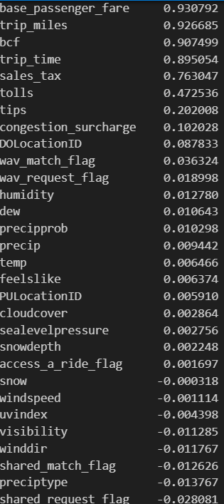
Linear Regression
Assuming Linearity, Homoscedasticity, no Multicollinearity of features
Computing Correlation matrix
Selecting highly correlated features to target
80/20 split
Fitting the model
Predicting
Evaluation : RMSE, R2
Reference: International Journal of Science and Research (IJSR) ISSN: 2319-7064 SJIF (2022): 7.942

Slide 11
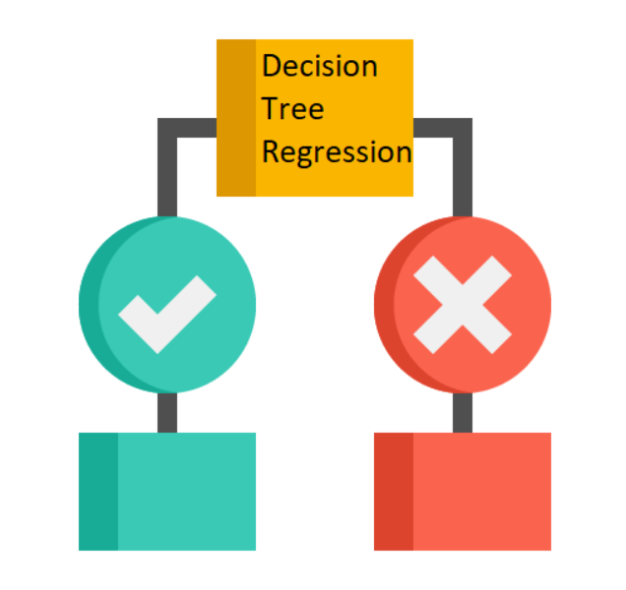
Decision Tree Regressor
Prepare the feature vectors using a `VectorAssembler` to combine features into a single feature vector column.
Node Splitting : selecting best feature to split
The objective is to minimize the impurity or error of the resulting partitions when selecting the feature and split point.
Making partitions as homogeneous as possible with respect to the target variable the repeat.
Predict using trained model
Evaluation
Reference: International Journal of Science and Research (IJSR) ISSN: 2319-7064 SJIF (2022): 7.942

Slide 12
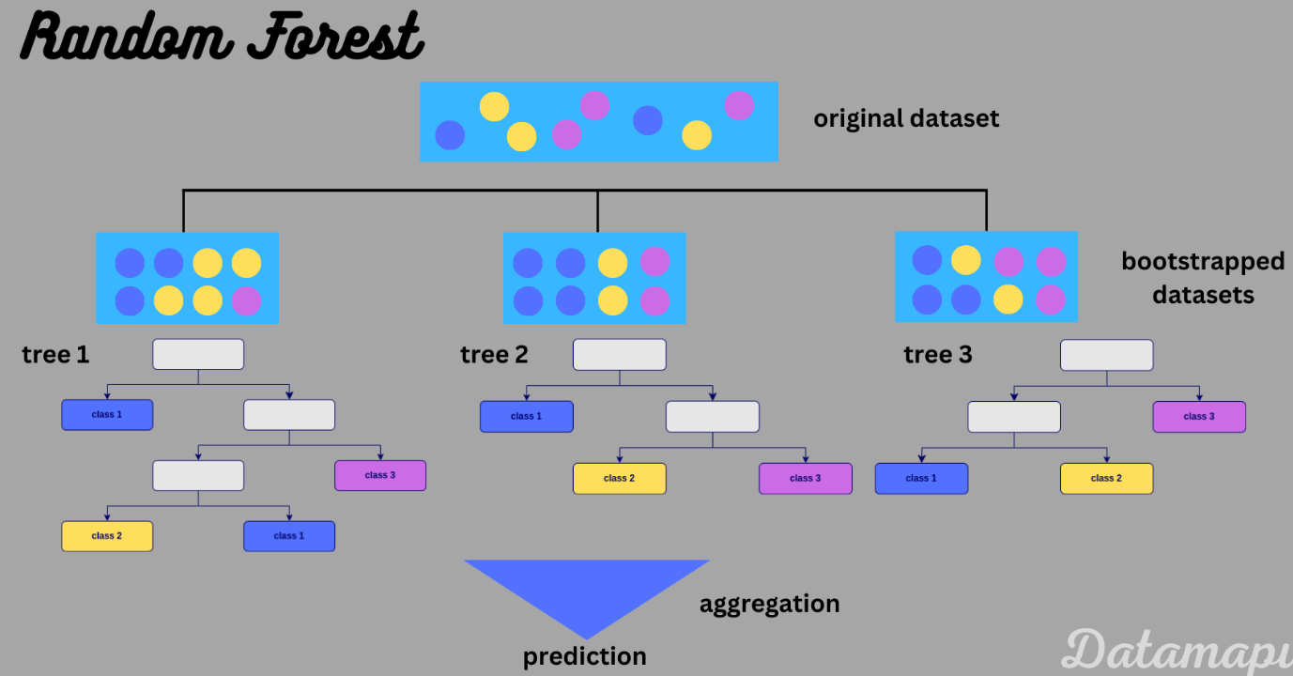
Random Forest regression
Decision Tress are easily overfitted
Ensemble learning method
Combines multiple decision trees to make predictions
Random Feature Selection at each node
Helps to decorrelate the individual trees
Bootstrapping
Voting Mechanism
Reduced Variance
Predict using trained model
Evaluation
Reference: International Journal of Science and Research (IJSR) ISSN: 2319-7064 SJIF (2022): 7.942

Slide 13
Evaluation
Random Forest Regression Root Mean Squared Error (RMSE) on test data = 5.09902
Decision Tree Regression Root Mean Squared Error (RMSE) = 3.7544254946589124
Linear Regression Train RMSE: 2.89133809032645
Linear Regression Test RMSE: 2.8093231066194324
Linear Regression R2 Score: 0.9356795622264915
Reference: International Journal of Science and Research (IJSR) ISSN: 2319-7064 SJIF (2022): 7.942

Slide 14
Conclusion
Linear Regression excels in predicting driver pay for big data, especially when dealing with Parquet files.
It outperforms Decision Tree and Random Forest models with the lowest RMSE on both training (2.891) and testing (2.809) datasets.
With an R-squared score of 0.936, Linear Regression explains around 93.6% of the variance in driver pay.
Its efficient handling of Parquet files and balance between accuracy and interpretability make it the preferred choice for predicting driver earnings.

Slide 15
Thank you
Taruna Sagar Mati, 202318045
Srinibas Masanta, 202318054
Shashwat Parikh, 202318062

