Slide 1

Salary Prediction of Data Scientist
M.Sc Data Science(sem-1)
Student Id – 202318026, 202318059
Course Id – IT606

Slide 2

Introduction
Now days, Major reason an employee switches the company is the salary of the employee. Employees keep switching the company to get the expected salary. And it leads to loss of the company and to overcome this loss we came with an idea what if the employee gets the desired/expected salary from the Company or Organization. In this Competitive world everyone has a higher expectation and goals. But we cannot randomly provide everyone their expected salary there should be a system which should measure the ability of the Employee for the Expected salary. We cannot decide the exact salary but we can predict it by using certain data sets. A prediction is an assumption about a future event.
In this project the main aim is predicting salary and making a suitable user-friendly graph. So that an Employee can get the desired salary on the basis of his qualification and hard work. For developing this system, we are using a Linear regression algorithm of supervised learning in machine learning.
We have used certain factors like geographical locations, company rating, Industry, Sector and company revenue as parameters for predicting the estimated salary.

Slide 3
Methodology
In order to obtain useful information on online recruitment of IT professionals, we compare and contrast different strategies with machine learning models. The procedure follows the best practices in literature and industry, which includes different categories:
Loading the Dataset: Here we load the dataset and also import all the required libraries which will used .
Correcting Inconsistencies: To remedy the inaccuracies and inconsistencies found in the survey, subject matter knowledge was required. We cleaned up the data by first converting all of the questions into variables, then translating all of the details into English. We put together several different words in the replies that refer to the same term. Corrected errors and misspellings. Finally, commas, apostrophes, quotation marks, question marks, and other punctuation symbols have been eliminated.
Manual feature engineering: Features which are not important are discarded and some are suspended (e.g. converted into numerical features) by misusing domain information.
Exploratory Data Analysis: Show the key visualizations that led to insights (scatter plots, heatmaps of feature correlations) and Explain
how these visualizations support our model
Model Building: To give original and integrated data definition, mathematical techniques and basic models were applied.

Slide 4

Project Plan
Data Cleaning
Importing Datasets and Python Libraries
Data Preprocessing
Feature Engineering
Feature Scaling
Exploratory Data Analysis
Training the Datasets
Model Training
Testing the Datasets
Drawing Insights

Slide 5
Experiment
We have used a glassdoor data set which has 15 columns and 957 rows.
We have variables like Job Title, Salary Estimate, Job Description, Rating, Company Name, Location, Headquarters, Size, Founded, Type of ownership, Industry, Sector, Revenue, Competitors
Evaluation Metric - For the evaluation of the regression models Linear regression , Random Forest Regression and Decession Tree Regression we have used Mean Squared Error (MSE) metric.

Slide 6
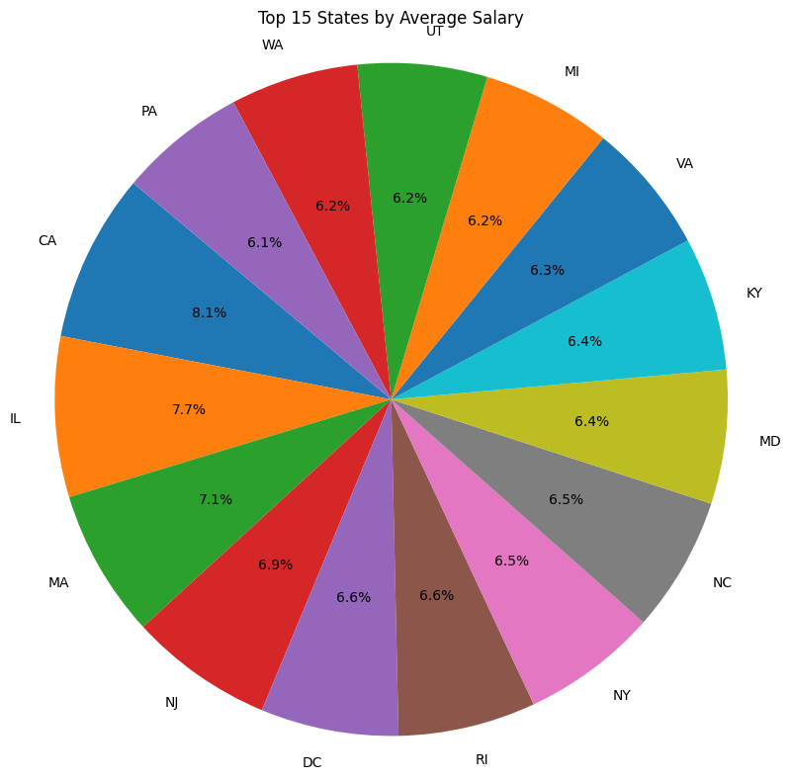
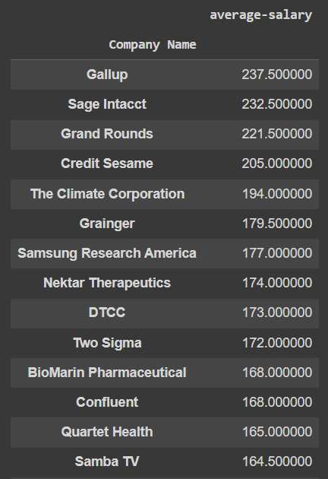
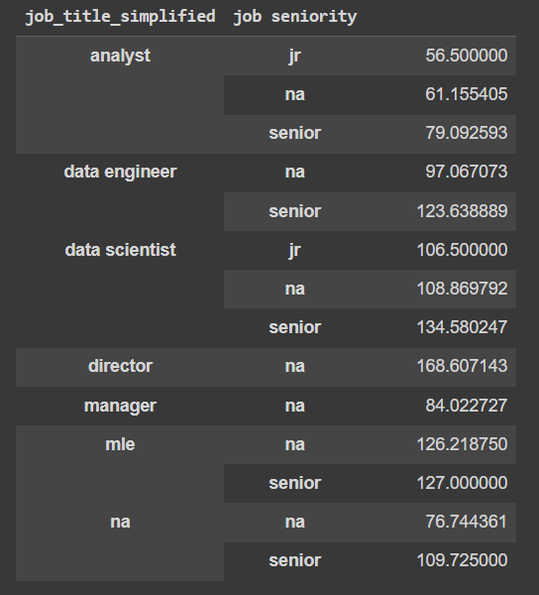
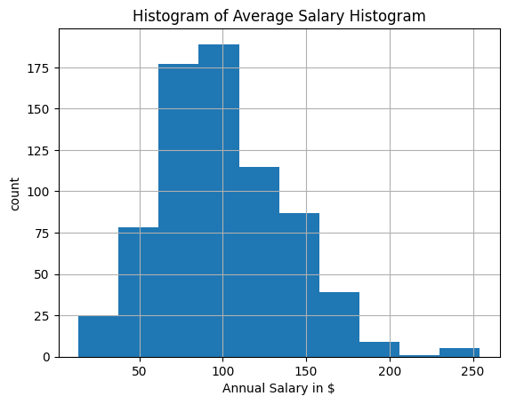
Exploratory Data Analysis

Slide 7

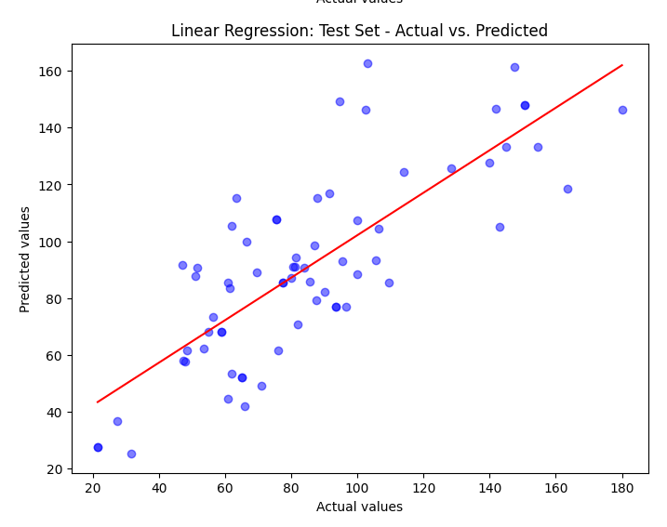
Building Model and Evaluation
For Regression Analysis :
After applying MSE on linear regression, Decision Tree Regression and Random Forest Regression, we found out Random Forest Regression is the best among the other the two.

Slide 8
References
Conclusion
We collected Data, cleaned them, Analysed them by graphs and tables, drawn insights and predicted salaries based on the data we had by applying different regression models and tested the accuracies for each.
In this project, our objective was to predict the salary of data scientists using three different machine learning models, namely Linear Regression, Decision Tree Regression and Random Forest. The journey involved data exploration, preprocessing, model building, and evaluation, with a focus on understanding the factors influencing data scientist salaries.

Slide 9
References
https://github.com/goodluck08/practice_dataset/blob/main/glassdoor_jobs.csv
https://www.glassdoor.co.in/Salaries/data-scientist-salary-SRCH_KO0,14.htm
https://youtu.be/RhEjmHeDNoA?si=XdVamLuLT0YTcO6W
https://youtu.be/Rbh1rieb3zc?si=TSMC4ffgdkriasVE
https://youtu.be/pqNCD_5r0IU?si=7hU5gFwdiOqJuuc8

