Slide 1

Job Hub
Connecting Job Seekers and Employers Seamlessly
Ngwava Jaqueline Kaloo – Founder / Developer
Date : 21/11/2025

Slide 2

Problem
Job seekers spend too long finding suitable jobs.
Employers struggle to find qualified candidates efficiently.
Existing platforms are fragmented and costly.

Slide 3

Solution
Upload CVs, apply to jobs quickly
Employers post jobs, review applications, hire efficiently
Real-time notifications keep users informed

Slide 4
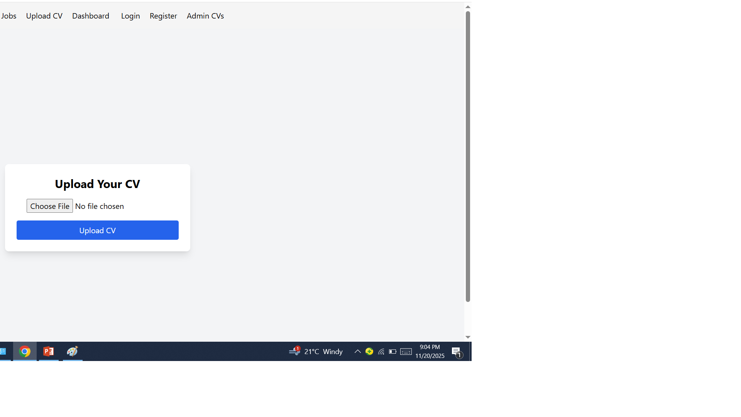
Product Demo / Screenshots

Slide 5
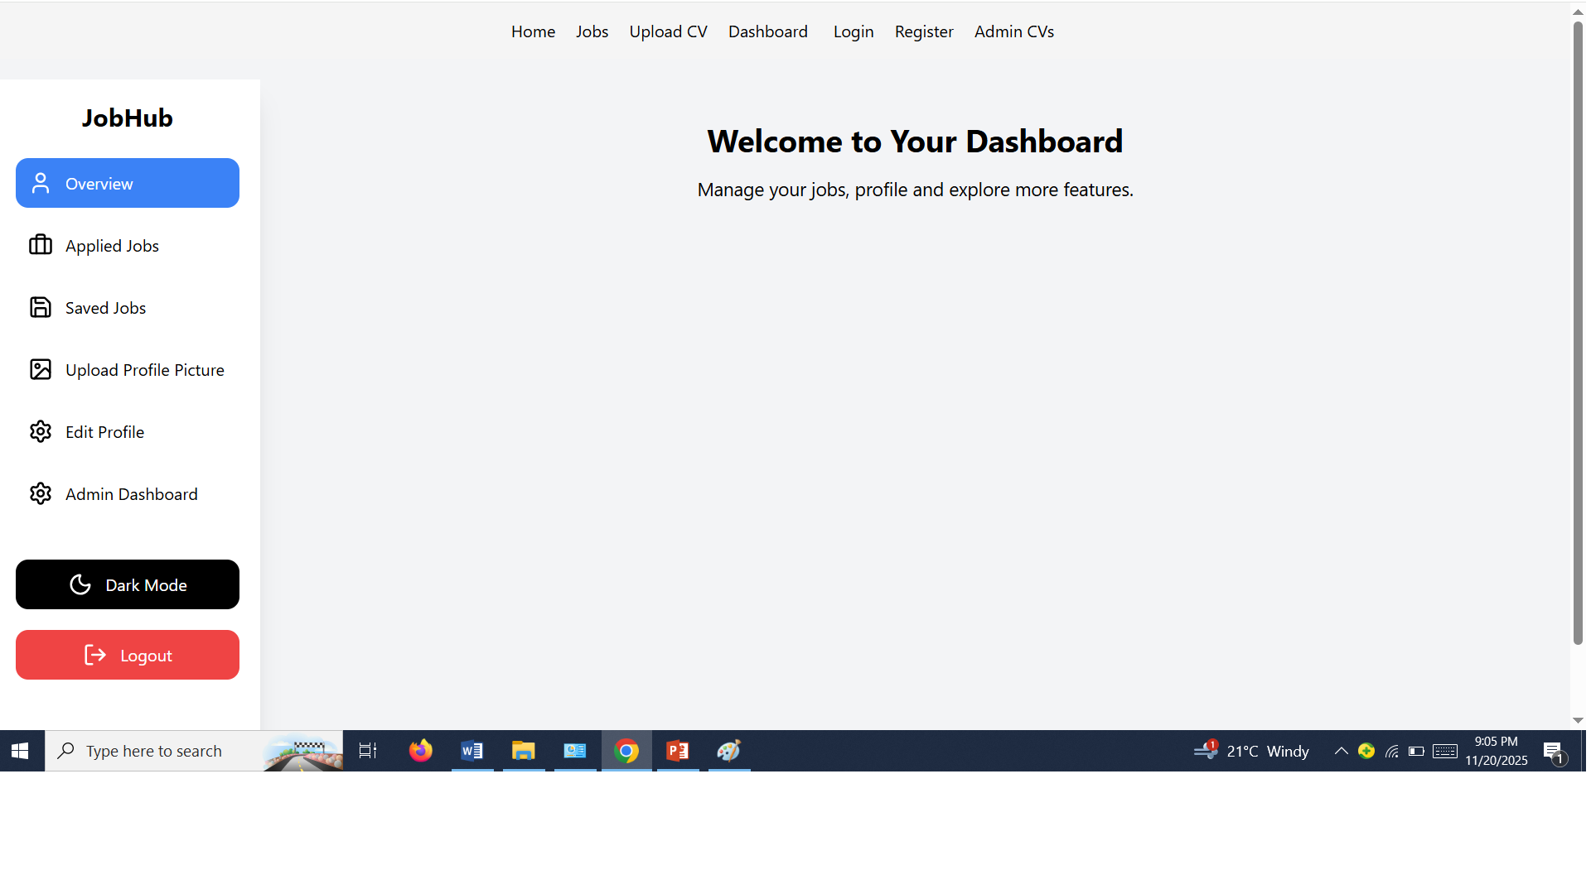

Slide 6
Market Opportunity
Online recruitment market size and growth potential
Target audience: graduates, professionals, SMEs, recruiters
Revenue opportunities

Slide 7
Business Model
Free for job seekers
Paid features for employers:
Featured job postings
Subscriptions for multiple listings
Ads or premium services

Slide 8
Technology Stack
Frontend: React.js
Backend: Node.js / Express
Database: MongoDB Atlas
Deployment: Render (backend), Vercel (frontend)

Slide 9
Traction & Milestones
MVP developed and deployed
Features: user registration, login, CV upload, job posting, notifications
Next steps: scale, acquire users, add premium features

Slide 10
Competitive Advantage
Faster job search & application
Real-time notifications
Both employers & job seekers in one ecosystem
Scalable & cost-effective

Slide 11
Team
Founder & Developer: Ngwava Jaqueline Kaloo
Roles and responsibilities
Designed and built full MERN Stack architecture
Developed secure API backend with authentication
Built interactive React user interfaces
Managed MongoDB database and optimized schema
Deployed platform (Render + Vercel + Atlas)
Implemented CV uploads and notifications
Ensured security, performance, and reliability
Tested and maintained system end-to-end

Slide 12
Call to Action
Seeking funding, partnerships, or mentorship
Goals: grow user base, enhance features, scale platform
Contact info: email, phone, website

Slide 13
Thank You
Job Hub Logo
Tagline
Questions?
Contact info

