Slide 1
Portfolio - CIS5014
Portfolio Order:
Models
Textures
Animations
Audio
Level Design

Slide 2
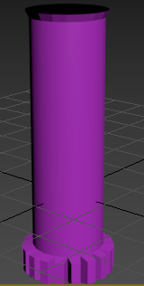
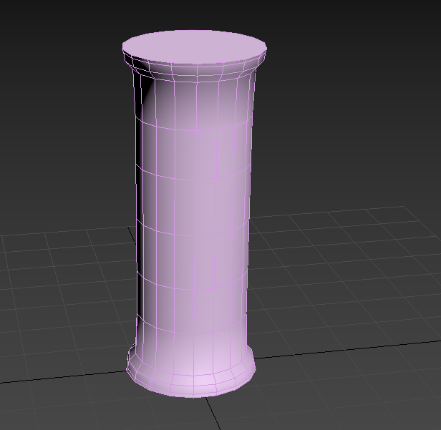
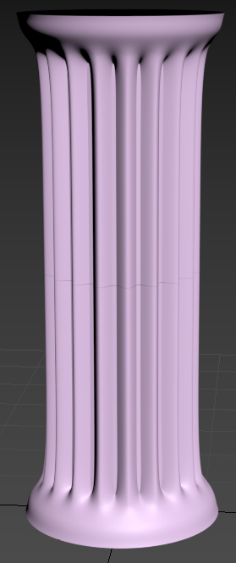
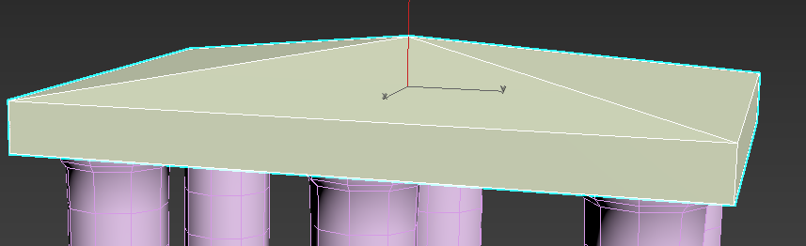
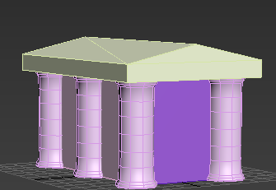
Shrine
The basic Shrine model is the most common in the game, Existing as both its own form and as the basis for two others – the Upgraded Shrine and the Maxed Shrine. For this reason, this shrine needed to be well made – and needed to fit the setting, more than any other model. The setting for this game is Classical Greece, as with Populus II, and so I wanted somewhat fitting models. Tomlinson (2010, p.160 ) suggests that Classical Greek Architecture had three major orders – Doric, Ionic and Corinthian. Of these, I chose to look to the Doric order for inspiration. Doric Architecture “was sturdier, with plain, spreading capitals but no base” – Tomlinson (2010, p161). This gave me a basis from which to take inspiration, with examples of Doric architecture such as The Parthenon being a significant basis for my models.
Figure 4.
Figure 5.
Second option for shrine roof
First option for shrine roof
The Shrine Roof
There where two options for the roof, Pyramid and sloped. Of the two, Sloped was used for the final Shrine. The bottom of the roof has been ommited as it will not be visible in the final game.
Figure 1.
Prototype column
Figure 2. Low-Poly column
Figure 3.
High-Poly Column
The columns of the shrine
The column – a major part of the shrine - has multiple forms. The third model serves as the basis for the normal map for the columns on the final shrine. The top and bottom of the columns have both been removed in the final model, as these should not be visible in any part of gameplay.
The Interior
The interior of the shrine has been blocked off with four planes. These can be left black or textured to give the appearance of something within the shrine.
Figure 6. The final Shrine

Slide 3
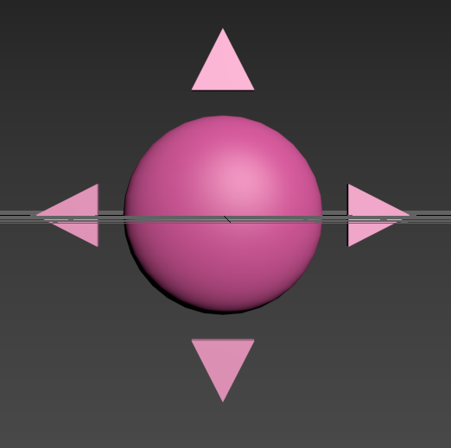
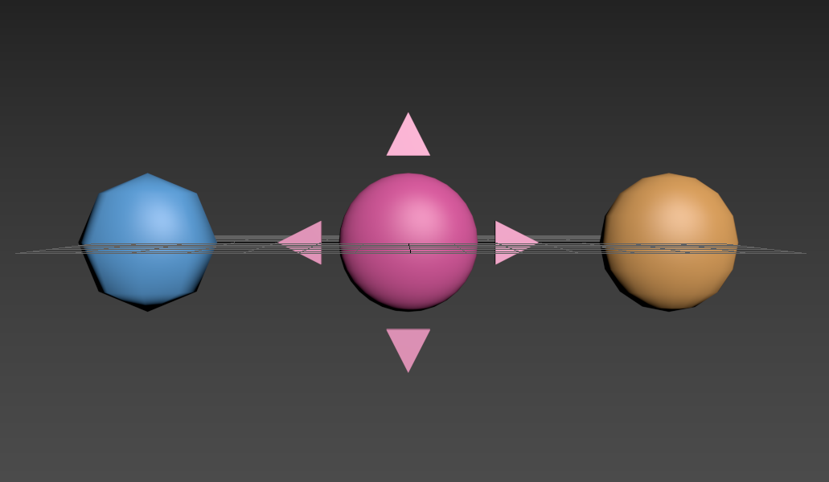
The God Sign
The God Sign is used in the game as the symbol of the Players power. In the full game, it can have a variety of effects on things in its radius- from increasing the speed of building to boosting the damage warriors can do against the enemy.
Making the God Sign
In making the God Sign, the most important decision was on the core. The design of the God Sign included a spherical core, however spheres are especially poly-heavy, and so a decision had to be made on how much detail to include without compromising performance (as seen in figure 8). Eventually, the final option (orange) was chosen.
Figure 7.
A sphere flattened in one axis, surrounded by four stout pyramids.
Figure 8.
A comparison between the different possible cores.

Slide 4
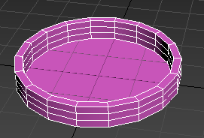
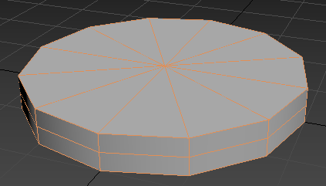
Colosseum
The Colosseums original design was more detailed, using a shell modifier on a cylinder to create a wrap effect. However, the effect intended for the colosseum – of a slowly sloping into the middle building- was eventually moved on to be entire done via texturing, leading to the second more simple model being created.
Figure 9.
Original Colosseum
Figure 10.
Later Colosseum

Slide 5
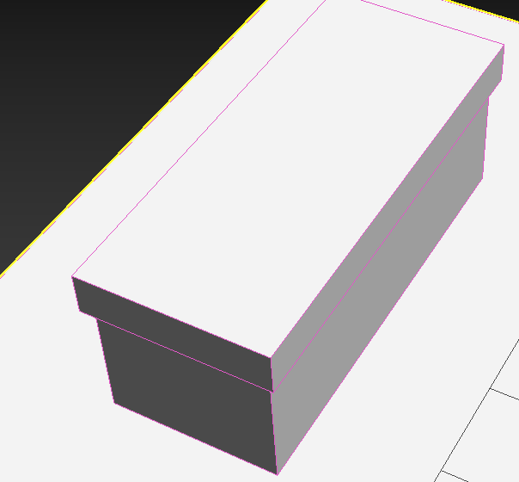
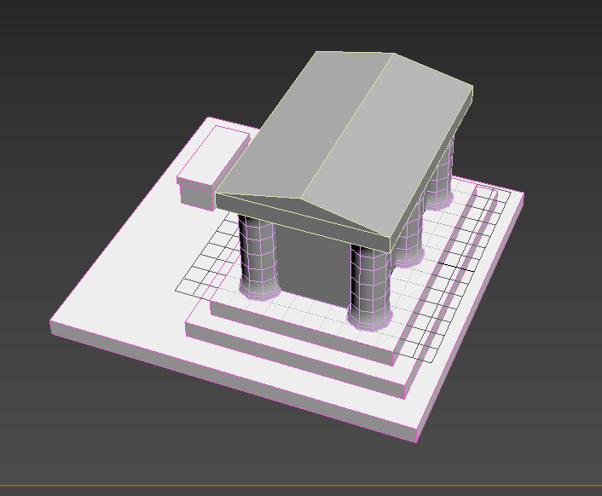
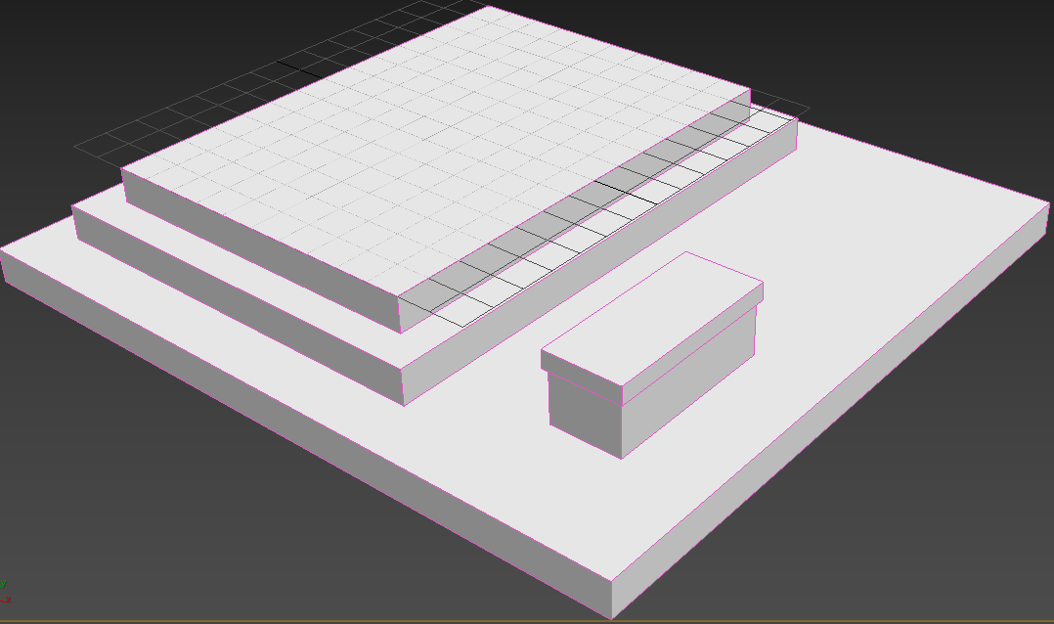
Shrine Upgrade
The first shrine upgrade needs to be most important, as it is much more often visible- especially in longer games. This is due to the third upgrade being limited in how many can exist per level.
All of these have been built seperately, allowing them to be textured seperately and thereby have the textures reused on each one.
Figure 11.
A tomb
Figure 13.
The fully upgraded shrine
Figure 12.
The upgrades to the shrine

Slide 6
References
Tomlinson, R and Bispham, E. (2010) The Edinburgh companion to ancient Greece and Rome. Edited by T. Harrison and B. Sparkes. Edinburgh: Edinburgh University Press.

