Slide 1
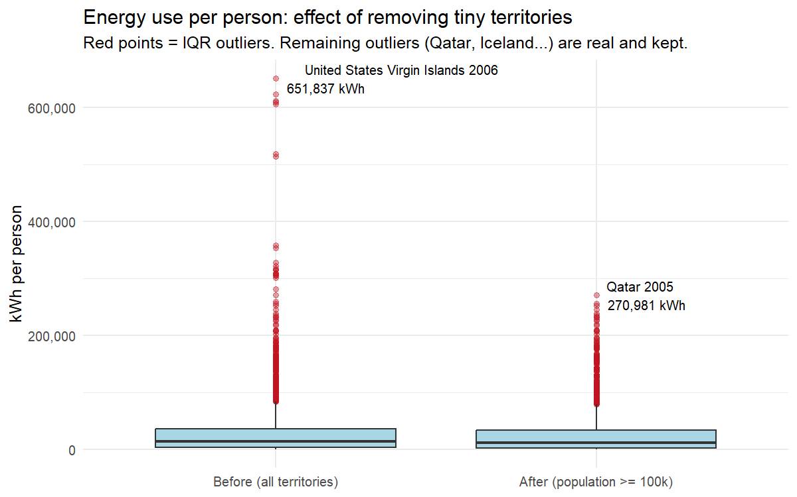
Is the World’s Electricity Getting Cleaner?
Exploring National Power Systems, 2000–2022
Silmara Souto (2023357), CCT College Dublin – Data Exploration & Preparation (CA1), November 2026
INTRODUCTION & MOTIVATION
DATA PREPARATION
Electricity is the largest emitter in the energy sector, producing nearly 40% of energy-related CO₂ (IEA, 2020). Between 2000 and 2022, wind and solar grew from 0.2% to 11.9% of global electricity, yet fossil fuels still supplied 61% (Rosado et al., 2026). This project explores how national electricity systems changed over this period and whether the change is related to wealth and energy use.
To answer this, the Our World in Data energy dataset was prepared and characterised, explored through five analytical questions (variation, covariation and unusual patterns), encoded with one-hot and label encoding, and reduced with Principal Component Analysis (PCA).
Cleaning pipeline
Step | Action and reason | Rows
1. Scope | Countries only (94 aggregates double-count), 2000–2022 | 5,040
2. Attributes | 15 of 130 kept; repeated versions of a variable removed | 5,040
3. Outliers | Territories < 100,000 people removed (see below) | 4,509
4. Missing | Complete-case analysis (rows with NA removed) | 3,511
5. Features | GDP & GHG per person, fossil share, 3 categorical | 3,511
Validity checks: all shares within 0–100%, no duplicated country-years.
Missing values
RESEARCH QUESTIONS
GDP was missing in 24.8% of rows (1,250 of 5,040), but never inside a series: it was missing for 55 whole countries (structurally missing). Mean or median imputation would invent an entire economy, so these rows were not imputed. The other variables had < 8% missing, so complete-case analysis removed 998 rows.
Main question: What characterises the move of national electricity systems away from fossil fuels (2000–2022), and how is it related to wealth and energy use?
The five analytical questions below guided the exploratory data analysis:
Q.1 How is energy use per person distributed across countries? (variation)
Q.2 How did the electricity mix change between 2000 and 2022? (variation)
Q.3 Do richer countries have cleaner electricity? (covariation)
Q.4 How does carbon intensity depend on the dominant source? (covariation)
Q.5 Did every country move towards renewables? (unusual patterns)
Outliers
The IQR rule (values beyond Q1 − 1.5×IQR or Q3 + 1.5×IQR) flagged 312 high energy users. Each case was investigated instead of deleted: real extremes were kept (Qatar, Iceland), while tiny territories dominated by a single plant were removed.
# IQR rule: flag values outside the fences
q <- quantile(x, c(.25, .75), na.rm = TRUE)
out <- x < q[1] - 1.5 * diff(q) |
x > q[2] + 1.5 * diff(q)
energy <- energy %>% filter(population >= 1e5)
DATASET CHARACTERISATION
The Our World in Data energy dataset (Rosado et al., 2026) combines Energy Institute, Ember and EIA data for countries and regions. Only countries from 2000 to 2022 were kept, as earlier electricity data are sparse and GDP is missing after 2022.
 | Raw data | Clean data
Rows | 23,377 | 3,511
Columns | 130 | 21
Years | 1900–2025 | 2000–2022
Entities | 314 (94 aggregates) | 158 countries
Missing values | GDP 24.8% (in scope) | 0
Identifiers | 3 | 3
Numeric attributes | 127 | 15
Categorical attributes | 0 | 3
Fig. 1 The US Virgin Islands (651,837 kWh per person, one oil refinery) is a structural outlier.
ENCODING
Categorical variables were converted to numbers with the method that fits their type (fastDummies package; Kaplan, 2024):
Attributes used (clean data) – identifiers: country, ISO code, year.
Numeric: population, GDP and GHG per person, energy and electricity use per person, carbon intensity (gCO₂/kWh) and the share (%) of coal, gas, oil, nuclear, hydro, wind, solar, renewables and fossil fuels in electricity.
Categorical: dominant source (nominal, 6 levels), period and energy-use level (ordinal); all three were created during preparation.
Variable | Type | Encoding | Example
dominant_source | Nominal (6) | One-hot | Hydro → 0 0 1 0 0 0
period | Ordinal (3) | Label | 2016–2022 → 3
energy_use_level | Ordinal (4) | Label | Very high → 4
Why: label encoding a nominal variable would create a false order (Hydro = 3 > Coal = 1); ordinal codes keep the real order. Check: every row has exactly one dummy = 1.
enc <- dummy_cols(energy, select_columns = "dominant_source")
enc$period_code <- as.integer(factor(enc$period,
levels = c("2000-2007", "2008-2015", "2016-2022")))

