Slide 1
Human Activity Recognition with Smartphones
AIML Cohort 11
Capstone Project
Group-6
Sudipta Saha (2023aiml572)
HarshaVardhana S A (2023aiml073)
Rajneesh Sharma (2023aiml027)
Awinash Kumar (2023aiml047)

Slide 2
Agenda
Overview
Problem Statement
Dataset Overview
Data pre-processed
Pre-requisite Summary
Loading and Reading Dataset
Dataset Overview
Finding out the Missing Values
Investigate participants activity durations
Normalize the numerical features
Analysing the Data (EDA)
Exploratory Data Analysis (EDA) Insights:
…..
…..
…..
…..
…..
8. Conclusion

Slide 3
1. Overview
Smartphones have become an essential tool in daily life, offering communication and intelligent assistance through advanced technology. With computing power, connectivity, and APIs to support third-party apps, smartphones also feature components like cameras, GPS, browsers, and embedded sensors such as accelerometers and gyroscopes. These enable context-aware applications based on user location, movement, and activity.
Activity Recognition (AR) involves monitoring a person’s physical state using smartphone sensors. With their widespread use and built-in sensors, smartphones can detect environmental changes and human motion.
The Human Activity Recognition (HAR) framework uses raw sensor data to detect and classify human movements through deep learning techniques. These models achieve high accuracy in identifying various actions from the sensed data.
The experiments have been carried out with a group of 30 volunteers within an age bracket of 19-48 years. The objective is to build a model that predicts human activities such as Walking, Walking Upstairs, Walking Downstairs, Sitting, Standing, and Laying.

Slide 4
2. Problem Statement
Traditional methods of monitoring human activity for health applications rely heavily on manual observations.
These methods can be time-consuming, inconsistent, and prone to errors.
There is a need for an automated, efficient, and accurate system to recognize different human activities and detect anomalies.
This need is particularly critical for applications in elderly care, chronic disease management, and rehabilitation.
Ensuring real-time recognition with high accuracy remains a challenge due to:
Variations in human movement
Sensor limitations
Data processing constraints
Developing a robust model is essential — one that:
Generalizes across diverse individuals and environments
Maintains computational efficiency

Slide 5
3. Dataset Overview
The Human Activity Recognition database was built from the recordings of 30 study participants performing activities of daily living (ADL) while carrying a waist-mounted smartphone with embedded inertial sensors. The objective is to classify activities into one of the six activities performed.
Dataset Source: https://www.kaggle.com/datasets/uciml/human-activity-recognition-with-smartphones
Test.csv and train.csv are uploaded in jupyter notebook for further processing.
UCI HAR Dataset with 10,299 samples.
561 features from sensors.
6 labeled human activities.
Train: 7,352 | Test: 2,947 samples

Slide 6
How data was recorded ?
30 participants (referred as subjects in this dataset) performed activities of daily living while carrying a waist-mounted smartphone. The phone was configured to record two implemented sensors (accelerometer and gyroscope). For these time series the directors of the underlying study performed feature generation and generated the dataset by moving a fixed-width window of 2.56s over the series. Since the windows had 50% overlap the resulting points are equally spaced (1.28s).This experiment was video recorded to label the data manually.
By using the sensors(Gyroscope and accelerometer) in a smartphone, they have captured '3-axial linear acceleration'(tAcc-XYZ) from accelerometer and '3-axial angular velocity' (tGyro-XYZ) from Gyroscope with several variations.

Slide 7
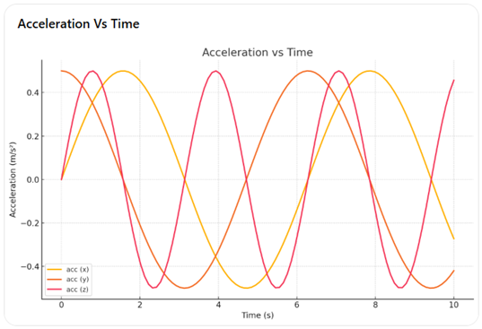
Let’s understand above information in graphical way below:
The Accelerometer and Gyroscope are also known as tri-axial sensors. Why?
Because they measure values on the X, Y, and Z axes over time.
Accelerometer Measures Acceleration
The accelerometer records acceleration along: X-axis, Y-axis and Z-axis

Slide 8
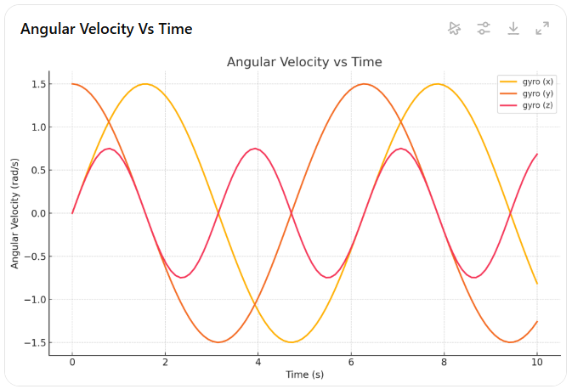
Gyroscope Measures Angular Velocity
The gyroscope records angular velocity along: X-axis, Y-axis and Z-axis

Slide 9
4. Data preprocessed
After getting Raw Sensor Data the Expert (Domain Expert, Signal Engineer Expert) are preprocessed this data and make some useful feature.
These sensor signals are preprocessed by applying noise filters and then sampled in fixed-width windows (sliding windows) of 2.56 seconds each with 50% overlap. ie., each window has 128 readings.
The acceleration signal was separated into Body and Gravity acceleration signals (tBodyAcc-XYZ and tGravityAcc-XYZ) using some low pass filter with corner frequency of 0.3Hz.
After that, the body linear acceleration and angular velocity were derived in time to obtain jerk signals (tBodyAccJerk-XYZ and tBodyGyroJerk-XYZ).
The magnitude of these 3-dimensional signals was calculated using the Euclidian norm. These magnitudes are represented as features with names like tBodyAccMag_, tGravityAccMag, tBodyAccJerkMag, _tBodyGyroMag and tBodyGyroJerkMag.

Slide 10
After getting Raw Sensor Data the Expert (Domain Expert, Signal Engineer Expert) are preprocessed this data and make some useful feature.
These are the signals that
we got so far.
tBodyAcc-XYZ
tGravityAcc-XYZ
tBodyAccJerk-XYZ
tBodyGyro-XYZ
tBodyGyroJerk-XYZ
tBodyAccMag
tGravityAccMag
tBodyAccJerkMag
tBodyGyroMag
tBodyGyroJerkMag
fBodyAcc-XYZ
fBodyAccJerk-XYZ
fBodyGyro-XYZ
fBodyAccMag
fBodyAccJerkMag
fBodyGyroMag
fBodyGyroJerkMag
For better remember : we can see above image, EXPERTS apply some filter on each window and get 1st vector, 2nd vector and…….. so on. On top of these vector, they computed below listed function.
mean(): Mean value
std(): Standard deviation
mad(): Median absolute deviation
max(): Largest value in array
min(): Smallest value in array
sma(): Signal magnitude area
energy(): Energy measure. Sum of the squares divided by the number of values.
iqr(): Interquartile range
entropy(): Signal entropy
arCoeff(): Autorregresion coefficients with Burg order equal to 4
correlation(): correlation coefficient between two signals
maxInds(): index of the frequency component with largest magnitude
meanFreq(): Weighted average of the frequency components to obtain a mean frequency
skewness(): skewness of the frequency domain signal
kurtosis(): kurtosis of the frequency domain signal
bandsEnergy(): Energy of a frequency interval within the 64 bins of the FFT of each window.
angle(): Angle between to vectors

Slide 11
We can obtain some other vectors by taking the average of signals in a single window sample. These are used on the angle() variable'
gravityMean
tBodyAccMean
tBodyAccJerkMean
tBodyGyroMean
tBodyGyroJerkMean
Y_Labels(Encoded) which are represented as numbers from 1 to 6 as their identifiers.
WALKING as 1
WALKING_UPSTAIRS as 2
WALKING_DOWNSTAIRS as 3
SITTING as 4
STANDING as 5
LAYING as 6

Slide 12
5. Pre-requisite Summary
OS –Windows
Component - Jupyter Notebook/ VS Code
Dataset Source- https://www.kaggle.com/datasets/saurabhshahane/road-traffic-accidents?select=RTA+Dataset.csv
Dataset type – CSV flat file
Version Control – https://github.com/2023aiml572/-Human-Activity-Recognition-for-Health-Monitoring-Using-Wearable-Devices

Slide 13
6. Loading and Reading Dataset
Environment setup
Install required libraries
Confirm Working Directory
Import Required Libraries
Load data from CSV files into Pandas data frames
Check basic statistics (.info, .head, .shape)
Import Required Libraries
import pandas
import numpy
import scikit-learn
import matplotlib
import keras

Slide 14
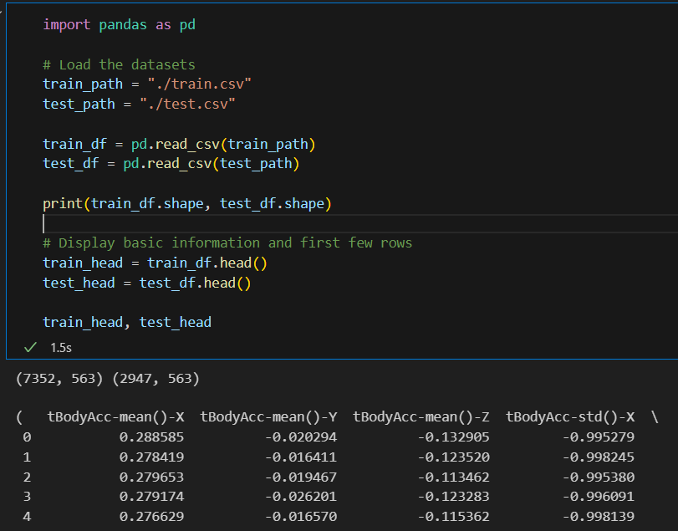
A. Dataset Overview:
1. Train set: 7,352 rows × 563 columns
2. Test set: 2,947 rows × 563 columns
3. Feature types:
- 561 float64 features (sensor readings)
- 1 int64 column: subject (subject ID)
- 1 object column: Activity (target label)

Slide 15
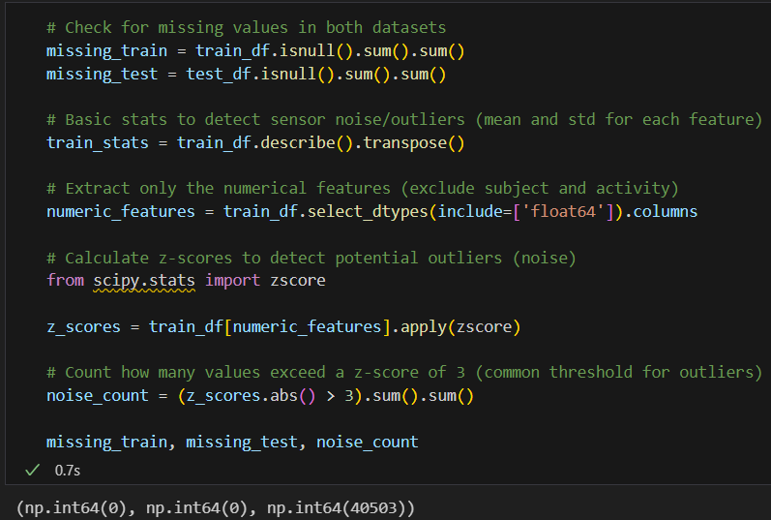
B. Finding out the Missing Values
- Missing Values:
1. Train Set: 0 missing values
2. Test Set: 0 missing values
- Sensor Noise (Potential Outliers): About 40,503 values exceed a z-score of 3, which might indicate sensor noise or extreme readings.

Slide 16
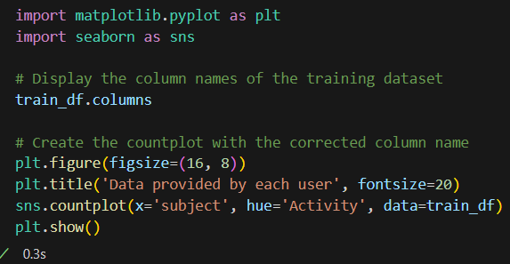
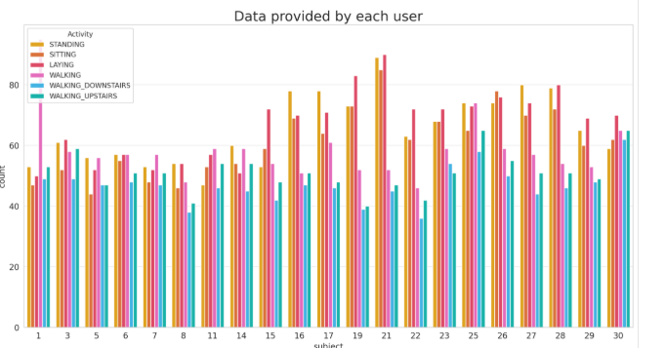
C. Investigate participants activity durations:
Since the dataset has been created in a scientific environment nearly equal preconditions for the participants can be assumed. Let us investigate their activity durations.
Nearly all participants have more data for walking upstairs than downstairs. Assuming an equal number of up- and down-walks the participants need longer walking upstairs.
We know that we have six class classification so, we have the big problem is to know or check is there any imbalanced in the data. And after plotting above graph, we can say data is balanced.
We have got almost same number of reading from all the subject.

Slide 17
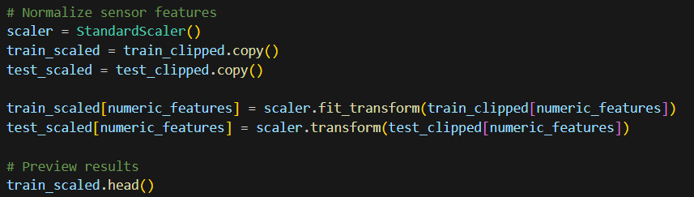
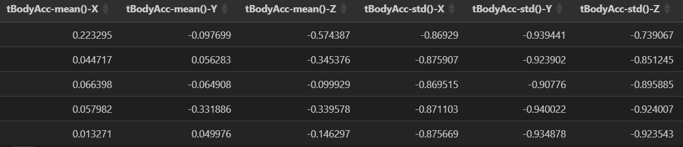
D. Normalize the numerical features :
Ensure proper scaling for machine learning models. Scaling to transform values into the range [0,1].

Slide 18
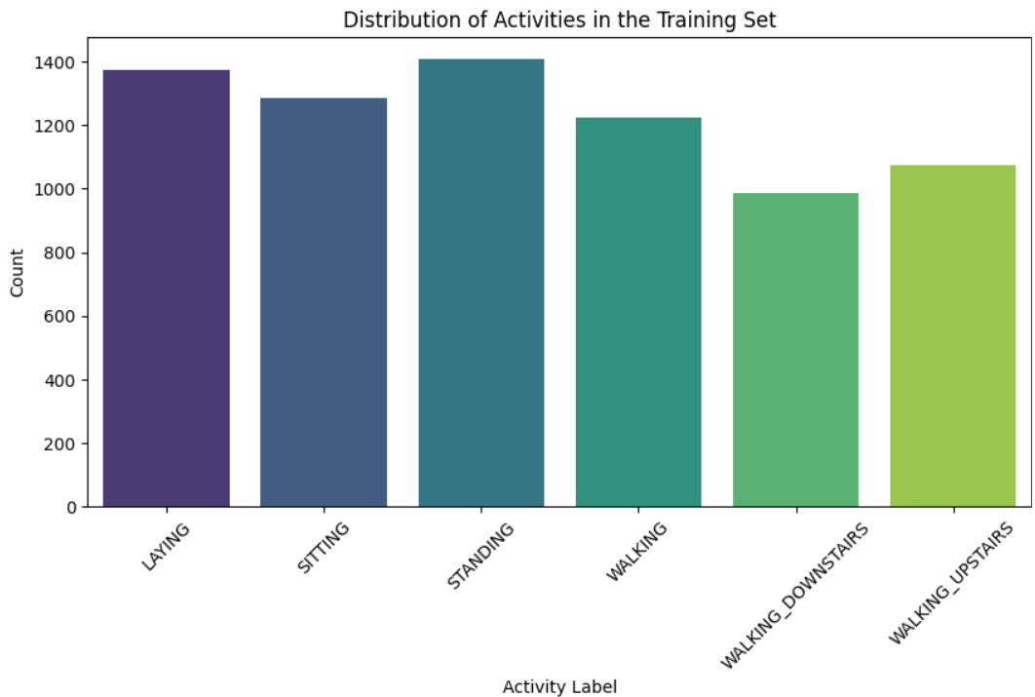
7. Analyzing the Data (EDA)
Here, first we perform EDA on Expert generated Data set. We try to understand the data then create some machine Learning model on top of it.
- Understanding trends in human movement.
- Identifying variations across different activities.
- Visualizing sensor signals for different physical movements.

Slide 19
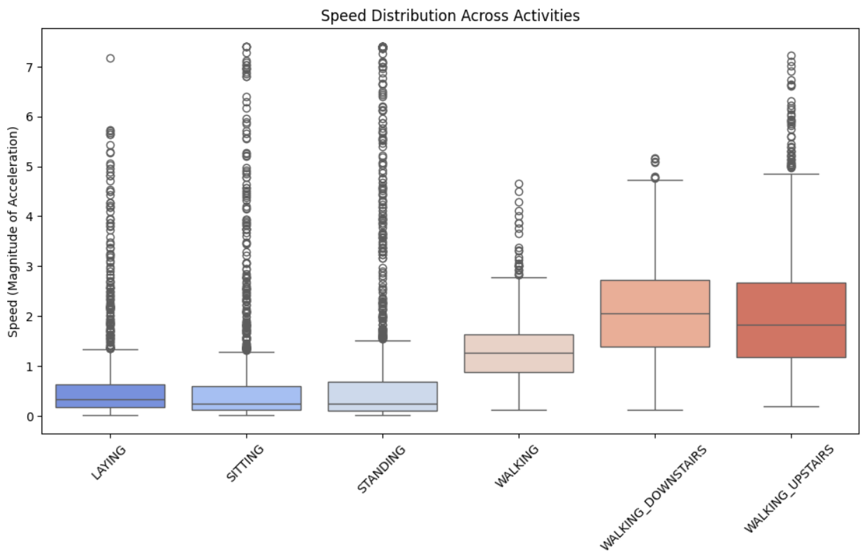
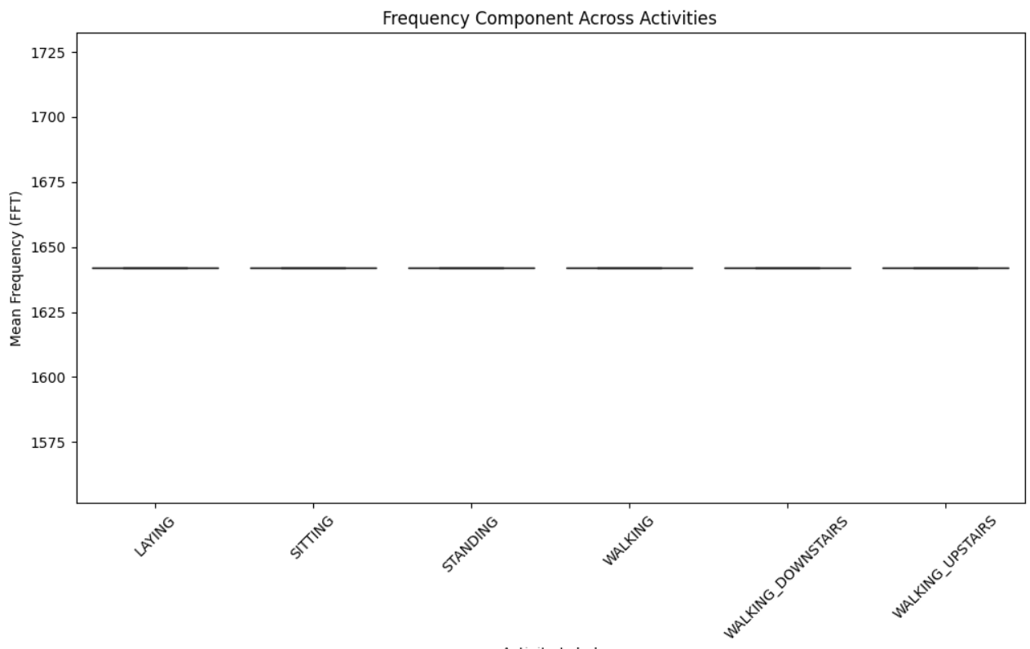
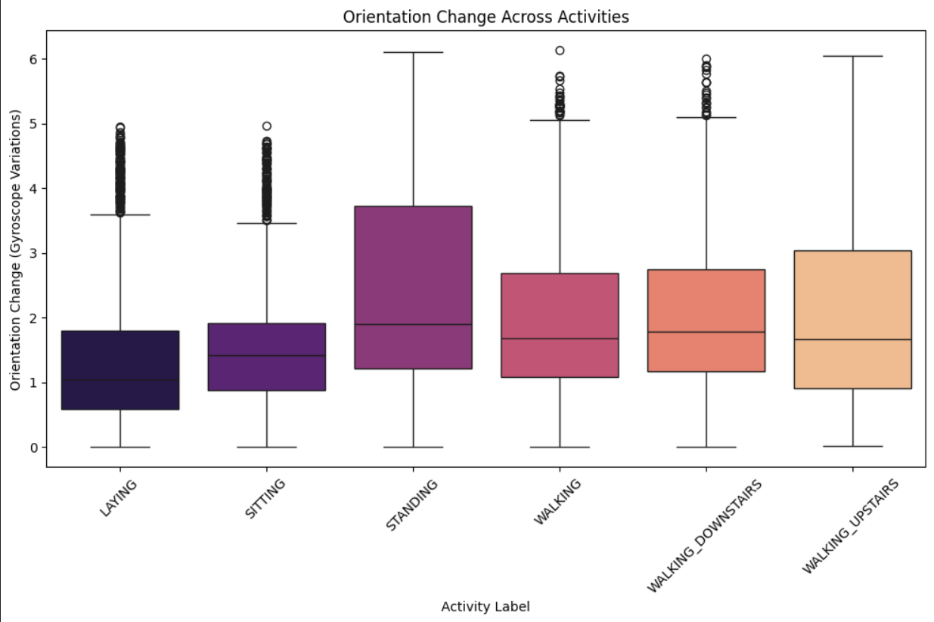

Slide 20
A. Exploratory Data Analysis (EDA) Insights:
1. Activity Distribution:
- The dataset has a fairly balanced distribution across activity types.
- No significant class imbalance, meaning the model won’t require oversampling or under sampling.
2. Speed Variations Across Activities:
- Higher speeds are observed in dynamic activities (Walking, Running, Stair Climbing).
- Lower speeds in static postures (Standing, Sitting, Laying).
3. Orientation Change Trends:
- More significant orientation changes in movement-related activities (Walking, Stair Climbing).
- Minimal changes in static activities (Standing, Sitting).
4. Frequency Component Distribution:
- Some activities have distinct frequency signatures, making them separable in the feature space.
- High-frequency components appear in movement activities.

Slide 21
EDA: Gyroscope Mean Values

Slide 22
EDA: Accelerometer Time-Series

Slide 23
EDA: Gyroscope Time-Series

Slide 24
Feature Engineering
Created jerk (acceleration change rate).
Orientation change via gyroscope drift.
Time & frequency domain features (FFT).

Slide 25
Feature Selection
Removed features with >0.9 correlation.
561 → 197 features retained.

Slide 26
PCA Reduction
Applied PCA: retained 95% variance.
Final: 94 principal components.

Slide 27
Modeling Strategy
Train/Test split: 80/20 (stratified).
Evaluation: Accuracy, F1, Recall, Precision.

Slide 28
Logistic Regression
Linear model (max_iter=1000).
Test accuracy: ~98.4%

Slide 29
Random Forest
100 trees, default depth.
Test accuracy: ~90.3%

Slide 30
SVM (RBF Kernel)
C=1, gamma='scale'
Best accuracy: ~98.6%

Slide 31
Model Comparison
SVM > LR > RF
SVM handles non-linear margins best

Slide 32
Model Tuning - CV
5-fold cross-validation.
Ensures generalizable results.

Slide 33
Grid Search (SVM)
C={0.1,1,10}, gamma={'scale','auto'}
Best: C=10, gamma='scale'

Slide 34
Tuned Model
Optimized SVM: ~99.1% CV accuracy
Improved margin fitting

Slide 35
Final Model
RBF SVM (C=10) chosen
Generalizes with 98–99% test accuracy

Slide 36
Key Findings
Sensor fusion boosts accuracy
Engineered features essential

Slide 37
Challenges
High dimensionality
Subtle differences between activities

Slide 38
Recommendations
Try LSTM for sequence modeling
Explore deployment on mobile

Slide 39
Conclusion
Accurate HAR using classical ML
Effective preprocessing & tuning

Slide 40
Thank You
Questions?
Cohort 11 – Group 6

