Slide 1
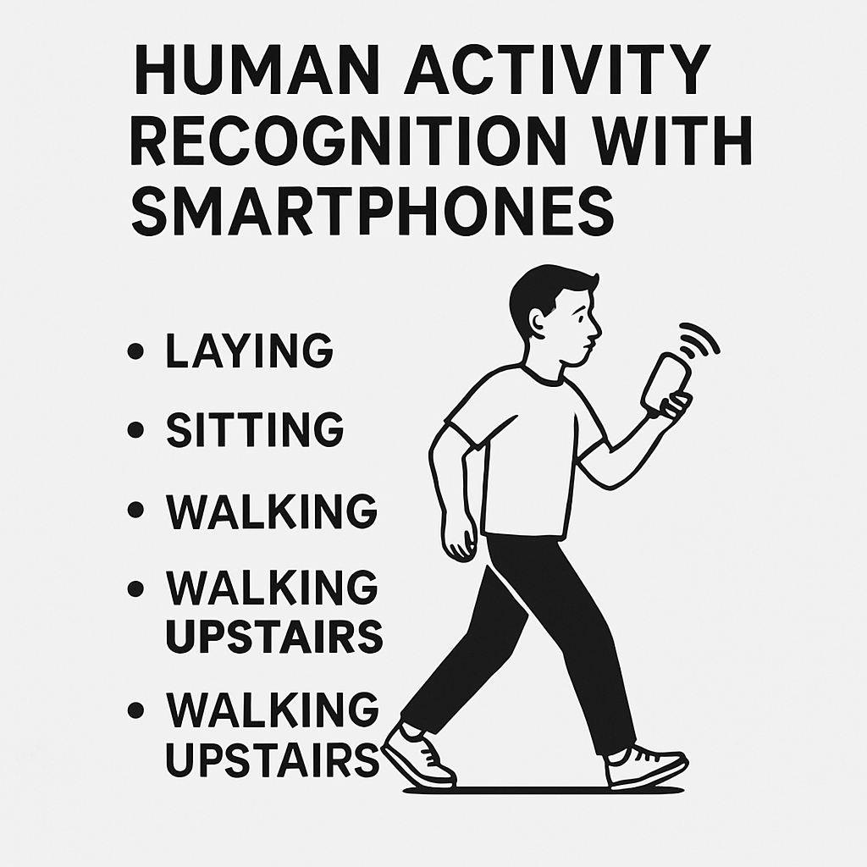
Human Activity Recognition with Smartphones
AIML Cohort 11
Capstone Project
Group-6
Awinash Kumar (2023aiml047)
HarshaVardhana S A (2023aiml073)
Rajneesh Sharma (2023aiml027)
Sudipta Saha (2023aiml572)

Slide 2
Table of contents
1. Overview
2. Problem Statement
3. Dataset Overview
4. Data Pre-processed
5. Prerequisite summary
6 Loading and Reading Dataset
7. Analyzing the data
8. Feature Engineering
9. Model Development
11. How to run locally
12. Deploy to Streamlit cloud
13. Thank You

Slide 3
1. Overview
Smartphones have become an essential tool in daily life, offering communication and intelligent assistance through advanced technology. With computing power, connectivity, and APIs to support third-party apps, smartphones also feature components like cameras, GPS, browsers, and embedded sensors such as accelerometers and gyroscopes. These enable context-aware applications based on user location, movement, and activity.
Activity Recognition (AR) involves monitoring a person’s physical state using smartphone sensors. With their widespread use and built-in sensors, smartphones can detect environmental changes and human motion.
The Human Activity Recognition (HAR) framework uses raw sensor data to detect and classify human movements through deep learning techniques. These models achieve high accuracy in identifying various actions from the sensed data.
The experiments have been carried out with a group of 30 volunteers within an age bracket of 19-48 years. The objective is to build a model that predicts human activities such as Walking, Walking Upstairs, Walking Downstairs, Sitting, Standing, and Laying.

Slide 4
2. Problem Statement
We want to use sensor data from wearable devices to automatically recognize different human activities like walking, sitting, or standing. This helps in tracking physical activity and detecting unusual patterns that might indicate health problems.
Traditional methods we used on manual observation, which is slow and inaccurate. An automated system is important for elderly care, rehabilitation, and managing chronic diseases.
However, it is challenging to build a model that works well in real-time due to:
- Differences in how people move.
- Sensor limitations.
- Processing large amounts of data.
So, the goal is to create a smart and efficient model that:
- Accurately detects activities.
- Works well for different people and situations.
- Uses computer resources effectively.

Slide 5
3. Dataset Overview
The Human Activity Recognition database was built from the recordings of 30 study participants performing activities of daily living (ADL) while carrying a waist-mounted smartphone with embedded inertial sensors. The objective is to classify activities into one of the six activities performed.
Dataset Source: https://www.kaggle.com/datasets/uciml/human-activity-recognition-with-smartphones
Test.csv and train.csv are uploaded in jupyter notebook for further processing.
UCI HAR Dataset with 10,299 samples.
561 features from sensors.
6 labeled human activities.
Train: 7,352 | Test: 2,947 samples

Slide 6
How data was recorded ?
30 participants (referred as subjects in this dataset) performed activities of daily living while carrying a waist-mounted smartphone. The phone was configured to record two implemented sensors (accelerometer and gyroscope). For these time series the directors of the underlying study performed feature generation and generated the dataset by moving a fixed-width window of 2.56s over the series. Since the windows had 50% overlap the resulting points are equally spaced (1.28s).This experiment was video recorded to label the data manually.
By using the sensors(Gyroscope and accelerometer) in a smartphone, they have captured '3-axial linear acceleration'(tAcc-XYZ) from accelerometer and '3-axial angular velocity' (tGyro-XYZ) from Gyroscope with several variations.

Slide 7
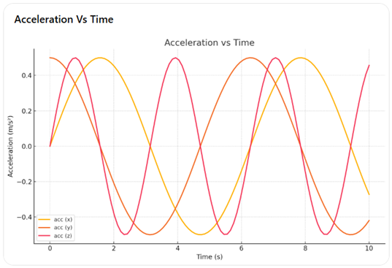
Let’s understand above information in graphical way below:
The Accelerometer and Gyroscope are also known as tri-axial sensors. Why?
Because they measure values on the X, Y, and Z axes over time.
Accelerometer Measures Acceleration
The accelerometer records acceleration along: X-axis, Y-axis and Z-axis

Slide 8
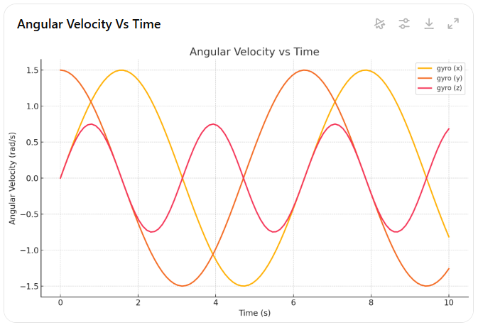
Gyroscope Measures Angular Velocity
The gyroscope records angular velocity along: X-axis, Y-axis and Z-axis

Slide 9
4. Data preprocessed
After getting Raw Sensor Data the Expert (Domain Expert, Signal Engineer Expert) are preprocessed this data and make some useful feature.
These sensor signals are preprocessed by applying noise filters and then sampled in fixed-width windows (sliding windows) of 2.56 seconds each with 50% overlap. ie., each window has 128 readings.
The acceleration signal was separated into Body and Gravity acceleration signals (tBodyAcc-XYZ and tGravityAcc-XYZ) using some low pass filter with corner frequency of 0.3Hz.
After that, the body linear acceleration and angular velocity were derived in time to obtain jerk signals (tBodyAccJerk-XYZ and tBodyGyroJerk-XYZ).
The magnitude of these 3-dimensional signals was calculated using the Euclidian norm. These magnitudes are represented as features with names like tBodyAccMag_, tGravityAccMag, tBodyAccJerkMag, _tBodyGyroMag and tBodyGyroJerkMag.

Slide 10
After getting Raw Sensor Data the Expert (Domain Expert, Signal Engineer Expert) are preprocessed this data and make some useful feature.
These are the signals that
we got so far.
tBodyAcc-XYZ
tGravityAcc-XYZ
tBodyAccJerk-XYZ
tBodyGyro-XYZ
tBodyGyroJerk-XYZ
tBodyAccMag
tGravityAccMag
tBodyAccJerkMag
tBodyGyroMag
tBodyGyroJerkMag
fBodyAcc-XYZ
fBodyAccJerk-XYZ
fBodyGyro-XYZ
fBodyAccMag
fBodyAccJerkMag
fBodyGyroMag
fBodyGyroJerkMag
For better remember : we can see above image, EXPERTS apply some filter on each window and get 1st vector, 2nd vector and…….. so on. On top of these vector, they computed below listed function.
mean(): Mean value
std(): Standard deviation
mad(): Median absolute deviation
max(): Largest value in array
min(): Smallest value in array
sma(): Signal magnitude area
energy(): Energy measure. Sum of the squares divided by the number of values.
iqr(): Interquartile range
entropy(): Signal entropy
arCoeff(): Autorregresion coefficients with Burg order equal to 4
correlation(): correlation coefficient between two signals
maxInds(): index of the frequency component with largest magnitude
meanFreq(): Weighted average of the frequency components to obtain a mean frequency
skewness(): skewness of the frequency domain signal
kurtosis(): kurtosis of the frequency domain signal
bandsEnergy(): Energy of a frequency interval within the 64 bins of the FFT of each window.
angle(): Angle between to vectors

Slide 11
We can obtain some other vectors by taking the average of signals in a single window sample. These are used on the angle() variable'
gravityMean
tBodyAccMean
tBodyAccJerkMean
tBodyGyroMean
tBodyGyroJerkMean
Y_Labels(Encoded) which are represented as numbers from 1 to 6 as their identifiers.
WALKING as 1
WALKING_UPSTAIRS as 2
WALKING_DOWNSTAIRS as 3
SITTING as 4
STANDING as 5
LAYING as 6

Slide 12
5. Pre-requisite Summary
OS –Windows
Component - Jupyter Notebook/ VS Code
Dataset Source- https://www.kaggle.com/datasets/saurabhshahane/road-traffic-accidents?select=RTA+Dataset.csv
Dataset type – CSV flat file
Version Control – https://github.com/2023aiml572/-Human-Activity-Recognition-for-Health-Monitoring-Using-Wearable-Devices

Slide 13
6. Loading and Reading Dataset
Environment setup
Install required libraries
Confirm Working Directory
Import Required Libraries
Load data from CSV files into Pandas data frames
Check basic statistics (.info, .head, .shape)
How data was recorded
30 participants (referred as subjects in this dataset) performed activities of daily living while carrying a waist-mounted smartphone. The phone was configured to record two implemented sensors (accelerometer and gyroscope). For these time series the directors of the underlying study performed feature generation and generated the dataset by moving a fixed-width window of 2.56s over the series. Since the windows had 50% overlap the resulting points are equally spaced (1.28s). This experiment was video recorded to label the data manually.

Slide 14
How data was recorded
By using the sensors (Gyroscope and accelerometer) in a smartphone, they have captured '3-axial linear acceleration'(tAcc-XYZ) from accelerometer and '3-axial angular velocity' (tGyro-XYZ) from Gyroscope with several variations.
prefix 't' in those metrics denotes time.
suffix 'XYZ' represents 3-axial signals in X, Y, and Z directions.
Let’s understand above information in graphical way below:
These are the signals that we got so far.
tBodyAcc-XYZ
tGravityAcc-XYZ
tBodyAccJerk-XYZ
tBodyGyro-XYZ
tBodyGyroJerk-XYZ
tBodyAccMag
tGravityAccMag
tBodyAccJerkMag
tBodyGyroMag
tBodyGyroJerkMag
fBodyAcc-XYZ
fBodyAccJerk-XYZ
fBodyGyro-XYZ
fBodyAccMag
fBodyAccJerkMag
fBodyGyroMag
fBodyGyroJerkMag
Y Labels (Encoded)
In the dataset, Y_labels are represented as numbers from 1 to 6 as their identifiers.
WALKING as 1
WALKING_UPSTAIRS as 2
WALKING_DOWNSTAIRS as 3
SITTING as 4
STANDING as 5
LAYING as 6

Slide 15
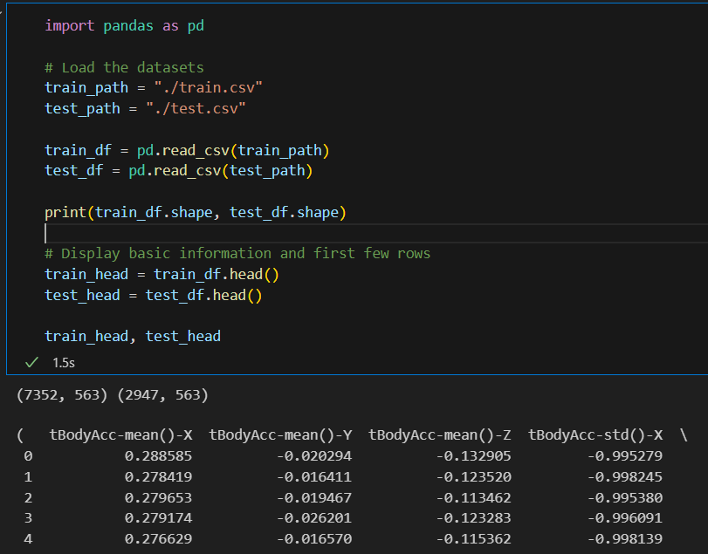
A. Dataset Overview:
1. Train set: 7,352 rows × 563 columns
2. Test set: 2,947 rows × 563 columns
3. Feature types:
- 561 float64 features (sensor readings)
- 1 int64 column: subject (subject ID)
- 1 object column: Activity (target label)

Slide 16
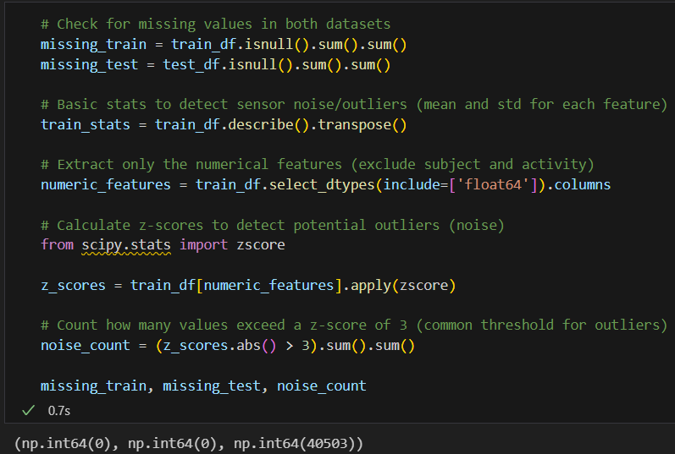
B. Finding out the Missing Values
- Missing Values:
1. Train Set: 0 missing values
2. Test Set: 0 missing values
- Sensor Noise (Potential Outliers): About 40,503 values exceed a z-score of 3, which might indicate sensor noise or extreme readings.

Slide 17
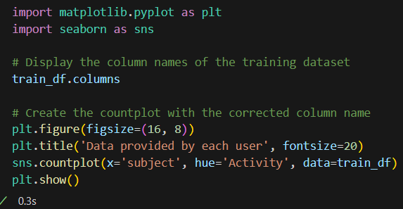
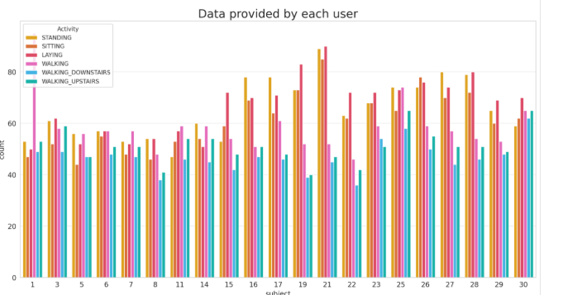
C. Investigate participants activity durations:
Since the dataset has been created in a scientific environment nearly equal preconditions for the participants can be assumed. Let us investigate their activity durations.
Nearly all participants have more data for walking upstairs than downstairs. Assuming an equal number of up- and down-walks the participants need longer walking upstairs.
We know that we have six class classification so, we have the big problem is to know or check is there any imbalanced in the data. And after plotting above graph, we can say data is balanced.
We have got almost same number of reading from all the subject.

Slide 18
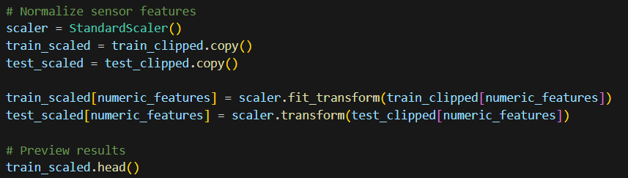
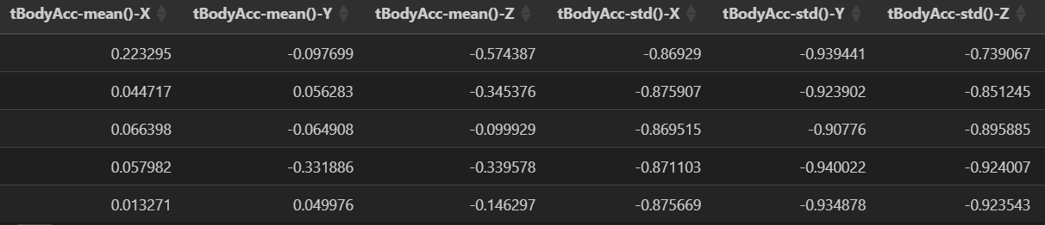
D. Normalize the numerical features :
Ensure proper scaling for machine learning models. Scaling to transform values into the range [0,1].

Slide 19
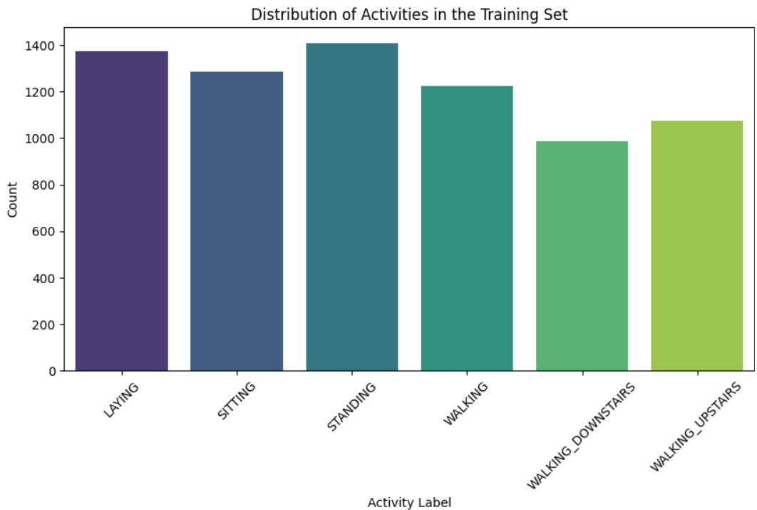
7. Analyzing the Data (EDA)
Here, first we perform EDA on Expert generated Data set. We try to understand the data then create some machine Learning model on top of it.
- Understanding trends in human movement.
- Identifying variations across different activities.
- Visualizing sensor signals for different physical movements.

Slide 20
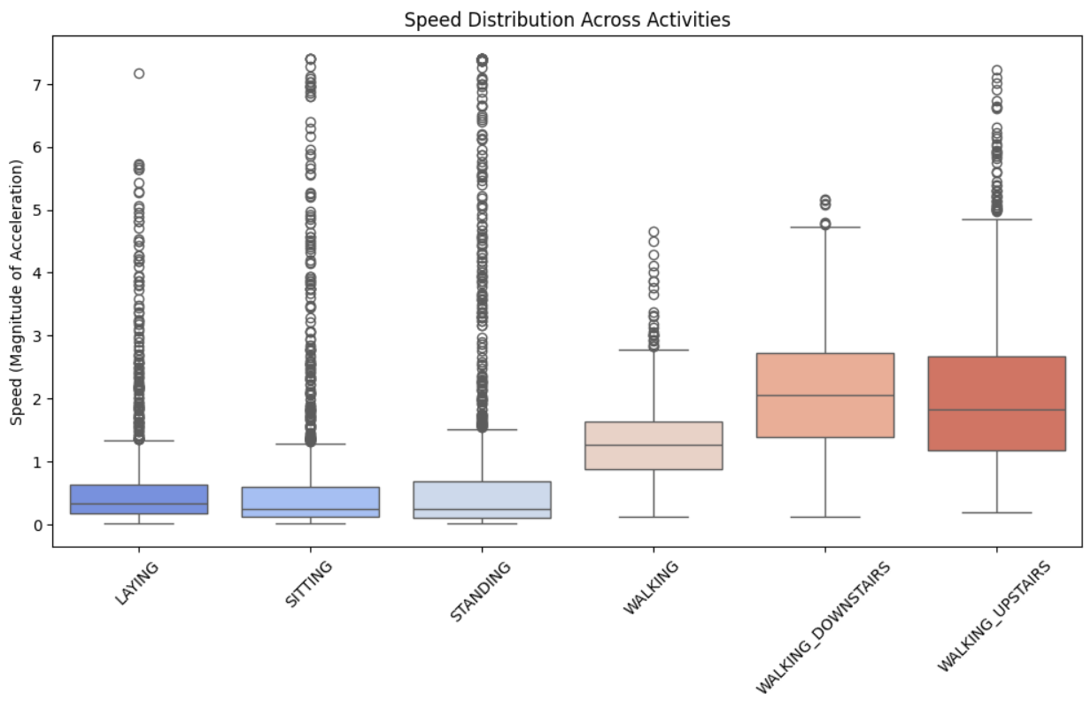
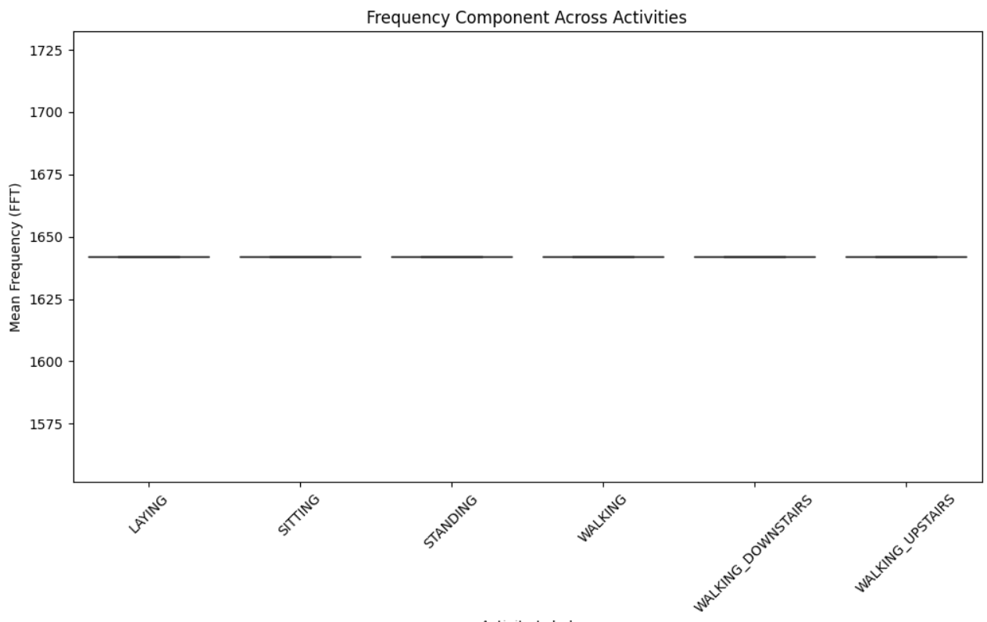
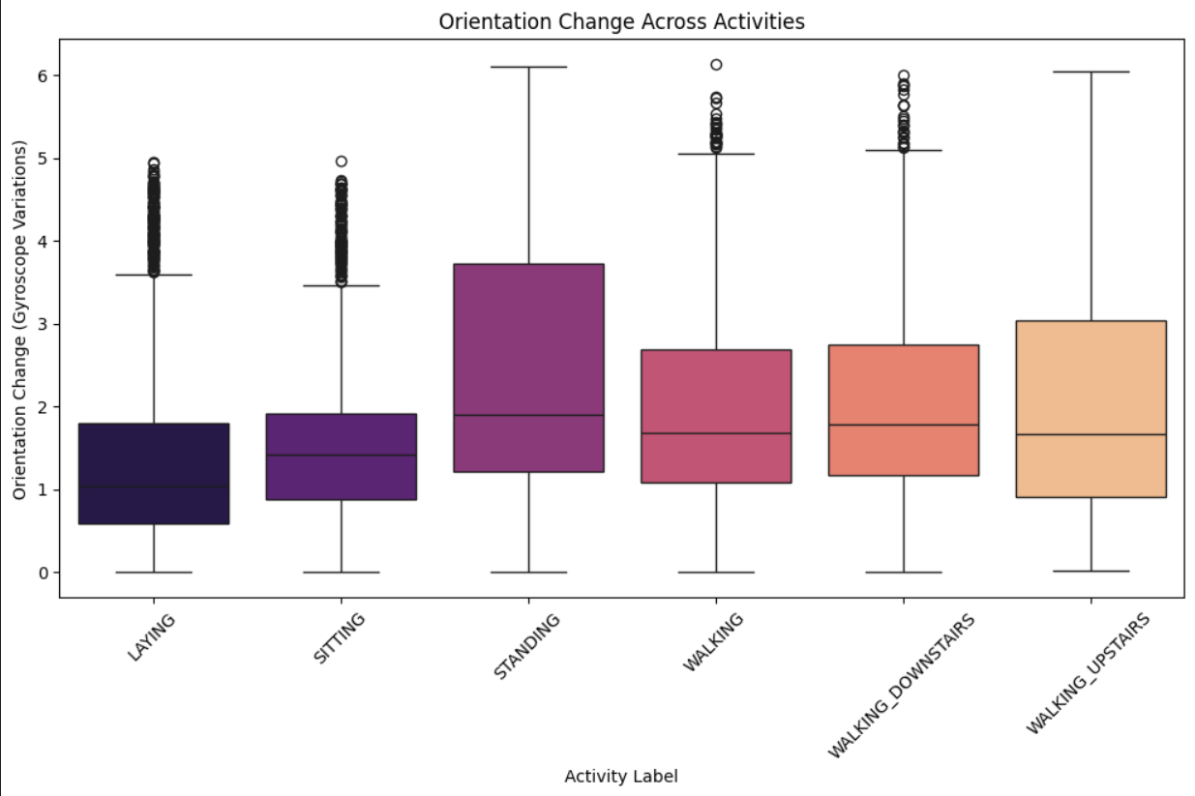

Slide 21
A. Exploratory Data Analysis (EDA) Insights:
1. Activity Distribution:
- The dataset has a fairly balanced distribution across activity types.
- No significant class imbalance, meaning the model won’t require oversampling or under sampling.
2. Speed Variations Across Activities:
- Higher speeds are observed in dynamic activities (Walking, Running, Stair Climbing).
- Lower speeds in static postures (Standing, Sitting, Laying).
3. Orientation Change Trends:
- More significant orientation changes in movement-related activities (Walking, Stair Climbing).
- Minimal changes in static activities (Standing, Sitting).
4. Frequency Component Distribution:
- Some activities have distinct frequency signatures, making them separable in the feature space.
- High-frequency components appear in movement activities.

Slide 22
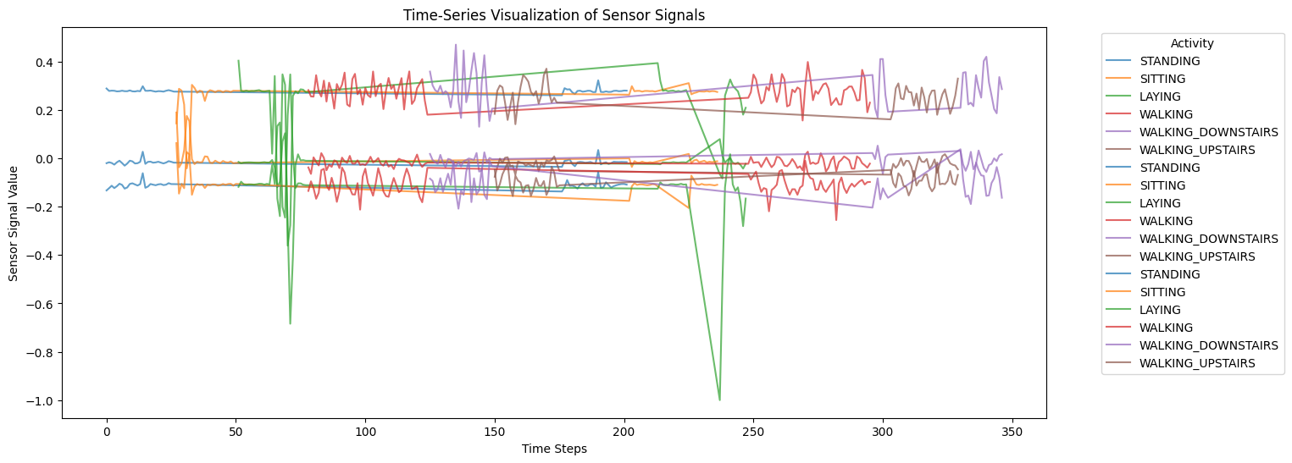
B. Time-Series Visualization Insights
Time-Series Visualization Insights
- The plot shows variations in body acceleration (X, Y, Z components) over time for a single subject across different activities.
- Distinct patterns emerge for different activities, confirming that sensor data effectively differentiates between movement types.
- Walking and stair-climbing activities have periodic oscillations, while static activities like standing and sitting have relatively flat sensor readings.

Slide 23
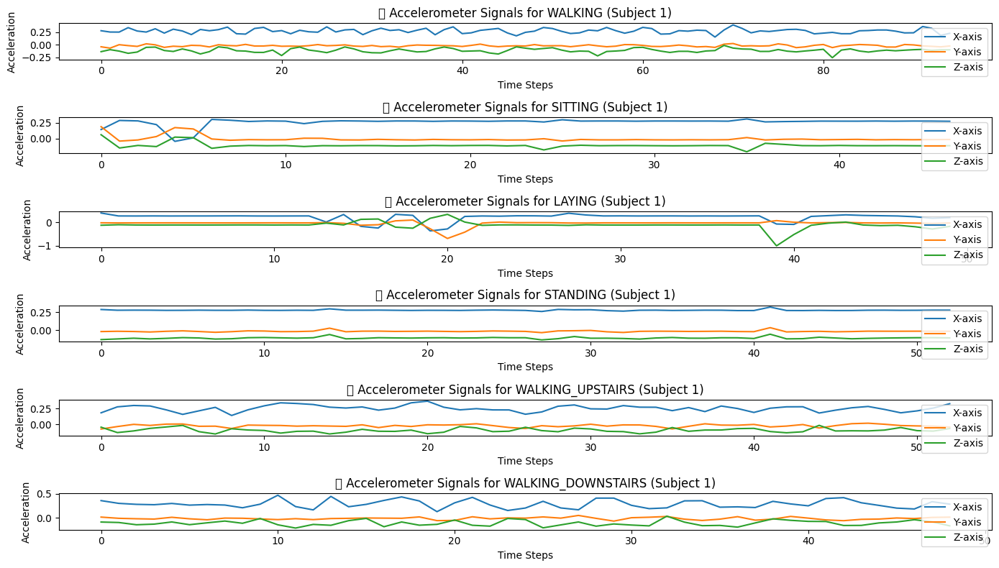
This diagram represents Accelerometer signal data for different physical activities performed by a all persons. The data captures accelerations across three axes—X-axis, Y-axis, and Z-axis—over time. It shows distinct activity patterns and motion signatures characterized by unique accelerometer signal behaviour.

Slide 24
Accelerometer Signals for WALKING:
X-axis (Blue): Demonstrates moderate fluctuation, indicating forward and backward motion during walking.
Y-axis (Orange): Also exhibits slight variations, suggesting minor side-to-side movements.
Z-axis (Green): Shows consistent, repetitive fluctuations, characteristic of vertical up-and-down movement associated with walking.
Overall, the periodicity and moderate variance clearly indicate rhythmic walking motion.
Accelerometer Signals for SITTING:
X-axis: Minimal fluctuations with slight variations, indicating little horizontal movement.
Y-axis: Minor deviations, representing limited sideways shifts or adjustments while sitting.
Z-axis: Stable and relatively flat, indicating negligible vertical movement.
The low variance across all axes confirms a largely stationary posture typical of sitting.
Accelerometer Signals for LAYING:
X-axis: Nearly stable with minimal fluctuation, suggesting horizontal immobility.
Y-axis: Similar low fluctuation, reinforcing minimal lateral movement.
Z-axis: Displays one notable dip, potentially a slight positional shift or sensor noise.
The signals clearly represent minimal motion, typical of a laying posture with occasional minor adjustments.

Slide 25
Accelerometer Signals for STANDING:
X-axis: Relatively stable and low fluctuations, signifying minimal horizontal displacement.
Y-axis: Limited variation similar to the X-axis, reflecting minimal side-to-side movement.
Z-axis: Consistently stable, suggesting a steady vertical posture.
These stable signals confirm the subject maintaining a static upright posture.
Accelerometer Signals for WALKING_UPSTAIRS:
X-axis: Moderate repetitive fluctuations, indicating forward motion combined with elevation gain.
Y-axis: Moderate fluctuations, less pronounced compared to X-axis, indicating sideways adjustments while climbing.
Z-axis: Frequent fluctuations with distinct peaks and troughs, clearly capturing vertical motion associated with ascending steps.
This clearly illustrates the characteristic vertical and forward motion of stair climbing.
Accelerometer Signals for WALKING_DOWNSTAIRS:
X-axis: Pronounced fluctuations, indicating notable forward momentum combined with descent.
Y-axis: Noticeable fluctuations, signifying lateral movement or stabilization during descent.
Z-axis: Distinct repetitive peaks and troughs, similar to WALKING_UPSTAIRS but with slightly different rhythmic patterns due to downward movement dynamics.
These signals vividly capture the downward stepping motion and the characteristic bounce while descending stairs.

Slide 26
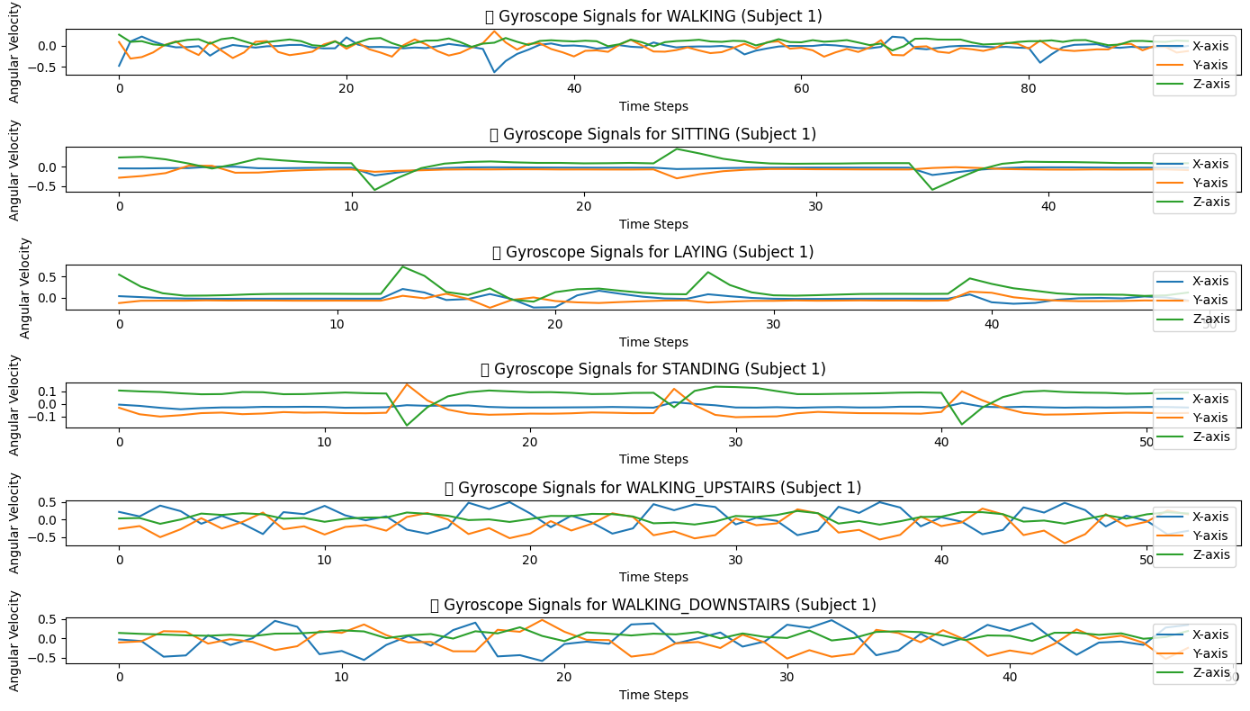
This diagram represents Gyroscope signal data for different physical activities performed by a all persons. The data captures accelerations across three axes—X-axis, Y-axis, and Z-axis—over time.

Slide 27
1. Gyroscope Signals for WALKING:
X-axis (Blue): Moderate and repetitive fluctuations indicating forward-backward rotation around the X-axis, reflecting natural rotational motion during walking.
Y-axis (Orange): Pronounced variations, suggesting noticeable lateral twisting or rotation around the Y-axis.
Z-axis (Green): Regular, moderate fluctuations, indicating consistent vertical axis rotation, possibly from torso rotation during walking.
These rhythmic signals clearly show repetitive rotational patterns inherent in the act of walking.
2. Gyroscope Signals for SITTING:
X-axis: Low and largely stable with slight deviations, indicating minimal rotational motion in horizontal orientation.
Y-axis: Slightly more visible fluctuation, suggesting occasional lateral or slight turning movements while sitting.
Z-axis: Mostly stable, but with minor irregular dips possibly representing small, occasional positional adjustments.
Overall, signals reflect minimal rotational motion, characteristic of maintaining a seated posture.
3. Gyroscope Signals for LAYING:
X-axis: Mostly stable, minimal fluctuations, indicating almost negligible rotation around X-axis while laying down.
Y-axis: Low variations indicating minor lateral rotations or slight positional shifts.
Z-axis: Occasional peaks but overall low variation, possibly indicating subtle repositioning movements.
These signals confirm very limited rotational activity typical of a resting or laying posture.

Slide 28
4. Gyroscope Signals for STANDING:
X-axis: Remarkably stable, negligible rotational motion, indicating upright stability.
Y-axis: Very minimal fluctuations, representing slight, infrequent lateral sway.
Z-axis: Stable with slight occasional shifts, typical of subtle balancing adjustments.
These stable gyroscopic signals highlight the minimal rotational dynamics involved in a stationary standing posture.
5. Gyroscope Signals for WALKING_UPSTAIRS:
X-axis: Frequent fluctuations, representing rotational motion due to inclined forward movements involved in ascending stairs.
Y-axis: Distinct fluctuations, indicating significant rotational motion around Y-axis, possibly due to balancing and stabilization.
Z-axis: Visible rhythmic variations, representing repetitive rotation on the vertical axis associated with stair climbing.
The pronounced fluctuations clearly highlight dynamic rotational movements involved in ascending stairs.
6. Gyroscope Signals for WALKING_DOWNSTAIRS:
X-axis: Prominent fluctuations capturing the forward tilting motion during descent.
Y-axis: Regular pronounced fluctuations, signifying lateral rotational adjustments as the subject descends.
Z-axis: Noticeably rhythmic fluctuations, suggesting torso rotations around the vertical axis, characteristic of descending stairs motion.
These signals vividly capture rotational dynamics that differentiate descending stairs from ascending stairs or walking on flat surfaces.

Slide 29
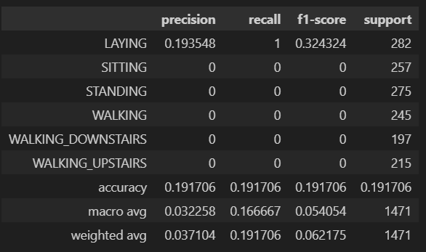
1. LAYING
Precision: 0.193548 (19.35%)
Recall: 1.0 (100%) - The model correctly identifies all instances of laying.
F1-score: 0.324324 (32.43%)
Support: 282 occurrences
Conclusion: Although recall is perfect, the precision is extremely low, indicating many false positives. The model often predicts other activities incorrectly as LAYING.
2. SITTING, STANDING, WALKING, WALKING_DOWNSTAIRS, WALKING_UPSTAIRS
Precision, Recall, F1-score: 0 (0%)
Conclusion: The model fails completely to detect these activities, indicating severe issues in distinguishing them from the LAYING activity.

Slide 30
Overall Accuracy:
Accuracy: 0.191706 (19.17%)
Extremely low accuracy indicating poor model performance overall.
Averages:
Macro Average (Unweighted average across classes):
Precision: 0.032258 (3.23%)
Recall: 0.166667 (16.67%)
F1-score: 0.054054 (5.40%)
Indicates poor overall performance across classes, severely impacted by zero values in multiple classes.
Weighted Average (Weighted by support, indicating real data distribution):
Precision: 0.037104 (3.71%)
Recall: 0.191706 (19.17%)
F1-score: 0.062175 (6.22%)
Poor performance, slightly better than the macro average due to the larger contribution of the LAYING class.

Slide 31
Summary of EDA:
1. Activity Distribution: The dataset is balanced, ensuring fair classification.
2. Sensor Trends:
- Acceleration varies distinctly across activities.
- Gyroscope readings indicate rotational motion differences.
3. Time-Series Insights:
- Periodic sensor signals suggest activity-specific movement patterns.
- Potential for feature engineering using signal frequency analysis.

Slide 32
8. Feature Engineering: Feature Selection & Optimization
Variance Threshold for Feature Selection
Used VarianceThreshold from sklearn.feature_selection to remove low-variance features.
Threshold set to 0.01 → removes features with variance < 0.01.
Low variance ≈ nearly constant → not useful for prediction.
Applied .fit_transform() on training data and .transform() on test data to prevent data leakage.
Output: 524 features retained after removal.
Outcome: Model becomes more efficient by keeping only informative features.
Remove Highly Correlated Features
Goal: Avoid redundancy, reduce overfitting, improve model performance.
Enhances interpretability and training speed.
After correlation filtering → 253 features retained (i.e., 271 correlated features removed).
Remove Highly Correlated Features
Goal: Avoid redundancy, reduce overfitting, improve model performance.
Enhances interpretability and training speed.
After correlation filtering → 253 features retained (i.e., 271 correlated features removed).

Slide 33
Feature Engineering Summary
Variance Thresholding: Removed 40 low-variance features.
Correlation Analysis: Removed 271 highly correlated features.
PCA (Dimensionality Reduction): Reduced features to 94, retaining 95% variance.
RFE (Feature Selection with SVM): Selected the top 50 most predictive features.
The dataset is now fully optimized and ready for SVM model training and evaluation.

Slide 34
9. Model Development
Label Encoding
Converts 'Activity' column from text (e.g., 'WALKING') to numeric labels (e.g., 0, 1, 2…).
Feature & Target Split
Drops 'Activity' and 'subject' columns to create X (features).
Stores the encoded 'Activity' as y (target).
Standardization
Uses StandardScaler to normalize feature values.
Ensures mean = 0 and standard deviation = 1.
Prevents any feature from dominating due to scale differences.
Shape Check
Verifies dimensions of the processed data:
x_train_scaled, x_test_scaled
y_train, y_test

Slide 35
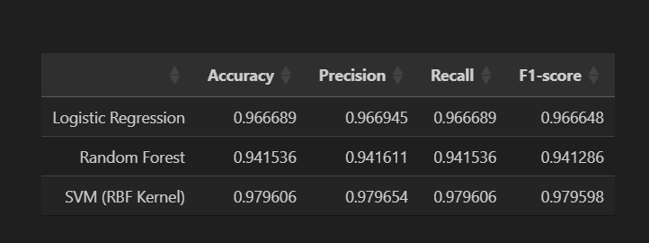
Model Evaluation Results
Logistic Regression
Accuracy: 96.67%
Performs very well on the dataset.
High precision, recall, and F1-score:
Indicates a good balance of false positives and false negatives.
Suggests the dataset is close to linearly separable.
Efficient, fast, and interpretable — great for baseline evaluation.

Slide 36
Random Forest
Accuracy: 94.15% (Lower than others)
Potential issues:
Struggles with high-dimensional and correlated features.
Sensitive to noise and may miss subtle patterns.
Still decent, but performance can improve with:
Better feature selection or dimensionality reduction (e.g., PCA).
Hyperparameter tuning.
SVM (RBF Kernel)
Accuracy: 97.96% (Best performer)
Precision, Recall, F1-score ≈ 98%
Performs best because:
RBF kernel models non-linear decision boundaries well.
Handles high-dimensional, sparse data efficiently.
Great synergy with scaled and cleaned features.

Slide 37
10. How to run locally
The Code is written in Python 3.7. If you don't have Python installed you can find it here. If you are using a lower version of Python you can upgrade using the pip package, ensuring you have the latest version of pip.
Clone the repo and `cd` into the folder
Install dependencies:
pip install -r requirements.txt
Run the app:
streamlet run app.py
11. Deploy to streamlit cloud
Push this project to GitHub
https://github.com/2023aiml073/-Human-Activity-Recognition-for-Health-Monitoring-Using-Wearable-Devices
Go to https://streamlit.io/cloud
Connect your repo and deploy

Slide 38
Thank You
For Your Attention!
Any Questions?

