Slide 1
PROJETO INTERDISCIPLINAR: SISTEMA EMPRESARIAL WEB DoaMais
Grupo Charge Back
Daniel Baptista
Fábio Spindola
Fabrício Nascimento
Leonardo Mouzinho

Slide 2
AGENDA
01
02
03
DESENVOLVIMENTO
ONG
Processo de desenvolvimento do projeto
Ong parceira
O SITE
Elementos do site

Slide 3
01
DESENVOLVIMENTO
Processo de desenvolvimento do projeto

Slide 4
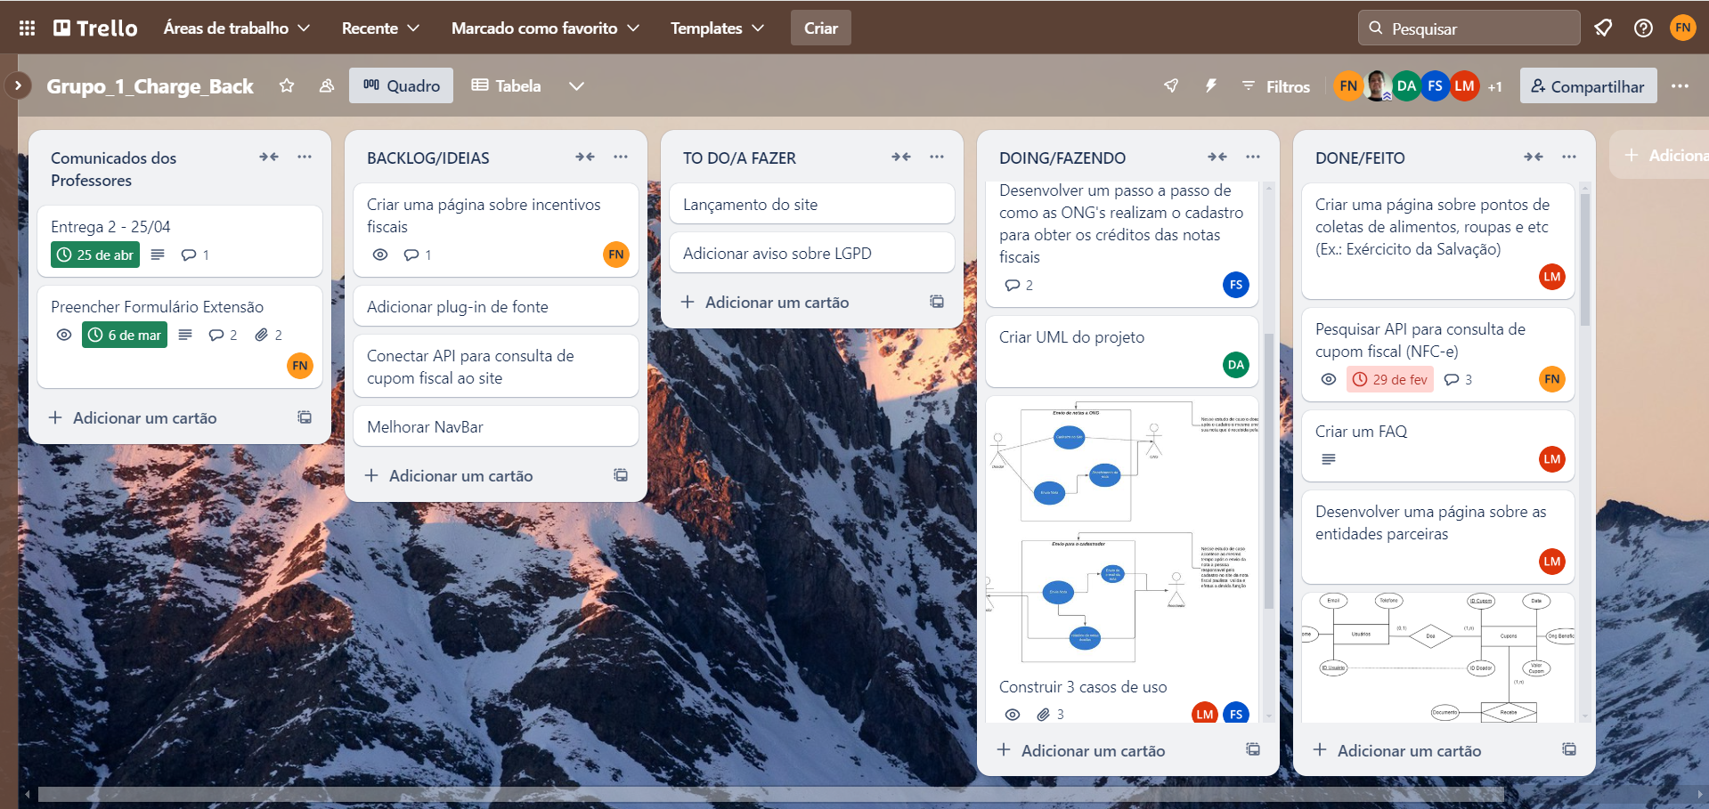
TRELLO
Todas as atividades planejadas e realizadas foram controladas por meio do Trello, utizando o framework Scrum para estruturar e gerenciar o trabalho.
Link: https://trello.com/b/gpL26cOT/grupo1chargeback

Slide 5
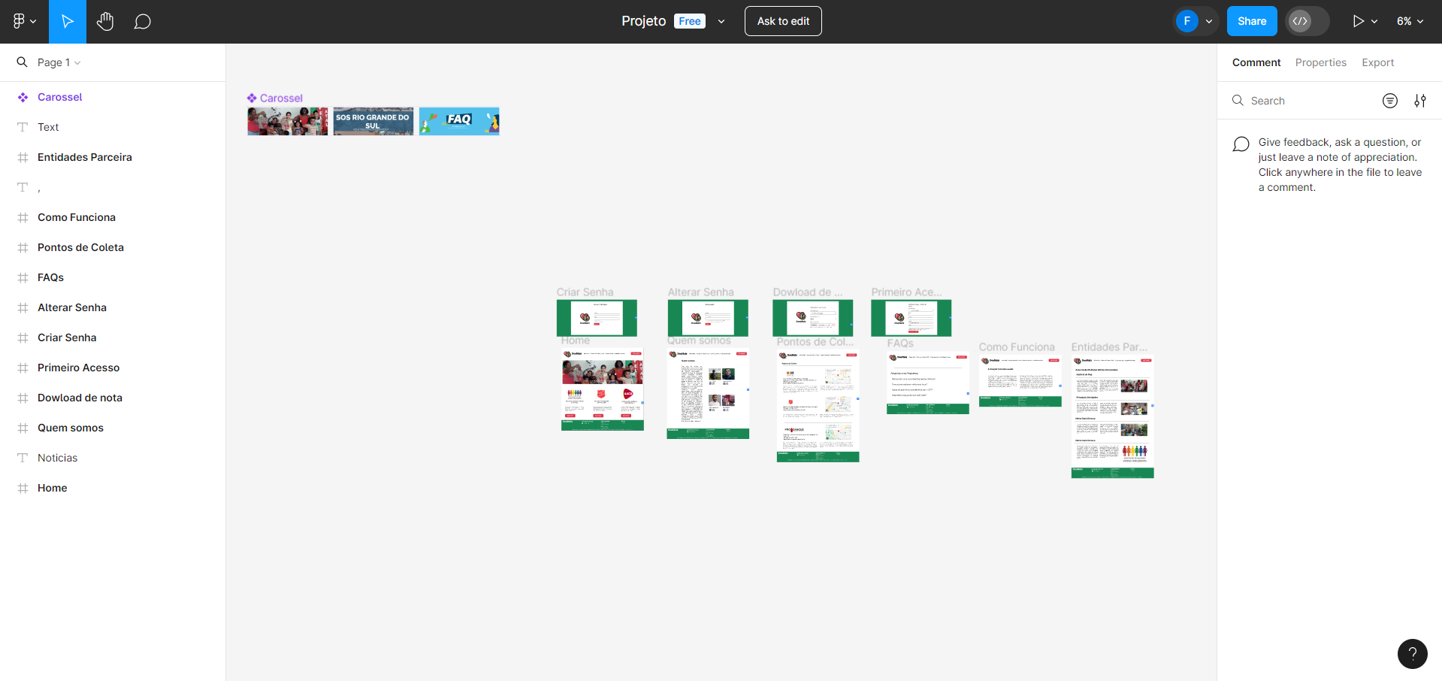
FIGMA
Construção e mudanças no designer do site, foram prototipadas e testadas no Figma antes da codificação.
Link: https://www.figma.com/design/x1PWvOffpN3Rvv6BHJ5oqM/Projeto?node-id=0-1&t=7fgCh8vIbiGquBwV-0

Slide 6
GUIA DE ESTILO
Construção de um Guia de Estilo (style guide) com os conjuntos de elementos, padrões e regras.
Regras essas que direcionaram na criação e manutenção de interfaces coerentes, consistentes e padronizadas.

Slide 7
REQUISITOS DO SISTEMA
Descrições dos serviços fornecidos pelo sistema e as suas restrições operacionais contidas nos requisitos do sistema levantados.

Slide 8
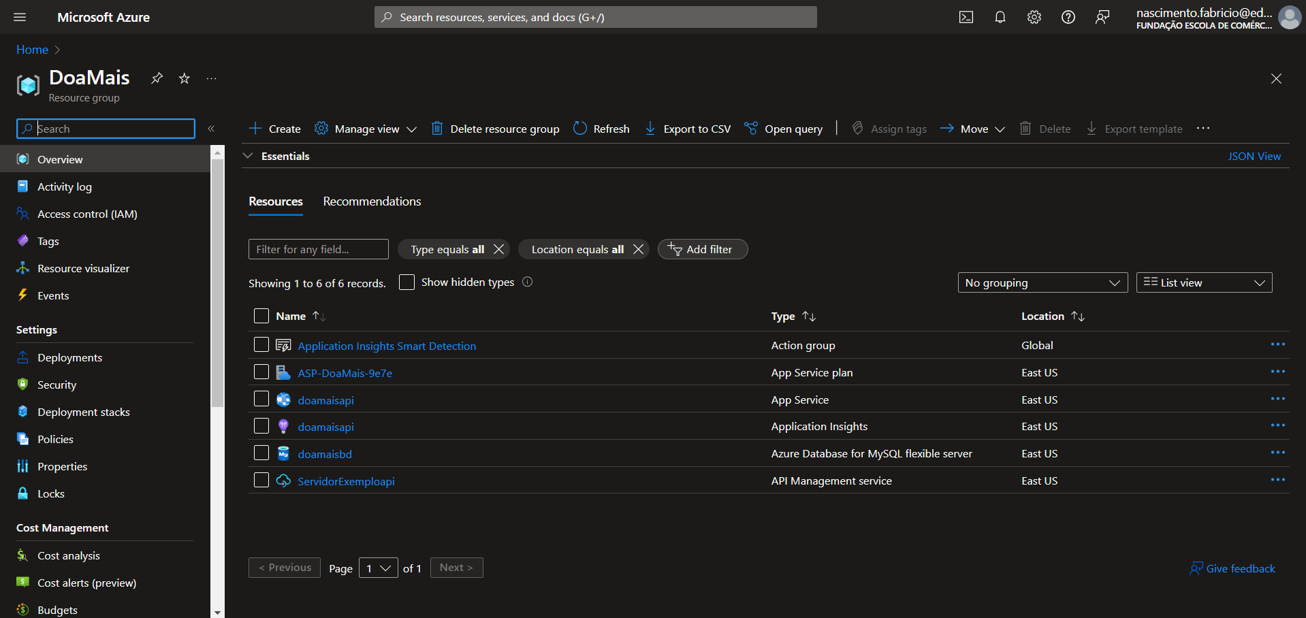
AZURE
Infraestrutura do site em nuvem.

Slide 9
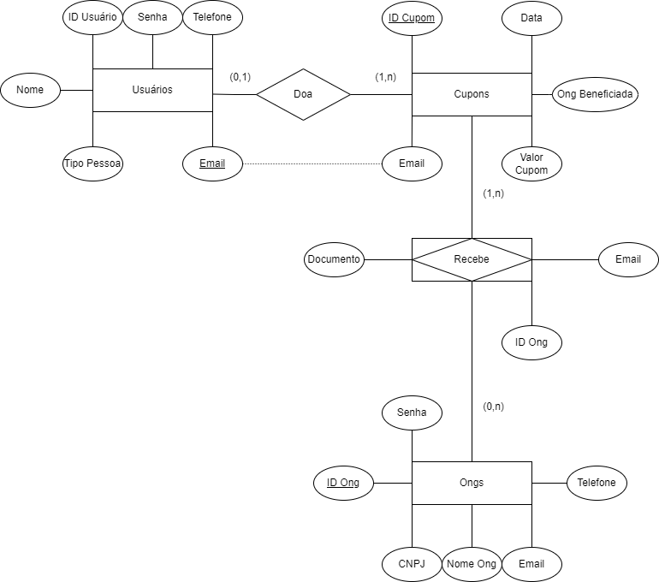
DER BANCO DE DADOS

Slide 10
02
ONG
Ong parceira

Slide 11

ASSOCIAÇÃO DE MULHERES UNIDAS VENCEREMOS
A AMUV tem como objetivo principal oferecer apoio e assistência a diversos grupos vulneráveis, com foco especial nas mulheres.

Slide 12
03
O SITE
Elementos do site

Slide 13

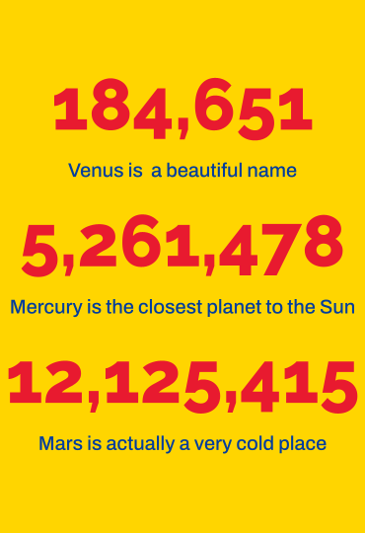

SITE RESPONSIVO
Site adaptativo para telas de:
320px — 480px: dispositivos móveis
481px — 768px: iPads, tablets
769px — 1024px: telas pequenas, laptops
1025px — 1200px: desktops, telas grandes
1201px e acima — telas muito grandes, TVs

Slide 14
WHOA!
This can be the part of the presentation where you introduce yourself, write your email…

Slide 15
CONCLUSION
You can give a brief description of the topic you want to talk about here. For example, if you want to talk about Mercury, you can say that it’s the smallest planet

Slide 16
OBRIGADO

Slide 17
CONTENTS OF THIS TEMPLATE
This is a slide structure based on a thesis defense
You can delete this slide when you’re done editing the presentation
FONTS | To view this template correctly in PowerPoint, download and install the fonts we used
USED AND ALTERNATIVE RESOURCES | An assortment of graphic resources that are suitable for use in this presentation
THANKS SLIDE | You must keep it so that proper credits for our design are given
COLORS | All the colors used in this presentation
INFOGRAPHIC RESOURCES | These can be used in the template, and their size and color can be edited
CUSTOMIZABLE ICONS | They are sorted by theme so you can use them in all kinds of presentations
For more info: SLIDESGO | SLIDESGO SCHOOL | FAQS
You can visit our sister projects: FREEPIK | FLATICON | STORYSET | WEPIK | VIDEVO

Slide 18
INTRODUCTION
You can give a brief description of the topic you want to talk about here. For example, if you want to talk about Mercury, you can say that it’s the smallest planet in the entire Solar System

Slide 19
MARKETING METHODS
MERCURY
VENUS
Mercury is the closest planet to the Sun and the smallest one in the entire Solar System. It’s also hot
Venus has a beautiful name. It’s the second-brightest natural object in the night sky after the Moon

Slide 20
MARKETING EVENTS
MARS
VENUS
MERCURY
Mars is actually a very cold place
Venus is the second planet from the Sun
It’s the closest planet to the Sun

Slide 21
MARKETING CAMPAIGN
MARS
VENUS
Mars is actually a very cold place
Venus is the second planet from the Sun
SATURN
JUPITER
It’s composed of hydrogen and helium
Jupiter is the biggest planet of them all

Slide 22
PHASES OF THE EVENT
MARS
VENUS
MERCURY
Mars is actually a very cold place
Venus is the second planet from the Sun
It’s the closest planet to the Sun
SATURN
JUPITER
NEPTUNE
It’s composed of hydrogen and helium
Jupiter is the biggest planet of them all
It’s the farthest planet from the Sun

Slide 23
AWESOME WORDS

Slide 24
—SOMEONE FAMOUS
“This is a quote, words full of wisdom that someone important said and can make the reader get inspired.”

Slide 25
SCHEDULE
9:00
10:00
11:00
12:00
13:00
PHASE 1
Task 1
Task 2
PHASE 2
Task 1
Task 2

Slide 26
365,654
Big numbers catch your audience’s attention

Slide 27
184,651
5,261,478
12,125,415
Venus is a beautiful name
Mercury is the closest planet to the Sun
Mars is actually a very cold place

Slide 28
EXPENSES GENERATED
25%
50%
25%
MERCURY
VENUS
MARS
It’s the closest planet to the Sun
Venus is the second planet from the Sun
Despite being red, Mars is a cold place

Slide 29
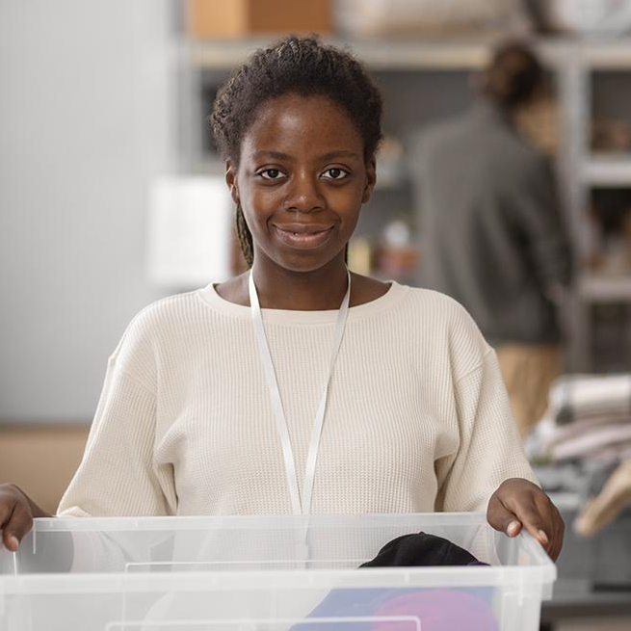

OUR TEAM
JENNA DOE
JOHN JAMES
You can speak a bit about this person here
You can speak a bit about this person here

Slide 30
MARKETING PROCESS
NEPTUNE
JUPITER
It’s the farthest planet from the Sun
Jupiter is the biggest planet of them all
01
02
03
04
MARS
VENUS
Mars is actually a very cold place
Venus is the second planet from the Sun

Slide 31
COLLABORATIVE ORGANIZATIONS
VENUS
Venus is the second planet from the Sun
MARS
Mars is actually a very cold place
JUPITER
Jupiter is the biggest planet of them all

Slide 32
MEDIA ADVERTISING
 | DESCRIPTION | PERCENTAGES
ONLINE | Despite being red, Mars is a very cold place | 50%
MASS MARKETING | Jupiter is the biggest planet in the Solar System | 25%
OFFLINE | Venus has a beautiful name, but also high temperatures | 25%

Slide 33
ALTERNATIVE RESOURCES
Here’s an assortment of alternative resources whose style fits the one of this template:
VECTORS:
Flat charity event twitter header

