Slide 1
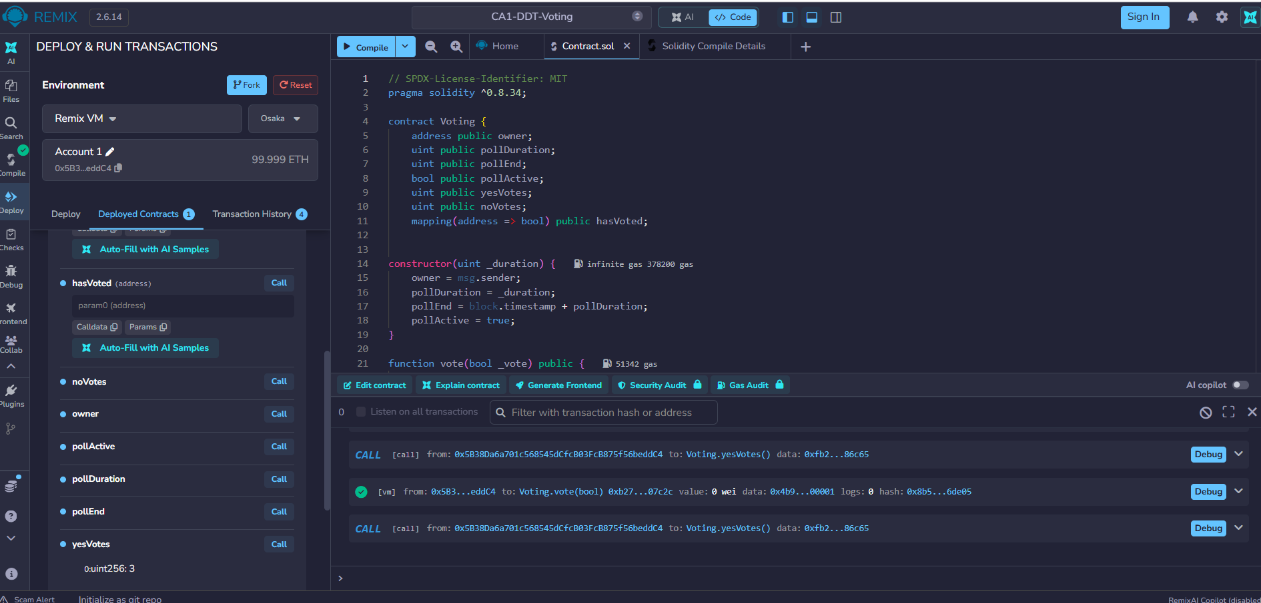
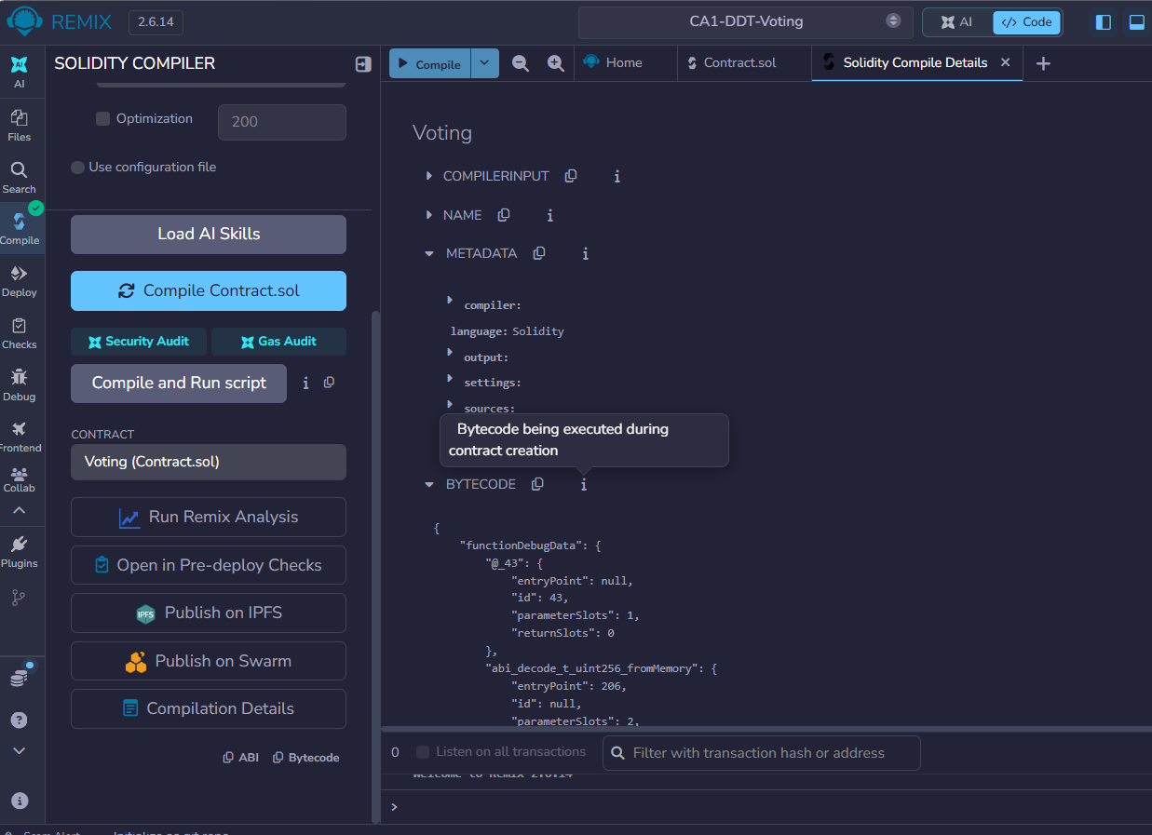
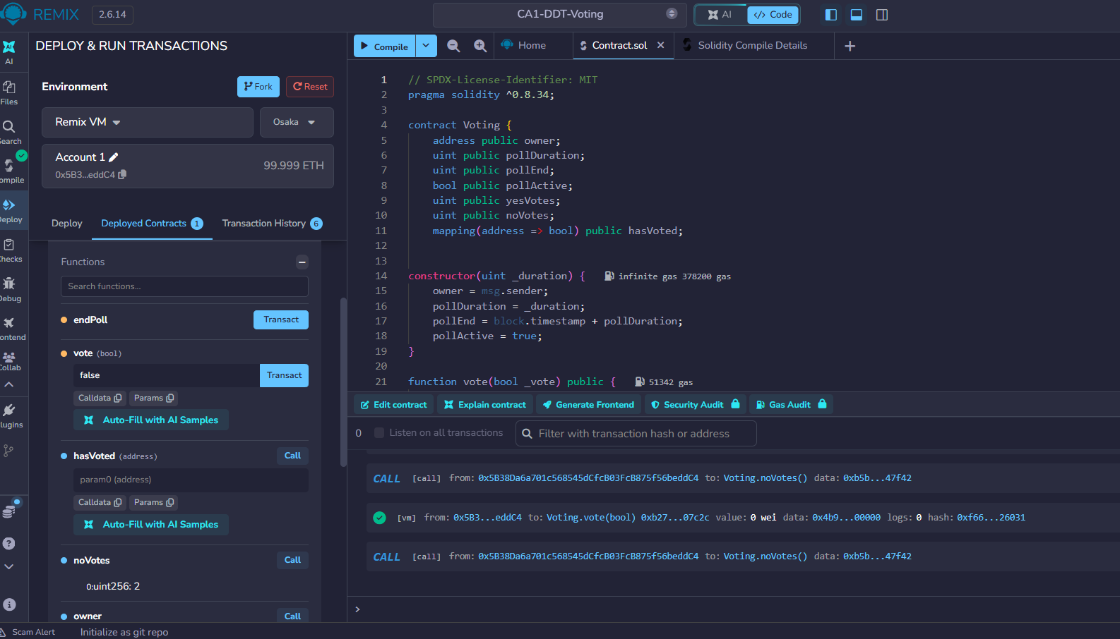
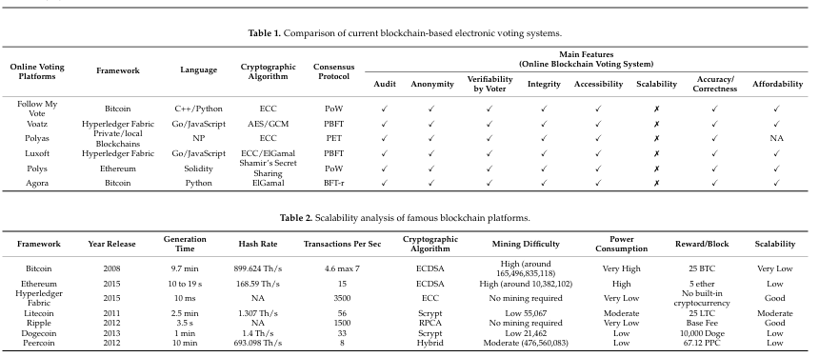
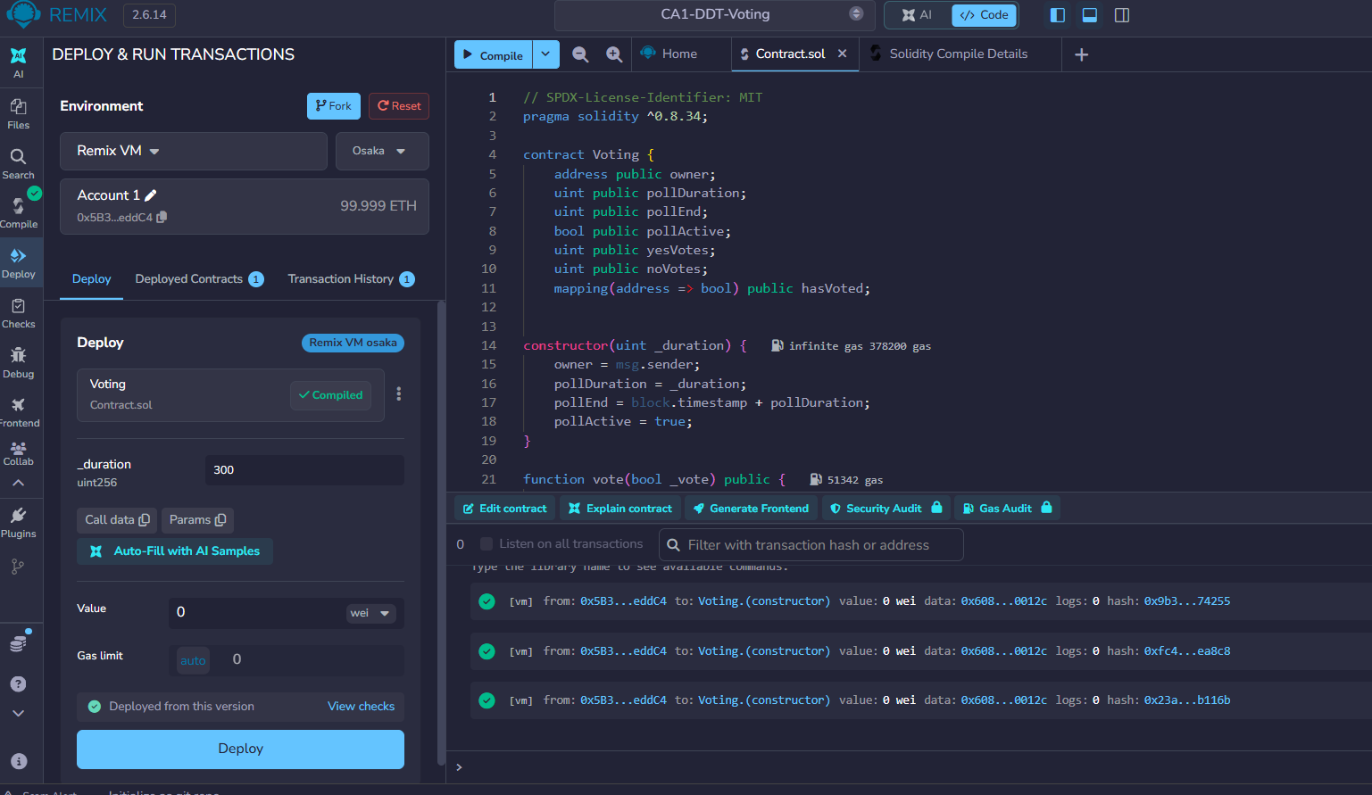
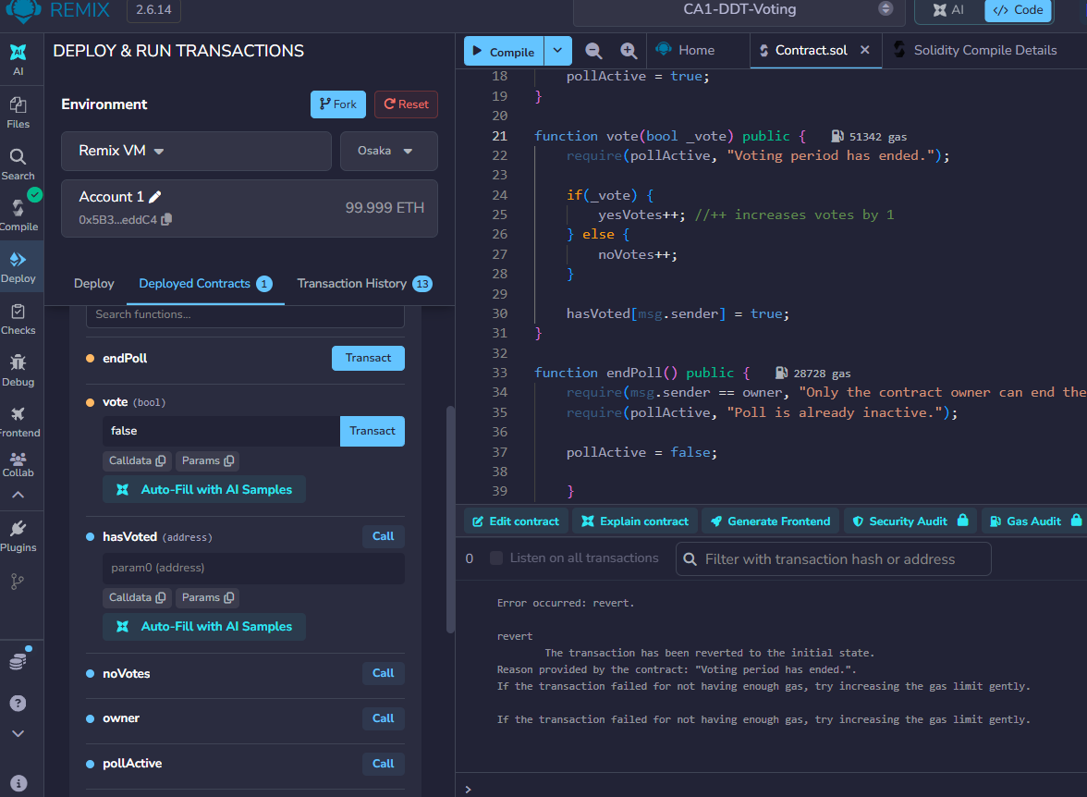
CA1 Distributed Digital Transactions
Isabel Melo - 2024226
BSc (Hons) in Computing in IT (3rd Yr)
INTRODUCTION
DECENTRALIZED APPLICATION - DDAPP
Voting tests
The use of technology on elections is not new, Ameen and Talab (2013) defined electronic voting or e-voting as “a voting system in which the election data is recorded, stored and processed primarily as digital information.”. The continuity of democracy relies on electoral integrity that increase people’s confidence in the majority vote. Technology has been inserted into the electoral process bringing more flexibility, cheap coasts and less turn for voters. However, digital methods still viewed with caution as it leads to new threats and vulnerabilities. In this scenario, Blockchain technology could provide benefits to the online voting systems using it characteristics such as “transparency, secrecy and non-repudiation” (Jafar, Aziz and Shukur, 2021). This presentation analyses a business model Blockchain technology used on Voting and Election Systems.
Contract compiled
ADVANTAGES AND DISADVANTAGES
Blockchain is a developing technology composes by a distributed ledger of transactions, that emerged in 2008 related to financial systems of bitcoins. “Unlike traditional databases, blockchains are made up of blocks containing transactions validated by encryption mechanisms, and their information cannot be removed or altered by anyone. These blocks are consistently linked, resulting in an ever-expanding chain of blocks.”. (Zhang, Y. et al., 2017 cited by Tareq et al., 2024, p.2). Blockchain technologies are expanding from financial systems to different fields that also could be benefited with it features as voting and election systems.
Traditional electronic voting protocols have a central authority that oversees the whole process. If someone wants to modify the records, it can be made quickly, on the other hand, blockchain technology store data in multiple nodes, so that it is not possible hack all nodes and change the data. (Jafar, Aziz and Shukur, 2021). Multiple nodes can be public and verified simultaneously, which is the biggest advantage while increase the transparency of the elections.
In contrast, scalability issues stand out as the main disadvantage for the application of blockchain in voting systems. The table bellow shows a comparison of current blockchain voting systems which none of them overcame the scalability issue due to the lack of technology as blockchains cannot be easily increased and shows slowness depending on the number of transactions required.
Vote(bool) true
yesVote
Deployed contract
Vote(bool) false
noVote
Tables of comparison between current blockchains and scalability analysis available on https://www.mdpi.com accessed on 12 nov. 2026
CRYPTOGRAPHIC METHODS
Regarding cryptographic methods, it is possible to observe in Table 1 that online voting platforms use different cryptographic algorithms to increase security and protect electoral data. Some platforms use Elliptic Curve Cryptography (ECC), while others use AES/GCM, ElGamal and Shamir’s Secret Sharing. The purpose of cryptographic algorithms is “ensure digital communications, but each comes with limitations of scalability, computational efficiency and vulnerability to emerging threats”. (Pal and Kishor, 2025). What we see is a combination of different cryptographic algorithms in hybrid environments. In this presentation, we will implement a decentralised application (DAPP) using Solidity through Remix IDE, a web-based environment for developing and testing smart contracts. The implementation will use the Ethereum-compatible blockchain environment, which provides the ECDSA cryptographic algorithm.
REFERENCES
Al-Ameen, A. and Talab, S. (2013) ‘The Technical Feasibility and Security of E-Voting’, International Arab Journal of Information Technology (IAJIT), 10(4), pp. 397–404. Available at: https://research.ebsco.com/plink/d31b8947-4c06-3c0d-9a32-53817ea4fe24 (Accessed: 12 November 2026).
Jafar, U., Aziz, M.J.A. and Shukur, Z. (2021). Blockchain for electronic voting system—Review and open research challenges. Sensors, [online] 21(17), p.5874. doi:10.3390/s21175874.
Pal, K. and Amit Kishor (2025) ‘Securing Blockchain Data Transactions: A Novel Cryptographic Framework for Enhanced Security and Efficiency’, International Journal of Performability Engineering, 21(11), pp. 651–660. doi:10.23940/ijpe.25.11. p5.651660.
Shakeelzafar3 (2024) Building a Voting Smart Contract in Solidity.md [Computer program]. Available at: https://github.com/shakeelzafar3/Voting-dApp-using-Ethereum-and-Solidity/blob/main/7%20-%20Building%20a%20Voting%20Smart%20Contract%20in%20Solidity.md (Accessed: 13 November 2026).
Tareq, M.A., Tripathi, P., Issa, Nurhayati Md and Miraz, M.H. (2024). Exploring the emerging technologies within the blockchain landscape. arXiv. doi:10.1007/978-3-031-50215-6_13.
“Voting period has ended”

