Slide 1
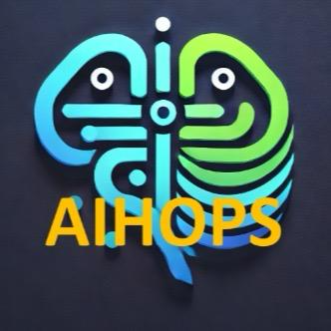
AIHOPS
Team Members:
Hagai Kordonsky
Shaked Matityahu
Idan Lobel
Amihai Blekherov

Slide 2
ALPHA - 28/1/2024
Must
User management
Basic UI
NTH
Gmail verification
Learn
Projects
DB
learn how to launch a website

Slide 3
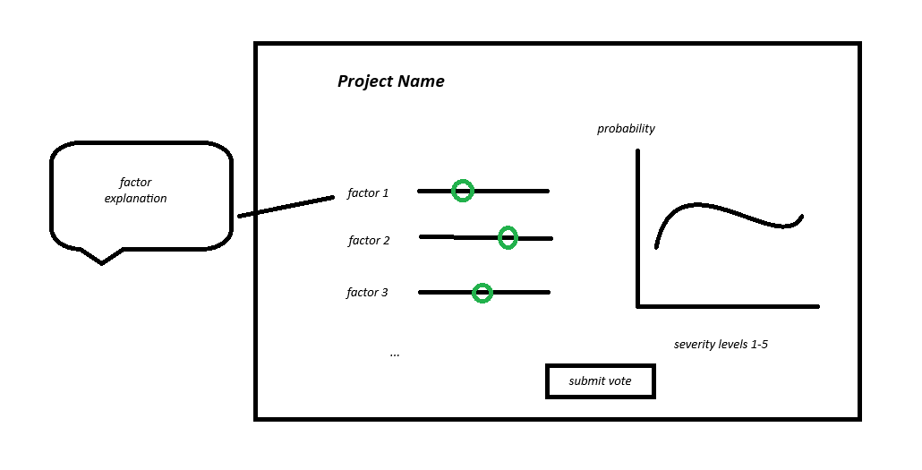
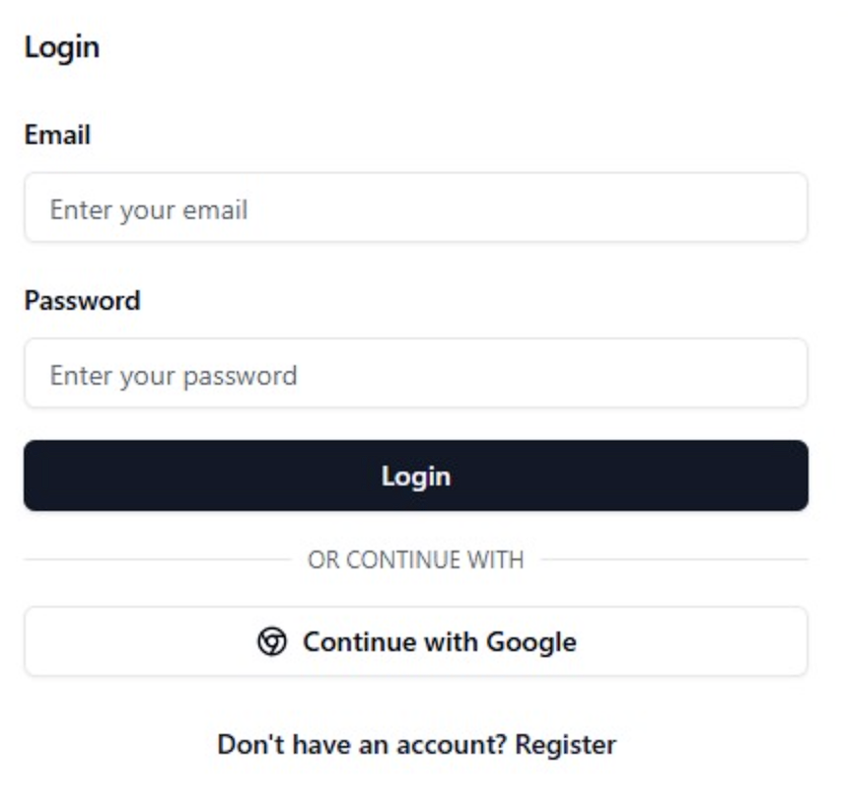
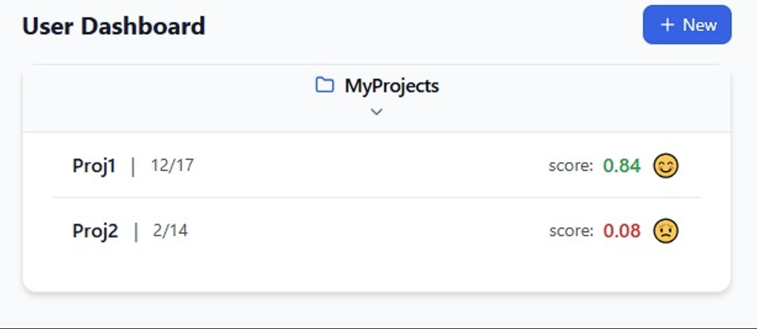

Slide 4
CHALLENGES
Planning challenge: Design a stable and concurrency safe system and think how to protect against all fail cases.
Learning new tool: React
Prepare for next stages: Find quality resources and gain knowledge about website launching and maintenance
Gmail API

Slide 5
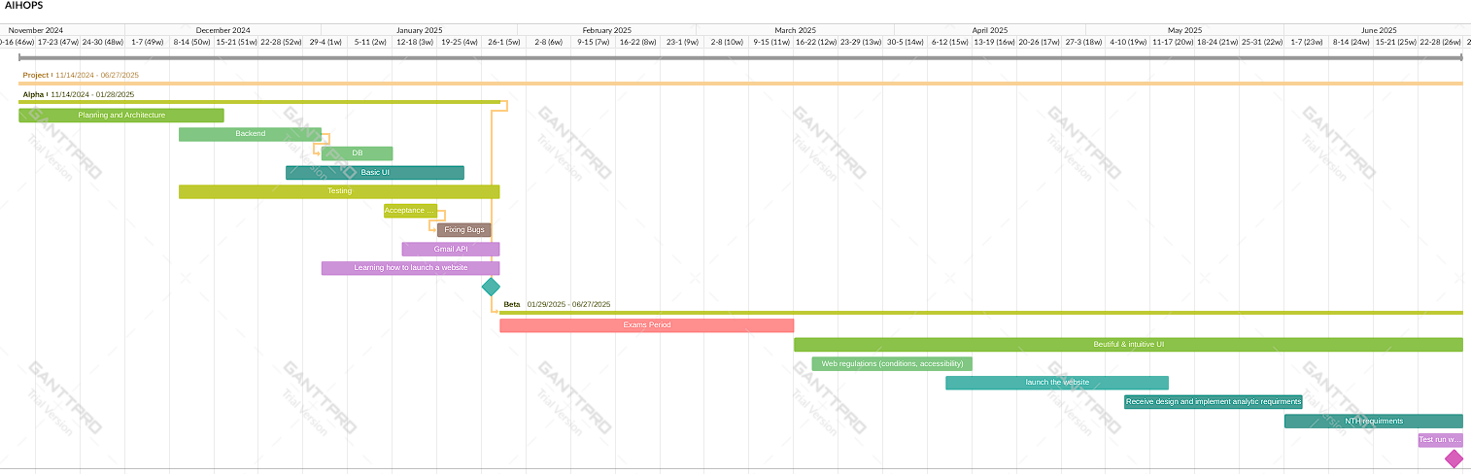
Project Overview

