Slide 1

WEB-Dev session-01
Welcome to all juniors of 2023 batch

Slide 2

In this session you will learn
Install Vs code in your system
Create your first web page
Learn all font formatting tags like heading and paragraph tags
Learn some more tags like anchor tag image tag,forms
Learn to style your web page using CSS3
Learn modern css tools like flexbox and grid

Slide 3

Installing Vs code in your system
Step 1- Go to google chrome and type vs code
Step2- Click on first link and click the download button on top right of the screen or https://code.visualstudio.com/Download click on above link
Download based on your operating system windows or mac
Vs code is a most famous code editor used by many developers and many build in extensions
Emmet features and user snippet support and so on

Slide 4


Slide 5
Html Structure
<!doctype html>
<html lang="en"> <head>
<title>
<!-- … -->
</head> <body>
<!-- … -->
</body> </html>
Html is the root element in html we have 2 major parts like head and body section head section contains part which is not visible to us but visible to search engines which helps them to redirect our file when we search it in google and for optimization and linking external styles sheets
Body section of html contains content to be displayed note in each element of html it is assigned to a box and in that we have two types block elements and inline elements
<!– comment --> is comment tag for user reference only
There are so miscellaneous stuff &copy for copyright symbol and &nbsp for white space and so on
In web programming its not about perfection but rather how will u use the concepts you already know
Tip – if u click windows + .(period) use can add emojis
In vs code if u click alt+shift+downarrow u can duplicate the line

Slide 6
Block and inline elements
In block type of elements each element occupies full width and height it takes of the content it occupies
In inline elements element only takes with of the content it occupies
Some block elements are h1,h2,div
Some inline elements are span , img , a

Slide 7
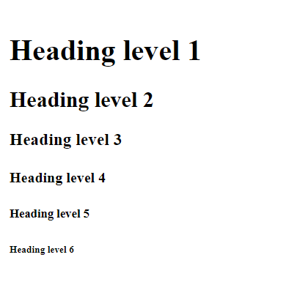
Introduction to HTML5
Heading element
<h1>Heading level 1</h1>
<h2>Heading level 2</h2>
<h3>Heading level 3</h3>
<h4>Heading level 4</h4>
<h5>Heading level 5</h5>
<h6>Heading level 6</h6>
Tips – If u select an element and click alt D it will select next occurrence
If u press alt and click on lines you want to change u change it all at once
All these only apply for vs code only

Slide 8
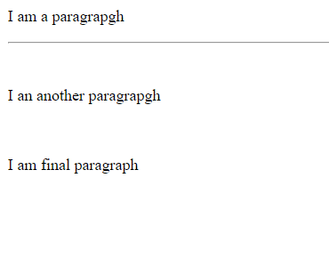
Paragraph and void elements
<p>I am a paragrapgh</p>
<hr>
<br>
<p>I an another paragrapgh</p>
<br>
<p>I am final paragraph</p>
Tips – best sources to learn web is mdn documentation and w3schools

Slide 9
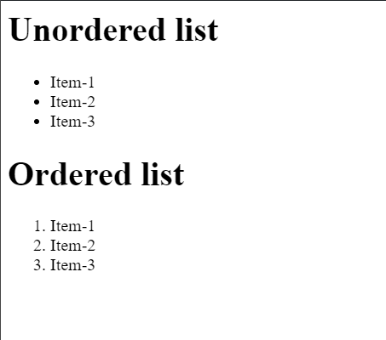
Lists – in html
<h1>Unordered list</h1>
<ul>
<li> Item-1 </li>
<li> Item-2 </li>
<li> Item-3 </li>
</ul>
<h1>Ordered list</h1>
<ol>
<li> Item-1 </li>
<li> Item-2 </li>
<li> Item-3 </li>
</ol>

Slide 10
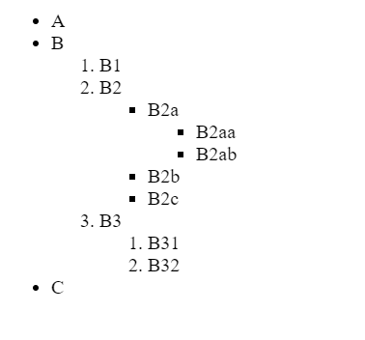
Nesting and indentation
<ul>
<li>A</li>
<li>B</li>
<ol>
<li>B1</li>
<li>B2</li>
<ul>
<li>B2a</li>
<ul>
<li>B2aa</li>
<li>B2ab</li>
</ul>
<li>B2b</li>
<li>B2c</li>
</ul>
<li>B3</li>
<ol>
<li>B31</li>
<li>B32</li>
</ol>
</ol>
<li>C</li>
</ul>

Slide 11
Attributes in html
All HTML elements can have attributes
Attributes provide additional information about elements
Attributes are always specified in the start tag
Attributes usually come in name/value pairs like: name="value“
Some examples are
href for a
scr for img

Slide 12
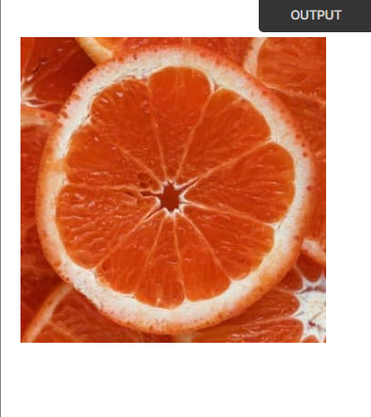

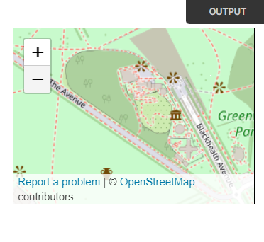
Image and anchor
and iframe tag
<img class="fit-picture" src="/media/cc0-images/grapefruit-slice-332-332.jpg" alt="Grapefruit slice atop a pile of other slices" />
<a href="https://www.w3schools.com">Visit W3Schools.com!</a>
<iframe id="inlineFrameExample" title="Inline Frame Example" width="300" height="200" src="https://www.openstreetmap.org/export/embed.html?bbox=-0.004017949104309083%2C51.47612752641776%2C0.00030577182769775396%2C51.478569861898606&layer=mapnik"></iframe>

Slide 13

Forms in html
<form class="form-example">
<div class="form-example">
<label for="name">Enter your name: </label>
<input type="text" name="name" id="name" required />
</div>
<div class="form-example">
<label for="email">Enter your email: </label>
<input type="email" name="email" id="email" required />
</div>
<div class="form-example">
<input type="submit" value="Subscribe!" />
</div>
</form>

Slide 14
Div and span elements
Div tag is used to group html elements puts related html elements in a single box
Span tag is used with html elements for special styling of some parts of the element

Slide 15
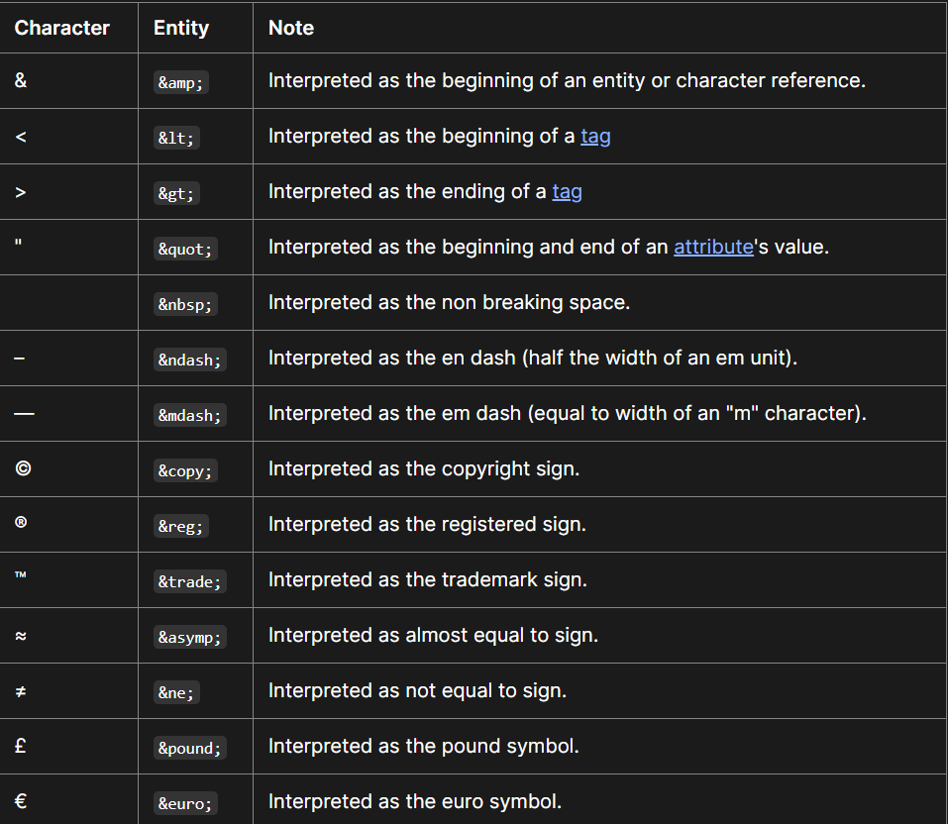
Miscellaneous

Slide 16
Cascading Style sheet (CSS3)
CSS (Cascading Style Sheets) is a language used for styling web documents. It defines how HTML elements are displayed on a webpage, controlling attributes like color, layout, and fonts. Selectors target specific elements, applying rules such as color, size, and positioning. Properties specify the desired visual characteristics, while values determine their specific settings. CSS offers flexibility through inheritance and cascading, allowing styles to propagate throughout a document and enabling responsive design. External, internal, or inline methods can incorporate CSS into HTML documents. CSS preprocessors like Sass extend functionality, while frameworks like Bootstrap provide pre-made styles for rapid development. Overall, CSS enhances web presentation and user experience.

Slide 17
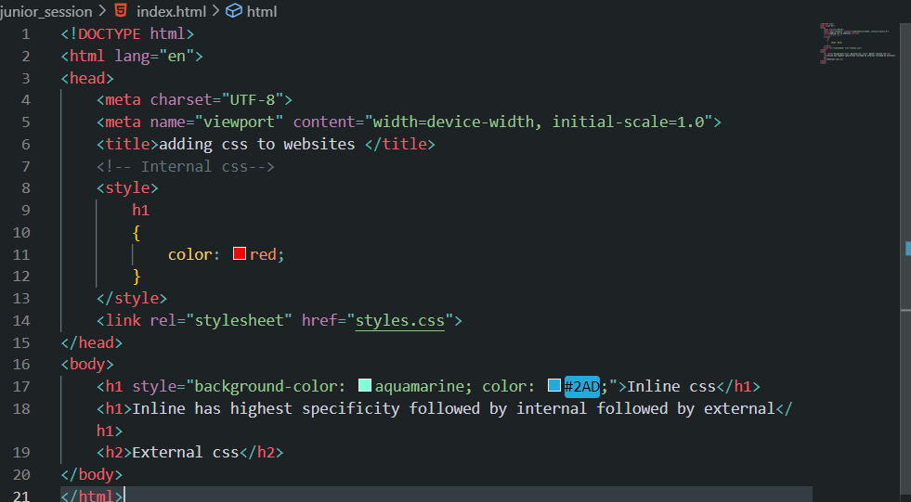
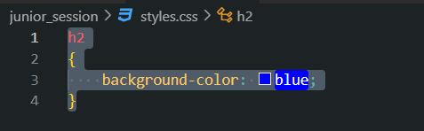
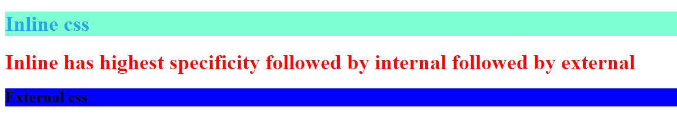
Ways to add css to website 1>Inline css 2> Internal css 3> External css
Tip- Its best practice to use external css over other two in your projects

Slide 18
footer {
font-size: 12pt;
}
html {
font-size: xx-large;
}
</style>
</head>
<html lang="en">
Css units
<!DOCTYPE html>
<head>
<meta charset="UTF-8">
<title>Font-Size</title>
<style>
#pixel {
font-size: 20px;
}
#point {
font-size: 20pt;
}
#em {
font-size: 1em;
}
#rem {
font-size: 1rem;
}
<body>
<p id="pixel">1 Pixel is 1/96 of an Inch</p>
<p id="point">1 Point is 1/72 of an Inch</p>
<footer>
<p id="em">1em is 100% the size of the parent element</p>
<p id="rem">1rem is 100% the size of the root element</p>
</footer>
</body>
</html>

Slide 19
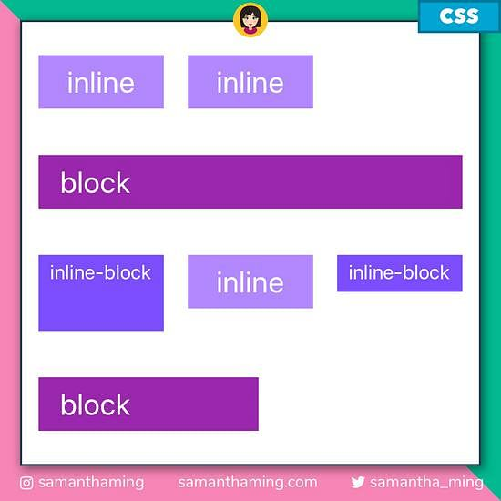

Slide 20
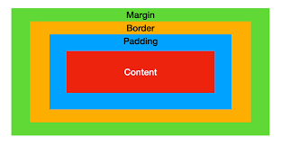
Css box-model

Slide 21
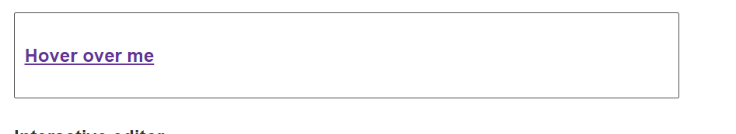
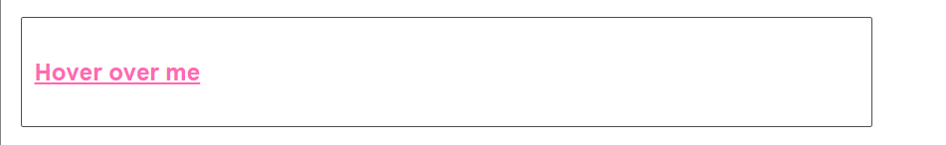
Pseudo elements
a:link,
a:visited {
color: rebeccapurple;
font-weight: bold;
}
a:hover {
color:hotpink;
}
<p><a href=“#">Hover over me</a></p>

Slide 22
Selectors in css
/* Inline styles */
<div style="color: red;"></div> <!-- Specificity: 1000 -->
/* ID selector */
#myElement {
color: blue;
} <!-- Specificity: 100 -->
/* Class selector */
.myClass {
color: green;
} <!-- Specificity: 10 -->
/* Tag selector */
p {
color: orange;
} <!-- Specificity: 1 -->
To select element to just write the name of the element like h1{ color:red}
To select classes you write . Followed by name of class like .class-name{ color:red}
To select id you write # followed by id name like #idname{ color:red} always remember that id must always be unique ie no two elements should have same id
To select child elements we use descendent selector like if there are paragraph under some div then we select those using div p { color : red}
To select sibling element we use + for direct sibling and ~ for all siblings like h1 ~ p { color :red}

Slide 23
Css positioning
https://developer.mozilla.org/en-US/docs/Web/CSS/position
There are 5 css positioning properties
1> static which is default for all elements
01
2> relative
02
3>absolute
03
4>fixed
04
5>sticky
05

Slide 24
Responsiveness of a website
Making a web site responsive is that your website looks good on all type of devices may it be mobile, tablet, mac, laptop
To make website responsive we use following techniques
Fluid layouts – giving all properties in percentages
Media-queries – Writtng separate css for each device
Flexbox- Most used tool for structuring one dimensional layouts
Grid – Used for building complex two dimensional layouts
Bootstrap – Using already developed components built by professionals in your websites
In this basic session we will only see basic flexbox and grid

Slide 25
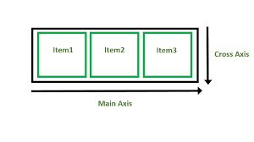
Flexbox
Basic properties you should know
1> display: flex
2> flex direction- row or column
3> justify content – some are center space- around space-between space-evenly
4> align items
5> flex basis

Slide 26
General takeaway
There are some css framewords like postcss and tailwind css they are just used to shorten our css code similarly there are css precompiler like sass which makes it easier to write css and later that code is compiled into css
Now with css-3 being very powerful with many features pre compiler is less used
Don’t worry that css is so vast believe me no one knows all the property I myself time to time go to mdn to know what css property does , it is only important to know how to apply the properties u know all how to improve using tools like mdn,chat gpt etc
Though I recommend everyone to not use chat gpt if u r just new and use only mdn and w3schools resources and inspect option of google

Slide 27

Thank you

