Slide 1



DEPARTMENT OF COMPUTER SCIENCE AND ENGINEERING
MDC-CS-501 Project Evaluation
For
B.Tech CSE (Cyber Security), 5th Sem – Batch 2024
Linux Persistence Change Sentinel
Presented by
Arun Kumar (2024A7R025)
Abhishek Sharma (2024A7R058)
MIET, Jammu | Academic Year 2026
Model Institute of Engineering & Technology (Autonomous)
Notes:
Good morning everyone. We are Arun Kumar and Abhishek Sharma from B.Tech CSE, Cyber Security, 5th semester, batch 2024. Our project for the MDC-CS-501 evaluation is called Linux Persistence Change Sentinel. In simple words, it is a small tool that watches important Linux configuration files and tells us when something has changed from a saved, trusted copy. We tested it safely on a mock Linux folder on Windows, and today we will explain the idea, the design, the results and the limits.

Slide 2

Table of Contents
1
Introduction & Background
2
Problem Statement
3
Project Objectives
4
Linux Persistence: Core Concepts
5
Proposed Solution: Scope & Boundaries
6
System Architecture
7
Technologies & Tools
8
Working Methodology
9
Change Detection Demonstration
10
SOC Dashboard & Results
11
Testing & Validation
12
Limitations & Future Scope
13
Conclusion & Thank You
Notes:
This is our agenda. We start with the background and the problem, then our objectives and the basic concepts. After that we show the solution, its architecture, the technologies and the step-by-step method. Then we demonstrate the three types of changes, show the dashboard, explain testing, and finish with limitations, future scope and the conclusion.

Slide 3
Introduction & Background
What is Linux persistence?
1
Ways an attacker keeps access after a reboot or logout. MITRE ATT&CK groups them under tactic TA0003.
Why configuration files?
2
Linux settings are plain text (e.g. /etc/crontab, sudoers). One small edit can make a program run automatically.
Why a baseline?
3
A saved known-good snapshot lets us see exactly what changed, instead of checking every file by hand.
Notes:
Persistence means an attacker keeps access to a system even after a reboot or logout. MITRE ATT&CK lists this as tactic TA0003. On Linux, many settings are plain text files, for example /etc/crontab, which schedules jobs. One extra line there can run a program automatically. That is why these files matter. A baseline is a saved known-good snapshot. If we compare today's files with the baseline, we can see exactly what changed instead of searching by hand.

Slide 4
Problem Statement
01
Stealthy persistence
02
Slow manual auditing
Attackers hide inside normal-looking files such as cron, sudoers and SSH keys.
Checking many system files by hand is tedious and easy to get wrong.
03
Exact differences needed
04
Heavy existing tools
A vague “file changed” alert is not enough; analysts need the exact lines.
Full file-integrity products are complex; a light, readable prototype is easier to learn from.
Need: a simple, explainable tool that shows what changed, where, and how important it is.
Notes:
We identified four problems. One: persistence is stealthy, because attackers hide inside normal-looking files like cron or SSH keys. Two: checking many system files by hand is slow and easy to get wrong. Three: a simple 'file changed' message is not enough, an analyst needs to see the exact lines. Four: full file-integrity products are heavy and complex, so a small readable prototype is better for learning. Our need is a simple tool that shows what changed, where, and how important it is.

Slide 5
Project Objectives
1
Baseline creation
Record the SHA-256 hash and details of 23 persistence locations.
2
Change detection
Compare a fresh scan with the baseline; classify ADDED, MODIFIED, DELETED.
3
Unified line diff
Show the exact lines added or removed in a modified file.
4
Severity & ATT&CK tag
Assign rule-based severity and a MITRE technique ID (e.g. T1053.003).
5
Local SOC dashboard
Let an analyst filter events and inspect diffs in a web page.
Notes:
We set five objectives. First, create a baseline using SHA-256 hashes and metadata of 23 persistence locations. Second, detect changes by comparing a new scan with the baseline and classifying them as added, modified or deleted. Third, show a unified line diff so the analyst sees the exact lines. Fourth, give each finding a rule-based severity and a MITRE ATT&CK tag. Fifth, build a local dashboard where an analyst can filter events and open the diff.

Slide 6
Linux Persistence: Core Concepts
Location | Why attackers use it | ATT&CK | Severity
/etc/crontab, cron.d/ | Run commands on a schedule | T1053.003 | HIGH
/etc/sudoers, sudoers.d/ | Grant admin rights | T1548.001 | CRITICAL
/etc/ld.so.preload | Load a library into every program | T1574.006 | CRITICAL
/etc/systemd/system/ | Start a service at boot | T1543.002 | HIGH
~/.ssh/authorized_keys | Keep key-based remote login | T1098.004 | HIGH
/etc/profile, ~/.bashrc | Run code at login / shell start | T1546.004 | MEDIUM
Illustrative example (cron line)
Remember
0 3 * * * root /tmp/.update.sh
Severity shows how sensitive a location is. It does not prove an attack.
Runs a hidden script every day at 3:00 AM, even after a reboot. Sentinel would flag the changed crontab.
Notes:
This table shows the main persistence locations that Sentinel watches. Cron runs jobs on a schedule, sudoers controls admin rights, ld.so.preload loads a library into every program, systemd starts services at boot, authorized_keys allows SSH key login, and shell start-up files run commands at login. Each location has a MITRE ATT&CK technique ID and a severity set by our rules. The example below is only illustrative: a cron line that would run a hidden script every day at 3 AM, even after a reboot. Important: the severity shows how sensitive the location is. It is not proof that someone attacked.

Slide 7
Proposed Solution: Scope & Boundaries
What Sentinel DOES
What Sentinel does NOT do
Scans 23 persistence locations
Stores a SHA-256 baseline snapshot
Detects ADDED, MODIFIED, DELETED
Shows unified line diffs
Adds rule-based severity + ATT&CK tag
Logs events and shows them on a dashboard
Monitor the system in real time
Prove malicious intent or name an attacker
Block, quarantine or repair changes
Claim verified use on real Kali / production Linux
Replace a full SIEM or EDR product
Detecting a change ≠ proving an attack
Notes:
Here we are clear about what Sentinel does and does not do. It scans 23 persistence locations, stores a SHA-256 baseline, detects added, modified and deleted items, shows line diffs, gives a rule-based severity with an ATT&CK tag, and logs events for a dashboard. It does not monitor the kernel in real time, it cannot prove malicious intent or identify an attacker, it does not block or fix anything, and we have not verified it on a real Kali or production system. The key message: detecting a change is not the same as proving an attack.

Slide 8
System Architecture
1 Target
2 Core Engine
3 JSON State
4 Interface
mock_linux/
scanner.py
baseline.json
manage.py
Safe sample Linux tree
Walks and hashes files
Hashes + content
baseline · scan · simulate · reset
cron + cron.d
baseline.py
events.json
Dashboard
/etc/crontab
Saves known-good state
Detected changes
127.0.0.1:8080
sudoers
detector.py
/etc/sudoers(.d)
Baseline vs current
SSH keys
rules.py
~/.ssh/authorized_keys
Severity + ATT&CK
Data flow: files → scan → compare → save event → show on dashboard. Pure Python 3 standard library; real OS files are never touched.
Notes:
Our design has four layers. Layer one is the target: the mock_linux folder, which copies the structure of a Linux file system safely. Layer two is the core engine in Python: scanner.py reads files and hashes them, baseline.py saves the known-good snapshot, detector.py compares baseline and current state, and rules.py gives severity and ATT&CK tags. Layer three is storage: baseline.json and events.json. Layer four is the interface: the manage.py command line and the web dashboard on localhost port 8080. Real operating-system files are never touched.

Slide 9
Technologies & Tools
Python 3 standard library
Dashboard & tooling
hashlib
SHA-256 file hashing
Front end
HTML5
CSS3
JavaScript
difflib
Unified line-by-line diffs
http.server
Local dashboard web server
Tooling
json
Baseline and event storage
manage.py CLI
Windows PowerShell
Python 3.14
unittest
Automated detector tests
Zero external packages: nothing to pip install
Notes:
The whole project uses only the Python 3 standard library, so there is nothing extra to install. hashlib creates SHA-256 fingerprints of files. difflib builds the unified line differences. http.server runs the local dashboard. json stores the baseline and the events. unittest runs our automated tests. The dashboard front end is plain HTML5, CSS3 and JavaScript. We run commands through manage.py in Windows PowerShell.

Slide 10
Working Methodology
1
2
3
4
5
Baseline
Simulate
Scan & Compare
Diff & Severity
Dashboard
Hash and record all 23 locations
Make a safe change in mock_linux/
Re-scan; compare hashes with baseline
Classify change, build diff, add severity
Save event; analyst reviews it
manage.py baseline
manage.py simulate
manage.py scan
difflib + rules.py
manage.py dashboard
Baseline
SHA-256 hash
Event log
Known-good snapshot of the files
Fingerprint; changes if content changes
events.json: record of each change
Notes:
This is the five-step cycle. Step one, baseline: we hash and record the 23 locations. Step two, simulate: we make a safe change inside mock_linux. Step three, scan and compare: Sentinel scans again and compares the new hashes with the baseline. Step four, diff and severity: it classifies the change, builds a unified diff with difflib and adds the rule-based severity. Step five, dashboard: the event is saved and shown so the analyst can review it. Three key terms: a baseline is the known-good snapshot; a SHA-256 hash is a fingerprint of the file content, and if one character changes the fingerprint changes; the event log is events.json, which records every detected change.

Slide 11
Change Detection Demonstration
MODIFIED
ADDED
DELETED
Scenario:
Harmless comment appended to mock_linux/etc/crontab
Detection:
SHA-256 differs from baseline
Output:
MODIFIED · HIGH · T1053.003 + line diff
Scenario:
New file in mock_linux/etc/cron.d/ not in baseline
Detection:
Path exists now, absent in baseline
Output:
ADDED event with the location’s severity
Scenario:
Baseline item removed from mock_linux/
Detection:
Path in baseline, missing now
Output:
DELETED event; old record kept
Demonstrated on dashboard
Covered by unit test
Covered by unit test
All scenarios run inside mock_linux/. The test comment is harmless: it is not a real cron task or an attack.
Notes:
Sentinel reports three kinds of change. MODIFIED: we appended a harmless comment to the mock crontab. The SHA-256 hash no longer matched the baseline, so Sentinel reported MODIFIED with HIGH severity and technique T1053.003, together with a line diff. This one we demonstrated on the dashboard. ADDED: a file that is present now but was not in the baseline. DELETED: a file that is in the baseline but is now missing. These two are covered by our unit tests. Everything happens inside mock_linux, and the test comment is harmless. It is not a real attack.

Slide 12
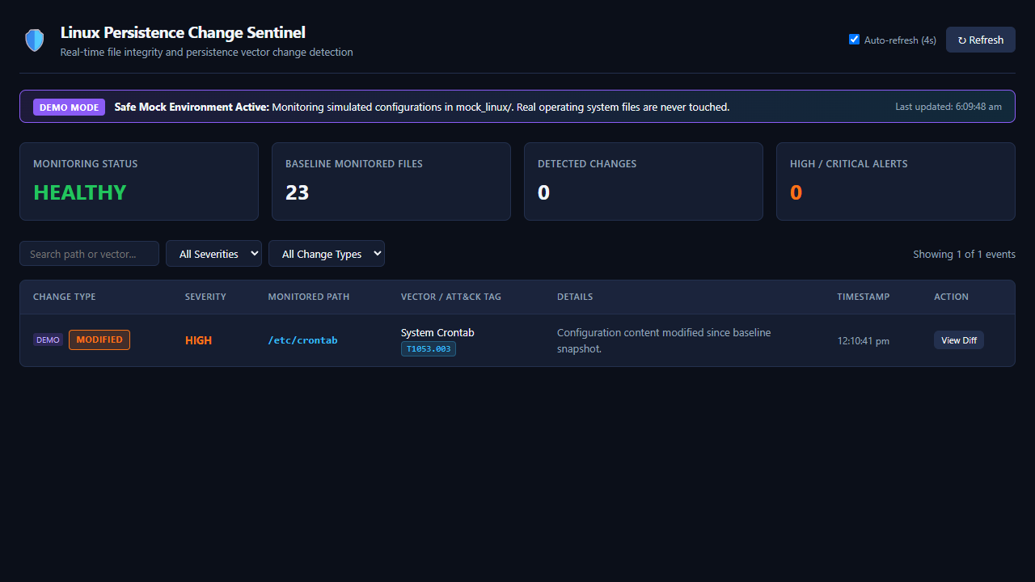
SOC Dashboard & Results
1
DEMO MODE banner
Only mock_linux/ is monitored
2
Summary cards
Status, 23 files, changes, High/Critical
3
Event row
MODIFIED · HIGH · /etc/crontab · T1053.003
Figure: Sentinel dashboard (mock environment, DEMO MODE)
Reading the screen: the summary cards show a clean state (0 changes) while the table still lists the earlier MODIFIED event. HIGH = sensitivity of the cron location, not proof of an attack.
4
Filters & View Diff
Search, severity, type; line diff
Notes:
This is a real screenshot from our dashboard, running locally on port 8080. At the top, the DEMO MODE banner says that only the mock_linux folder is monitored and real OS files are never touched. The four cards show monitoring status, the 23 monitored files, the number of detected changes and the high or critical alerts. The table shows our event: MODIFIED, severity HIGH, path /etc/crontab, tagged T1053.003. The View Diff button opens the line-by-line difference. In this capture the cards show a clean state while the log still lists the earlier modified event. Remember that HIGH reflects how sensitive cron is, not proof of malicious activity.

Slide 13
Testing & Validation
4 / 4
0.049 s
0
unit tests passed
reported test run time
false alarms on a clean scan
What the 4 tests check
Demonstrated manually
Clean scan gives no events
ADDED file is detected
MODIFIED file is detected, with diff
DELETED file is detected
Baseline of the mock tree
Clean scan: no changes
Modified mock crontab → MODIFIED, HIGH
Reset returns to clean state
Results are from the team’s earlier reported runs on the mock tree. No performance benchmarks are claimed.
Notes:
In our earlier test run, all four unit tests passed in 0.049 seconds, with no false alarm on a clean scan. The tests check four situations: a clean scan produces no events, an added file is detected, a modified file is detected with its diff, and a deleted file is detected. We also demonstrated by hand: create the baseline, run a clean scan, modify the mock crontab, see the MODIFIED event on the dashboard, and use reset to return to a clean state. These are the reported results from our test runs on the mock tree. We do not claim any performance benchmark, and we have not tested on a live Linux system.

Slide 14
Limitations & Future Scope
Current Limitations
Future Scope
Tested only on a mock Linux tree on Windows
Mock /etc/crontab is a sample file, not the real one
Scan on demand; not real-time monitoring
Severity is rule-based; not proof of attack
No auto-response or attacker identification
No whitelist: normal admin edits are flagged too
Test on a real Linux VM (e.g. Kali)
Real-time hooks: inotify, eBPF, auditd
Alerting and SIEM forwarding
Whitelisting and change approval
Cover more persistence locations
Notes:
Let us be honest about the limits. We tested only on a mock Linux folder on Windows, not on real Kali or production Linux, and the mock crontab is a sample file. Sentinel scans on demand, it is not real-time. Severity is rule-based and is not proof of attack. It does not respond automatically or identify attackers, and without whitelisting, normal admin changes will also be flagged. In future work we can test on a real Linux virtual machine, add real-time monitoring with inotify, eBPF or auditd, forward events to a SIEM with alerts, add whitelisting and approval of changes, and cover more persistence locations. These are future ideas, not current features.

Slide 15
Conclusion & Thank You
Key contributions
Thank You
Working prototype: SHA-256 baseline of 23 persistence locations
Detects ADDED, MODIFIED and DELETED items with exact line diffs
Local SOC-style dashboard with rule-based severity and ATT&CK tags
Honest scope: change detection, not attack proof; validated on a mock tree
Questions & Discussion
Arun Kumar
Abhishek Sharma
MIET, Jammu | 2026
Notes:
To conclude: we built a working prototype that baselines 23 persistence locations with SHA-256, detects added, modified and deleted items, shows exact line diffs, and presents results on a local dashboard with rule-based severity and MITRE ATT&CK tags. We kept the scope honest: Sentinel detects changes, it does not prove attacks, and it was validated on a mock tree. Thank you for listening. We are happy to answer your questions.

