Slide 1

Student Performance AI
Predicting Student Exam Risk Using Machine Learning
Dataset: 1,000 Students | 16 Features | Best Model: XGBoost | R² = 0.8613
JK Lakshmipat University | B.Tech CSE (AI) | 2024BTech029 – Garv Sharma
Scan for GitHub

Slide 2
Agenda
What we'll cover today
01
Problem Statement
05
Model Training
Why student risk prediction matters
LR · Decision Tree · Random Forest · XGBoost
02
Dataset Overview
06
Evaluation & Results
1,000 students, 16 features, data quality
R², RMSE, MAE, MAPE comparison
03
Exploratory Data Analysis
07
Deployment
Distributions, correlations, insights
Streamlit app + risk classifier
04
Feature Engineering
08
GitHub & Conclusion
Selecting the 6 best predictors
Repo, QR code, next steps

Slide 3
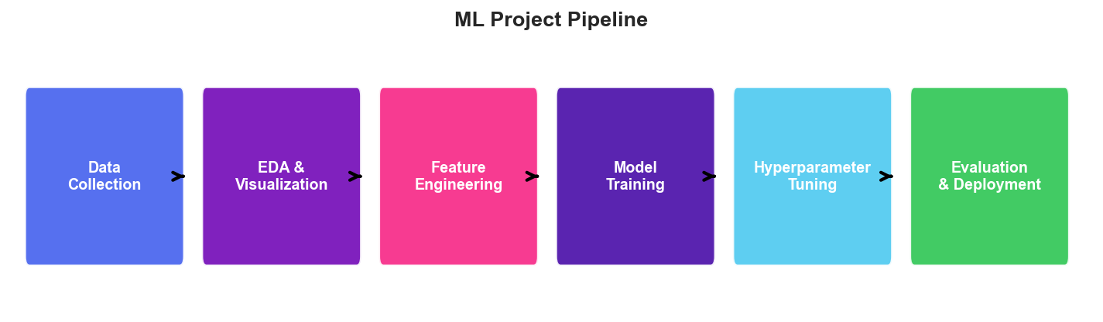
Problem Statement
The challenge of student academic risk
Many students silently fall behind until it's too late for intervention. Traditional grading systems only flag failure AFTER it happens. Goal: Build a predictive ML model that identifies at-risk students EARLY using daily habits and behavioural data — enabling proactive support.
1,000
Students Surveyed
16
Features Collected
91
Missing Values Handled
4
ML Models Compared

Slide 4
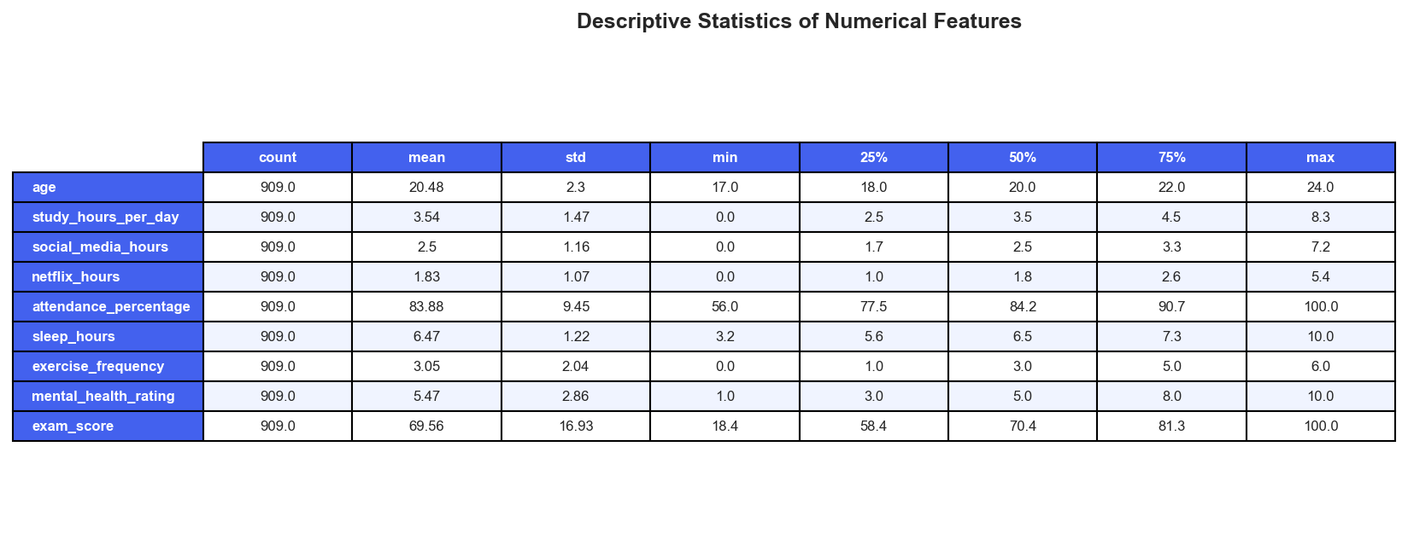
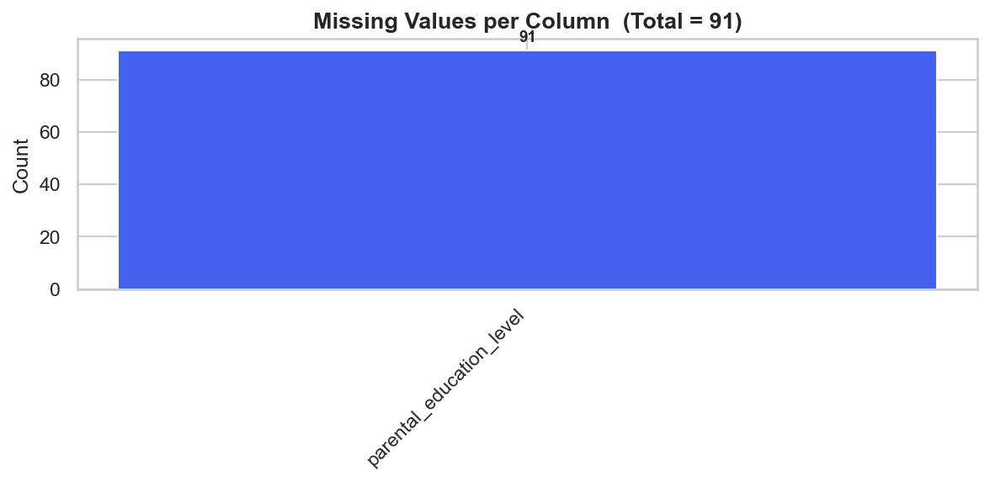
Dataset Overview
student_habits_performance.csv — 1,000 rows × 16 columns
Key Dataset Facts • 1,000 students, 909 after cleaning • 91 missing values → dropped rows • 0 duplicate records • Target: exam_score (continuous, 0–100) • Mix of numerical & categorical features

Slide 5
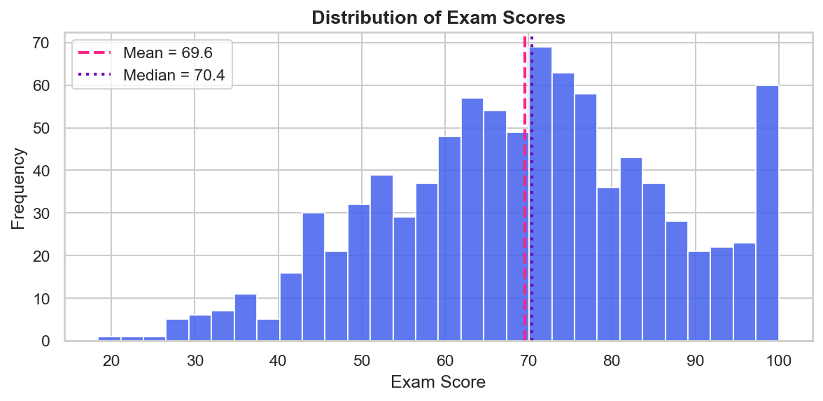
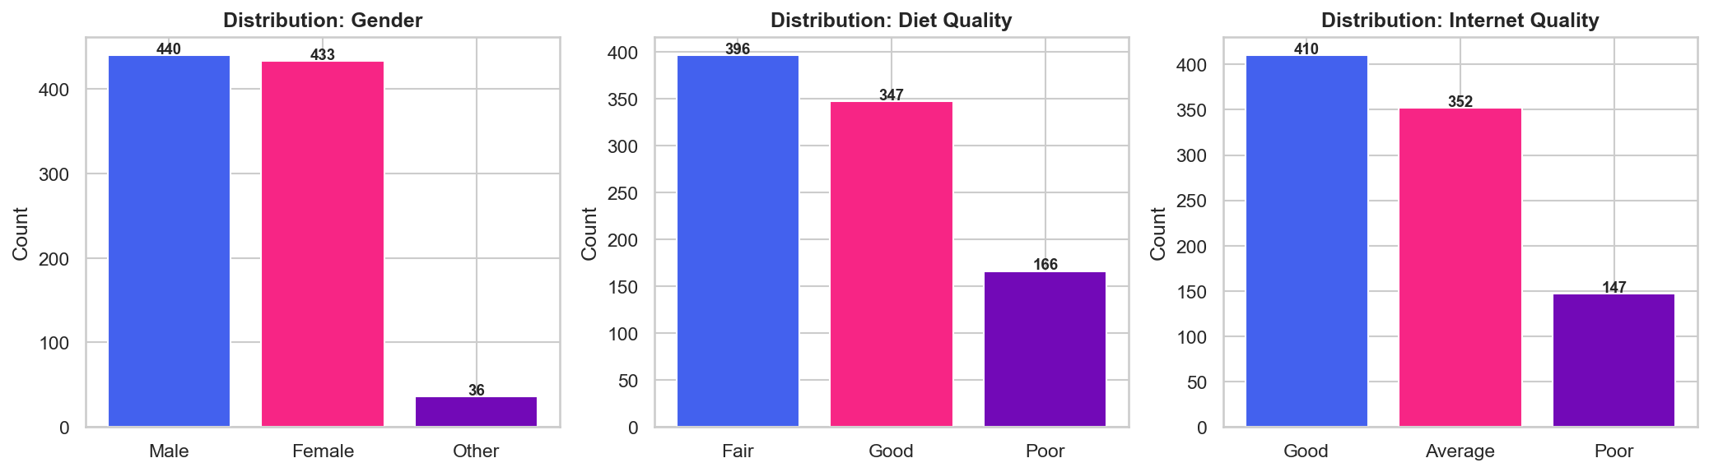
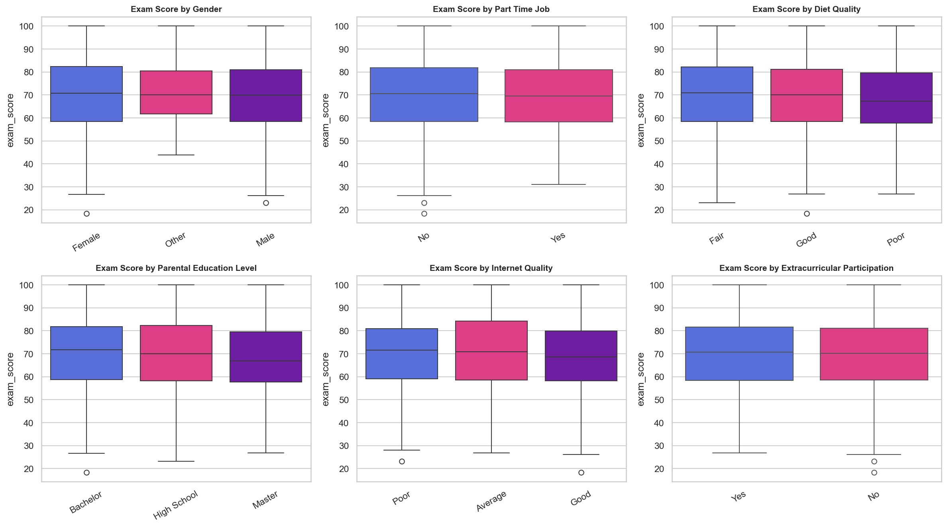
Exploratory Data Analysis
Numerical feature distributions

Slide 6
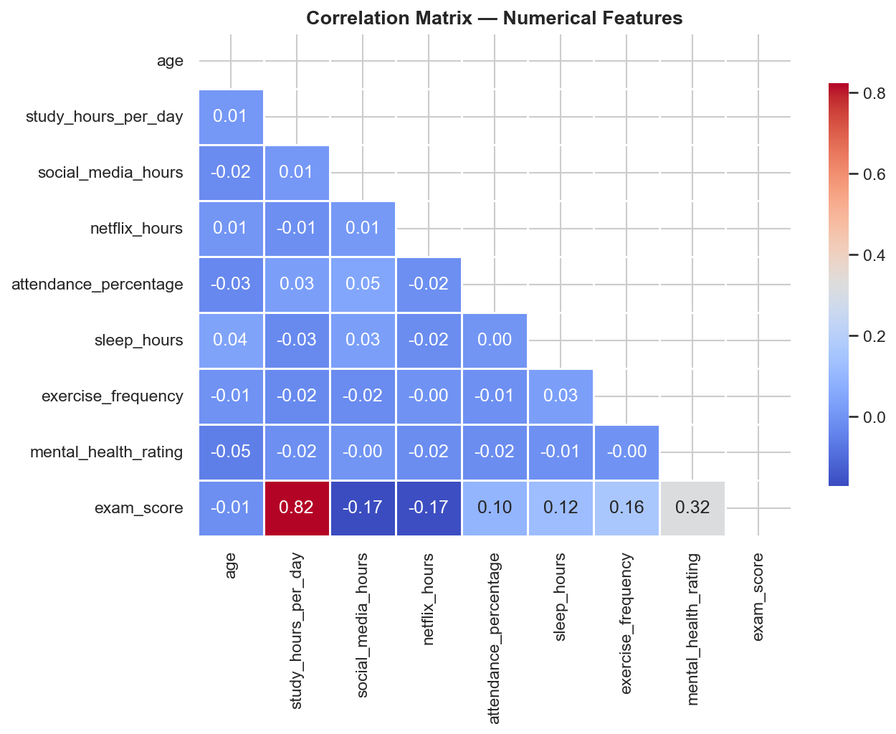
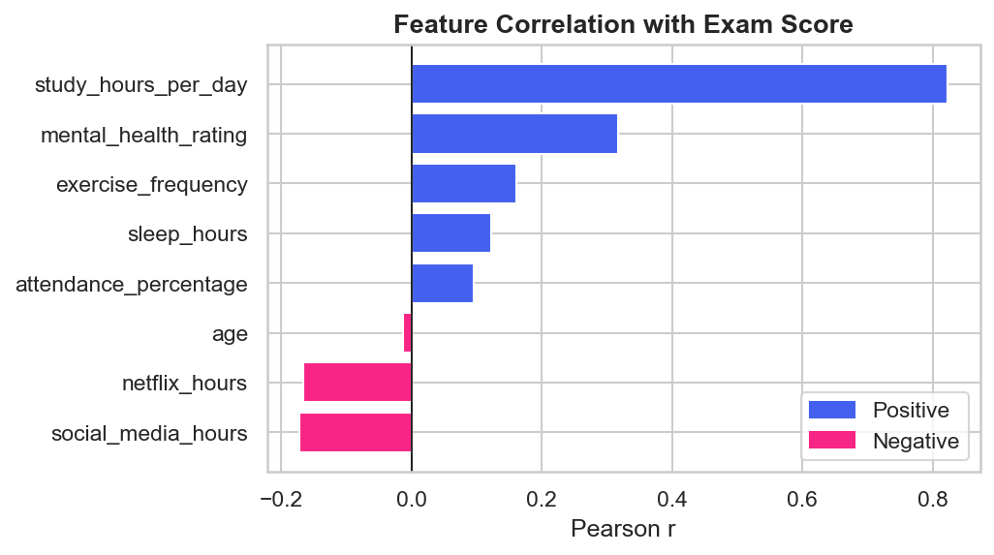
EDA: Correlation Analysis
How features relate to exam performance
Key Findings • study_hours_per_day: strongest +ve r • mental_health_rating: strong +ve • attendance_percentage: +ve impact • social_media_hours: -ve impact • sleep_hours: moderate +ve • netflix_hours: mild -ve

Slide 7
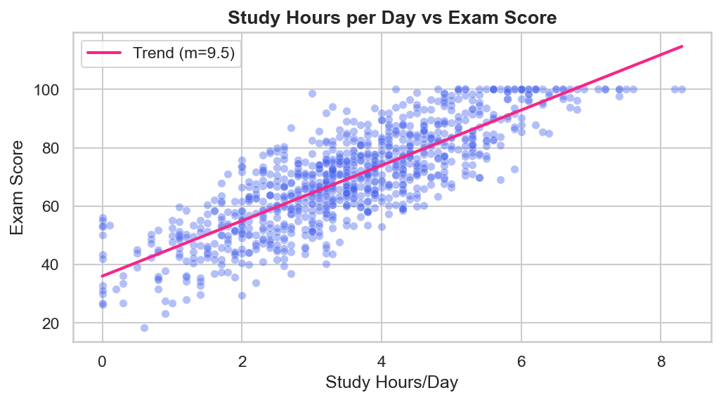
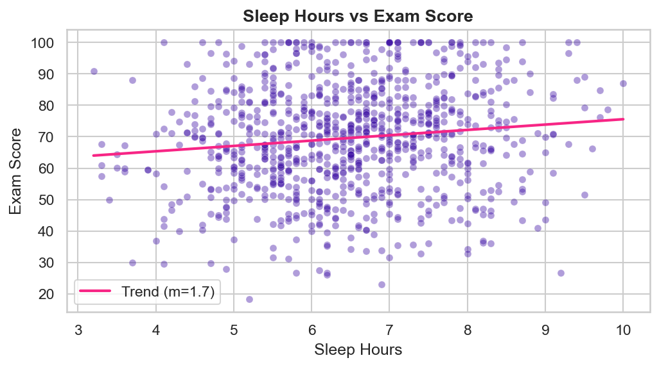
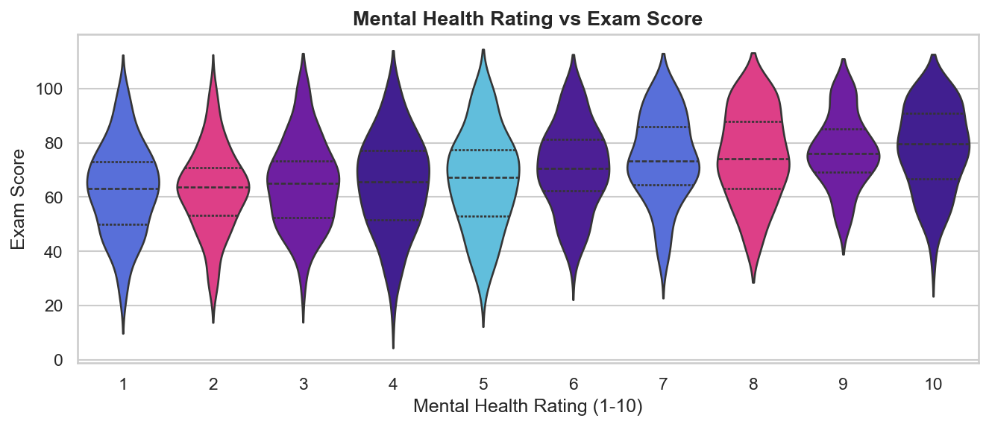
Feature Analysis
Scatter plots — individual feature vs exam score

Slide 8
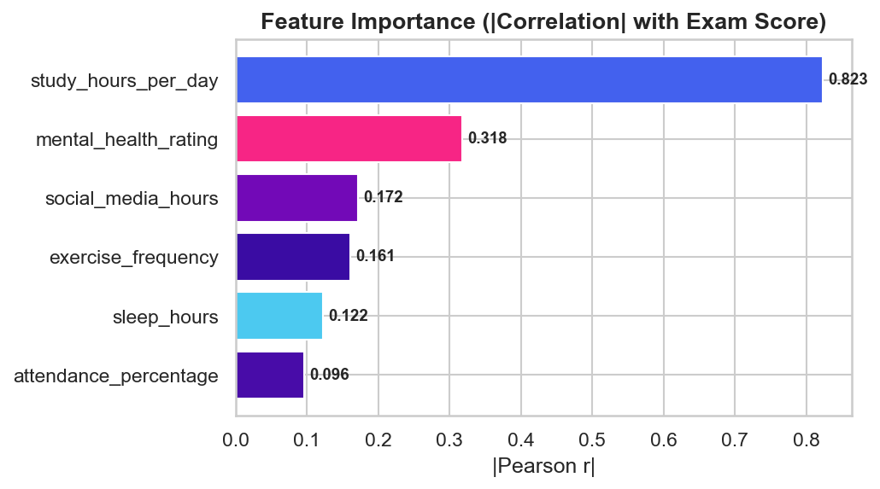
Feature Engineering
Selecting the 6 most impactful features
study_hours_per_day
social_media_hours
Strongest predictor
Distraction factor (-)
mental_health_rating
sleep_hours
Cognitive readiness
Recovery & focus
Strategy: Ensemble Mixed Selection Balanced statistical dependency + Pearson correlation → 6 features selected from 14 candidates
attendance_percentage
exercise_frequency
Classroom engagement
Physical wellbeing

Slide 9
Model Training
4 algorithms benchmarked with GridSearchCV (5-fold CV)
Linear Regression
Decision Tree
Random Forest
XGBoost ★
Baseline model No hyperparameters Fast & interpretable
max_depth: [3,5,10] min_samples_split: [2,5] Non-linear splits
n_estimators: [50,100] max_depth: [5,10] Ensemble of trees
Gradient boosting Regularization BEST PERFORMER
Training Configuration
• Train/Test Split: 80% / 20% (727 / 182 samples)
• Cross-Validation: 5-Fold GridSearchCV
• Optimization Metric: neg_mean_squared_error
• Label Encoding applied to all categorical features
• No feature scaling needed for tree-based models

Slide 10
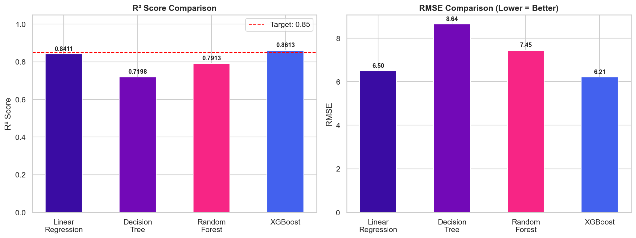
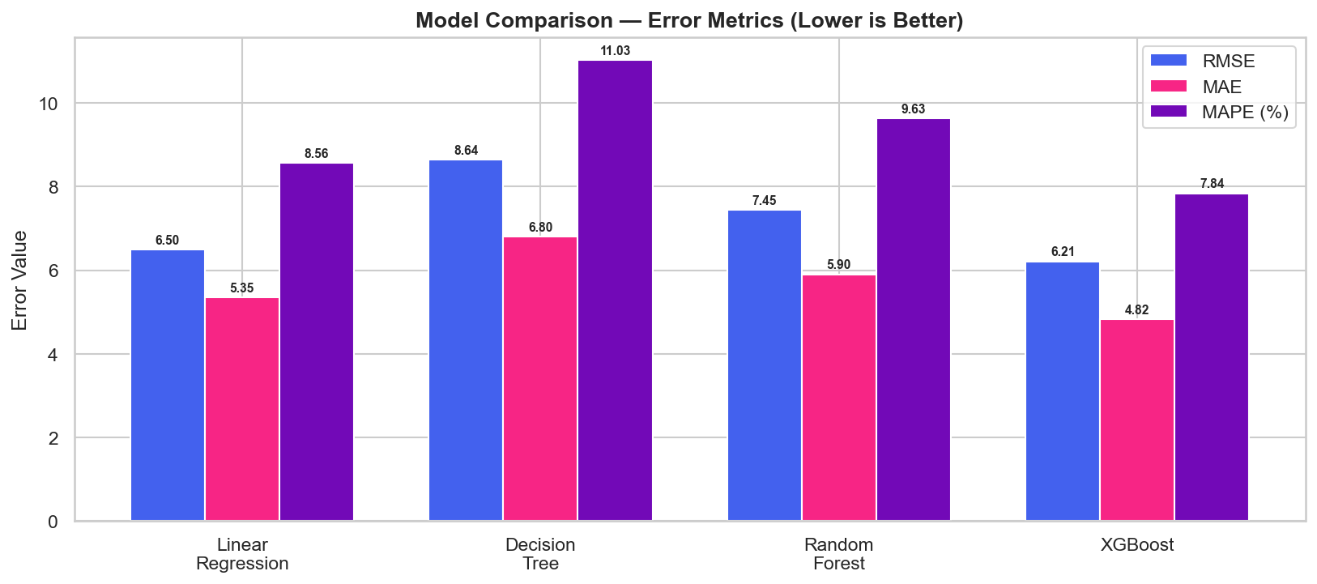
Model Evaluation
Quantitative comparison across all 4 models

Slide 11
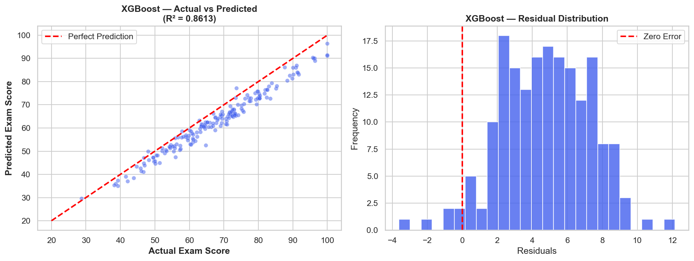
Best Model: XGBoost
Actual vs Predicted & Residual Analysis
R² Score
0.8613
MAE
4.82
RMSE
6.21
MAPE
7.84%

Slide 12
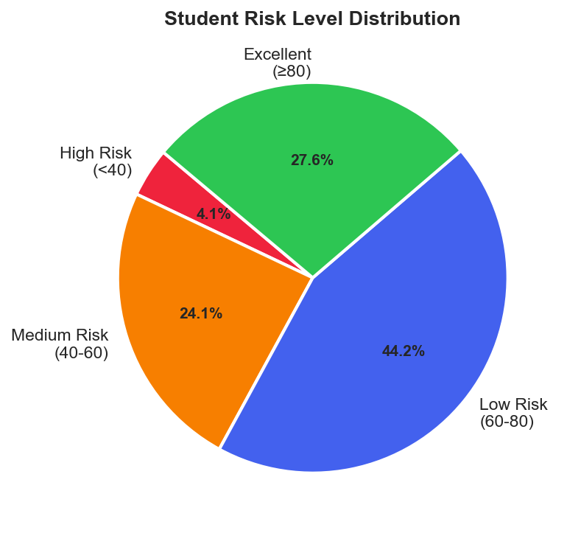
Risk Classification System
Post-prediction risk level assignment
High Risk ⚠️
Score < 40
Immediate intervention required
Medium Risk 🟠
Score 40–60
Needs improvement to pass
Low Risk 🟢
Score 60–80
Performing well, room to grow
Excellent 🌟
Score ≥ 80
Outstanding performance!

Slide 13
Deployment: Streamlit App
Interactive prediction dashboard
App Features
Saved Model
✓ Interactive sliders for all 6 input features
• best_student_model.pkl — XGBoost (final)
✓ Real-time exam score prediction
• Trained with GridSearchCV best params
✓ Risk level badge (High / Medium / Low / Excellent)
• Input shape: (n, 6) | Output: float (score)
✓ Model info panel with feature list & R² score
• Loaded via: joblib.load()
✓ Deployed via Streamlit Cloud
Input Features (6)
→ study_hours_per_day
→ social_media_hours
→ mental_health_rating
→ sleep_hours
→ attendance_percentage
→ exercise_frequency

Slide 14
GitHub Repository
Access full project source code & notebook
Repository Details
🔗 https://github.com/2024BTech029GarvSharma/ML-Student-Risk
📁 ml_project.ipynb — Full analysis notebook
📁 ml.py — Streamlit prediction app
📁 best_student_model.pkl — Trained XGBoost model
📁 student_habits_performance.csv — Dataset
Scan to access the repo
📁 README.md — Project documentation
Tech Stack
Python · Pandas · Scikit-learn · XGBoost · Matplotlib · Seaborn · Streamlit · Joblib

Slide 15
Conclusion & Future Work
Key takeaways and next steps
✅ Best Model
Future Roadmap
XGBoost achieved R²=0.8613, MAE=4.82 — best overall balance
→ Deep learning models (LSTM for longitudinal tracking)
✅ Key Drivers
→ Real-time data pipeline integration with LMS
Study hours, mental health & attendance drive performance most
→ Expand dataset to 10,000+ students across institutions
✅ Risk System
4-tier risk classifier enables proactive student intervention
→ Add explainability layer with SHAP values
✅ Deployment
→ Mobile app deployment for student self-assessment
Live Streamlit app for real-time predictions

Slide 16
Thank You!
Garv Sharma | 2024BTech029 | B.Tech CSE (AI)
JK Lakshmipat University, Jaipur
github.com/2024BTech029GarvSharma/ML-Student-Risk

