Slide 1

A CLOUD SECURE STORAGE MECHANISM BASED ON DATA DISPERSION AND ENCRYPTION
SDG GOAL : 9 ( Industry, Innovation and Infrastructure )
PROJECT INCHARGE:
Dr. V. Subedha, Professor TEAM GUIDE:
Mr. C. Thyagarajan, Assistant Professor
BATCH NUMBER : C12
TEAM MEMBERS :
211420104288 - Tharuneshwaran G
211420104299 - Vengateswaran R
211420104305 - Vimal M

Slide 2
OBJECTIVES
Enhance data security in cloud storage systems by preventing data leakage at the storage layer.
Develop a mechanism that combines data dispersion and encryption to safeguard data confidentiality.
Implement a hierarchical management approach to strengthen key security and prevent unauthorized access to encrypted materials.

Slide 3
ABSTRACT
Cloud storage services are vital components of cloud computing, but face security challenges. This project introduces the Cloud Secure Storage Mechanism (CSSM) to enhance data confidentiality. CSSM utilizes data dispersion and distributed storage to mitigate data compromise risks. Encryption, chunking, and distributed storage methods protect data integrity and confidentiality. Searching dispersed data by mapped keywords ensures access. The hierarchical management approach streamlines resource allocation and access control, optimizing storage utilization and administrative oversight. With CSSM, even if data fragments are compromised, overall system security remains intact.

Slide 4
INTRODUCTION
Cloud storage, a fundamental aspect of modern computing, offers vast scalability and convenience for storing data.
Security concerns persist regarding unauthorized access and data breaches in cloud storage.
Encryption serves as a crucial tool in securing cloud storage by transforming data into an unreadable format using cryptographic algorithms.
Data dispersion techniques fragment data into smaller pieces and disperse them across multiple storage locations, enhancing security.

Slide 5
Fragmentation makes it difficult for attackers to reconstruct the original data without access to all dispersed fragments.
The combination of encryption and data dispersion methodologies fortifies the confidentiality and integrity of stored information.
Security and privacy considerations are essential in ensuring the trustworthiness of cloud-based services in the evolving landscape of cloud storage.

Slide 6
LITERATURE SURVEY
S . No. | AUTHOR | TITLE | TECHNIQUE USED
1 | Geeta Sharma, Sheetal Kalra | A Lightweight User Authentication Scheme for Cloud-IoT Based Healthcare Services | Proposes a lightweight user authentication scheme for cloud-IoT healthcare services. Utilizes robust security measures to ensure data integrity and confidentiality.
2 | Geeta Sharma, Sheetal Kalra | Advanced Lightweight Multi-Factor Remote User Authentication Scheme for Cloud-IoT Applications | Introduces a multi-factor authentication scheme tailored for cloud-IoT applications. Implements formal security analysis to validate the effectiveness of the proposed scheme.

Slide 7
S . No. | AUTHOR | TITLE | TECHNIQUE USED
3 | Chandrakar P, Om H | An efficient two-factor remote user authentication and session key agreement scheme using Rabin cryptosystem | Presents a two-factor authentication and session key agreement scheme utilizing the Rabin cryptosystem. Ensures mutual authentication and secure session key agreement between users and servers.
4 | Yoon, E.-J.; Ryu, E.-K.; Yoo, K.-Y | Further improvement of an efficient password-based remote user authentication scheme using smart cards | Proposes enhancements to a password-based remote user authentication scheme using smart cards. Addresses vulnerabilities such as parallel session attacks and insecure password changes.

Slide 8
S . No. | AUTHOR | TITLE | TECHNIQUE USED
5 | H.Y. Chien, J. K. Jan, Y.M. Tseng | An efficient and practical solution to remote authentication: smart card | Advocates for smart card-based remote authentication. Highlights the efficiency and practicality of smart card solutions compared to traditional methods.
6 | Yifei Chen, Meng Li, Shuli Zheng, Donghui Hu, Chhagan Lal & Mauro Conti | One-Time, Oblivious, and Unlinkable Query Processing Over Encrypted Data on Cloud | A forward private SSE scheme utilizing trapdoor permutations without an ORAM-like construction.

Slide 9
S . No. | AUTHOR | TITLE | TECHNIQUE USED
7 | Xianrui Meng; Haohan Zhu; George Kollios | Top-k Query Processing on Encrypted Databases with Strong Security Guarantees | Employing EHL encrypted data structure coupled with secure sub-protocols under adaptive CQA security.
8 | Rui Li; Alex X. Liu | Adaptively Secure Conjunctive Query Processing over Encrypted Data for Cloud Computing | Utilizing Indistinguishable Bloom Filter (IBF) for indexing and Indistinguishable Binary Tree (IBtree) for efficient query processing.

Slide 10
S . No. | AUTHOR | TITLE | TECHNIQUE USED
9 | Yu Lei; Alex X. Liu; Rui Li | Secure KNN Queries over Encrypted Data: Dimensionality Is Not Always a Curse | Introducing 2DSkNN scheme with locality sensitive hashing (LSH) to enhance security and efficiency.
10 | Xinyu Lei; Alex X. Liu; Rui Li; Guan-Hua Tu | A Secure and Efficient Scheme for SkNN Query Problem Over Encrypted Geodata on Cloud | Employing projection function-based approach and indistinguishable Bloom filter tree for secure and efficient location-based query processing.

Slide 11
EXISTING SYSTEM
The existing system of our project highlights the rapid evolution of cloud computing, particularly in storage services, which have become essential for applications like pattern recognition and image forensics. Amazon Web Services (AWS) has solidified its position as the industry standard, with Swift, a key component of OpenStack, gaining popularity as a cloud storage mechanism. Despite these advancements, ensuring data security at the storage layer remains a challenge such as managing encryption keys, implementing access controls, ensuring compliance across locations, verifying data integrity, preventing insider threats, and securing data during transit. These require robust encryption, access controls, compliance management, data integrity checks, monitoring, and ongoing risk assessments. Encrypted data outsourced to the cloud directly may pose significant confidentiality and privacy risks. Existing searchable encryption schemes fall short in providing comprehensive solutions for fully functional search capabilities over encrypted cloud data.

Slide 12
PROPOSED SYSTEM
The Cloud Secure Storage Mechanism (CSSM) proposed in this project aims to prevent data breaches at the storage layer within cloud environments. By integrating data dispersion and distributed storage, CSSM achieves encrypted, chunked, and distributed storage, enhancing the security of cloud storage systems. Additionally, CSSM adopts a hierarchical management approach and combines user passwords with secret sharing to prevent cryptographic material leakage, ensuring the confidentiality of sensitive data. We introduced an efficient and reliable methodology for search over encrypted data. Here the encrypted keyword search pre computes the resulting search documents for the input query from users through Natural language processing Technique which is implemented on gateway (client side) on user file upload. Overall, CSSM represents a significant advancement in cloud storage security, offering a robust solution to safeguard against data breaches. Through its innovative techniques and comprehensive approach, CSSM provides highly secure storage for cloud environments, minimizing the risk of unauthorized access to sensitive data.

Slide 13
ADVANTAGES
The data which is stored in the cloud that is very safe and secure.
There is no leakage of data.
We can share the data with the secret key, trapdoor and the authentication is strong.
To be able to search files using the keywords inside the content of the file.

Slide 14
MODULES
Group creation
Data owner should be register in this environment and create a group. Data users also register and give request to group owner to add a group user. Data owner accept the request from the user. Multiple groups can be created. Each group is having owner and users. Data user only can access the respective data owner documents. Data user cannot access the webpage until the data owner accepts the request.
Text mining process
In this module the data owner can upload the document. Data owner can upload the files, the content of file is to be extracted using NLP technique and that words can get synonyms using Word Net tool. In first step of text mining process POS tagger is implemented to extract the keywords in files.NLP process is used to extractthe literal meaning of keywords previously extracted. The Words are analyzed in Word Net API so that the related terms can be found for use in the index file. This index file will be generated for each upload from group owner and saved as a serializable object in cloud. All the communication to cloud server will be done through web service.

Slide 15
Blind Storage
The uploaded data are encrypted in gateway after Natural language Processing is done and stored as index file. The owner can give access control and privileges to user while uploading the data. Access control refers to whether the user has permission to access the file or not. The privilege refers to how much extend that the user has rights over the data (read and write). The file will be split into blocks and encrypted using RSA encrypting algorithm and the encrypted blocks will be uploaded to the cloud service and stored in blind storage. Blind storage all documents are divided into fixed size blocks. These blocks are indexed by sequence of random integers. Files contents are stored in block randomly so the cloud can view encrypted content only. Encryption key only knows to data owner.
Query search
Data user will try to search a query in cloud server. The cloud servers map the keywords and search the related files. The cloud server gives the related filename to user. To view the content the user should click the filename; at that time user request to cloud server and server send the user details and filename to the data owner. Then data owner knows all public key of user so to encrypt the private key using data user public key and the encrypted key send to server and server send that key details to user, then user decrypt the key using our private key. After that the data user can get private key of data owner and then access the data through blind storage.

Slide 16
CSSM Encryption and Decryption
RSA:
The RSA encryption algorithm, widely used for secure data transmission, relies on the complexity of factoring large prime numbers. In RSA, entities possess public and private keys; the former encrypts, and the latter decrypts messages. Security hinges on the difficulty of factoring large primes composing the modulus. To encrypt, senders use the recipient's public key for modular exponentiation. RSA finds applications in HTTPS, digital signatures, and key exchange. However, its computational demands increase with larger keys, and security depends on robust prime numbers and key lengths.
BASE 64:
Base64 is a binary-to-text encoding scheme that transforms binary data into a format suitable for transmission over text-based communication channels, such as email or URLs. Unlike encryption algorithms, Base64 does not encrypt data for security purposes; rather, it encodes data to ensure compatibility and integrity during transmission. In Base64 encoding, each group of three bytes (24 bits) of input data is converted into four characters from the Base64 alphabet, which consists of 64 printable ASCII characters. This encoding process involves dividing the input data into six-bit chunks and mapping them to the corresponding Base64 characters. Base64 encoding is commonly used in scenarios where binary data needs to be represented as text, such as encoding binary attachments in email messages or transmitting binary data over HTTP headers. However, it's important to note that Base64 encoding does not provide encryption or security features, and the encoded data can be easily decoded back to its original binary form.

Slide 17
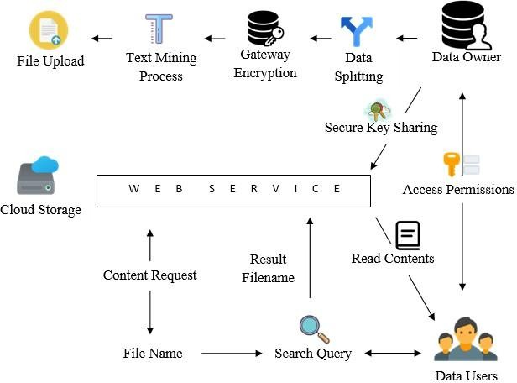
SYSTEM ARCHITECTURE

Slide 18
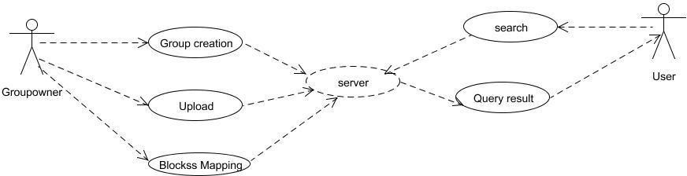
USECASE DIAGRAM

Slide 19
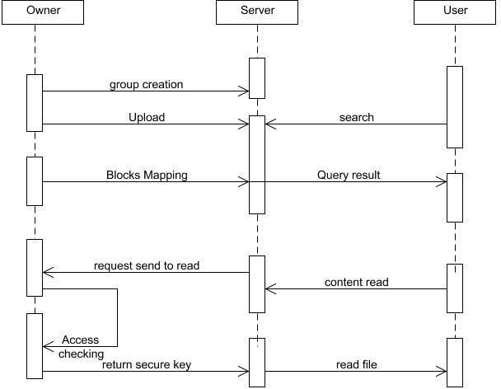
SEQUENCE DIAGRAM

Slide 20
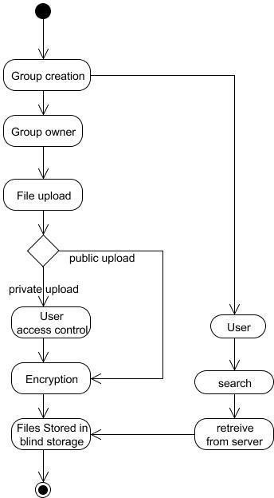
ACTIVITY DIAGRAM

Slide 21
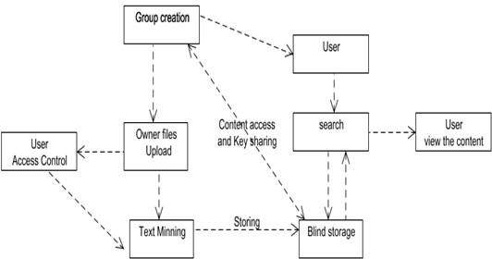
COLLABORATION DIAGRAM

Slide 22
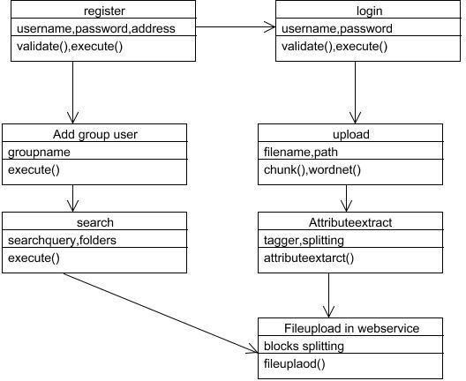
CLASS DIAGRAM

Slide 23
ENVIRONMENT REQUIREMENTS
HARDWARE REQUIREMENTS
Hard Disk : 250GB and Above
RAM : 4GB and Above
Processor : i3 and Above
SOFTWARE REQUIREMENTS
Windows 7(1no)
JDK 1.7
My SQL 5.0
Tomcat6.0
Word Net

Slide 24
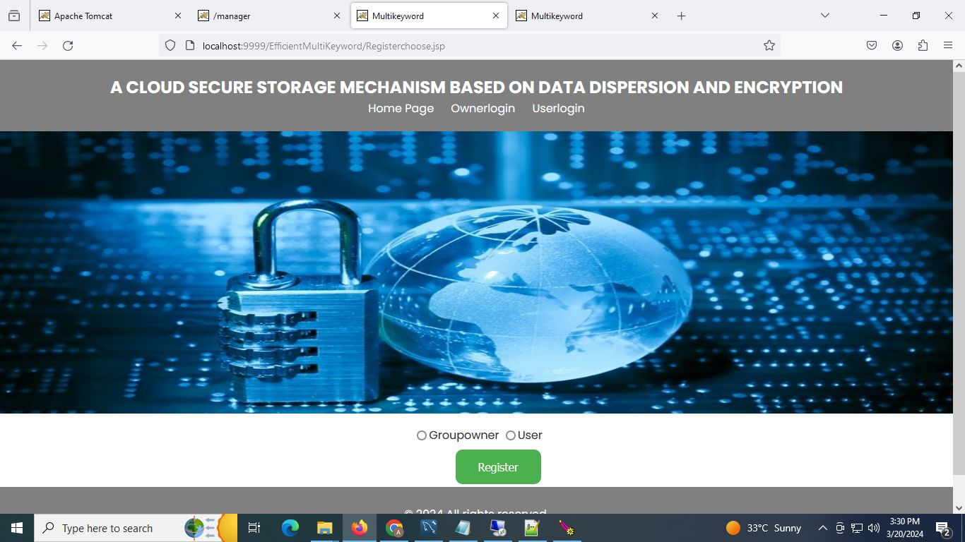
SAMPLE SCREENSHOTS

Slide 25
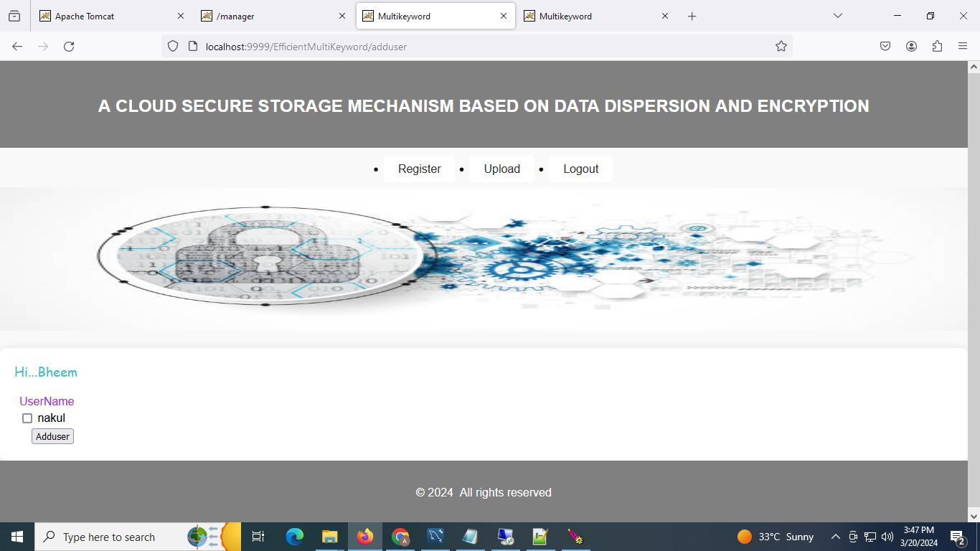

Slide 26
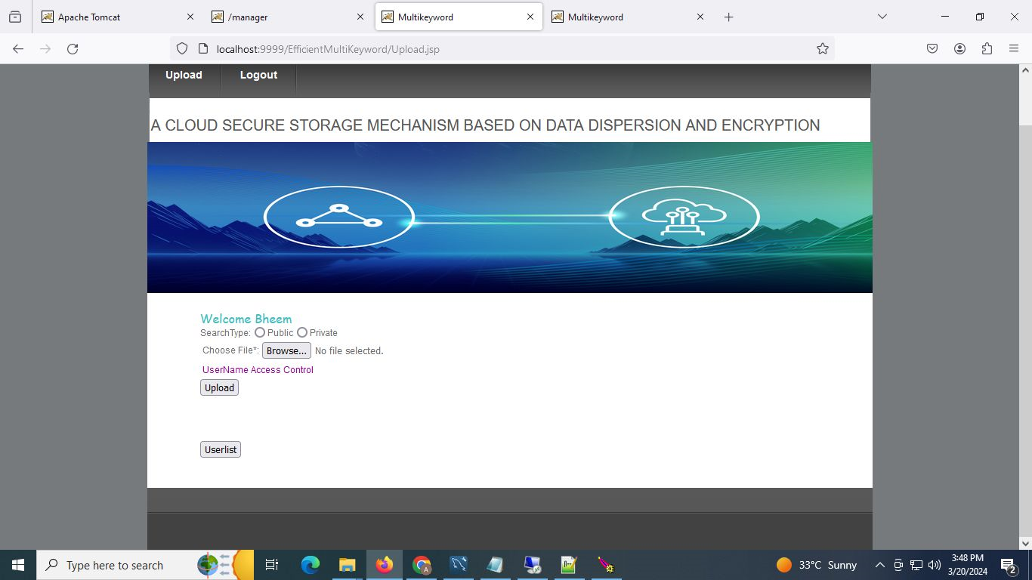

Slide 27
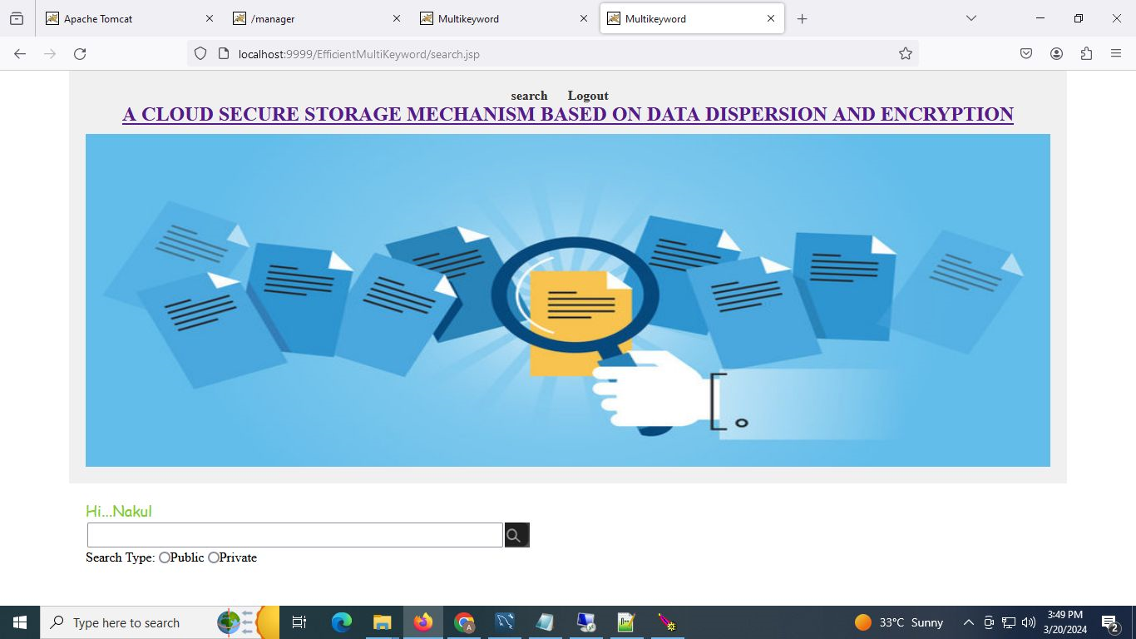

Slide 28
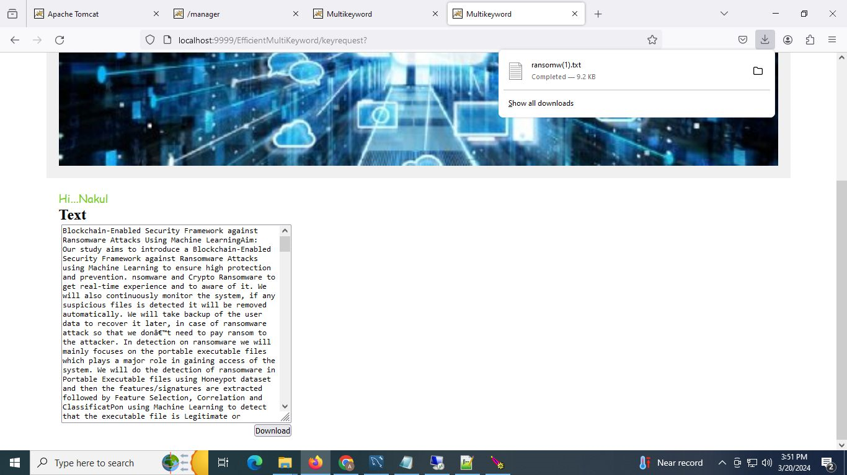

Slide 29
CONCLUSION
Our project addresses cloud data leakage by introducing CSSM, the Cloud Secure Storage Mechanism. CSSM combines data dispersal and encryption to enhance data security and malicious attacks. Experimental results demonstrate CSSM's effectiveness in preventing data leakage with acceptable performance overhead. We also introduce efficient keyword search, ensuring accurate and secure search over encrypted data while preserving privacy through blind storage. Access controls are implemented for each user, enhancing security. CSSM offers a practical solution for cloud storage security, promising robust protection and efficient data management, bolstering trust in cloud computing technologies.

Slide 30
FUTURE SCOPE
To address ongoing security challenges, our project plans to enhance our cloud secure storage mechanism. Specifically, we aim to improve key management by implementing dual-server hot backup or cluster approaches for updating the index tree in response to user key changes. Additionally, we propose future enhancements such as creating multiple user groups, enabling multimedia search, adopting asymmetric encryption like RSA, incorporating natural language processing for text mining, and generating index files and keys directly on the cloud. These improvements will bolster our system's resilience against vulnerabilities, reduce the risk of data leakage, and ensure the confidentiality of sensitive information stored in cloud environments.

Slide 31
REFERENCES
Bhardwaj, F. Al-Turjman, M. Kumar, T. Stephan, and L. Mostarda, ‘‘Capturing-the-invisible (CTI): Behavior-based attacks recognition in IoT-oriented industrial control systems,’’ IEEE Access, vol. 8, pp. 104956–104966, 2020.
M. Kumar, A. Rani, and S. Srivastava, ‘‘Image forensics based on lighting estimation,’’ Int. J. Image Graph., vol. 19, no. 3, Jul. 2019, Art. no. 1950014.
M. Kumar, S. Srivastava, and N. Uddin, ‘‘Image forensic based on lighting estimation,’’ Austral. J. Forensic Sci., vol. 51, no. 3, pp. 243–250, Aug. 2017.
J. Li, Y. Zhang, X. Chen, and Y. Xiang, ‘‘Secure attribute-based data sharing for resource-limited users in cloud computing,’’ Comput. Secur., vol. 72, pp. 1–12, Jan. 2018.
Y. Zhang, X. Chen, J. Li, D. S. Wong, H. Li, and I. You, ‘‘Ensuring attribute privacy protection and fast decryption for outsourced data security in mobile cloud computing,’’ Inf. Sci., vol. 379, pp. 42–61, Feb. 2017.
The OpenStack Project. OSSA-2015-006: Unauthorized Delete of Versioned Swift Object. Accessed: Apr. 14, 2015. [Online]. Available: https://security.openstack.org/ossa/OSSA-2015-006.html
The OpenStack Project. OSSA-2015-016: Information Leak Via Swift Tempurls. Accessed: Aug. 26, 2015. [Online]. Available: https://security. openstack.org/ossa/OSSA-2015-016.html - Date: January 2018

Slide 32
THANK YOU

