Slide 1
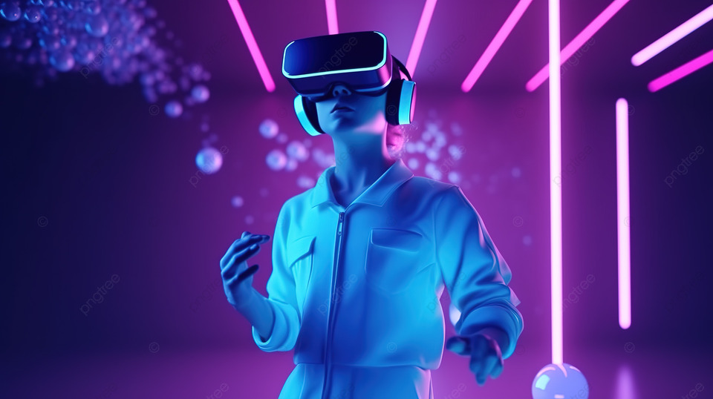
DIGIHUMAN NEXUS STREAMLINING ANIMATION WITH AI AND UNITY3D FOR VIRTUAL CHARACTERS GUIDE DR.R.JOSPHINE LEELA ME., PH.D., PROFESSOR RAGUL E 211420104213 SANKARANARAYANAN K 211420104243 SARAN Y 211420104243 SDG GOAL 9 : INDUSTRIES , INNOVATION & INFRASTRUCTURE
DOMAIN : DEEP LEARNING & VIRTUAL AVATAR

Slide 2
Base Paper: Deep Reconstruction of 3-D Human Poses From Video
Author: Jian Liu, Naveed Akhtar , and Ajmal Mian
Deep learning enables 3-D mesh reconstruction from images, but extending this to videos is challenging due to limited annotated data. We introduce a method to synthesize annotated monocular action videos with realistic cloth deformations. Additionally, we propose an end-to-end trainable recurrent neural network for full pose mesh recovery from videos, ensuring temporal coherence and geometric consistency. Validation demonstrates the effectiveness of our approach with quantitative and qualitative analyses on proposed and benchmark datasets.

Slide 3
ABSTRACT
Animating virtual characters in virtual reality (VR) poses significant challenges, especially in conveying nuanced facial expressions. Conventional methods rely on costly motion capture or labor-intensive manual inputs, hampering accessibility and efficiency. Introducing DigiHuman Nexus: a groundbreaking solution automating facial animation for virtual human characters. Through seamless integration of cutting-edge technologies like Blaze Pose, Unity3D, and Media Pipe, DigiHuman Nexus revolutionizes animation creation. Blaze Pose's real-time pose estimation, producing 33 body key points at over 30 frames per second, proves invaluable for applications from fitness tracking to sign language recognition. By combining Blaze Pose with DigiHuman Nexus, lifelike body movements are seamlessly infused into virtual character animations. Moreover, Media Pipe's sophisticated functionalities enhance the precision of human movement portrayal within virtual environments. DigiHuman Nexus marks a pivotal milestone, poised to revolutionize animation creation across VR, augmented reality (AR), and beyond. With versatile solutions tailored to diverse applications necessitating lifelike virtual character animations, DigiHuman Nexus promises transformative innovation.

Slide 4
PROBLEM STATEMENT
The problem statement for DigiHuman revolves around the limitations inherent in traditional animation methods, which struggle to accurately capture the complexities of human movement and expression. Manual animation processes are time-consuming, labor-intensive, and often fall short of achieving the required level of realism, particularly in applications such as gaming, virtual reality, and film production. Moreover, existing techniques encounter difficulties in handling the intricacies of input data, such as video recordings containing human actions and facial expressions. There is a pressing need for a more efficient and automated solution that can harness advanced technologies like deep learning and computer vision to generate lifelike animations from such input data, all while ensuring accuracy and realism. DigiHuman seeks to address this need by offering a revolutionary approach to animation creation
EXISTING SOLUTION:
Existing animation methods are hindered by their manual, time-consuming nature, which often fails to achieve the realism demanded by applications like gaming, virtual reality, and film production. These techniques struggle to handle complex input data such as video recordings of human actions and facial expressions. Thus, there is a need for an automated solution leveraging advanced technologies like deep learning and computer vision to generate life like animations efficiently and accurately, promising to streamline the process and deliver results that meet the highest standards of quality and fidelity.

Slide 5
PROPOSED SOLUTION
Introducing DigiHuman, a revolutionary solution poised to elevate virtual human animation to new heights. Leveraging the power of deep learning and computer vision, DigiHuman offers a comprehensive approach to animation generation. Its backend architecture processes input data, including video recordings and semantic segmentation, to accurately capture body movements and facial expressions. Through techniques such as body pose estimation and facial landmark detection, DigiHuman ensures realism and diversity in animations.
The frontend processing refines data with signal filtering techniques, maps character movements accurately, and integrates background images for immersive experiences. Supported by meticulous training procedures and real-world datasets, Digi Human's pre-trained models are fine-tuned with human feedback, enhancing animation fidelity and efficacy. While challenges persist, DigiHuman represents a significant advancement in animation technology, promising captivating facial animations with unmatched precision and efficiency.

Slide 6
LITERATURE SURVEY
Badler, N. I., Palmer, M. S., & Bindiganavale, R. (1999) Animation Control for Real-Time Virtual Humans. Communications of the ACM, 42(8), 64–73.
This paper discusses animation control techniques for real-time virtual humans. It explores methods to enable natural and responsive animations in virtual environments. By focusing on real-time performance, the authors present strategies for effectively controlling virtual human movements, gestures, and expressions, aiming to enhance user interaction and immersion. The paper highlights the importance of animation control systems in shaping the behavior and appearance of virtual characters, thereby improving the overall quality of virtual experiences.
Bai, Z., Yao, N., Liu, L., Chen, H., & Wang, H. (2023) A Simple Approach to Animating Virtual Characters by Facial Expressions Reenactment. In 2023 IEEE Conference on Virtual Reality and 3D User Interfaces Abstracts and Workshops (VRW), pp. 585–586. IEEE.
This study presents a straightforward method for animating virtual characters through facial expression reenactment. The authors propose a technique that leverages facial expression data to animate virtual characters in real-time. By reenacting facial expressions captured from input data, such as video recordings, the system generates lifelike animations for virtual characters. This approach offers simplicity and efficiency in animating virtual characters, making it suitable for various applications in virtual reality and 3D user interfaces.

Slide 7




TECHNOLOGY STACK
Python 3.12
NumPy
TensorFlow
Keras
OpenCV
Media Pipe
Hardware Requirements :
Hard Disk : Min 400MB, Ram : Min 8GB

Slide 8
SYSTEM ARCHITECTURE
This presentation offers a systematic examination of DigiHuman Nexus, a cutting-edge system aimed at revolutionizing virtual human animation. Our study delves into the intricate workings of DigiHuman Nexus, exploring its backend architecture and frontend processing. We dissect how this innovative system analyzes input video data, capturing body movements and facial expressions with precision, to generate lifelike animations. Additionally, we uncover the training and testing procedures employed by DigiHuman Nexus, including the use of real-world datasets and human feedback to refine animation fidelity. Throughout the presentation, we address challenges and future directions, highlighting opportunities for improvement and expansion. By the end, attendees will gain a comprehensive understanding of DigiHuman Nexus and its potential to reshape virtual human animation across various industries and applications.
Keywords: Virtual human animation, DigiHuman Nexus, system study, animation generation, deep learning, computer vision.

Slide 9
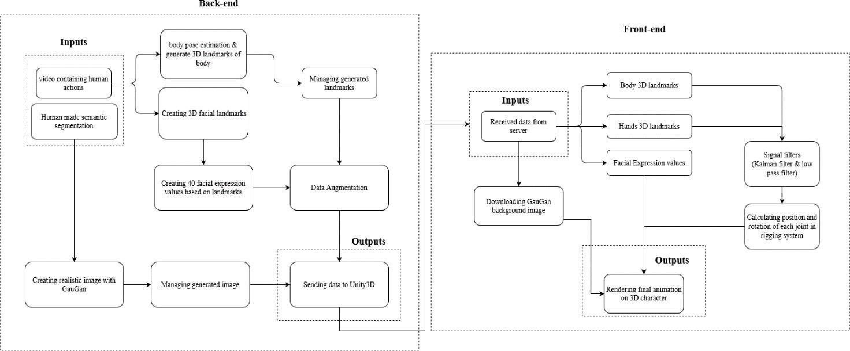
ARCHITECTURAL DIAGRAM

Slide 10
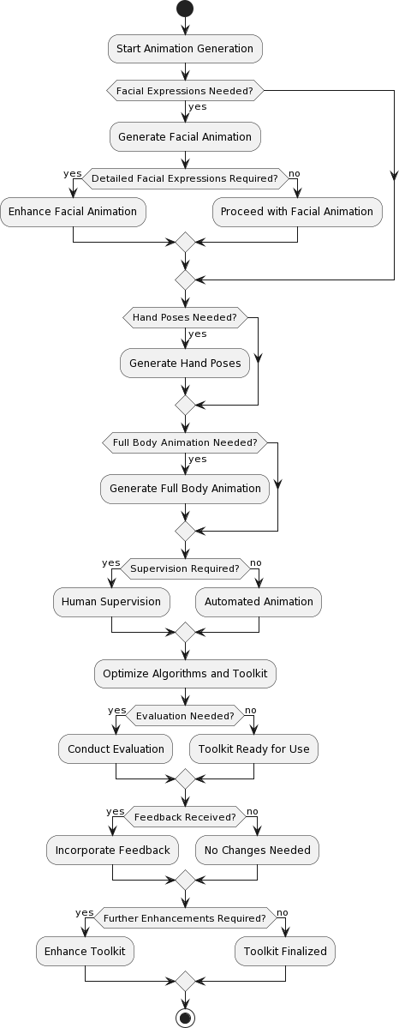
ACTIVITY DIAGRAM

Slide 11
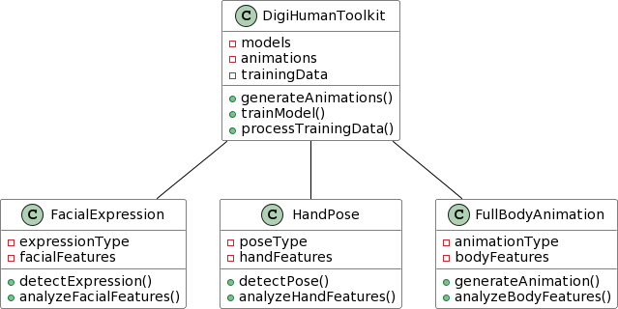
CLASS DIAGRAM

Slide 12
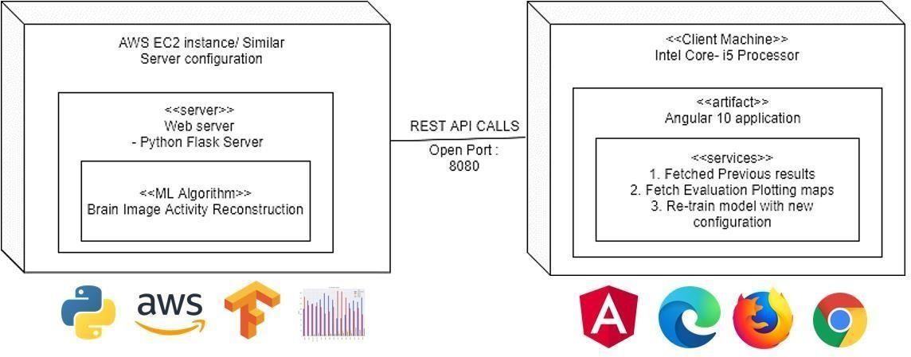
DEPLOYMENT DIAGRAM

Slide 13
DESIGN MODULE
DigiHuman employs deep learning and computer vision to create lifelike animations from input video data. Its architecture includes backend and frontend components essential for animation creation. The backend processes input data, estimating body poses, generating facial landmarks, computing facial expressions, and synthesizing background images. On the frontend, DigiHuman refines processed data and renders final animations, ensuring immersive and realistic results.
Backend Architecture
Digi Human's backend analyzes video recordings and semantic segmentation data, estimating body poses and generating facial landmarks. It computes facial expressions, augments data diversity, synthesizes background images, and integrates processed data into Unity3D for animation rendering.
Frontend Architecture
The frontend receives processed data from the backend, filters signals, calculates joint positions and rotations, retrieves background images, and renders final animations. This process ensures smooth animations with precise character movements and enhanced visual impact. DigiHuman renders complete animation sequences on 3D characters, integrating processed data with background images for immersive and realistic animations suitable for various applications.

Slide 14
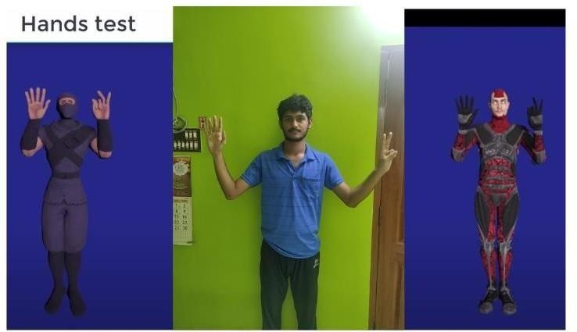
HAND TEST RECOGNITION

Slide 15
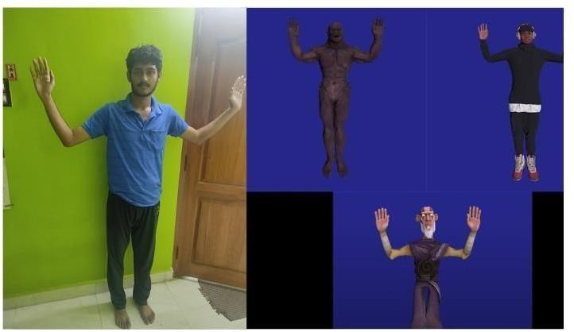
FULL BODY TEST RECOGNITION

Slide 16
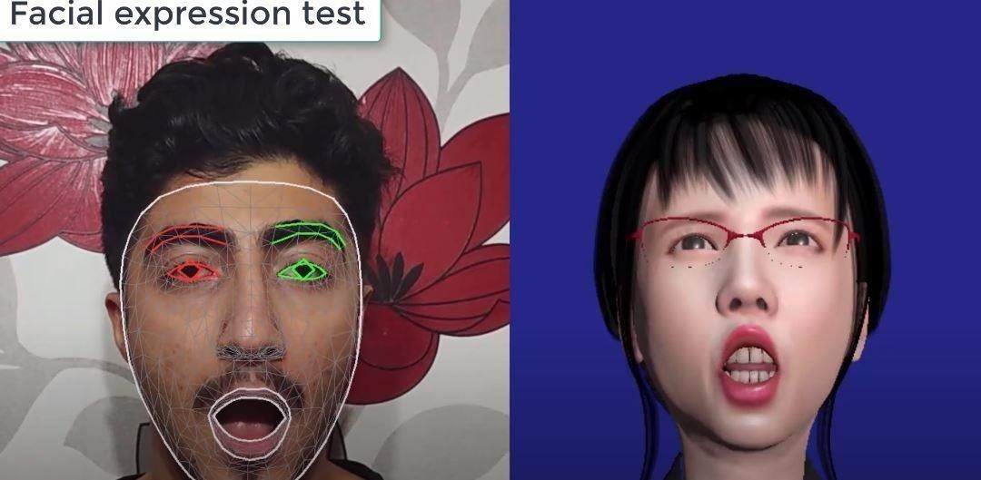
FACE EXPRESSION RECOGNITION

Slide 17
CONCLUSION & FUTURE WORK
The DigiHuman project offers a sophisticated system for automatic facial animation generation and manipulation, employing state-of-the-art technologies in machine learning, computer vision, and virtual reality. Through detailed analysis of its architecture and components, the project demonstrates seamless integration of backend server functionalities, frontend interface components, and machine learning models, enabling real-time visualization, user interaction, and customization of facial animations from input video data. Looking ahead, future enhancements could include advanced animation techniques like emotion-driven animation and lip- syncing, integration of external APIs for speech recognition and sentiment analysis, cloud-based rendering for scalability, cross-platform compatibility, collaborative animation features, improved user interface design, augmented reality integration, and community-building features, fostering a more inclusive and versatile platform for animation creation and sharing across diverse industries and domains.

