Slide 1

ANALYSIS AND PREDICTION OF AIR POLLUTION USING MEMORY BASED LEARNING APPROACES
Team Members: Guide:
Radhey Shyam R D Elangovan
Ragul A
Jayakant P

Slide 2
Introduction
Air pollution is a critical environmental issue affecting various countries around the world. The alarming levels of air pollution in many cities of India have serious implications on public health, environment and the quality of life. The current state of air pollution in India is analyzed and a prediction model is deployed to estimate future pollution levels. The analysis of air pollution involves examining various factors such as industrial emissions, vehicular pollution, biomass burning and dust particles. The data collected from monitoring stations in the form of satellite imagery and other relevant sources are used for the analysis. The study utilizes advanced data analytics techniques using machine learning algorithms to develop a predictive model for estimating air pollution levels. The historical pollution data along with meteorological parameters used as inputs to train the model. The potential applications of the analysis and prediction model are being discussed. It highlights the significance of such models in aiding policymakers and environmental agencies in making informed decisions and implementing effective strategies to mitigate air pollution.

Slide 3
Existing System
Accurate and comprehensive air pollution data is crucial for effective environmental management and public health protection. However, missing data in air pollution monitoring datasets can hinder the ability to analyze and understand pollution patterns. This abstract presents a novel approach for hierarchical recovery of missing air pollution data using an improved Long-Short Term Context Encoder network. The proposed method leverages the hierarchical structure of air pollution data, where various pollutants are measured at different monitoring stations across a region. The network is designed to capture long-term and short-term contextual information from neighbouring stations and time intervals, respectively. By exploiting the spatial and temporal dependencies, the network can effectively recover missing data points. To enhance the performance of the network, several improvements are introduced. These include the incorporation of attention mechanisms to focus on relevant features and the utilization of residual connections to alleviate information loss during network training. Additionally, data augmentation techniques are applied to address data sparsity and improve the network's generalization ability.

Slide 4
Proposed System
The Accurate analysis and prediction of air pollution levels are crucial for effective mitigation strategies and policy-making. So, a system is proposed to utilize memory-based learning techniques for analyzing and predicting air pollution in India. It utilizes inputs such as pollutant concentrations, meteorological variables, geographical features and temporal information to train the machine learning models. It allows the system to capture complex relationships and patterns in the data. The system aids in designing pollution control measures like issuing timely alerts and optimizing resource allocation for air quality management in India. It utilizes machine learning algorithms for the analysis and prediction of air pollution in India. The system's ability to capture complex relationships and provide accurate forecasts can contribute to mitigate the adverse effects of air pollution and improve public health.

Slide 5
Demerit
Complexity in training the data model..
Low accuracy predictions.
Undeployed model leading to instability.
Relies only on the implemented algorithm for output.

Slide 6
Literature Review
Title : : EFFECTIVE PREDICTION OF CARDIOVASCULAR DISEASE USING CLUSTER OF MACHINE LEARNING ALGORITHMS
Author: G. Jignesh Chowdary1 , Suganya. G , Premalatha. M
Year : 2020
Cardiovascular diseases are one of the diseases that account for the loss of millions of lives each year. Lack of early prediction is the primary reason for the loss of lives, and this encourages researchers to develop intelligent systems for better prediction. In this paper, a novel ensemble methodology is introduced which uses the voting of Logistic Regression(LR), Random Forest(RF), Artificial Neural Network activated with ReLU function(NNR), K-Nearest Neighbors (KNN) and Gaussian Naive Bayes(GNB) to predict the possibility of heart disease. The model is developed using Python-based Jupyter Notebook and Flask and is trained using the standard dataset from Kaggle. The results upon comparison with the individual models witness the better accuracy of using ensemble modeling and hence a better prediction leading to life-saving.

Slide 7
Advantages
Machine learning techniques such as memory-based approaches are used to build a statistical predictive model.
More than two algorithms are implemented for comparative analysis.
A Full-stack application for the model is deployed which can be easily accessed.
Enhanced accuracy & performance level.

Slide 8
Literature Review
Title : REVIEW OF HEART DISEASE PREDICTION SYSTEM USING DATA MINING AND HYBRID INTELLIGENT TECHNIQUES
Author: R. Chitra1 and V. Seenivasagam2
Year : 2013
The Healthcare industry generally clinical diagnosis is done mostly by doctor’s expertise and experience. Computer Aided Decision Support System plays a major role in medical field. With the growing research on heart disease predicting system, it has become important to categories the research outcomes and provides readers with an overview of the existing heart disease prediction techniques in each category. Neural Networks are one of many data mining analytical tools that can be utilized to make predictions for medical data. From the study it is observed that Hybrid Intelligent Algorithm improves the accuracy of the heart disease prediction system. The commonly used techniques for Heart Disease Prediction and their complexities are summarized in this paper.

Slide 9
List of Modules
Data Pre-processing
Data Analysis of Visualization
Implementing Extra Tree Classifier Algorithm
Implementing Random Forest Classifier Algorithm
Implementing XG Boost Classifier Algorithm
Deployment Using Django

Slide 10
Environmental Requirements
1. Software Requirements:
Operating System : Windows 10 or later
Tool : Any IDE for deployment and development
2. Hardware requirements:
Processor : Intel i3 (minimum configuration)
Hard disk : Minimum 80 GB
RAM : Minimum 2 GB

Slide 11
System Study
Aim:
To develop a machine learning-based system for air pollution prevention that can accurately predict pollution levels, identify pollution sources, and suggest actionable recommendations to reduce and mitigate air pollution.
Objectives:
Collect and preprocess diverse and reliable air quality data from multiple sources.
Develop accurate machine learning models for predicting air pollution levels and identifying pollution sources.
Create an accessible platform for real-time monitoring, providing actionable recommendations, and promoting public awareness and engagement in pollution reduction efforts.

Slide 12
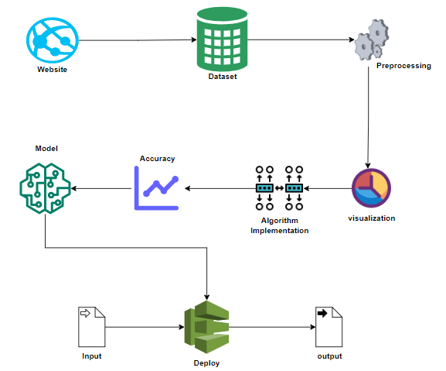
System Architecture

Slide 13
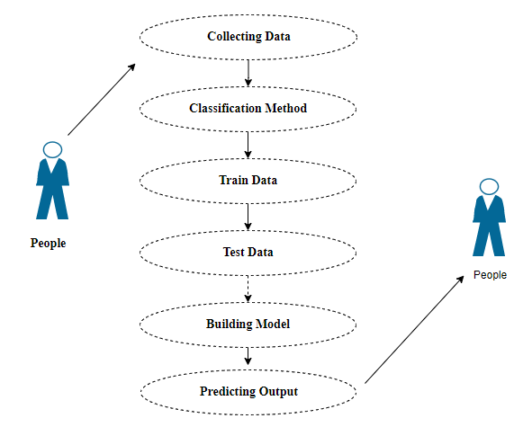
Use Case Diagram

Slide 14
Module Description
Data Pre-processing:
The Data Preprocessing module is pivotal for preparing air quality data for analysis. It starts with aggregating data from diverse sources, followed by cleaning to remove inconsistencies and outliers. This stage also involves transforming the data into a standardized format, ensuring compatibility with our machine learning models. Feature engineering is then applied to select relevant features, such as pollutant levels and weather conditions. The data is further processed for desired analysis resolution. This meticulous preparation is essential for the accurate prediction of air pollution levels, setting a strong foundation for our analysis and model effectiveness.

Slide 15
Data visualization
The Data Visualization module plays a pivotal role in presenting the analyzed air pollution data in an accessible and informative manner. Leveraging a combination of interactive charts, graphs and maps this module translates complex datasets into intuitive visual representations that enable users to discern trends, patterns and insights with ease. Through our web application interface, users can explore various aspects of air quality, including pollutant concentrations, temporal trends and spatial distribution. Additionally, the module incorporates real-time updates and customizable features, allowing users to tailor visualizations to their specific needs and preferences. By enhancing the interpretability and accessibility of air quality data, the Data Visualization module empowers stakeholders, policymakers and the public to make informed decisions as well as take proactive measures towards mitigating the adverse effects of air pollution on public health and the environment.

Slide 16
Conclusion
The applications of machine learning for predicting air pollution holds immense promise to address the critical issue of air quality in urban environment. The machine learning models have shown the ability to accurately predict pollution levels, identify pollution sources and offer necessary actions or recommendations for mitigation.

Slide 17
Algorithm implementation
The Algorithm Implementation module encompasses the integration of various memory-based learning algorithms, including Random Forest Classifier, Decision Tree Classifier and Extra Trees Classifier within our full-stack web application architecture. This module is responsible for implementing these algorithms to analyze historical air pollution data, identify patterns, relationships between pollutant concentrations, meteorological variables, geographical features and generate accurate predictions of future air pollution levels. Leveraging machine learning libraries and frameworks such as scikit-learn and TensorFlow, the system utilizes these algorithm's predictive capabilities to provide actionable insights for policymakers and stakeholders. Additionally, the module incorporates mechanisms for model training.

Slide 18
Future Work
Advanced Model Interpretability: It will focus more on developing advanced techniques for interpreting machine learning models that are used to predict air pollution. It helps us to understand various factors for air pollution and improve the transparency of model recommendations.
Integration with Environmental Policies: It will explore various ways to seamlessly integrate machine learning predictions into environmental policies and regulations thereby ensuring that data-driven insights directly inform decision-making and pollution reduction strategies.

