Slide 1
PANIMALAR ENGINEERING COLLEGE COMPUTER SCIENCE ENGINEERING CARDIOVASCULAR PREDICTION USING SUPERVISED MACHINE LEARNING TECHNIQUES
Team Members:
2020PECCS247 - RITHIVASAN S
2020PECCS251 - SABARI D Our Guide
2020PECCS276 - TAMILSELVAN S MRS. K. CINTHUJA, M.E.

Slide 2
Abstract:
Cardiovascular diseases (CVDs) are a leading cause of mortality and morbidity worldwide, necessitating the development of accurate predictive models for early detection and intervention. This research focuses on the application of supervised machine learning techniques to predict cardiovascular events and outcomes based on patient data. The performance of each model is evaluated using appropriate evaluation metrics, such as accuracy, precision, recall, and area under the receiver operating characteristic. Additionally, feature importance analysis is conducted to identify the key variables contributing to the prediction of cardiovascular events. This research highlights the effectiveness of supervised machine learning techniques in predicting cardiovascular events using patient data. The developed models have the potential to aid healthcare professionals in identifying at-risk individuals and implementing personalized preventive strategies. Further research can explore the integration of additional data sources, such as genetic information and wearable device data, to enhance the predictive capabilities and enable proactive cardiovascular care.

Slide 3
Existing System:
We report on a naturalistic study investigating the effects of routine driving on cardiovascular activation. We recruited 21 healthy young adults from a broad geographic area in the Southwestern United States. Using the participants’ own smartphones and smartwatches, we monitored for a week both their driving and non-driving activities. Monitoring included the continuous recording of a) heart rate throughout the day, b) hand motion during driving as a proxy of persistent texting, and c) contextualized driving data, complete with traffic and weather information. These high temporal resolution variables were complemented with the drivers’ biographic and psychometric profiles. Our analysis suggests that anxiety predisposition and high speeds are associated with significant cardiovascular activation on drivers, likely linked to sympathetic arousal. Surprisingly, these associations hold true under good weather, normal traffic, and with experienced drivers behind the wheel. The said findings call for attention to insidious effects of apparently benign drives even for people in their prime. Accordingly, our research contributes to intriguing new discourses on driving affect and personal health informatics.
Index Terms—cardiovascular activation, heart rate, sympathetic arousal, naturalistic driving studies, trait anxiety, driving speed, affective computing

Slide 4
Disadvantages:
They did not deploy the model.
They analyze on only driver health.
They did not use machine learning techniques.
Ineffective approach of this problem.

Slide 5
Proposed System:
Aims to develop a robust cardiovascular prediction model using supervised machine learning techniques. System to develop the project using machine learning algorithm. Recently, Machine learning and Artificial intelligence has plays a big role in various industries for their improvement and development. So we tried to implement Machine learning algorithm to diagnosis the cardiovascular disease. The system will utilize a diverse and comprehensive dataset comprising patient records, clinical features, lifestyle habits, and historical medical data related to cardiovascular diseases. The primary objective is to create a predictive model that can accurately assess cardiovascular risk and aid healthcare professionals in making informed decisions regarding patient care and prevention strategies. We collected the previous record of patient who had the cardiovascular disease and who doesn’t had the disease and those who had symptoms. By collection those people information our machine is tried to identifies the pattern of the datasets by various performing calculations. After identifies the pattern using various provide healthcare professionals with a powerful tool for early detection and risk stratification of cardiovascular diseases, ultimately leading to improved patient outcomes and reduced morbidity and mortality rates associated with these conditions. If we give an input it clearly show us that the person is affected or not.

Slide 6
Advantages:
We build a framework based full-stack application for deployment purposes.
We collect the patient records for train the data.
We compare more than two algorithms.

Slide 7
Environmental Requirements:
1. Software Requirements:
Operating System : Windows
Tool : Anaconda with Jupyter Notebook
2. Hardware requirements:
Processor : Intel core i3
Hard disk : minimum 300 GB
RAM : minimum 4 GB

Slide 8
INTRODUCTION:
Domain overview
Cardiovascular Prediction using Machine Learning is the system that is used to predict the diseases from the symptoms which are given by the patients or any user. The system processes the symptoms provided by the user as input and gives the output as the probability of the disease.

Slide 9
MACHINE LEARNING:
Machine learning is to predict the future from past data. Machine learning (ML) is a type of artificial intelligence (AI) that provides computers with the ability to learn without being explicitly programmed. Machine learning focuses on the development of Computer Programs that can change when exposed to new data and the basics of Machine Learning, implementation of a simple machine learning algorithm using python. Process of training and prediction involves use of specialized algorithms. It feed the training data to an algorithm, and the algorithm uses this training data to give predictions on a new test data. Machine learning can be roughly separated in to three categories. There are supervised learning, unsupervised learning and reinforcement learning. Supervised learning program is both given the input data and the corresponding labeling to learn data has to be labeled by a human being beforehand. Unsupervised learning is no labels. It provided to the learning algorithm. This algorithm has to figure out the clustering of the input data. Finally, Reinforcement learning dynamically interacts with its environment and it receives positive or negative feedback to improve its performance.

Slide 10
Preparing the Dataset :
This dataset contains number of records of features extracted from patients, which were then used to find the heart attack from the patient.

Slide 11
Literature survey:
General
A literature review is a body of text that aims to review the critical points of current knowledge on and/or methodological approaches to a particular topic.
It is secondary sources and discuss published information in a particular subject area and sometimes information in a particular subject area within a certain time period.
Its ultimate goal is to bring the reader up to date with current literature on a topic and forms the basis for another goal, such as future research that may be needed in the area and precedes a research proposal and may be just a simple summary of sources. Usually, it has an organizational pattern and combines both summary and synthesis.

Slide 12
Title : EFFECTIVE PREDICTION OF CARDIOVASCULAR DISEASE USING CLUSTER OF MACHINE LEARNING ALGORITHMS
Author: G. Jignesh Chowdary1 , Suganya. G 2 , Premalatha. M3
Year : 2020
Cardiovascular diseases are one of the diseases that account for the loss of millions of lives each year. Lack of early prediction is the primary reason for the loss of lives, and this encourages researchers to develop intelligent systems for better prediction. In this paper, a novel ensemble methodology is introduced which uses the voting of Logistic Regression(LR), Random Forest(RF), Artificial Neural Network activated with ReLU function(NNR), K-Nearest Neighbors (KNN) and Gaussian Naive Bayes(GNB) to predict the possibility of heart disease. The model is developed using Python-based Jupyter Notebook and Flask and is trained using the standard dataset from Kaggle. The model is tested and evaluated based on accuracy, precision, specificity, sensitivity, error. Testing witnessed an accuracy of 89% and a precision of 91.6%, along with a sensitivity of 86% and specificity of 91%. The results upon comparison with the individual models witness the better accuracy of using ensemble modeling and hence a better prediction leading to life-saving.

Slide 13
Title : REVIEW OF HEART DISEASE PREDICTION SYSTEM USING DATA MINING AND HYBRID INTELLIGENT TECHNIQUES
Author: R. Chitra1 and V. Seenivasagam2
Year : 2013
The Healthcare industry generally clinical diagnosis is done mostly by doctor’s expertise and experience. Computer Aided Decision Support System plays a major role in medical field. With the growing research on heart disease predicting system, it has become important to categories the research outcomes and provides readers with an overview of the existing heart disease prediction techniques in each category. Neural Networks are one of many data mining analytical tools that can be utilized to make predictions for medical data. From the study it is observed that Hybrid Intelligent Algorithm improves the accuracy of the heart disease prediction system. The commonly used techniques for Heart Disease Prediction and their complexities are summarized in this paper.

Slide 14
Objectives:
The goal is to develop a machine learning model for heart attack Prediction, to potentially replace the updatable supervised machine learning classification models by predicting results in the form of best accuracy by comparing supervised algorithm.

Slide 15
Scope of the Project:
Here the scope of the project is that integration of patients attack with computer-based prediction could reduce errors and improve prediction outcome. This suggestion is promising as data modeling and analysis tools, e.g., data mining, have the potential to generate a knowledge-rich environment which can help to significantly improve the quality of heart attack prediction.

Slide 16
List of Modules:
Data Pre-processing
Data Analysis of Visualization
Bagging Classifier
Support vector machine
MLP Classifier
Deployment Using Django

Slide 17
PYTHON:
Introduction:
Python is an interpreted high-level general-purpose programming language. Its design philosophy emphasizes code readability with its use of significant indentation. Its language constructs as well as its object-oriented approach aim to help programmers write clear, logical code for small and large-scale projects.

Slide 18
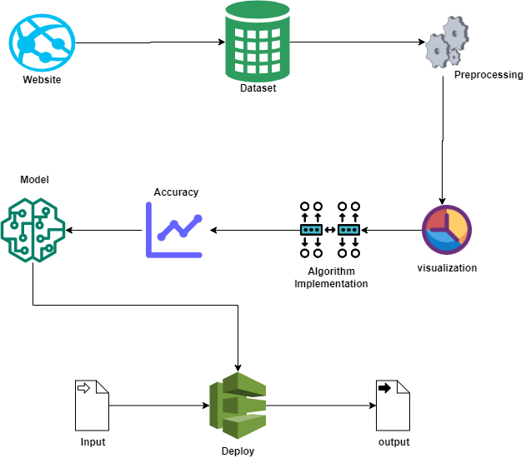
System Architecture:

Slide 19
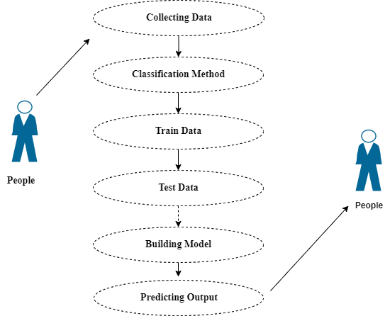
Use Case Diagram:

Slide 20
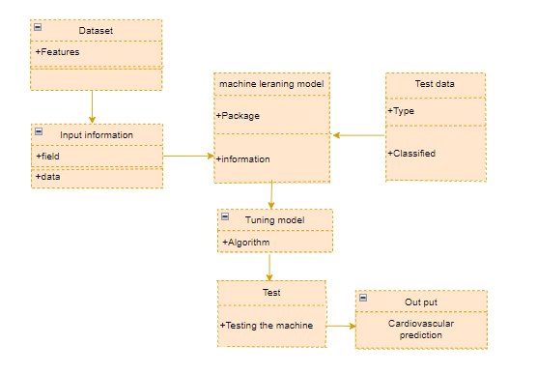
Class Diagram :

Slide 21
Module description:
Data Pre-processing
Validation techniques in machine learning are used to get the error rate of the Machine Learning (ML) model, which can be considered as close to the true error rate of the dataset.
If the data volume is large enough to be representative of the population, you may not need the validation techniques. However, in real-world scenarios, to work with samples of data that may not be a true representative of the population of given dataset. To finding the missing value, duplicate value and description of data type whether it is float variable or integer.
The sample of data used to provide an unbiased evaluation of a model fit on the training dataset while tuning model hyper parameters.

Slide 22
Data Validation/ Cleaning/Preparing Process:
Importing the library packages with loading given dataset. To analyzing the variable identification by data shape, data type and evaluating the missing values, duplicate values.
A validation dataset is a sample of data held back from training your model that is used to give an estimate of model skill while tuning model's and procedures that you can use to make the best use of validation and test datasets when evaluating your models.
Data cleaning / preparing by rename the given dataset and drop the column etc

Slide 23
Exploration data analysis of visualization
Data visualization is an important skill in applied statistics and machine learning.
Statistics does indeed focus on quantitative descriptions and estimations of data.
Data visualization provides an important suite of tools for gaining a qualitative understanding.
This can be helpful when exploring and getting to know a dataset and can help with identifying patterns, corrupt data, outliers, and much more.

Slide 24
Comparing Algorithm with prediction in the form of best accuracy result:
It is important to compare the performance of multiple different machine learning algorithms consistently and it will discover to create a test harness to compare multiple different machine learning algorithms in Python with scikit-learn.
It can use this test harness as a template on your own machine learning problems and add more and different algorithms to compare.
Each model will have different performance characteristics. Using resampling methods like cross validation, you can get an estimate for how accurate each model may be on unseen data.

Slide 25
Algorithm Explanation:
In machine learning and statistics, classification is a supervised learning approach in which the computer program learns from the data input given to it and then uses this learning to classify new observation.
This data set may simply be bi-class (like identifying whether the person is male or female or that the mail is spam or non-spam) or it may be multi-class too.
Some examples of classification problems are: speech recognition, handwriting recognition, bio metric identification, document classification etc

Slide 26
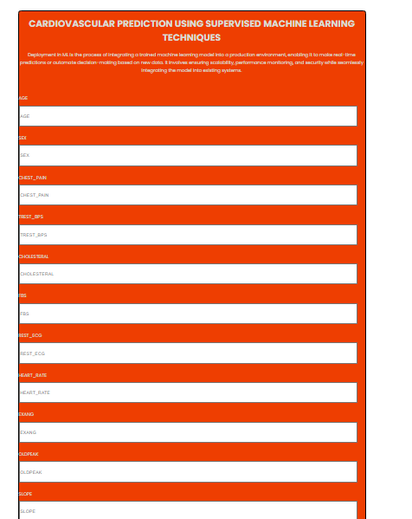
OUTPUT:

Slide 27
Conclusion:
The analytical process started from data cleaning and processing, missing value, exploratory analysis and finally model building and evaluation. The best accuracy on public test set is higher accuracy score will be find out. This application can help to find the Prediction of Heart Attack.

Slide 28
Future Work:
Heart Attack prediction to connect with cloud.
To optimize the work to implement in Artificial Intelligence environment.

