Slide 1



Department of Computer Science and Engineering
BUILDING AN ANESTHESIA PREDICTION SYSTEM FO
Mruthunjeyan A 211420104171
Jenish Vicmon A 211420104112
Kadher Naina Mohamed 21120104116
Mr. A.Karthikeyan
Associate Professor
Dr.G.Senthilkumar
Associate Professor

Slide 2
Introduction
Modern surgical procedures require anaesthesia in order to ensure patients' comfort and safety. To achieve optimal patient outcomes and minimize adverse events, anaesthesia dosage levels need to be calculated precisely. Anaesthesia dosage calculation is a time-consuming and error-prone process that poses significant challenges to healthcare professionals.
As a response to these challenges, this project proposes an innovative solution based on machine learning techniques that automates and optimizes anaesthesia dosage calculations. This solution reduces the risk of errors and improves patient safety by harnessing the power of advanced algorithms and data analysis.
By automating the calculation process and leveraging machine learning algorithms, our solution aims to empower healthcare professionals with accurate and timely anaesthesia dosage predictions, allowing them to focus more on patient care and less on manual administrative tasks

Slide 3
Objective of the Project
The development of an automated and optimized anaesthesia dosage calculation system using machine learning techniques represents a significant advancement in the field of healthcare technology. By addressing the challenges associated with manual calculation methods, our solution aims to enhance patient safety, streamline clinical workflows, and empower healthcare professionals with accurate and efficient anaesthesia dosage predictions. Through innovation and collaboration, we have the opportunity to revolutionize anaesthesia administration practices, ultimately improving patient outcomes and transforming the delivery of healthcare services.

Slide 4
Abstract of the project
This project presents the development of an Anesthesia Dosage Level Prediction using machine learning techniques.
Anesthesia dosage level is a critical task in medical practice, and inaccurate level can lead to patient safety concerns.
This project aims to enhance the precision and efficiency of anesthesia dosage calculations by leveraging regression algorithms and boosting algorithm.
The proposed system provides an intuitive for medical professionals, ensuring accurate and safe anesthesia administration.

Slide 5
Literature Survey
1. Data-Driven Visual Characterization of Patient Health-Status Using Electronic Health Records and Self-Organizing Mapset David Chushig-Muzo et al.(2020):Data-driven models based on Machine Learning (ML) have been intensively considered for extracting knowledge and discovering patterns related to diseases 2.Does Artificial Intelligence Make Clinical Decision Better? A Review of Artificial Intelligence and Machine Learning in Acute Kidney Injury Prediction Tao Han Lee et al.(2021):Advances in computing technology have led to the recent use of machine learning and artificial intelligence in AKI prediction, recent research reported that by using electronic health records (EHR) the AKI prediction via machine-learning models can reach AUROC over 0.80, in some studies even reach 0.93. 3. Quantitative Analysis of Anaesthesia Recovery Time by Machine Learning Prediction Models: A Prospective Study by Shumin Yang et al. (2022): Accurate prediction of anaesthesia recovery time can support anaesthesiologist decision-making during surgery to help reduce the risk of surgery in patients.

Slide 6
Existing System
In contemporary medical practice, anaesthesia dosage determination remains predominantly reliant on manual processes, with healthcare professionals playing a central role in the calculation and administration of anaesthetic agents.
Healthcare providers draw upon established guidelines, clinical expertise, and institutional protocols to compute initial dosages, considering factors such as drug potency, patient demographics, and anticipated surgical duration.
There is an increasing recognition of the need for advanced technological solutions, such as automated anaesthesia dosing systems, to enhance precision, efficiency, and safety in anaesthesia management.
By automating the dosage calculation process, these systems have the potential to reduce the burden on healthcare professionals, streamline clinical workflows, and enhance overall patient safety during surgical procedures.

Slide 7
Proposed System
The proposed system represents a significant advancement in anaesthesia dosage calculation through the integration of regression algorithms and boosting techniques, which are subsets of machine learning.
The DecisionTreeRegressor algorithm, a core component of the system, is adept at modelling complex relationships between patient variables and anaesthesia dosage levels.
This algorithm's flexibility allows it to adapt to diverse patient populations and surgical scenarios, ensuring robust performance across different clinical contexts.
Complementing the DecisionTreeRegressor is the boosting algorithm, another powerful tool in the system's arsenal. Boosting algorithms iteratively improve the predictive performance of weak learners, such as decision trees, by emphasising the prediction errors and refining the model iteratively.
Moreover, the system's user-friendly interface plays a crucial role in facilitating its adoption by medical professionals. The intuitive design allows users to input patient data seamlessly and interpret dosage recommendations effectively.

Slide 8
Software / Hardware used
Hardware:
OS-Windows 7,8,10 (32 or 64 bit)
RAM-4GB
Software:
Python IDLE
Jupyter Notebook
Numpy
Pandas

Slide 9
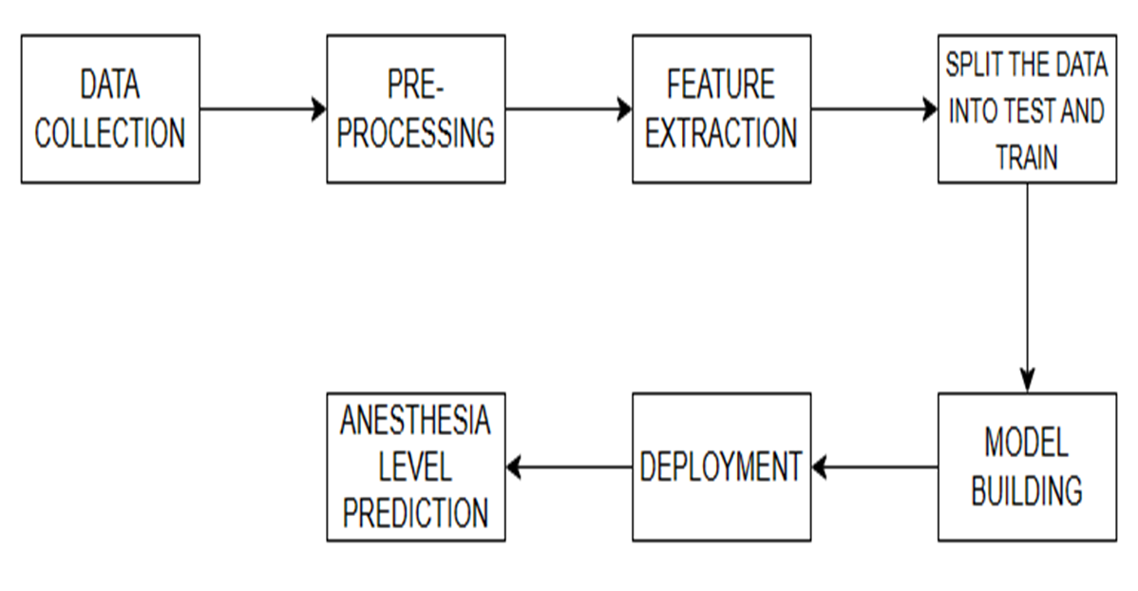
Architecture / Methodology used

Slide 10
System Implementation
COLLECTION OF DATA
PREPROCESSING THE DATA
MODEL TRAINING
PROCESSING THE DATA
EXTRACTION OF FEATURES
EVALUATING THE MODEL
INTEGRATION AND DEPLOYMENT

Slide 11
Algorithm
Regression :
When the output is a continuous value, the task is a regression.
Linear regression:
Finds a way to correlate each feature to the output to help predict future values.
Classification - Decision tree
Highly interpretable classification or regression model that splits data-feature values into branches at decision nodes (e.g., if a feature is a color, each possible color becomes a new branch) until a final decision output is made.
Gradient-boosting trees
Gradient-boosting trees is a state-of-the-art classification/regression technique. It is focusing on the error committed by the previous trees and tries to correct it.

Slide 12
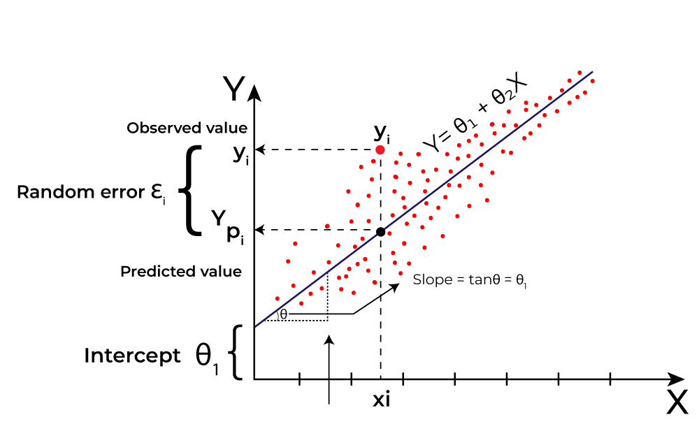

SIMPLE LINEAR REGRESSION
This is the simplest form of linear regression, and it involves only one independent variable and one dependent variable. The equation for simple linear regression is:
where:
Y is the dependent variable
X is the independent variable
β0 is the intercept
β1 is the slope

Slide 13
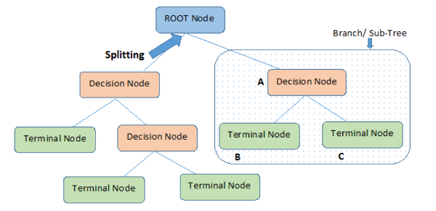
DECISION TREE REGRESSION
A decision tree is a non-parametric supervised learning algorithm for classification and regression tasks. It has a hierarchical tree structure consisting of a root node, branches, internal nodes, and leaf nodes. Decision trees are used for classification and regression tasks, providing easy-to-understand models.

Slide 14
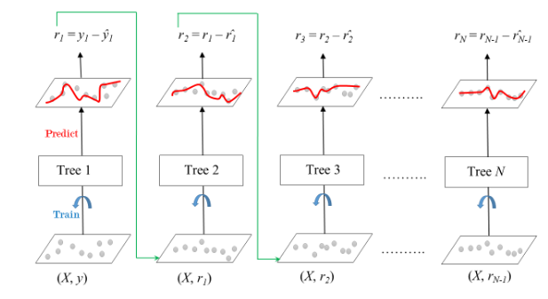
Gradient Boosting
Gradient Boosting is a powerful boosting algorithm that combines several weak learners into strong learners, in which each new model is trained to minimize the loss function such as mean squared error or cross-entropy of the previous model using gradient descent.
Formula :
y(pred) = y1 + (eta * r1) + (eta * r2) + ....... + (eta * rN)

Slide 15
Modules Description
Collection of datasets:
Data used in this paper is a set of product reviews collected from Medical Anesthesia Target controlled infusion history records. This step is concerned with selecting the subset of all available data that you will be working with.
Data pre-processing:
Formatting: The data you have selected may not be in a format that is suitable for you to work with.
Cleaning: Cleaning data is the removal or fixing of missing data. There may be data instances that are incomplete and do not carry the data you believe you need to address the problem.
Sampling: There may be far more selected data available than you need to work with. More data can result in much longer running times for algorithms and larger computational and memory requirements

Slide 16
Splitting data into test and train:
Splitting your dataset into training and testing sets is a fundamental step in machine learning and data analysis. It allows you to assess how well your model performs on data it has never seen before.
Training Set: This subset is used to train your machine learning model. The model learns patterns and relationships within the data by analyzing both the features (X) and the corresponding target (y).
Testing Set: This subset is kept separate and is not used during training. Instead, it's reserved to evaluate how well the trained model performs when it's asked to make predictions or classifications. .
Feature Extraction:
Next thing is to do Feature extraction is an attribute reduction process. Unlike feature selection, which ranks the existing attributes according to their predictive significance, feature extraction actually transforms the attributes. The transformed attributes, or features, are linear combinations of the original attributes. Finally, our models are trained using Classifier algorithm. We use classify module on Natural Language Toolkit library on Python.

Slide 17
Model Evaluation:
Model Evaluation is an integral part of the model development process. It helps to find the best model that represents our data and how well the chosen model will work in the future. Evaluating model performance with the data used for training is not acceptable in data science because it can easily generate overoptimistic and over fitted models. There are two methods of evaluating models in data science, Hold-Out and Cross-Validation. To avoid over fitting, both methods use a test set (not seen by the model) to evaluate model performance. Performance of each classification model is estimated base on its averaged. The result will be in the visualized form. Representation of classified data in the form of graphs. Accuracy is defined as the percentage of correct predictions for the test data. It can be calculated easily by dividing the number of correct predictions by the number of total predictions.

Slide 18
Result & Discussion
The implementation of the proposed anaesthesia dosage prediction system has yielded promising results, showcasing its potential to enhance patient care and safety in clinical settings. Through rigorous training of regression algorithms and boosting techniques, the system achieved high levels of accuracy in predicting anaesthesia dosages based on patient data, as evidenced by minimal deviation between predicted and actual dosage levels, as measured by evaluation metrics such as Mean Absolute Error (MAE) and Mean Squared Error (MSE).
The user-friendly interface of the system allowed medical professionals to input patient data and receive real-time anaesthesia dosage recommendations. This feature streamlined the decision-making process during surgical procedures, enhancing workflow efficiency and enabling clinicians to make informed decisions quickly. Feedback from healthcare professionals indicated a high level of satisfaction with the system's usability and functionality, with the intuitive design of the user interface and the implementation of error handling mechanisms contributing to a positive user experience.
By optimizing anaesthesia dosages based on patient characteristics and surgical requirements, the system contributed to enhanced patient safety, recovery, and overall satisfaction with the surgical experience.

Slide 19
Reference Paper/ URL
[1] David Chushig-Muzo, Cristina Soguero-Ruiz, A.P. Engelbrecht, Pablo De Miguel Bohoyo, Inmaculada Mora-Jiménez(2020) Data-Driven Visual Characterization of Patient Health-Status Using Electronic Health Records and Self-Organizing Maps.
[2] Tao Han Lee, Jia Jin Chen, Chi Tung Cheng, Chih-Hsiang Chang(2021) Does Artificial Intelligence Make Clinical Decisions Better? A Review of Artificial Intelligence and Machine Learning in Acute Kidney Injury Prediction.
[3] Shumin Yang, Huaying Li, Zhizhe Lin (2022)
Quantitative Analysis of Anesthesia Recovery Time by Machine Learning Prediction Models.
[4] Brett L Moore, Larry D Pyeatt, Vivekanand Kulkarni, (2022). Reinforcement Learning for Closed-Loop Propofol Anesthesia: A Study in Human Volunteers.
[5] Won Joon Yung, MyungJae Shin,(2023). Deep reinforcement learning-based propofol infusion control for anaesthesia: A feasibility study with a 3000-subject dataset.
[6]Xiuding Cai, Jiao Chen, Yaoyao Zhu, Beimin Wang, Yu Yao (2023). Towards Real-World Applications of Personalized Anesthesia Using Policy Constraint Q Learning for Propofol Infusion Control.
[7] Mingjin Chen, Yongkang He, Zhijing Yang(2023). A Deep Learning Framework for Anesthesia Depth Prediction from Drug Infusion History.

