Slide 1


Department of Computer Science and Engineering
Comprehensive Guide to Mining Employee Helmet with Vital Parameter Monitoring
KAMESH C 211420104119
PIRANAVA GURU RK 211420104192
KAMESHWARAN ED 211420104121
Dr. S. HARIHARAN
Asst. Prof
Dr. SENTHIL KUMAR
Professor

Slide 2
Introduction
In recent years, the integration of Artificial Intelligence (AI) into occupational safety management has emerged as a promising avenue for enhancing workplace safety.
One crucial aspect of this application is the prediction of worker risk levels, which involves leveraging advanced AI algorithms to analyze a multitude of variables and discern patterns that may contribute to potential hazards.
The proactive identification of risks enables organizations to preemptively address and mitigate workplace dangers, thereby fostering a safer and healthier working environment.
This innovative approach harnesses the power of machine learning and data analytics to predict worker risk levels with a higher degree of accuracy and efficiency than traditional methods.
By incorporating AI processes into risk assessment, organizations can not only prioritize safety protocols but also optimize resource allocation and improve overall occupational health and safety outcomes.

Slide 3
Objective of the Project
The scope of this project is to develop an advanced AI-based system for predicting worker risk levels within occupational environments.
Leveraging artificial intelligence techniques, including machine learning algorithms and predictive analytics, the system aims to analyze various factors contributing to worker safety and well-being.
These factors may include historical incident data, environmental conditions, job-specific hazards, and individual health records.
The system will be designed to dynamically assess and predict the potential risk level for each worker, allowing for proactive measures to be implemented to mitigate risks and enhance overall safety.
The primary objective is to create a robust and efficient model that can accurately predict the likelihood of workers encountering safety hazards or facing health risks based on real-time and historical data.

Slide 4
Literature Survey
Introduction:
Overview of the importance of safety in mining operations
Introduction to wearable technology and its applications in various industries
Importance of monitoring vital parameters in hazardous environments like mining
Wearable Technology in Mining:
Review of literature on the adoption of wearable technology in the mining industry
Identification of challenges specific to the mining sector and how wearable technology addresses them

Slide 5
Existing System
At the end of 2021 Q2, coronavirus disease 2019 (COVID-19) in Indonesia experienced a continuous increase in positivity and mortality rates .
There are limited studies regarding the factors of COVID-19 mortality in Indonesia with a more balanced dataset.
The previous studies only implemented logistic regression, sensitive to the imbalanced dataset.
Meanwhile, other countries implemented survival analysis to overcome the problem.
Most survival analyses using Cox proportional hazard (CPH) model require the variables to be time-independent.

Slide 6
Proposed System
The proposed system for predicting worker risk levels utilizes advanced Artificial Intelligence (AI) processes to enhance workplace safety and preemptively identify potential hazards.
Leveraging machine learning algorithms, the system aims to analyze a comprehensive set of variables, including historical incident data, individual worker performance metrics, environmental conditions, and task-specific parameters.
By amalgamating these diverse data sources, the system can identify patterns and correlations that may indicate an increased risk of accidents or injuries.
The implementation of predictive analytics will enable organizations to take proactive measures to mitigate risks and improve overall safety protocols.

Slide 7
Software / Hardware used
1. Software Requirements:
Operating System : Windows
Tool : Anaconda with Jupyter Notebook
2. Hardware requirements:
Processor : Pentium IV/III
Hard disk : minimum 80 GB
RAM : minimum 2 GB

Slide 8
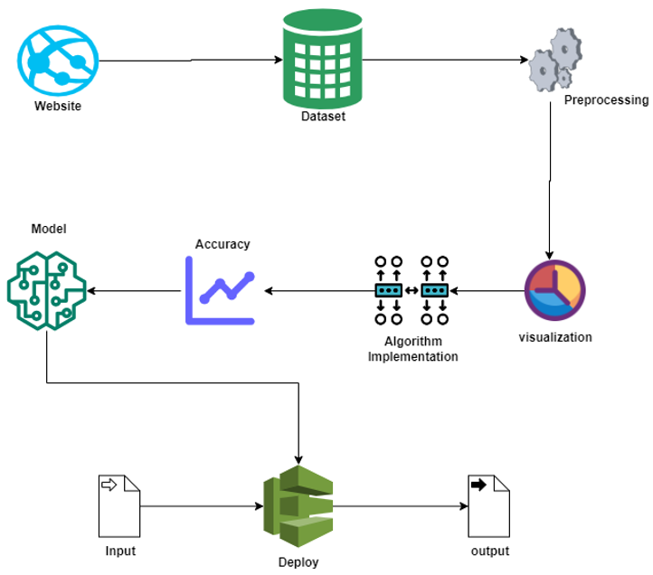
Architecture

Slide 9
Result & Discussion
In conclusion, the utilization of AI processes for predicting worker risk levels represents a significant leap forward in enhancing occupational safety and well-being.
By leveraging advanced algorithms and machine learning techniques, organizations can now proactively identify potential risks and implement preventive measures to mitigate them.
The predictive capabilities of AI not only streamline risk assessment but also empower employers to create targeted interventions tailored to specific job roles and workplace conditions.
This not only enhances the overall safety culture but also contributes to increased productivity and employee satisfaction.

Slide 10
Reference
P. Kunekar et al., "IoT based Smart Security Helmet for Miner’s Safety," 2023 5th Biennial International Conference on Nascent Technologies in Engineering (ICNTE), Navi Mumbai, India, 2023, pp. 1-5, doi: 10.1109/ICNTE56631.2023.10146728. keywords: {Accelerometers;Technological innovation;Head;Wireless networks;Weapons;Real-time systems;Safety;ESP8266;IFTTT;IoT;Mining Industry;Safety Measures;Sensors},
Rai, A. Rai and A. Upadhyay, "Smart Wearables For Coal Mine Workers," 2023 2nd International Conference on Vision Towards Emerging Trends in Communication and Networking Technologies (ViTECoN), Vellore, India, 2023, pp. 1-6, doi: 10.1109/ViTECoN58111.2023.10156904. keywords: {Temperature sensors;Wireless sensor networks;Head;Wearable computers;Employment;Safety;Fuel processing industries;Arduino;Smart Helmet;Smart Jacket;Gas Sensor;IOT},
D. Devi, N. Prasanna, R. P. Ram and N. N. Mohamed, "Machine Learning Based Smart Helmet for Air Quality and Hazardous Event Detection in the Mining Industry," 2023 International Conference on Self Sustainable Artificial Intelligence Systems (ICSSAS), Erode, India, 2023, pp. 1790-1795, doi: 10.1109/ICSSAS57918.2023.10331685. keywords: {Temperature sensors;Employee welfare;Machine learning algorithms;Artificial neural networks;Safety;Mining industry;Intelligent sensors;Artificial Neural network;smart helmet;mining industry;sensors},
M. Priyatharishini and M. T. Rani, "Smart Safety Helmet for Protecting Lives of Workers in Mining Industry," 2023 7th International Conference on Electronics, Communication and Aerospace Technology (ICECA), Coimbatore, India, 2023, pp. 394-400, doi: 10.1109/ICECA58529.2023.10394840. keywords: {Gases;Head;Real-time systems;Safety;Fuel processing industries;Data mining;Mining industry;Internet of Things;Radio Frequency;Wireless Sensor Network;monitoring system;Global Positioning System;Augmented reality;Edge computing},

