Slide 1


Department of Computer Science and Engineering
ENHANCING DEEPFAKE DETECTION
SDG 16 : Peace, Justice, and Strong Institutions
KISHOREKUMAR V 211420104135
MONNIESH B 211420104168
NIVESHKUMAR S 211420104186
Mr.A.Karthikeyan
Assistant Proffessor
Dr.G.Senthilkumar
Associate Proffessor

Slide 2
Introduction
The increasing sophistication of mobile camera technology and the ever-growing reach of social media and media sharing portals have made the creation and propagation of digital videos more convenient than ever before.
Until recently, the number of fake videos and their degrees of realism has been limited by the lack of sophisticated editing tools, the high demand on domain expertise, and the complex and time-consuming process involved.
In particular, a new vein of AI-based fake video generation methods known as Deep Fake has attracted a lot of attention recently. It takes as input a video of a specific individual (’target’), and outputs another video with the target’s faces replaced with those of another individual (’source’).
The back bone of deep fake is deep neural networks trained on face images to automatically map the facial expressions of the source to the target. With proper post-processing, the resulting videos can achieve a high level of realism.

Slide 3
Abstract
As deepfake techniques become more sophisticated, the demand for fake facial image detection continues to increase. Various deepfake detection techniques have been introduced but detecting all types of deepfake images with a single model remains challenging. We propose a technique for detecting various types of deepfake images using three common traces generated by deepfakes: residual noise, warping artifacts, and blur effects.
We adopted a network designed for steganalysis to detect pixel-wise residual-noise traces. Several deepfake detection approaches have been presented in this effort on picture forensics of generic image alterations. This used noise due to erroneous geometry and light predictions, as well as colour mismatch in two eyes. Deepfake employing the 2D direction discrepancy between the head's general circumference and restricted facial region

Slide 4
Objective of the Project
We propose a technique for detecting various types of deep fake images using three common traces generated by deep fakes: residual noise, warping artifacts, and blur effects.
We adopted a network designed for steganalysis to detect pixel-wise residual-noise traces.
We also consider landmarks, which are the primary parts of the face where unnatural deformations often occur in deep fake images, to capture high-level features.
Finally, we apply features from various image quality measurement tools that can capture traces of blurring.

Slide 5
Existing System
The existing system is current context revolves around the rapid development of face forgery generating algorithms that create manipulated images and videos, contributing to the proliferation of fake information that's challenging to detect.
Due to the significant concerns posed by these facial manipulation technologies, the field of computer vision is increasingly focusing on face forgery detection. However, existing detection systems often struggle in real-world applications due to poor generalization across unseen domains.
To address this, we used a deepfake detection method called Meta Deepfake Detection (MDD), which employs meta-learning principles to establish a model capable of directly detecting unseen domains without requiring frequent updates. MDD utilizes meta-weight learning to adapt information from source domains to target domains, facilitating the generation of effective domain representations.
The approach involves creating meta-train and meta-test sets using a multi-domain strategy, and employs techniques like pair-attention loss and average-center alignment loss to enhance detection capabilities. The proposal is evaluated against popular deepfake datasets to showcase its generalization and effectiveness in comparison to baseline methods.

Slide 6
Proposed System
In this project, we proposed a generalized detection method to detect three types of deep fake techniques: face swap, puppet-master, and attribute change.
We exploited three types of common traces residual noise, warping artifacts, and blur effects generated by the deep fake process. We applied them to the proposed network for deep fake detection.
First, a network designed for steganalysis was adopted as the base network to detect residual noise. Second, landmark patches were extracted from the semantic facial region to detect warping artifacts, which are unnatural high-level features.
The results revealed that each detection strategy is effective, and the performance of the proposed network is superior to that of existing networks.
Because a deep fake video inherits residual features from image operations, our approach can be directly adopted for deep fake video detection pipelines based on frame-by-frame detection.
Based on the proposed method, we plan to expand this study to include a deep fake video detection method. We hope this method is robust against signal- and time-based attacks.

Slide 7
LSTM
The Long Short-Term Memory (LSTM) algorithm is a specialized form of recurrent neural networks designed to overcome challenges in learning and retaining long-term dependencies within sequential data..
Widely used in various domains, LSTMs are particularly valuable in time- series prediction tasks, such as meteorological forecasting. In this project, LSTMs are employed to model the complex relationships in historical weather data, providing a powerful tool for accurate monsoon predictions by effectively addressing the sequential nature of meteorological variables.
The algorithm's versatility and ability to handle both short-term and long-term dependencies make it a key component in enhancing the accuracy of forecasting models in applications requiring a deep understanding of sequential data

Slide 8
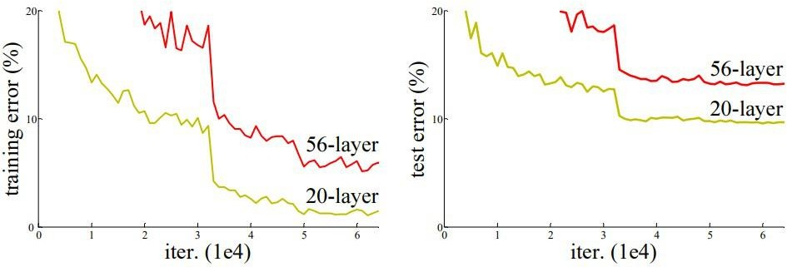
RESNET
After the first CNN-based architecture (AlexNet) that win the ImageNet 2012 competition, Every subsequent winning architecture uses more layers in a deep neural network to reduce the error rate.
This works for less number of layers, but when we increase the number of layers, there is a common problem in deep learning associated with that called the Vanishing/Exploding gradient.
This causes the gradient to become 0 or too large.

Slide 9
LITERATURE SURVEY
TITLE: Exploring Frequency Adversarial Attacks for face forgery Detection
YEAR: 2022
AUTHOR: Shuai Jia, Chao Ma, Taiping Yao, Bangjie Yin, Shouhong Ding, Xiaokang Yang
ABSTRACT: Various facial manipulation techniques have drawn serious public concerns in morality, security, and privacy. Although existing face forgery classifiers achieve promising performance on detecting fake images, these methods are vulnerable to adversarial examples with injected imperceptible perturbations on the pixels. Meanwhile, many face forgery detectors always utilize the frequency diversity between real and fake faces as a crucial clue. In this paper, instead of injecting adversarial perturbations into the spatial domain, we propose a frequency adversarial attack method against face forgery detectors. Concretely, we apply discrete cosine transform (DCT) on the input images and introduce a fusion module to capture the salient region of adversary in the frequency domain. Compared with existing adversarial attacks (e.g. FGSM, PGD) in the spatial domain, our method is more imperceptible to human observers and does not degrade the visual quality of the original images. Moreover, inspired by the idea of meta-learning, we also propose a hybrid adversarial attack that performs attacks in both the spatial and frequency domains.

Slide 10
LITERATURE SURVEY
TITLE: Learning Meta Pattern For Face Anti-Spoofing
YEAR: 2022
AUTHOR: Rizhao cai, zhi Li, Renjie Wan, Haoliang Li, Yongjian Hu, Alex C.Kot
ABSTRACT:
Face Anti-Spoofing (FAS) is essential to secure face recognition systems and has been extensively studied in recent years. Although deep neural networks (DNNs) for the FAS task have achieved promising results in intra-dataset experiments with similar distributions of training and testing data, the DNNs’ generalization ability is limited under the cross-domain scenarios with different distributions of training and testing data. To improve the generalization ability, recent hybrid methods have been explored to extract task-aware handcrafted features (e.g., Local Binary Pattern) as discriminative information for the input of DNNs. However, the handcrafted feature extraction relies on experts’ domain knowledge, and how to choose appropriate handcrafted features is underexplored. To this end, we propose a learnable network to extract Meta Pattern (MP) in our learningto-learn framework. Moreover, we devise a two-stream network to hierarchically fuse the input RGB image and the extracted MP by using our proposed Hierarchical Fusion Module (HFM).

Slide 11
LITERATURE SURVEY
TITLE: Towards Generalaizable Deepfake Detection With Locality-Aware AutoEncoder
YEAR: 2022
AUTHOR: Mengnam Du, Shiva Pentyala, Yuening Li, Xia Hu
ABSTRACT:
With advancements of deep learning techniques, it is now possible to generate super-realistic images and videos, i.e., deepfakes. These deepfakes could reach mass audience and result in adverse impacts on our society. Although lots of efforts have been devoted to detect deepfakes, their performance drops significantly on previously unseen but related manipulations and the detection generalization capability remains a problem. Motivated by the fine-grained nature and spatial locality characteristics of deepfakes, we propose Locality-Aware AutoEncoder (LAE) to bridge the generalization gap. In the training process, we use a pixel-wise mask to regularize local interpretation of LAE to enforce the model to learn intrinsic representation from the forgery region, instead of capturing artifacts in the training set and learning superficial correlations to perform detection. We further propose an active learning framework to select the challenging candidates for labeling, which requires human masks for less than 3% of the training data, dramatically reducing the annotation efforts to regularize interpretations. Experimental results on three deepfake detection tasks indicate that LAE could focus on the forgery regions to make decisions.

Slide 12
LITERATURE SURVEY
TITLE: NAS-FAS: Static-Dynamic Central Diffrence Network Search For Face Anti-Spoofing
YEAR: 2022
AUTHOR: Zitong Yu, Jun Wan, Yunxiao Qin, Xiaobai Li, Stan Z.Li, Guoying Zhao
ABSTRACT:
Face anti-spoofing (FAS) plays a vital role in securing face recognition systems. Existing methods heavily rely on the expert-designed networks, which may lead to a sub-optimal solution for FAS task. Here we propose the first FAS method based on neural architecture search (NAS), called NAS-FAS, to discover the well-suited task-aware networks. Unlike previous NAS works mainly focus on developing efficient search strategies in generic object classification, we pay more attention to study the search spaces for FAS task. The challenges of utilizing NAS for FAS are in two folds: the networks searched on 1) a specific acquisition condition might perform poorly in unseen conditions, and 2) particular spoofing attacks might generalize badly for unseen attacks. To overcome these two issues, we develop a novel search space consisting of central difference convolution and pooling operators. Besides, we propose Domain/Type-aware Meta-NAS, which leverages cross-domain/type knowledge for robust searching.

Slide 13
Software / Hardware Requirements
H/W SYSTEM CONFIGURATION:
PROCESSOR - I3, I5, I7, AMD Processor
RAM - Above 8 Gb
HARD DISK - Above 500 GB
S/W SYSTEM CONFIGURATION:
OPERATING SYSTEM - Windows 8/10
FRONT END - HTML ,CSS
NOTEBOOK - Anaconda(Jupiter)
IDLE - Python(3.10)

Slide 14
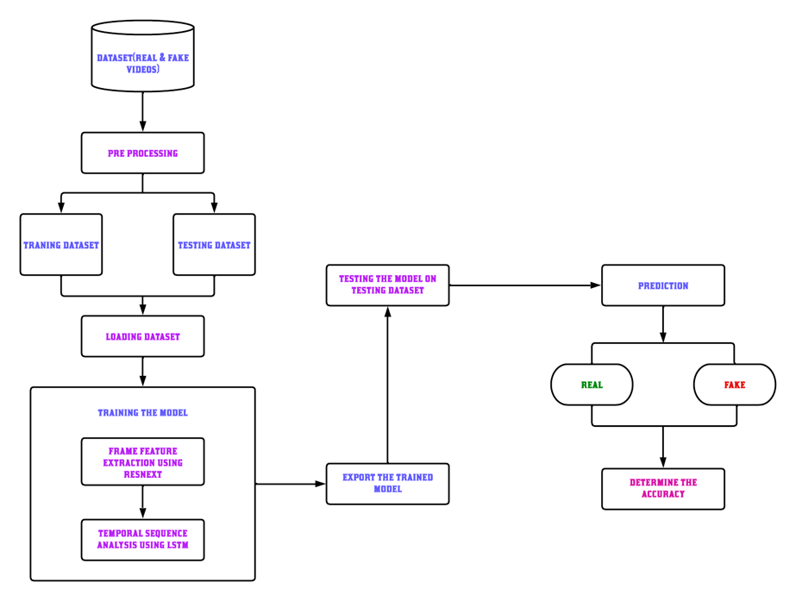
System Architecture

Slide 15
System Implementation
Dataset and preprocessing
Feature extraction
Experimental Setup
Evaluation metrics

Slide 16
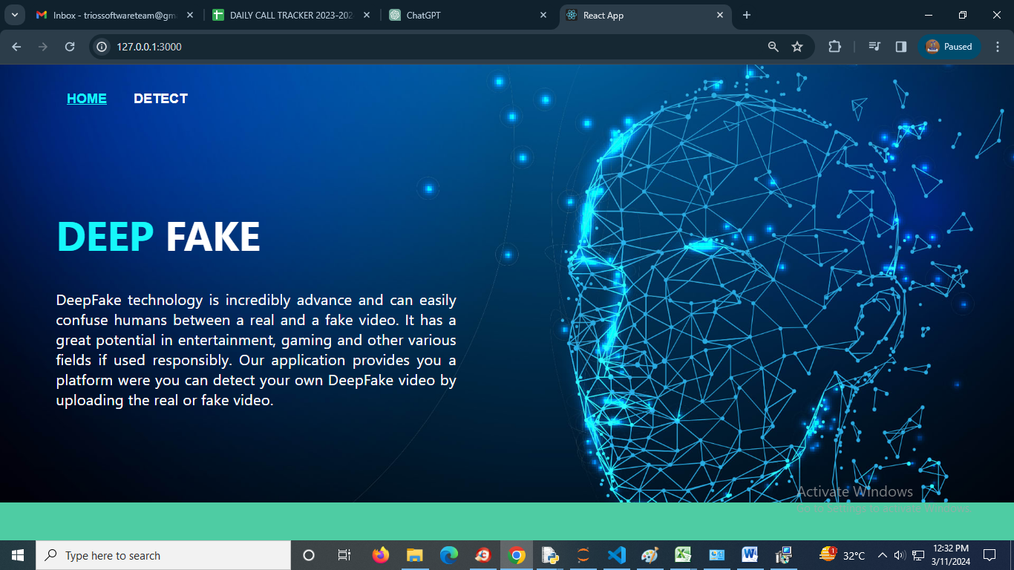
Result
Home page

Slide 17

Result
Detect Page

Slide 18

Output
Output(Real)

Slide 19

Output
Output(Fake)

Slide 20
FUTURE ENHANCEMENT
Checking Facts: Verification involves checking if what someone says or shares on social media is actually true. It's like being a detective and finding out if a story is real or just a made-up one.
Confirming Sources: We look at where the information comes from. Is it from a reliable source like a news organization or an official spokesperson? Or is it from someone who might not be trustworthy?
Looking for Clues: Sometimes, we can tell if something is fake by looking closely. For example, if a photo looks weird or if the writing doesn't seem right, it could be fake.
Double-Checking: Before believing or sharing something, it's a good idea to double-check with other sources. That way, we can be more sure if something is true or not.
Stopping Misinformation: Verifying things on social media helps stop false information from spreading. It keeps everyone informed with the right facts.

Slide 21
Conclusion
This project is used as a deep fake creation, and detection methods. Deep fake creates forged images or videos that persons cannot differentiate from real images or videos.
Deep fakes are created using generative adversarial networks, in which two machine learning models exit.
One model trains on a dataset and the other model tries to detect the deep fakes. The forger creates fakes until the other model can't detect the forgery.
Deep fakes creating fake news, videos, images, and terrorism events that can cause social and financial fraud. It is increasing affects religions, organizations, individuals and communities', culture, security, and democracy.
When deep fake videos and images increase on social media people will ignore to trust the truth.
So, deep fake datasets and cross-platform detection techniques need to be developed in the future. This needs efficient, reliable and robust mobile detectors to detect deep fakes in widely used mobile devices.
Moreover, will improve deep fake detection by integrating deep fake detection and object detection algorithms.

Slide 22
References
[1]. K. Sun, H. Liu, Q. Ye, Y. Gao, J. Liu, L. Shao, and R. Ji, ‘‘Domain general face forgery detection by learning to weight,’’ in Proc. AAAI Conf. Artif. Intell., 2021, vol. 35, no. 3, pp. 2638–2646.
[2]. S. Jia, C. Ma, T. Yao, B. Yin, S. Ding, and X. Yang, ‘‘Exploring frequency adversarial attacks for face forgery detection,’’ in Proc. IEEE/CVF Conf. Comput. Vis. Pattern Recognit. (CVPR), Jun. 2022, pp. 4103–4112.
[3]. Z. Yu, J. Wan, Y. Qin, X. Li, S. Z. Li, and G. Zhao, ‘‘NAS-FAS: Static-dynamic central difference network search for face anti-spoofing,’’ IEEE Trans. Pattern Anal. Mach. Intell., vol. 43, no. 9, pp. 3005–3023, Sep. 2021.
[4]. R. Cai, Z. Li, R. Wan, H. Li, Y. Hu, and A. C. Kot, ‘‘Learning meta pattern for face anti-spoofing,’’ IEEE Trans. Inf. Forensics Security, vol. 17, pp. 1201–1213, 2022.
[5]. M. Du, S. Pentyala, Y. Li, and X. Hu, ‘‘Towards generalizable DeepFake detection with locality-aware AutoEncoder,’’ in Proc. 29th ACM Int. Conf. Inf. Knowl. Manag., Oct. 2020, pp. 325–334.

