Slide 1



Department of Computer Science and Engineering
PIXEL FORGED DEVICE DRIVER PLATFORM
Team Members Name / Register Number
ARAVIND P K(211420104021)
AMBAREESHAN N (211420104025)
ARIN R S(211420104023)
Guide Name & Designation
Mr N SASIKUMAR M.E.
Coordinator Name & Designation
Dr. SENTHIL KUMAR G, PhD.

Slide 2
INTRODUCTION
This system deals with the enhances system of camera were the person faces are been recorded in the database for finding wether the person is known or unknown person.
If the person appears on the camera, the detection program detects the human face matches it with the database and then it shows the person is known.
If unknown person appears then it shows not matched.

Slide 3
OBJECTIVEOF THE PROJECT
The objective of the system is to have the system to identify the human face and match with the database.
For training the database we should feed multiple number of images to get the accurate result.
The model will get trained with multiple images.

Slide 4
ABSTRACT
This innovative project harnesses the power of Artificial Intelligence (AI) and Machine Learning (ML) to create a robust system for real-time personnel tracking and identification. By leveraging advanced computer vision algorithms, the system can accurately detect and recognize individuals within a camera feed, enabling seamless monitoring of their entry and exit times.
Through sophisticated facial recognition techniques, known individuals are swiftly identified, with their names automatically linked to the corresponding timestamps. The system's adaptability is one of its key strengths. In scenarios where an unknown individual is detected, the system intelligently flags the occurrence as "not matching.“
This prompts user intervention, allowing personnel to promptly input the unidentified individual's identity. By continuously updating its database with newly provided information, the system enhances its recognition capabilities over time, ensuring improved accuracy and reliability in future detections. Moreover, the system's user interface is designed for intuitive interaction, facilitating streamlined management of personnel movement.

Slide 5
PROBLEM STATEMENT
The face identification should be done properly to give the accurate output for that the model needs to be trained in such a way that the person should be identified properly.
The person entry and the exit time should be noted in the detection log properly.
Multiple faces should be detected in same time

Slide 6
EXISTING SYSTEM
Detection of person using their shirt print , for finding the type of the persons who will cause chaos in a situation.
Survillance of criminal activites in a containment zone and avoid the further development of problem.

Slide 7
DISADVANTAGE OF EXHISTING SYSTEM
Conversion will be late.
It takes long time to solve the data set.
It is a long process for filter the data.
Low redundancy to perform the prediction

Slide 8
ADVANTAGE OF PROPOSED SYSTEM
This is published as an open source so any one can use the service.
It supports all the platforms in software.
Accuracy to a greater instinct

Slide 9
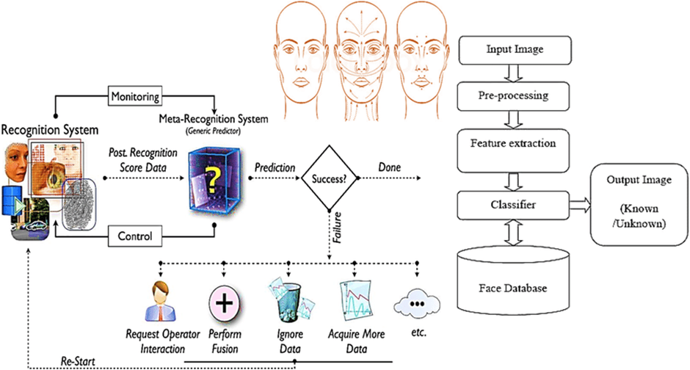
SYSTEM WORKFLOW

Slide 10
MODULES
Open CV
Python

Slide 11
SOFTWARE AND HARDWARE REQUIRMENT
HARDWARE:
I3 Intel
RAM >8GB
GPU:MX230 NVIDIA
SOFTWARE:
OS: windows
Tool: python, idle, notepad, Open CV

Slide 12
CONCLSION
Summarize the key findings and results obtained from the project. Reflect on the achievements and limitations of the system. Discuss the implications of the results and their significance in the context of face detection and recognition technology.
Github:https://github.com/Drugbullets/person_detection

