Slide 1

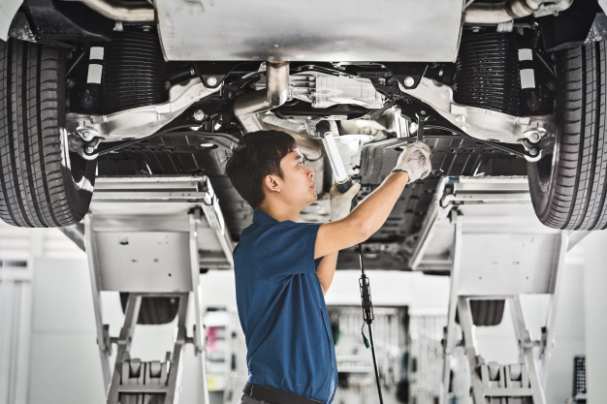
PANIMALAR ENGINEERING COLLEGE
PROJECT NAME
INTEGRATED AUTOMOTIVE MAINTENANCE AND OPERATIONS PLATFORM
Team members & Guide
ATHIGIRI ARULALAN A S
CSE E
211420104031
ARUN VENKATESH R
CSE E
211420104029
ARUN S
CSE E
211420104025
VINMATHI M S
CSE DEPT
(GUIDE)
-----
-----
-----

Slide 2
Introduction
The speed of our life is boosted tremendously with the advancement of the automotive industry
In today's fast-paced world, vehicle breakdowns can disrupt daily schedules and inconvenience motorists.
For Many years vehicle owners stranded on the road with broken down vehicles in the middle of nowhere.
This is an Android application platform offers efficient and timely assistance to users facing automotive breakdowns, aiming to address diverse needs and ensure a hassle-free experience.
Features: From dispatching qualified drivers to resolving emergency fuel issues and locating nearby repair workshops, the platform leverages mobile technology and real-time data processing.

Slide 3
Objective of the Project
The Integrated Automotive Maintenance and Operations Platform is designed to streamline and enhance the operational processes of automobile service providers.
It manages
customer information
vehicle maintenance records,
work orders
billing.
In this project to tackle the problems with an application that request nearby service providers to help the stuck users to the users desired location

Slide 4
Literature Survey
YEAR | TITLE AND JOURNAL | AUTHOR NAME | DESCRIPTION | ADVANTAGES | DISADVANTAGES
2021 | TITLE: Vehicle Service System JOURNAL: IRJET | Vigyani Singh, Saurav Shinde ,Prachi Khedlekar , Nisha Patil. | www.irjet.net/archives/V8/i6/IRJET-V8I681.pdf | This is provide the user to pre-book of slots, auto calculation of bill and time, and a module to describe steps that undergoes during the procedure of servicing of a vehicle. | This system doesn’t provide the payment method.
2022 | TITLE: THE VEHICLE SERVICE MANAGEMENT SYSTEM JOURNAL: INT-JECSE | K.Mallikarjun ,V Geetha , M. Pedda Chandrasekhar | https://www.researchgate.net/publication/363700029_THE_VEHICLE_SERVICE_MANAGEMENT_SYSTEM | It maintains the data of the users and their vehicles condition . So that the customers can get timely remainder for the vehicle service | It only gives the information to the user and do not take information from the user

Slide 5
Literature Survey
YEAR | TITLE AND JOURNAL | AUTHOR NAME | DESCRIPTION | ADVANTAGES | DISADVANTAGES
2020 | TITLE: WEBSITE AND MOBILE APPLICATION FOR AUTOMOBILE SERVICE CENTER. JOURNAL: IJEAST | Uma Thakur , Manthan Borkar Anshu Kamble , Payal Suryawanshi,Yashwant Mishra. | http://ijeast.com/papers/785-787,Tesma501,IJEAST.pdf | The owners will be notified about their vehicles condition and send the remainder accordingly | It does not provide any on road assistance
2020 | TITLE: Automobile Service System JOURNAL: IJRASET | Kavita Joshi, Hetali Patel, Zeenal Patel, Dhanlaxmi Prasad, Kunika Tandel | http://doi.org/10.22214/ijraset.2020.5136 | Availability of the showrooms are told | There is no road assistance and voice assistance

Slide 6
Existing System
In an existing automobile system, the dealer ships and insurance companies tried to tackle these problems
* Helpline number
* on-road Service
These services were a hassle to work with.
It take hours to get the desired service at the desired location.

Slide 7
Problem Statement
This project is to create a mobile application where users can book mechanics, drivers, and gas service.
Automobile users are the group of people who need service for their cars.
Automobile users who encounter problems during long drives must seek the assistance of a mechanic.
Automobile owner who has their own car but needs a driver for a long drive.
So, automobile users do not need to go to different websites to get service for their cars; they can get all their needs met in this system.

Slide 8
Proposed System
In Proposed system, IAMOP is designed to provide a comprehensive range of services to users,
This system includes features for
Book mechanic
Driver booking
Emergency Petrol and Diesel Service
Towing Service
The proposed system aims to provide a seamless and efficient user experience for all automobile-related services, while ensuring reliability, quality, and timely delivery of all services.

Slide 9
Module
Mechanic Service
Driver Booking
IAMOP
Emergency Petrol / Diesel Solutions
Towing Service

Slide 10
Software / Hardware used
HARDWARE REQUIREMENT
Memory (RAM): 8 GB
Hard Drive: 32 GB
Internet Connection : Stable
SOFTWARE REQUIREMENT
FRONT END : Android
DATA BASE : SQL Server
WEB SERVICE : Dotnet

Slide 11
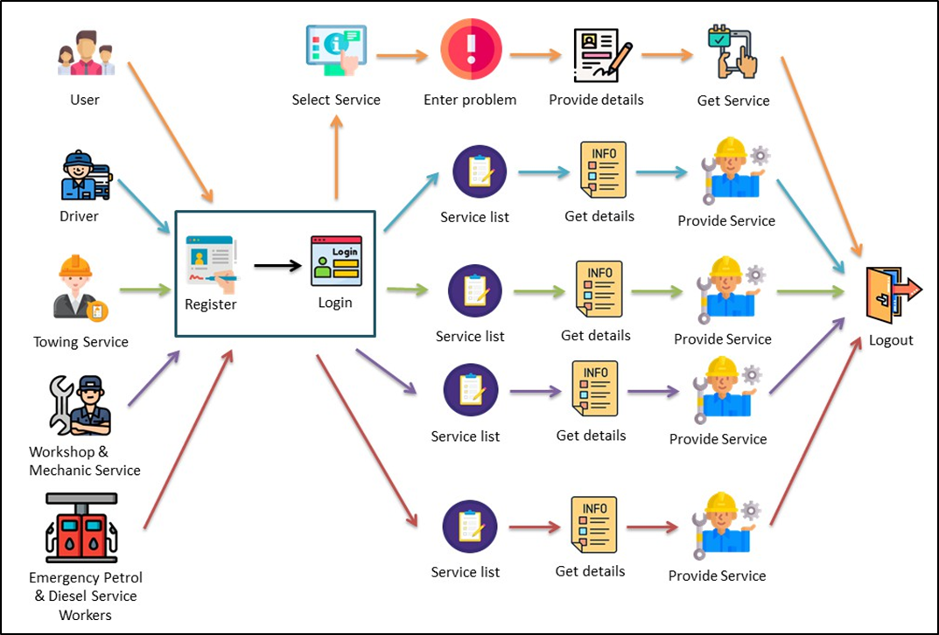
Architecture / Methodology used

Slide 12
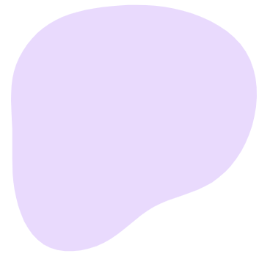

Module Explanation
Mechanic Service
Users can book mechanic assistance anytime, anywhere.
The app locates the nearest trained professional mechanic to the user.
The mechanic will be arriving at the selected location as soon as possible.

Slide 13
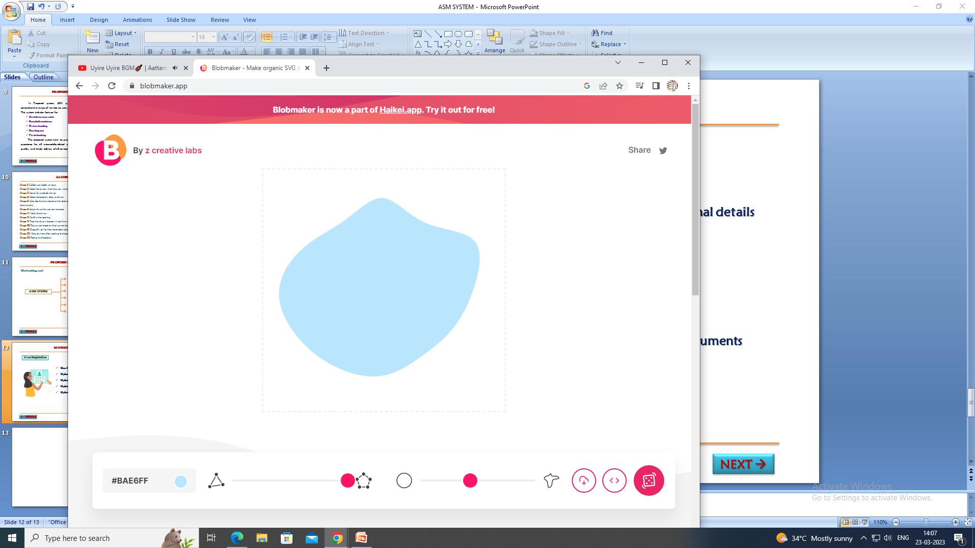

Module Explanation
Driver Booking
If the user have a car but can not drive for long distance in that time the user can book a driver.
The user can pick the location from the map on the display; alternatively, the user can type in the address,
The user must provide the time at which the driver should arrive at the destination.

Slide 14

Module Explanation
Emergency Petrol / Diesel Solutions
For drivers facing fuel-related issues while on the road, our dedicated emergency gasoline service provides efficient solutions.
Users can use our platform for connecting with the nearest petrol stations or booking convenient fuel delivery services .

Slide 15

Module Explanation
Towing Service
Towing service involves the transportation of vehicles that are unable to operate on their own due to breakdowns, accidents, or other reasons.
Towing companies use specialized vehicles equipped with towing equipment to safely move vehicles from one location to another.

Slide 16
Conclusion / Feature Enhancement
In conclusion, the proposed automobile management system aims to provide a comprehensive and efficient solution to manage all aspects of car-related services.
The system offers users a wide range of services, including on-call diagnostics, roadside assistance, car rental, hiring a private driver, and selling spare parts, all accessible via web applications and mobile-friendly.
By providing a seamless and efficient user experience, the proposed system can help improve service quality, reduce turnaround times, and increase customer satisfaction.

Slide 17
Reference Paper/ URL
[1] John Aiyesehinde1, Clinton Aigbavboa2 “Identifying the critical factors driving the quality of After-sales services in the Nigerian automotive industry”; IEEE Conference; DOI: - 10.1109/AFRICON46755.2019.9134022.
[2] Syahrul Nizam Samsudin1 Bulan Abdullah2 Noriah Yusoff3 “Customer Satisfaction and Service Experience in Big Data Analytics for Automotive Service Advisor”; IEEE Conference; DOI:- 10.1109/I2CACIS54679.2022.9815482.
[3] Teodor-Constantin Nichiţelea1 Maria-Geanina Unguritu2 “Automotive Ethernet ApplicationsUsing Scalable Service-Oriented Middleware over IP: Service Discovery”; IEEE Conference; DOI:- 10.1109/MMAR.2019.8864701.
[4] Syahrul Nizam Samsudin1 Bulan Abdullah2 Noriah Yusoff3 “Big Data Model of Customer Satisfaction and Service Experience (CSSE) for Automotive Aftersales Services“ ; IEEE Conference ; DOI:- 10.1109/ICRAIE52900.2021.9703988.
[5] Chia-Ching Fu1 Ben-Hau Chia2 Chung-Wei Lin3 “Runtime Software Selection for Adaptive Automotive Systems“ ; IEEE Conference; Electronic ISBN:978-1-4503-7999-1.

Slide 18
Reference Paper/ URL
[6] Kavita Joshi1, Hetali Patel2, Zeenal Patel3, Dhanlaxmi Prasad4, Kunika Tandel5 “Automobile Service System” International Journal for Research in Applied Science & Engineering Technology (IJRASET)ISSN: 2321-9653; IC Value: 45.98; SJ Impact Factor: 7.429 Volume 8 Issue V May 2020
[7] 1Prof. Uma Thakur, 2Manthan Borkar, 3Anshu Kamble, 4Payal Suryawanshi, 5Yashwant Mishra “website and mobile application for automobile service center” International Journal of Engineering Applied Sciences and Technology, 2020 Vol. 5, Issue 1, ISSN No. 2455-2143, Pages 782-784.
[8] C.K. Gomathy , M. Pedda Chandrasekhar , K. Mallikarjun, Dr.V Geetha “The Vehicle Service Management System” International Journal ofEarly Childhood Special Education (INTJECSE) DOI:10.9756/INTJECSE/V14I5.66 ISSN: 1308-5581 Vol 14, Issue 05 2022.
[9] Vigyani Singh1, Saurav Shinde2 ,Prachi Khedlekar3 , Prof. Nisha Patil4, “Vehicle Service System” International Research Journal of Engineering and Technology (IRJET) e-ISSN: 2395-0056 Volume: 08 Issue: 06 | June 2021.32
[10] Sathwik Krishna. L*1, Siva Rama Krishna. S1, Abdul Amjad. S1, Mahesh Babu. U1, Lakshmi Surekha. T5 ” A Vehicle Breakdown Service Provider System” International Journal of Scientific Research in Computer Science, Engineering and Information Technology, ISSN : 2456-3307 , Volume 7, Issue 4 Page Number: 567-572 , July-August-2021 doi : https://doi.org/10.32628/CSEIT2174129

