Slide 1



SIGN LANGUAGE RCOGNITION USING MACHINE LEARNING
Department of Computer Science and Engineering
Sustainable Development Goals-4 (Quality education)
Team Members Name / Register Number YOGESH I B (211420104313)
HARRESH A (211420104094) SOMPALLI VENU (211420104083)
Guide Name & Designation
DR. V SATHYA PREIYA, M. C. A.,
M. Phil., M. E., Ph.D.,
Coordinator Name & Designation
Dr. N.PUGHAZENDI M.E, Ph.D.,
1

Slide 2
Introduction
Machine learning-based language recognition is transforming communication for the deaf and hard of hearing. Using computer vision and neural networks, hand movements are interpreted into text and speech. The system, adaptable to various applications, aims to enhance accessibility. Challenges include adapting to sign language variations and improving accuracy in different settings.
The technology's potential impact on education, work, and social interactions could empower the hearing impaired. Ongoing research focuses on accurate algorithms, addressing cultural differences, and improving user interaction.

Slide 3
Objective of the Project
Developing a reliable sign language recognition system:
Design and implement a system that can accurately recognize gestures in different languages while ensuring reliability in different scenarios around the world.
Improve communication accessibility:
Improve accessibility for people with disabilities by creating an interface that allows them to communicate consistently through the user's language.

Slide 4
Problem Statement
The desire for a computer-based solution is significant in this age of technology for deaf people. However, researchers have been working on the problem for quite some time, and the results are promising. Although interesting technologies for voice recognition are becoming available, there is currently no commercial solution for sign recognition on the market.
The gesture is a vital and meaningful mode of communication for the deaf person. So here is the computer-based method for regular people to understand what the differently-abled individual is trying to say.

Slide 5
Literature Survey
YEAR | TITLE AND JOURNAL | AUTHOR | DESCRIPTION | ADVANTAGES | DISADVANTAGES
2023 | “sign language recognition by image processing” | Sabari Priya A., | The system aims to bridge the communication gap between individuals with speaking and hearing abilities and those without. | User-Friendly HCI: Utilizes a gesture-only interface, enhancing accessibility for seamless interaction. | It does not discuss the accuracy or performance metrics of the proposed system.
2023 | “sign language recognition using python and opencv” | Dipalee Golekar. | It discusses the development of a sign language detection system using action recognition. | Evaluates hand gesture techniques comprehensively, discussing merits and limitations in various scenarios. | There is no discussion about potential challenges or limitations faced during the development and implementation of the system.

Slide 6
Existing system
Deep Sign : is a learning-based system that uses convolutional neural networks(CNN) for sign language recognition. Focus on American Sign Language (ASL) recognition.
UNISign : UNIsign is a system designed to recognize Greek Sign Language (GSL). It combines computer vision and machine learning algorithms for accurate recognition.
SLR Toolkit : The SLR Toolkit is a framework that helps develop sign language recognition systems. It includes tools for data processing, feature extraction, and model training

Slide 7
Proposed System
The proposed sign language recognition system is designed to be a comprehensive, user- friendly and adaptive platform that meets the communication needs of the deaf. The system includes several key features and functions aimed at high accuracy, real-time performance and continuous improvement.
Landmark Detection with CNNs
Hybrid CNN-RNN Model for Gesture Recognition
Show Real-Time Inference
User Interface for Visual Feedback

Slide 8
Software / Hardware used
Software Requirement: Operating System like Windows, Mac,Linux.
Hardware Requirement:
Camera | Good quality,3MP higher
RAM | Minimum 8GB or higher
GPU | 4GB dedicated Processor: Intel Pentium 4 or higherHDD: 10GB or higher
Monitor | 15” or 17” colour monitor
Mouse | Scroll or Optical Mouse or Touch Pad
Keyboard | Standard 110 keys keyboard

Slide 9
Algorithm used
Random Forest Classifier algorithm is used to solve for regression or classification problems.It is made up of collection of decision trees
Advantages:High accuracy,It reduces overfitting in decisssion trees,It automates missing values present in the data,It is flexible to both classification and regression problems.

Slide 10
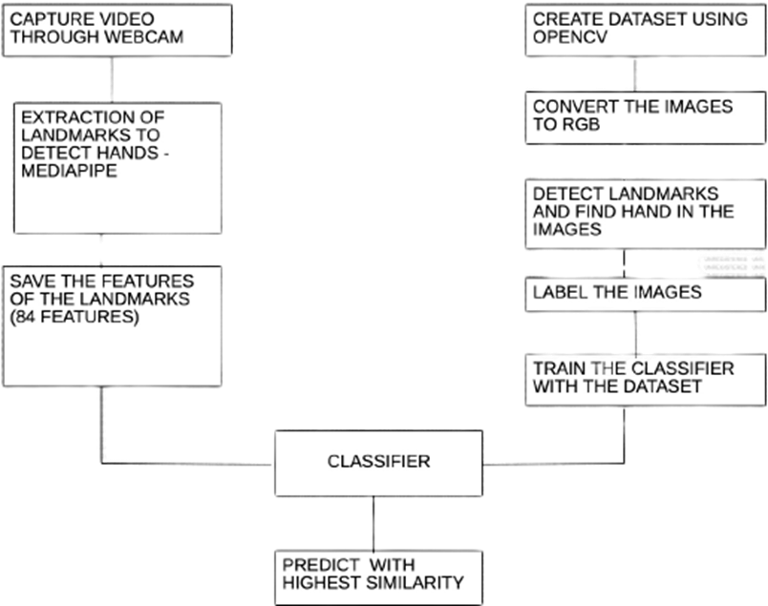
Architecture / Methodology used

Slide 11
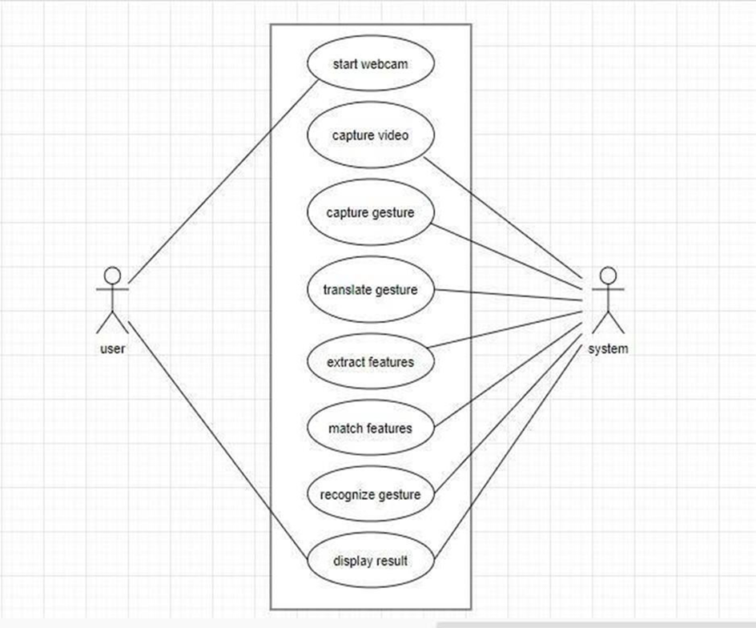
System Design –Use Case diagram

Slide 12
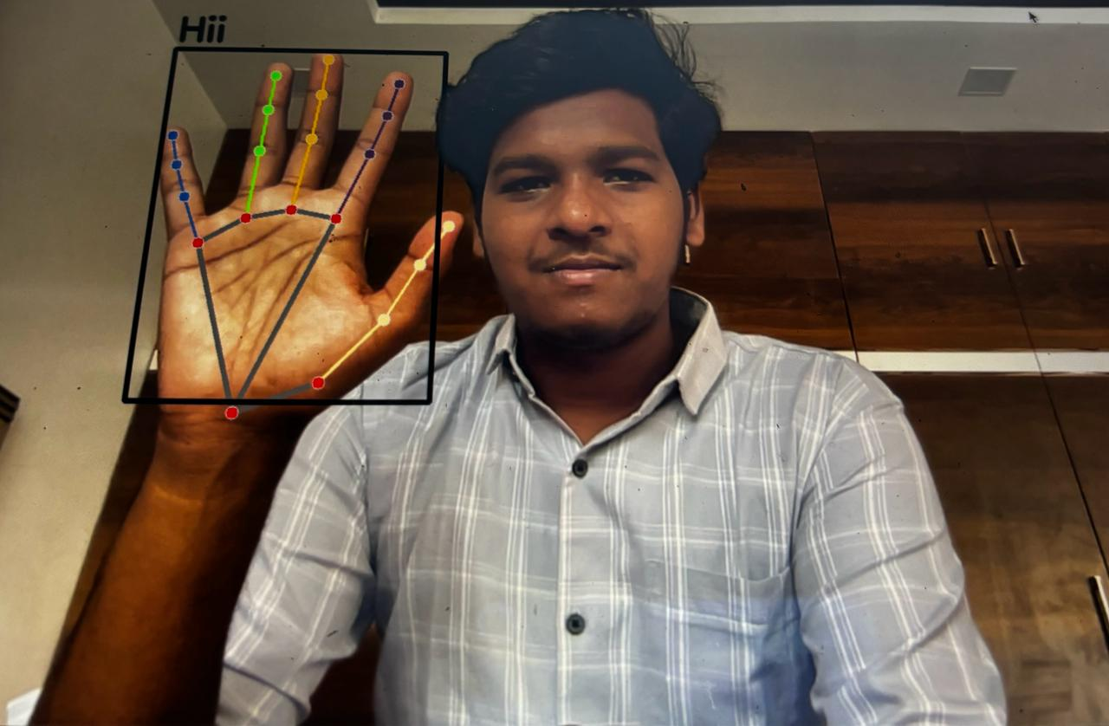
Results

Slide 13
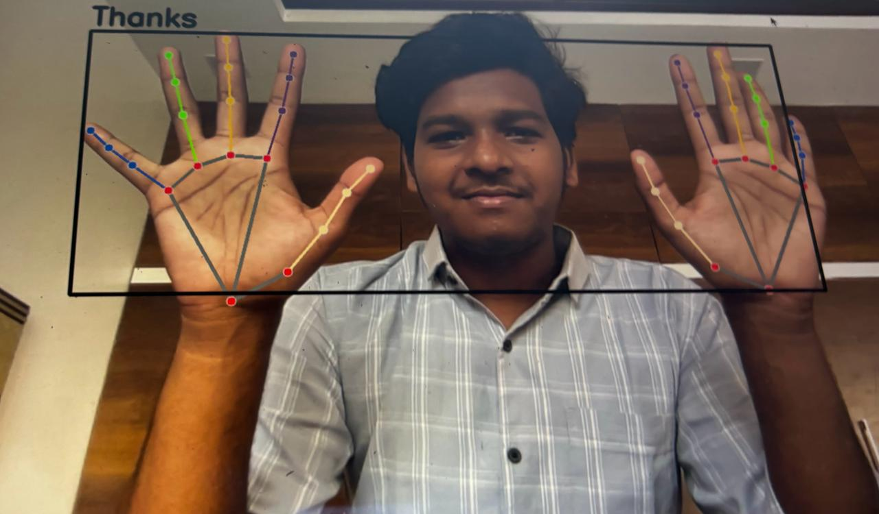
Results

Slide 14
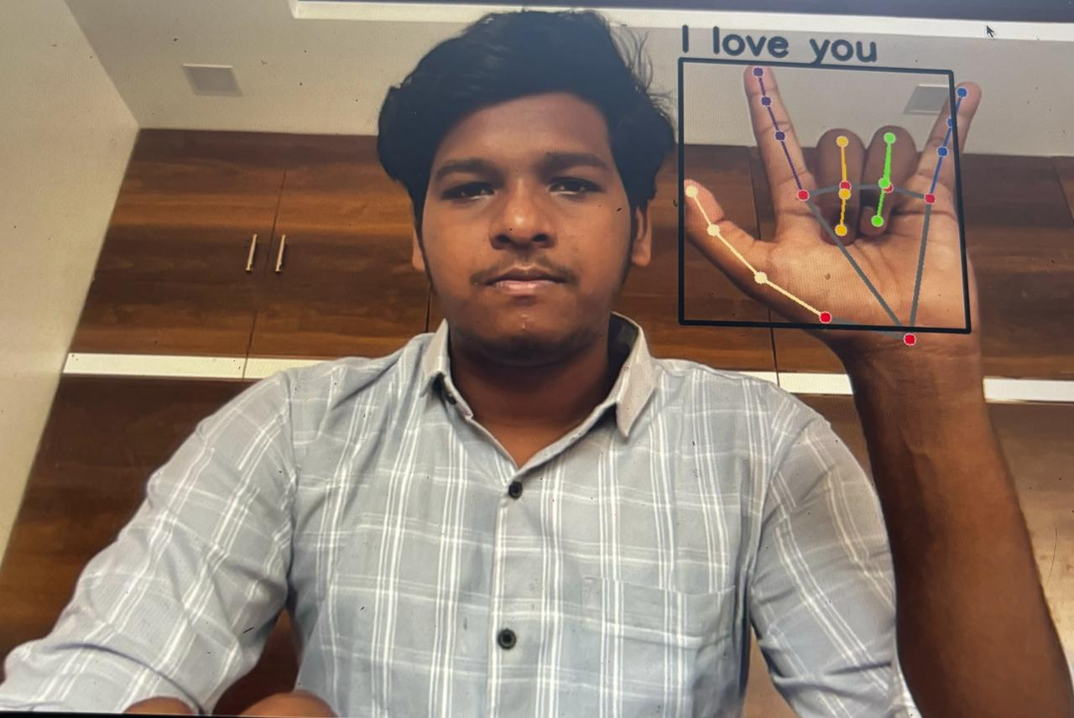
Screen Shots

Slide 15
Feature Enhancement
Online Learning and Adaptation:Research and implement online learning algorithms that allow systems to adapt and improve in real-time based on user interactions and evolving communication methods.
Real world setting:Conduct field tests and deploy the system in the real world, gathering valuable feedback for further development in collaboration with members of the deaf community.
Compatibility between languages:Learn how to adapt the system to recognize gestures from different sign languages, improving global inclusivity.

Slide 16
Conclusion
The sign language recognition system presented in this project shows promising potential in the interpretation and recognition of sign language gestures. Key achievements and results:
Accurate gesture recognition
Real Time Inference
Marker detection accuracy
User Interface Efficiency

Slide 17
Reference Paper/ URL
[1] K Ashokkumar, S Parthasarathy, S Nandhini, K Ananthajothi, “Prediction of grape leaf through digital image using FRCNN”, Measurement: Sensors, Volume 24, 2022, 100447, ISSN 2665-9174, https://doi.org/10.1016/j.measen.2022.10044 7.
[2] Kumar, P., Kumar, S.V. (2023). DDoS Attack Prediction System Using Machine Learning Algorithms. In: Tuba, M., Akashe, S., Joshi, A. (eds) ICT Systems and Sustainability. ICT4SD 2023. Lecture Notes in Networks and Systems, vol 765. Springer, Singapore. https://doi.org/10.1007/978-981- 99-5652-4_31
[3] P. Kumar, S. Swetha and M. Sundari, "Secured Web-based Alumni Network and Information Systems," 2023 7th International Conference on Intelligent Computing and Control Systems (ICICCS), Madurai, India, 2023,pp.1427-1434,doi: 10.1109/ICICCS56967.2023.10142761.
[4] Ananthajothi K, Karthick T, Amanullah M, Automated rain fall prediction enabled by optimized convolutional neural network- based feature formation with adaptive long short-term memory framework. Concurrency Computat Pract Exper. 2022; 34(11):e6868.doi: 10.1002/cpe.6868

Slide 18
THANK YOU

