Slide 1



Department of Computer Science and Engineering
Human Activity Recognition through Ensemble Learning of Multiple Convolutional Neural Networks
Team Members Name / Register Number
GURRAM LOKESH - 211420104087
KAMULURI AARIF AHMED -211420104122
PONNAGANTI THARAK SRINIVAS MANOJ - 211420104036
S PREENA JACNITH SHALOM
ASSISTANT PROFESSOR
Dr N PUGHAZENDI
PROFESSOR

Slide 2
INTRODUCTION
In today's data-driven world, accurately recognizing human activities holds immense importance across numerous domains such as healthcare, security, and entertainment. Traditional methods of activity recognition often face limitations due to their reliance on handcrafted features and lack of scalability. To overcome these challenges, our approach leverages the power of Convolutional Neural Networks (CNNs) and ensemble learning techniques. From healthcare monitoring to security surveillance and interactive technologies, our system has broad implications across various domains. By accurately detecting and classifying human activities, it can support decision-making processes, automate tasks, and enhance user experiences in diverse settings.

Slide 3
OBJECTIVE OF THE PROJECT
Enhance Accuracy: Improve the accuracy of human activity recognition by leveraging the strengths of multiple Convolutional Neural Networks (CNNs) through ensemble learning techniques.
Robustness: Create a robust system capable of accurately recognizing human activities across diverse environments and conditions by combining the predictions of multiple CNN models.
Adaptability: Design a system that can adapt to changes in human activities and environmental factors over time, ensuring continued effectiveness in real-world applications.
Real-time Processing: Implement efficient algorithms and architectures to enable real-time processing of streaming data, facilitating timely and responsive human activity recognition.

Slide 4
LITERATURE SURVEY
S.NO | TITLE | CONTENT | AUTHOR | YEAR
1 | Deep Convolutional Neural Networks On Multichannel Time Series For Human Activity Recognition | A new method to automate feature extraction for the human activity recognition task. The proposed method builds a new deep architecture for the CNN to investigate the multichannel time series data. This deep architecture mainly employs the convolution and pooling operations to capture the salient patterns of the sensor signals at different time scales. | Jian Bo Yang, Minh Nhut Nguyen | 2020

Slide 5
LITERATURE SURVEY
S.NO | TITLE | CONTENT | AUTHOR | YEAR
2 | Human Activity Recognition Using LSTM-RNN Deep Neural Network Architecture | split data into 80:20, training, testing, for instance split the remaining training data into 80:20, training: The validation Sub-sample a couple of random selections of the training data and train the model with this and record the performance on the validation set. Perform the sequence with different percentages of training and testing data to get the optimal value. | Schalk Wilhelm Pienaar1, | 2019
5

Slide 6
ALGORITHM
Algorithm Used: CNN Model Training
Description: Trains multiple Convolutional Neural Network (CNN) models on different subsets of the training data.
Algorithm Used : Ensemble Construction
Description: Constructs an ensemble of CNN models by selecting a subset of well-performing models from the training phase.
Algorithm Used : Prediction Fusion
Description: Combines predictions from each CNN model in the ensemble using techniques such as averaging or voting.

Slide 7
EXISTING SYSTEM
In existing system, mostly we use CCTV camera for the surveillance or monitoring. It was a traditional method to identify what types of works are done. It’s hard to watch our CCTV footage for many hours. In Existing system, there is lot of man work to monitor the works. In our proposed system, we decrease the man work.

Slide 8
PROPOSED SYSTEM
In this proposed system, we propose the convolution neural network method for action recognition in video. The input video will be captured by using the webcam. The input video is converted into number of frames. Then the CNN (Convolution Neural Network) algorithm is used in order to detect the particular part of the frame. Then the maximum weight values are taken from the feature extraction frames by using the Convolution neural network. Finally the action will be detected in the videos and then the label (action name) is identified. Then that output taken to the firebase and the firebase value given to the user via android notification.

Slide 9
ADVANTAGE
We trained and tested our models and their ensembles using dataset. Training accuracies and losses of the three CNN models. After about Several epochs, the accuracies crossed and approached above 80% accuracy over the course of the 50 epochs. The validation accuracies, however, lay between 70 - 80% with a higher degree of variation observed as compared to the training procedure.

Slide 10
PROBLEM STATEMENT
Current Limitations: Existing human activity recognition (HAR) methods face challenges in achieving high accuracy and robustness, especially in complex real-world scenarios.
Single Model Dependency: Many HAR systems rely on single models, which may lead to limited performance and scalability, particularly when dealing with diverse datasets and environments.
Need for Versatility: There is a growing need for more versatile HAR solutions that can accurately recognize human activities across diverse contexts and provide insights into the decision-making process.

Slide 11
Software Requirements
Operating System :Windows 10 (64 bit)
Software : Python and Anaconda
Tools : Jupyter Note Book and Spyder IDE

Slide 12
Hardware Requirements
Hard Disk : 500GB and Above
RAM : 4GB and Above
Processor : I3 and Above
Webcam

Slide 13
MODULE DESCRIPTION
Video Streaming
Deep learning algorithm
Classification

Slide 14
Video streaming
The input video will be captured by using the webcam. The input video is converted into number of frames. Video sequences present great variability due to huge scale changes, viewpoint variation and camera motion which pose great challenges for both video representations and classiﬁcation.

Slide 15
Deep learning algorithm
The convolution neural networks (CNN) have been studied in the video domain for a large variety of classiﬁcation tasks. The captured video is feed into the convolution neural network and it is highly desired to have an end-to-end learning framework that can establish effective video representations while simultaneously conducting efficient video classiﬁcation.

Slide 16
Classification
Then the maximum weight values are taken from the feature extraction frames by using the Convolution neural network. According to video labels the entire network is trained for action recognition. Finally the action will be detected in the videos and then label (action name) is identified. After that the detected value passed to the user through firebase via android notification.

Slide 17
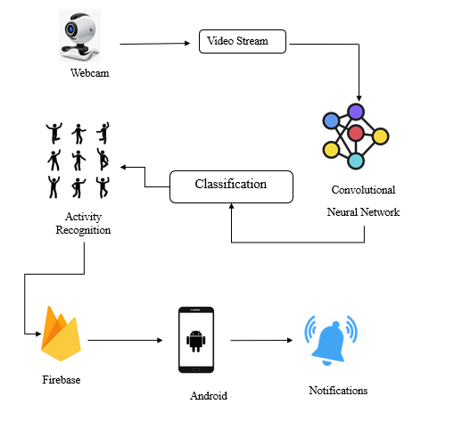
SYSTEM ARCHITECTURE

Slide 18
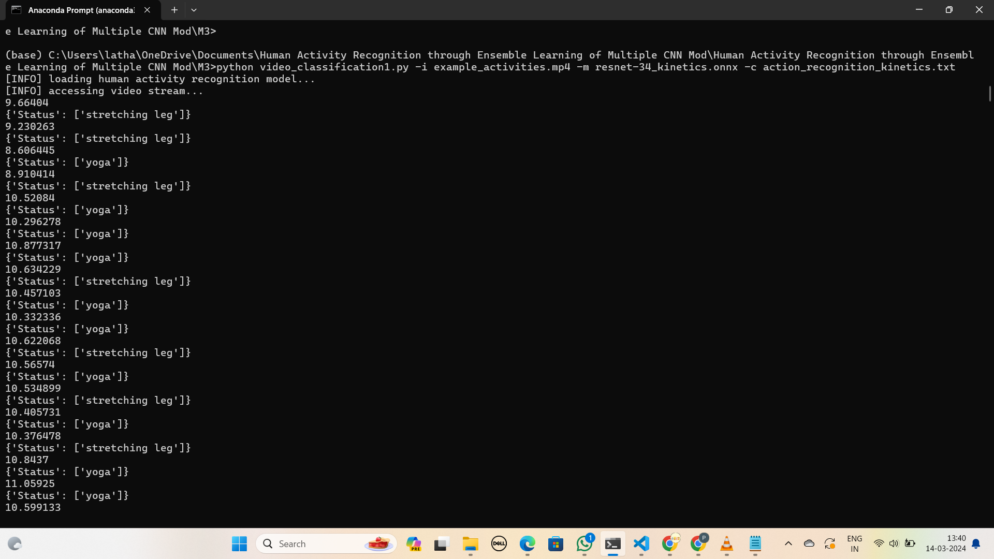
TESTING /PERFORMANCE EVALUATION / RESULTS

Slide 19
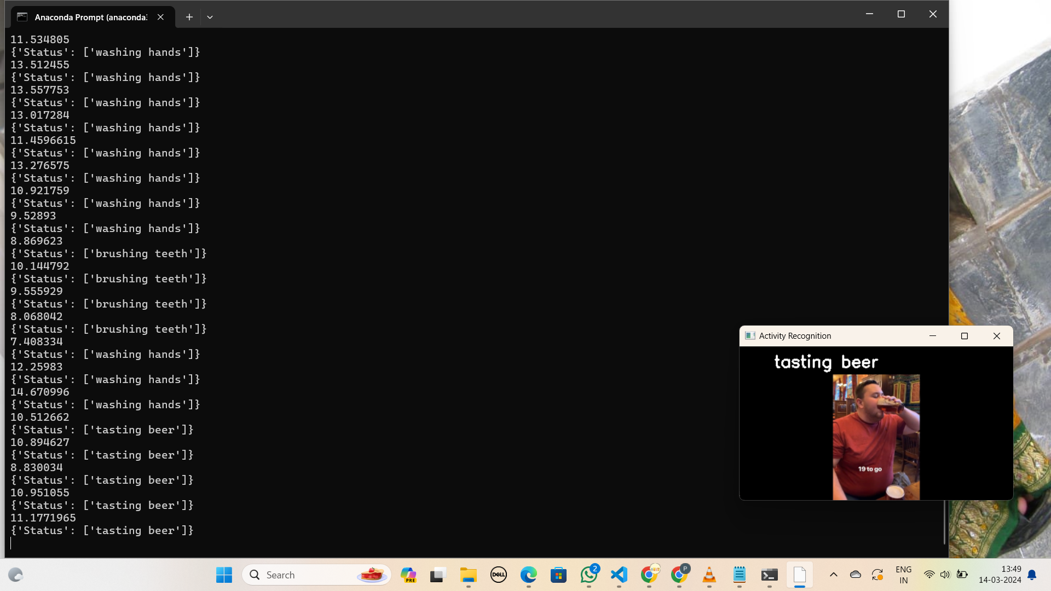
SCREEN SHOTS

Slide 20


SCREEN SHOTS

Slide 21
FUTURE ENHANCEMENT
Moreover, currently an ensemble of average of the three models is created but for further exploration, a future direction can be performing weighted ensemble learning such that the best performing model has the most effect in the ensemble. Furthermore, we can explore the area of ensemble learning for a hybrid model, that is, ensemble learning of CNN and RNN models.

Slide 22
Conclusion
We presented three CNN based models as well as their ensembles for dataset. It was found that the performance of the ensemble model is better than that of individual models. One of the ensemble model performed better than the methods in the literature. In the dataset we used, we see a class imbalance such that we have 38% samples for walking class but hardly 5% for sitting and standing. In future, the results might be improved even more, if we can remove the class imbalance from dataset.

